Slide 1
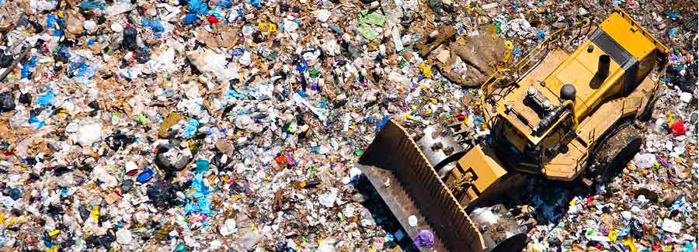
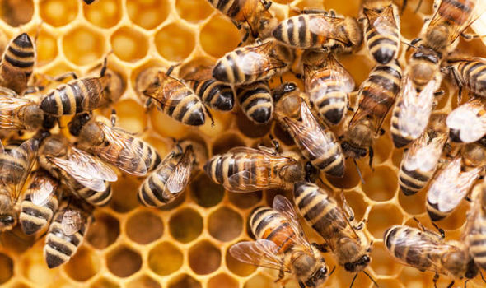
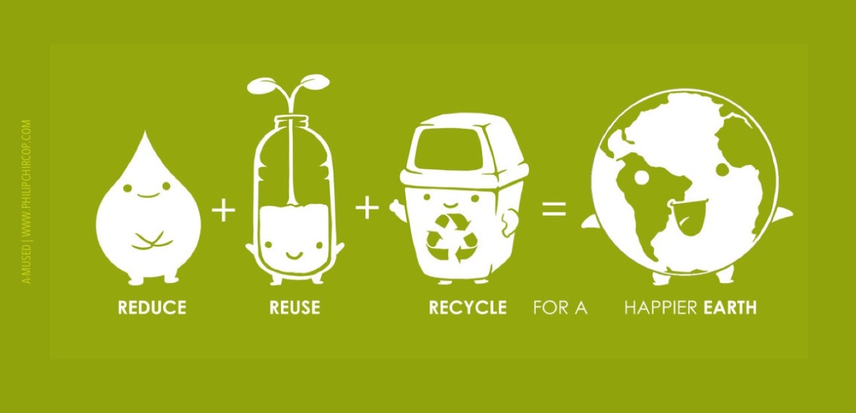

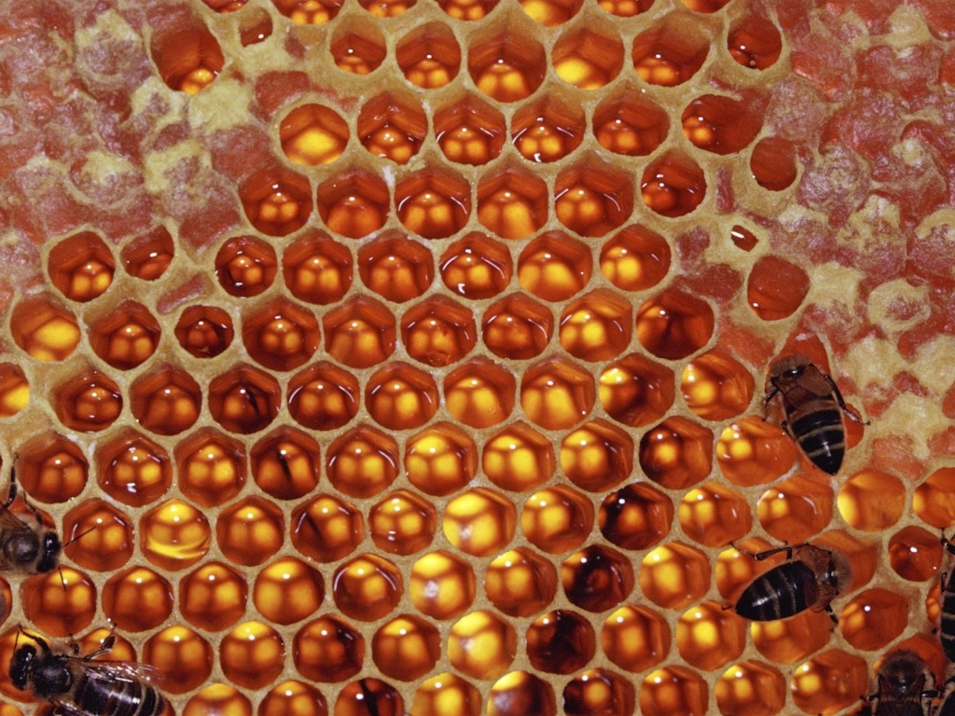


Waste
USA EPA,
Region 10
EcoLearn
4th Grade: Why should we reduce the amount of garbage we produce?
Notes:
http://www.philipchircop.com/post/117077877097/reduce-reuse-recycle-today-the-22nd-of-april

Slide 2
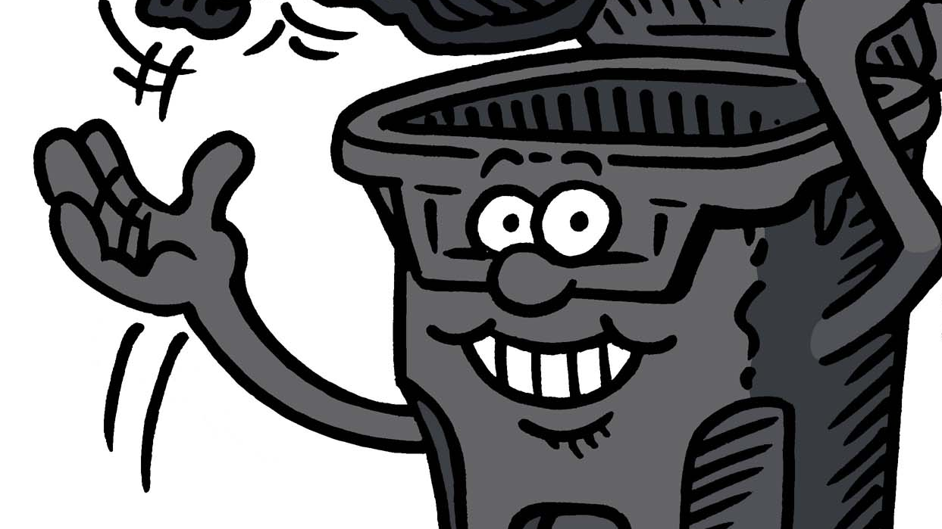
Today:
Today you will learn…
  • what happens to trash after you throw it away
  • how long it takes for garbage to decompose in the environment
  Key Words:
  Waste
  Landfill
  Decomposition
  Recycle
  Reduce
  Reuse
Notes:
http://www.winnipeg.ca/waterandwaste/garbage/cartcollection.stm

Slide 3
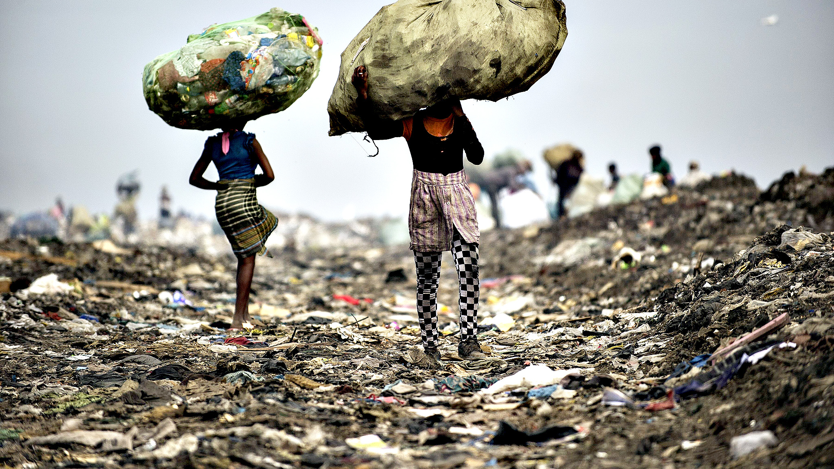
Today’s purpose is to learn why you should reduce the amount of garbage you produce, recycle what you can, and reuse items whenever possible.
Notes:
http://blogs.ft.com/photo-diary/tag/garbage/

Slide 4
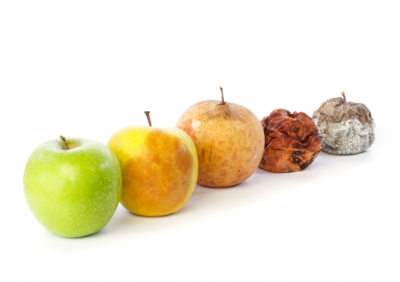
How long it takes
Number each item in order of how long it takes them to break down (1 being the fastest to decay)
Discuss your answer with your groups.
Notes:
http://www.cateconomica.com/Autor/Guillem-Tapia

Slide 5
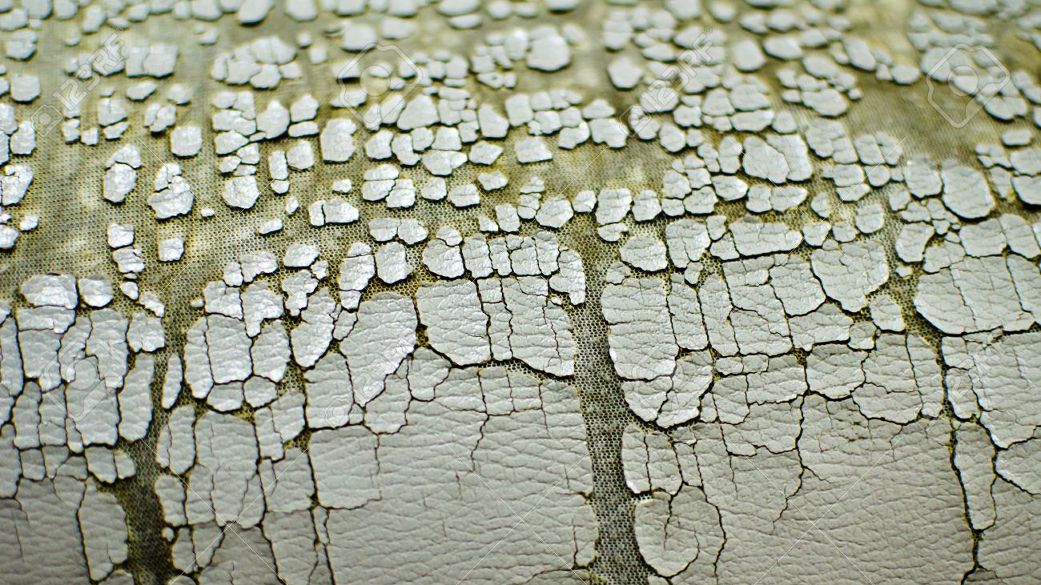
Now discuss with your groups how long you think it takes each item to break down (from days to years).

Slide 6
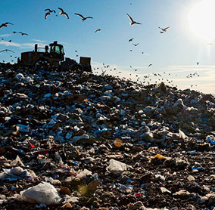
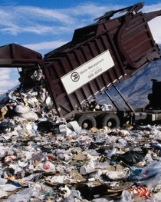
What can you do to reduce the amount of time your trash is in the landfill?
Notes:
http://www.lgean.org/city/landfills.htm
http://vault.sierraclub.org/sierra/201203/grapple-trash-bible-126.aspx

Slide 7
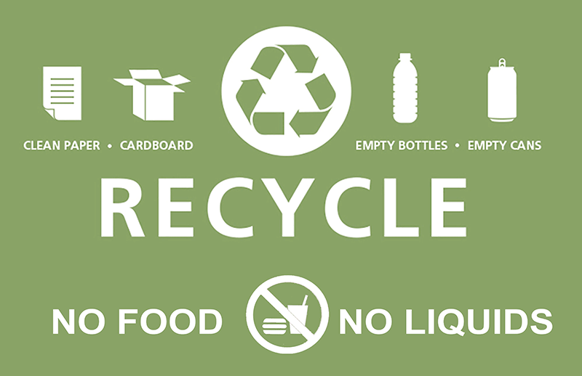
Recycle
Recycle and compost the appropriate materials.
While a glass bottle may never decompose in a landfill, it can be recycled and reused.
Notes:
http://www.miami.edu/finance/index.php/green_u/recycling/

Slide 8
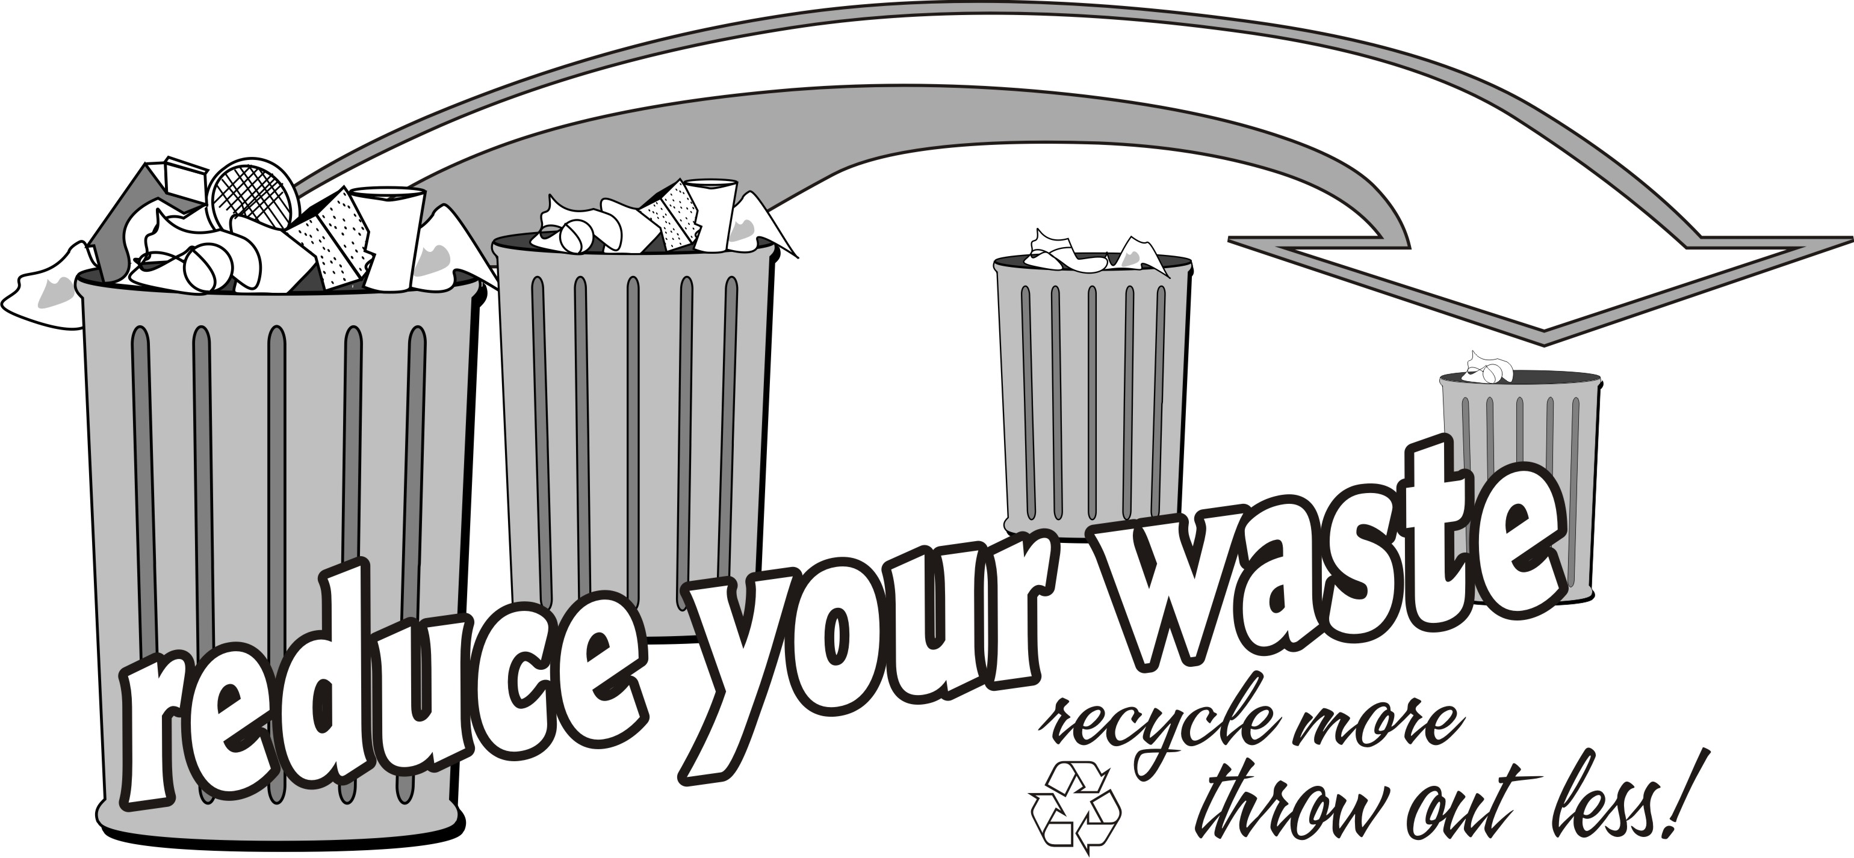
Reduce
Reduce the amount of material you throw away, especially things that take a long time to decompose!
Instead of using a Styrofoam cup for your hot chocolate, try a reusable mug!
Notes:
http://www.capitalregionrecycling.com/Programs/WasteReduction.aspx

Slide 9
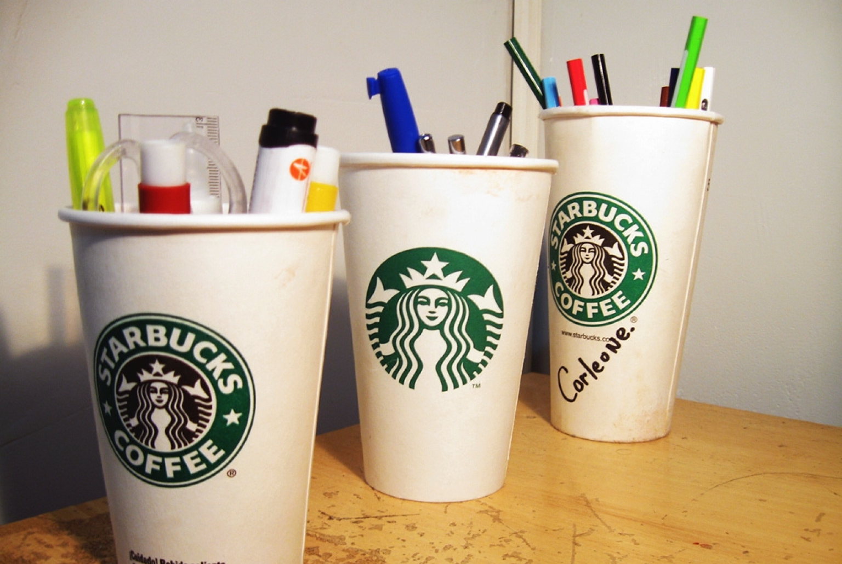
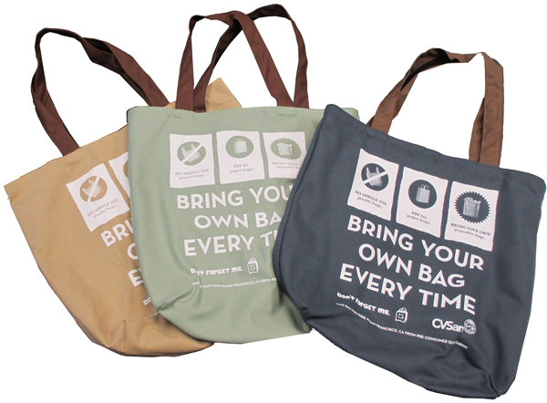
Reuse
Your old glass bottle could be a new vase. You can decorate a tin can to be a pencil holder.
This way these items can be useful and stay out of our landfills!
Notes:
http://www.huffingtonpost.com/2013/05/05/reuse-paper-cups_n_3165925.html
http://www.cvsan.org/reuse

Slide 10
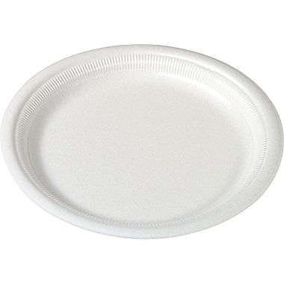
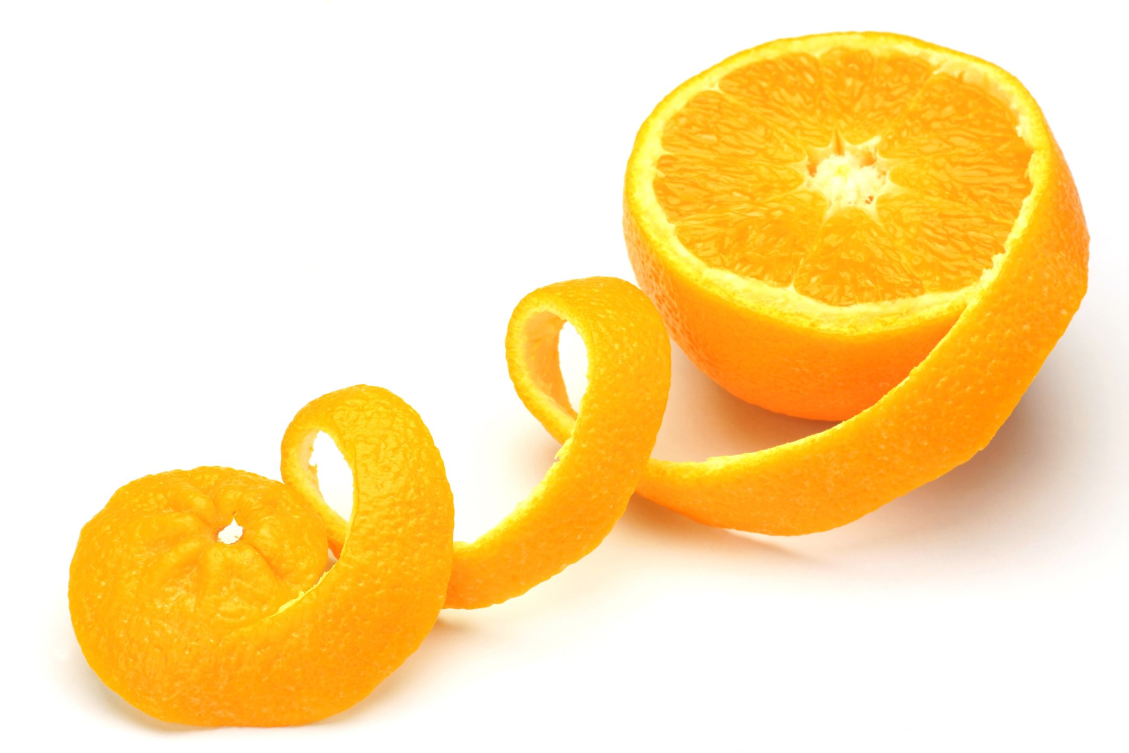
Homework:
Experiment:
  How long it takes an orange peel versus an apple core to decay?
  Paper plate versus a Styrofoam plate?
Notes:
https://topnaturalremedies.net/natural-treatment/orange-peel-and-its-unknown-benefits/
http://www.staples.com/SOLO-Basix-Foam-Plates-9-inch-500-Case/product_817474
As a class, follow the scientific method to make a hypothesis, design an experiment, carry out the experiment, and look at the results. A great way to set up this experiment is to take jars (with lids), fill them part way with water, put the material that you want to decompose in it, seal the lid and put it next to a window. Over time, the material will break down and the class will be able to watch for most of the school year! Have the students make weekly observations in a classroom “lab” notebook, describing what they see happening in the jars.
Find an item that you were going to throw away and find a new use for it. [For example, old ripped up t-shirts can be sewn into a quilt or made into a rug; old crayons can be melted to make new crayons, etc.] Write a business proposal trying to sell your new product and explain why people should buy it (include environmental motives).

Slide 11
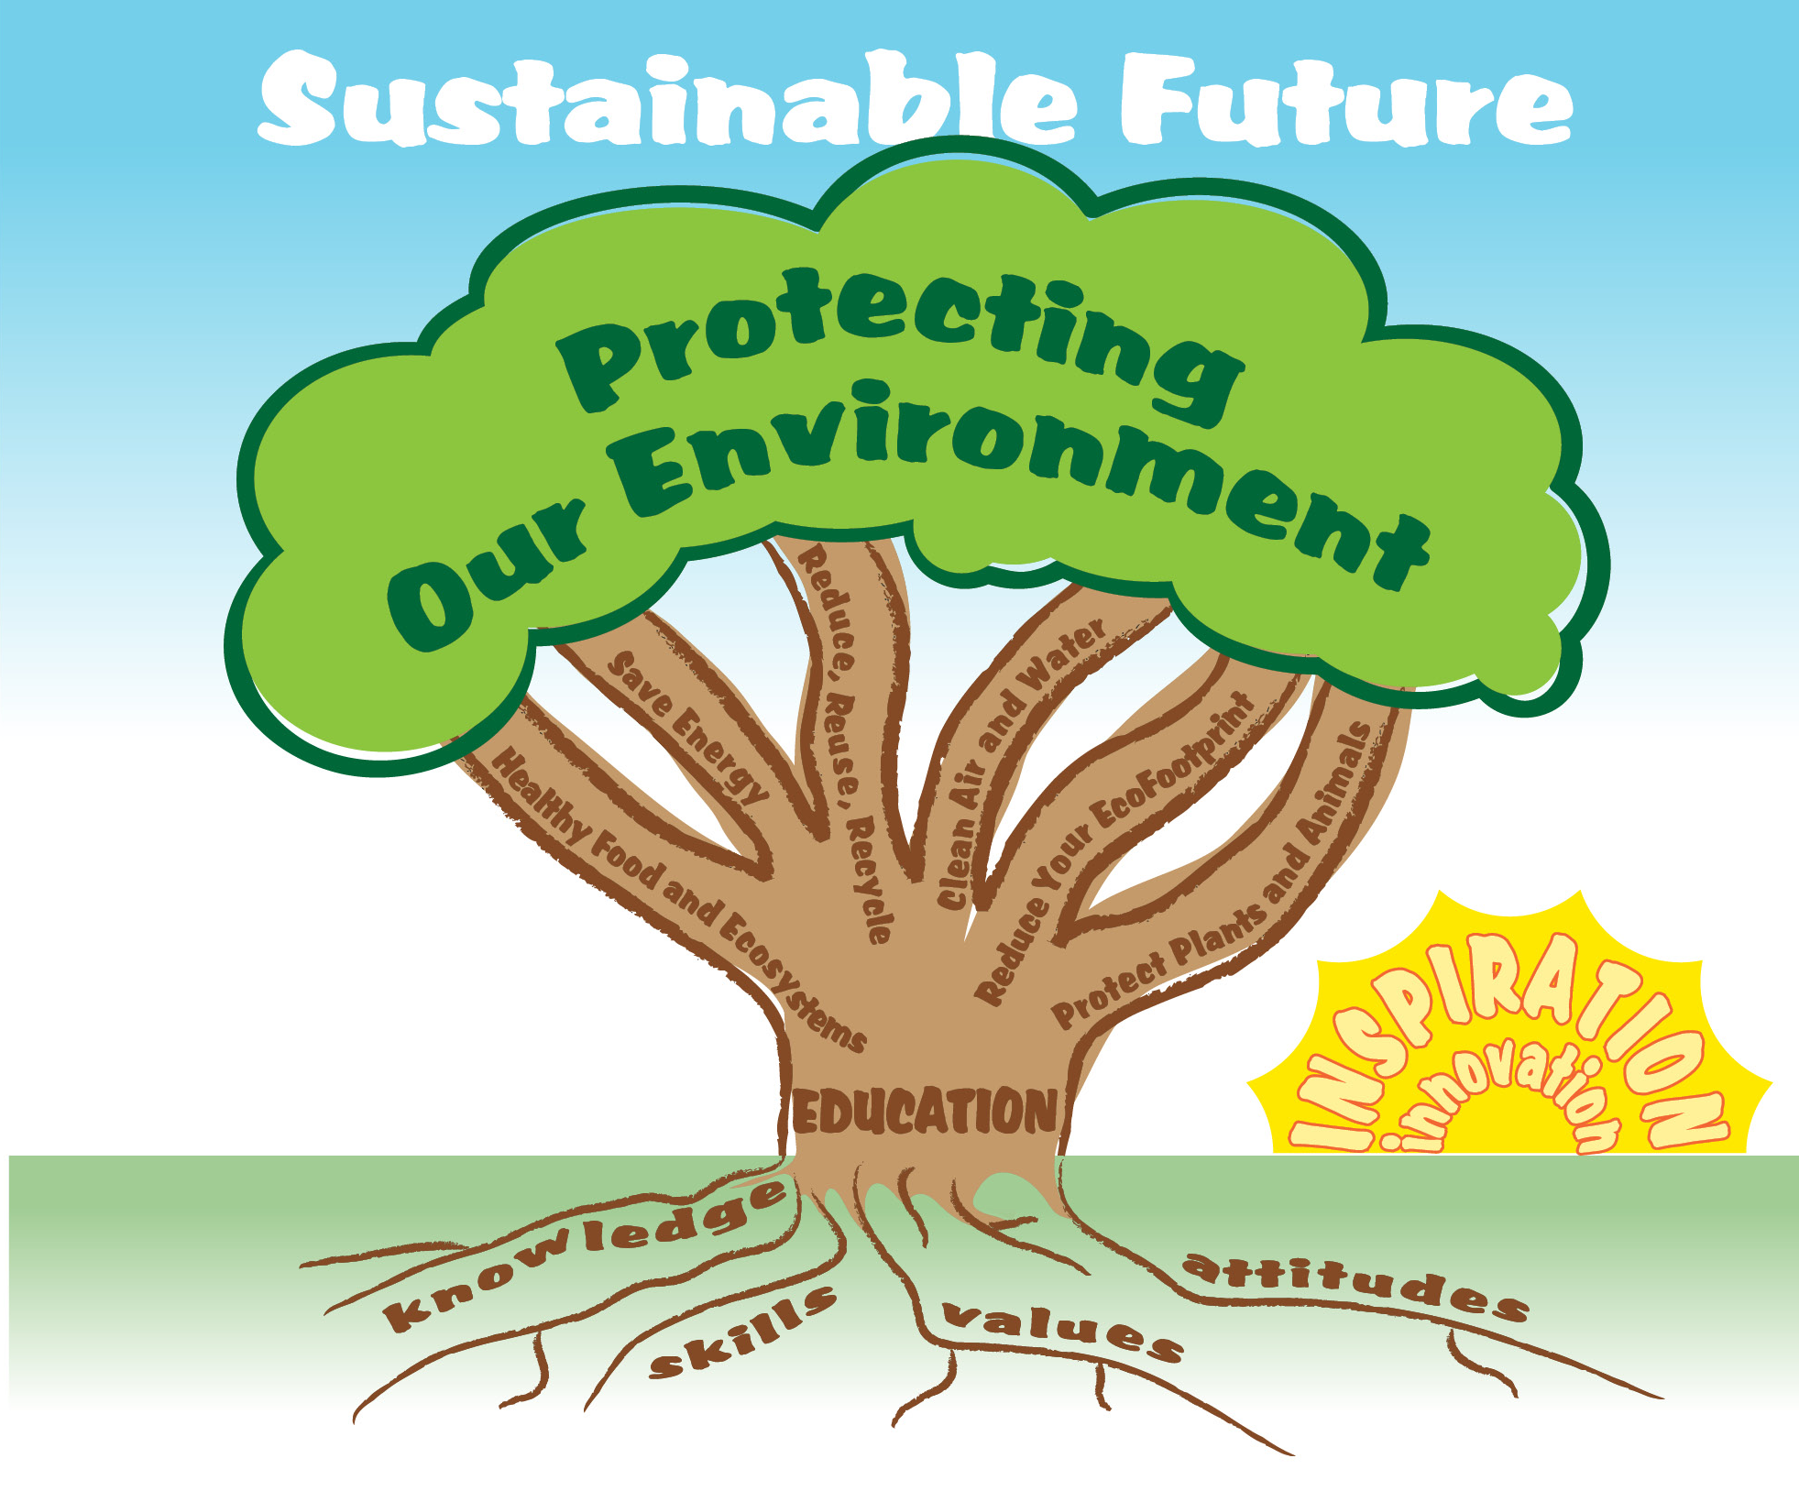

EcoLearn
Developed by the Environmental Protection Agency
With support from Department of State
Virtual Students of Foreign Service Interns
https://www.epa.gov/education
US EPA
Region 10
EcoLearn
For more information: hanft.sally@epa.gov or salazar.viccy@epa.gov

