Slide 1
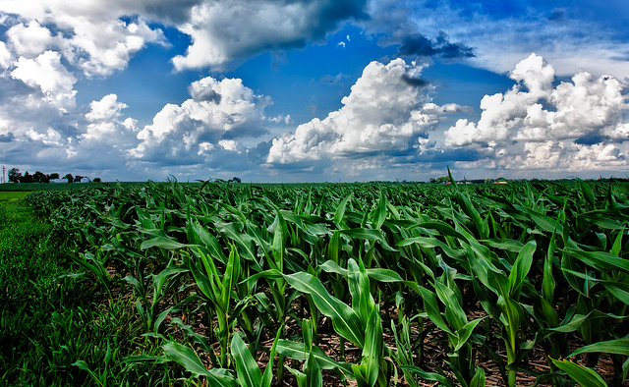



5th Grade: Food from Farm to Plate Increase awareness of the food system and all steps and processes foods undergo before they reach consumers
US EPA, Region 10 EcoLearn
Notes:
Image Source:
https://beyondthispoint2014.wordpress.com/

Slide 2
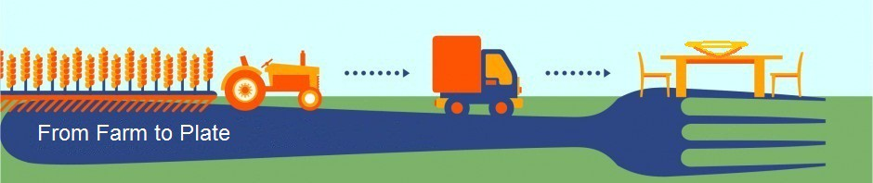
Objective
Today you will learn…
The food system and steps involved in getting food from a farm to our plate
How far away our food is grown
What resources are used in the production of our food
Notes:
Image Source:
https://presidiumfarmtoplate.wordpress.com/

Slide 3
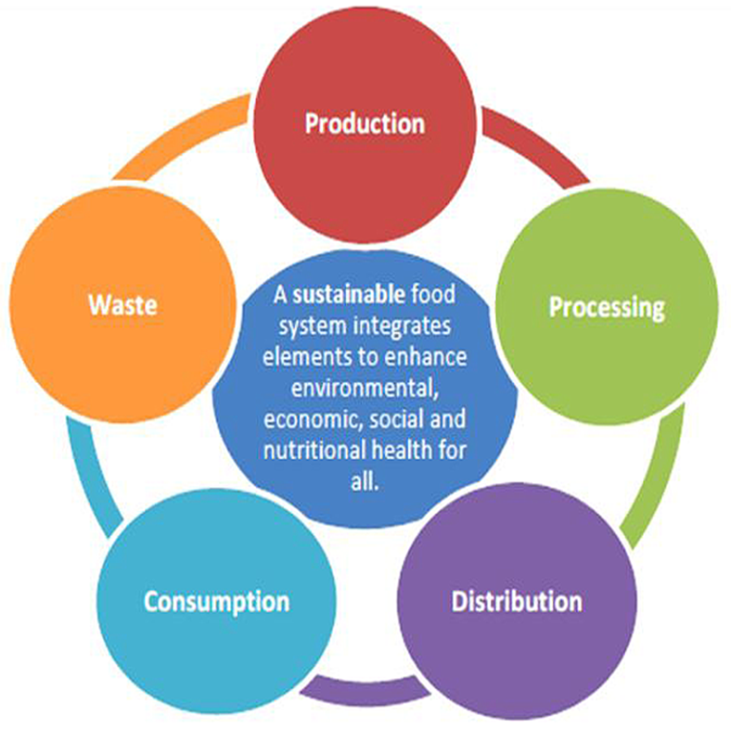
Key Words
Food
Food system
Agriculture
Consumer food choice
Notes:
Image Source:
http://rvfoodsystem.org/

Slide 4
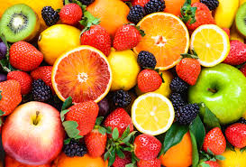
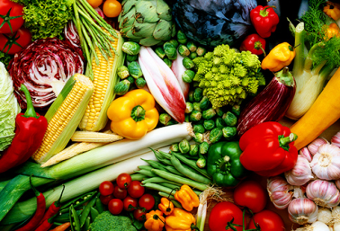
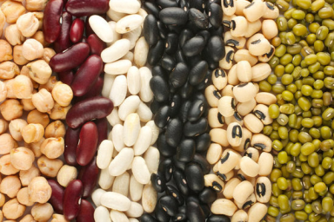
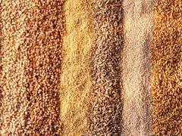
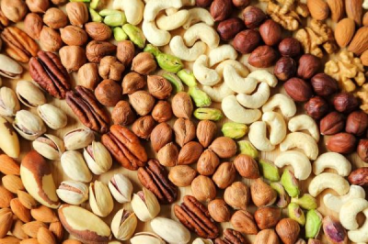
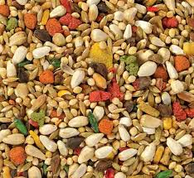
Do Now
Farm to Plate Game!
Write down everything you ate or drank during your last meal.
Underline all the foods that come from plants.
For example: Fruits, Vegetables, beans, grains, nuts and seeds
Click for Audio
Notes:
Image Sources
http://givingtreesnacks.com/fruit-versus-cholesterol/
http://www.webmd.com/diet/ss/slideshow-powerhouse-vegetables
https://foodimentary.com/2017/01/06/january-6th-is-national-bean-day/
http://www.womansday.com/food-recipes/food-drinks/g1056/types-of-whole-grains/
http://www.upi.com/Health_News/2016/07/29/Regular-nut-consumption-linked-to-less-inflammation/3891469810215/
http://www.downrightnatural.com/index.php?main_page=index&cPath=44

Slide 5
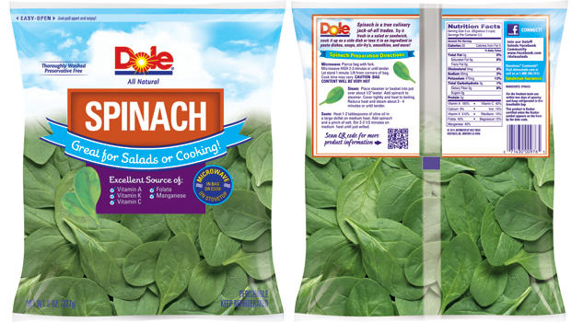
Example
Where does spinach come from?
Notes:
Use the bag of spinach (or other vegetable) as an example and ask the students where they think the spinach came
from? Students will likely say a grocery store or market, but they should be encouraged to think about how it got to the
market. Explain that all information about the production and route of the spinach to their plate can be found on the
labels on the bag. Show the labels.
Image Source:
http://www.cbsnews.com/news/dole-recalls-spinach-salad-due-to-salmonella-contamination/

Slide 6
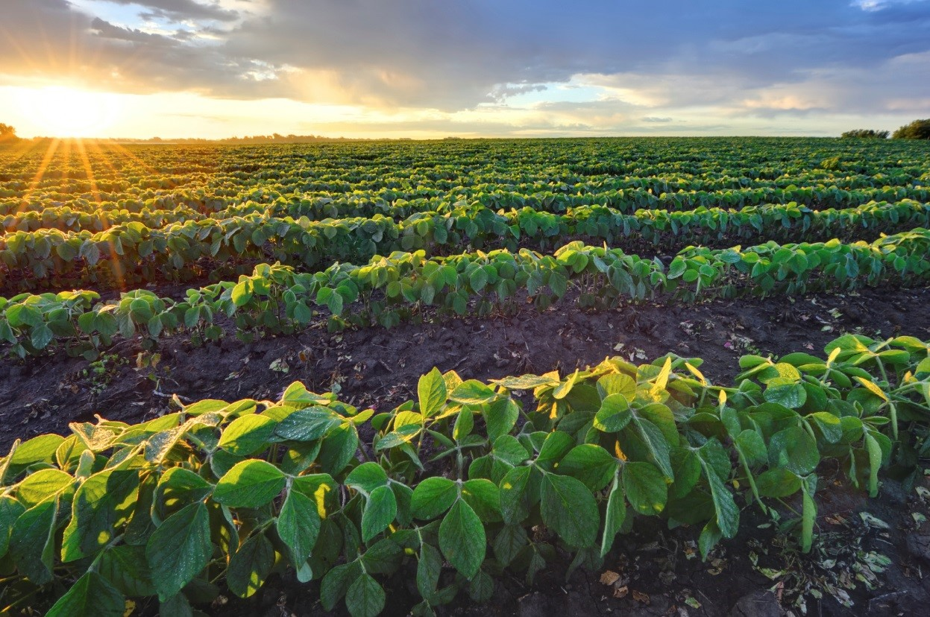
Food Systems
Step 1: Production
Notes:
Image Source:
http://www.foodinsight.org/newsletters/news-bite-ific-foundation-hosts-communications-workshop-food-production-emerging-market

Slide 7
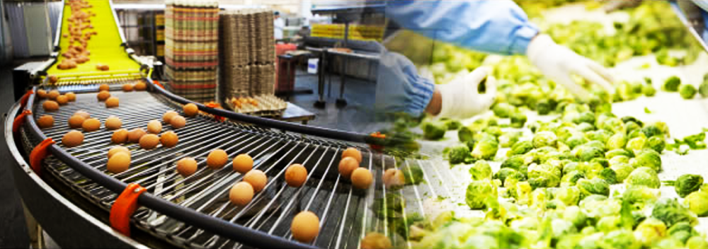
Food Systems
Step 2: Processing
Notes:
Image Source:
http://www.foodprocessingtechasia.com/

Slide 8
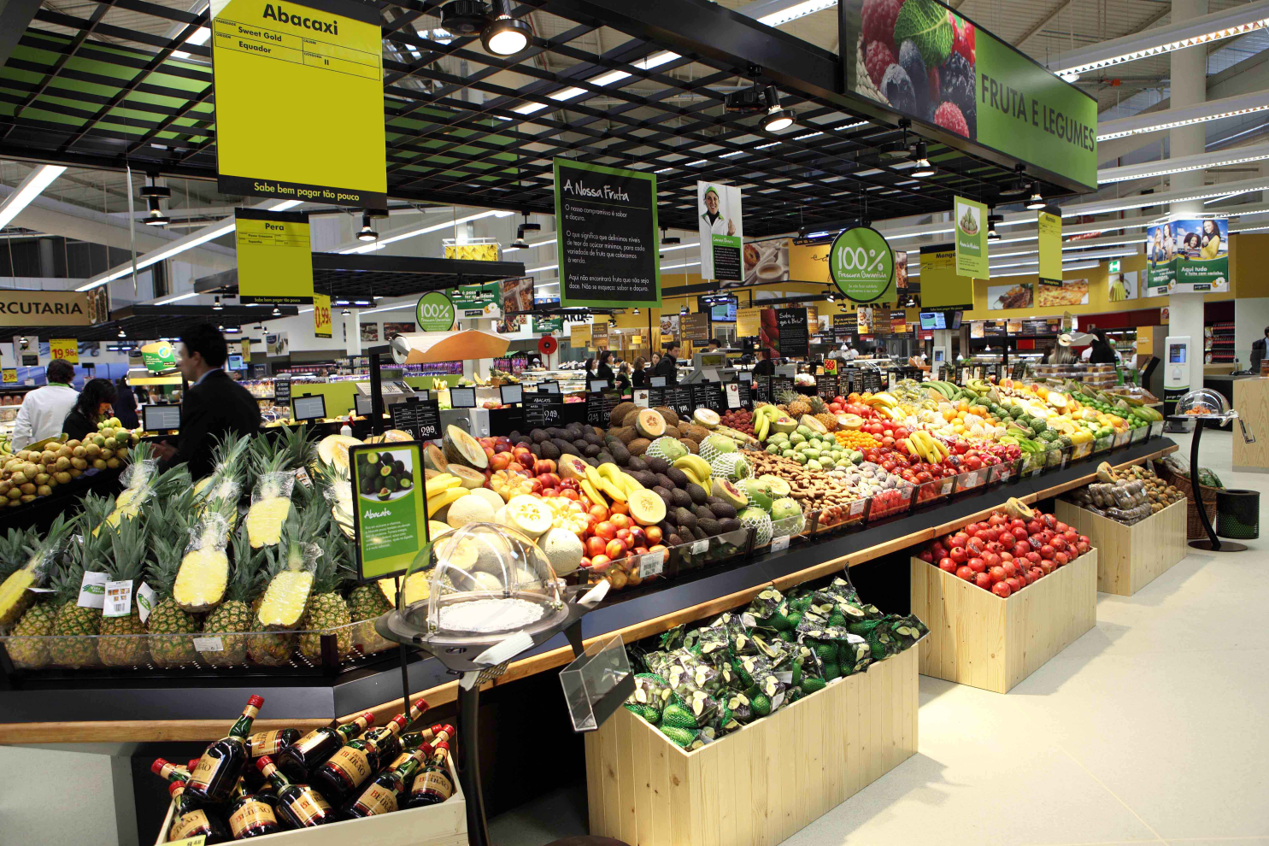
Food Systems
Step 3: Distribution
Notes:
Image Source:
http://www.jeronimomartins.pt/media/galeria-de-imagens/contentitem-imagemgaleria_lojapingodoce_frescos.aspx

Slide 9
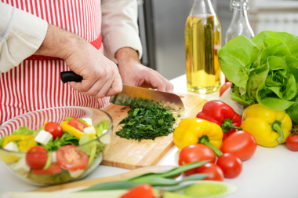
Food Systems
Step 4: Consumption
Notes:
Image Source:
http://news.unl.edu/newsrooms/unltoday/article/new-cooking-classes-offered-at-wellness-kitchen/

Slide 10
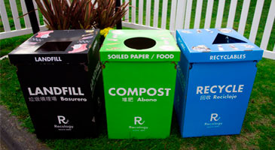
Food Systems
Step 5: Composting/Recycling
Notes:
Image Source:
https://sfenvironment.org/zero-waste/recycling-and-composting/event-recycling-and-composting

Slide 11
The Farm to Plate Game
Each student will represent a different role within the food system
Arrange yourselves in the order of the steps a fruit or vegetable travels from farm to plate
Each student should announce their role and share any thoughts about the process and steps
Notes:
*Hand out farm to plate cards

Slide 12
The Farm to Plate Game: Answers
1. Farmer (Producer): a person/company who grows and harvests food on a farm
2. Food Inspector: a person/company who visits farms or processing centers to ensure that foods are grown and processed safely
3. Food Processor: a person/company who washes, cuts, mixes, and packages food from the farm
4. Food Transporter: a person/company who moves food from one location to another, such as by truck, train, ship, or airplane.

Slide 13
The Farm to Plate Game: Answers
5. Food Distributor: a person/company who decides which stores receive the food
6. Advertiser: a person/company who designs the advertisements that promote food to consumers
7. Grocer/Food Retailer: person/company who sells food to consumers (such as through a grocery store or supermarket)
8. Consumer: a person who buys the food that has been grown or prepared
9. Compost/Waste Manager: a person/company who disposes of leftover food scraps by either composting or throwing food away (sending to a landfill)

Slide 14
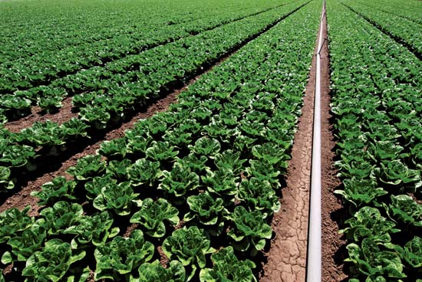
Closure
Where does the spinach from the beginning of the lesson come from?
Notes:
Image Source:
https://www.britannica.com/plant/spinach/images-videos

Slide 15
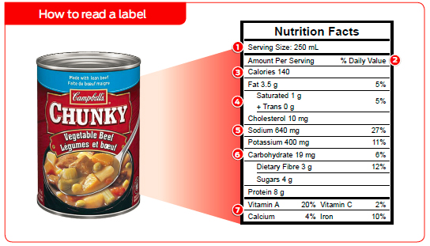
Homework
Click for Audio
Notes:
Image Source: http://www.coach.ca/food-labels-decoded-p154628

Slide 16


EcoLearn
Developed by the Environmental Protection Agency
With support from Department of State
Virtual Students of Foreign Service Interns
https://www.epa.gov/education
US EPA
Region 10
EcoLearn
For more information: hanft.sally@epa.gov or salazar.viccy@epa.gov

