Slide 1


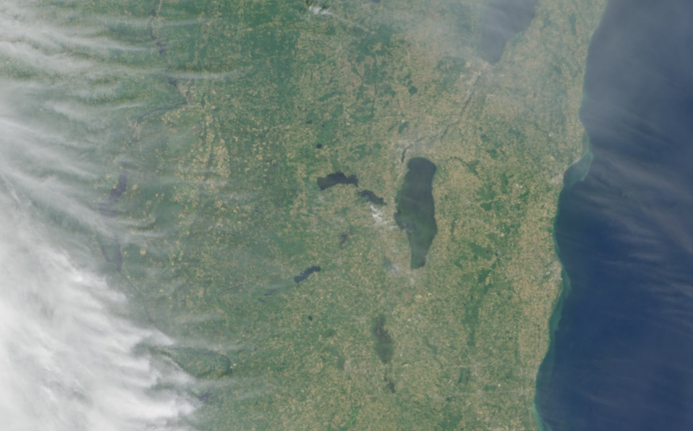


The Cyanobacteria Assessment Network (CyAN) Project
Cyanobacteria Index (CI_{Cyano})
True Color
Bridget Seegers
Notes:
Like many many good stories our starts in Ohio on the shores of Lake Erie…
Width: 57.17 mi Volume: 115.2 cubic miles Area: 9,940 mi² Length: 241.1 mi
View from above of a microcystis cyanobacteria bloom on Lake Erie in 2011, which covered 67% of the lake.
cyanobacteria, means it is a photosynthetic bacteria, sometimes referred to as blue-green algae. This specifically is microcystis, which produce a variety of toxins.
Hepatotoxins include Microcystins Nodularins Cylindrospermopsins
Neurotoxins include anatoxins and saxitoxins.
“A new paradigm for lake and reservoir research and management through global monitoring, modeling, and engaging and empowering people networks”

Slide 2
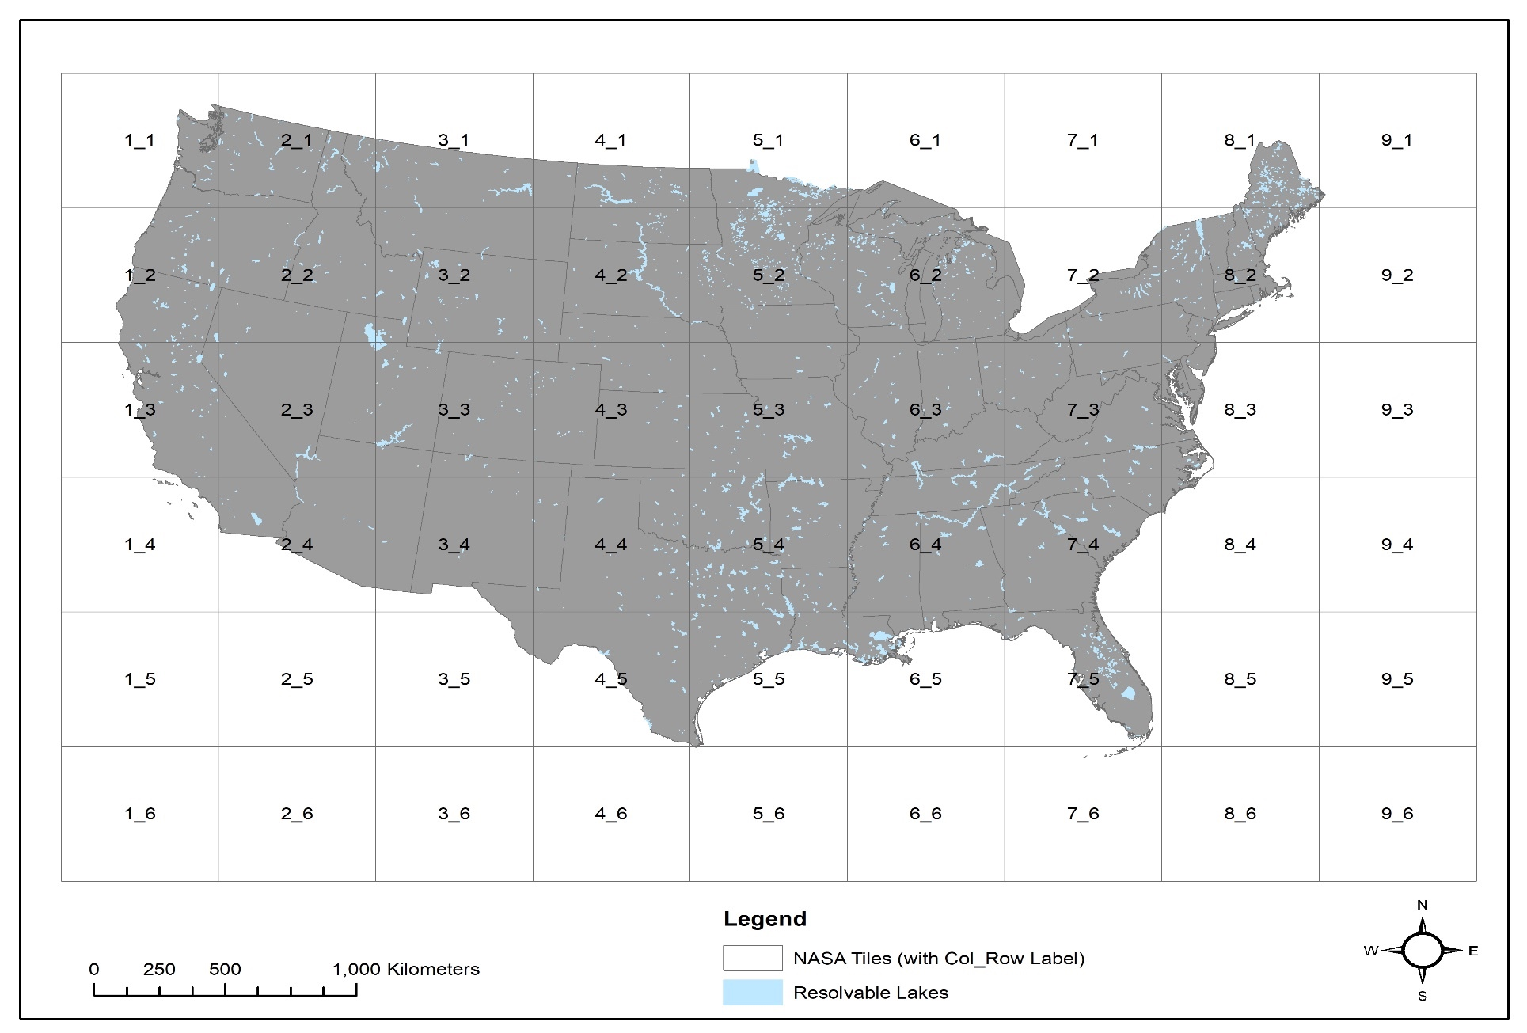
Contiguous US (CONUS) tiles
European Space Agency sensors:
MERIS on Envisat (2002-2012)
OLCI on Sentinel-3A (2016-present)
OLCI on Sentinel-3B (2018-present)
Full resolution (300 m)
3 pixels
2,300 Resolvable lakes
<1% of lakes resolved
33% of surface intakes
1 pixel
15,545 resolvable lakes
5.6% of lakes
resolved 57% of surface intakes
Notes:
54 tiles.
A conservative 3x 3-pixel grid may provide data for 1862 (< 1%) of U.S. NLA lakes and reservoirs.
A 300 m resolution sensor may provide data for 15,545 (5.6%) continental
U.S. NLA lakes and reservoirs
Single 300 m pixel resolution resolved 57% of public water surface intake (PWSIs) and a 3x 3-pixel array resolved 33% of PWSIs.

Slide 3

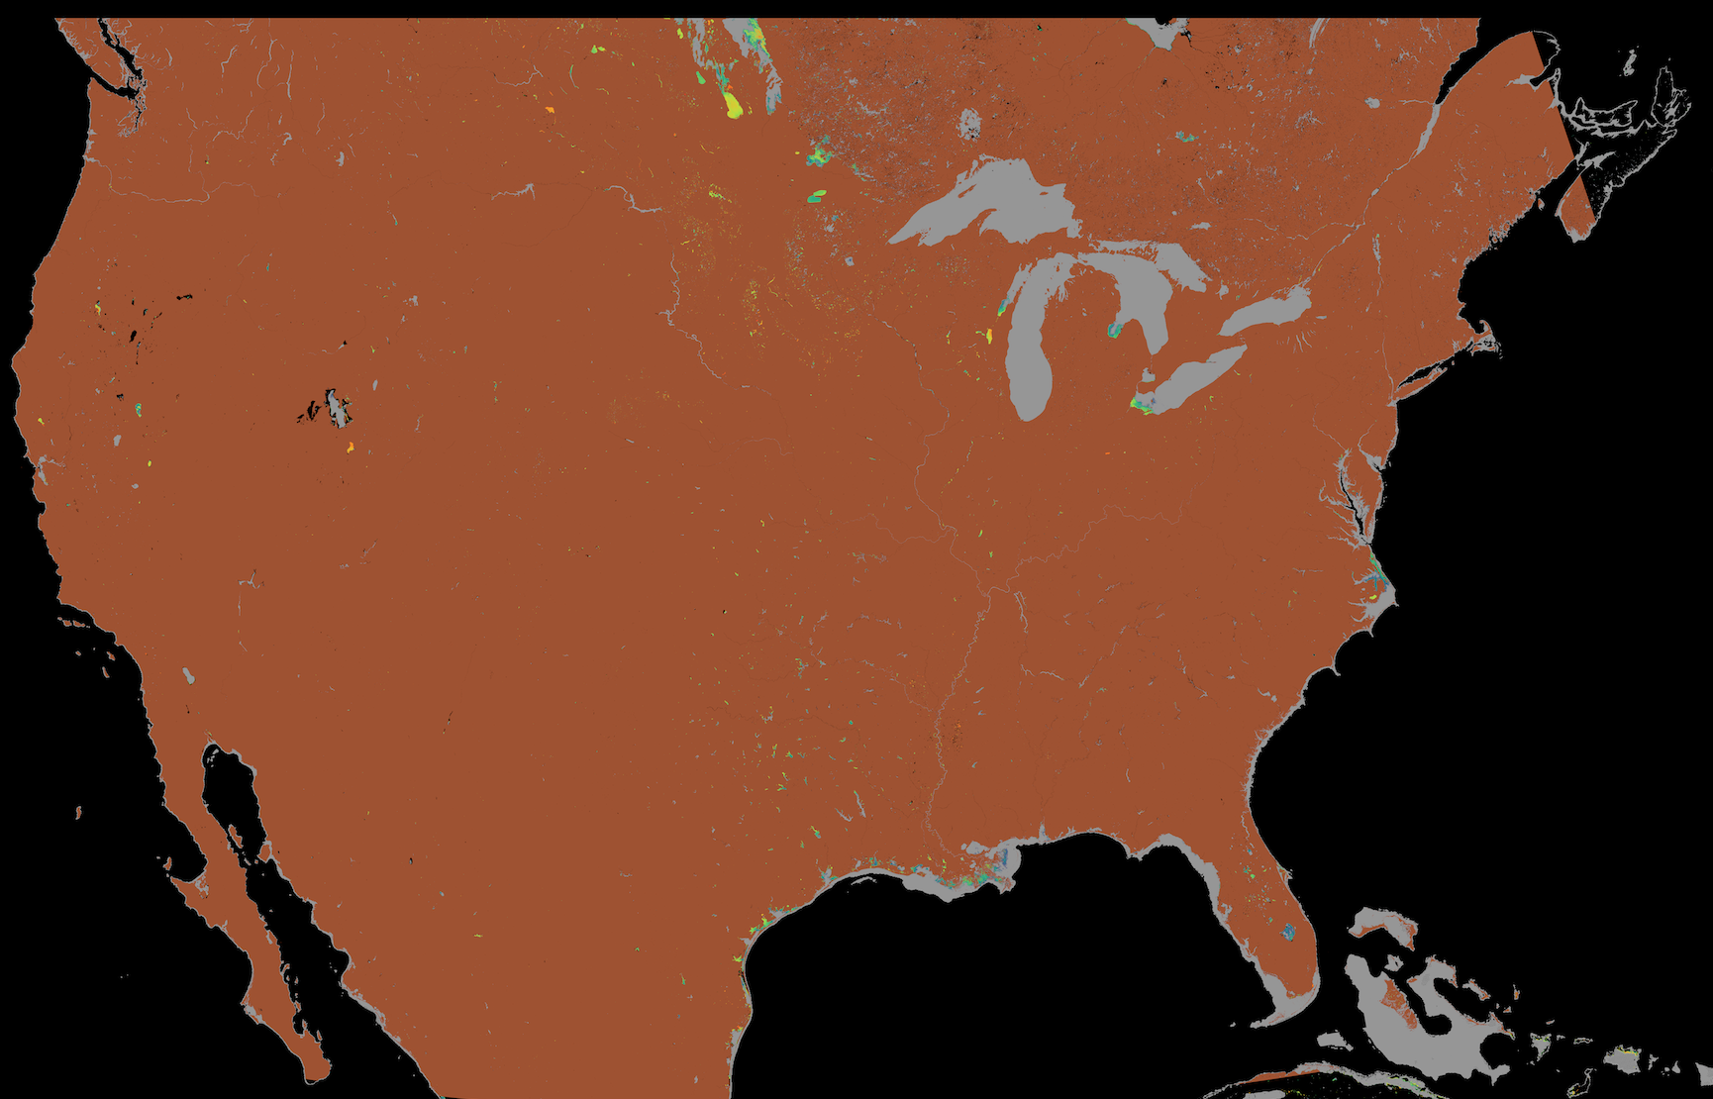
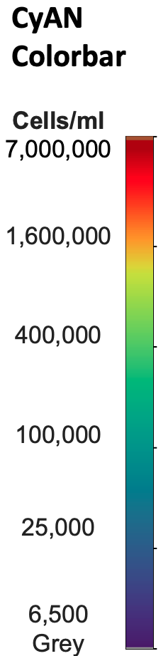
Daily, weekly (Sunday to Saturday).
Recently added rolling 28-day, monthly and seasonal files
September 5-11, 2021.
High
Low
Grey Below detect
Brown Land

Slide 4
September 5-11, 2021
High
Low
Grey Below detect
Brown Land
Link for Chat
Manuscript supplemental data provides a list of resolvable lakes by state.
https://www.sciencedirect.com/science/article/pii/S1364815218302482#sec5

Slide 5
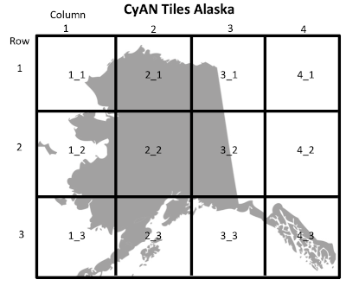
Alaska Tiles
Grey Cyanobacteria below detection
Brown Land
Black No data
5,874 lakes resolvable lakes

Slide 6
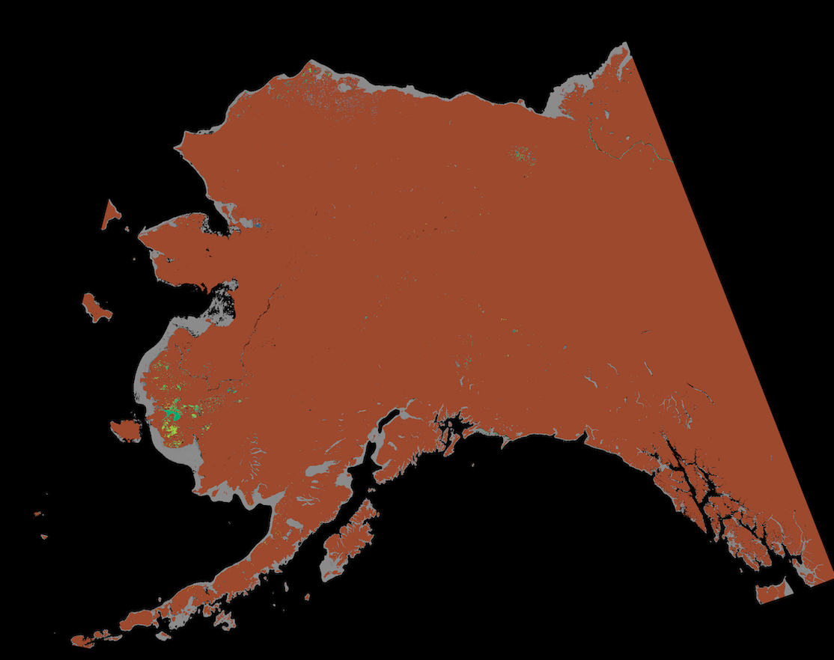
Alaska Tiles
5,874 lakes resolvable lakes

Slide 7
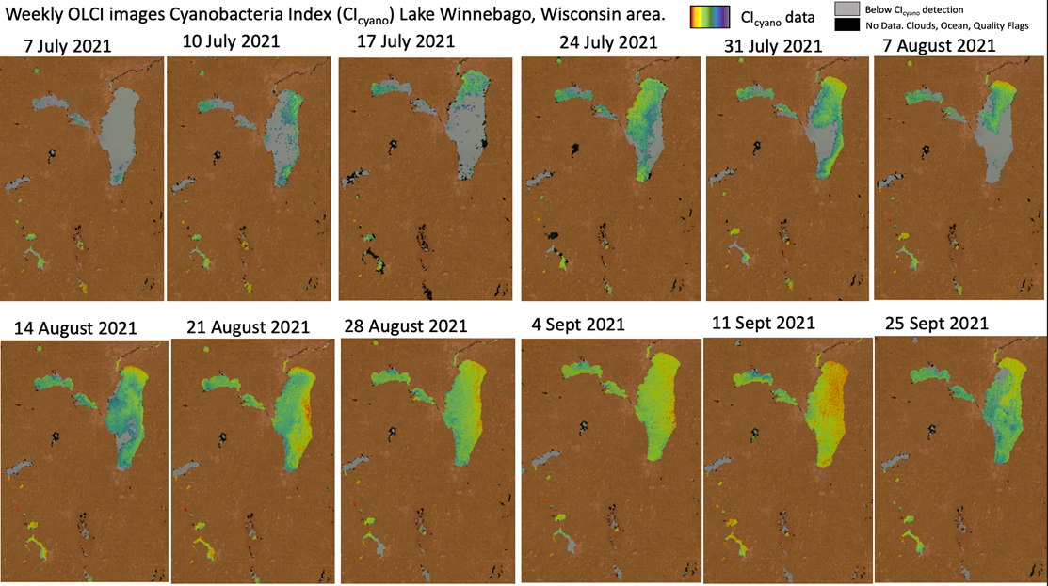

Slide 8
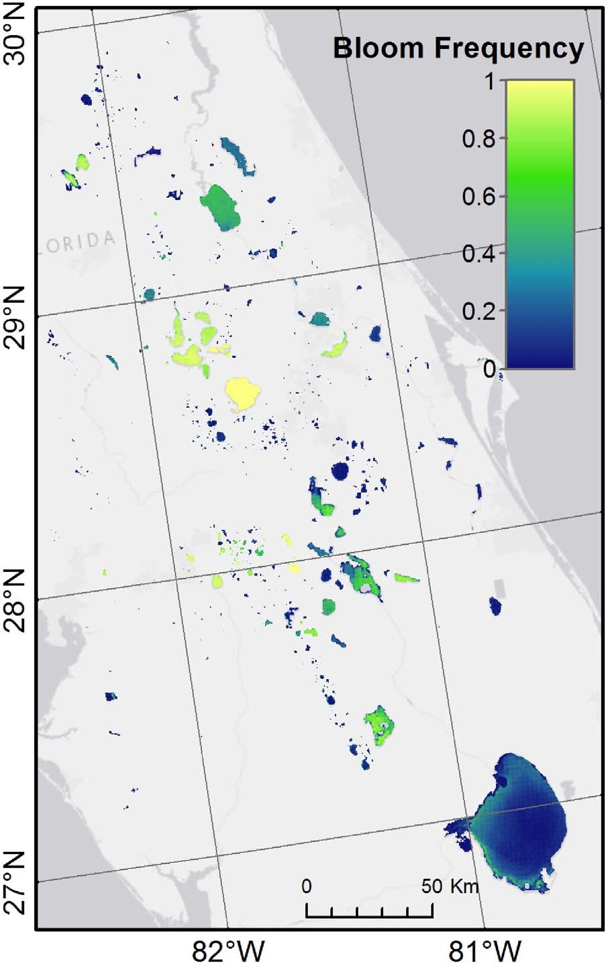
2008 - 2011
All publications are available the CyAN website
https://www.epa.gov/water-research/cyanobacteria-assessment-network-cyan
Clark et al. 2017
Notes:
Another exciting thing about the satellite data is that it is part of a long time series. On the top left you can see satellite images of Lake Erie from 2002 to 2011 scrolling by. And now with the cyanobacteria index we can turn that data into estimates of cyanobacteria in the lake and we can look for changes over time. This can lead to some very interesting science. The image on the right is actually a summary of 4 years of data from central Florida from 2008 to 2011. The colors in the lakes from blue to yellow represent the frequency of observed cyanobacteria bloom events that occurred above the World Health organization threshold for high risk. An area of blue has a value of zero indicatig that the area had no high risk cyanobacteria events over the 4 years, while the yellow color indicates that in all observations over 4 years the area was categorized as having a high risk cyanobacteria bloom.
It gives us and a water manager some insights into which areas have a major cyanobacteria problem. That image on the right deomstrates a summary study for individual lakes in a region. The map on the bottom is another way to summarize cyanobacteria satellite dat for the entire united states. Each hexagon represents a state and the colors represent the frequency over a year of a the observation of cyanobacteria from no bloom occurrence being represented in blue and high risk bloom conditions in dark green with low and moderate bloom in between indicated by the lighter green colors. This is just another example of the type of analysis that could be done with our CyAN satellite products.

Slide 9
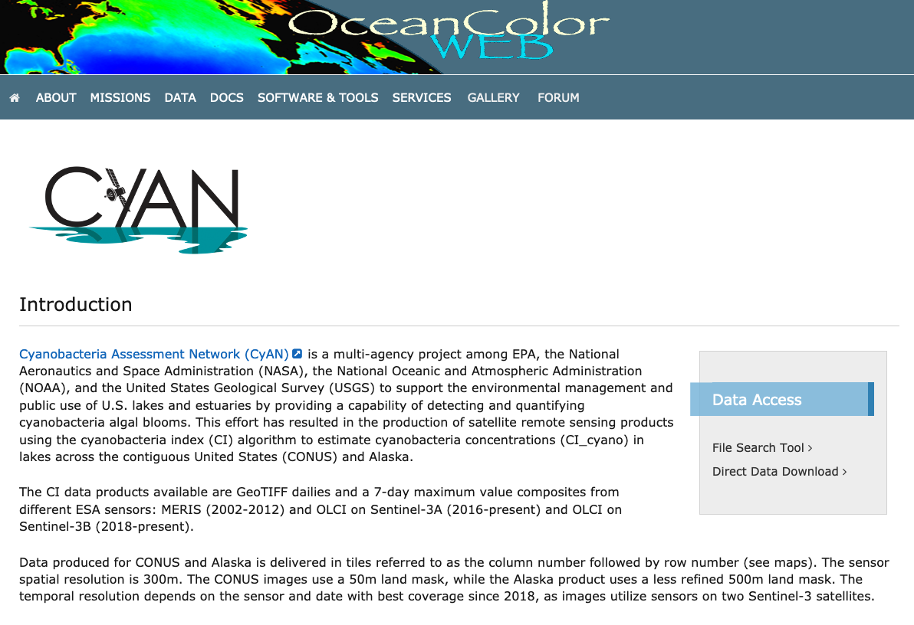
CyAN data site
https://oceancolor.gsfc.nasa.gov/projects/cyan/

Slide 10
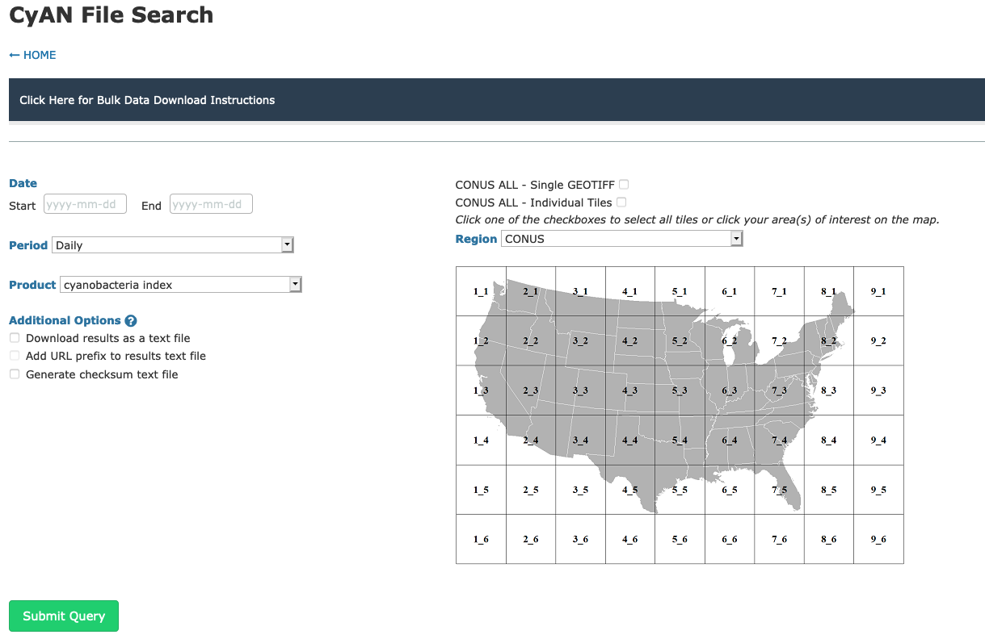

Slide 11
CyAN data site
https://oceancolor.gsfc.nasa.gov/projects/cyan/
Site for
CyAN project and data information
Data
Trainings
Shapefiles

Slide 12
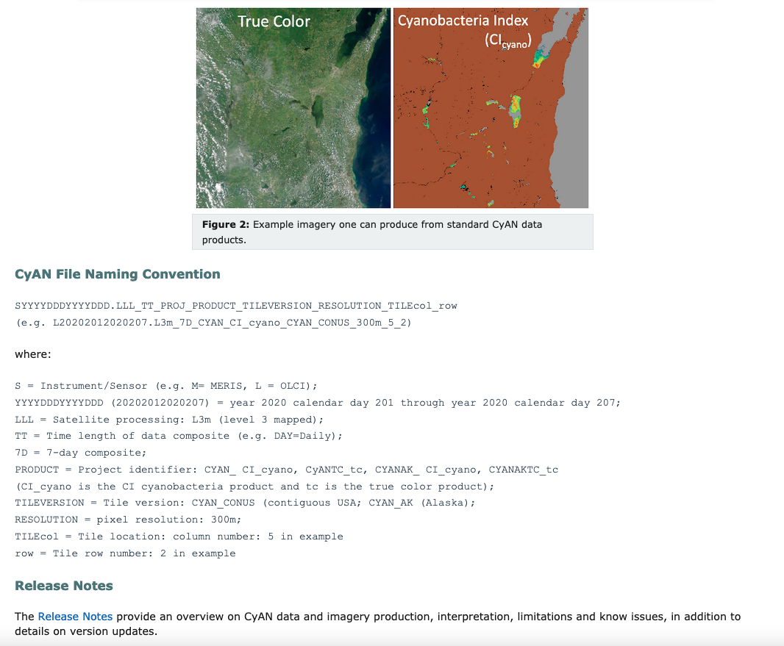

Slide 13
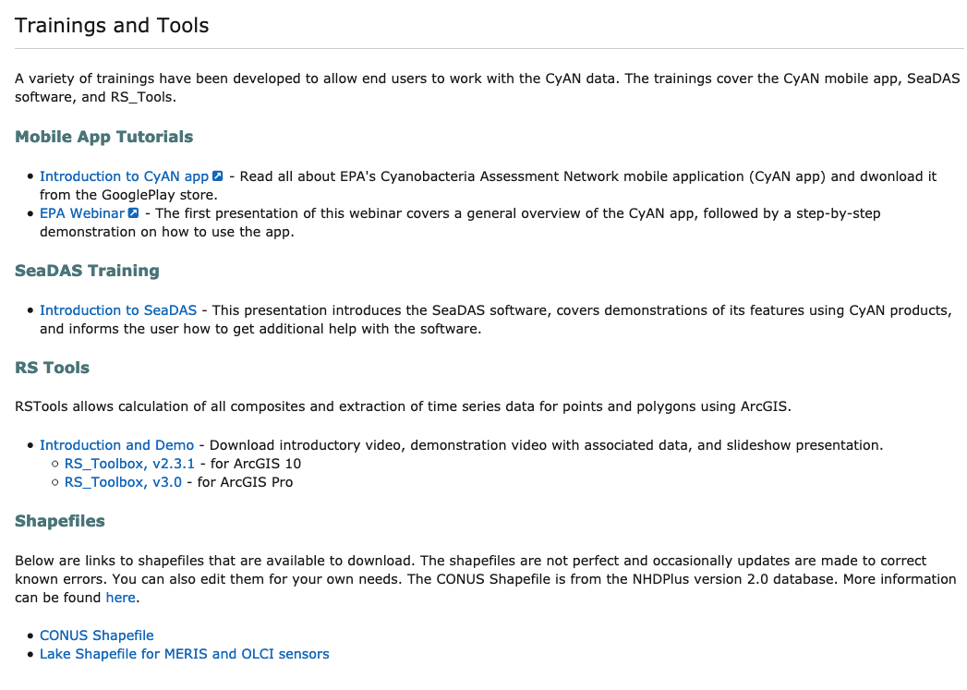

Slide 14
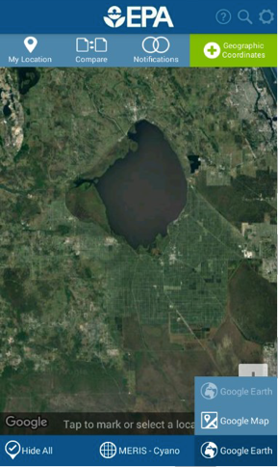
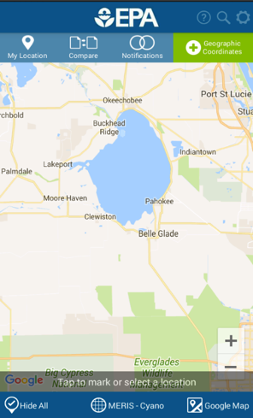
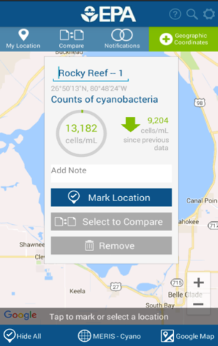
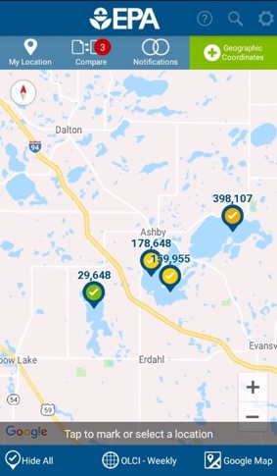
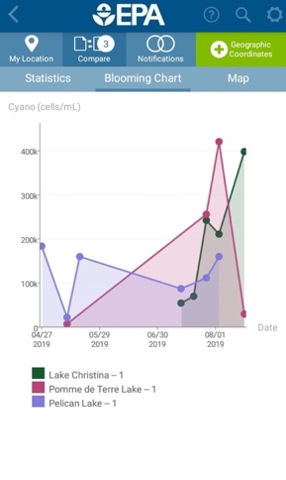

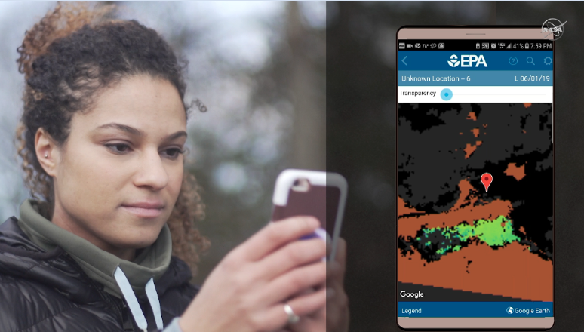
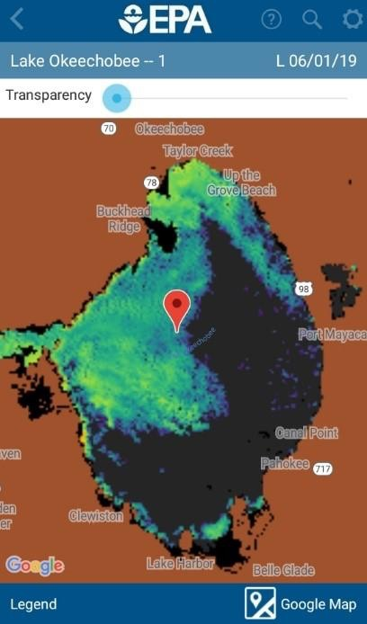
App
A1
B1
C1
Android only
C2
C3
Notes:
The big goal for the CyAN project is to provide reliable satellite imagery to help monitor for cyanobacteria blooms. The imagery will then provide decision makers and resource managers with data to make good decisions. The examples thus far have focused more on the scientist, manager, and researcher communities use of the data, but I have exciting news that our CyAN project collaborators at the EPA have developed a neat CyAN app that to get the data literally into everyone’s hands. This is exciting, because image you have your canoe on your roof and you want to go for a paddle or your fishing polls are packed or maybe you just want to go jump into a lake a cool off, but before you do want to check the water quality in a lake near you This app will allow you do this.

Slide 15

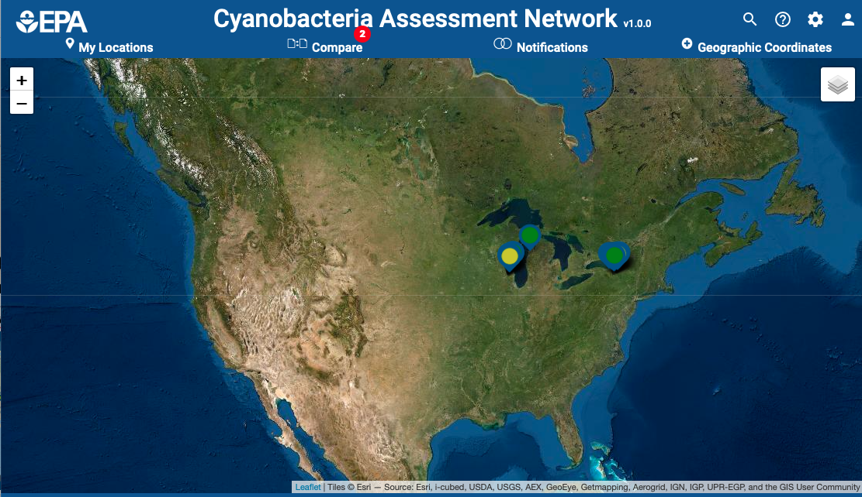
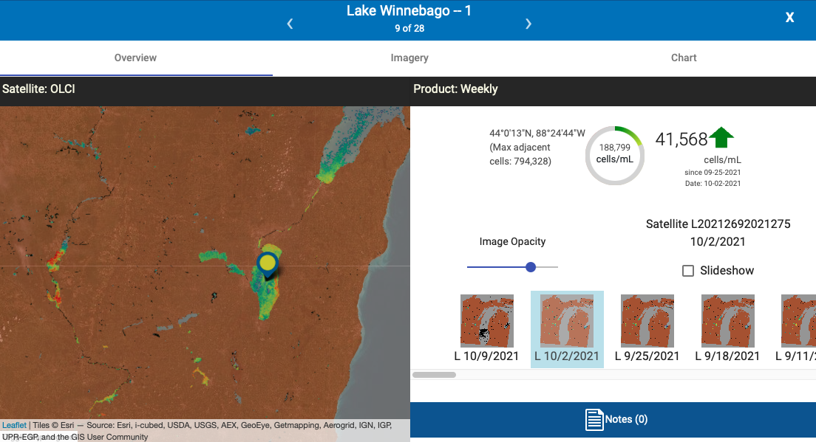
NEW CyAN Web App
Provides a platform for all browsers
https://qed.epa.gov/cyanweb/
CyAN Apps
CyAN apps get data to the water managers and the public in a user-friendly way
New web interface for all platforms
The phone app is for Android only.
Features include:
Easy to drop pins for areas of interest
Look at recent imagery
Compare locations
Notes:
Beyond the traditional data websites the CyAN project also delivers satellite data and imagery via apps.

Slide 16
Links
Manuscript supplemental data provides a list of resolvable lakes by state.
https://www.sciencedirect.com/science/article/pii/S1364815218302482#sec5
CyAN data site
https://oceancolor.gsfc.nasa.gov/projects/cyan/
CyAN web app
https://qed.epa.gov/cyanweb/
All publications are available the CyAN website
https://www.epa.gov/water-research/cyanobacteria-assessment-network-cyan

