Slide 1
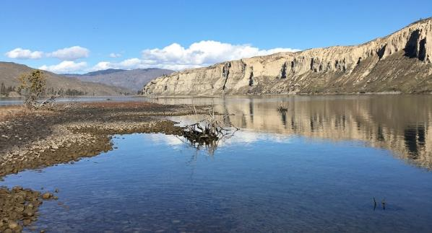
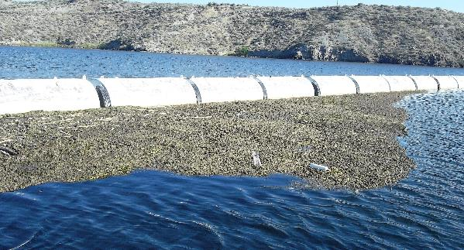
Seattle District Harmful Algae Bloom Overview:
Chief Joseph Dam - Rufus Woods Lake
Kent Easthouse and Eric Zimdars
Seattle District-Water Management Section
January 2023

Slide 2
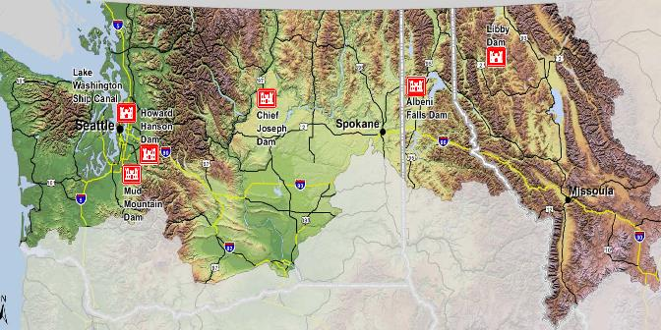
Location
One project in Seattle District known to have HABs – Chief Joseph Dam
Columbia River
Downstream Grand Coulee Dam and Lake Roosevelt
Rufus Wood Lake – 50 mile long run of river reservoir

Slide 3
Harmful Algae Bloom
1 of 3 known lakes in Washington with long term reoccurring anatoxin-a dominated HABs
Annual HAB since 2010
Floating mats
Benthic origin
Anatoxin-a concentrations range from about 1 to over 1000 µg/L
Dominated by Oscillatoria/Phormidium
HAUL

Slide 4
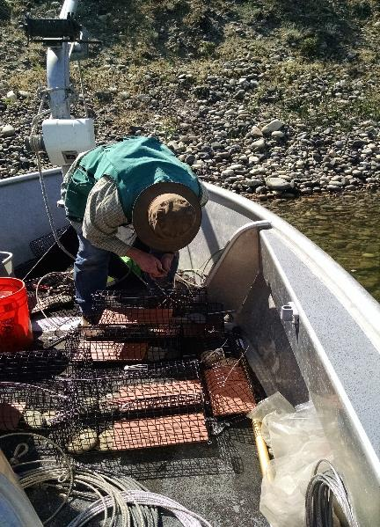
Research
Long term monthly water quality monitoring since 2004 – nutrients, metals, chl a, plankton
Floating mat samples since 2011 – toxins/species
Water column samples since 2011 – toxins/species
2011-2013 Aquaculture impact study
2012 Upstream source tracking study
2016 Periphyton study – tiles/rocks/species
2023 Proposed research – benthic study/water column toxins/spatial distribution
HAUL

Slide 5
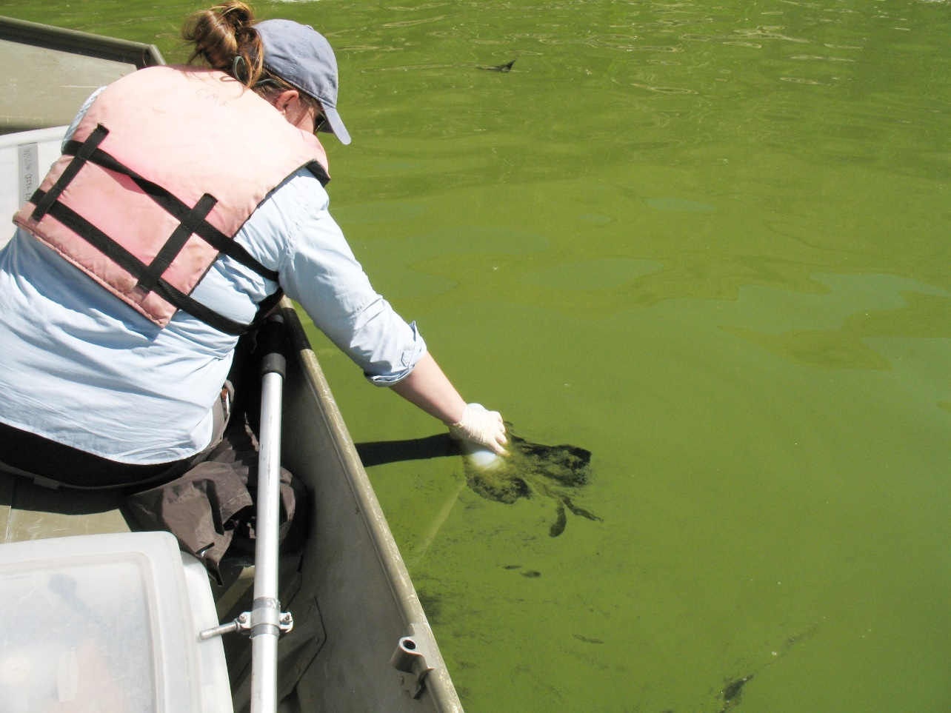
Portland district
Harmful algal blooms
USACE Portland District
Water Quality Section
Kathryn Tackley
Norm Buccola
Holly Bellringer
Sarah Burnet
sarah.h.burnet@usace.army.mil
503-808-4869
Photo: Frank Wilhelm
11 January 2023

Slide 6
Portland district cyanohab advisories & Sampling effort
*Notes:
2019 New recreational guidelines
2012-2018 APHA excluded from “toxic species” list
2014 NWP cyanoHABs policy changed
2008 Initial NWP cyanoHABs policy established
ND = Not detected (n=21)
TBL = Toxins below OHA limit (n=2)
BNS = Bloom not sampled (n=12)
HCC = High cell count (n=4)
Notes:
2022
Willow Creek Reservoir had a 75-day advisory with toxins up to ~1000 ug/L MC.
Blooms were observed and samples collected/shipped from Fern Ridge and Dorena but toxins were ND levels.
Compare the advisories to the sampling efforts that occurred.
-We have 21 instances of samples shipped for analysis with non-detect results
-2 instances where samples were analyzed but the limits were below OHA guidelines
-12 instances where the blooms were not sampled either due to lack of personnel to collect and ship a sample or the bloom did not seem severe enough
-4 instances of high cell counts but still non detects which would not be listed after the 2014 sampling change

Slide 7
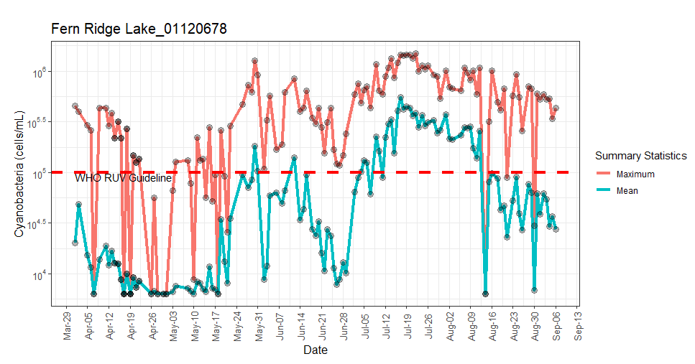
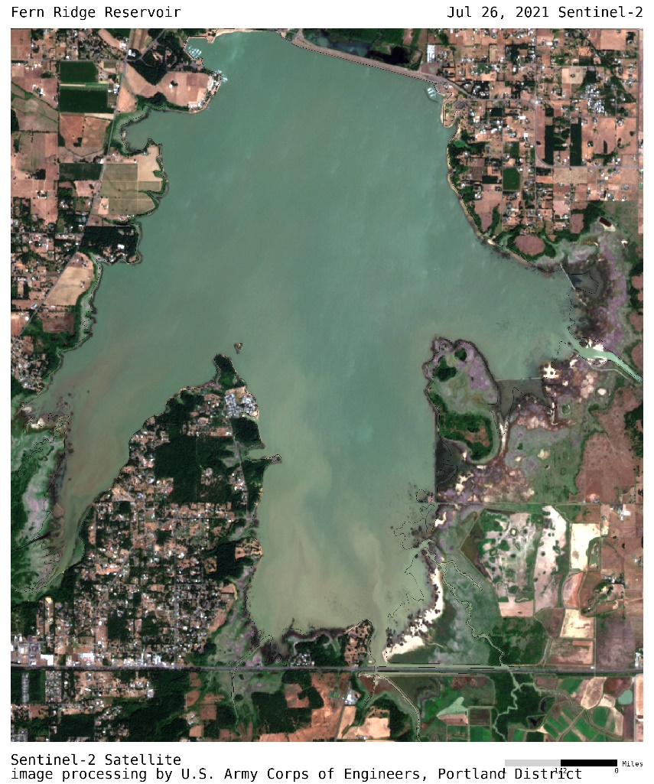
Continued Research
Satellite imagery provides cyanoHABs information for Oregon waterbodies
    Example of one tool: Corps monitors cyanoHABs blooms using Sentinel-2 imagery
  DEQ provides cyanobacteria counts from satellite imagery
Notes:
Continued research
1) Satellite imagery provides cyanoHABs information for Oregon waterbodies
-Example of one tool: Corps monitors cyanoHABs blooms using Sentinel-2 imagery
2) The time series plots include all waterbodies identified from EPA’s CyAN project. The plots report both the daily average and daily maximum abundance from April 1st to the present.
-These provide estimates of cyanobacterial abundance may be skewed by cloud cover, ice cover, sun glint, water surface roughness, dry lake beds, algal mats and shoreline effects.
Figures: Time series plots of daily maximums and daily means of cyanobacterial abundance (cells/mL) of the waterbodies during 2021-04-01 and 2021-09-06. Red dashed line: WHO RUV Guideline - World Health Organization Recreational Use Value Guideline for moderate probability of adverse health effects, which is 100,000 cyanobacterial cells/mL.
The 7-Day Average Daily Maximum is used for summarizing the cyanobacterial abundance.
The table includes all waterbodies with 7-Day Average Daily Maximum of cyanobacterial abundance above the World Health Organization (WHO) guideline value (100,000 cells/mL) for moderate probability of adverse health effects in the past 7 days. Potential health risks for the possible exposure through recreational activities, such as contact, ingestion and inhalation, during cyanobacterial abundance above this guideline level include skin irritations and gastrointestinal illness (WHO 2003).
All data presented in this report are provisional and subject to change. We suggest examining additional imagery from Sentinel 2 (https://www.sentinel-hub.com/explore/sentinelplayground/) or following up with site visits to confirm on the ground conditions.

Slide 8
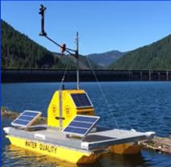
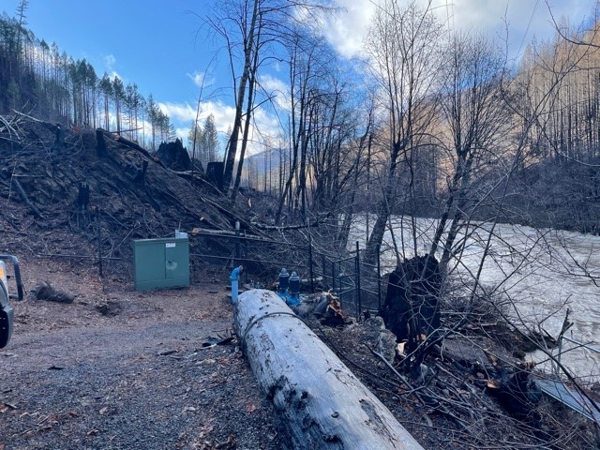



Continued Research
Lake monitoring efforts with USGS, EWEB, and City of Salem
Buoy platform previously located in Detroit (2019 & 2020) and Cougar (2020 & 2021) reservoirs
Buoy platform with vertical profiling system installed at Detroit and Blue River Reservoirs in 2022
    Multi-parameter data sonde and satellite uplink
      Temperature, conductivity, DO, turbidity, pH, Chla, phycocyanin, fDOM
Monitoring post-wildfire events
  Heavy fire seasons in 2018 - 2020
  Research in Mckenzie watershed on increased sedimentation and nutrients (C, N, P) as sources for cyanoHABs
Photos: Kurt Carpenter USGS
Beachie Creek and Lionshead Fires 2020
Notes:
Also there is significant cooperative efforts between USGS, EWEB, and City of Salem to utilize a vertical profiling station previously installed at Detroit and Cougar reservoirs and at Detroit and Blue River in 2022
This will give us an invaluable look at when these blooms develop, how they progress through the season, where they tend to concentrate in the water column on a daily and seasonal basis, and how other water quality parameters may be used to forecast pending bloom conditions.
This info would help water treatment facility staff determine when and where to sample and if operators need to adjust treatment processes.
-Another effort, in partnership with OSU, is looking to assess potential water quality impacts from fires near various reservoirs. We would like to better understand how fire activity, along with potentially higher nutrient levels, may impact HAB production.
-Sampling post fires can be complicated though if you miss the rain events that can start washing sediment into the nearby water channels. These events may also occur quickly causing flashiness and fluxuation in the data or missed sampling opportunities.
-Sampling can also be limited due to site access
-Also, it would be important to know what the water quality was like pre-burn which is data we may not have.

Slide 9

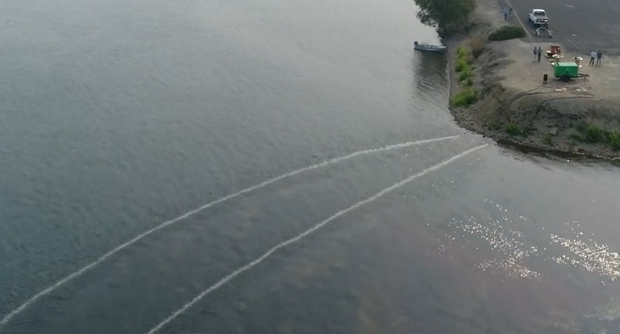
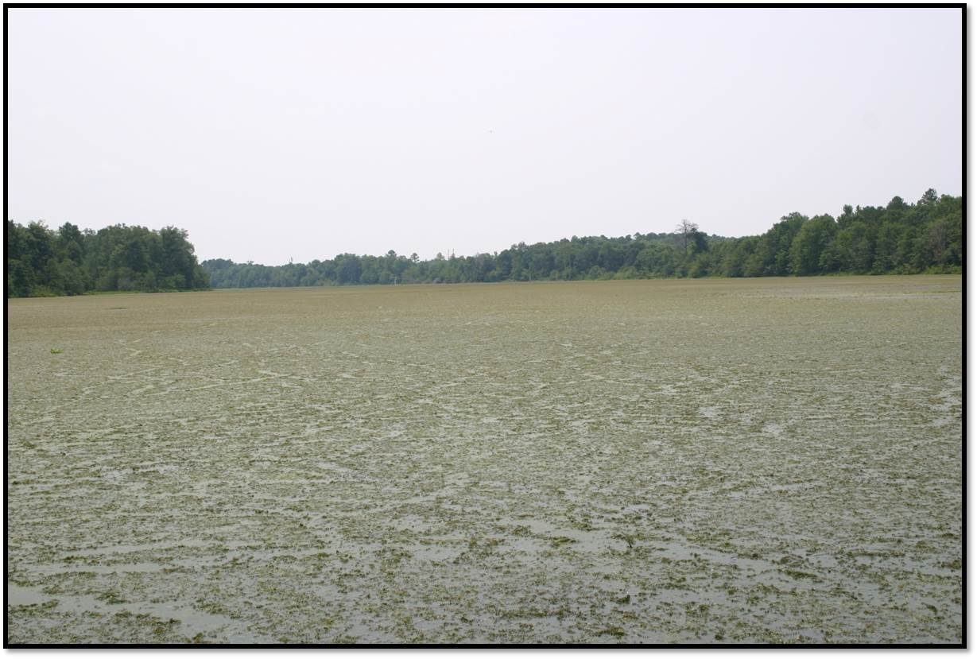
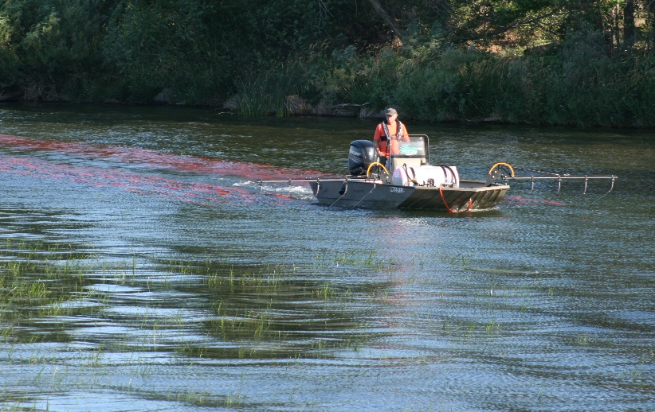
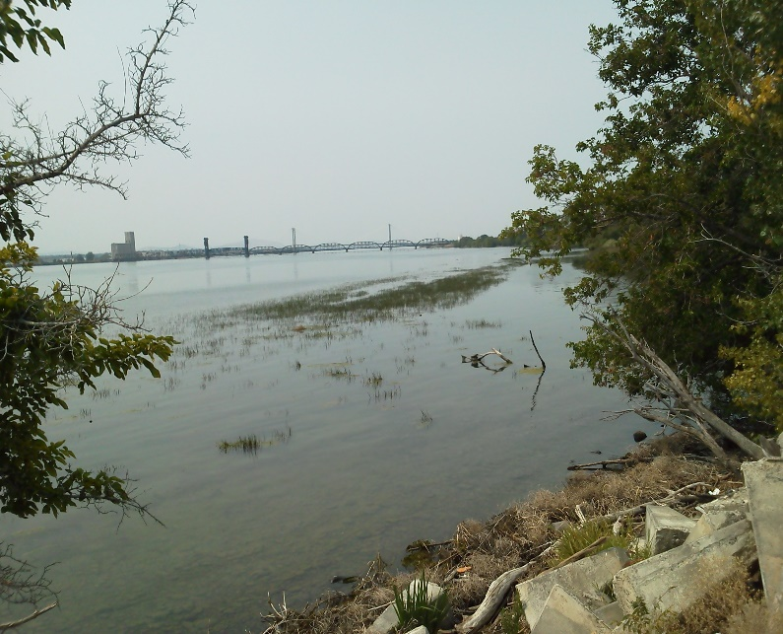
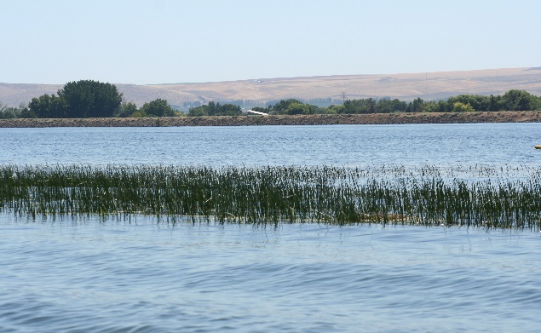
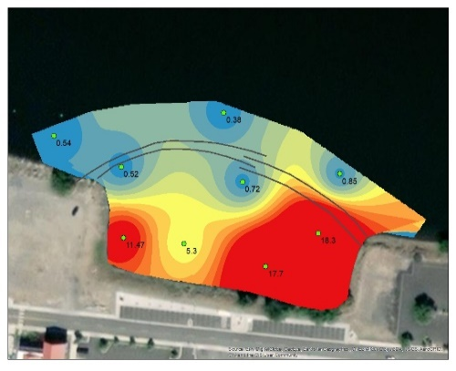
USACE:
NWW-HABs
Damian Walter
US Army Engineers
Walla Walla District
“The views, opinions and findings contained in this presentation are those of the author(s) and should not be construed as an official Department of Army position, policy, or decision, unless so designated by other official documentation.”

Slide 10
NWW HABs:
Walla Walla District (NWW)- Not actively looking for (Operations).
No active or specific HAB program.
Do have APMP that provides some tools if necessary.
District direction/position is reporting to State and Local Health Departments, and they address.
NWW HAB actions:
Will report HAB blooms if get a call/report from the public and if seen on patrols or while in the field.
Will post signage provided by State and Local Health Departments, but will not perform sampling etc.

Slide 11
NWW HABs Future:
-HABs are coming due to various factors, climate change etc.
a. In 2021 had a HAB in McNary reservoir near Columbia park, lead to City and local health closing a portion of the shoreline. First NRM closure/impact of a HAB in NWW.
-NWW Operations POC- Damian Walter, damian.j.walter@usace.army.mil; secondary Matthew.W.Drumheller@usace.army.mil District ECC & Christopher.H.Alford@usace.army.mil NRM Lead.
& Steve.T.Juul@usace.army.mil District Hydrology and Hydraulics Branch.
Questions?

Slide 12
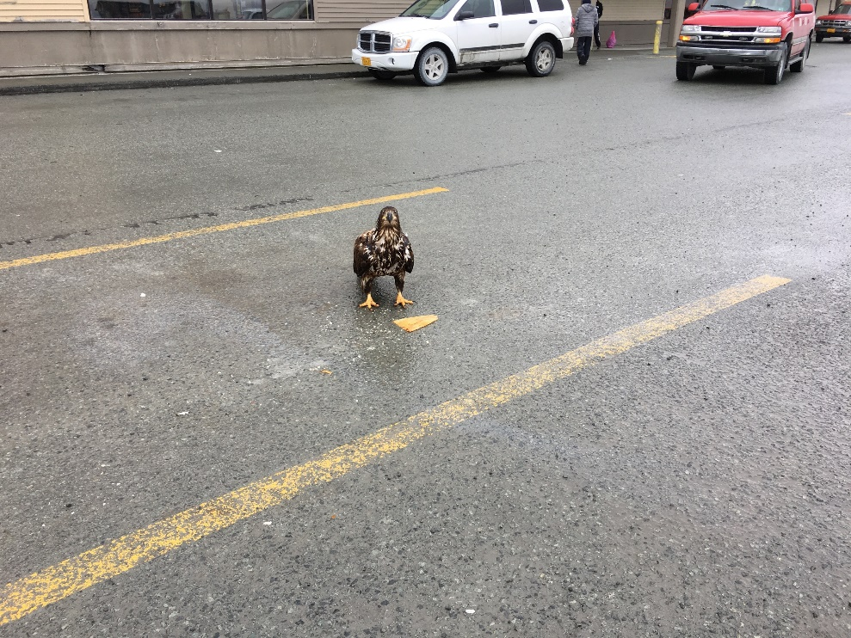
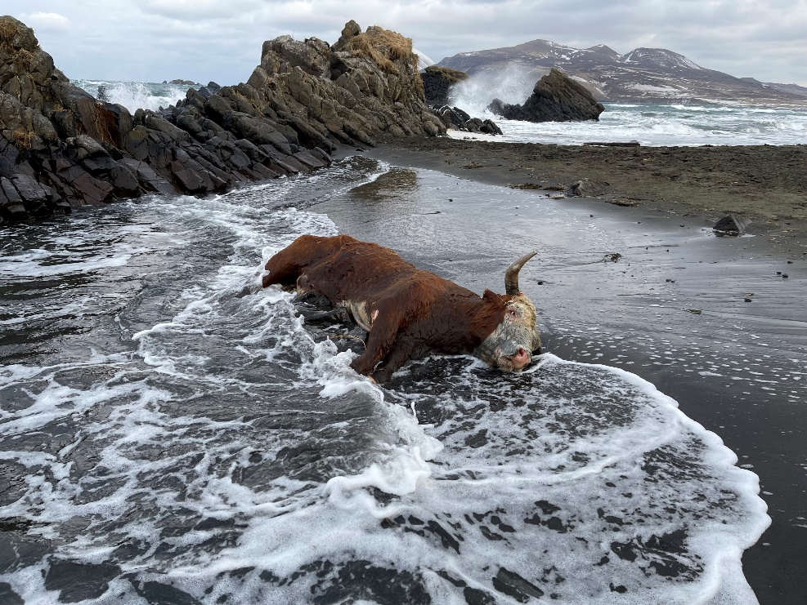
ALASKA District Harmful Algal Bloom Monitoring Overview:
Mike Rouse – Chief of Environmental Resources Section, Civil Works Branch.
Michael.B.Rouse@usace.army.mil
907-753-2743

Slide 13
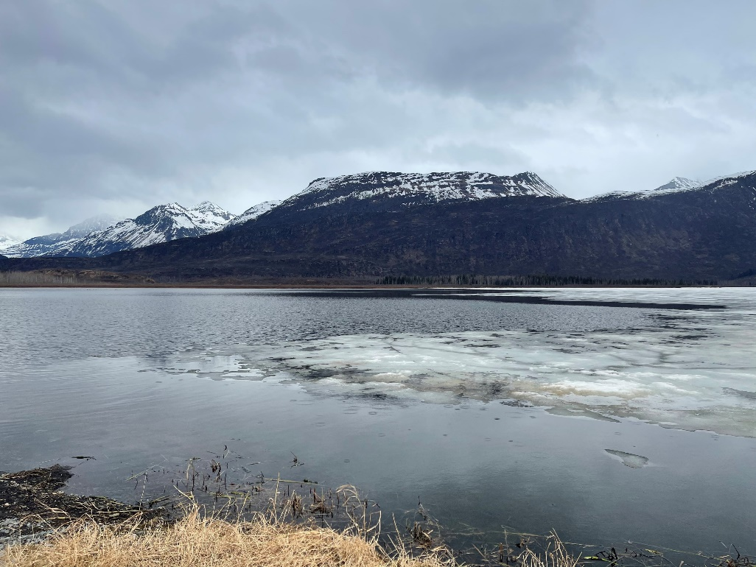
No Active hab monitoring program
Robe Lake 206, native macrophyte proliferation after natural hydrology interrupted in the 1950’s.
Alaska Harmful Algal Bloom Network (AHAB). https://ahab.aoos.org/ Established in 2017. Phytoplankton monitoring and shellfish testing.
Likely opportunities to coordinate/cross-pollinate as our staff frequently operate in remote locations.

Slide 14
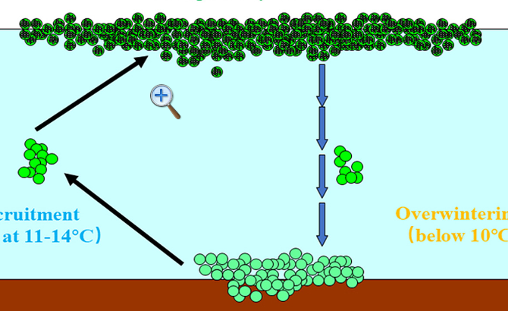
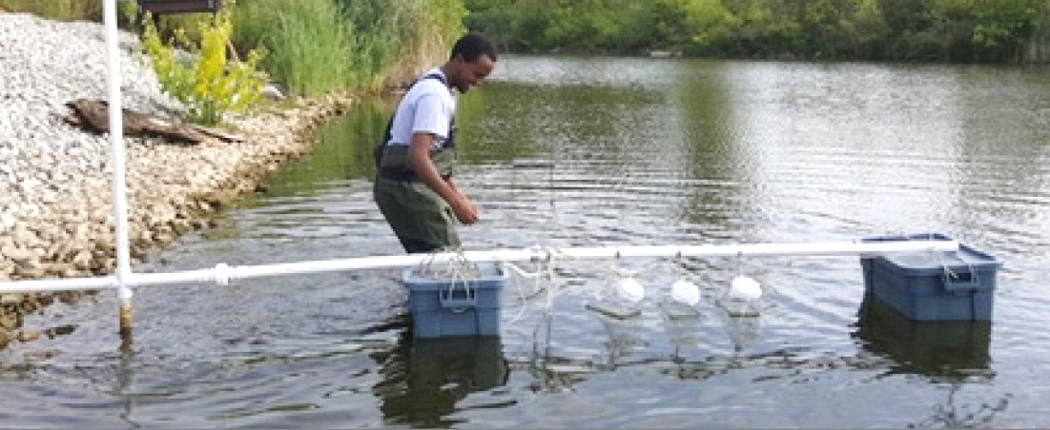
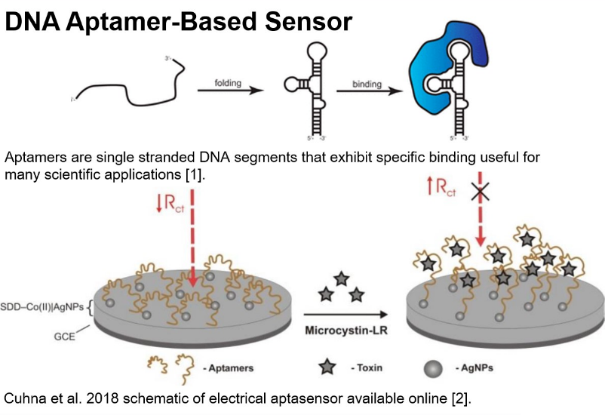

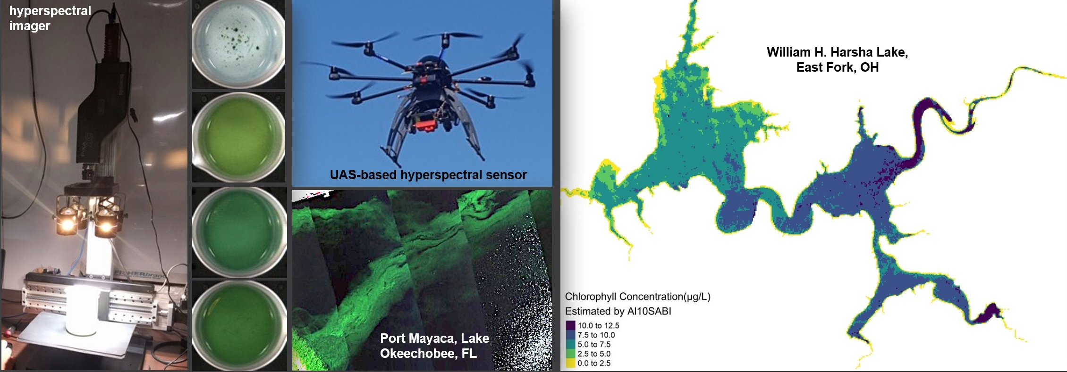
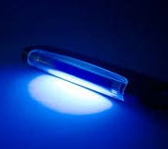
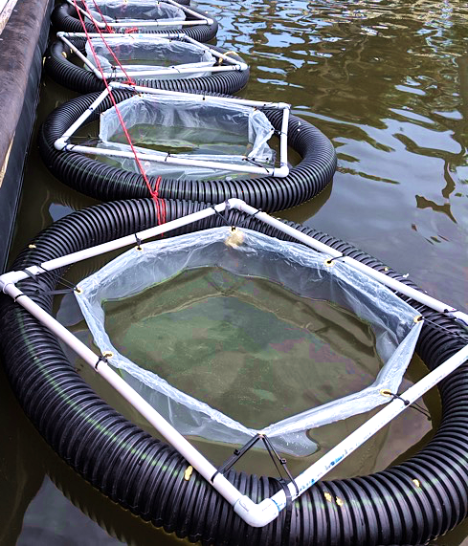
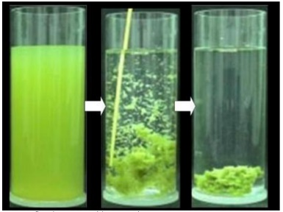
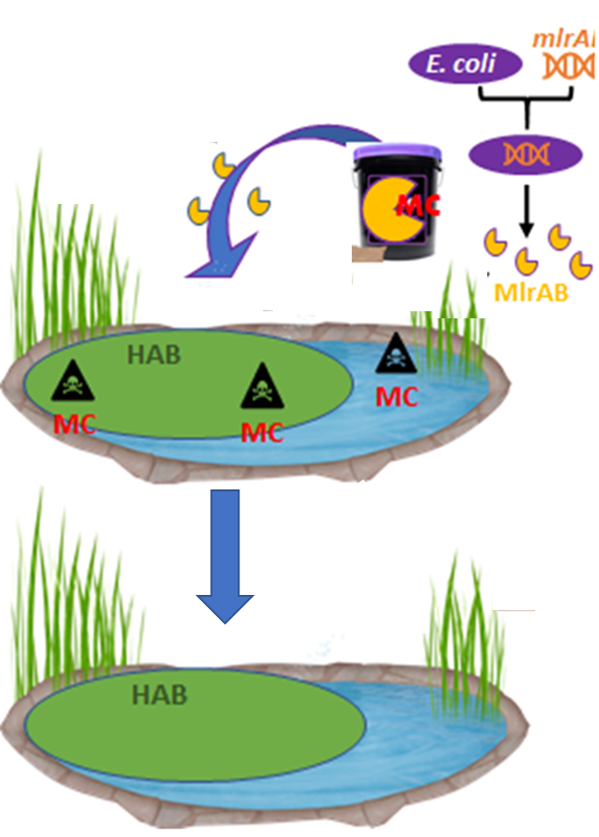
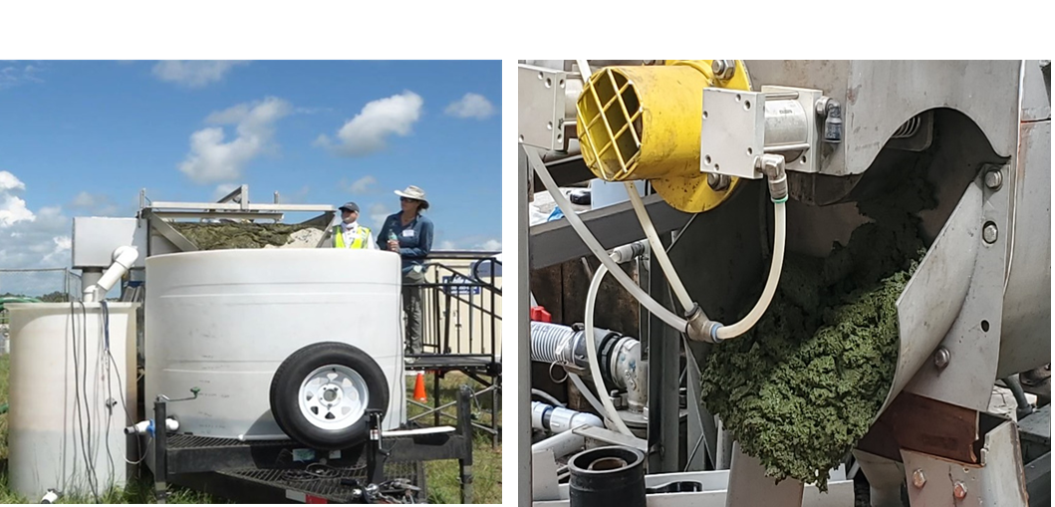
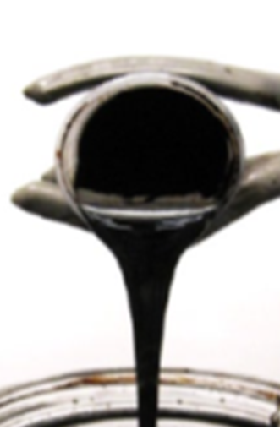
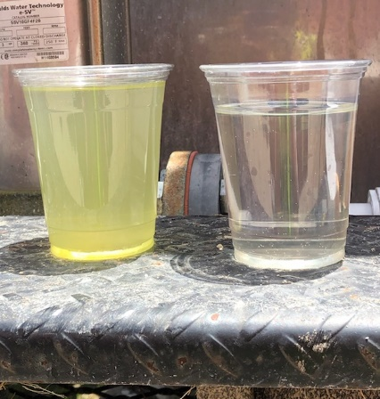
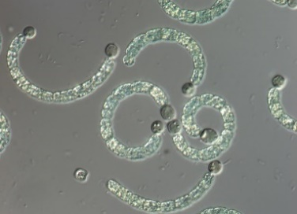
Overview of USACE-funded HAB projects by research focus area
USACE Freshwater HAB R&D Initiatives
HAB Research Focus Area: Prevention Reduce biomass and toxicity AND/OR demonstrate reduction in available nutrients feeding the bloom within an aquatic system
HAB Research Focus Area: Detection Develop rapid, reliable and cost-effective technologies and standardized approaches for improved HAB monitoring and detection.
UAS-based hyperspectral sensor (left); satellite-based cyanoHAB detection in small inland waters (right)
DNA Aptamer-Based Cyanotoxin Sensor
can “seed”
the next HAB event
overwintering cells
Low-energy ultrasound photo provided by Dr. Linda Weavers, The Ohio State University
Treating cyanobacteria in sediment
HAB Research Focus Area: Management Remove or inactivate HAB biomass and toxins through physical, chemical, and/or biological processes
HABITATS: HAB Interception, Transformation
and Treatment System
2020 USACE Innovation of the Year Award Winner
Ultraviolet light¹
HABITATS permanently removes HAB biomass and associated nutrients, is applicable to freshwater bodies across our Nation, and is scalable can treat millions of gallons of water/day – producing clean water and biofuel.
Flocculation^{[3]}
Novel oxidant materials
Innovativeaalgaecide and applications
Bioremediation
Floatation
Manipulation^{[4]}
1. https://www.jneurosci.org/content/37/10/2517; 2. https://www.researchgate.net/profile/Isabel_Cunha4/publication/326519771_Aptamer-Based_Biosensors_to_Detect_Aquatic_Phycotoxins_and_Cyanotoxins/links/5c4640cb458515a4c73766d9/Aptamer-Based-Biosensors-to-Detect-Aquatic-Phycotoxins-and-Cyanotoxins.pdf?origin=publication_detail; 3. https://repository.tudelft.nl/islandora/object/uuid:b0b6e05d-49d8-4cc0-9e28-f510b0a8b215/datastream/OBJ/download; 4. https://ecos.csiro.au/cyanobacteria-responsible-for-january-fish-kill/

Slide 15
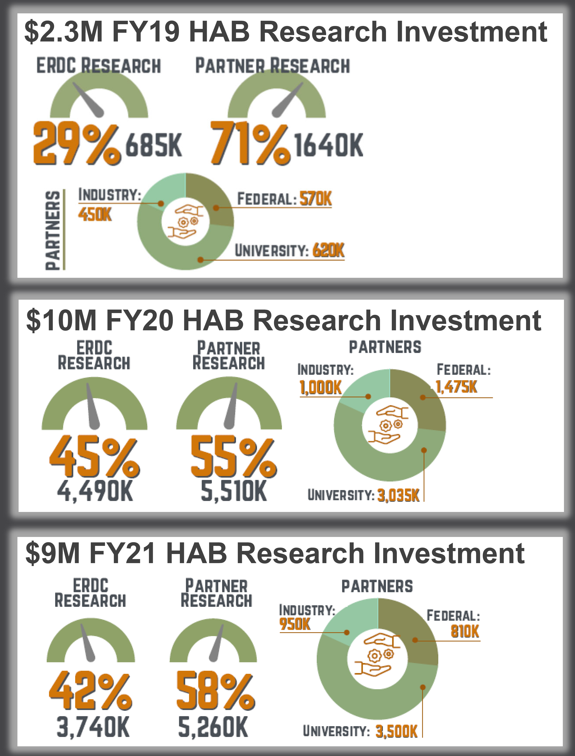
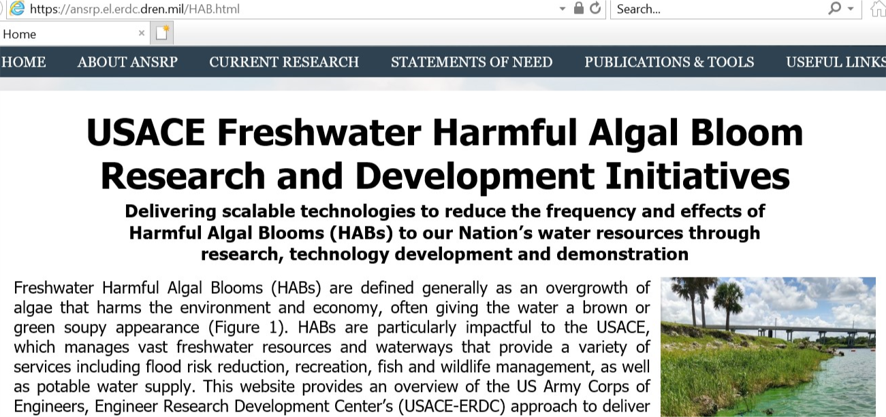

Authorizations, Appropriations & Allocations
USACE Freshwater HAB R&D Initiatives
2018 Water Resources Development Act (WRDA) included U.S. Army ERDC Directive
  Deliver a HAB prevention, detection and management technology demonstration program
  Required scalable technologies
  Panel (right) shows appropriations and allocations by Fiscal Year FY19-FY21
2020 WRDA Sec 128
  Directed continued implementation of the HAB research
  Authorized $25M for HAB technology demonstrations
FY22 Appropriations (FY23 Similar!)
  $10.5M continued HAB R&D
  $4M WRDA 2020 Sec 128 HAB Demo Plan
https://ansrp.el.erdc.dren.mil/HAB.html

Slide 16

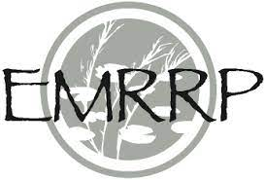
Contacts
Mandy (Seattle), Ben (near Anacortes)
Mandy Michalsen, Ph.D., P.E.
Program Manager, Strategic Initiatives
USACE ERDC Environmental Laboratory
Mandy.M.Michalsen@usace.army.mil
Cell: (206) 605-6075
Ben Kocar, Ph.D.
Research Soil and Environmental Scientist
Benjamin.D.Kocar@erdc.dren.mil
Cell: (360) 362-2740
Al Cofrancesco, Ph.D.
Senior Technical Advisor, HAB Program
USACE ERDC Environmental Laboratory
Alfred.F.Cofrancesco@usace.army.mil
Cell: (601) 831-0686
Mike Greer
Program Manager, Aquatic Plant Control and Aquatic Nuisance Species Research Programs
USACE ERDC Environmental Laboratory
Michael.J.Greer@usace.army.mil
Office: (716) 879-4229
Brook Herman, Ph.D.
Acting Program Manager, Ecosystem Management and Restoration Research Program
USACE ERDC Environmental Laboratory
Brook.D.Herman@usace.army.mil
Cell: (601) 634-3248
Christine VanZomeren
Associate Technical Director
Environmental Engineering and Sciences
USACE ERDC Environmental Laboratory
Christine.M.VanZomeren@usace.army.mil
Office: (601) 634-3702
Jen Seiter-Moser, Ph.D.
Acting Technical Director
Environmental Engineering and Sciences
USACE ERDC Environmental Laboratory
Jennifer.M.Seiter-Moser@usace.army.mil
Office: (601) 634-4038
https://apcrp.el.erdc.dren.mil
https://ansrp.el.erdc.dren.mil​
https://emrrp.el.erdc.dren.mil/
https://ansrp.el.erdc.dren.mil/HAB.html

