Slide 1
Transboundary Watershed Grant Program Notice of Funding Opportunity Informational Webinar
https://www.epa.gov/grants/us-british-columbia-transboundary-watershed-grant-program
*This webinar will be recorded. If you would like to request a recording or slide deck of the presentation, please send an email request to Chatriand.Tyler@epa.gov
Notes:
Tyler
Welcome everyone! Thank you for being here.
Before we get started, this webinar will be recorded, and if you would like a copy of the recording or of the slides from today’s presentation, please send an email to Tyler at Chatriand.Tyler@epa.gov. We will also have a reminder with my email address at the end of the presentation.
Note can move through the slides on your own.
[Press the record button.]

Slide 2
Agenda
Welcome and Teams Overview
Background on the Program
Overview of this Funding Opportunity
How to Apply for an EPA Grant
Tips and Resources
Questions
Notes:
Tyler
Overview of the webinar agenda.
Regarding questions, we are going to pause throughout to allow for questions as well as have some time at the end. Any questions we receive that are applicable to this open funding opportunity we will capture and include in a frequently asked questions document and post on the website. That will be done at the end of each week up until two weeks before the opportunity closes.

Slide 3
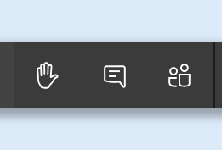
How to Participate
Please keep your microphone on mute unless you are speaking.
After the presentation, we will have time for questions.
Submit questions via the chat or raise hand function.
We will address questions in the order they are received.
Click to open chat function
Notes:
Tyler
AS we mentioned earlier, we’ll be pausing for questions throughout the presentation and should have ample time at the end for Q&A.

Slide 4
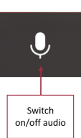
Introductions
Please type the following into the chat...
your name and
who you are representing on today's webinar
email address
Notes:
Tyler
OK so we’ll provide some brief introductions for the EPA team and we are also asking that everyone on the call please type the following information into the chat.
Tyler
Matt Szelag
Michelle
Tiffany Eastman
Peter Brumm
Tyler slides 1 – 13
Michelle slides 14 - 27

Slide 5
Background
British Columbia is home to significant exploration and mining activity, some which have current impacts or potential impacts on rivers flowing into Alaska, Washington, Idaho, and Montana
U.S. Federal, State, and Tribal governments are actively engaged in coordination and monitoring efforts associated with transboundary mining pollution.
The Consolidated Appropriations Act, 2024, Public Law 118, directs EPA to “continue and expand its work coordinating with Federal, State, local, and Tribal agencies to monitor and reduce transboundary mining pollution in the Kootenai watershed and other U.S.- British Columbia transboundary watersheds… The Committees provide $2,000,000 for such monitoring, management, and interagency activities in the U.S.-British Columbia transboundary watersheds.
Notes:
Tyler
Now I will provide some high-level background information on the Program. I apologize in advance for the lack of pictures and the word-heavy slides…
The TWG Program largely stems from the fact that BC
EPA Office of International and Tribal Affairs (OITA), along with Regions 8 and 10, developed a funding plan to award these funds through this competitive grant program.

Slide 6
Background
The goals of EPA’s transboundary watershed program are to monitor, assess, document, and reduce transboundary mining pollution originating in the Canadian Province of British Columbia.
In pursuing these goals, EPA seeks to foster coordination among Federal, State, and Tribal agencies regarding efforts to meet the program’s goals and to develop the capacity of all levels of government to develop and/or refine effective, comprehensive programs for transboundary watershed protection and management.
Notes:
Tyler
Are there any questions on background information?

Slide 7
Funding Opportunity
Key Facts
Eligibility Criteria
Track Concept
Core Elements
Example Activities
Evaluation Criteria
Notes:
Tyler

Slide 8
Key Facts
Funding Opportunity Number: EPA-R10-WD-TWG-2025-01
Assistance Listing Number: 66.436
Total Available Funds: $1,800,000
Maximum Application Amount: $600,000
Project Length: up to 6 years
Number of Awards Anticipated: up to 10
Dates:
November 18, 2024 – opportunity opened on grants.gov
January 17, 2025 – opportunity closes at 11:59 PM Eastern Time (8:59 PM Pacific)
March 2025 – anticipated notification of selection
June 2025 – anticipated award
Notes:
Tyler
Going over some key facts.
Assistance Listing Number 66.436, which includes Surveys, Studies, Investigations, Demonstrations, and Training Grants and Cooperative Agreements - Section 104(b)(3) of the Clean Water Act
Note that $200,000 of the $2M is being used to fund Interagency Agreements for USGS and USFWS related to their respective roles in Transboundary Watershed monitoring efforts.
Also note that projects may be fully, partially, or incrementally funded through this opportunity. Future funding for this program is not known at this time, but if future congressional funding does become available, we will have the ability to incrementally fund projects. So ideally, we are intending to fund projects that are repeatable year to year, but severable. And we can go over some examples and answer questions on that later in the presentation.
Applications must substantially comply with the application submission instructions and application content requirements set forth in the funding opportunity.
Applications must be submitted through Grants.gov on or before the application submission deadline of January 17, 2025.

Slide 9
Eligibility Criteria
Eligible applicants include Indian Tribes, Intertribal consortia, state governments, and local governments
Applications must address activities taking place within transboundary watersheds that have existing or proposed mining activities in BC
For the purpose of this funding opportunity, transboundary watersheds are defined as rivers, lakes, or watersheds that flow from the Canadian Province of British Columbia (B.C.) into the states of Montana (represented by EPA Region 8), Idaho, Washington, and/or Alaska (represented by EPA Region 10). These watersheds must have existing or proposed mining activities in B.C. that impact (or may impact) U.S. waters.
One application per applicant. There is no limit to partnering.
No cost share/match requirement
Notes:
Tyler
Section 2 of the NOFO.
We encourage partnerships and collaboration

Slide 10
Track Concept and Priority Areas
Three separate applicant tracks
Track One is for development of transboundary watershed programs that address potential impacts from existing or proposed mining activities in B.C. in the Kootenai/y watershed in the state and/or Tribal territories within Idaho and Montana.
Track Two is for development of transboundary watershed programs that address potential impacts from existing or proposed mining activities in B.C. in transboundary watersheds in the state of and/or Tribal territories within Washington.
Track Three is for development of transboundary watershed programs that address potential impacts from existing or proposed mining activities in B.C. in transboundary watersheds in the state of and/or Tribal territories within Alaska.
EPA anticipates awarding approximately $600,000 per Track.
Notes:
Tyler
Section 3 of the NOFO.
Under this competition, EPA also reserves the right to fund the top ranked proposal for each represented state in EPA Region 10 or 8, contingent on the quality of the proposals and funding availability.

Slide 11
Core Elements
Applications must address at least one of the following core elements:
Monitor, assess, and report on baseline conditions and status/trends over time in transboundary waters.
Monitor, assess, and report on human health and ecosystem health.
Participate in regulatory processes, including regulatory processes in Canada and B.C.
Participate in international watershed policy discussions.
Implement regulations related to transboundary mining pollution.
Evaluation scores will not depend on the number of elements addressed but rather on the quality with which the elements are addressed.
Notes:
Tyler
Next, I’ll go over the Core Elements, which are also covered under section 3 of the NOFO.

Slide 12
Example Activities
Objectives and eligible activities within these core elements are meant to support items such as:
Develop and implement studies to analyze human and ecosystem risk from transboundary mining or address transboundary mining pollution.
Identify pollutants of concern and quantify pollutants, ecosystem response, and ecosystem health.
Support development and review of water quality standards or screening thresholds.
Collect information to support and/or conduct CWA 303(d) assessments in addition to Total Maximum Daily Load (TMDL) development.
Participate in intergovernmental meetings on transboundary watershed pollution (including travel to and from meetings).
Host conferences, workshops, or other forums for discussing transboundary mining pollution.
Participate in International Joint Commission (IJC) meetings.
Participate in US and/or Canadian regulatory processes that affect U.S. transboundary watersheds, such as environmental assessments, permitting decisions, and watershed plans.
Review and comment on mine treatment technologies, remedial investigations, mine reclamation and closure plans, and restoration plans.
Notes:
Tyler
These are some examples. not an exhaustive list. Note this is a subset of the examples provided in Section 3 of the NOFO.
Pause for questions. Check punctuation.

Slide 13
Evaluation
We will use the evaluation criteria in the NOFO to evaluate applications.
Criteria | Points
Project Need | 10
Project Tasks | 20
Milestone Schedule | 10
Budget | 10
Environmental Results: Outputs, Outcomes, and Tracking | 10
Transfer of Results | 10
Programmatic Capability, Technical Experience, and Qualifications | 10
Partnerships | 10
Timely Expenditure of Funds | 10
Notes:
Tyler
​​Applications will be reviewed by a review panel and assistance agreements funded under this announcement will be selected by a selection official.
​Applications will first be evaluated against the threshold factors listed in Section 2 (Eligibility Requirements) of the NOFO. Only those applications which meet all the threshold factors will be evaluated by the review panel using the evaluation criteria listed above and in Section 6 of the NOFO. Generally, each evaluation criteria is worth 10 points except Project Tasks, which is worth 20 points. Each application will be given a numerical score and will be rank-ordered by the review panel.
​The review panel will provide preliminary funding recommendations to the EPA Selection Official(s) based on these reviews and rankings.
​​Final funding decisions will be made by the selection official. In making the final funding decisions, the selection official may also consider the following factors:
​1. Geographic distribution of funds (3 geographic tracks).
​2. Diversity of projects.
​3. Availability of funds.
​4. The similarity of the project to other projects already being funded by EPA.​
Pause for questions.

Slide 14
How to Apply
Application Requirements: before you apply
Application Components
Application Tips and Resources
Notes:
Michelle

Slide 15
Application requirements: before you apply Grants.gov
You will apply through Grants.gov
Catalog of Federal Domestic Assistance (CFDA) #
66.436
Funding Opportunity #
EPA-R10-WD-TWG-2025-01
Register with SAM (SAM.gov) to obtain a Unique Entity Identifier (UEI). Registration is required to complete a grant application in grants.gov.
For 24/7 assistance, excluding federal holidays
grants.gov: 1-800-518-4726 or support@grants.gov
Notes:
Michelle
Registering to apply for grants on Grants.gov includes several steps and types of registration, including SAM.gov, and Grants.gov accounts.
The System for Award Management (SAM.gov) is a government-wide registry for organizations doing business with the Federal government. SAM.gov centralizes information about grant recipients and provides a central location for grant recipients to change organizational information. Grants.gov uses SAM.gov to establish organizational authority for its users and to provide unique entity identification numbers. SAM registration must be renewed annually.
First, you must register with SAM.gov to obtain a Unique Entity Identifier (UEI). The UEI is a 12-character alphanumeric identifier assigned to all entities (public and private companies, individuals, institutions, or organizations) to do business with the Federal Government. Organizations will also need to designate an E-Business Point of Contact (EBiz POC). It can take 7-10 business days to fully complete the registration process required for most funding opportunities. There is no fee for registering with SAM.gov.
Grants.gov
After obtaining the UEI for the organization from SAM.gov, you must return to Grants.gov to continue registration. There is no fee for registering with Grants.gov.
Grants.gov provides 24/7 support. Call 1-800-518-4726 or email support@grants.gov. You can also find training and videos at Training Resources and Videos for Grants.gov.
For help with SAM.gov, call 866-606-8220. You can also chat with the Federal Service Desk.

Slide 16
General Tips in Applying for Grants Application Components
Mandatory Documents:
1. SF-424: Application for Federal Assistance
Application cover sheet, grant project/budget period, federal (and match) funds, appropriate signatures.
2. SF-424A: Budget Information
3. Project Narrative: Cover Page, Workplan, Budget detail
4. EPA Form 4700‑4: Preaward Compliance Review Report
Collects information that enables EPA to determine whether applicants are developing projects, programs, and activities on a non-discriminatory basis.
5. EPA Form 5700‑54: Key Contacts Form
Collects contact information for individuals responsible for various aspects of the proposed work, including authorized representative, payee, administrative contact, and investigators.
Notes:
Michelle

Slide 17
Application Components – continued
Other Documents, as applicable:
Resumes
Partnership Letters
Current Negotiated Indirect Cost Rate Agreement
EPA Form 6600‑06: Certification Regarding Lobbying
(Contains certifications about the use of Federal appropriated funds in connection with lobbying. For applications EPA receives that request more than $100,000 in federal funds.)
Notes:
Michelle
ICR deminimus is now 15%

Slide 18
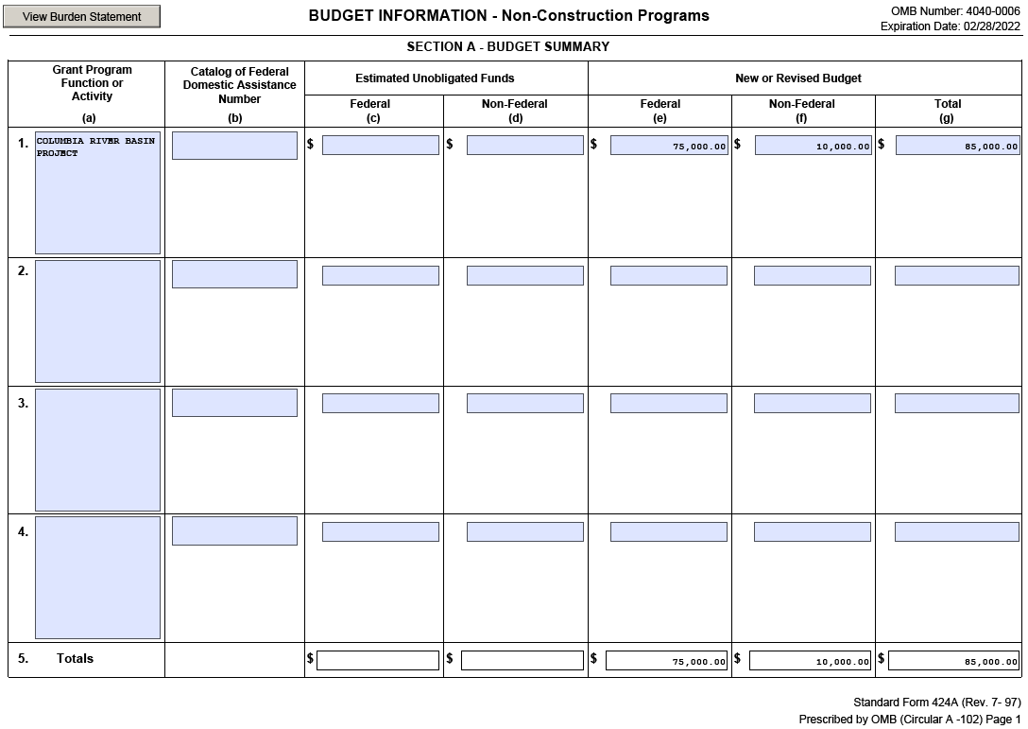
Application components: SF-424A
Notes:
Michelle
This is the Section A budget summary sheet where you will put your total federal request…

Slide 19
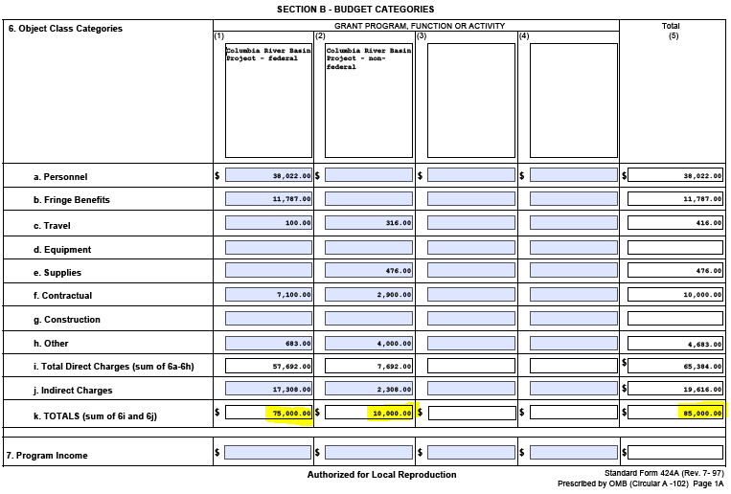
Application components: SF-424A
Notes:
Michelle
And this is the Section B budget categories sheet. You only need to fill out sections A and B.
Columns split by EPA/federal funds and cost share/match. DO NOT USE CENTS. The form calculates totals on its own. These totals should be the same as those included in your detailed budget. One of the most common mistakes we see is budget tables which are not showing the same totals across the board. Totals in SF424, SF424A, Project Narrative/Budget Narrative should be the same.

Slide 20
Application Components: Budget Detail
Follow federal cost principles of 2 CFR 200 Subpart E.
The Budget Detail must exactly match the SF-424A across all cost categories (Personnel, Travel, etc.).
Show your math in the Budget Detail.
e.g., Personnel cost = 1 Biologist * $35.25/hour * 0.3 FTE (626.4 hours/year) = $22,081.
All elements of Budget Detail should be reflected in Workplan.
e.g., Going to Fernie, B.C. is line item in Travel; this must be in the Workplan.
Please also reference the Interim General Budget Development Guidance for Applicants and Recipients of EPA Financial Assistance.
Notes:
Michelle

Slide 21
Budget Best Practices
 | EPA Requested Funding
Personnel
1 Project Manager 1.0 FTE Full Time @ $92,501/year (3 years). $92,501 x 3 x 1 = $277,503 | $277,503
1 Grant Administrator 0.5 FTE Full Time @ $80,000/year (3 years). $80,000 x 3 x 0.5 = $120,000 | $120,000
1 Scientists 0.25 Full Time FTE @ $100,033/year (3 years). $100,033 x 3 x 0.25 = $75,024.75 | $75,025
Total Personnel | $472,528
Applicants are required to provide an overall detailed budget table, a budget narrative, and a detailed budget by year.
Follow the instructions, include details, and show your math.
Use General Services Administration rates for Travel (lodging, per diem, etc.)
Make sure the costs are allowable.
Double and triple check your math.
Do not use cents. Round to whole numbers.
Make sure the budget numbers match across all budget tables.
Notes:
Michelle

Slide 22
Other Considerations
International Travel - requires pre-approval
Conferences – attending or hosting
Quality Assurance Project Plan
https://www.epa.gov/irmpoli8/environmental-information-policy-procedures-and-standards
Project Management
Notes:
Michelle
International Travel
EPA policy requires that all foreign travel must be approved by its Office of International and Tribal Affairs. The recipient agrees to obtain prior EPA approval before using funds available under this agreement for international travel unless the trip(s) are already described in the EPA approved budget for this agreement. Foreign travel includes trips to Mexico and Canada but does not include trips to Puerto Rico, the U.S. Territories or possessions. Recipients that request post-award approval to travel frequently to Mexico and Canada by motor vehicle (e.g., for sampling or meetings) may describe their proposed travel in general terms in their request for EPA approval. Requests for prior approval must be submitted to the Project Officer for this agreement.
The Fly America Act and Foreign Travel The recipient understands that all foreign travel funded under this assistance agreement must comply with the Fly America Act. All travel must be on U.S. air carriers certified under 49 U.S.C. Section 40118, to the extent that service by such carriers is available even if foreign air carrier costs are less than the American air carrier.
5. If the recipient proposes international travel the EPA Project Officer will obtain and document the proper approvals from the EPA Office of International and Tribal Affairs (OITA).
a. International travel includes trips to Mexico and Canada but does not include trips to Puerto Rico, the U.S. Territories or possessions. Recipients that routinely travel to Mexico and Canada by motor vehicle (e.g., for sampling or meetings) may describe their travel in general terms in the application. OITA may then approve the travel generally as opposed to the recipient obtaining OITA approval on a trip-by-trip.
b. If OITA has not provided approval at time of award the EPA assistance agreement will include a grant specific term and condition precluding the use of EPA funds for international travel until the requisite approval is provided.
c. If the recipient has not identified all trips EPA will fund at time of award or indicates that there will be no international travel by employees, EPA’s
General Terms and Conditions require the recipient to obtain EPA approval for international travel.
Conferences
A conference means an event whose primary purpose is to disseminate technical information beyond the recipient or subrecipient and is necessary and reasonable for successful performance under the Federal award. Allowable conference costs may include the rental of facilities, speakers' fees, attendance fees, costs of meals and refreshments, local transportation, and other items incidental to such conferences unless further restricted by the terms and conditions of the Federal award. The costs of identifying and providing locally available dependent-care resources for participants are allowable as needed. Conference hosts/sponsors must exercise discretion and judgment in ensuring that conference costs are appropriate, necessary, and managed to minimize costs to the Federal award. The Federal agency may authorize exceptions for programs including Indian Tribes, children, and the elderly. See also §§ 200.438, 200.456, and 200.475.

Slide 23
Application Components: Budget Detail Guidance Documents
Interim General Budget Development Guidance for Applicants and Recipients of EPA Financial: https://www.epa.gov/sites/default/files/2019-05/documents/applicant-budget-development-guidance.pdf
How to Develop a Budget: https://www.epa.gov/grants/how-develop-budget
Subaward Policy Frequent Questions: https://www.epa.gov/system/files/documents/2023-04
Best Practice Guide for Procuring Services, Supplies, and Equipment Under EPA Assistance Agreements: https://www.epa.gov/grants/best-practice-guide-procuring-services-supplies-and-equipment-under-epa-assistance/epa_subaward_policy_frequent_questions.pdf
Notes:
Michelle
We’ve posted other helpful documents/sites for additional guidance, policy and regulations here.

Slide 24
Tips and resources
Terms and Conditions
General Tips
Other Considerations
Notes:
Michelle

Slide 25
Terms and Conditions
If you are new to an EPA award, make sure you will be able to comply with the general terms and conditions before applying:
General Administrative Terms and Conditions -- https://www.epa.gov/grants/grant-terms-and-conditions
Cooperative Agreement Terms and Conditions
Notes:
Michelle

Slide 26
General Tips
Allow sufficient time to register, input and review application materials, and submit before the deadline
Ensure the Authorized Organization Representative signs the application
Review the Uniform Grant Guidance that applies to all federal grants: https://www.epa.gov/grants/uniform-requirements-managing-grants-apply-all-federal-executive-agencies
For detailed guidance on how to apply for EPA grants: https://www.epa.gov/grants
Notes:
Michelle
Mention all Qs will be posted to website, weekly up to the week before it closes.

Slide 27
Questions?
January 17, 2025 - NOFO closes - applications due
GRANTS.GOV
Funding Opportunity Number: EPA-R10-WD-TWG-2025-01
Assistance Listing Number: 66.436
Program website: https://www.epa.gov/grants/us-british-columbia-transboundary-watershed-grant-program
For access to this webinar recording or to ask us a question: Chatriand.Tyler@epa.gov
Notes:
Michelle

