Slide 1
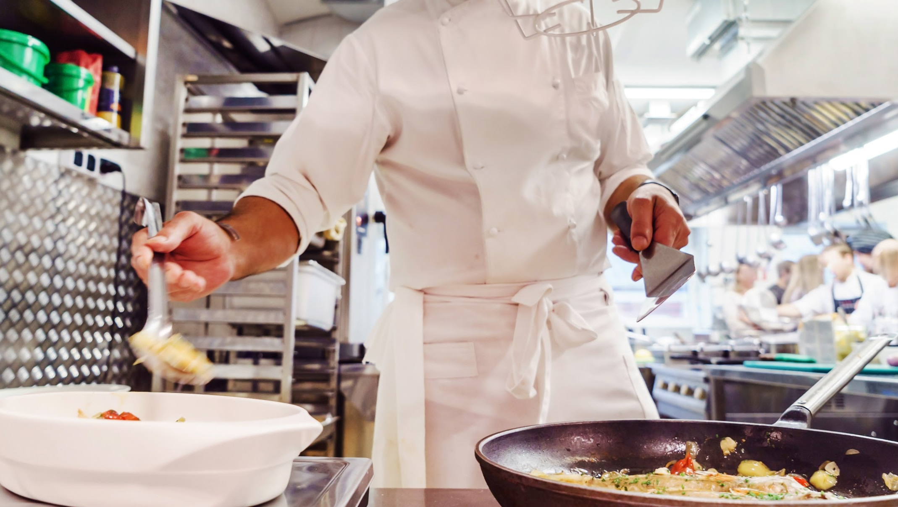
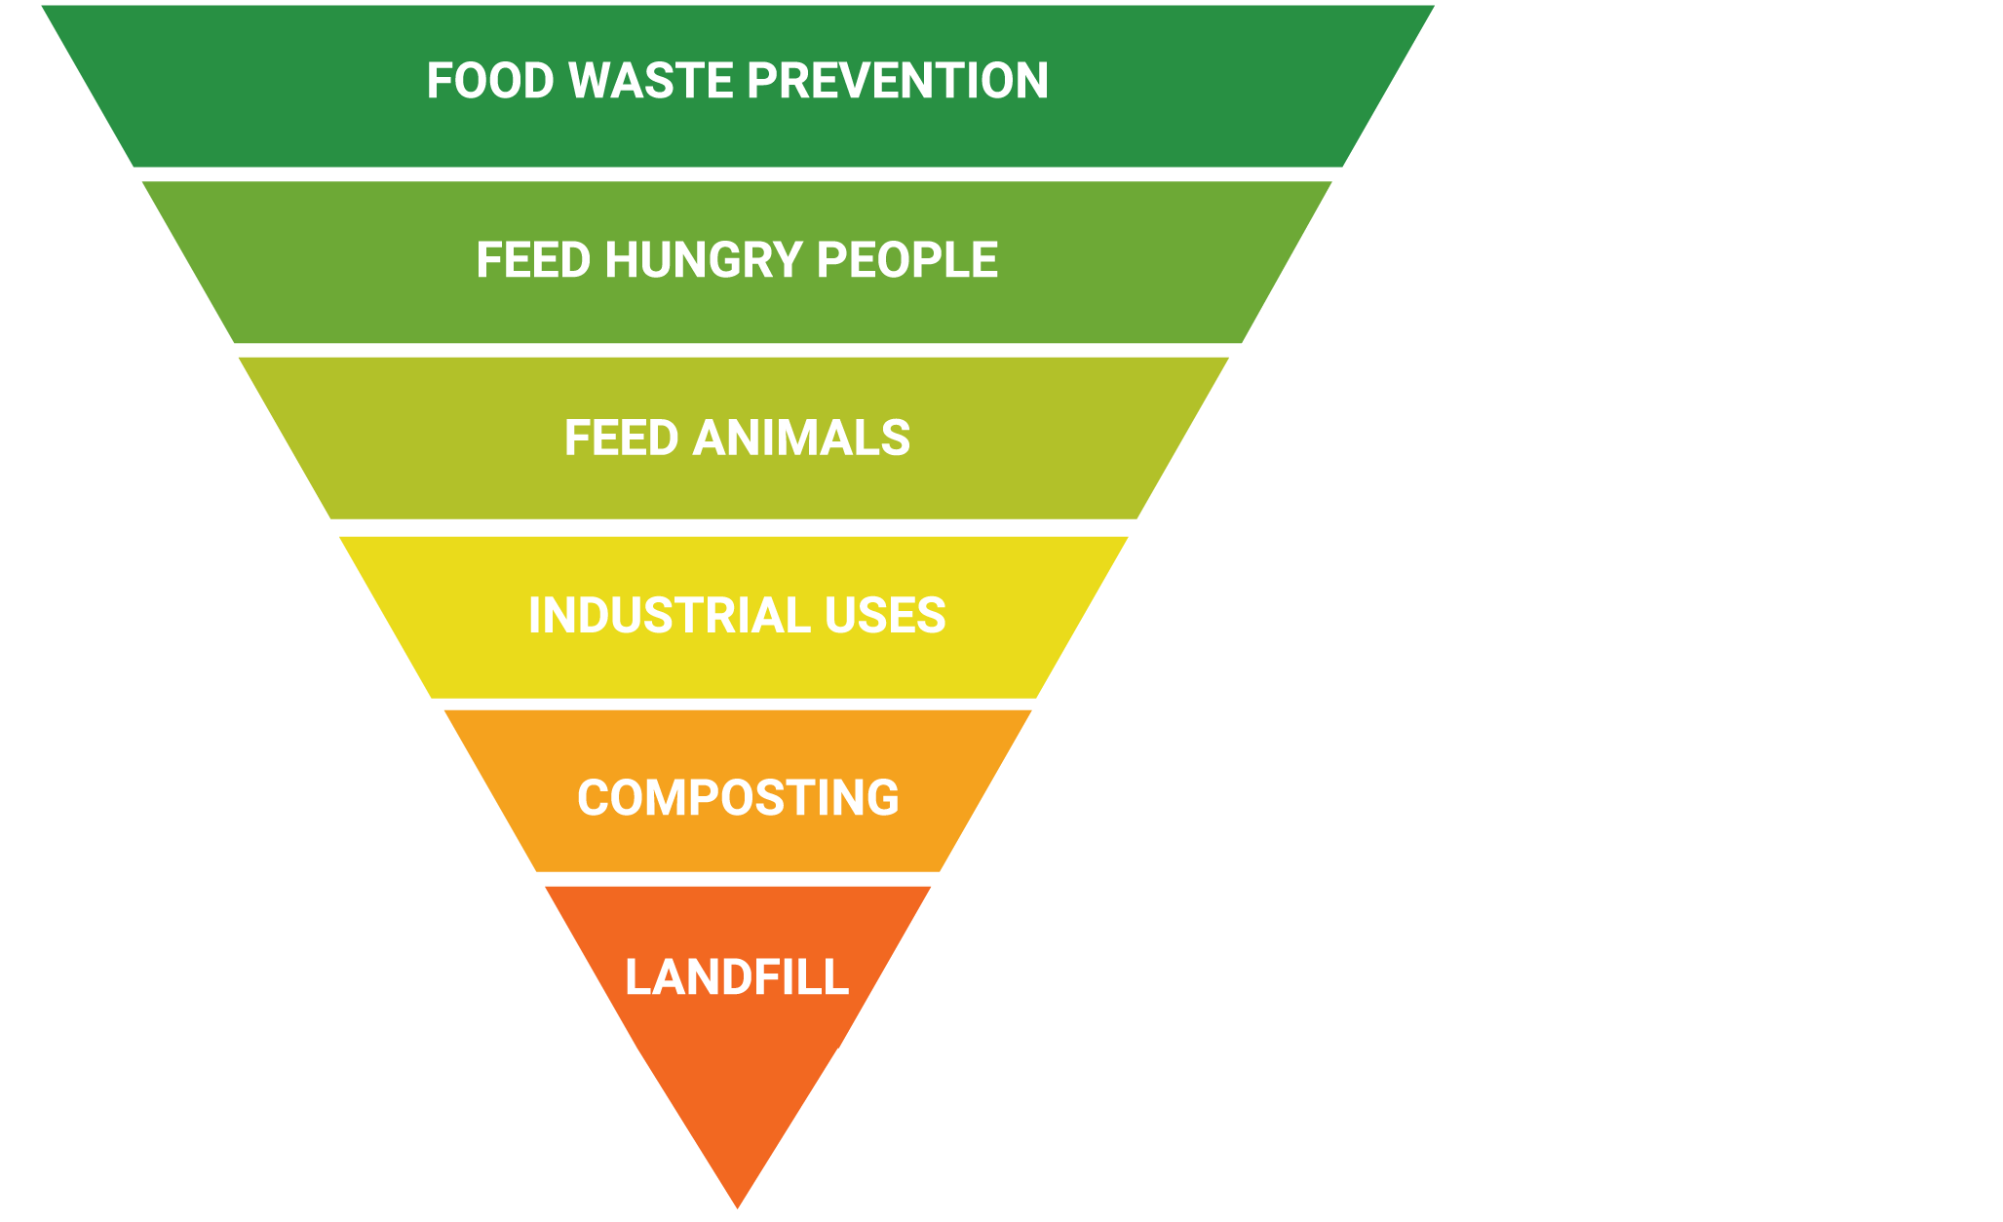

Your Options for Addressing Waste
Why Food Waste Prevention Matters
Todd Pendexter
Business Development Director

Slide 2

The Food Waste Problem
40%
Of food in the U.S. is wasted
Notes:
We’ve been tracking and studying food waste for over a decade. We work in all foodservice segments from hospitality to colleges to B&I. We’re in Google cafes and remote mining stations in the Australian Outback. Our data shows that it’s common to see 4-10% of purchased food thrown away before it’s even plated. That’s food that’s grown, transported, purchased and prepared.

Slide 3
Your Options for Addressing Waste
Notes:
There are several options for addressing that food waste. You might be familiar with this food waste hierarchy...

Slide 4
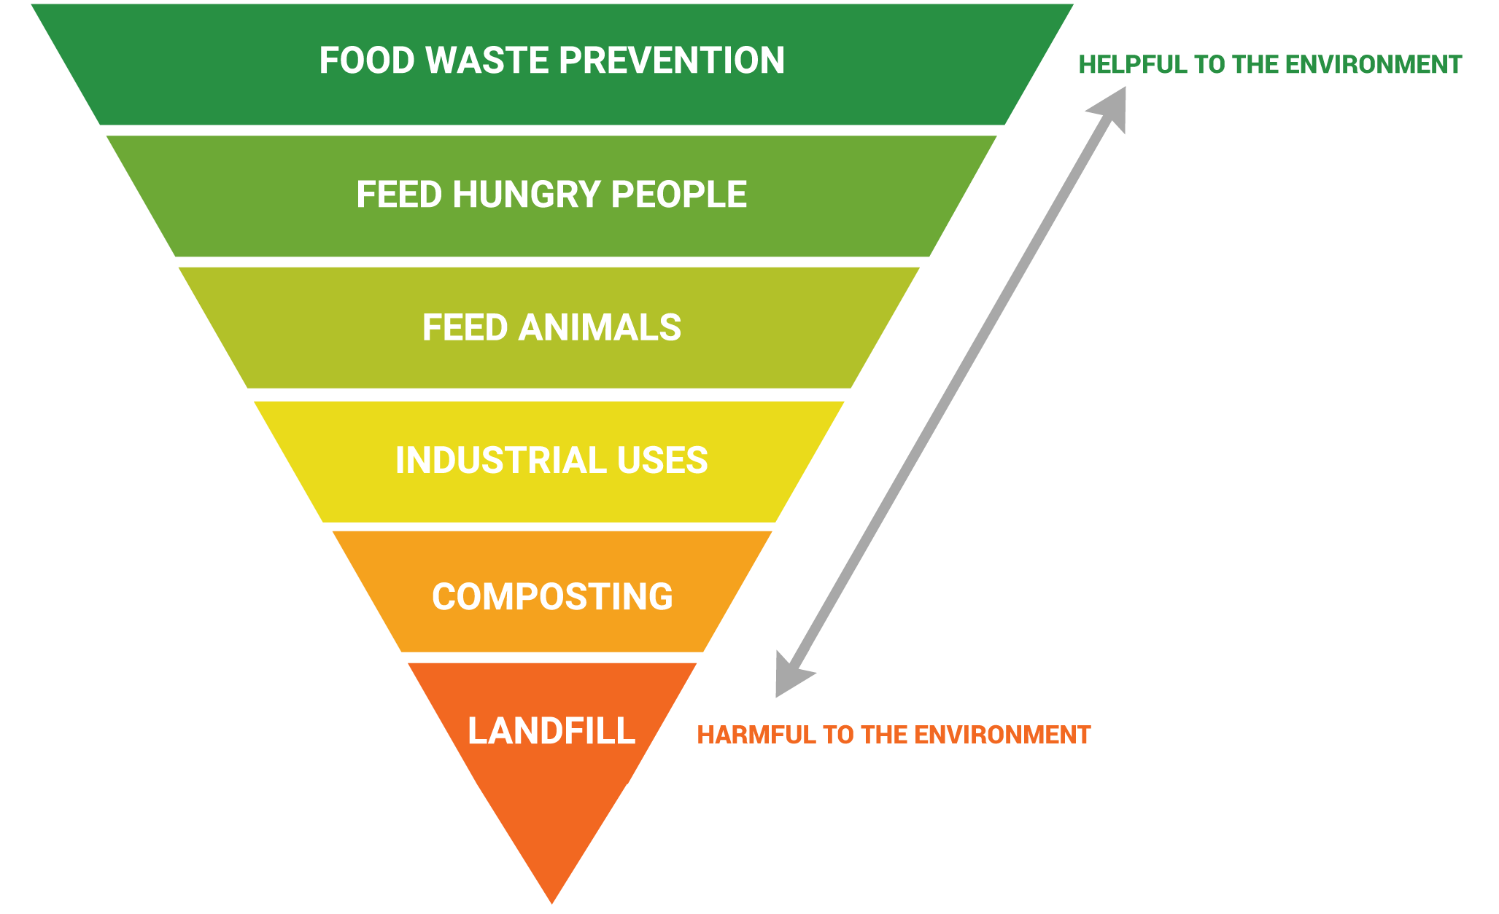
Your Options for Addressing Waste
Notes:
It lays out the most environmentally friendly options to the least. Food waste prevention is the most environmentally beneficial because it is the only option that can prevent environmental problems like C02 emissions generated through food production and later food decomposition. It keeps water from being squandered growing food that will just be wasted.

Slide 5
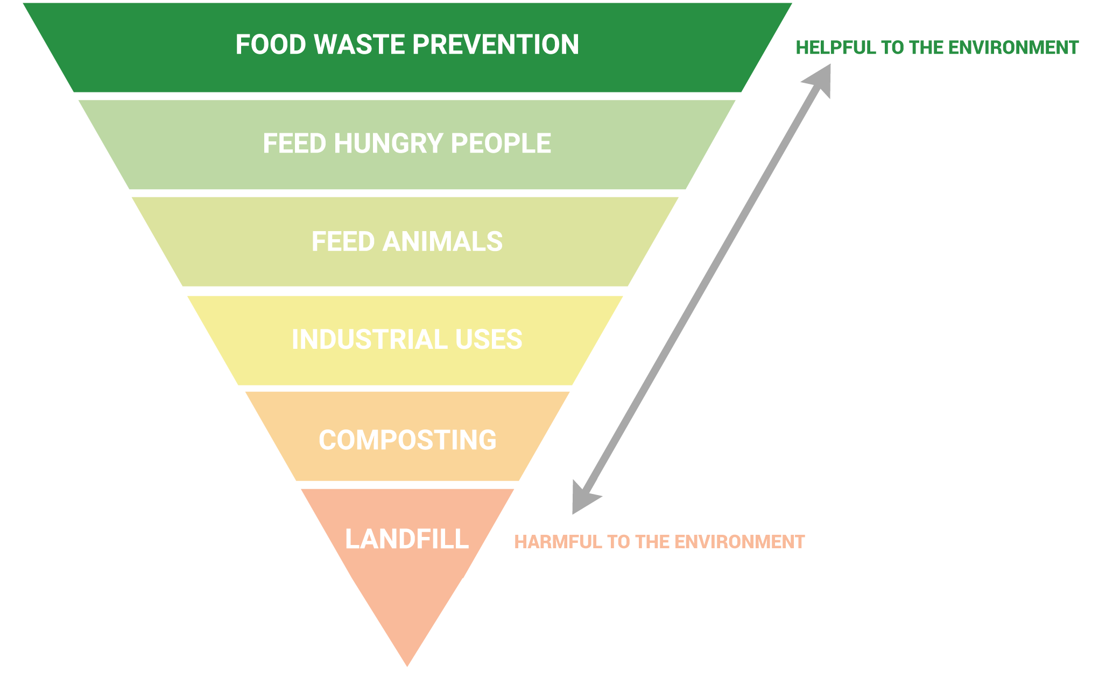
Your Options for Addressing Waste
The only option that meaningfully impacts your bottom line
Notes:
But it’s also the one solution in this list that can also impact your bottom line.

Slide 6
Your Options for Addressing Waste
The only option that meaningfully impacts your bottom line
Cuts food purchases
Notes:
Cuts food purchase costs

Slide 7
Your Options for Addressing Waste
The only option that meaningfully impacts your bottom line
Cuts food purchases
Cuts labor
Notes:
Cuts labor

Slide 8
Your Options for Addressing Waste
The only option that meaningfully impacts your bottom line
Cuts food purchases
Cuts labor
Cuts disposal fees
Notes:
Cuts disposal fees
It's very rare when the best thing you can do environmentally is also the best thing you can do financially. This is one of those rare win wins.

Slide 9
Food Waste Costs a Bundle
4-10%
of purchased food is thrown away before being plated
Notes:
We’ve been tracking and studying food waste for over a decade. We work in all foodservice segments from hospitality to colleges to B&I. We’re in Google cafes and remote mining stations in the Australian Outback. Our data shows that it’s common to see 4-10% of purchased food thrown away before it’s even plated. That’s food that’s grown, transported, purchased and prepared.

Slide 10
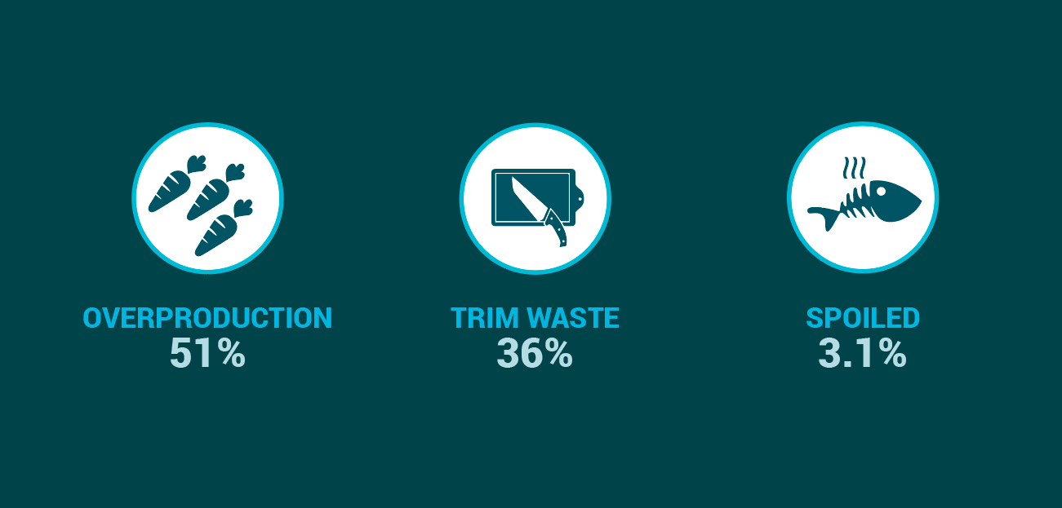
Behaviors That Create Food Waste
10
Notes:
We’ve also found from our data that again and again the vast majority of food waste is generated through overproduction. We all know why this happens: stated or unstated there is a deep-seated fear in foodservice of running out of food. Merchandising at salad bars, buffets and other displays has to look full and fresh from opening till closing. This generates massive amounts of waste.

Slide 11




Prevention Happens Through Measurment
improve forecast quality change menu purchasing
DATA
Measurement
Prevention
increase awareness spark communication increase engagement
BEHAVIOR CHANGE

Slide 12
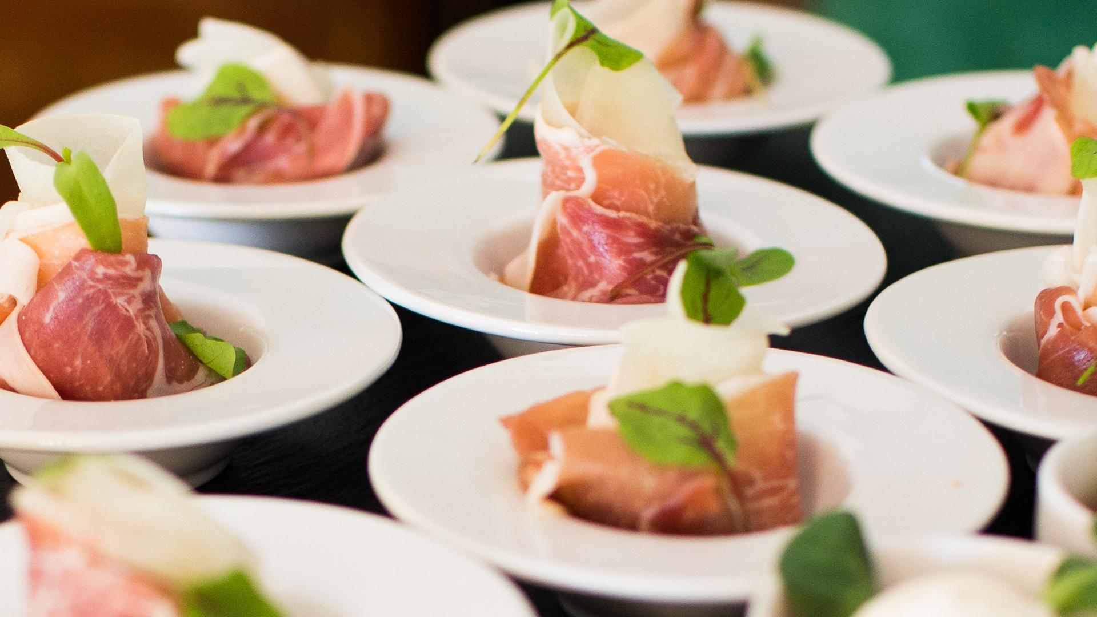


Impact of Prevention Through Measurement
Prevention Happens Through Measurement
improve forecast quality change menu purchasing
DATA
Reduce Waste
Increase Savings
Reduce pre-consumer food waste by 50% or more
Save 2-8% or more on annual food purchases
Measurement
Prevention
increase awareness spark communication increase engagement
BEHAVIOR CHANGE
Notes:
The good news is that overproduction can be managed. But you have to understand why and where it’s happening, and then change behaviors that lead to it. We make smart scales where you weigh food waste, and enter information on when and why it happened.

Slide 13

Thank you
Contact us today to learn more about LeanPath Food Waste Solutions
Todd Pendexter
Business Development Director
T: 1 234 567 7890
W: yourcompany.com
503.862.2257
tpendexter@leanpath.com
T: 1 234 567 7890
W: yourcompany.com

Slide 14
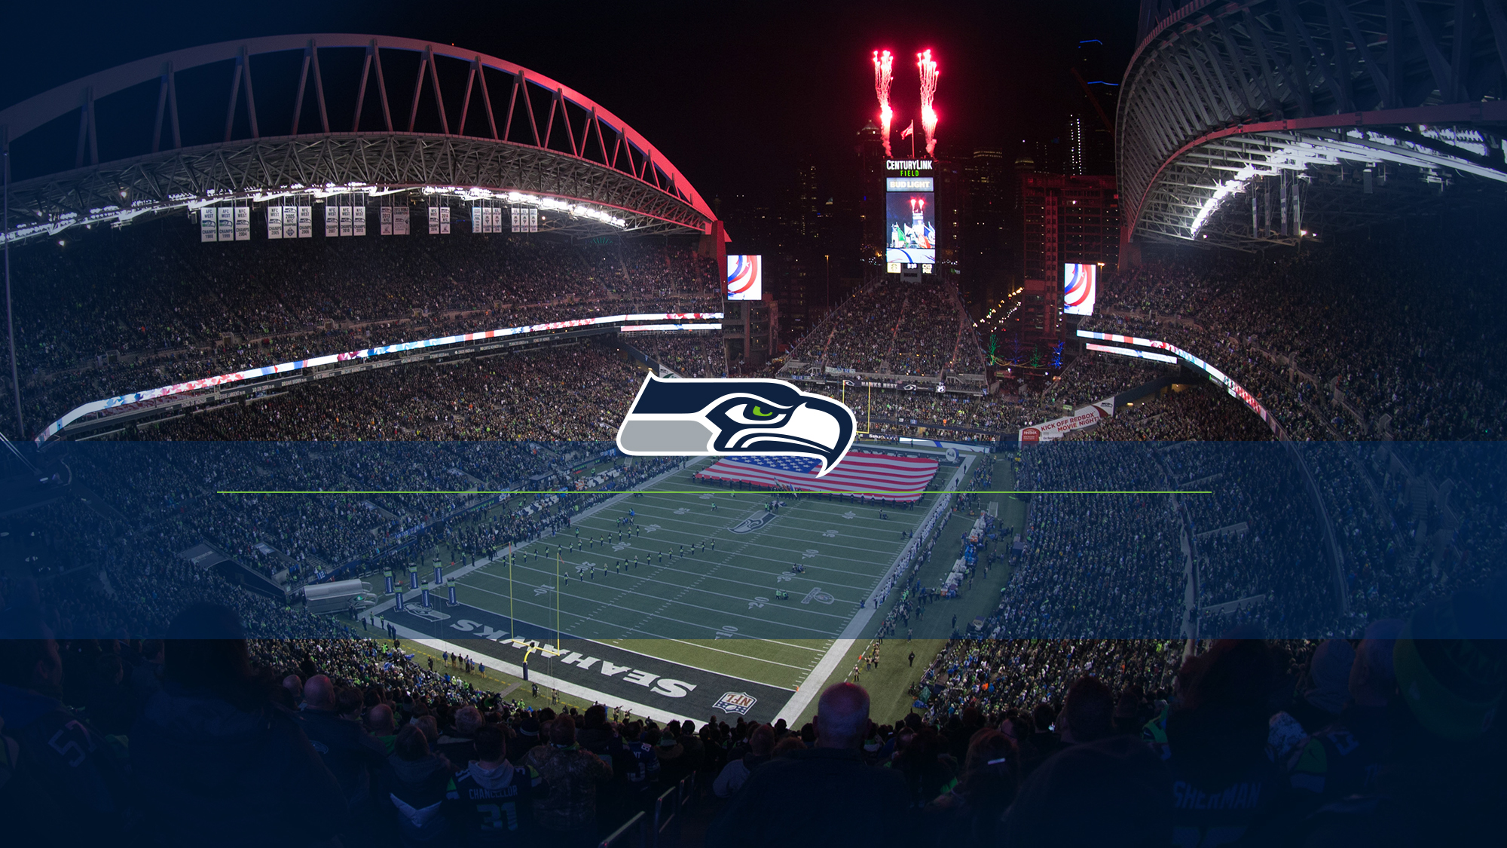
First & Goal Hospitality

Slide 15

Preventing Food Waste
Current Waste Diversion
Rethinking Food Waste
Smart Partnerships

Slide 16
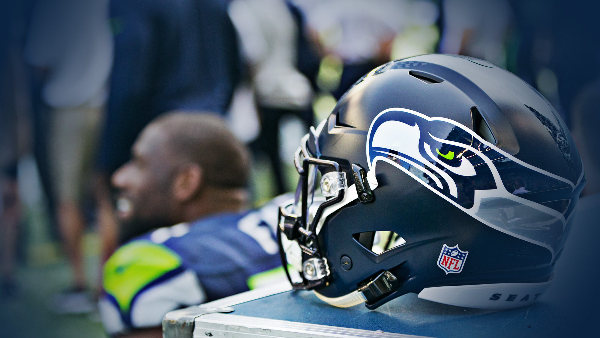
CENTURYlINK FIELD Food waste prevention

Slide 17
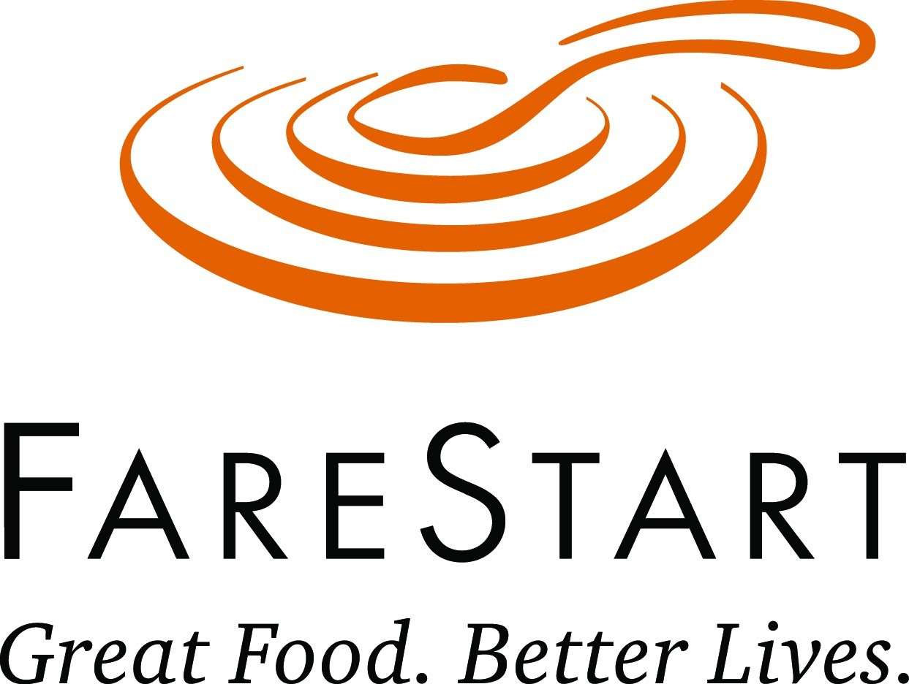
Attention on the Details
Use of production sheets enables our culinarians to produce to what is ordered vs. to what the front line associate thinks is needed.
Accurate production sheets limits the amount of waste that is composted at the end of the events.
Tracking of waste in stands helps to keep track of how to produce for different events: Sounders, Seahawks, Stadium Concert, WaMu Concert, Flat Show, Catering.
Unique design for each Department’s needs
Food bank donations
Keeping ahead of the compost

Slide 18

Alternative methods
Identifying unique characteristics of the operation
Use of Carbon Filters to reduce ethylene gas in produce cooler
Weighing Compostable materials from Production kitchen
Filtering fryer oil to reduce waste

Slide 19
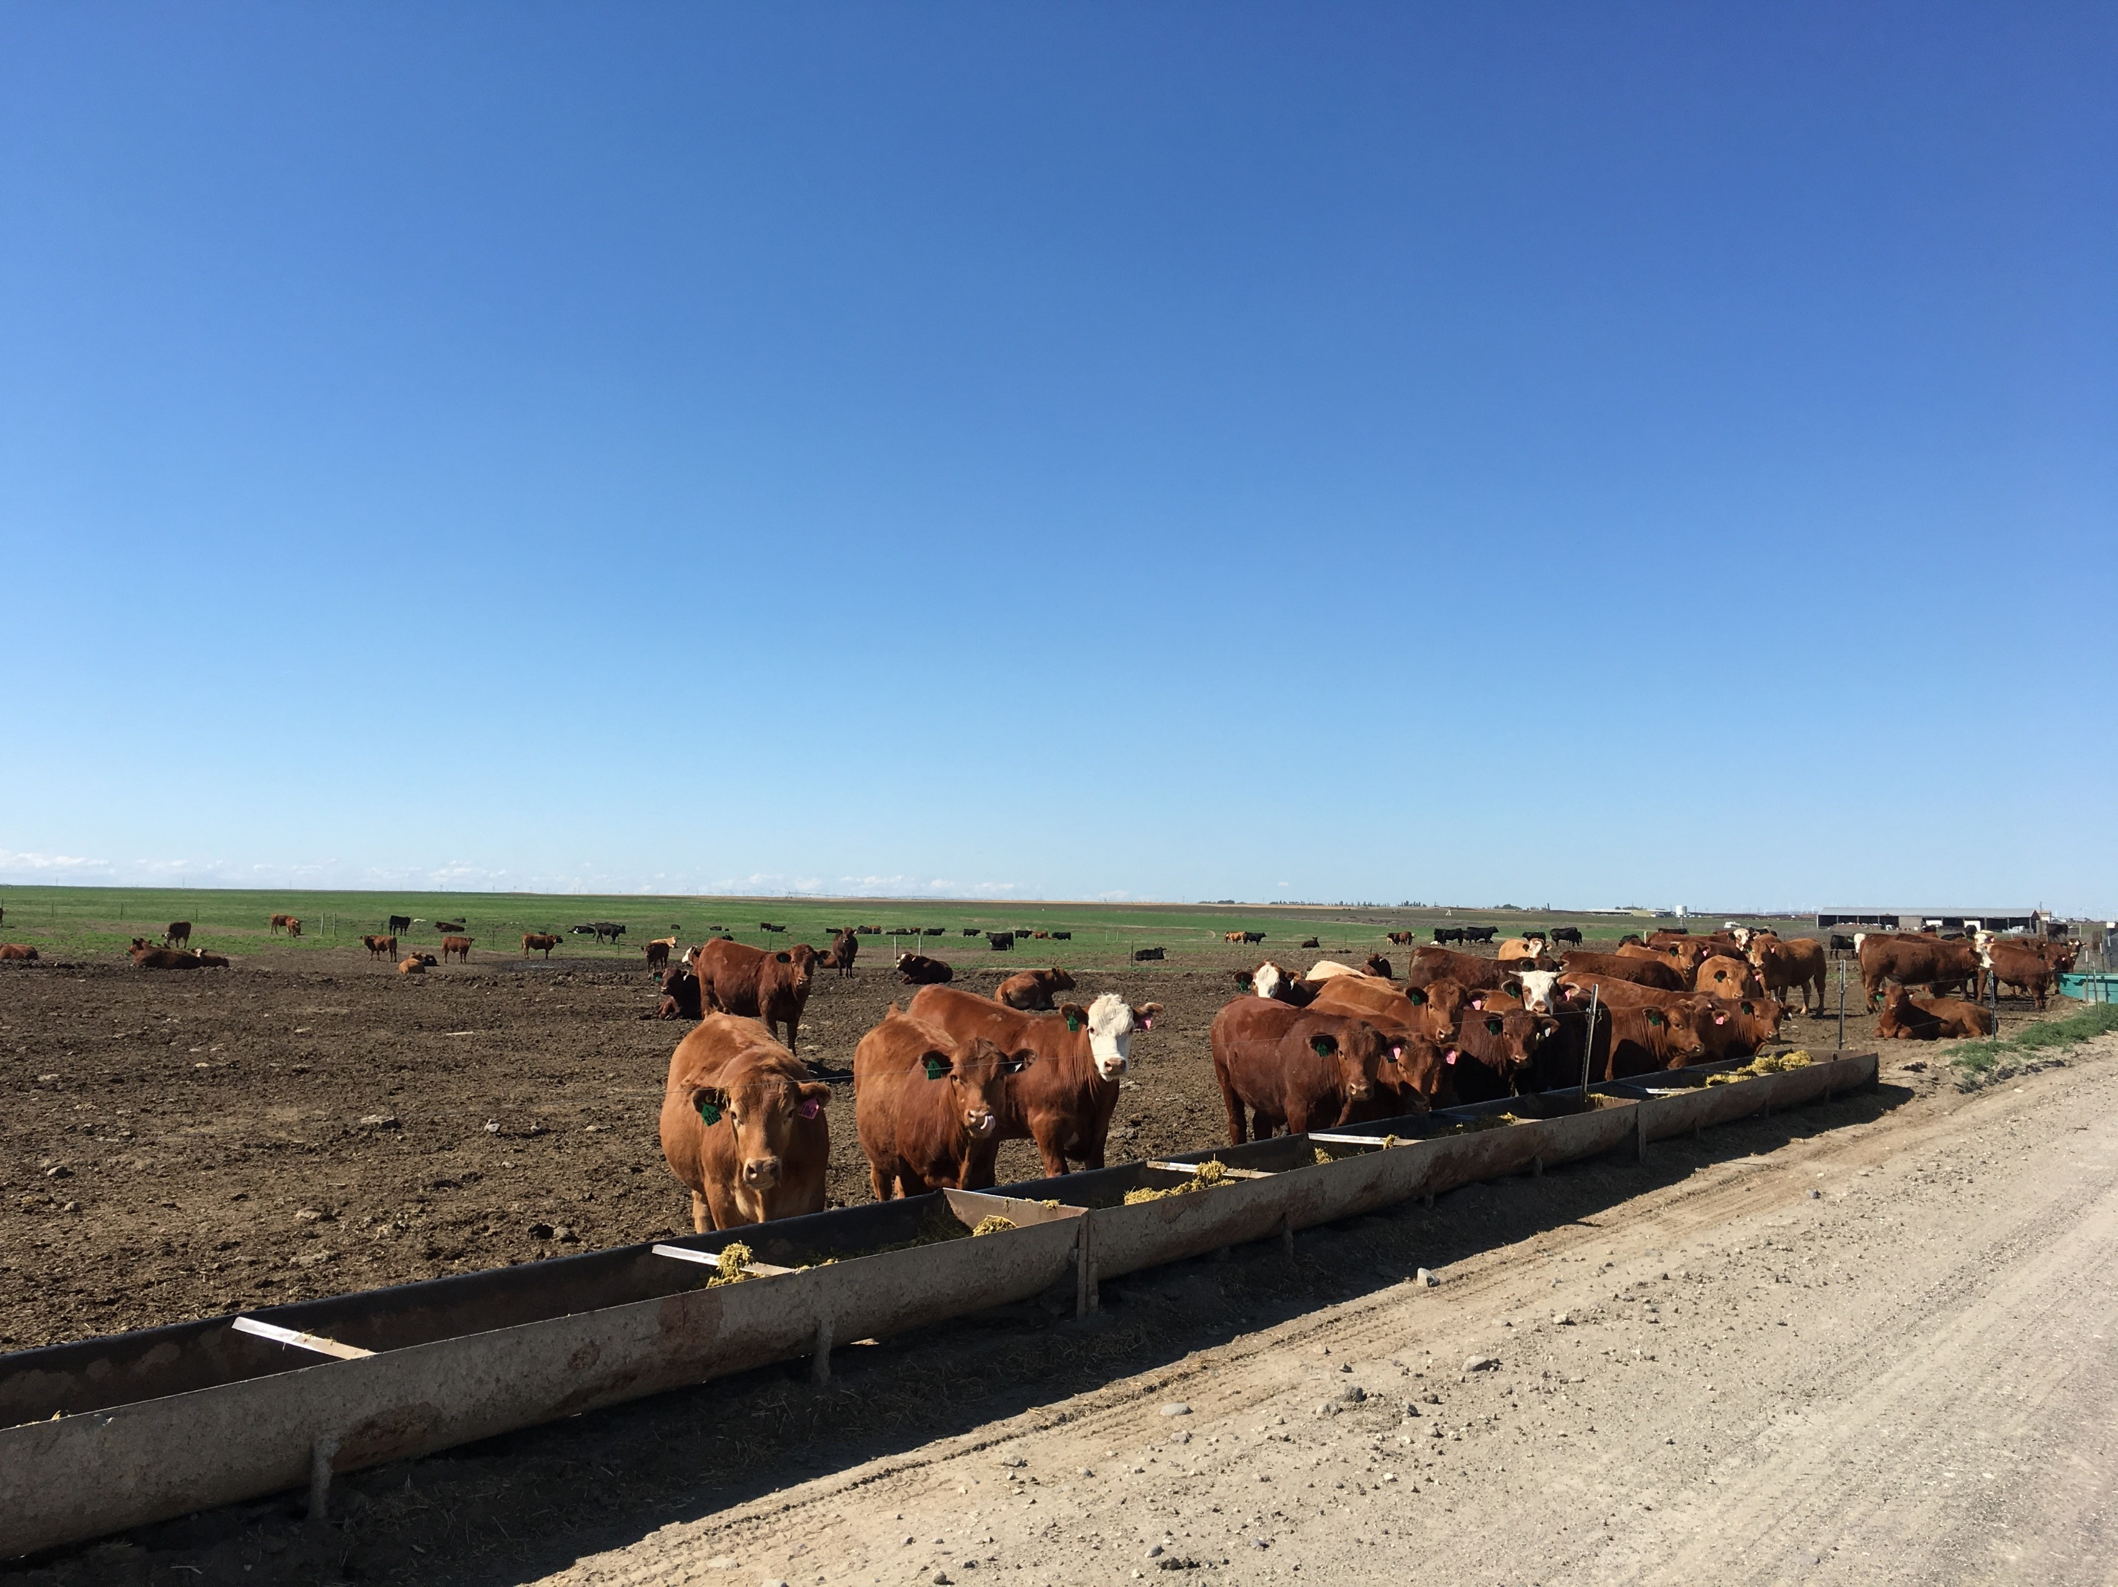
Smart Partnerships
Following the food through the full cycle.
Sustainable sourcing with similar whole picture philosophy and accountability.
Caring for the food.
Completing the loop with Sound Sustainable Farms
Community Outreach

Slide 21
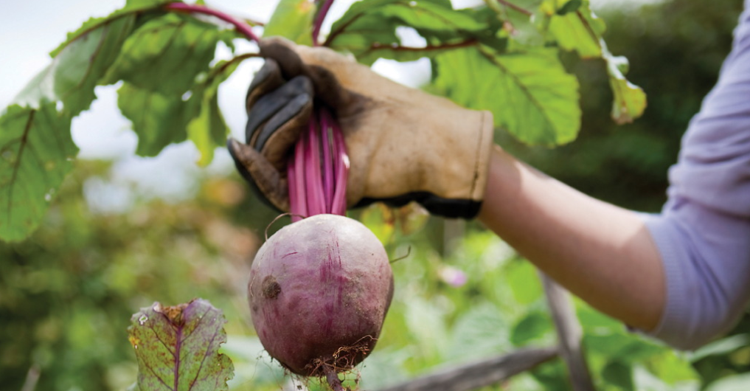

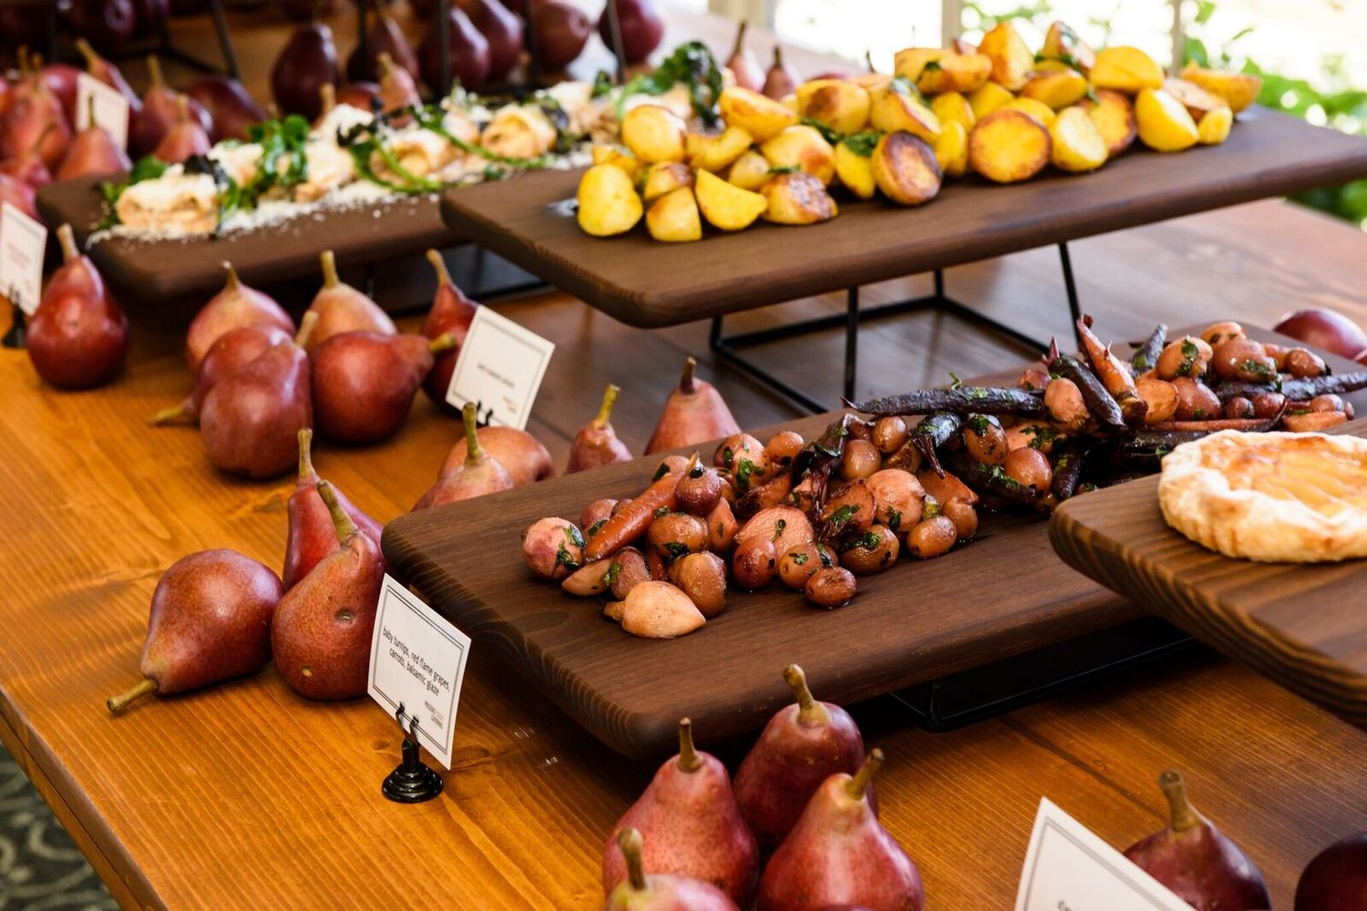
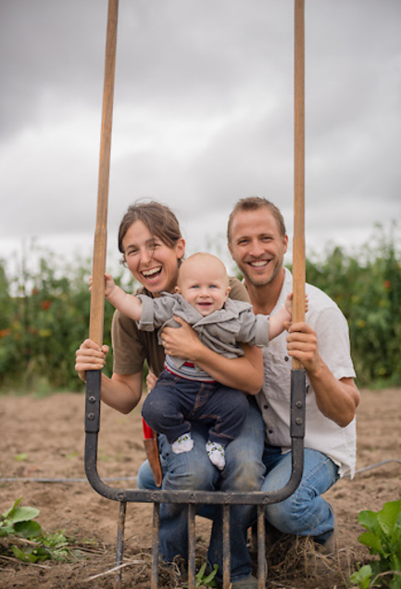
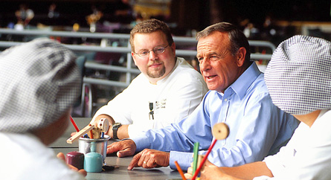
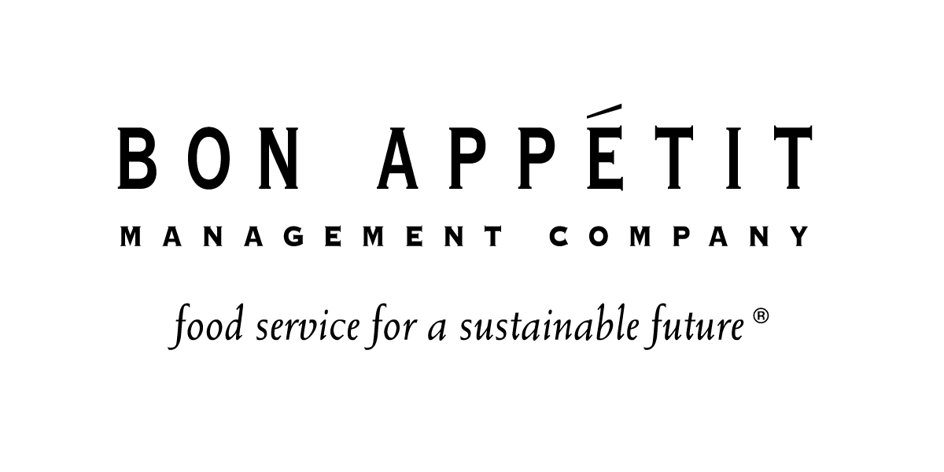
Notes:
Our pursuit of from-scratch cooking and environmentally and socially responsible sourcing proved to be an act of disruption that fundamentally shaped the food service industry.
Today we serve some of the world’s most influential companies — the headquarters for Google, LinkedIn, Twitter, Starbucks, Target, and Nordstrom, to name just a few.
We provide café and catering services to corporations and universities at more than 1,000 locations in 33 states, and operate more than a dozen public restaurants attached to museums and other specialty venues — proving that it’s possible to cook delicious food that is alive with flavor and nutrition at a large scale.
Most importantly, the 200 million meals we serve annually are not only delicious, they also embody core values — about wellness, dignity, community, and conservation — that we take very seriously.

Slide 22





















BON APPÉTIT CLIENTS
Notes:
22
More than 1,000 cafes in 33 states, from Silicon Valley giants (Google, LinkedIn, Twitter, Adobe, Oracle, SAP) to national retail names (Starbucks, Nordstrom’s, Zulily, Best Buy, Abercrombie & Fitch), to top universities and museums.
Locally:
o Starbucks
o Google
o Nordstrom
o Seattle Art Museum
o Bill Melinda Gates Foundation
o Cornish
o Fred Hutch
o Zulily
o Adobe
o Seattle Cancer Care Alliance
o Whiman College
o St. Martins

Slide 23
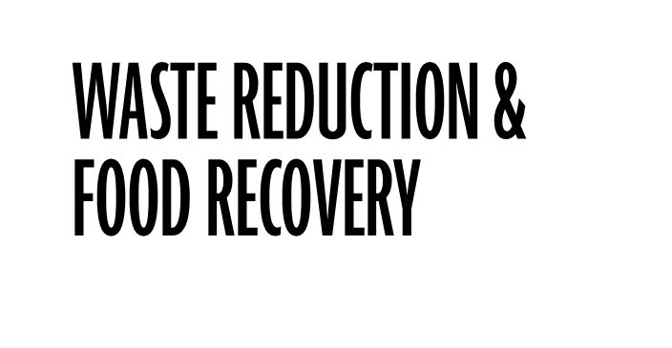
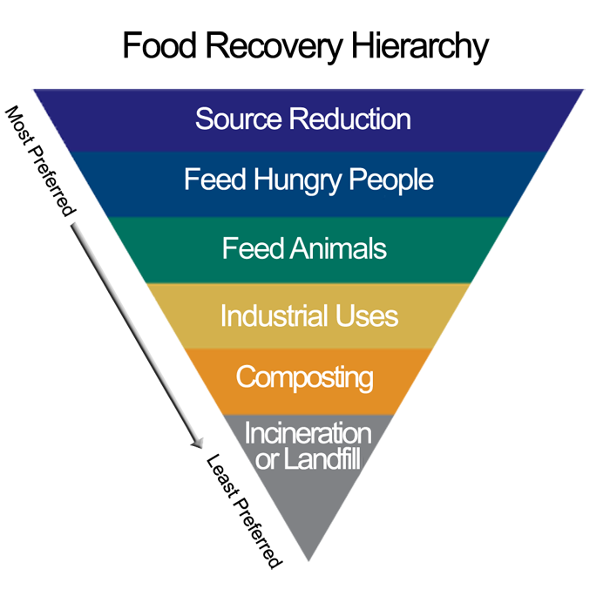
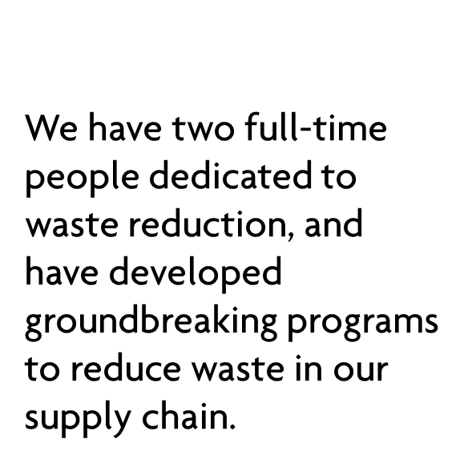

Notes:
At Bon Appétit we have been leaders in waste reduction for many years.
· Inaugural members of the Food loss and waste 2030 champions and have pledged to reduce food waste by 50%
We follow the EPA’s Food Recovery Hierarchy and practice:
Source reduction in the kitchen
Source reduction on the farm (Imperfectly Delicious Produce program)
Food recovery (donating regularly to local food banks)

Slide 24
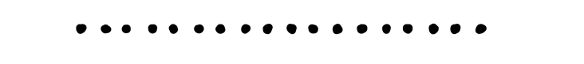
FOOD WASTE: WHAT WE’RE DOING
Preparing food from scratch and batch cooking
Talking people out of trays
Composting and recycling
Food recovery:
Around the country, we work with food banks and nonprofit organizations such as the Food Recovery Network and Feeding America.
Here in Seattle our partner is Food Lifeline.
Notes:
Preparing food from scratch. All of our chefs cook from scratch using fresh, local, and seasonal products. We encourage snout-to-tail and stem-to-root cooking by making all of our own stocks and soups — great destinations for bones and vegetable trimmings. Being chef driven means we don’t have restrictive cycle menus and corporate recipes: our chefs cook in season and have tremendous flexibility in their daily menus and can quickly regroup and re-purpose food as needed. We also have more cooked-to-order stations in our cafes which reduces overproduction.
Batch cooking. Our vegetables are prepared in batches at the last possible minute and served in the smallest possible quantities, to ensure both freshness and that we don’t prepare more food than is needed.
Talking people out of trays. In 2005 our general manager at Saint Joseph’s College of Maine pioneered trayless dining after he found he could cut consumer waste in half simply by removing the trays from the café. Trayless dining is now a nationwide movement – dozens of our college dining halls and corporate cafés have tossed their trays. Going trayless encourages people to take just what they can eat, not what they can carry, and substantially cuts down on post-cooking food waste.
Even though we are proactive, there is always inevitably some food going to waste. We try to find alternative uses and destinations for it by:
Composting and recycling. We compost food waste on site and through municipal programs; we send scraps to Farm to Fork partners (for animal feed or composting) and waste fryer oil to bio-fuel processors (in fact, some of our catering vans run on waste vegetable oil from our cafés).
· At Seattle U, as with many of our locations, we have pre consumer waste compost for campus gardens
SU very committed to waste reduction and sustainability, makes our job much easier
We custom tailor each program to each location but never compromise our mission
Food recovery.
· Founding partner Food Recovery Verified
· 80% of our accounts to be Food Recovery Verified by end of this year
· Co-authored FRN guide to food recovery and guide to gleaning
· I was on inaugural Seattle’s Table donor committee 26 years ago
· I work with very active student body and field lots of great ideas from students.
o Student projects
o Challenges with understanding what can be donated/health codes
o Challenged us to develop an app for advance ordering to reduce over-production
Low Carbon Day initiative 10years, educating consumers about carbon footprint and impact of choices they make
reduced waste by 30%
Month long waste reduction education program

Slide 25


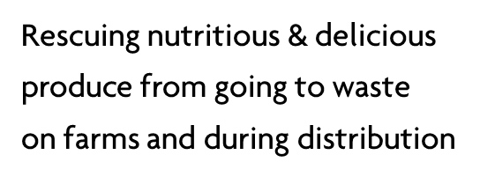
Notes:
Our Imperfectly Delicious Produce program rescues nutritious and delicious but cosmetically challenged produce from going to waste on farms and during distribution.
In the U.S. nearly one-third of the 430 billion pounds of food produced is not available at the retail and consumer levels. That’s approximately 133 billion pounds of food, most of which is perfectly nutritious, high-quality food that simply doesn’t meet cosmetic standards for the retail market, like these gnarly-looking carrots.
This is problematic not just because wasted food wastes all the resources that went into growing and harvesting the food, but because many Americans face food insecurity and we are currently wasting food that could feed hungry people. Wasted food also has an environmental impact that affects us all, as food that rots in landfills creates methane, a powerful greenhouse gas that’s 20 times more powerful than carbon dioxide.
Since its launch in May 2014, the Imperfectly Delicious program has rescued nearly 6 million pounds of produce
Now in use by other companies

Slide 26
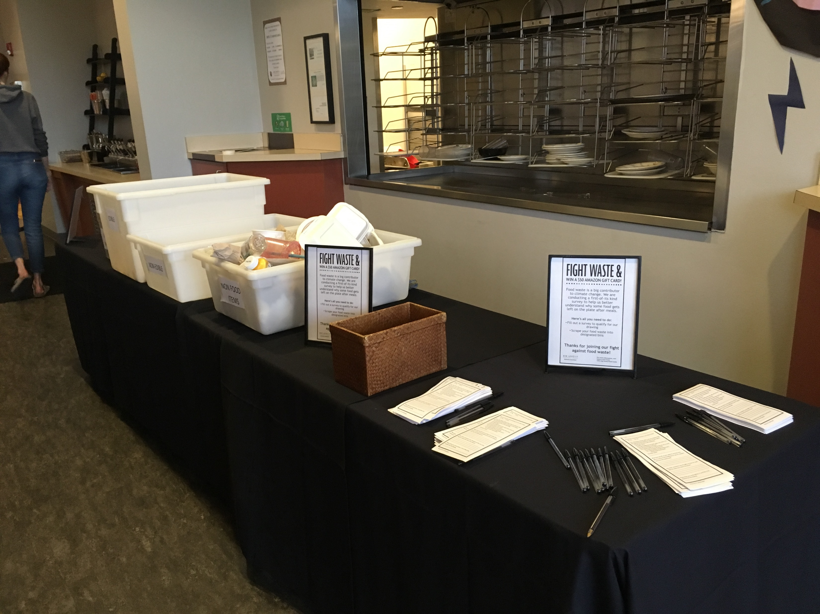
STUDYING WASTE
We’re piloting a post-consumer waste study with the Natural Resources Defense Council
Notes:
· There is very little research on plate waste in food service operations; this study will be the first of its kind to provide much needed insight on what food is left on our guests’ plates at the end of each meal and why. The findings from this study will inform the steps Bon Appétit takes to reduce food waste in hundreds of our cafés around the country.
We plan to conduct the study over various meal periods with several client partners. During the surveyed meal periods, the researchers will set up tables in front of the dish return and garbage area. On the table, there will be:
* an information table that explains the study to guests;
* designated bins to separate and categorize guests’ waste (the researchers will take plates from guests’ and separate the waste into the appropriate bin); and
* A short (1 minute) paper survey that guests will be asked to fill out, if they have time.
This study is being run at Bon Appétit cafés through the end of 2018 and we plan to publish findings in early 2019.

Slide 27


Bon Appétit

Slide 28

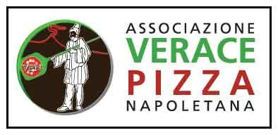


Slide 29

EPA works to ensure that:
Americans have clean air, land and water
All parts of society--communities, individuals, businesses, and state, local and tribal governments--have access to accurate information sufficient to effectively participate in managing human health and environmental risks

Slide 30


Slide 31
What was the Genesis of Tutta Bella?
Desire to build a meaningful business A Leader in Fiscal, Social, and Environmental Stewardship
Strategy: choose a popular category Two most popular foods in America are Pizza and Burgers
Respected by all and respectful of all constituents: Employees, Customers & Business Peers
An underlying principle and long-standing belief: Profit is a result, not the goal

Slide 32
Business Recipe
Ingredients for Success:
Purpose
Values
Vision

Slide 33
Our Purpose
“To nourish lives by sharing traditions, authentic food and love.”

Slide 34
Tutta Bella Values-based Hiring System
Tutta Bella strives to live Our Purpose of nourishing lives by sharing traditions, authentic food, and love, by only hiring people that share Our Values.
Behaviors that show a dedication to Our Values were identified by interviewing some of our most successful team members.
We call these team members Role Models.
In an effort to surround our Role Models with others likely to be as successful as them, we have developed interview systems to gain insight into the values of our candidates.
Our Values, and the behaviors of our Role Models (RM’s) are outlined in the next slides

Slide 35
Tutta Bella Values-based Hiring System
Behaviors / Attributes of Role Models and Our Values
Love
Innovation
Growth
Community
Passion

Slide 36
Tutta Bella Values-based Hiring System
Community
Strive to engage with the community
Appreciate Tutta Bella’s community involvement
Make Tutta Bella a warm community gathering place
Want to make a difference outside of the four walls of the restaurant

Slide 37
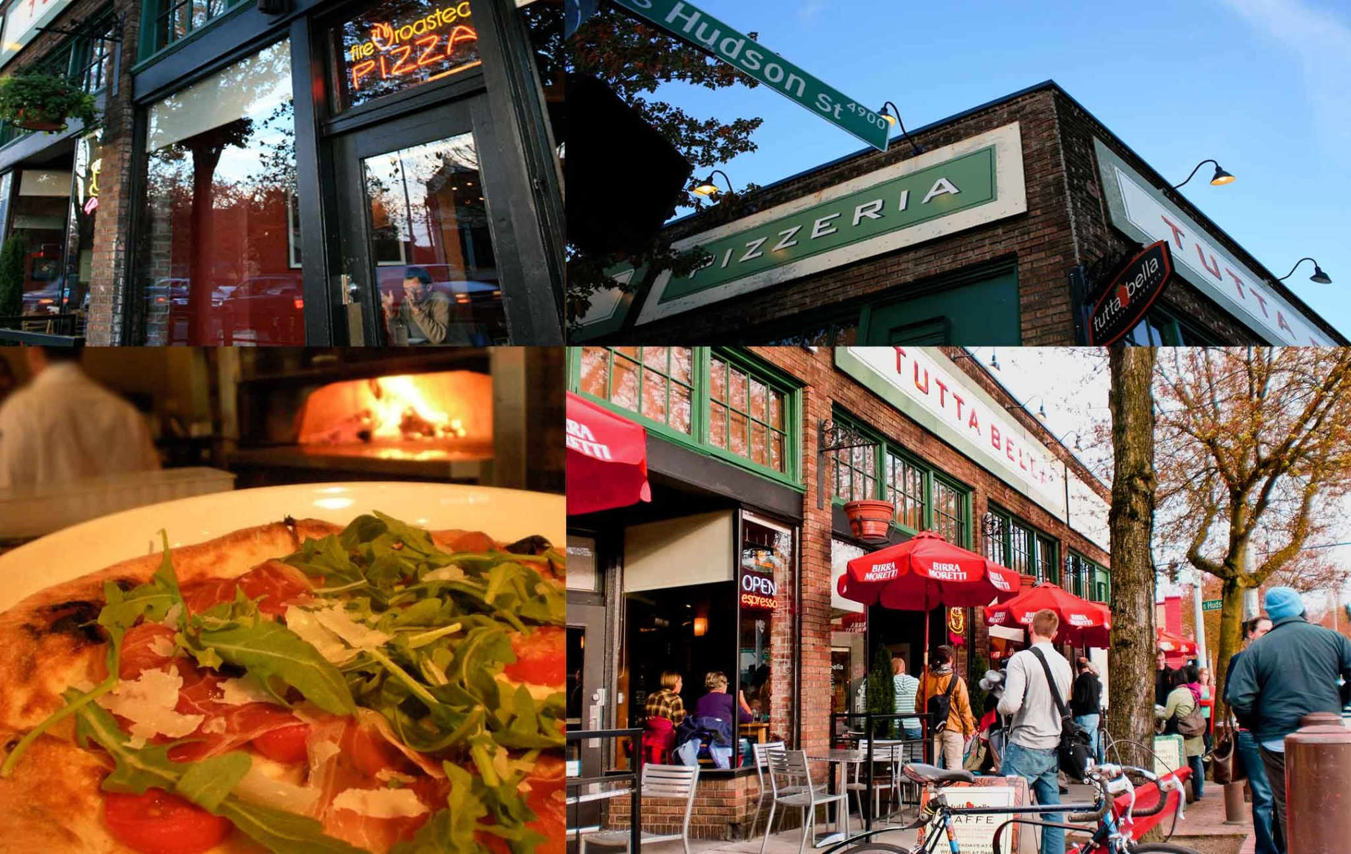
Tutta Bella Experience - Columbia City

Slide 38
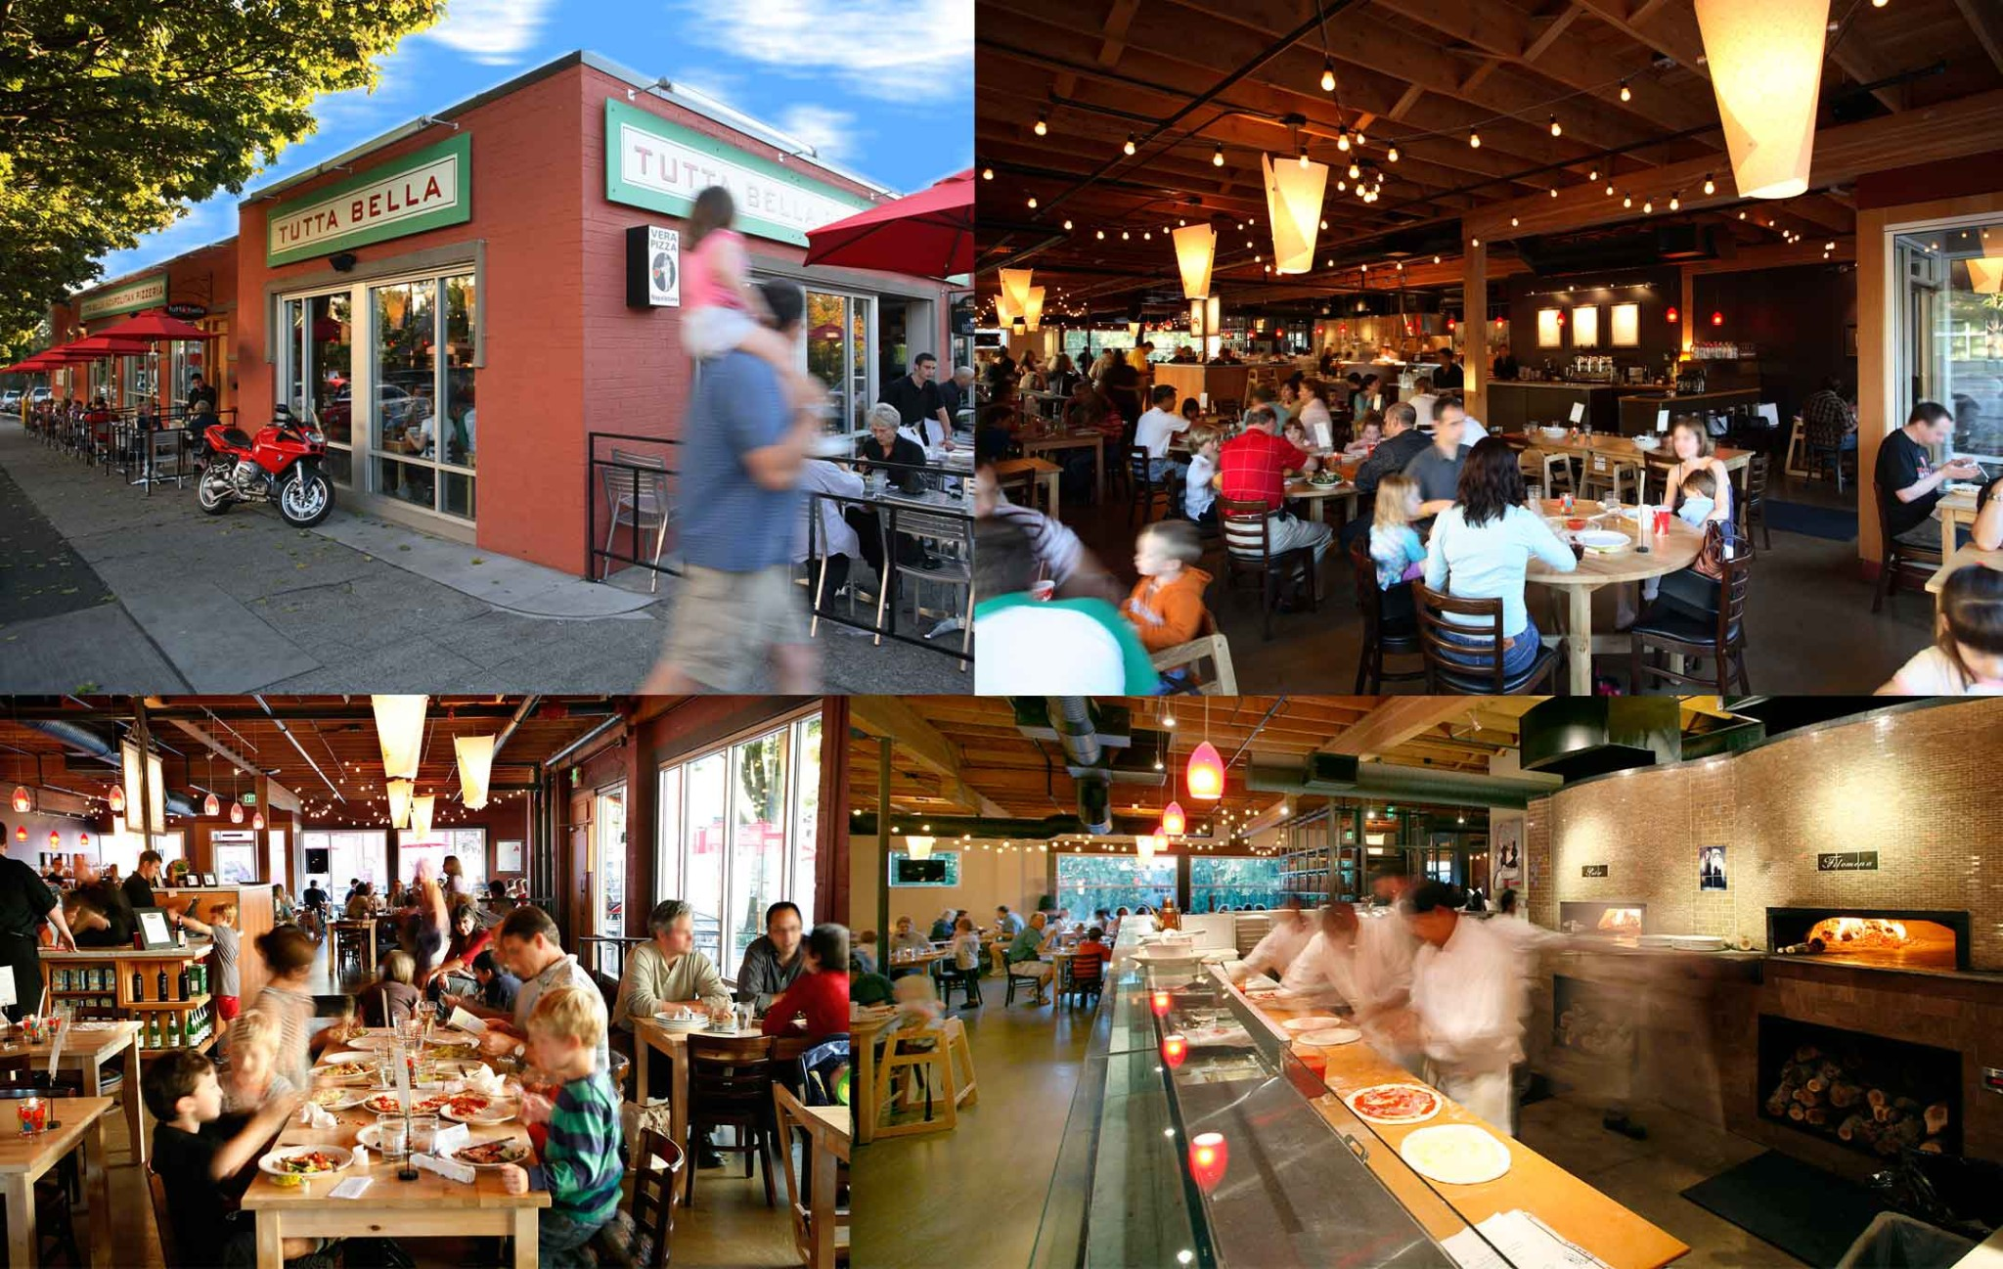
Tutta Bella Experience - Wallingford

Slide 39
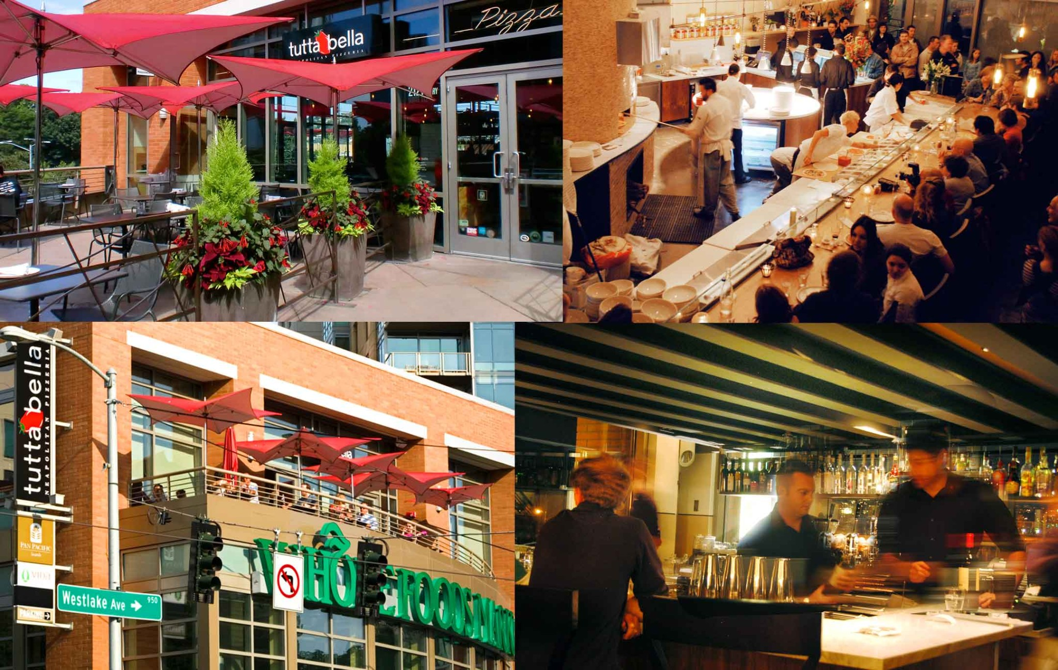
Tutta Bella Experience - South Lake Union

Slide 40
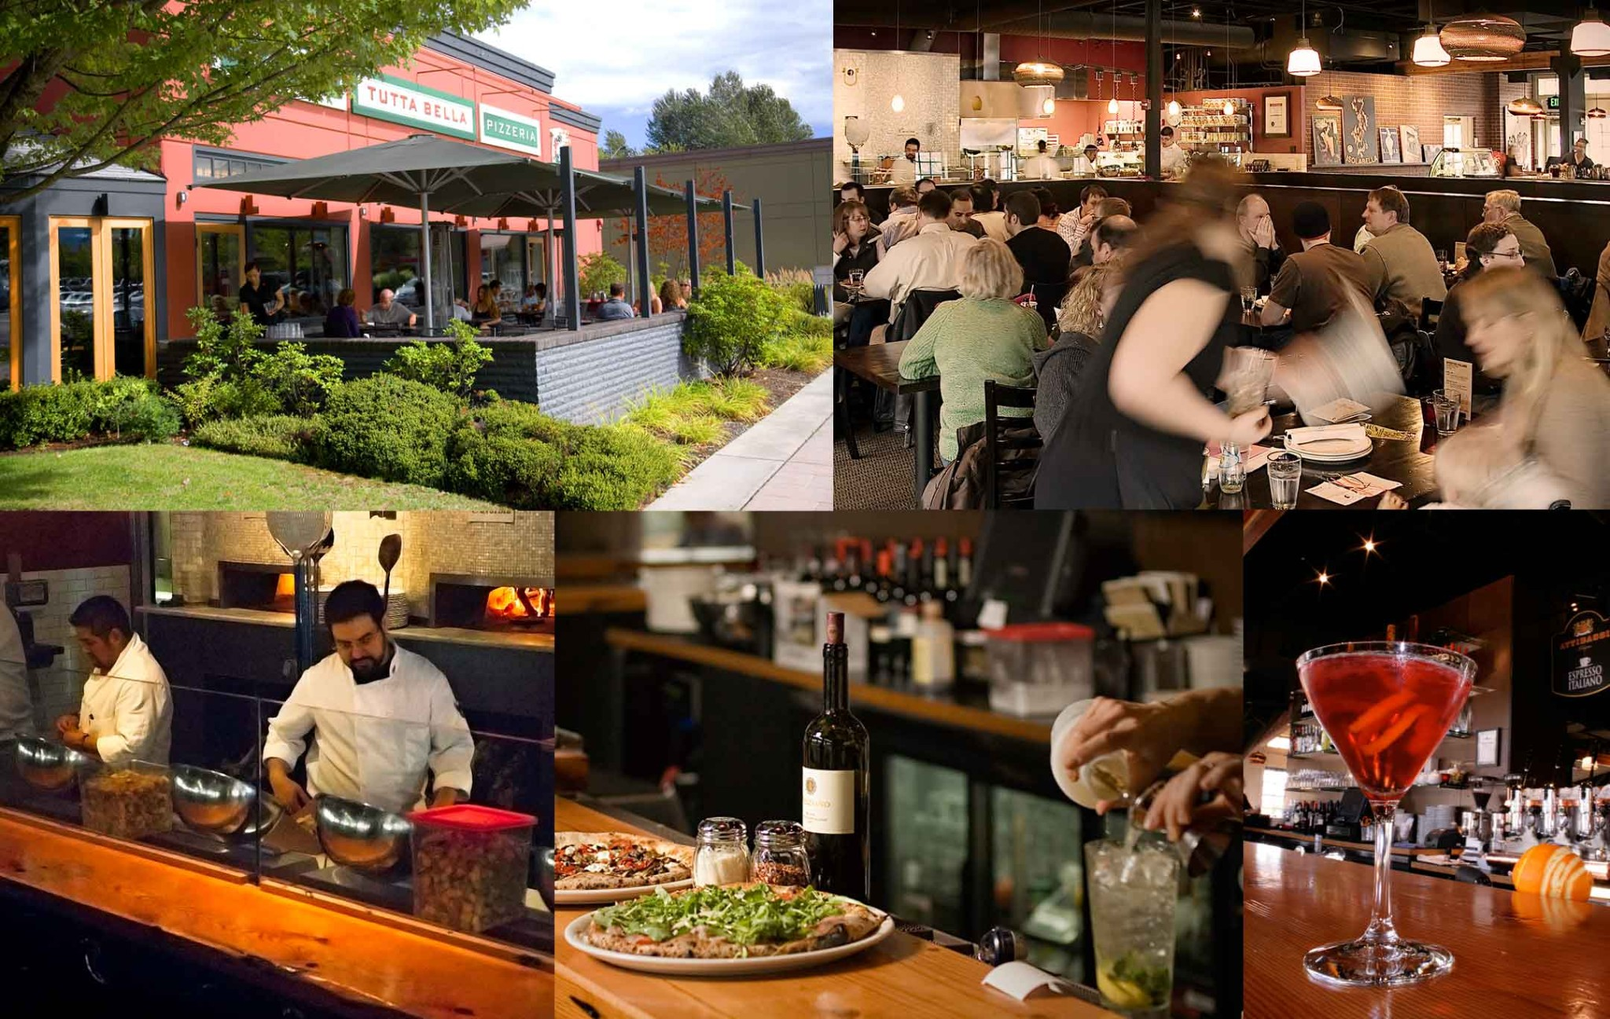
Tutta Bella Experience - Issaquah

Slide 41
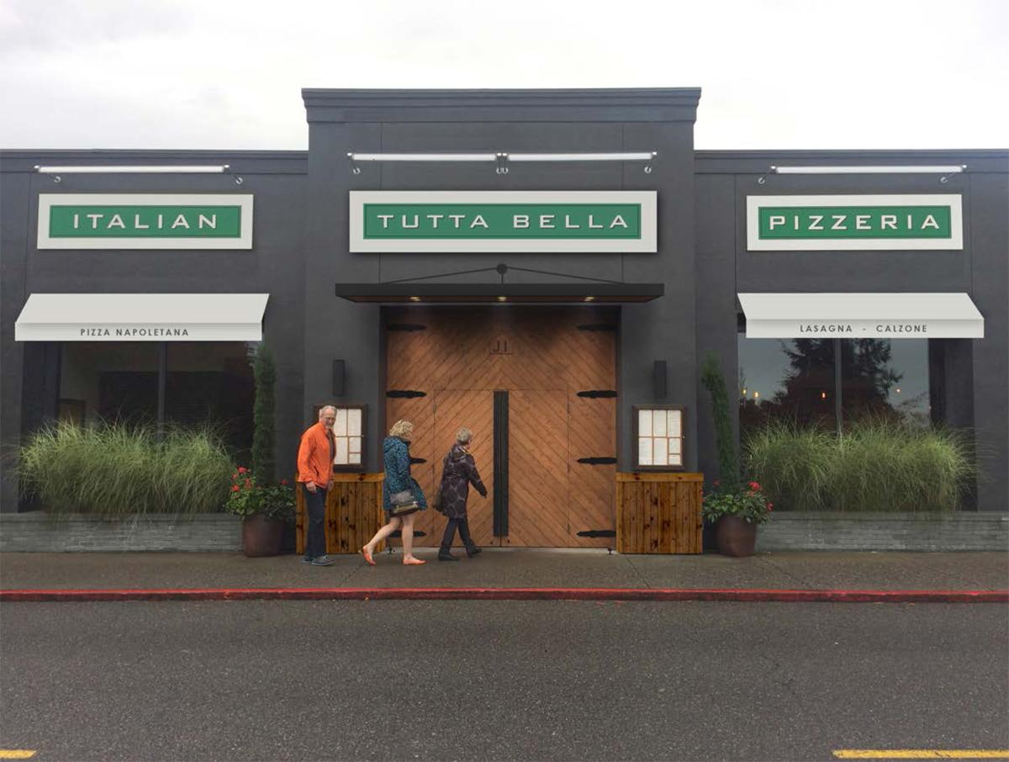
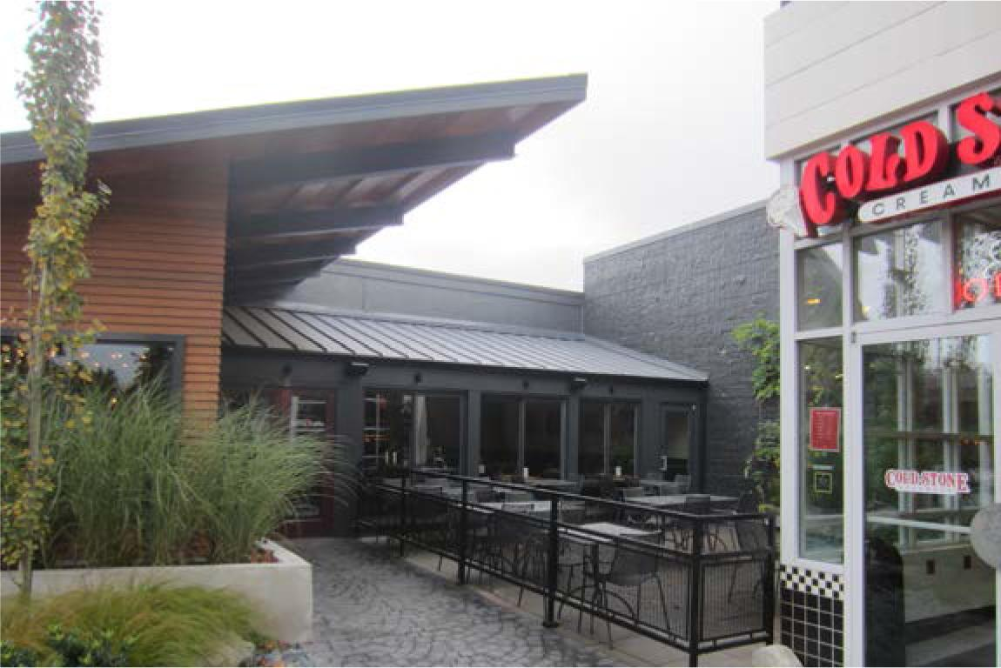
Tutta Bella Experience - Bellevue

Slide 42
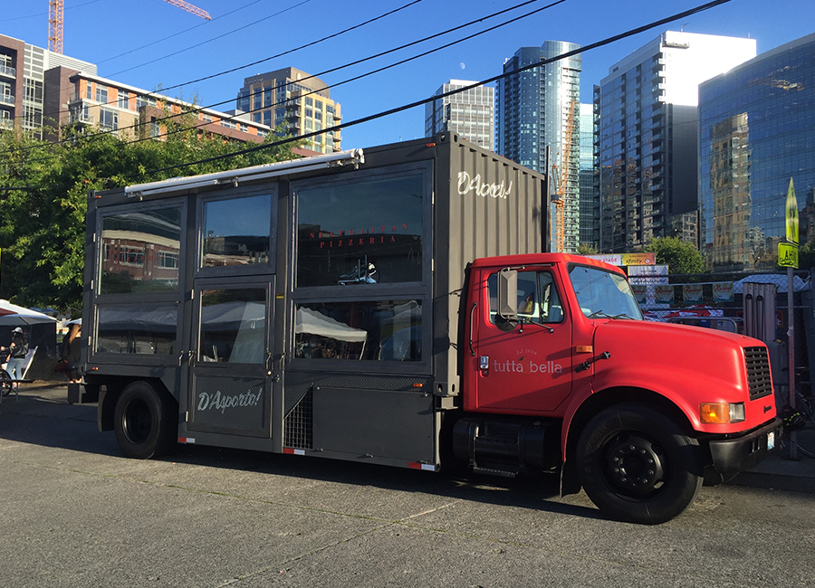
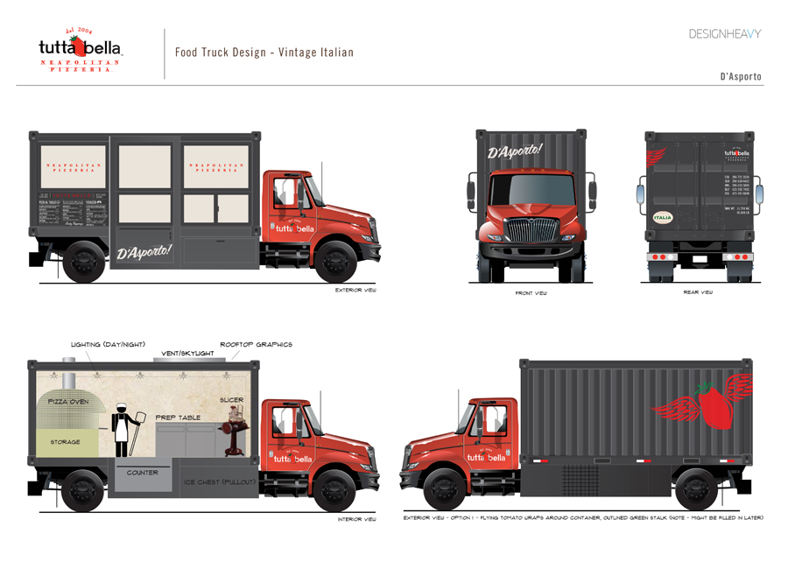
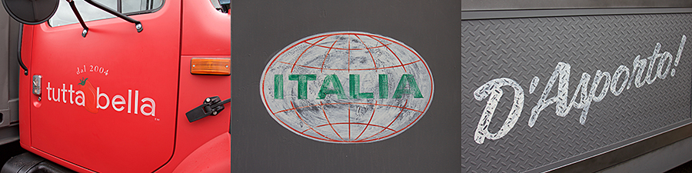
Tutta Bella Experience - D’Asporto

Slide 43
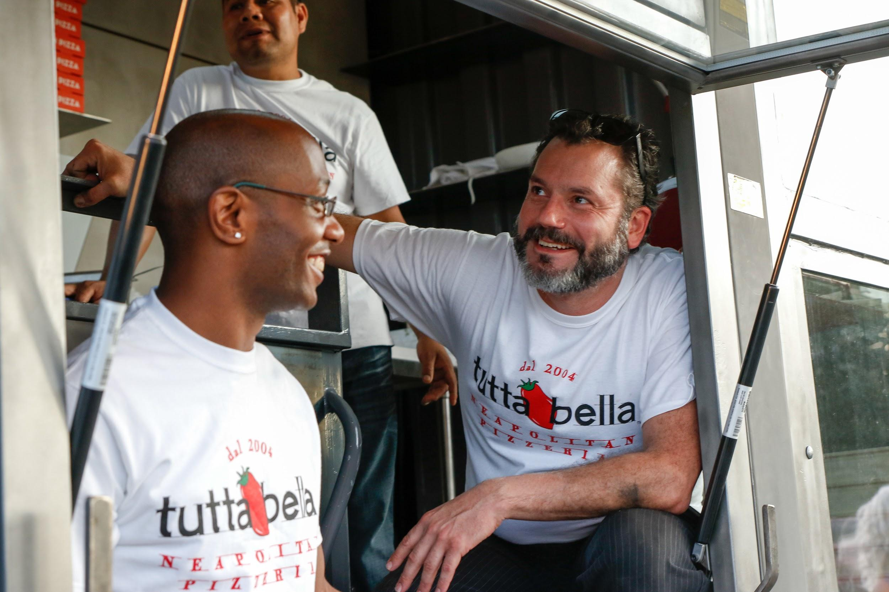
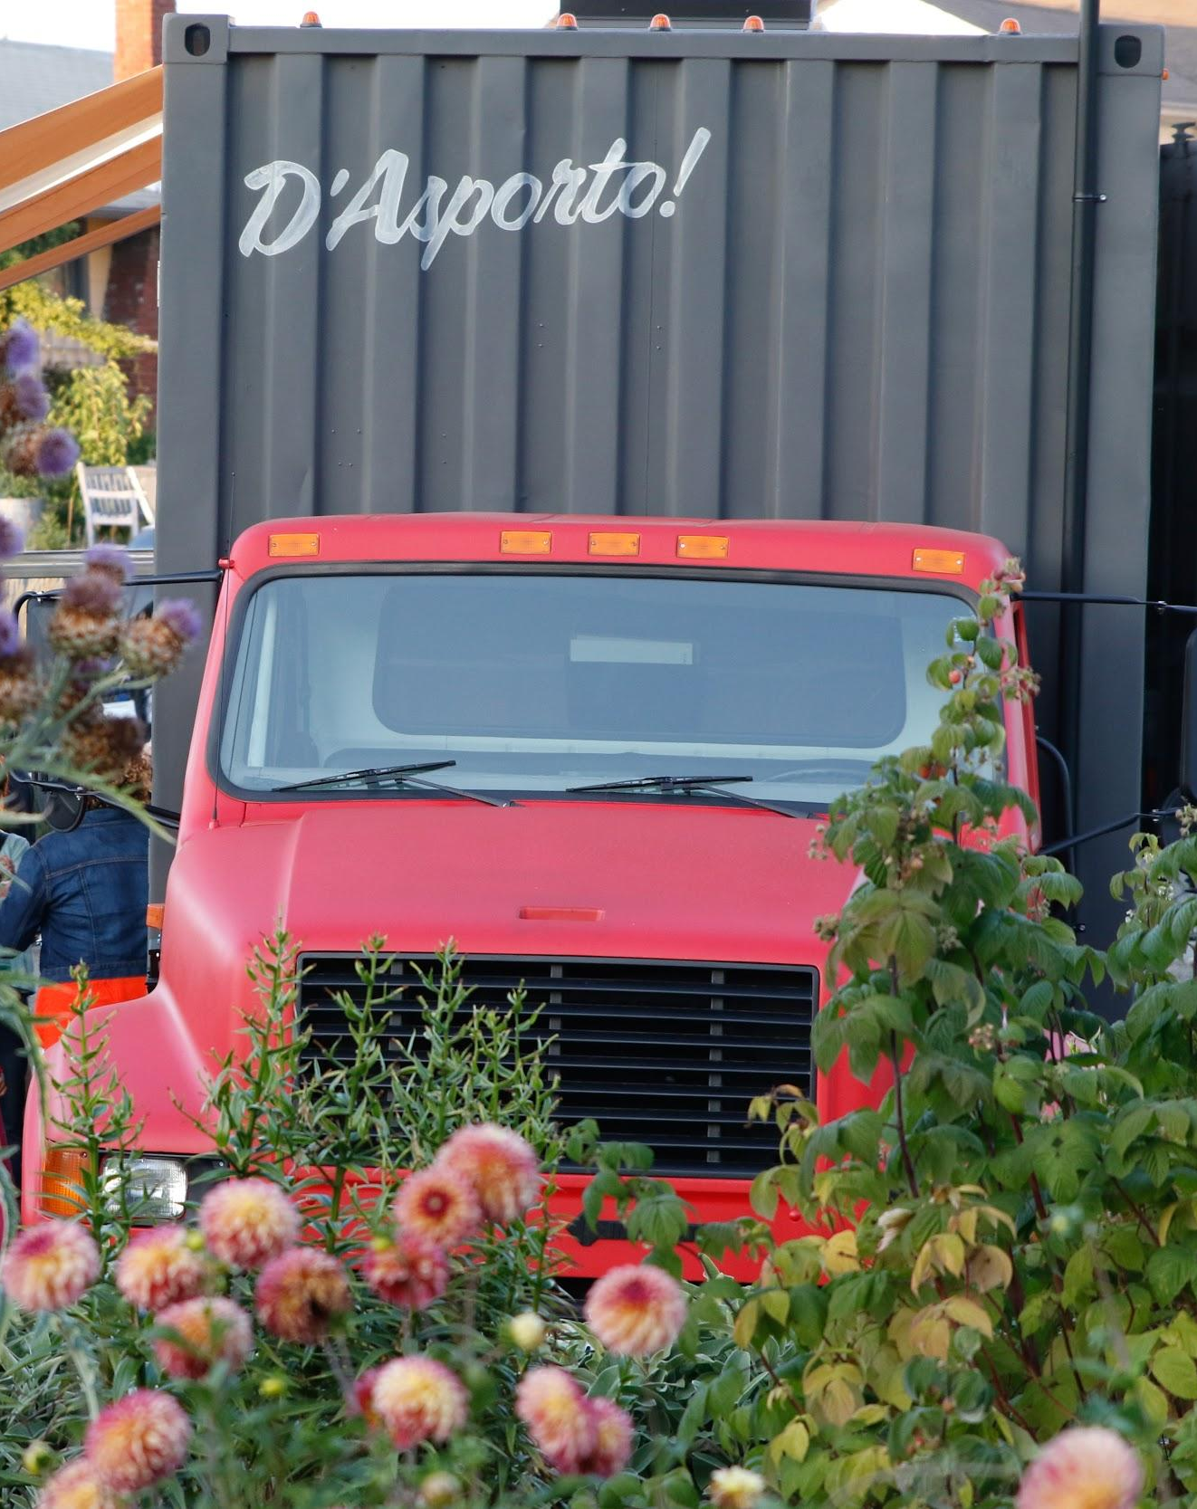
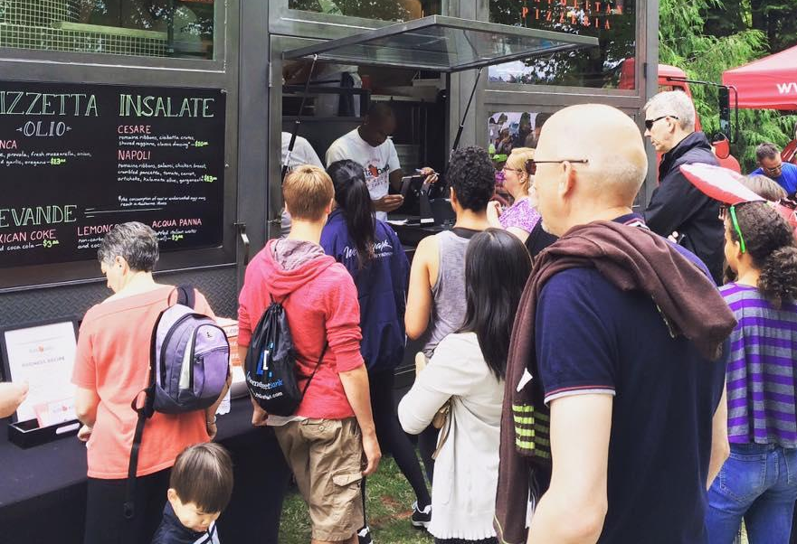
Tutta Bella Experience - D’Asporto

Slide 44
Tutta Training: Know your stuff!
10 Point Pizza Guidelines COMPOSITION SPECIFICATION
Pelt 1/16 inch thick
Sauce Evenly distributed, 1 ¼ inch from the edge
Toppings Even distribution, even portioning
Cornicione Light, fluffy, airy, patina of crunch
Flame BB’s The size of a quarter or less, less than 5 total
Color Evenly browned and golden on top/bottom
Size 13 inches
Shape Artisanal round
Cut 6 even slices that separate from each other
Garnish Garnish evenly distributed on all pieces

Slide 45
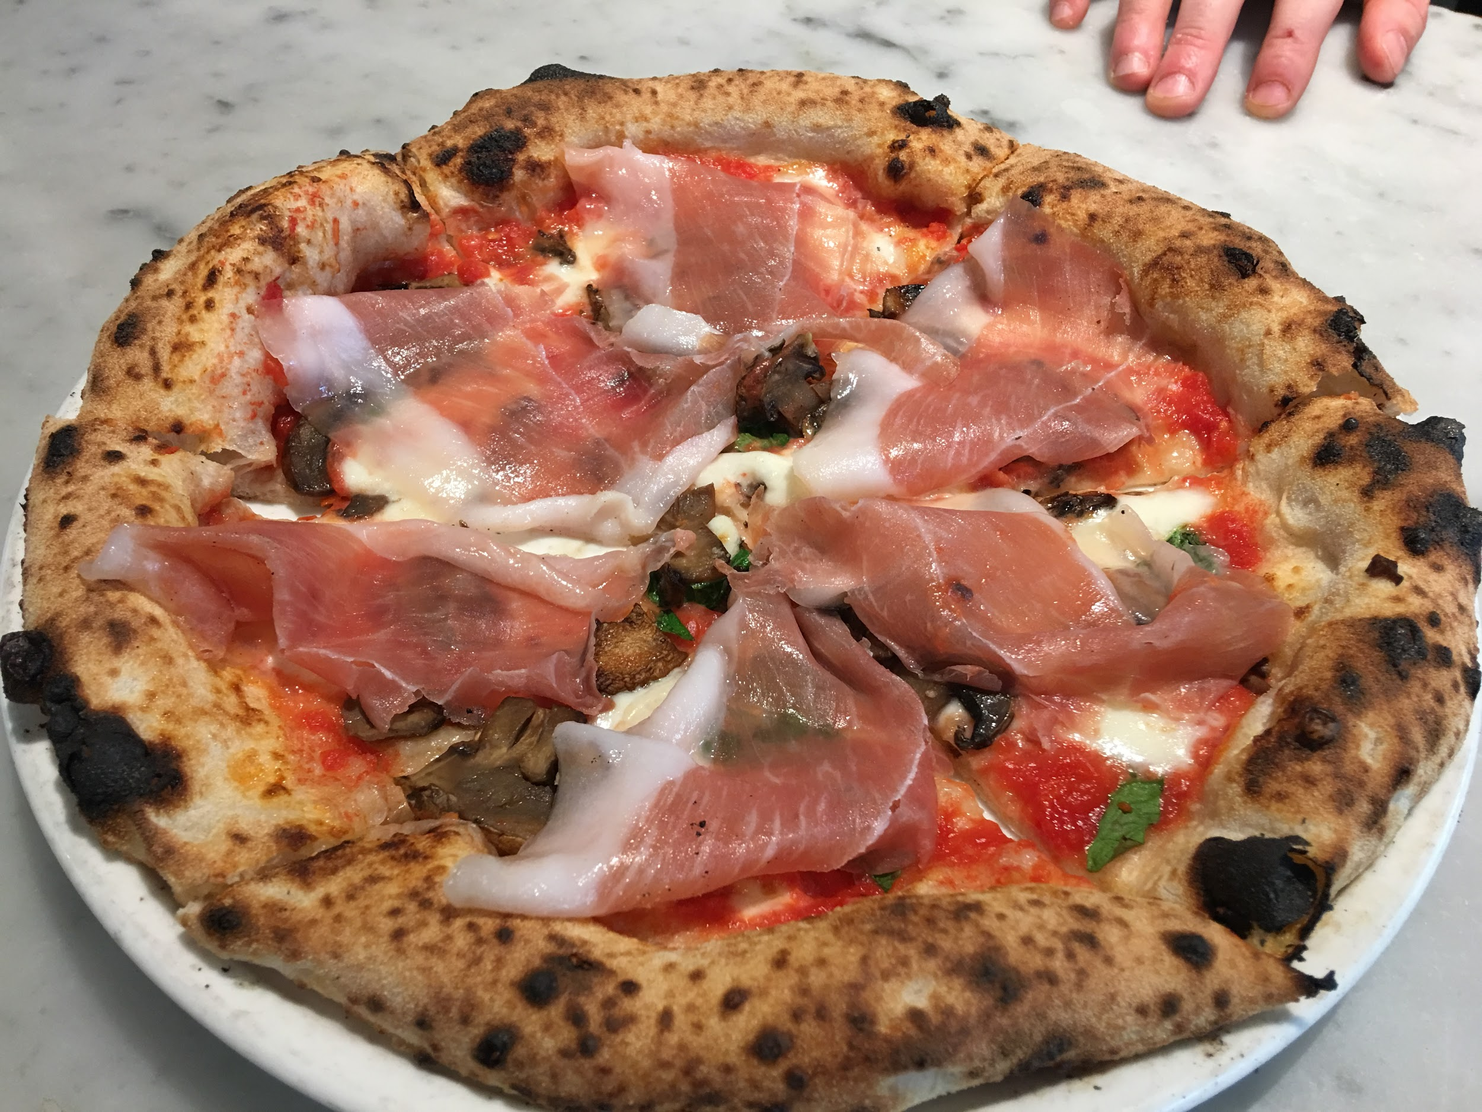
10 Points to a Perfect Pizza

Slide 46

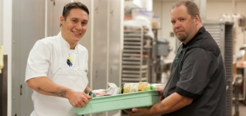
Living our vision: Environmental Stewardship & Food Rescue
Started in 1989, Food Lifeline’s “Seattle's Table” is a nationally recognized program that captures prepared and perishable foods from local restaurants, hotels, universities and corporate cafeterias. This food is then delivered directly to 50 meal programs throughout King County, turning surplus food into hot meals for people in need.
Since 2015, Tutta Bella, in partnership with Food Lifeline and Seattle’s Table has helped provide over 10,000 meals to local families.

Slide 47
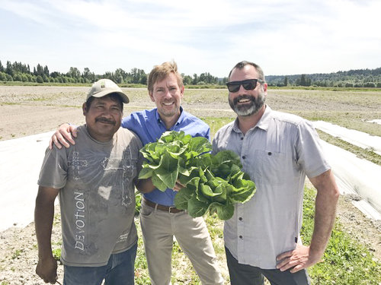
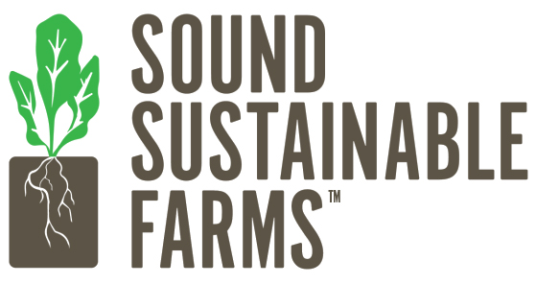
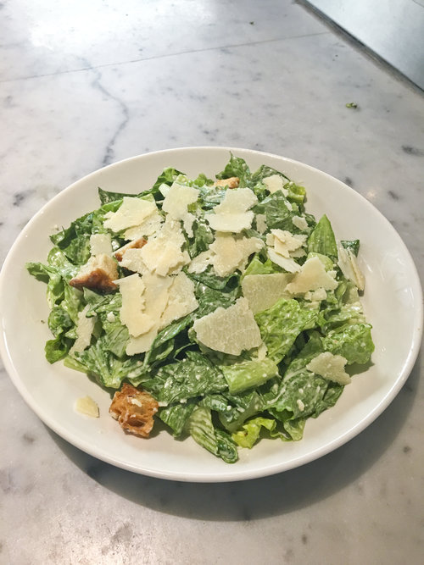
Living our vision: Environmental Stewardship & Food Recovery
Fresh Romaine lettuce grown at Sound Sustainable Farms, June 2017. This same lettuce head went directly into a salad whipped up by Tutta Bella's Chef Brian Gojdics (right). True farm to table product!

Slide 48







Tutta Bella In The Community
Partnerships For Positive Impact
Notes:
We found a niche in taking care of volunteers / Amara Forever Family Meal/ Kindering “Sib Shop” Millionaire Basil Program/Ads in Parent Map and on the radio

Slide 49
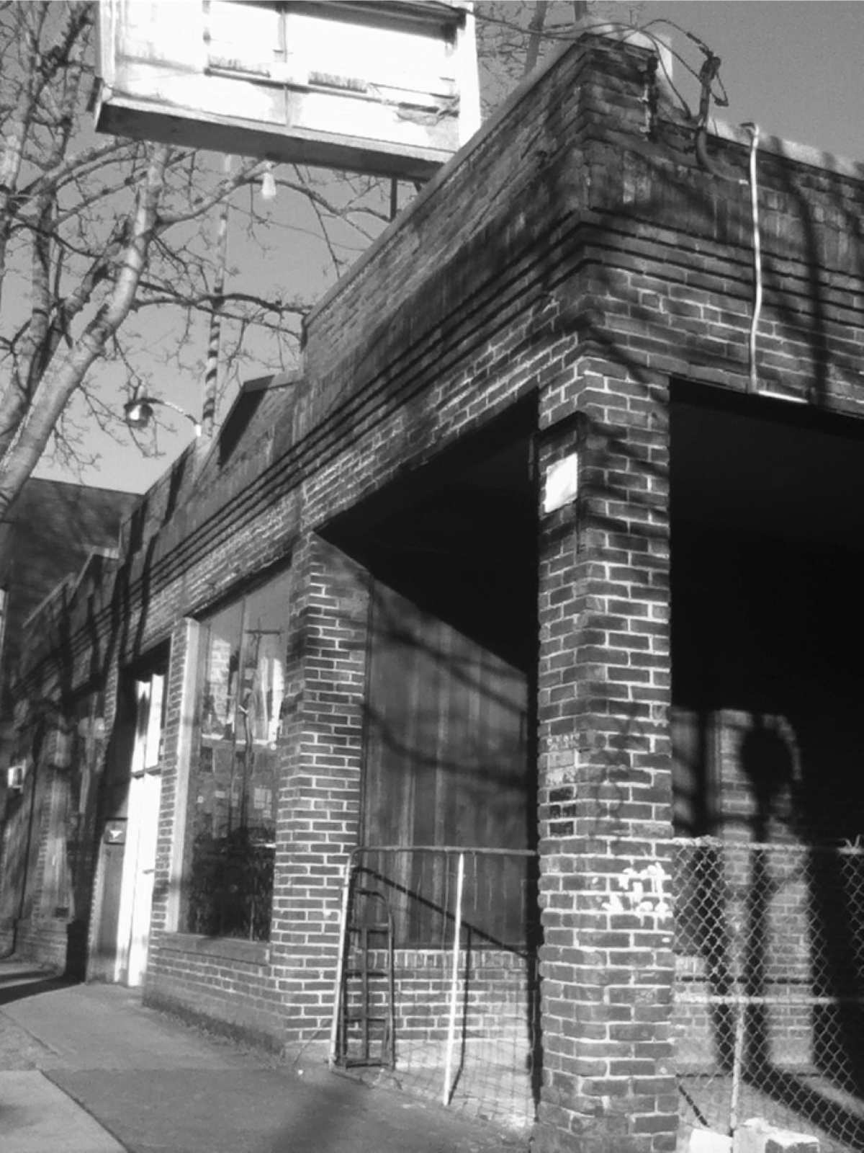
Living our Vision: Invigorating Communities

Slide 50
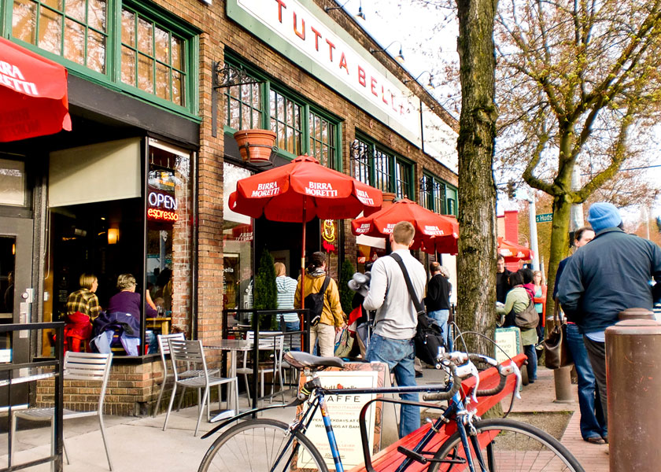
Living our vision: Invigorating Communities

Slide 51


Slide 52
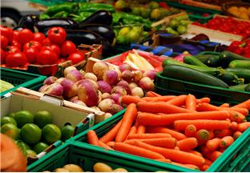
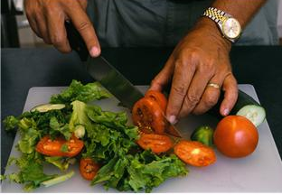
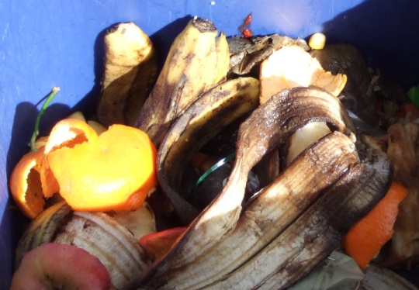
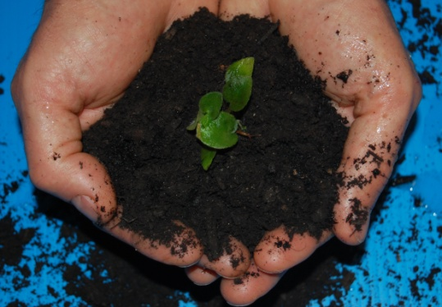
The Sustainable Management Of Food June 7, 2018 Hospitality Food Recovery Summit Domenic Calabro U.S. EPA, Region 10
www.epa.gov/foodrecoverychallenge

Slide 53

The Problem
40% of all food in the U.S. today goes uneaten; only 3% of wasted food is recovered for composting or digestion
1 in 8 U.S. households were “food insecure” in 2016
On a lifecycle basis, wasted food accounts for 15% of domestic GHG emissions
Citations: Feeding America, USDA, EPA, NRDC

Slide 54
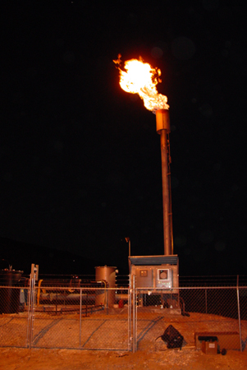
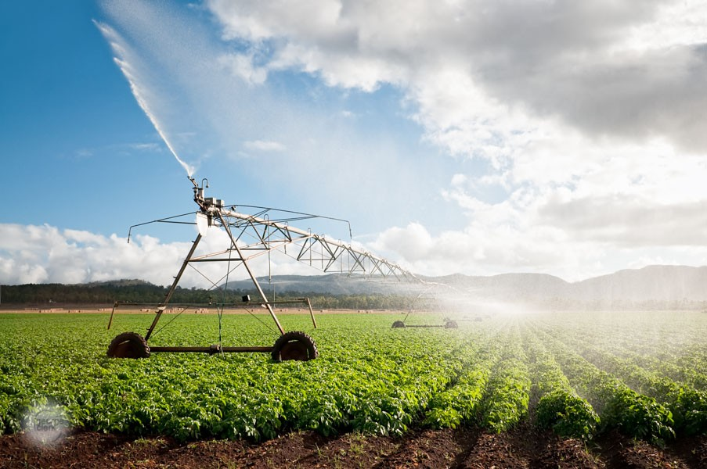


Wasted Food Impacts Our Environment
Wasted food enters a landfill and decomposes, producing methane (25x the warming potential of CO₂) for decades, contributing to about 15% of the nation’s GHG emissions.
Getting food from farm to fork accounts annually for 25% of annual fresh water use, 50% of land use, and 10% of energy consumption in the United States. (NRDC)
Food production also impacts water quality, soil productivity
Notes:
As you already know: Food is the largest category in the municipal waste system, in a landfill it decomposes and create methane.
But if we only look at the end of life we miss all the other embedded resources of food, like the transportation costs or the water used in producing food. FUN FACT: the water used to produce a quarter pound hamburger patty is the equivalent of a 90min shower!
Not to mention the social impacts!

Slide 55
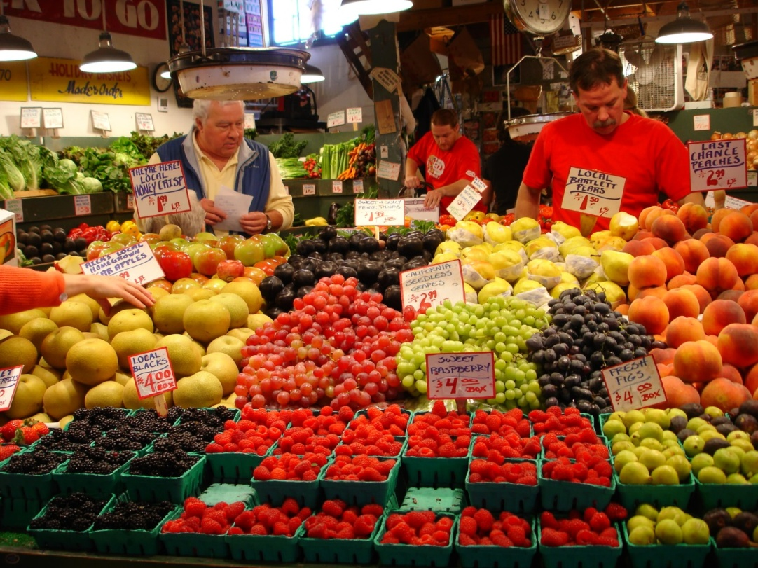
Wasted Food Impacts Our Society
1 in 8 Americans (42 million people) were food insecure in 2016, meaning they didn’t have consistent access to adequate food. (USDA)
Reducing edible food losses by just 15% could feed half of all hungry Americans every year. (NRDC)
Food insecurity and lack of access to healthy foods can also increase the likelihood for chronic health issues.

Slide 56
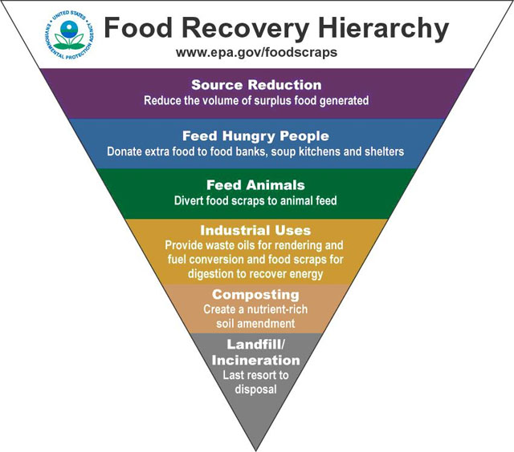
How is the EPA helping
prevent wasted food?
Commercial Food Recovery Challenge
Residential Food: Too Good to Waste
K-12 Schools School Food Share
Notes:
Okay, so I realize that’s a lot of bad news. Now I’m going to get into what we can and already are doing to solve this problem. EPA has developed a food recovery hierarchy. It illustrates that waste prevention (also known as source reduction) and donation are the most preferred approaches to achieve cost savings and societal benefits, significantly reducing the environment impact that wasted food has on our country and the planet.

Slide 57
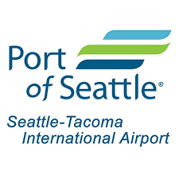











Who Is Taking EPA’s Food Recovery Challenge?
Notes:
Participating in the challenge are over 700 business and institutions across the nation, from grocers to universities and K-12 Schools, to sports and entertainment venues, hotels, and restaurants. Nationally, participants are as varied as Disneyland, Del Monte Foods, casinos on the Las Vegas Strip, and the National Hockey League. Participants in Washington include Safeco Field, Century Link Field, the University of Washington, the Snoqualmie Tribe, and PCC Natural Markets.

Slide 58
Thank You
Questions?
Domenic Calabro
calabro.domenic@epa.gov
(206) 553-6640
https://www.epa.gov/sustainable-management-food

Slide 59





Powerful Partnerships

Slide 60



Partnering with the Community

Slide 61





Innovative & Collaborative Effort to Close the Loop on Organics Recycling

Slide 62



“We continue to make CenturyLink Field one of the most environmentally friendly and sustainable facilities in the world. Our partnership with Cedar Grove allows us to focus on locally sourced, organic products that provide the highest quality food and beverage choices for our fans and support eco-friendly practices.” -Seahawks Vice President of Operations/General Manager of CenturyLink Field David Young

