Slide 1


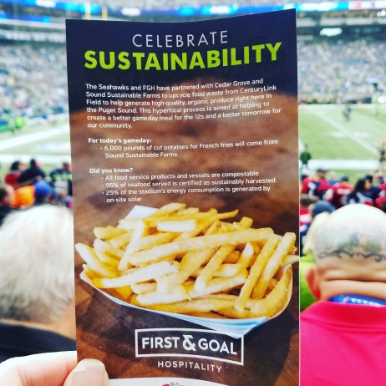
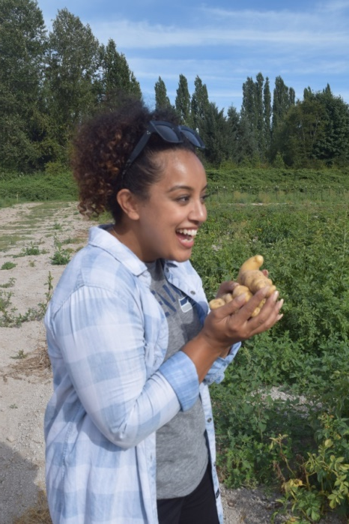
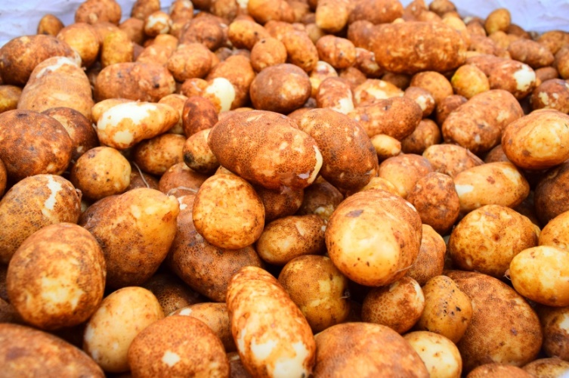
Powerful Partnerships

Slide 2
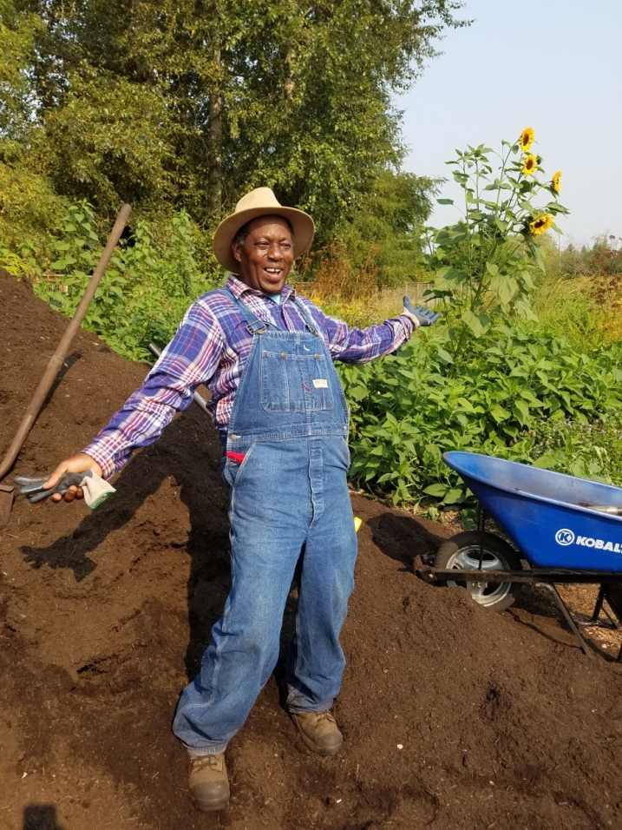
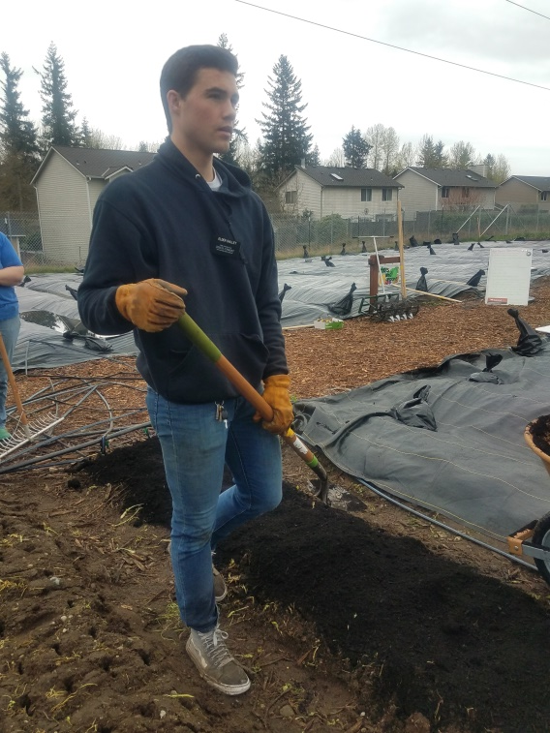
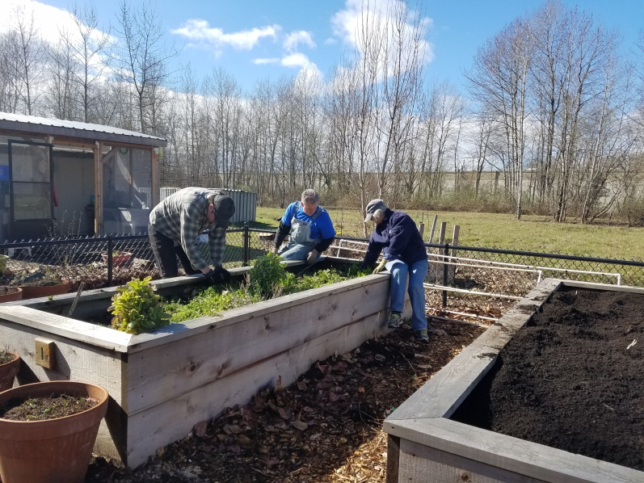
Partnering with the Community

Slide 3
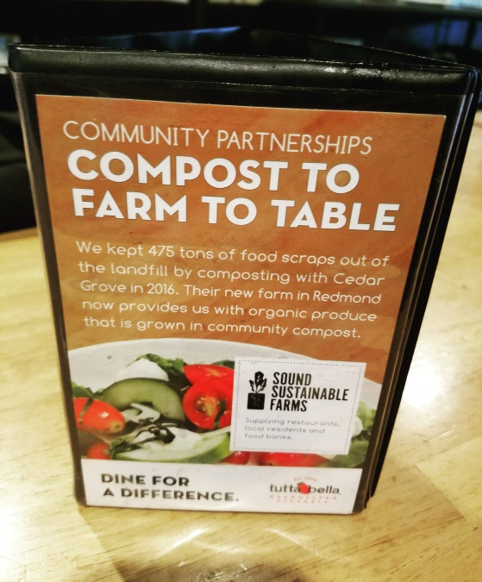
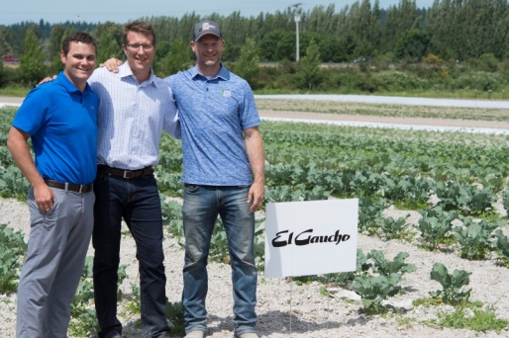
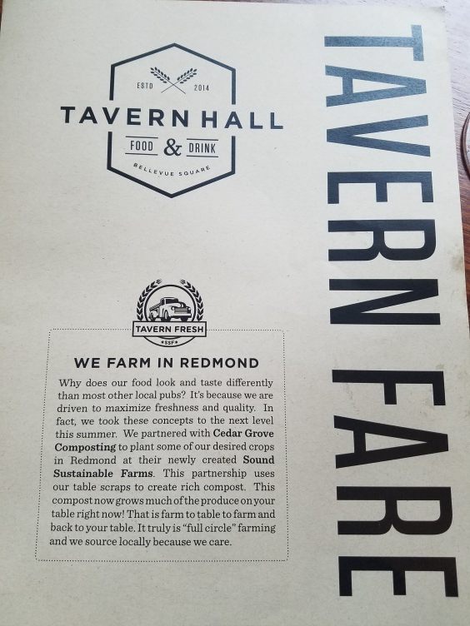


Innovative & Collaborative Effort to Close the Loop on Organics Recycling

Slide 4


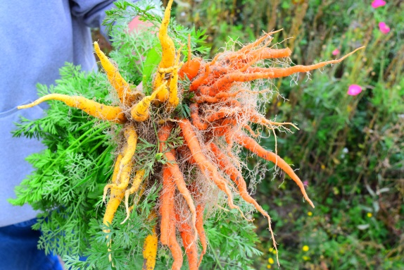
“We continue to make CenturyLink Field one of the most environmentally friendly and sustainable facilities in the world. Our partnership with Cedar Grove allows us to focus on locally sourced, organic products that provide the highest quality food and beverage choices for our fans and support eco-friendly practices.” -Seahawks Vice President of Operations/General Manager of CenturyLink Field David Young

