Slide 1

First & Goal Hospitality

Slide 2

Preventing Food Waste
Current Waste Diversion
Rethinking Food Waste
Smart Partnerships

Slide 3

CENTURYlINK FIELD Food waste prevention

Slide 4

Attention on the Details
Use of production sheets enables our culinarians to produce to what is ordered vs. to what the front line associate thinks is needed.
Accurate production sheets limits the amount of waste that is composted at the end of the events.
Tracking of waste in stands helps to keep track of how to produce for different events: Sounders, Seahawks, Stadium Concert, WaMu Concert, Flat Show, Catering.
Unique design for each Department’s needs
Food bank donations
Keeping ahead of the compost

Slide 5

Alternative methods
Identifying unique characteristics of the operation
Use of Carbon Filters to reduce ethylene gas in produce cooler
Weighing Compostable materials from Production kitchen
Filtering fryer oil to reduce waste

Slide 6
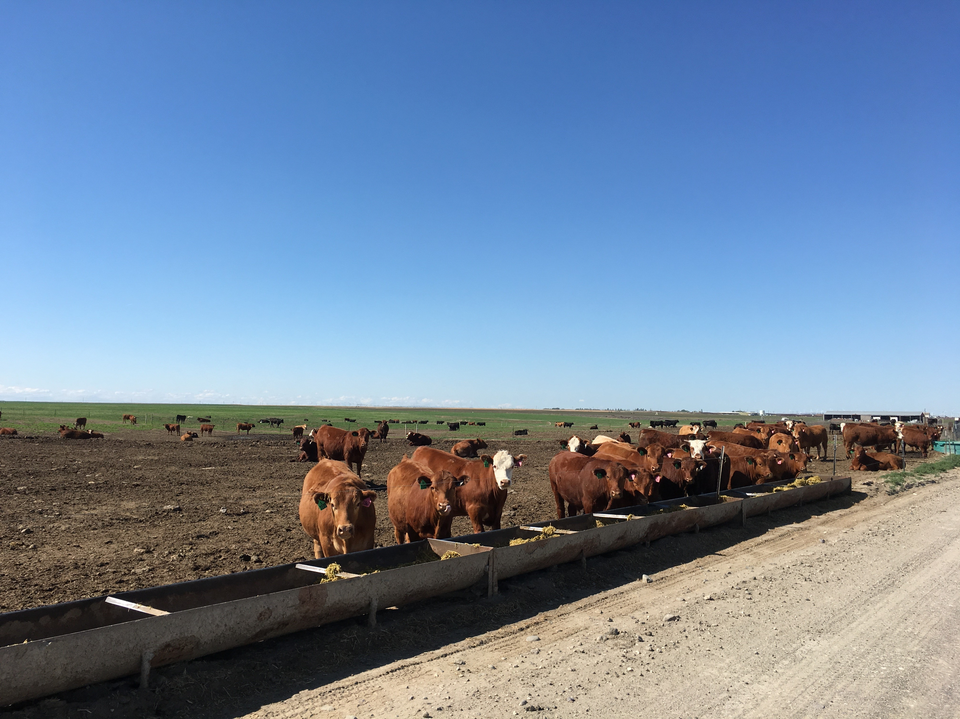
Smart Partnerships
Following the food through the full cycle.
Sustainable sourcing with similar whole picture philosophy and accountability.
Caring for the food.
Completing the loop with Sound Sustainable Farms
Community Outreach

