Slide 1
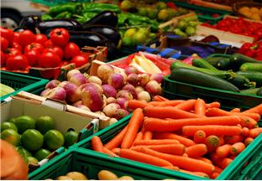

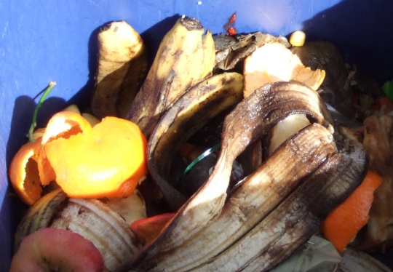
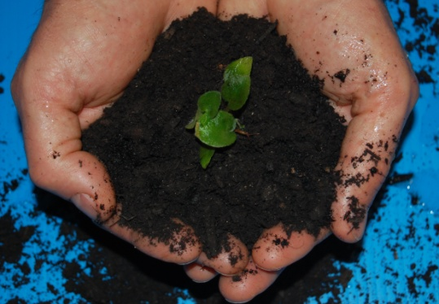
The Sustainable Management Of Food
June 7, 2018
2018 Hospitality Food Recovery Summit
Domenic Calabro
U.S. EPA, Region 10
www.epa.gov/foodrecoverychallenge

Slide 2

The Problem
40% of all food in the U.S. today goes uneaten; only 3% of wasted food is recovered for composting or digestion
1 in 8 U.S. households were “food insecure” in 2016
On a lifecycle basis, wasted food accounts for 15% of domestic GHG emissions
Citations: Feeding America, USDA, EPA, NRDC

Slide 3
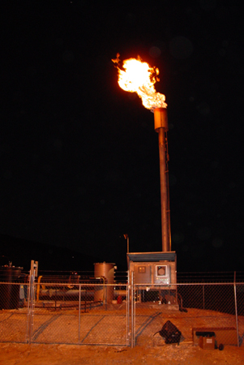
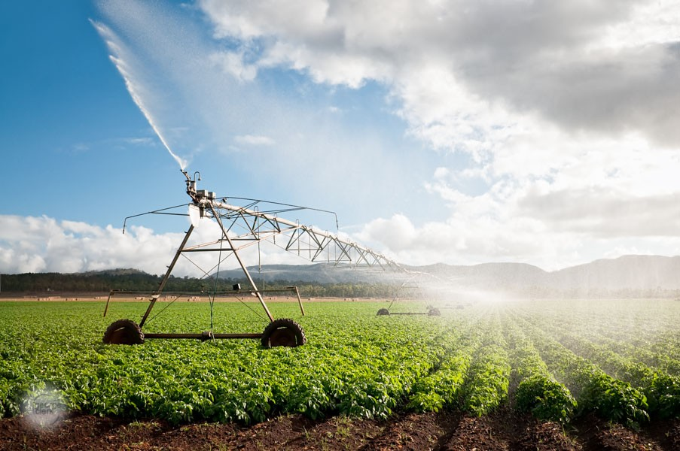


Wasted Food Impacts Our Environment
Wasted food enters a landfill and decomposes, producing methane (25x the warming potential of CO₂) for decades, contributing to about 15% of the nation’s GHG emissions.
Getting food from farm to fork accounts annually for 25% of annual fresh water use, 50% of land use, and 10% of energy consumption in the United States. (NRDC)
Food production also impacts water quality, soil productivity
Notes:
As you already know: Food is the largest category in the municipal waste system, in a landfill it decomposes and create methane.
But if we only look at the end of life we miss all the other embedded resources of food, like the transportation costs or the water used in producing food. FUN FACT: the water used to produce a quarter pound hamburger patty is the equivalent of a 90min shower!
Not to mention the social impacts!

Slide 4
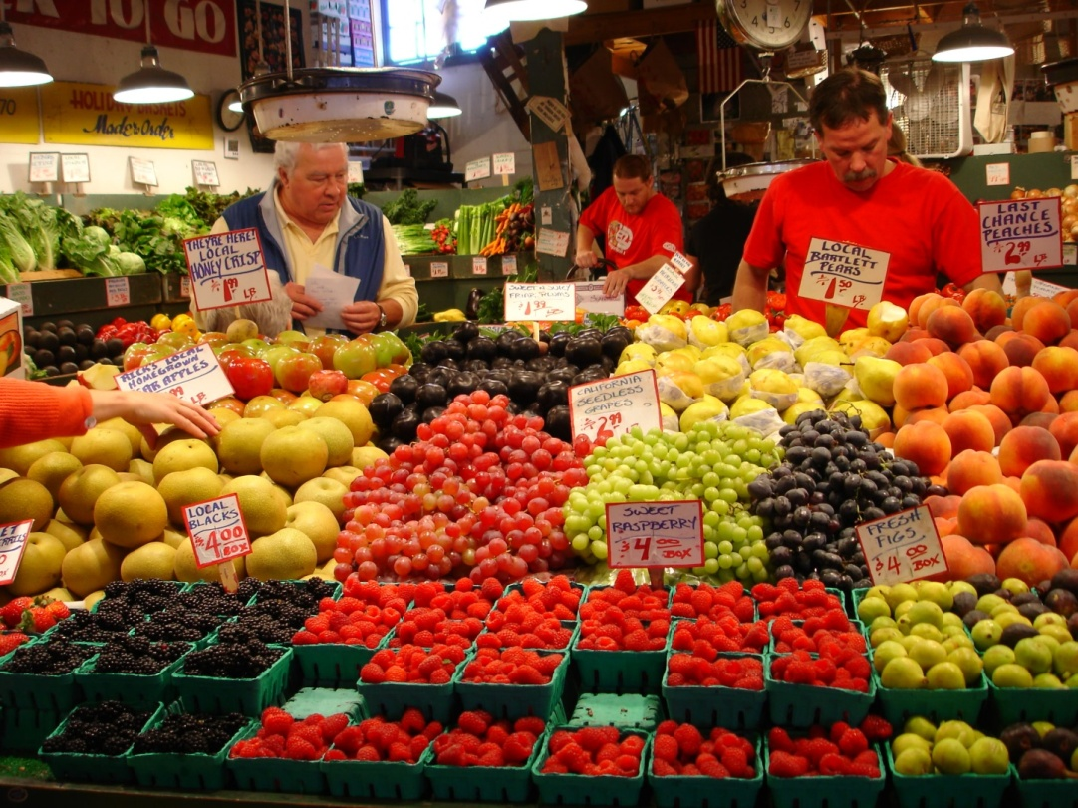
Wasted Food Impacts Our Society
1 in 8 Americans (42 million people) were food insecure in 2016, meaning they didn’t have consistent access to adequate food. (USDA)
Reducing edible food losses by just 15% could feed half of all hungry Americans every year. (NRDC)
Food insecurity and lack of access to healthy foods can also increase the likelihood for chronic health issues.

Slide 5
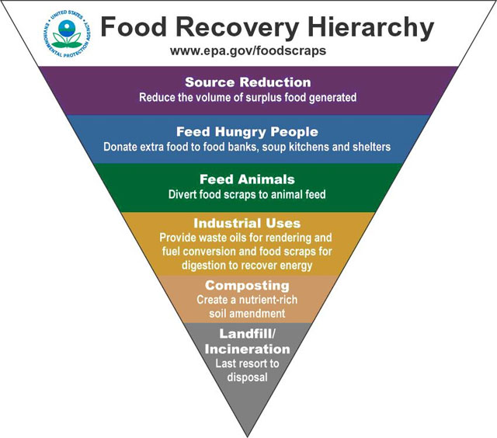
How is the EPA helping
prevent wasted food?
Commercial
Food Recovery Challenge
Residential
Food: Too Good to Waste
K-12 Schools
School Food Share
Notes:
Okay, so I realize that’s a lot of bad news. Now I’m going to get into what we can and already are doing to solve this problem. EPA has developed a food recovery hierarchy. It illustrates that waste prevention (also known as source reduction) and donation are the most preferred approaches to achieve cost savings and societal benefits, significantly reducing the environment impact that wasted food has on our country and the planet.

Slide 6












Who Is Taking EPA’s Food Recovery Challenge?
Notes:
Participating in the challenge are over 700 business and institutions across the nation, from grocers to universities and K-12 Schools, to sports and entertainment venues, hotels, and restaurants. Nationally, participants are as varied as Disneyland, Del Monte Foods, casinos on the Las Vegas Strip, and the National Hockey League. Participants in Washington include Safeco Field, Century Link Field, the University of Washington, the Snoqualmie Tribe, and PCC Natural Markets.

Slide 7
Thank You
Questions?
Domenic Calabro
calabro.domenic@epa.gov
(206) 553-6640
https://www.epa.gov/sustainable-management-food

