Slide 1

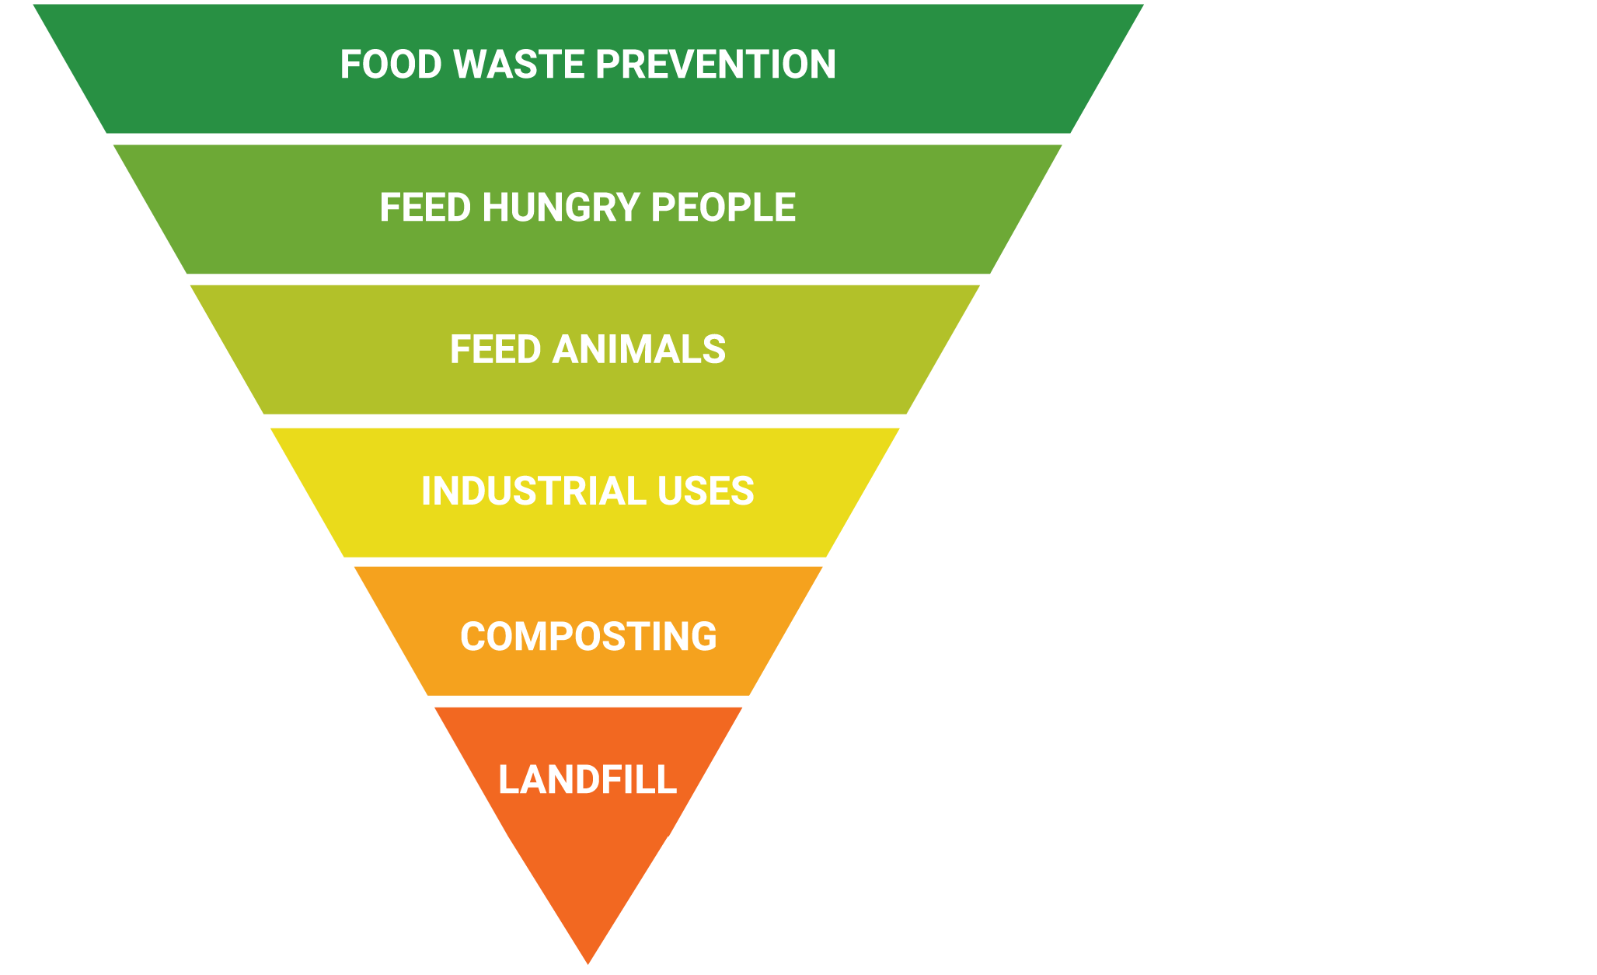

Your Options for Addressing Waste
Why Food Waste Prevention Matters
Todd Pendexter
Business Development Director

Slide 2

The Food Waste Problem
40%
Of food in the U.S. is wasted
Notes:
We’ve been tracking and studying food waste for over a decade. We work in all foodservice segments from hospitality to colleges to B&I. We’re in Google cafes and remote mining stations in the Australian Outback. Our data shows that it’s common to see 4-10% of purchased food thrown away before it’s even plated. That’s food that’s grown, transported, purchased and prepared.

Slide 3
Your Options for Addressing Waste
Notes:
There are several options for addressing that food waste. You might be familiar with this food waste hierarchy...

Slide 4
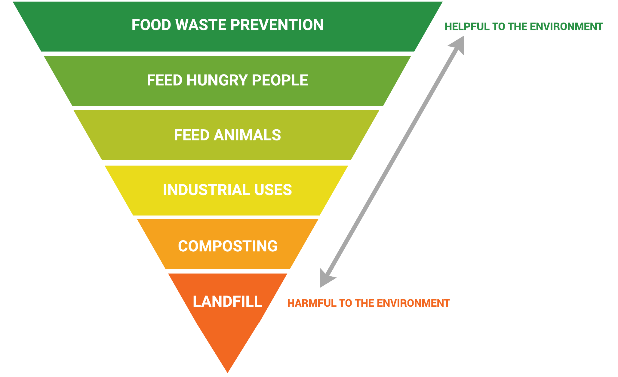
Your Options for Addressing Waste
Notes:
It lays out the most environmentally friendly options to the least. Food waste prevention is the most environmentally beneficial because it is the only option that can prevent environmental problems like C02 emissions generated through food production and later food decomposition. It keeps water from being squandered growing food that will just be wasted.

Slide 5
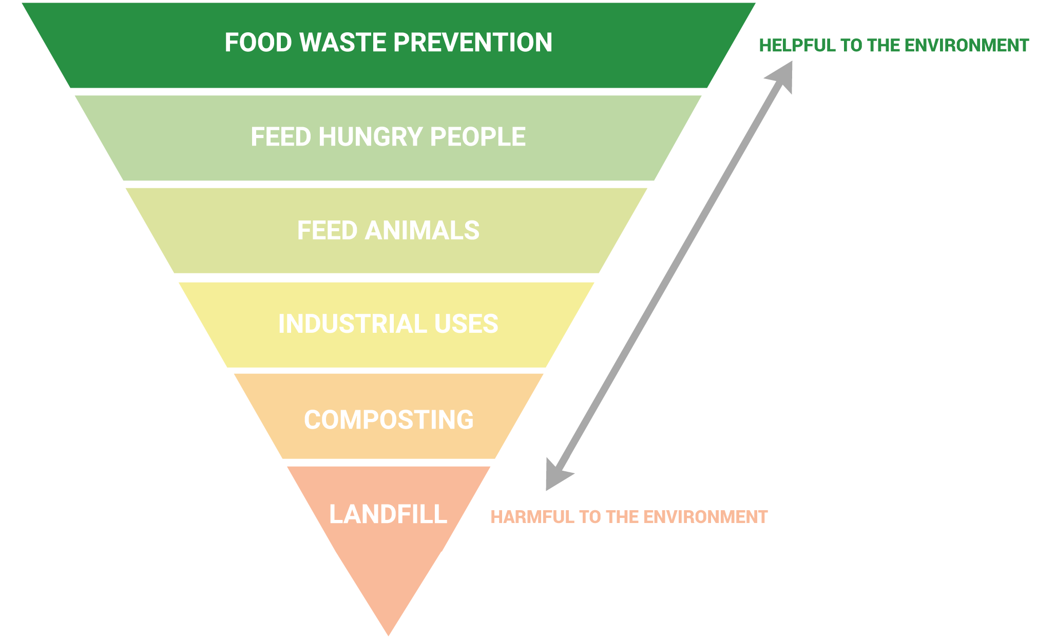
Your Options for Addressing Waste
The only option that meaningfully impacts your bottom line
Notes:
But it’s also the one solution in this list that can also impact your bottom line.

Slide 6
Your Options for Addressing Waste
The only option that meaningfully impacts your bottom line
Cuts food purchases
Notes:
Cuts food purchase costs

Slide 7
Your Options for Addressing Waste
The only option that meaningfully impacts your bottom line
Cuts food purchases
Cuts labor
Notes:
Cuts labor

Slide 8
Your Options for Addressing Waste
The only option that meaningfully impacts your bottom line
Cuts food purchases
Cuts labor
Cuts disposal fees
Notes:
Cuts disposal fees
It's very rare when the best thing you can do environmentally is also the best thing you can do financially. This is one of those rare win wins.

Slide 9
Food Waste Costs a Bundle
4-10%
of purchased food is thrown away before being plated
Notes:
We’ve been tracking and studying food waste for over a decade. We work in all foodservice segments from hospitality to colleges to B&I. We’re in Google cafes and remote mining stations in the Australian Outback. Our data shows that it’s common to see 4-10% of purchased food thrown away before it’s even plated. That’s food that’s grown, transported, purchased and prepared.

Slide 10
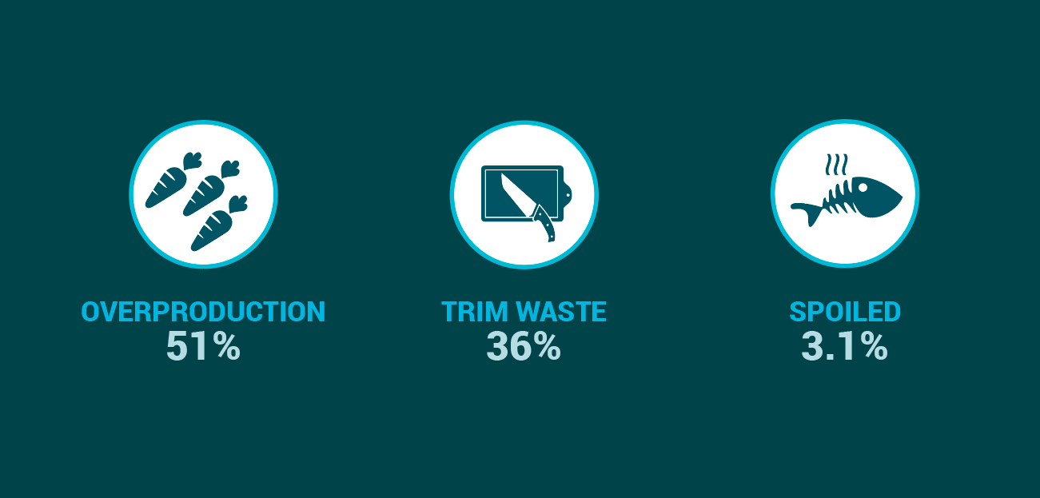
Behaviors That Create Food Waste
10
Notes:
We’ve also found from our data that again and again the vast majority of food waste is generated through overproduction. We all know why this happens: stated or unstated there is a deep-seated fear in foodservice of running out of food. Merchandising at salad bars, buffets and other displays has to look full and fresh from opening till closing. This generates massive amounts of waste.

Slide 11
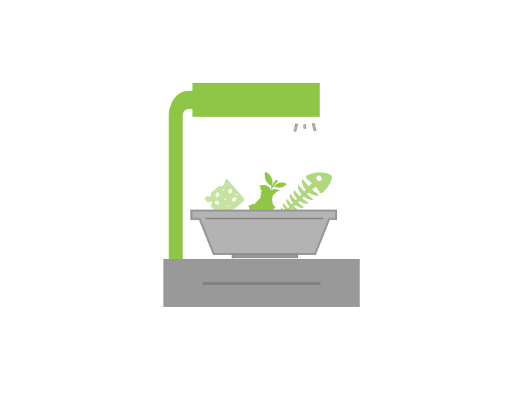



Prevention Happens Through Measurment
improve forecast quality change menu purchasing
DATA
Measurement
Prevention
increase awareness spark communication increase engagement
BEHAVIOR CHANGE

Slide 12



Impact of Prevention Through Measurement
Prevention Happens Through Measurement
improve forecast quality change menu purchasing
DATA
Reduce Waste
Increase Savings
Reduce pre-consumer food waste by 50% or more
Save 2-8% or more on annual food purchases
Measurement
Prevention
increase awareness spark communication increase engagement
BEHAVIOR CHANGE
Notes:
The good news is that overproduction can be managed. But you have to understand why and where it’s happening, and then change behaviors that lead to it. We make smart scales where you weigh food waste, and enter information on when and why it happened.

Slide 13

Thank you
Contact us today to learn more about LeanPath Food Waste Solutions
Todd Pendexter
Business Development Director
T: 1 234 567 7890
W: yourcompany.com
503.862.2257
tpendexter@leanpath.com
T: 1 234 567 7890
W: yourcompany.com

