Slide 1
Idaho Crop Residue Burning (CRB) April 18, 2012 Mary Anderson 2012 Smoke Management in the Northwest

Slide 2
History of Ag Burning in Idaho
2007 Ninth Circuit Decision - January
SIP did not have adequate demonstration
Idaho stopped crop residue burning in Idaho outside Reservation boundaries
Negotiations
SAFE, DEQ, ISDA, EPA, farm organizations and farmers who burn crop residue
Agreement reached December 19, 2007
Designed basic requirements of revised CRB program
More restrictive on both DEQ and growers

Slide 3
History (2)
Legislation
House Bill 557
Signed and effective March 7, 2008
Transferred program from ISDA to IDEQ
Field location and burn information will be available to public
Set registration fee
Prohibits DEQ from approving burns if air quality has reached or is forecasted to reach 75% of any NAAQS or 80% of the 1-hour action level for PM2.5
Air Quality Rules
Board approved temporary rules, effective April 2, 2008
Rules final at end of this session

Slide 4
History (3)
State Implementation Plan (SIP)
Public comment April 2 – May 2, 2009
Final submitted to EPA May 28, 2008
EPA approved August 1, 2008
Approval was effective September 1, 2008
Draft Operating Guide – July 31, 2008
Registration
On-line registration starts August 1, 2008
Would allow burns for September 2, 2008
Start of 2008 burn season – September 2, 2008
Notes:
SIP
Demonstrates our program will comply with the Clean Air Act.
Key componenets
rules
resources (staff)
able to execute as designed – actively manage the program
SIP for Idaho give Idaho authority to run air program
Air rules are part of the SIP

Slide 5
Key Points from Agreement
Enforceability of program
DEQ run program
Switch authorities from ISDA to DEQ
Statewide program
Model program after Nez Perce Program
Protect air quality to 75% of NAAQS
PM_{2.5} not to exceed 26 µg/m³ for 24-hr period
Daily dispersion forecast by professional meteorologist
Use operating guide as starting point
Need consistency between programs – states and tribes
Short-term impacts (1 hr) need to review based on EPA’s new AQI
Notes:
The new CRB program is designed to be protective of public health. To ensure the protection of public health, DEQ is prohibited from approving burns if the air quality exceeds or is expecting to exceed these standards, over the next 24-hours.
The NAAQS stands for the National Ambient Air Quality Standards. The 2 pollutants that are of main concern during CRB season are fine particulate matter and ozone.
The action criteria is a short term level that is designed to protect the public from acute exposure to air pollutants.
DEQ will review air quality monitoring data to determine whether concentrations are below these levels or not.

Slide 6
Key Points from Agreement (2)
Totally transparent program
Incorporate key aspects of transparency from Washington Program
Incorporate enforceability of transparency into SIP
Enhanced documentation process
Develop real-time GIS display of data
Implement enhanced information dissemination system
Legislation introduced by growers
Supported by DEQ, ISDA, and SAFE
Examine adequacy of existing monitoring network
Notes:
The new CRB program is designed to be protective of public health. To ensure the protection of public health, DEQ is prohibited from approving burns if the air quality exceeds or is expecting to exceed these standards, over the next 24-hours.
The NAAQS stands for the National Ambient Air Quality Standards. The 2 pollutants that are of main concern during CRB season are fine particulate matter and ozone.
The action criteria is a short term level that is designed to protect the public from acute exposure to air pollutants.
DEQ will review air quality monitoring data to determine whether concentrations are below these levels or not.

Slide 7
Key Points from Agreement (2)
Build in cooperation with other smoke management regulators
Annual and on-going review process
Monitoring/exposure studies – if grant money, need can be identified
>20,000 acres of blue grass burned triggers SIP evaluation
Develop concurrent timeline
Legislation
SMP
SIP
Assemble implementation committee
Notes:
The new CRB program is designed to be protective of public health. To ensure the protection of public health, DEQ is prohibited from approving burns if the air quality exceeds or is expecting to exceed these standards, over the next 24-hours.
The NAAQS stands for the National Ambient Air Quality Standards. The 2 pollutants that are of main concern during CRB season are fine particulate matter and ozone.
The action criteria is a short term level that is designed to protect the public from acute exposure to air pollutants.
DEQ will review air quality monitoring data to determine whether concentrations are below these levels or not.

Slide 8
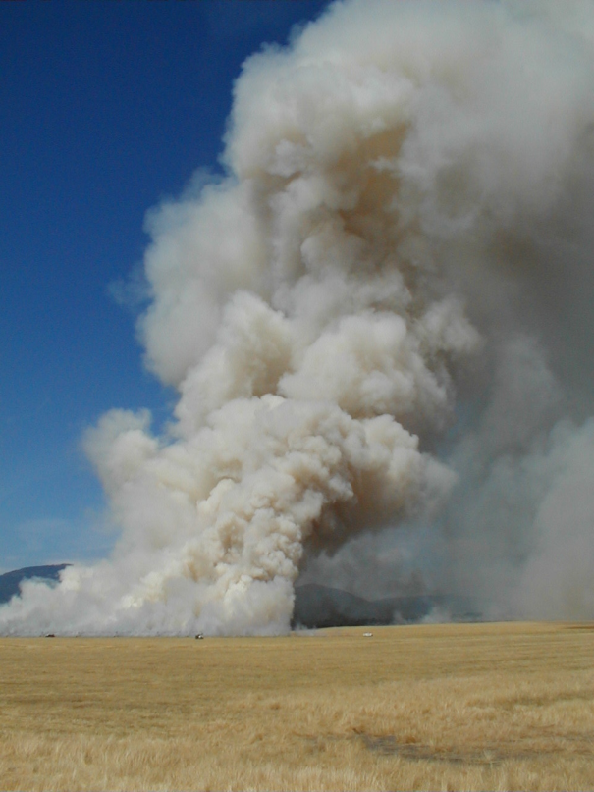
Program Design

Slide 9
DEQ CRB Staff
Smoke Analysts – 2
North Idaho – Lewiston Regional Office
South Idaho – State Office in Boise
Make burn decision
Seasonal Field Staff – 9
North Idaho – 3
South Idaho – 6
Issues burn approvals, contact growers, observe and document burns, and outreach
Regional Office Staff
Ambient monitoring
Supervision
Burn decisions

Slide 10
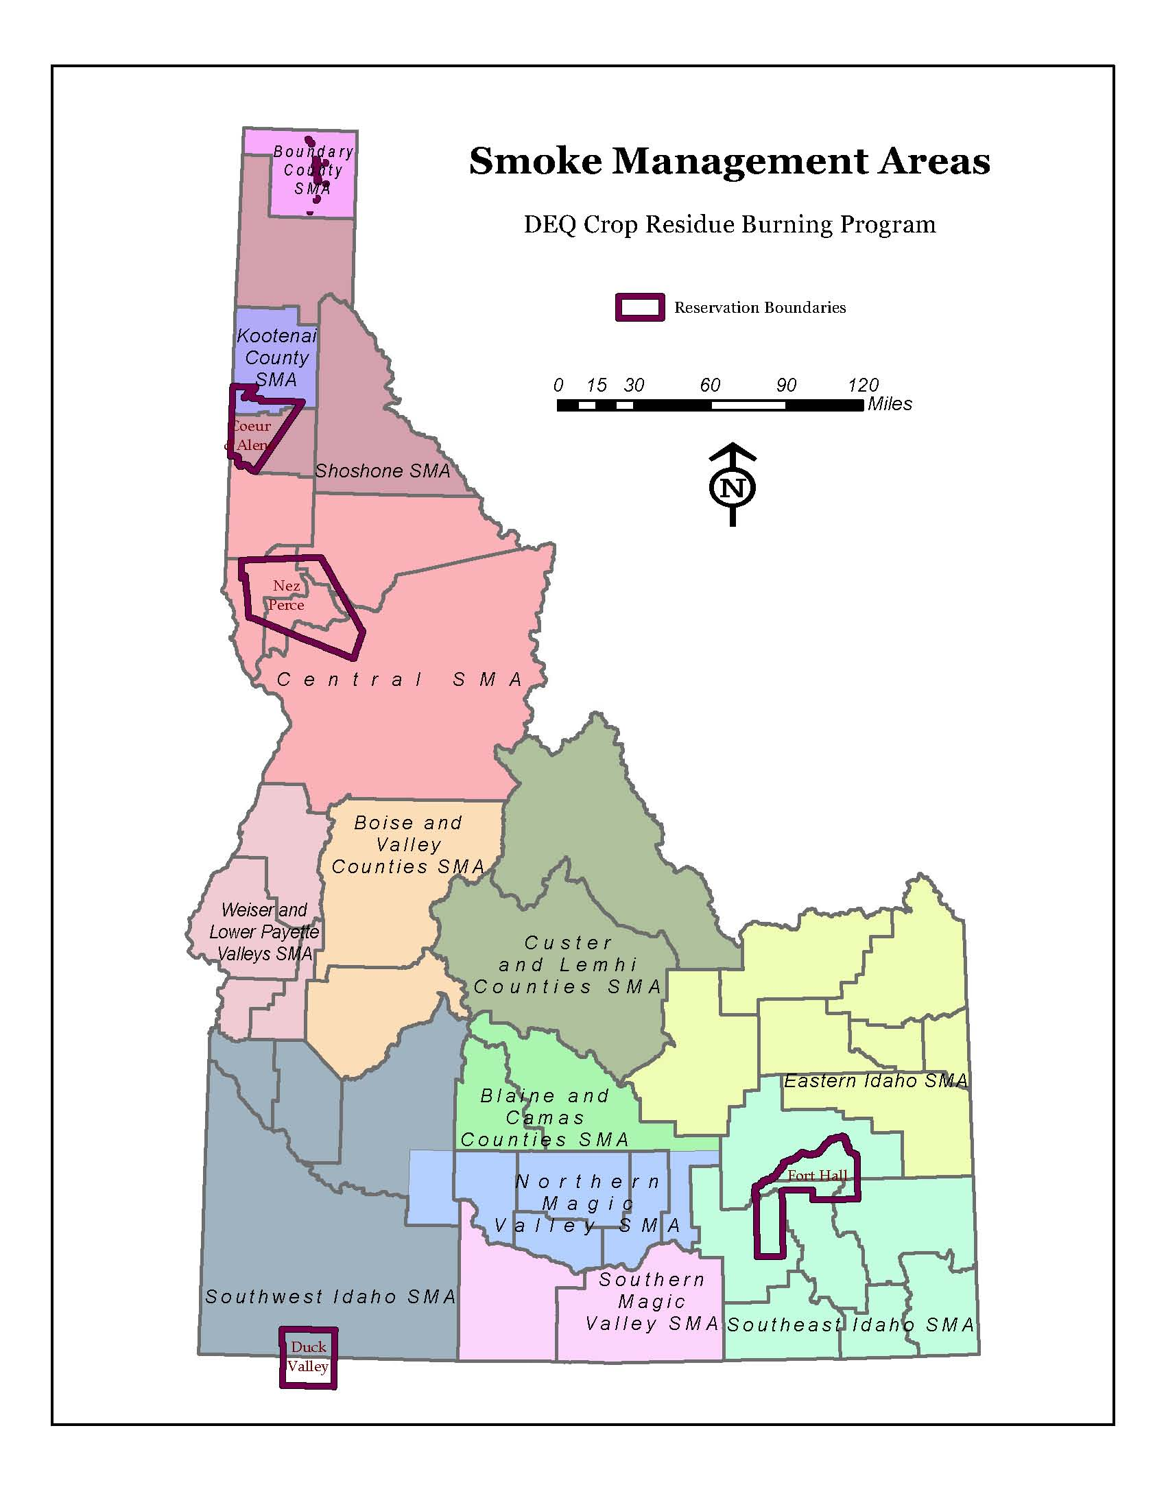
Notes:
13 BMAs, only 10 had registered fields

Slide 11
Burn Approval Criteria (DEQ’s requirements for approving burn)
Expected emissions from all burns that day
Moisture content of crop residue
Acreage, crop type, and fuel characteristics
Meteorological Conditions
Proximity to:
Institutions with sensitive populations
Other burns
Public roadways
Airports
Other relevant factors
Notes:
All burns includes other types of burns
prescribed
wildfire

Slide 12
Weather Parameters
Ventilation index
Cloud cover
Surface wind speed and direction
Transport wind speed and direction
Mixing height
Relative humidity
Inversion conditions

Slide 13
Notification of Approval (Grower’s requirements for burn)
Burn location
Burn window
Conditions for burns near institutions with sensitive populations
No burn if field is within 3 miles of such institution, sustained wind speed <12 mph
Specific wind direction if required
Protection of public roadways
Requirement to withhold fuel if air quality reaches program concentration limits

Slide 14
