Slide 1
Meeting objectives and Introductions

Slide 2
Objectives
Bring Burners, Regulators and Interested Parties Together
Further Communication, Cooperation, and Collaboration
Break Down Real and Imagined Barriers
Share Information, Insight and Tools
Share and Build on the Executive Team’s Mission and Vision
Protect Public Health
Protect the Use of Fire As a Tool
Meet Land Management Objectives
Boldly Go Where No One Has Gone Before

Slide 3

Another Burn Call Decision

Slide 4
Taking the next steps
Smoke management in the northwest

Slide 5
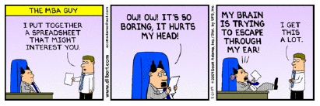
Notes:
Try not to make this painful

Slide 6
2011 Recommendation topics
How do we….
Share the airshed?
Educate each other?
Communicate our mission and vision?
Improve trust among each other?
Improve compliance?

Slide 7
2011 Recommendation topics
(cont.)
What could the Executive Team do to help?
What tools and information are needed to make “go/no go” decision?
How do you and your agency ensure that the tribal authorities and rules under the CAA/FARR are considered?

Slide 8
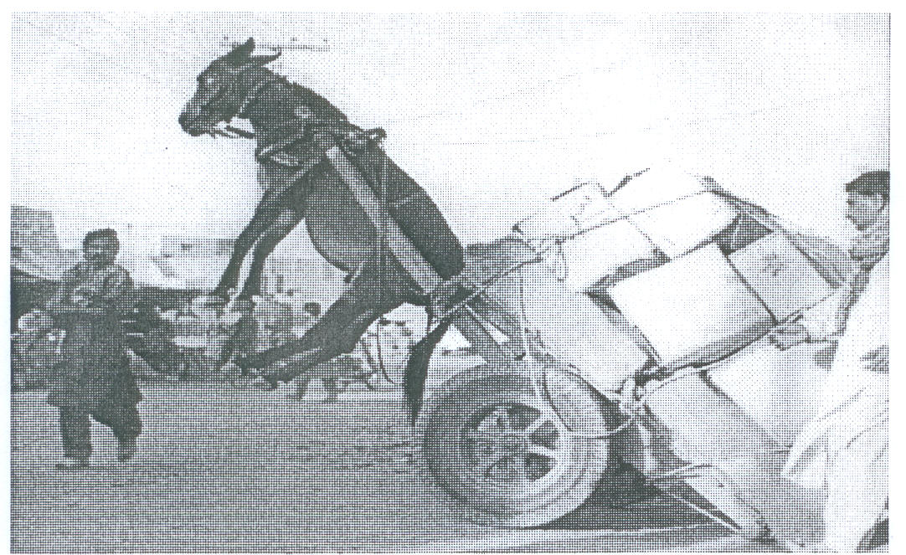
Taking the
Next Steps –
Following up
on our
2011 work
Is there a better way?

Slide 9
4 Focus Topics - 2012
Sharing the Airshed
Education
Improving Trust
Tribal Authorities and Rule Considerations

Slide 10
Steps - Today
Decide which topic most interesting to you.
Sign up for topic (see flipchart). Max. 9
Small group discussion Friday to follow-up.
Friday – groups will discuss recommendations and preliminary next steps in 2012/2013.

Slide 11
Questions?

Slide 12
Taking the next steps
Smoke management in the northwest

Slide 13
Steps - Today
Form workgroups.
Each workgroup has a leader.
Review 2011 recommendations.
Are there additional recommendations?
What are some preliminary steps to take action on some of these recommendations?
      SMART targets
      Action steps

Slide 14

SMART Targets
Specific
Measurable
Attainable
Relevant
Timebound
2012-2013

Slide 15

Preliminary action Steps - Write it down!
What to do to reach the target?
Who will do it?
When to do it by?
What resources or level of effort are needed?

Slide 16

An Action Plan is the Vehicle to Reach Your Objectives and Targets
We’ll make it
by APRIL
2013
Develop
SOP by
Oct. 2012
TARGET
When will
we get
there?
SOPs
Comm
Info
Resources
Plan

