Slide 1
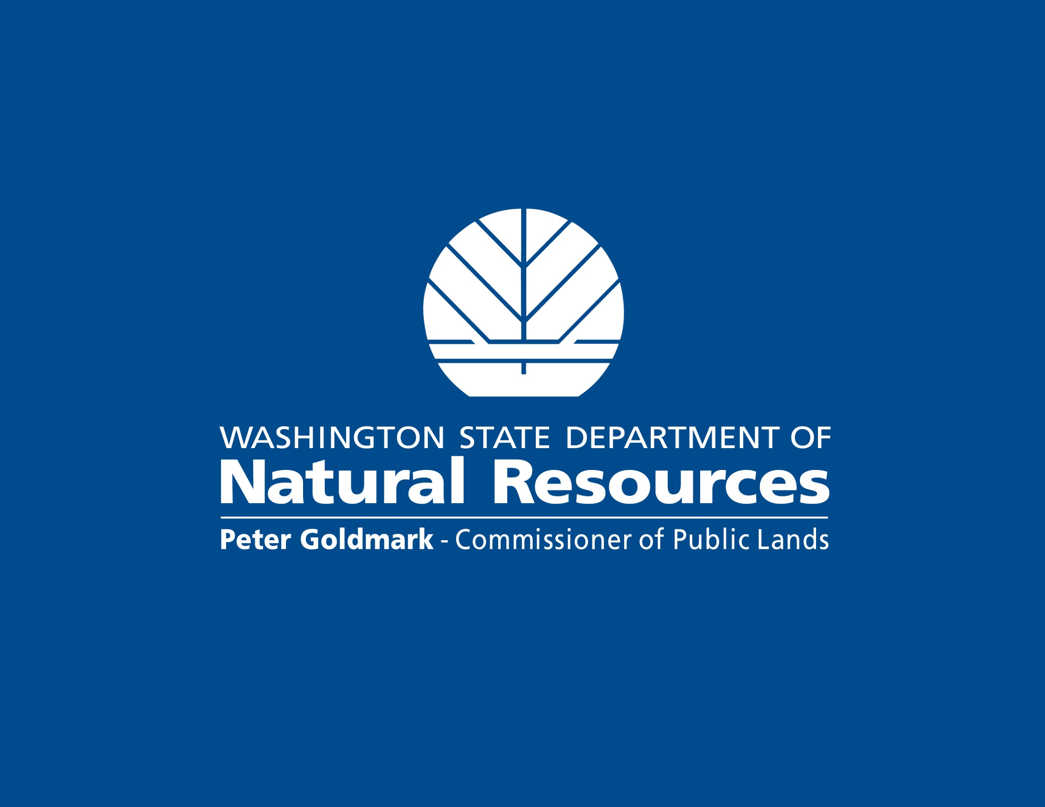

Slide 2
Mark Gray, Assistant Division Manager, Resource Protection Division April 19, 2012
Washington DNR Regulating Prescribed Burning

Slide 3
DNR’s regulatory responsibilities
Smoke management
Fire prevention
Scope of the burning regulation program
Burning permits and liability

Slide 4
Our Smoke Management Responsibility
Assure that burning is in compliance with the Washington Clean Air Act. [RCW 76.04.205].
Regulate burning permits to protect life, property and/or for the public health, safety, and welfare. [RCW 70.94.6534].
Administer a program to reduce statewide emissions from silvicultural forest burning. [RCW 70.94.6536].

Slide 5
Our Smoke Management Responsibility
Smoke Management Plan since 1970
SMP mandatory since 1991
SMP is part of the state air quality implementation plan

Slide 6
Our Fire Prevention Responsibility
Require permits for most fires on DNR protected land. DNR may issue a burning permit if:
All requirements relating to firefighting equipment, the work to be done, and precautions to be taken before commencing the burning have been met;
No unreasonable danger will result;
DNR may refuse, revoke, or postpone permits when necessary for the safety of adjacent property or when necessary in their judgment to prevent air pollution.

Slide 7
Our Fire Prevention Responsibility
Any fire on or threatening any forest land burning uncontrolled and without proper action being taken to prevent its spread, notwithstanding the origin of the fire, is a public nuisance by reason of its menace to life and property.

Slide 8
What Our Program Covers
Permitting and regulating burning on land protected by DNR. [RCW 76.04.205].
Assure that the federal government participates in the smoke management plan. [RCW 70.94.6536].

Slide 9
What Our Program Does Not Cover
Permitting and regulating outdoor burning on lands where the DNR does not have fire protection responsibility. [RCW 70.94.6534].

Slide 10
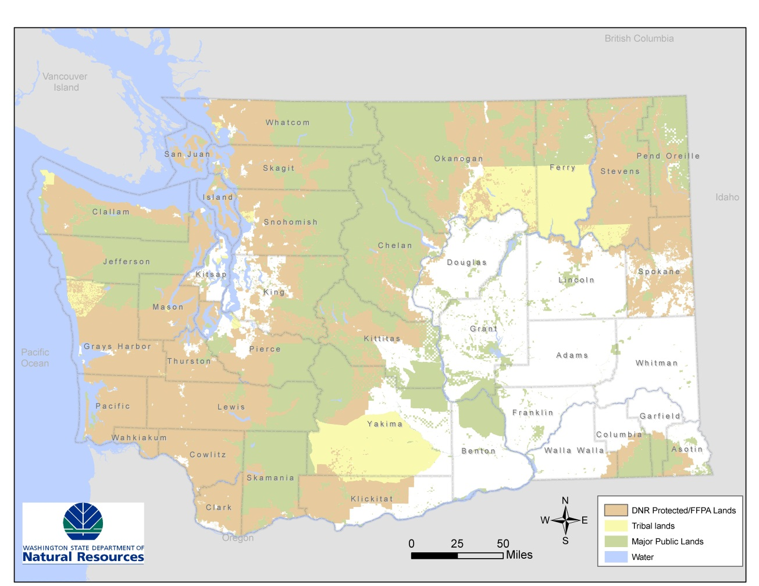
Geographic Extent - Forest Land Statewide

Slide 11
Permitting
Permit all burning on forest land.
Written permits for all burns >10’ in diameter.
Permit “by rule” burns <10’ in diameter.
Issue smoke management approval for all burning on federal forest land.

Slide 12
Decision Making
All burns over 100 tons of fuel are approved by the smoke management specialist in Olympia.
Decisions regarding permitting and regulating burning are made by the
DNR Regional Manager, or
Federal Agency Administrator on federal land.

Slide 13
Indian Country
DNR has no authority to regulate burning on tribal land.
We presume DNR has authority to regulate burning on non-Indian owned forest land within reservations

Slide 14
Federal Land
DNR not authorized to permit or regulate burning on federal land, but
Federal agencies must particpate in the smoke management plan.

Slide 15
Burning Regulation and Liability
Landowner Contingency Account
All forest landowners pay into the account.
If a landowner operation causes a fire
Then the Account pays for suppression
If not negligent, and
After a deductible
If your prescribed fire escapes, all landowners pay.

