Slide 1
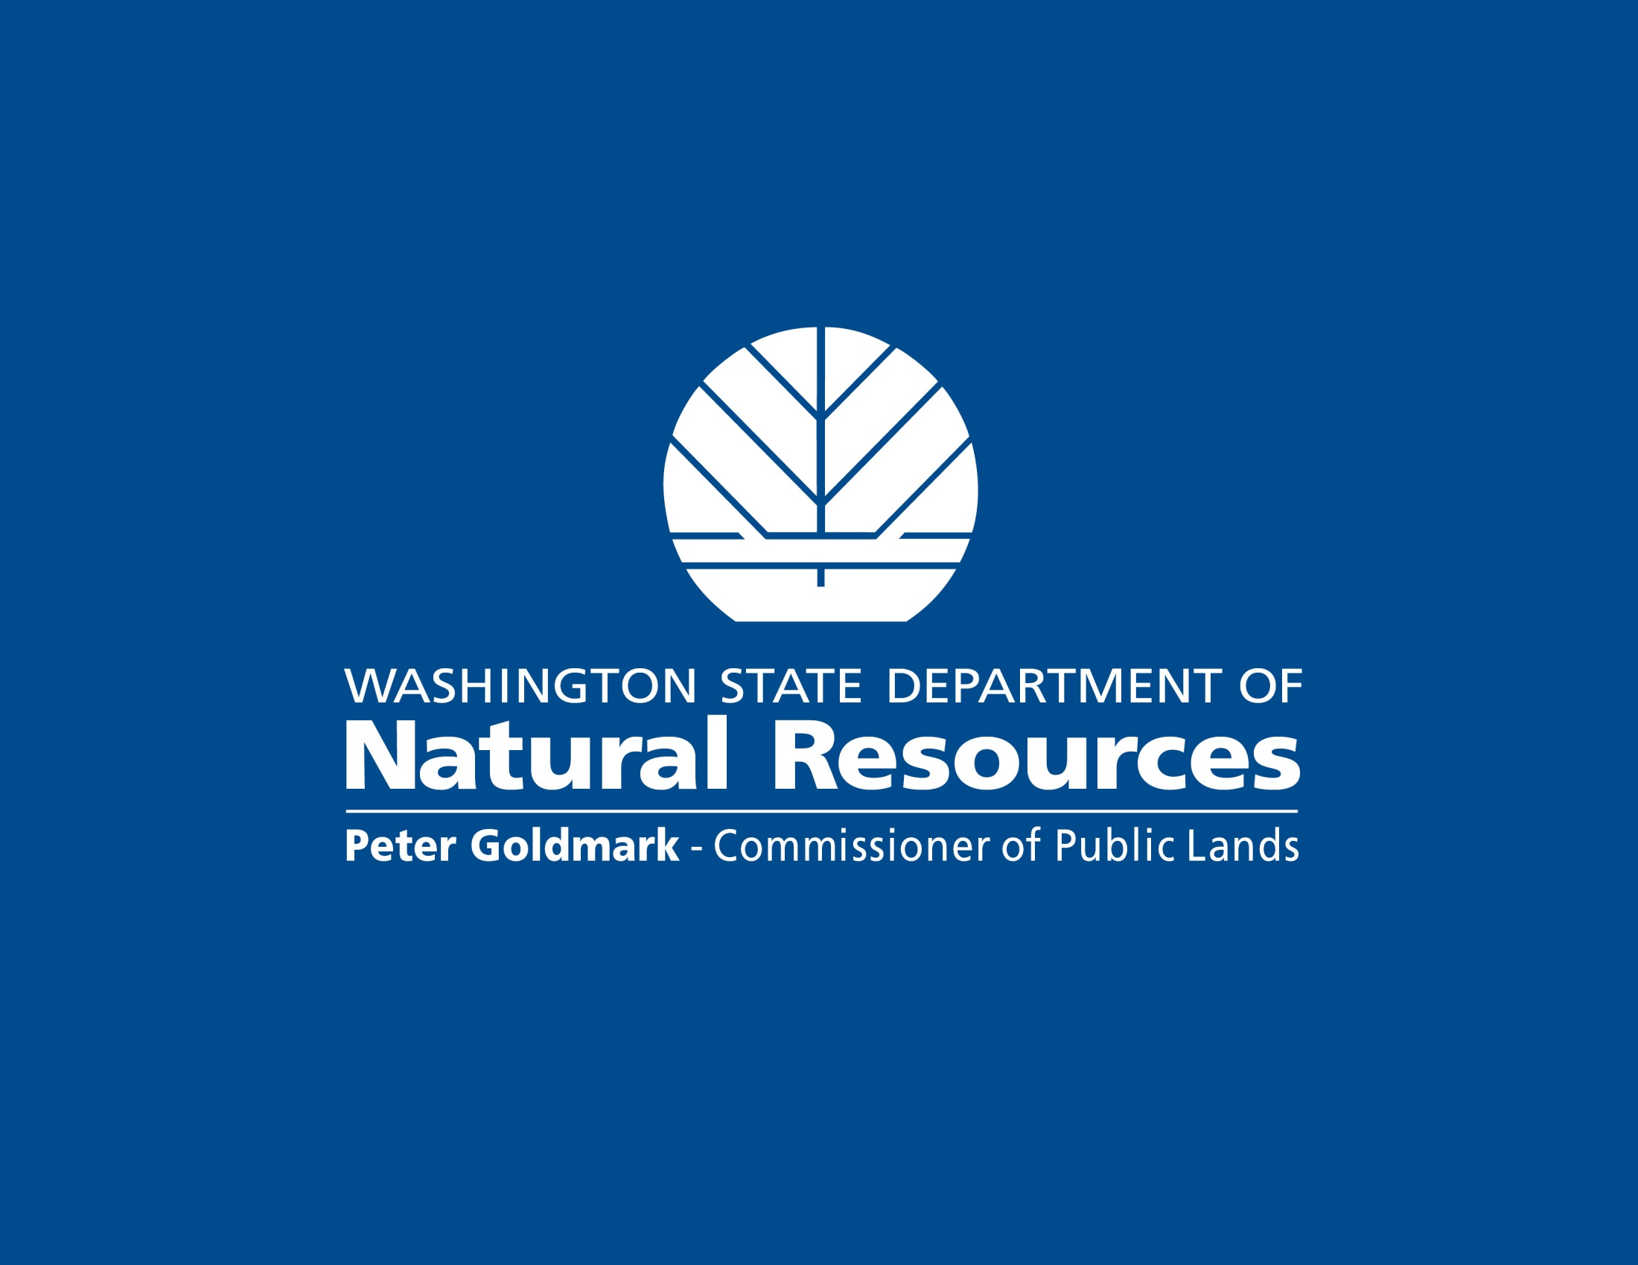

Slide 2
Mark Gray, Assistant Division Manager, Resource Protection Division
April 19, 2012
Washington Biomass Study

Slide 3
Purpose
Seek sustainable uses for the supply of woody biomass from Washington forests.
Encourage the emerging green economy and help address climate change.
Provide income for forest landowners while improving forest health, creating rural jobs, and reducing wildfire risk.

Slide 4
Key Finding
Market use of biomass could more than double without any impacts to forest sustainability

Slide 5
Methodology
The study determined the total volume of forest biomass produced by logging operations in the state.
This amount was then reduced by:
  The volume that would not be brought to the roadside due to operational factors and would remain on the site, contributing to ecological functions.
  The volume that, due to unfavorable site and road conditions, would not be collected.
  The volume that would remain in slash piles and landings due to lack of demand for the product currently.

Slide 6
What the Report Says

Slide 7
More Information
Washington State Forest Biomass Supply Assessment
http://www.dnr.wa.gov/Publications/em_finalreport_wash_forest_biomass_supply_assess.pdf
Supply Assessment Fact Sheet:
http://www.dnr.wa.gov/Publications/em_fs12_004_1_biomass.pdf
Supply Assessment Executive Summary:
http://www.dnr.wa.gov/Publications/em_executive_summary.pdf
Forest Practices Biomass Work-group:
http://www.dnr.wa.gov/ResearchScience/Topics/OtherConservationInformation/Pages/em_forest_practices_biomass_work_group.aspx
Pilot Projects:
http://www.dnr.wa.gov/ResearchScience/Topics/OtherConservationInformation/Pages/em_forest_biomass_initiative.aspx

