Slide 1
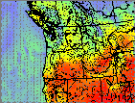
Modeling Tools for Smoke Management
Robert Elleman EPA Region 10
Andrea Boyer Nez Perce Tribe
Rick Hardy Idaho DEQ

Slide 2
Modeling Tools for Smoke Management
Robert Elleman EPA Region 10
Andrea Boyer Nez Perce Tribe
Rick Hardy Idaho DEQ

Slide 3
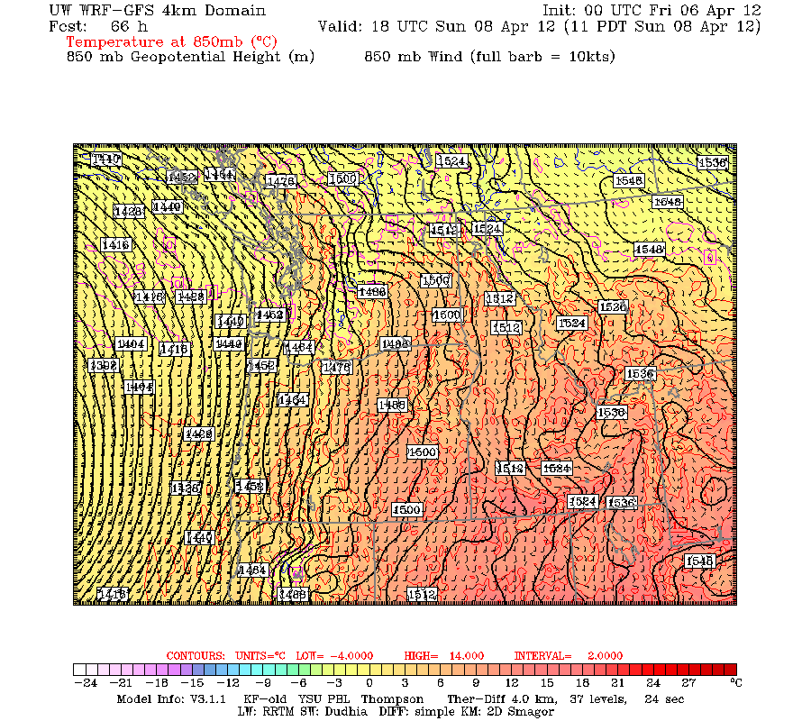
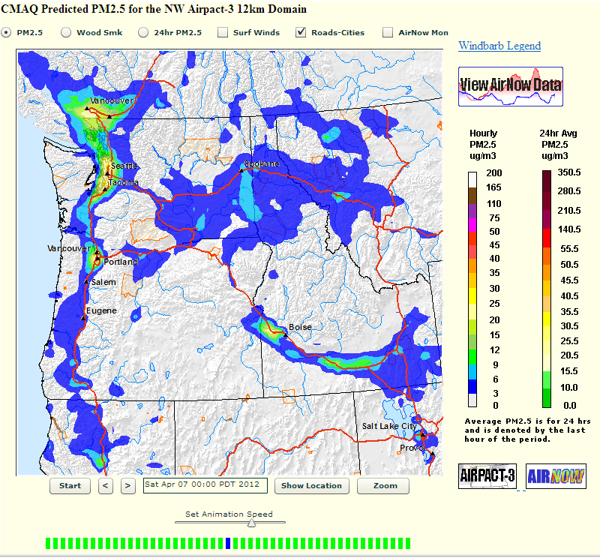
Which Modeling Tools
Meteorological model by University of Washington
Air quality model by Washington State University
Partly funded by the PNW (WA/OR/ID) states, tribes, and EPA through Clean Air Act 105, etc.
Notes:
Not BlueSky and other tools funded by FLMs, though we give passing reference

Slide 4
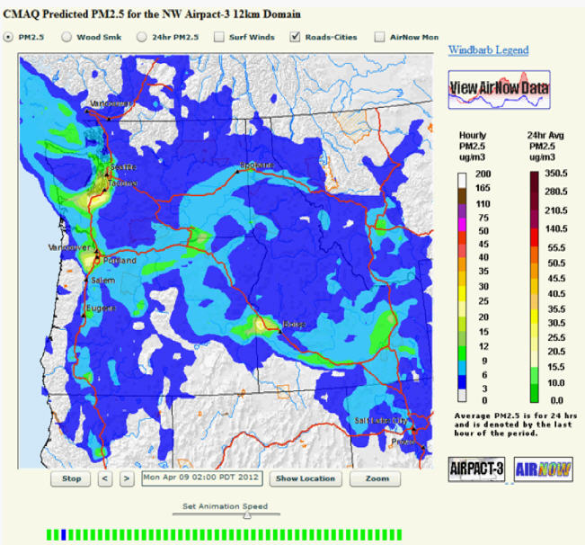
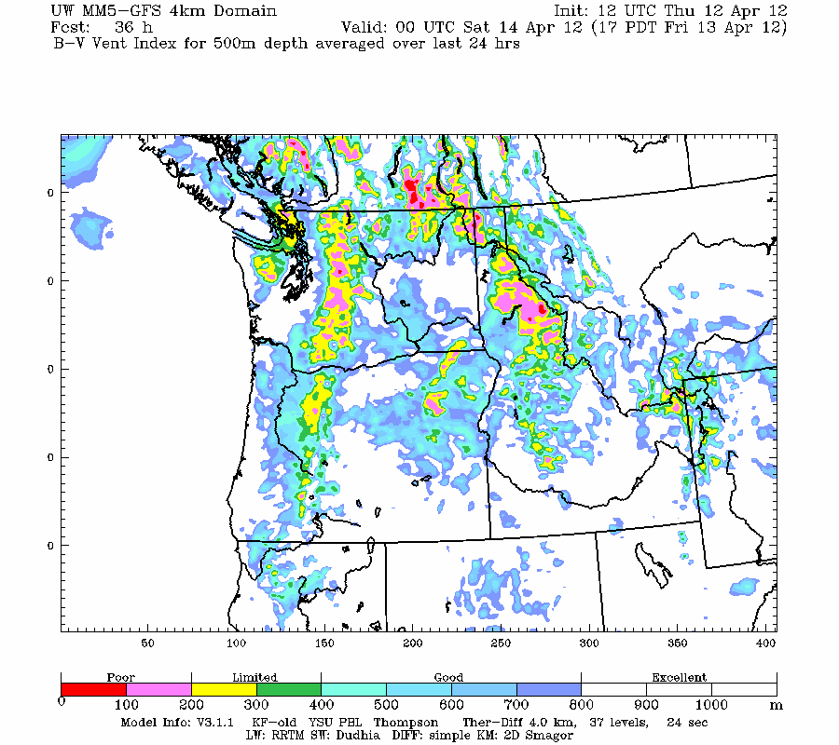
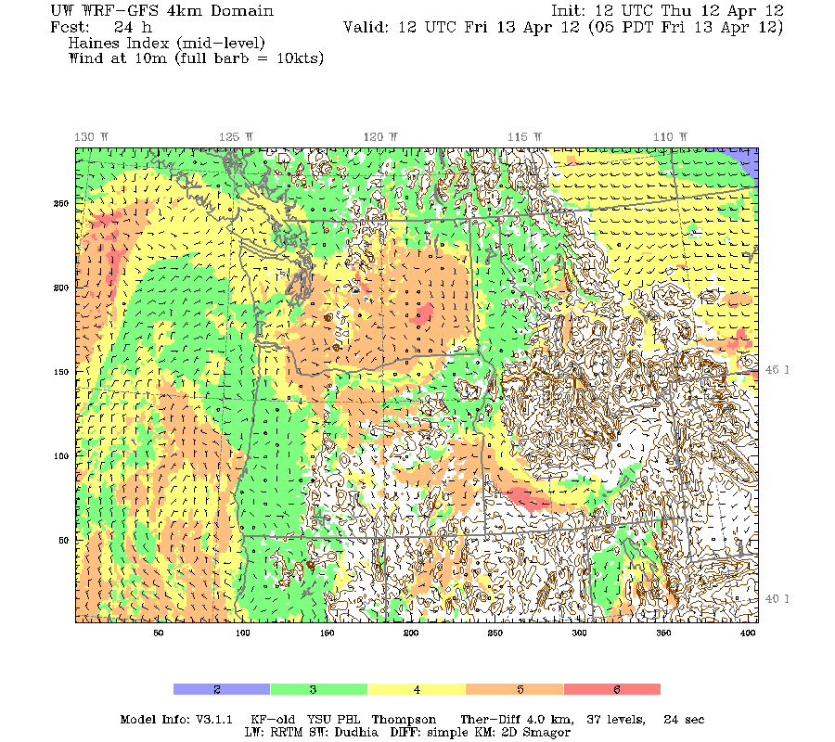
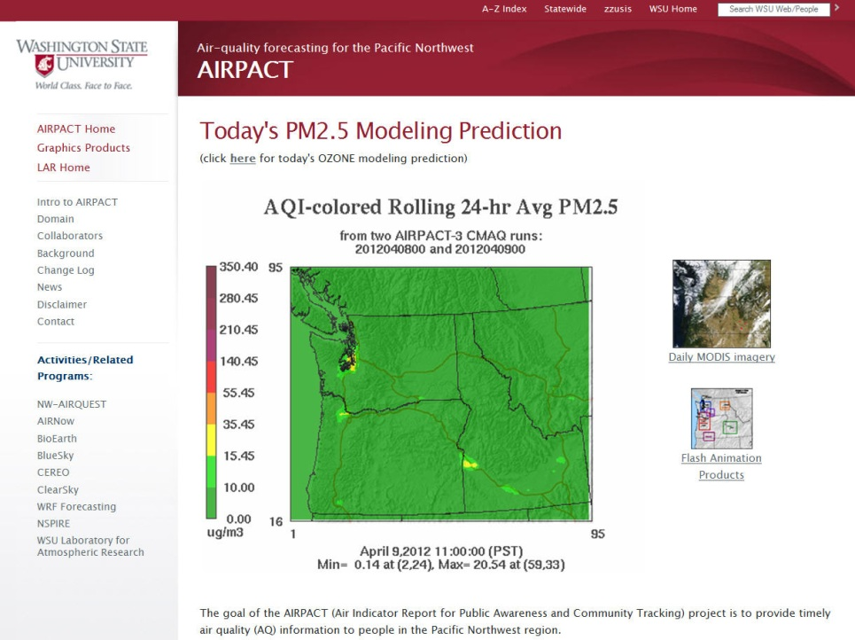
Northwest Regional Modeling Consortium
NW-AIRQUEST
Meteorological Modeling
Mostly related to air quality
Fund UW WRF model
Diverse membership
State/Local/Tribal AQ agencies and EPA
Other smoke managers: USFS-Airfire, WA DNR
National Weather Service-Seattle, Seattle Public Utilities, Washington DOT
UW, WSU
Air Quality Science
Fund Airpact and ClearSky at WSU
Receptor modeling
Other technical needs
Membership
All AQ-related
Sustaining members are State/Local/Nez Perce and EPA
Notes:
Could note recent participation by Iberdrola and anticipated participation by King 5 TV in Seattle.
Could also note budget issues and need to for all users to become contributing members. We are constantly trying to find the right balance in terms of funding model, flexibility, accountability, etc. It is a constant battle, but that is what keeps us evolving and finding new applications for the products.
NRMC has sustaining members and associate members. The associate members are Environment Canada, Pacific and Yukon Region, BC Ministry of Environment, and National Park Service.
NW-AIRQUEST is an air quality consortium. Much of the work is focused around WSU’s modeling, but we also have activities that are collaborations among agencies. NW-Airquest collaborative members are:
International
Environment Canada BC Ministry of Environment Metro Vancouver
Federal
USDA Forest Service, Region 6
USDA Forest Service, Pacific Northwest Research Station National Park Service, Pacific West Region
State
Washington Department of Natural Resources

Slide 5
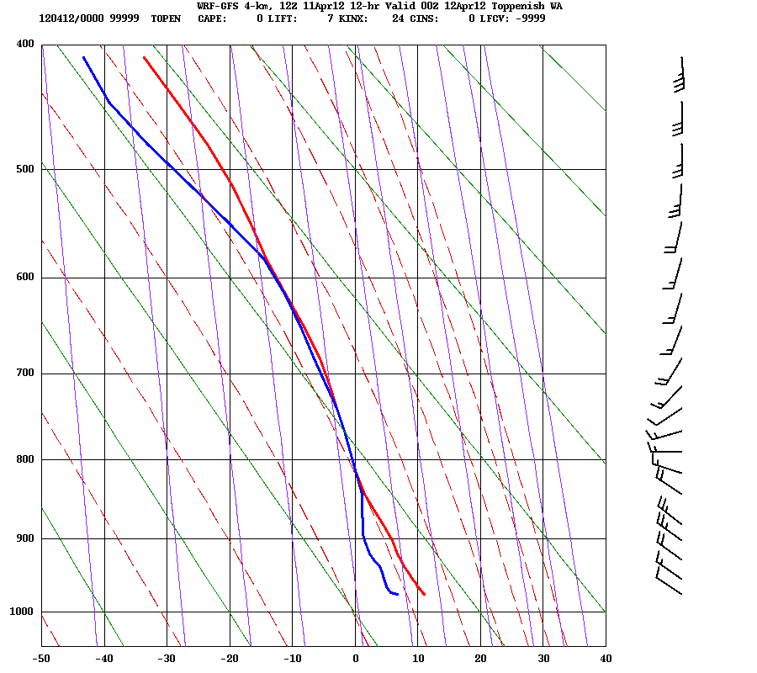
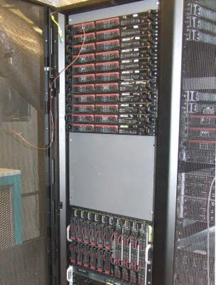
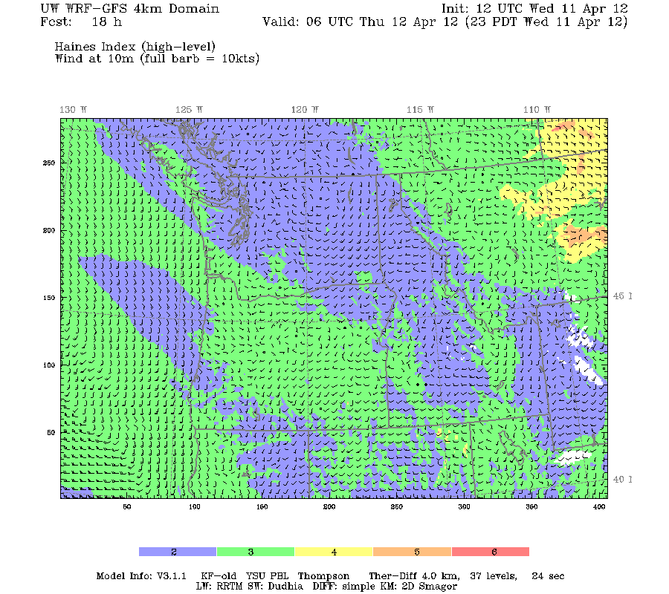
Meteorological Modeling
WRF
Computer Model
Outputs
Inputs
Global Weather Forecast Model
Regional Inputs:
Sea surface temperature
Snow cover
High resolution topo and land use
Land temperature
Notes:
Model is run by Cliff Mass at the University of Washington and his team of 3-5 scientists. The group has been doing this for 20 years and are national experts on regional weather modeling and its application to government/corporate needs. The system is constantly evolving and improving, staying at the forefront of the science. A recent example is the addition of a 1.3km domain, made possible by advances in computer processors, memory, and hard drives.
The outputs have been designed by NRMC (“Consortium”) members. More on that in a minute.

Slide 6
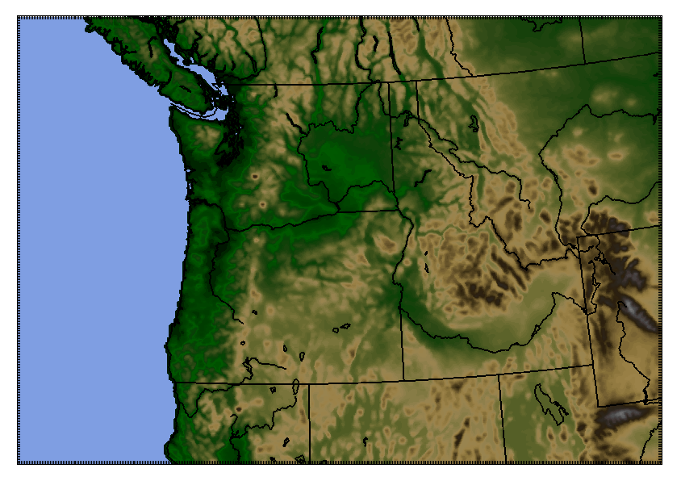
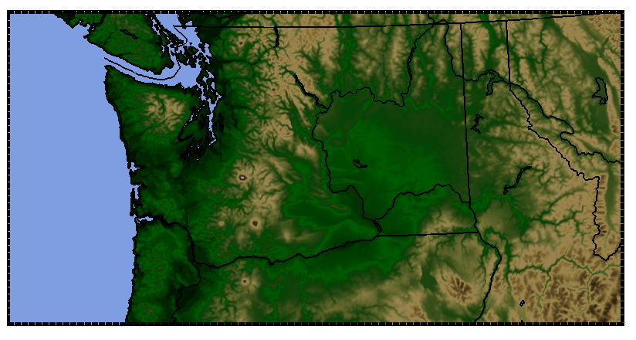
WRF Model Domains
36 km and 12 km domains set up the finer-scale ones of more interest
4 km Domain
1.3 km Domain
Notes:
Effective resolution is about 4x the resolution, so ~15km for the 4 km domain and ~6 km for the 1.3 km domain. Notice that the Puget Sound does not really show up until the 1.3km domain. Which one do you think has a better representation of the sea breeze? Same goes for mountain and valley flow.
The 1.3 km domain was initially just the Puget Sound region for testing purposes. It was expanded to include the state of Washington because WA Ecology is a major supporter of the weather modeling consortium. Idaho DEQ and Nez Perce (and the EPA tribal program) paid for the domain to be extended eastward specifically for smoke management purposes. Iberdrola Renewables paid for an extension southward from Mount Hood previously to Salem currently. Though Iberdrola is no longer a member.

Slide 7
1.3 km domain
Notes:
Blowing up the 1.3 km domain gives you a better feel for the topographical features it can and cannot pick up.

Slide 8
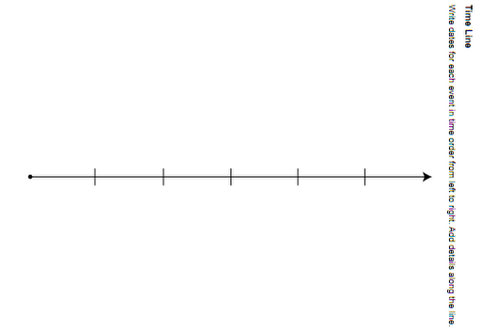
How Many Days of Forecast
Each model produces a forecast for the next:
36/12/4km forecasts the next 3.5 days
Extended 36/12 km model adds on another 4 days for a total of 7.5 days
1.3 km forecasts the next 2 days
4AM model (12Z) finishes mid-morning (36/12/4km) and mid-afternoon (1.3km)
hours 0-84
36/12/4 km
hours 85-180
Extended 36/12 km
hours 0-48
1.3 km
Notes:
The 36/12/4 km domains forecast 84 hours (3.5 days). Since they finish around 9 AM/PM, or 5 hours into their forecast, there are more like 79 hours that are true forecasts. Once the three domains finish, the 36/12 km domains continue on to quickly add on another four days of forecast. For the 1.3 km domain, it finishes at 2:30 AM/PM, resulting in about 37 hours of true forecast that hasn’t happened yet.

Slide 9
WRF Uses and Limitations
Uses
Limitations
(the biggest ones)
PM and ozone alerts and curtailments
Smoke dispersion forecast
Meteorological dataset for airshed planning and air permitting
Air terminal forecasts
Snow/windstorm/icestorm/fog/rain/flood forecasts by weather community
Weather community has typically overlooked performance during high-pressure ridges
Our most important weather pattern for AQ
Often needs bias correction as a result
Deterministic run that does not take advantage of what we know about the model uncertainty

Slide 10
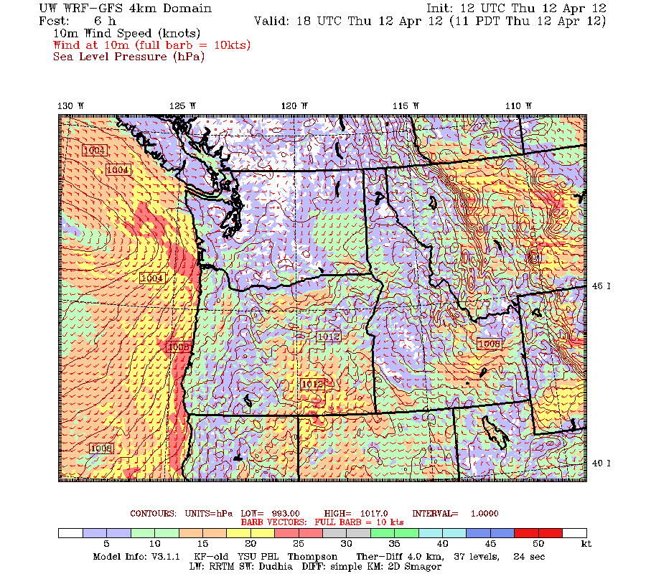
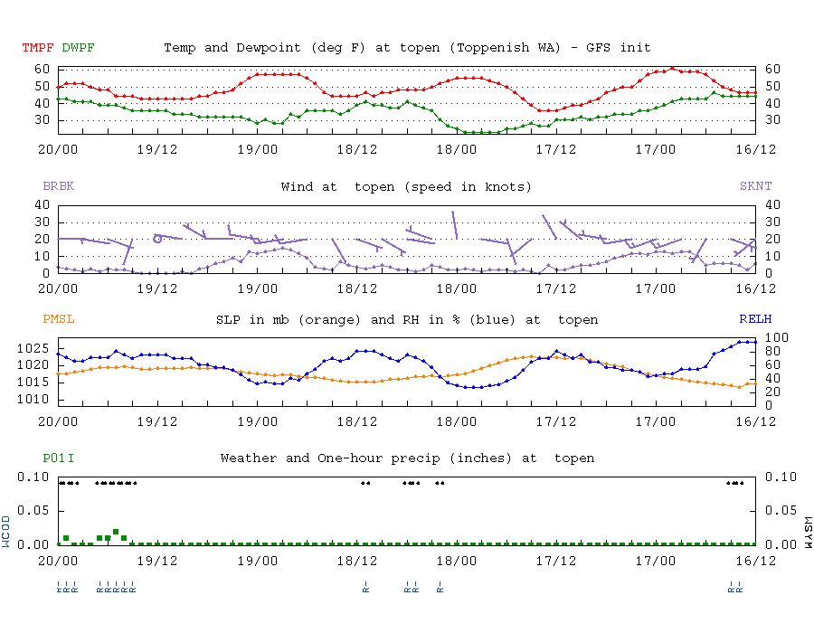
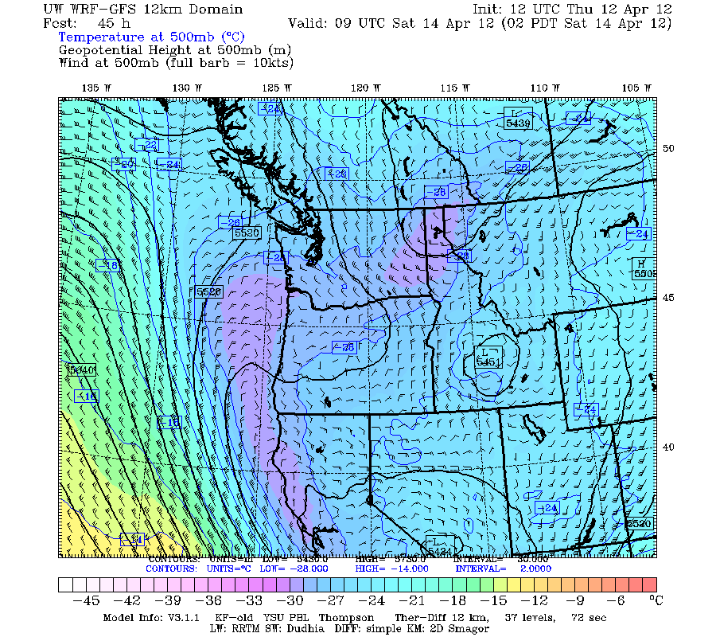
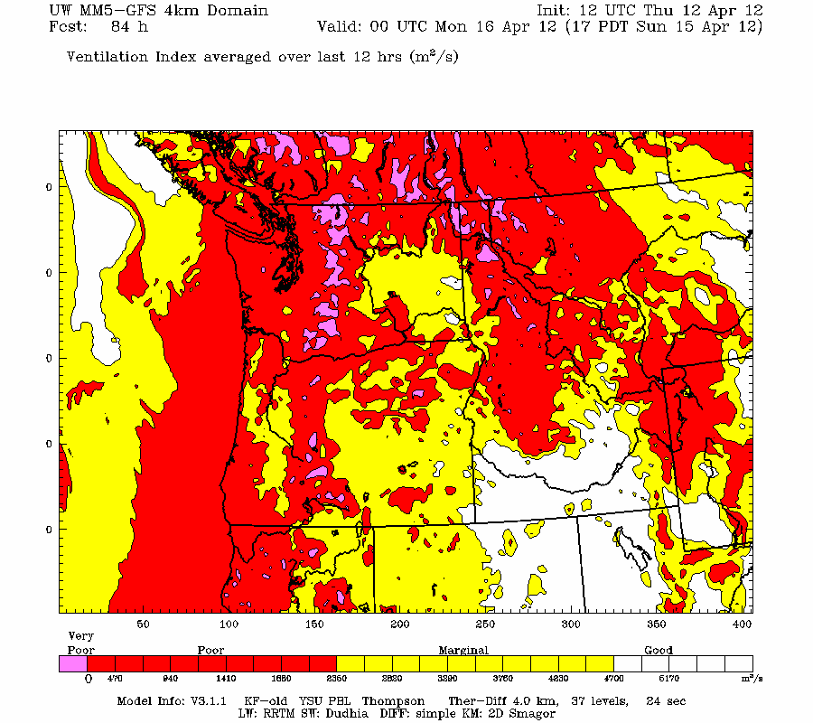
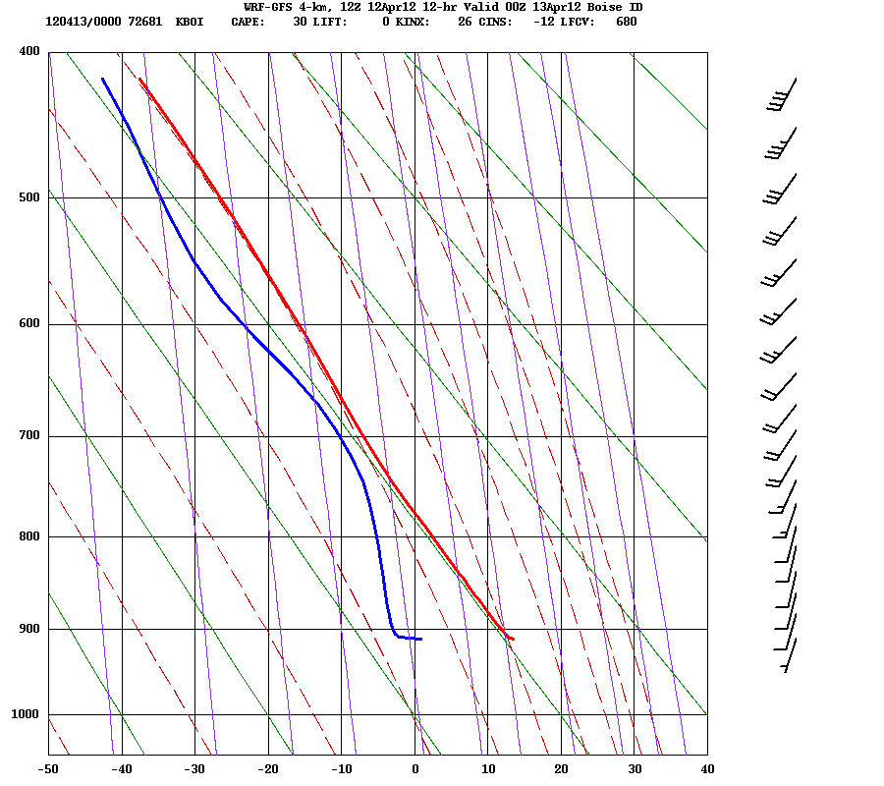
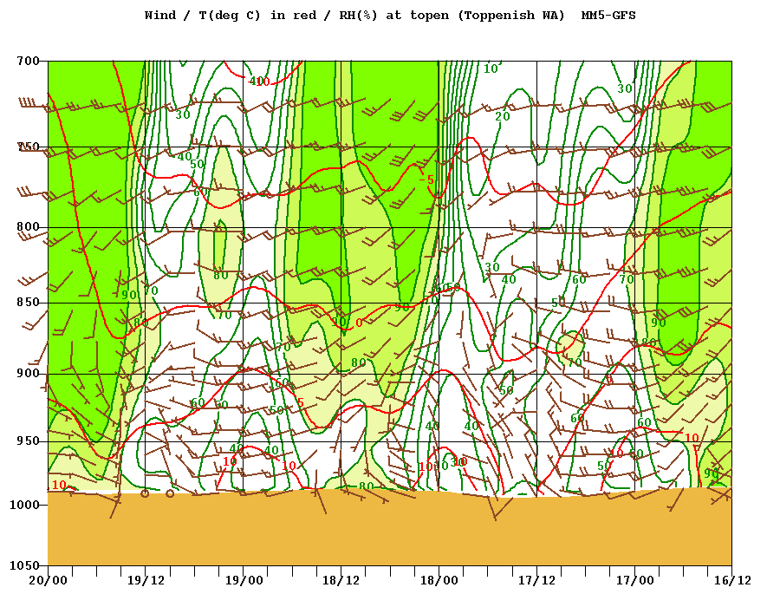
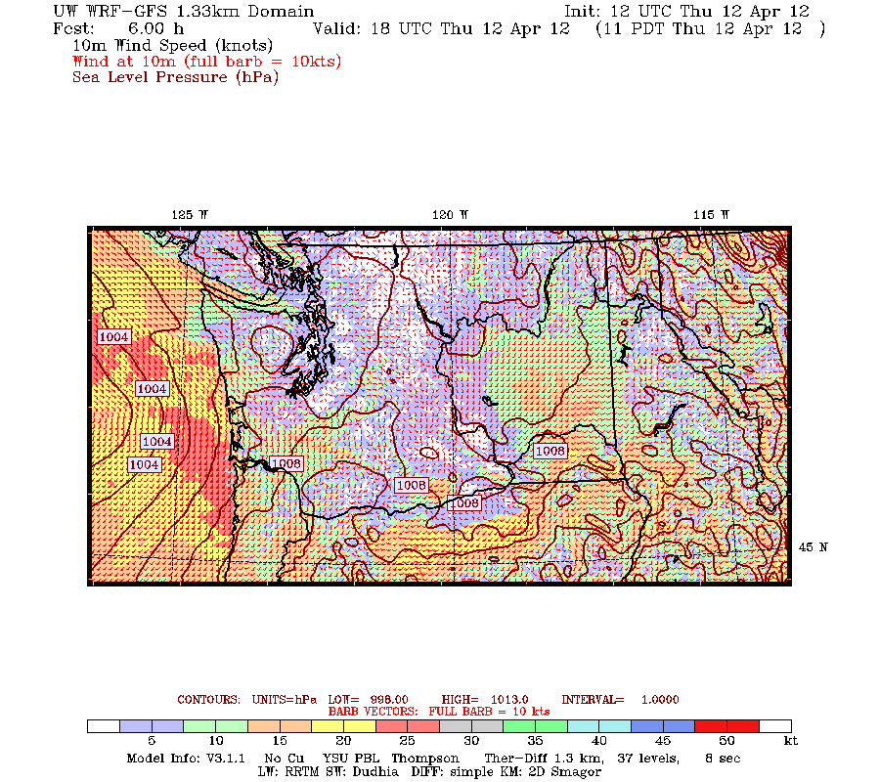
WRF products
http://www.atmos.uw.edu/mm5rt/
Standard weather products
500 mb, fronts, winds, precip
Air quality products
Ventilation index
Haines index
More detailed products
Soundings
Meteograms
Time-height cross sections
All at 4 resolutions
36/12/4/1.3 km
Notes:
Can geek out with 500 mb heights, precipitation, etc. if you want.

Slide 11
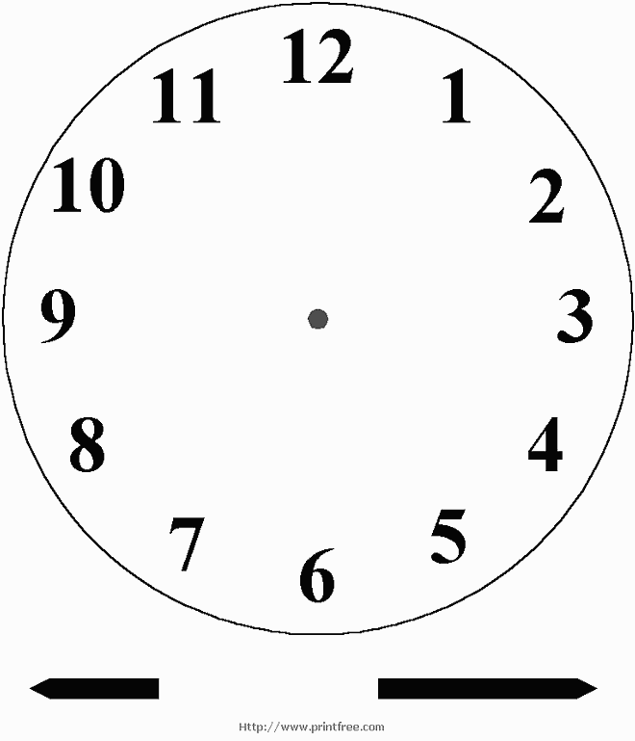
WRF Daily Timing
WRF is run twice a day based on 0Z and 12Z global forecast model
Results for 4PM into the future for the 0Z run
Results for 4AM into the future for the 12Z run
Extended 36/12 km
complete
4 km complete
1.3 km complete
PST
36/12 km complete
Global Model Results Arrive at UW
Notes:
The global model starts at 4 AM/PM but takes a few hours to run and transmit to UW. Once UW gets the global model at around 7:30 AM/PM, they run the WRF regional model. The 36/12 km model is done by 9AM, the 4km is done soon after. The 1.3 km domain takes considerably longer because it needs to wait until the 4 km is done before it starts and because it is resource-intensive. If you need to look at the 1.3 km model between 8AM and 2PM, your best bet is to look at the run from the afternoon before, which would have completed by 2:30 AM.

Slide 12
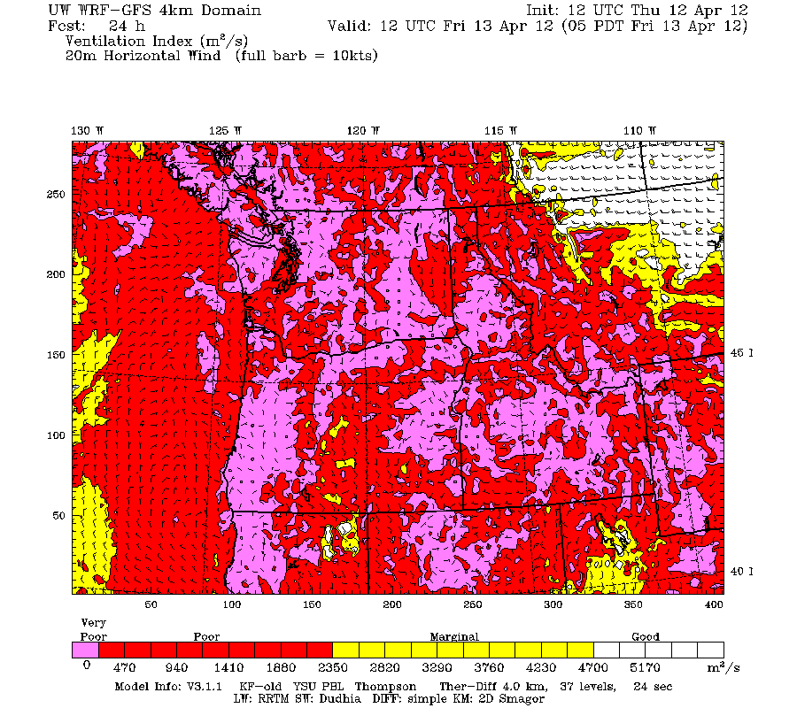
Ventilation Index Example
http://www.atmos.uw.edu/~ovens/loops/wxloop.cgi?mm5d3_vent+///3
Notes:
4 km ventilation index. Can get this for every three forecast hours. This is actually a loop on the website:

Slide 13
B-V Ventilation Index, 24 hr average
http://www.atmos.uw.edu/~ovens/loops/wxloop.cgi?mm5d3_ventbv24+///3
Notes:
Ventilation Index and “B-V” ventilation index are not that different. Plus, there are two options for the B-V index. My advice is to choose one and get comfortable with it. If you need a suggestion on which to choose, start with the 24-hour averaged BV index (500 m depth). Over a short period of time you will get a mental calibration for what the colors mean for your airshed and application.

Slide 14
Haines Index
http://www.atmos.uw.edu/~ovens/loops/wxloop.cgi?mm5d3_hainm+///3

Slide 15
Modeling Tools for Smoke Management
Robert Elleman EPA Region 10
Andrea Boyer Nez Perce Tribe
Rick Hardy Idaho DEQ

Slide 16
WRF Products Useful in a Burn Forecast http://www.atmos.washington.edu/mm5rt/
Ventilation Index
Planetary Boundary Layer
850 mb Temp, Winds, Heights
Precipitation
Soundings
Haines Index

Slide 17
Ventilation Index Example
Notes:
4 km ventilation index. Can get this for every three forecast hours. This is actually a loop on the website:
The ventilation index is the product of the models output of the PBL height and the 20m wind speed. Forecasters use these values to determine the potential of the atmosphere to disperse contaminants such as smoke.
Low ventilation values (below ~2400 m/s) usually indicate that stagnant conditions are expected.
When forecasting must look at both current and projected values.

Slide 18
B-V Ventilation Index, 24 hr average
Notes:
B-V Ventilation Index uses the Brunt-Vaisala Frequency (rather than the PBL output) to determine stability within the PBL and to calculate the index. Both versions use the 20m winds.
Ventilation Index and “B-V” ventilation index are not that different. Plus, there are two options for the B-V index. My advice is to choose one and get comfortable with it. If you need a suggestion on which to choose, start with the 24-hour averaged BV index (500 m depth). Over a short period of time you will get a mental calibration for what the colors mean for your airshed and application.

Slide 19
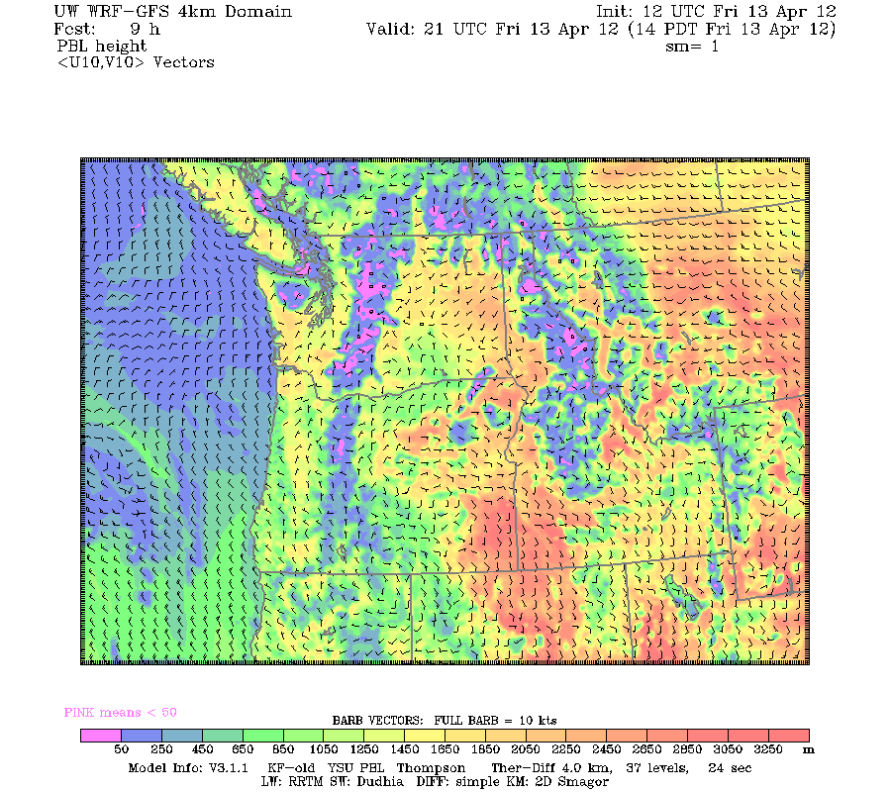
Planetary Boundary Layer (PBL)
Notes:
Model calculated height in meters.
The PBL shows the depth of potential mixing for the lowest part of the atmosphere. Forecasters can get an idea of regions under the influence of inversions as inversions squeeze the height of the PBL.

Slide 20
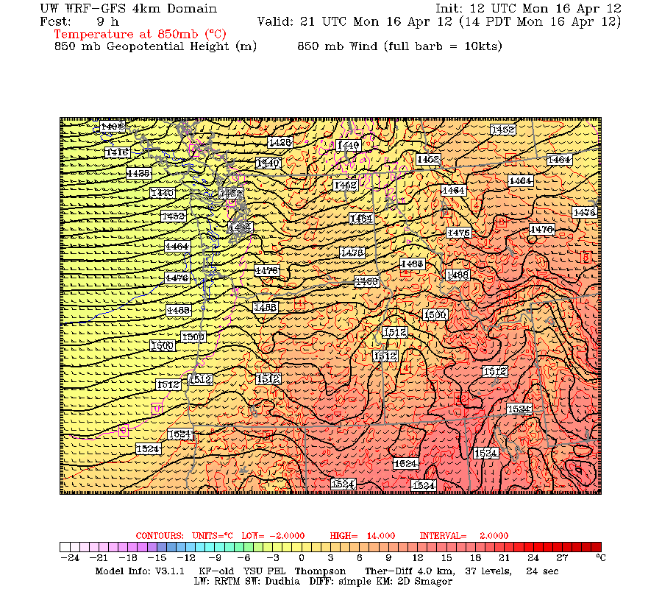
850 mb Temp, winds, heights
Notes:
Solid black lines are isohypses, or lines that connect regions that are the same distance from sea level to the pressure surface that is being examined. Line labeled 1550 = 850 mb pressure surface at that point resides 1550 meters above sea level.
Background color represents the air T at 850 mb in Celsius. The scale separates regions of different temperature every 4 degrees.
The wind barbs represent the strength and direction of the wind at the 850 mb atmospheric pressure level.
Depicts the horizontal transport of warm and cold air masses. Gives forecasters a good idea of the conditions in the lower atmoshere and how the surface air temperature will changes during the daylight hours.

Slide 21
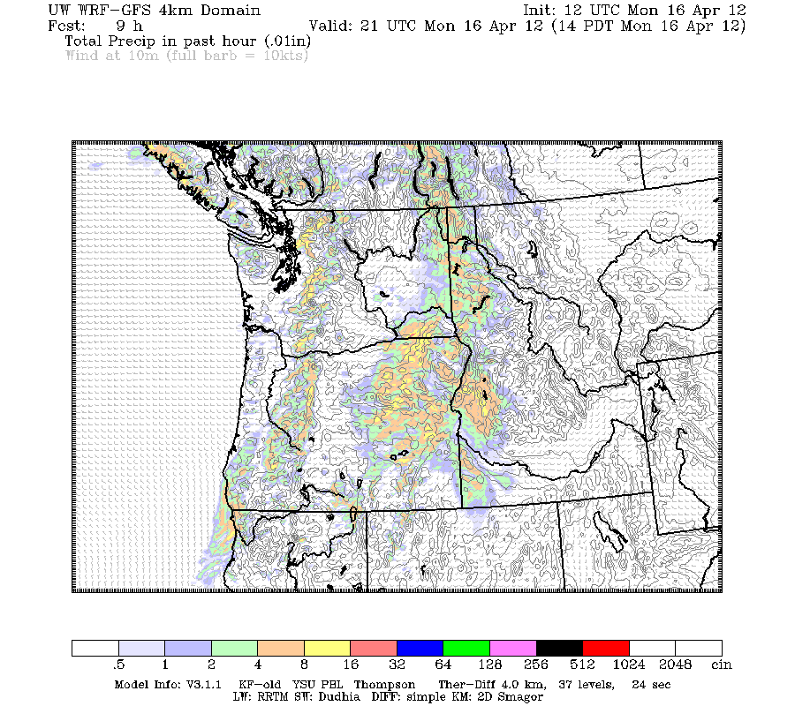
Precipitation, 1-hour
Notes:
Background color represents the amount of forecasted precipitation in 1/100 inches over the chosen time period. For example, a value of 50 (blue) would be 50/100 inches or equivalent to .5 inches of rain.
The color-bar located at the bottom identifies the amount of precipitation for each shading of color. Total precipitation graphics are available for 1, 3, and 24 hour periods and different regions depending on the resolution selected (36, 12 and 4 km resolutions).
Thin grey lines represent isobars which are defined as lines of constant pressure.

Slide 22
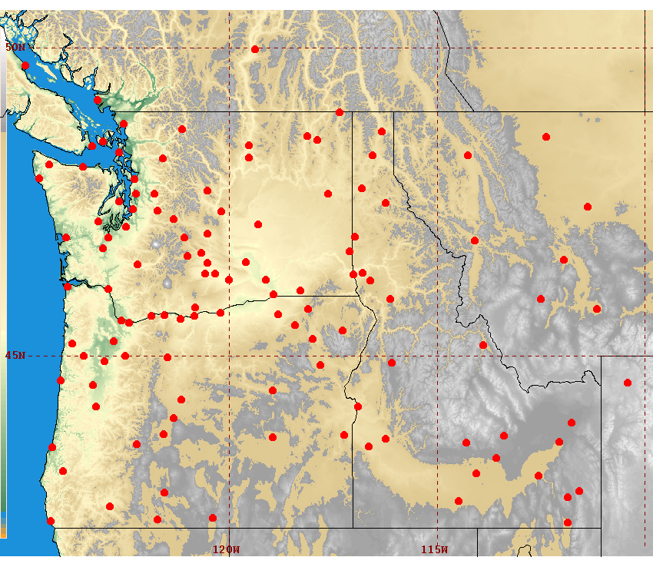
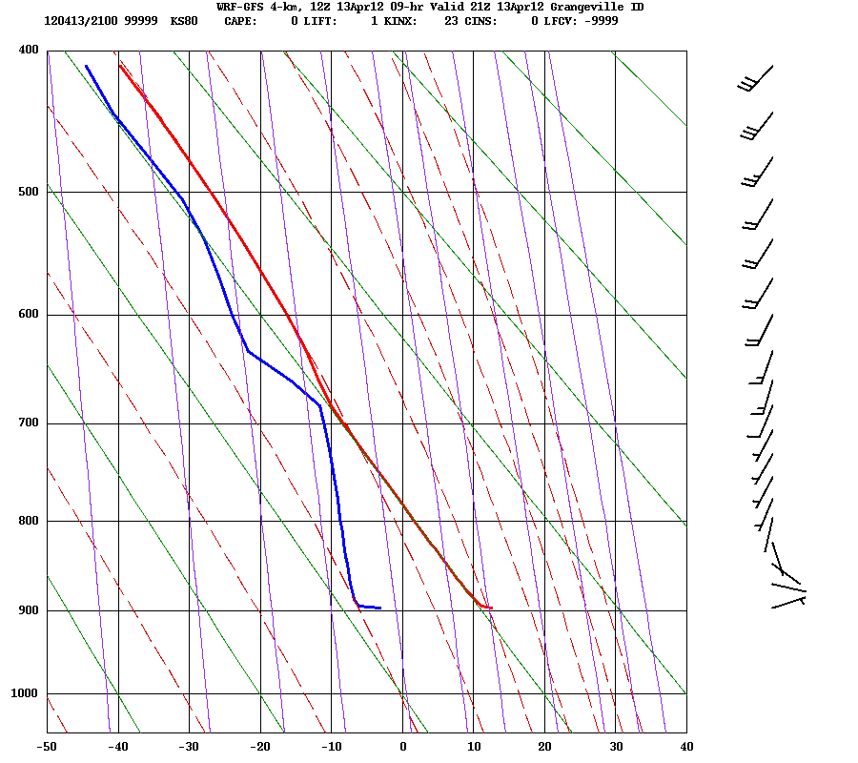
Soundings
Notes:
Good for indicating the height of the PBL and the location and strength of the inversion.

Slide 23
Haines Index
Notes:
Haines Index is a weather index that measures for potential for rapid forest fire growth. The index provides forecasters the ability to recognize which fires have the right conditions to expand rapidly and cause potential risks for firefighters and the surrounding land. The index is derived from the stability and moisture content of the lower atmosphere. The WRF model calculates the index at the mid-elevation range (850-700mb) and high elevation range (700-500mb).
A Haines Index of 6 means a high potential for large fire growth, 5 is medium, 4 is low. Anything less than 4 = very low potential.

Slide 24
Modeling Tools for Smoke Management
Robert Elleman EPA Region 10
Andrea Boyer Nez Perce Tribe
Rick Hardy Idaho DEQ

Slide 25
NW-AirQuest Tools
Regional air-science collaboration with WSU
Modeling tools
Regional speciation & receptor modeling analyses
EI and mobile source modeling collaboration
Special studies capability via mobile air laboratory
ClearSky agricultural burn model
AIRPACT regional photochemical model
Satellite products “toolbox” (in development)
Notes:
Tools leverage other work

Slide 26
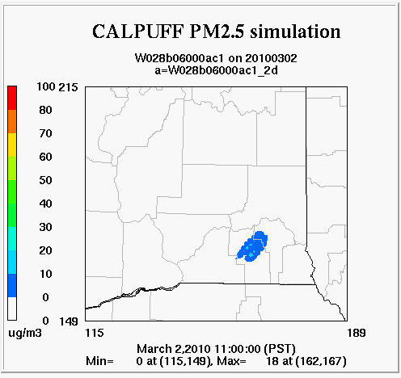
ClearSky A tool for planning agricultural burns
CALPUFF- based
Runs pre-set default burns or “gaming mode”
Planned phase-out in late 2012 or 2013
AIRPACT4 to add “Clearsky-type” functionality

Slide 27
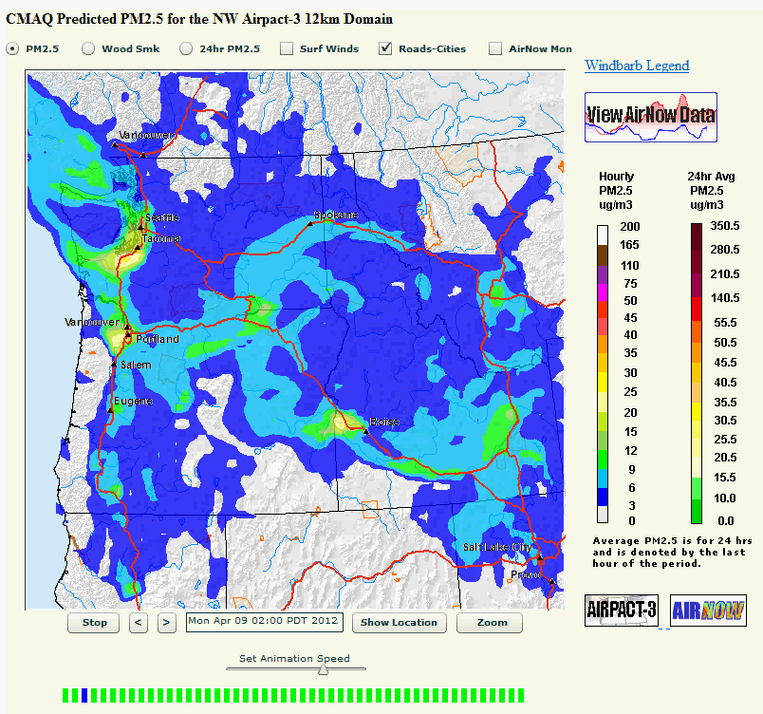
Airpact model
Hourly PM_{2.5} Concentrations (April 9)
CMAQ “One Atmosphere” Photochemical Model
All pollutants
Met conditions from UW WRF
Available daily by ~06:30 am Pacific Time

Slide 28
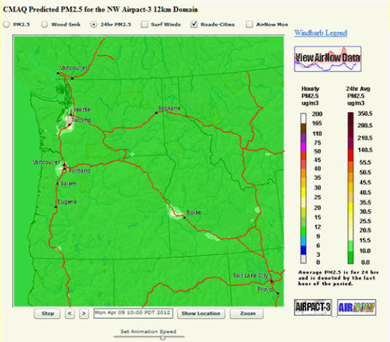
Airpact3 Current Version
24-Hour PM_{2.5} Concentrations (April 9)
12 km grid
Boundary Cond:
MOZART-4 global model
Includes all emissions:
Industrial
Mobile Source
Biogenic
Area Sources
Wildfire/Rx/Ag burning currently not included.

Slide 29


Slide 30
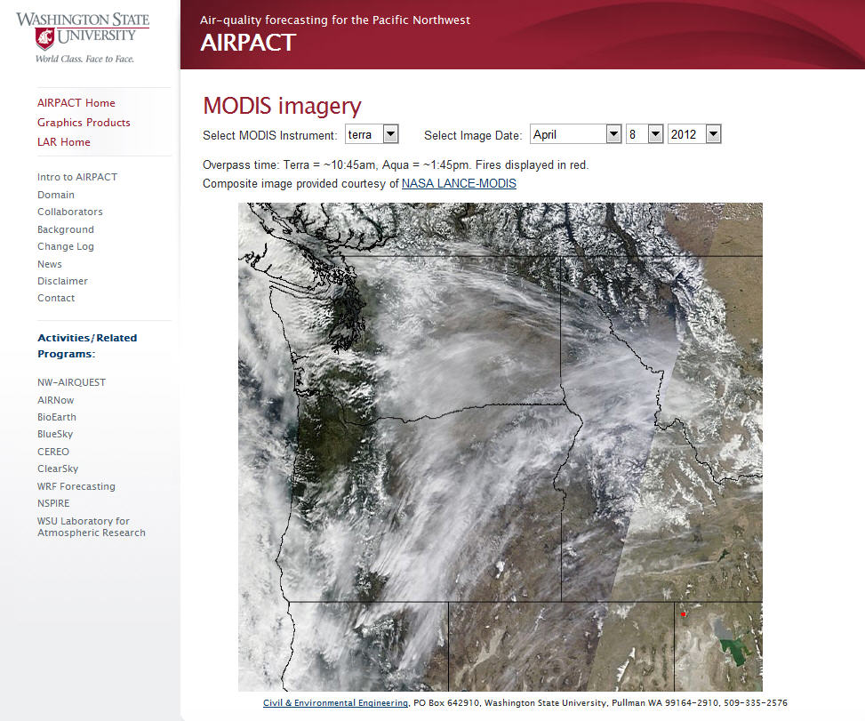

Slide 31
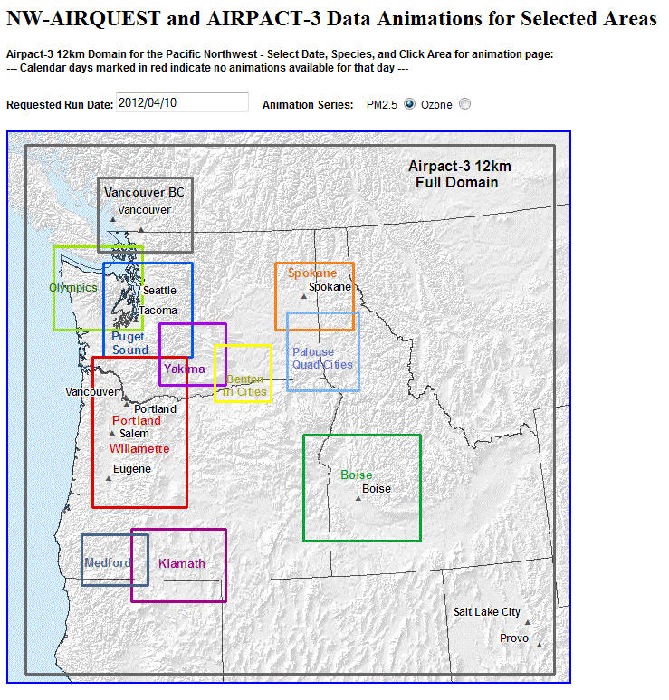
Notes:
Set based on user input from NW-Airquest members

Slide 32
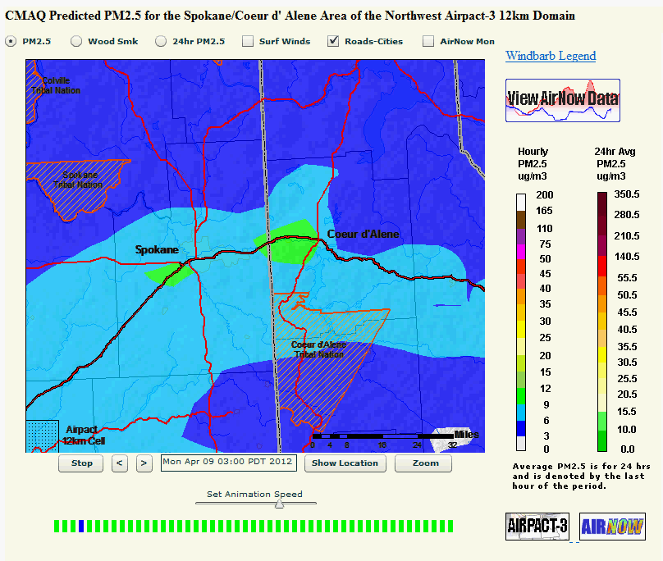
Spokane/CDA Area, 1-hr PM_{2.5}

Slide 33
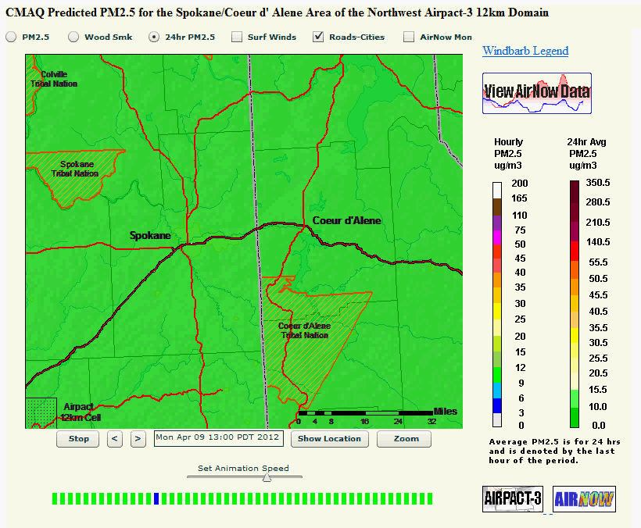
Spokane/CDA Area, 24-hr PM_{2.5}

Slide 34
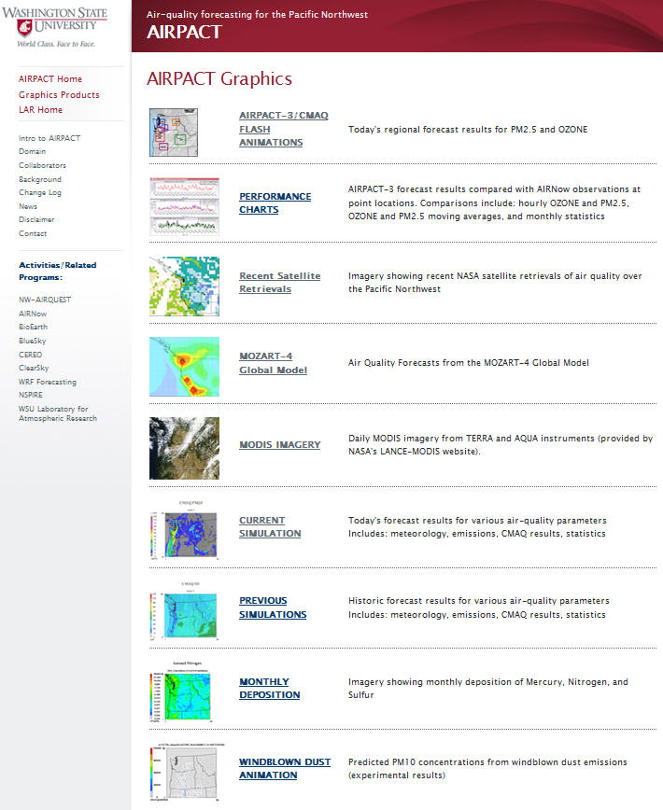

Slide 35
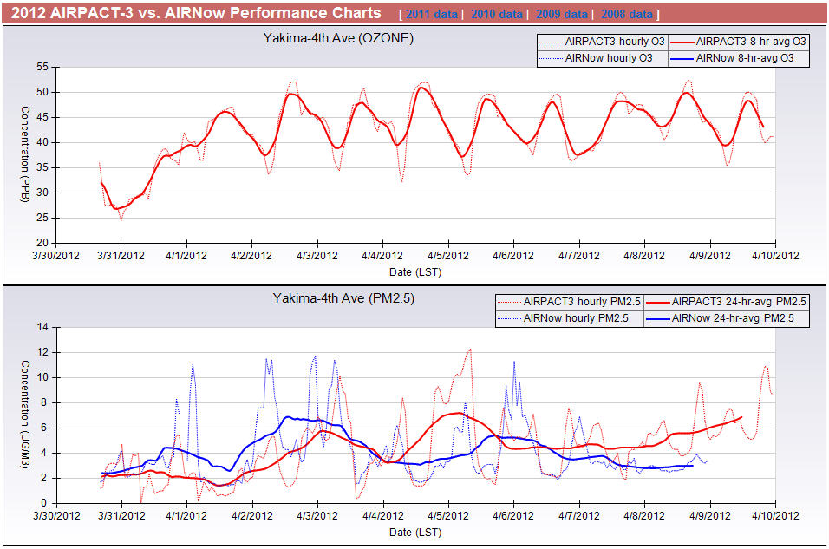

Slide 36
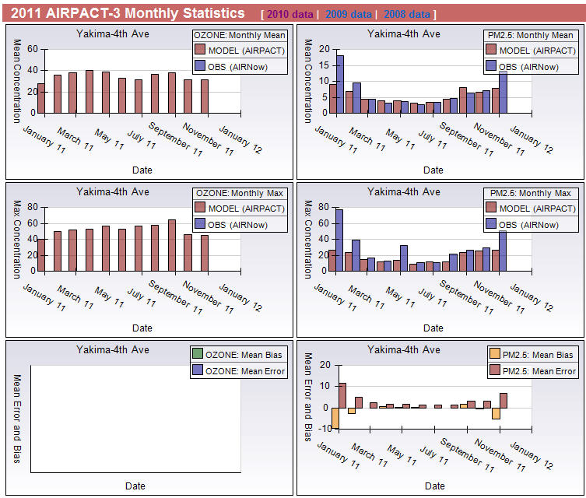

Slide 37
AIRPACT3 Uses and Limitations
Uses
Limitations
PM and ozone forecasts
Accounts for photochemistry
Diagnosing unknown “haze” events
Retrospective diagnosis of Air Quality episodes
Airshed planning & air regulatory issues
Currently no wildland or prescribed fires, Ag Burns
PM forecasts are biased high in some areas, low in others. Check Performance for your area!
Emission assumptions may not represent all locations at all times.

Slide 38
AIRPACT4 Improvements 2012/2013 Workplan
Move from 12-km grid to 4-km grid
Updated emission inventories
Upgrade from MOBILE6 to new MOVES model
Update from 2008 to 2012/2013 emissions inventories
Wildfires and approved prescribed fires
integrated using BlueSky Framework (Smartfire)
“ClearSky-type” functionality by running Ag-burn defaults overnight resulting in PM_{2.5} “tracer” for Ag fires

Slide 39
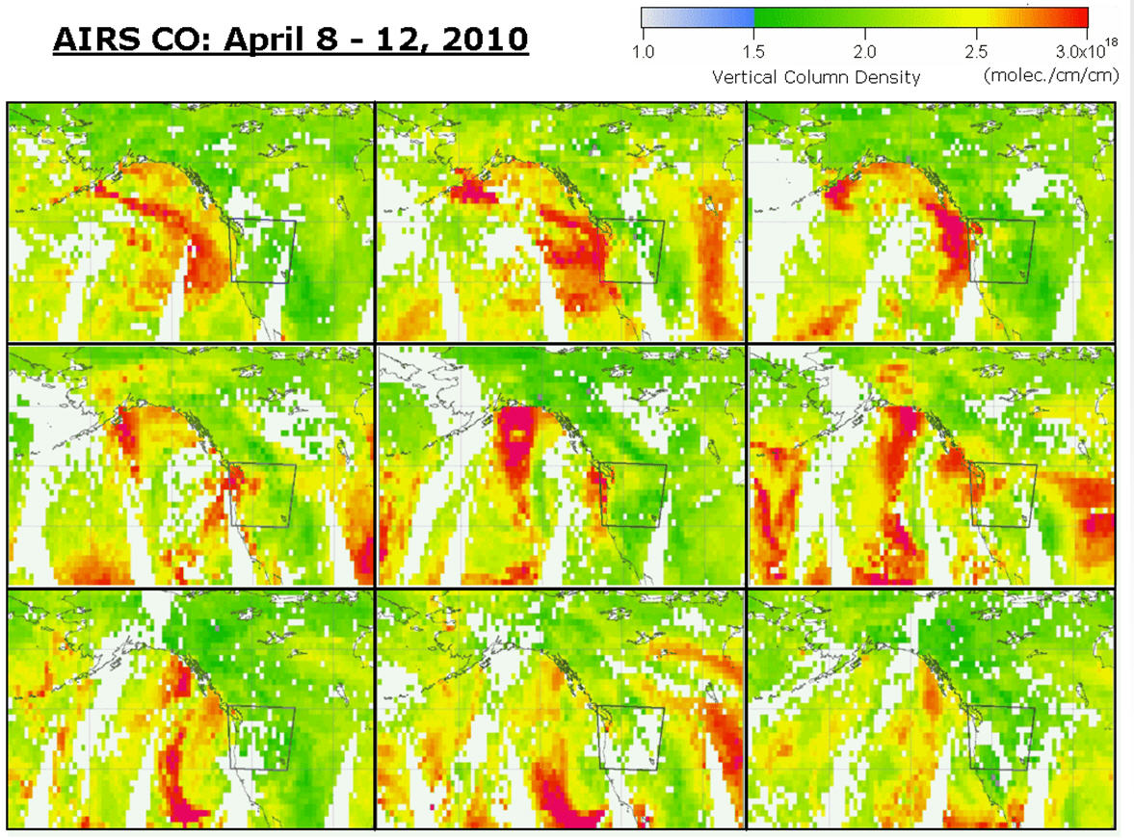
EPA/WSU GEOSS Users Group (EPA R10, WSU, Wa-ECY, Id-DEQ, Or-DEQ, PSCA, Nez Perce Tribe, USDA-Portland, Metro Vancouver, USDA Airfire Team, Air Protection-BC, Env. Canada )
Goal: To build a web-based toolbox of satellite AQ products in the AIRPACT4 projection to facilitate comparison and analyses.
Web page to be developed by 2013

Slide 40

Final Thoughts
Questions?
Thank you

