Slide 1
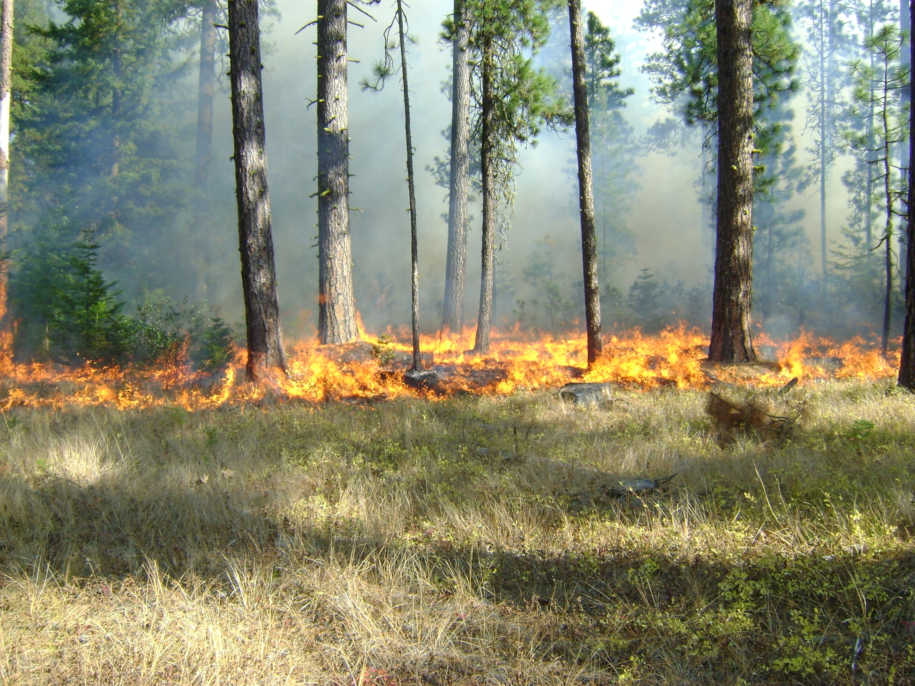
Washington Prescribed Fire Council:
Fire - Part of the Problem and Solution
2012, Smoke Management in the Northwest, Boise ID
M. Reese Lolley, The Nature Conservancy, EWA Forests Program

Slide 2
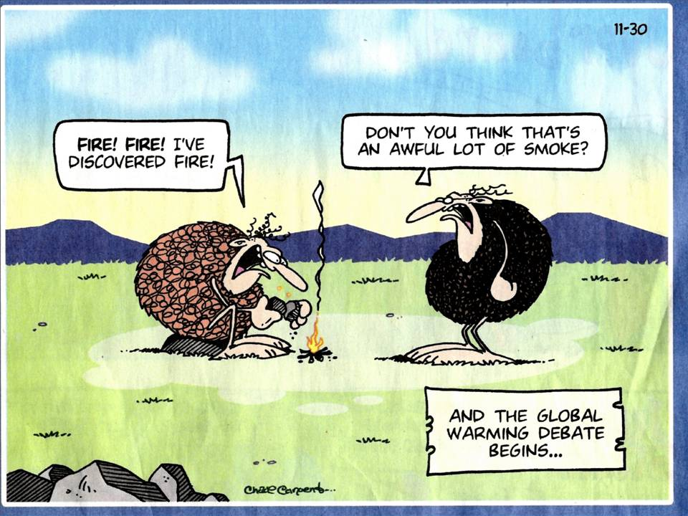
2012 Smoke Management in the Northwest, Boise ID
Reese Lolley, The Nature Conservancy, EWA Forests Program
(
)

Slide 3
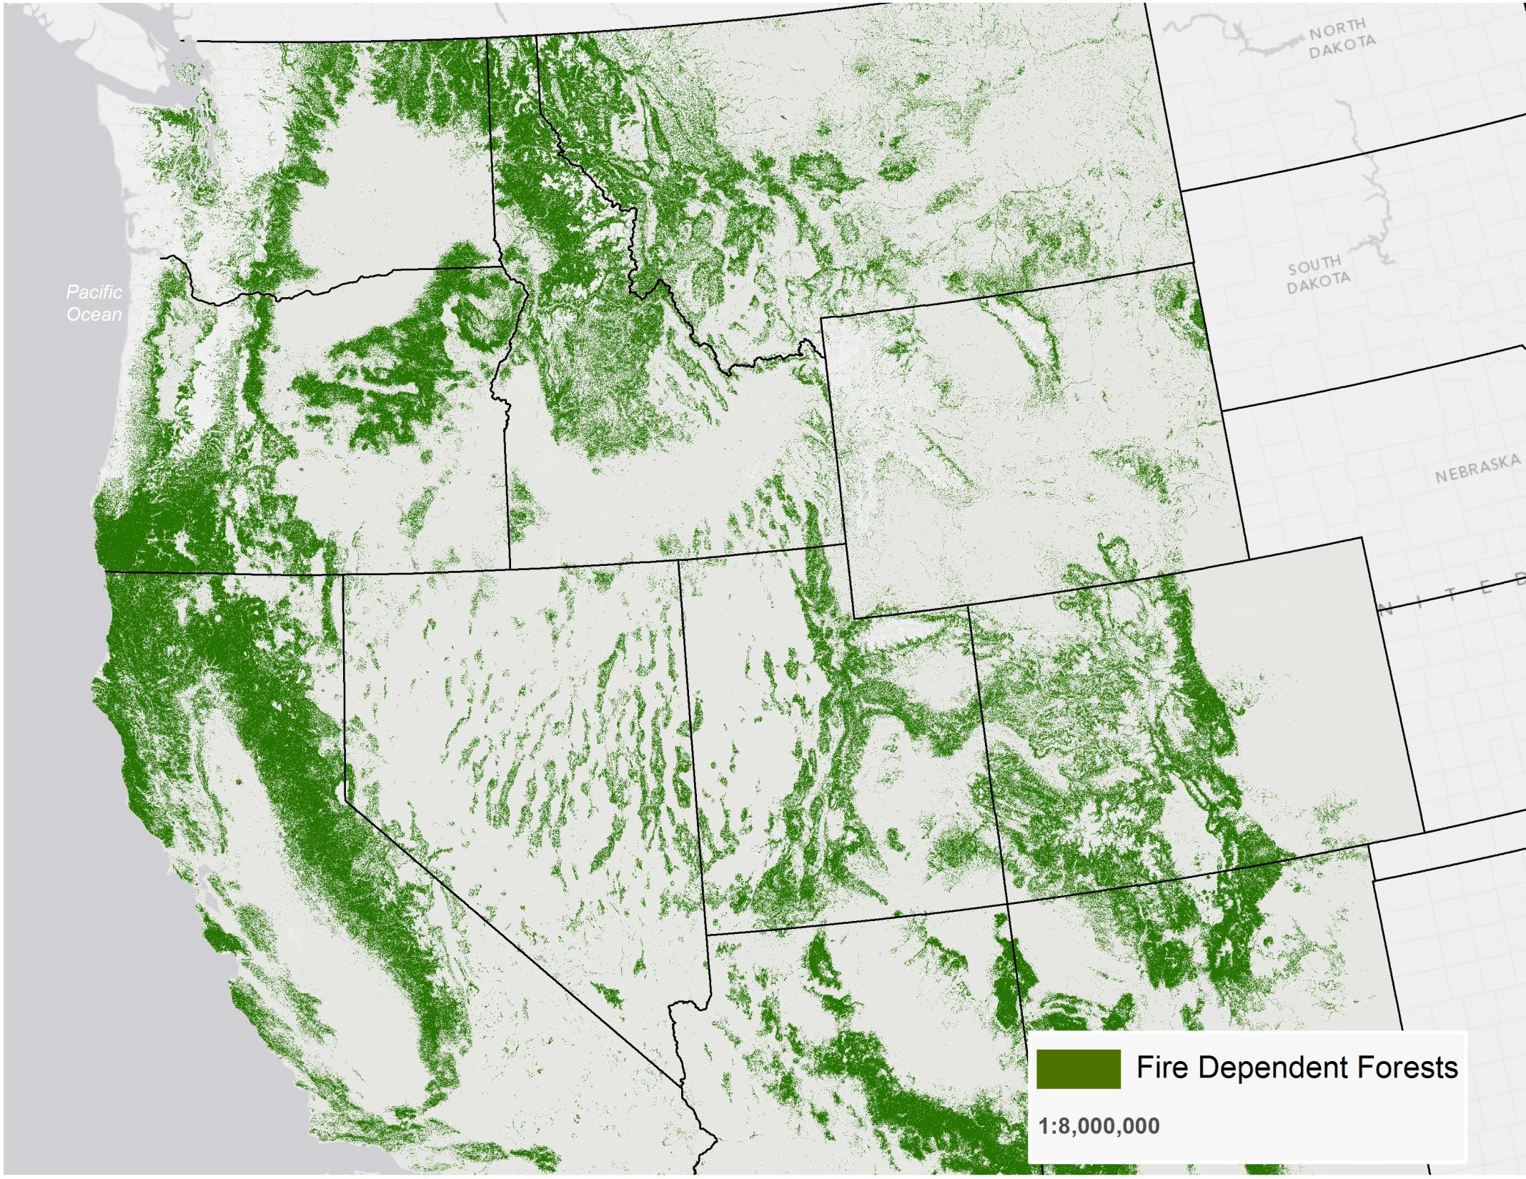
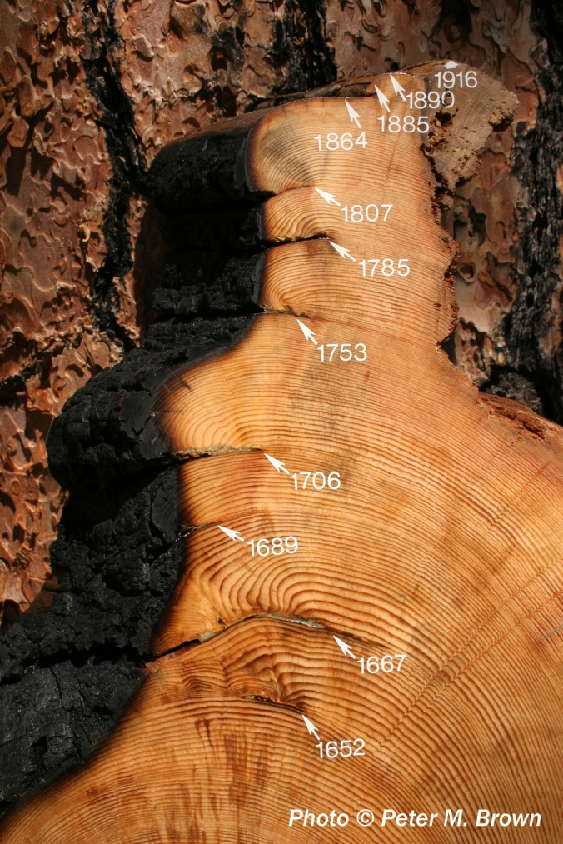

Slide 4
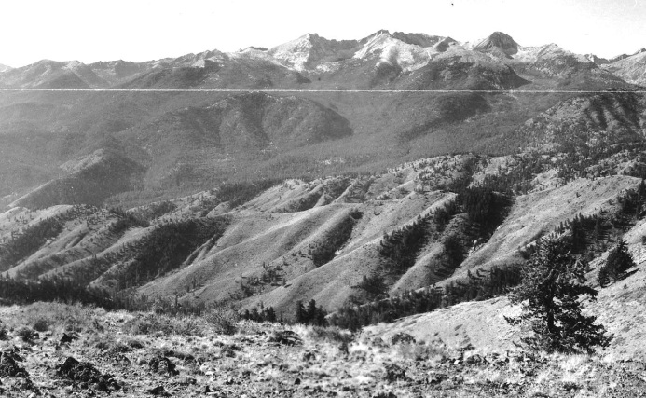
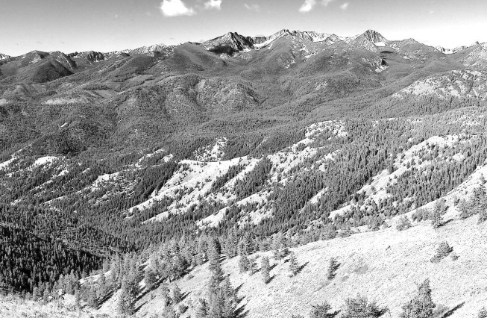
” and where restoration may be needed.
1930
2011
A
B

Slide 5
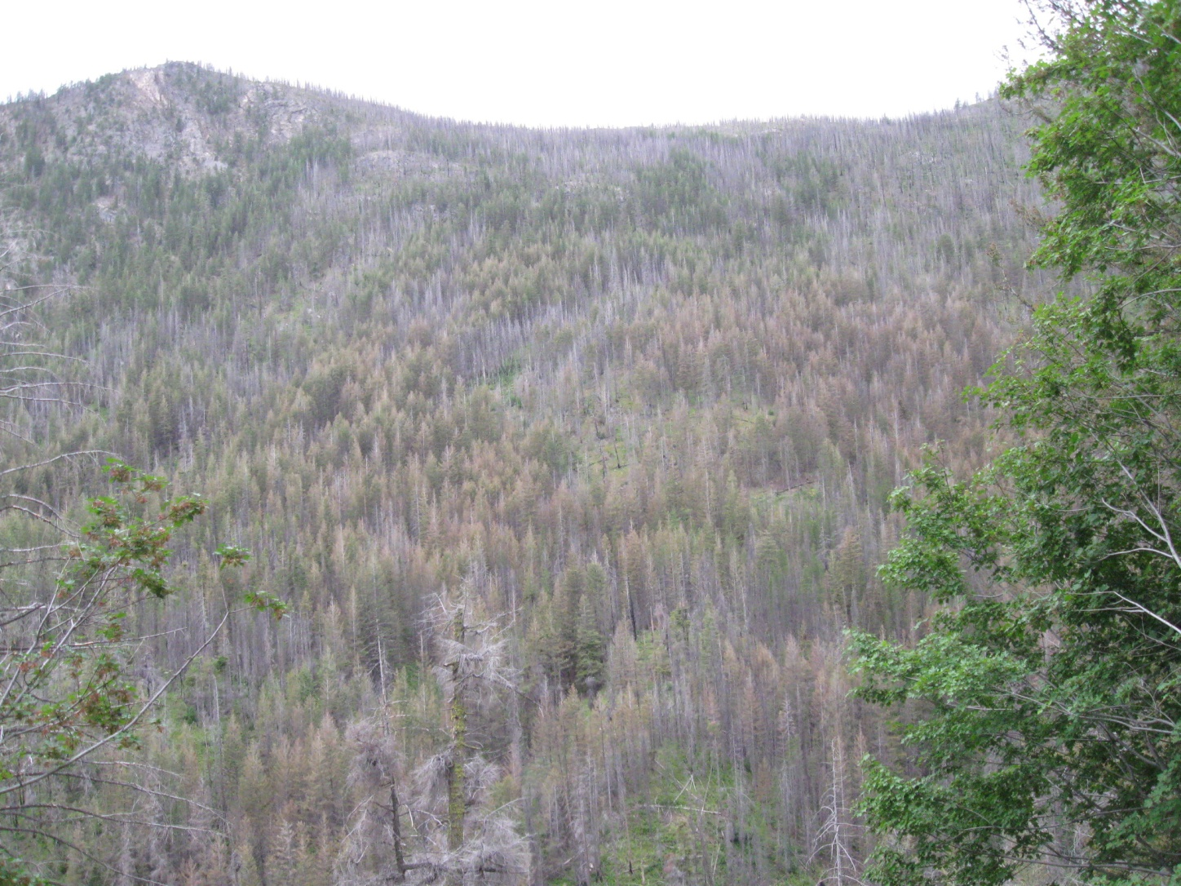
Forest conditions- health
2012 Smoke Management in the Northwest, Boise ID
Reese Lolley, The Nature Conservancy, EWA Forests Program
Uncharacteristic - western spruce budworm, W. pine beetle
Wildfire: Monastery Complex Fire, 2011
Satus Pass, WA

Slide 6
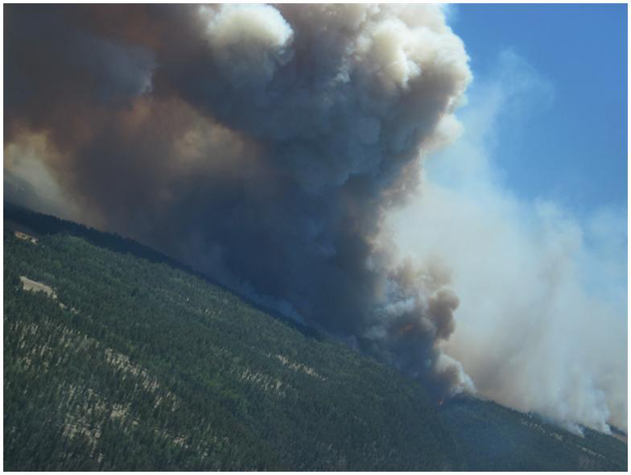
Wildfire: Wallow Fire, 2011
Arizona-New Mexico
538,049 acres
$109 million
72 structures destroyed

Slide 7
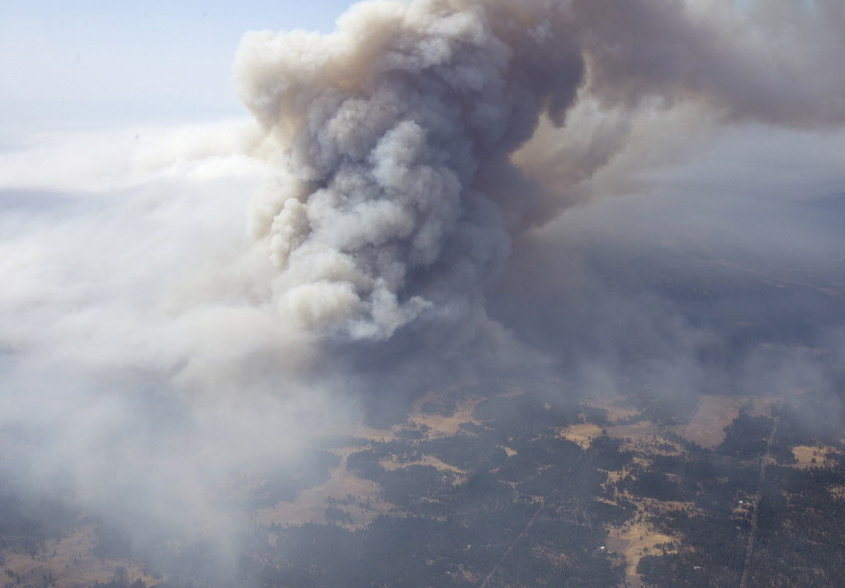
Wildfire: Monastery Complex Fire, 2011
Satus Pass, Washington
3,600 acres
$4.9 million
30 structures

Slide 8
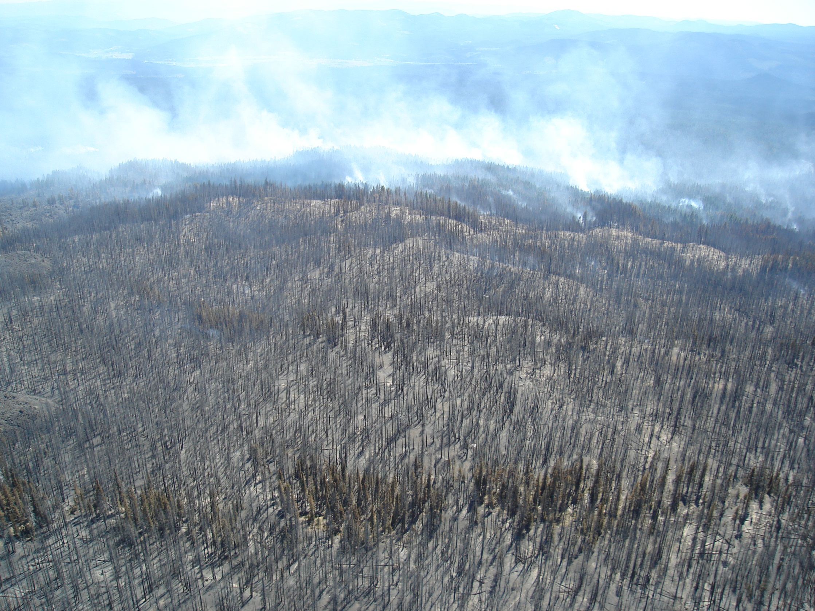
Washington Prescribed Fire Council
2012 Smoke Management in the Northwest, Boise ID
Reese Lolley, The Nature Conservancy, EWA Forests Program
Wildfire: Monastery Complex Fire, 2011
Satus Pass, WA

Slide 9
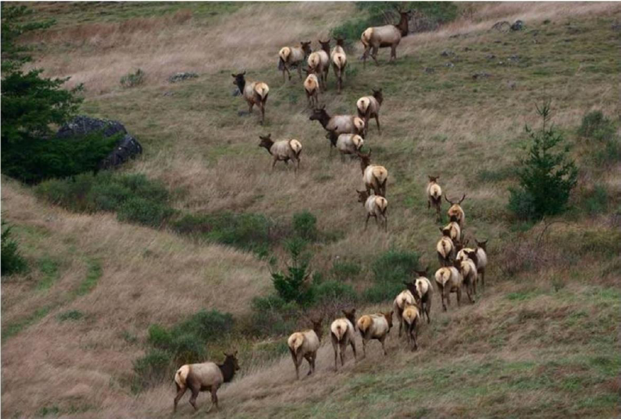
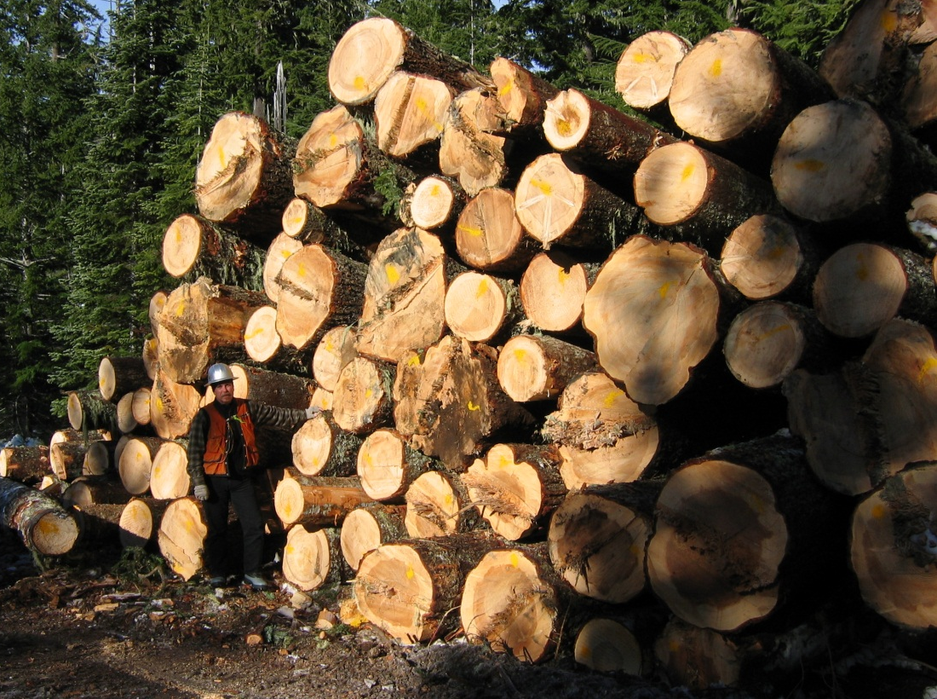
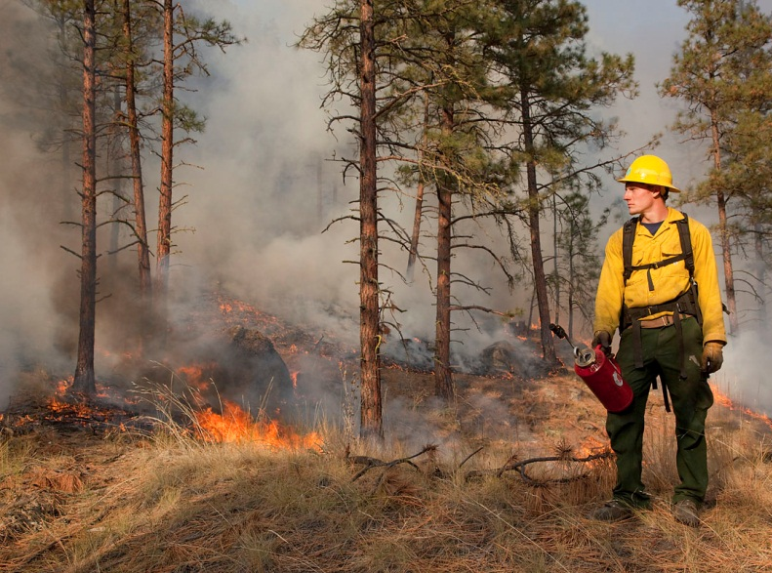
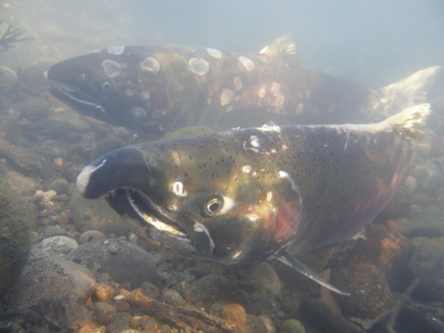
VS

Slide 10
Integrated Approach
VS

Slide 11
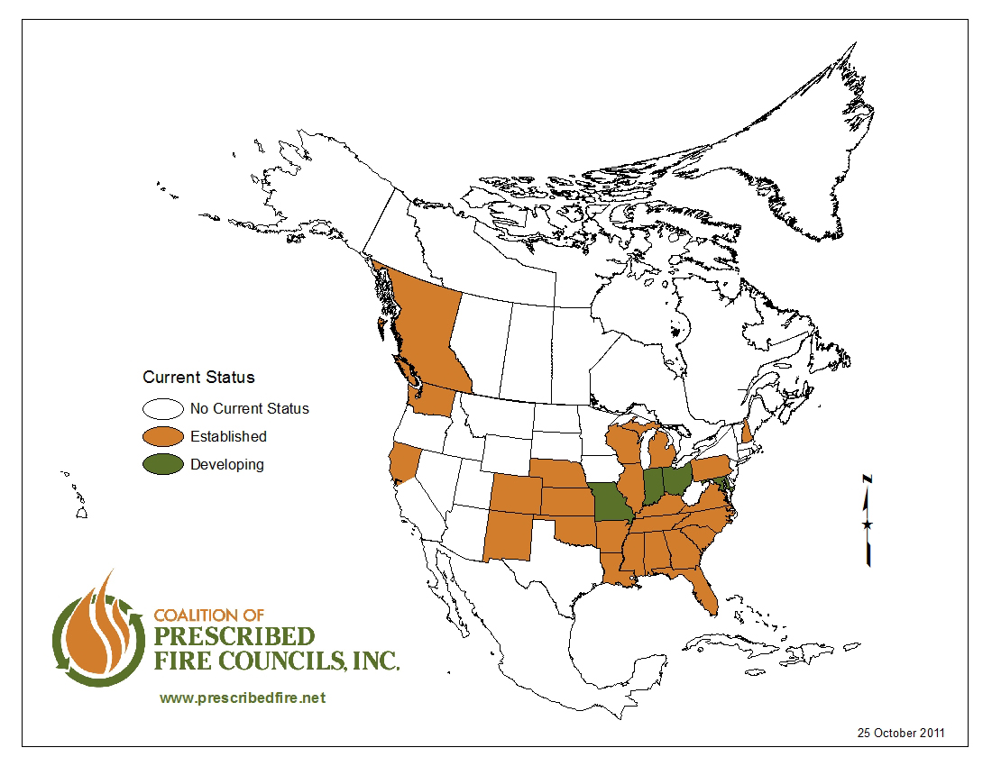

Slide 12
Mission: promote the appropriate use of prescribed fire for enhancing public safety, managing resources, and sustaining environmental quality

Slide 13
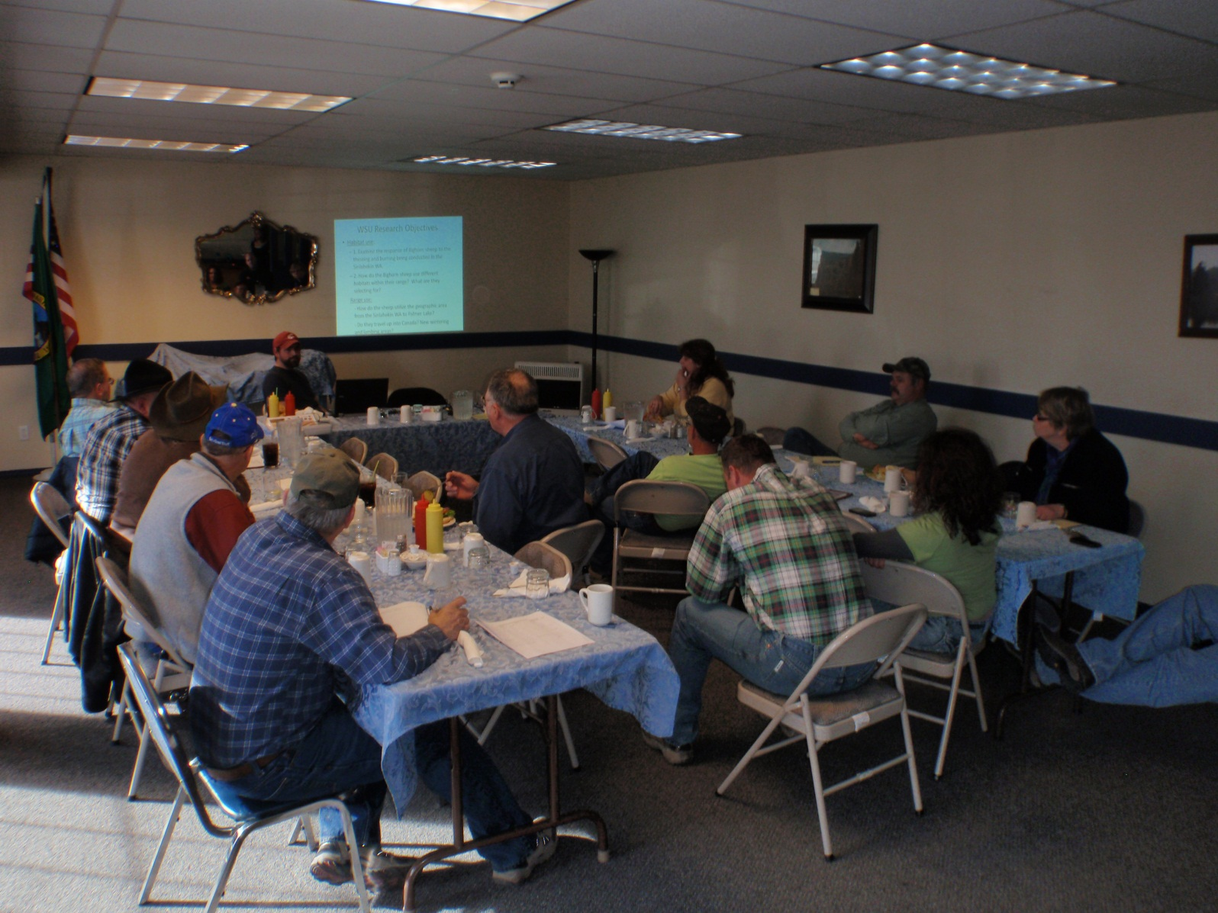
North Central Washington Prescribed Fire Council
Photo: Clearwater Basin Collaborative

Slide 14
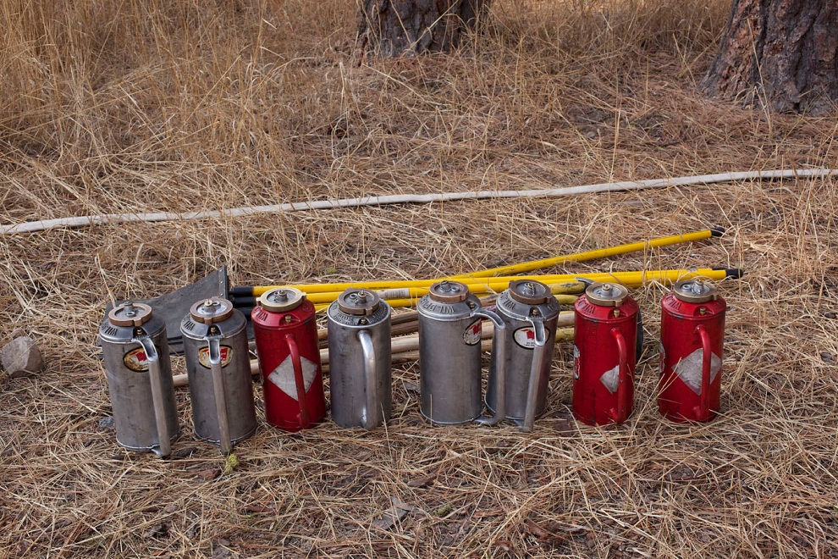
Washington Prescribed Fire Council
Mission: To protect, conserve, and expand the safe use of prescribed fire on the Washington landscape to meet both public and private management objectives.
Photo credit: John Marshall
Notes:
Within the Rock-Wenas landscape, we will be expanding the FRS approach to include treatment costs-revenues and road-stream interactions in the decision support network.
Be sure to note that TNC will be “hiring” USFS technical specialists to help ensure success.

Slide 15
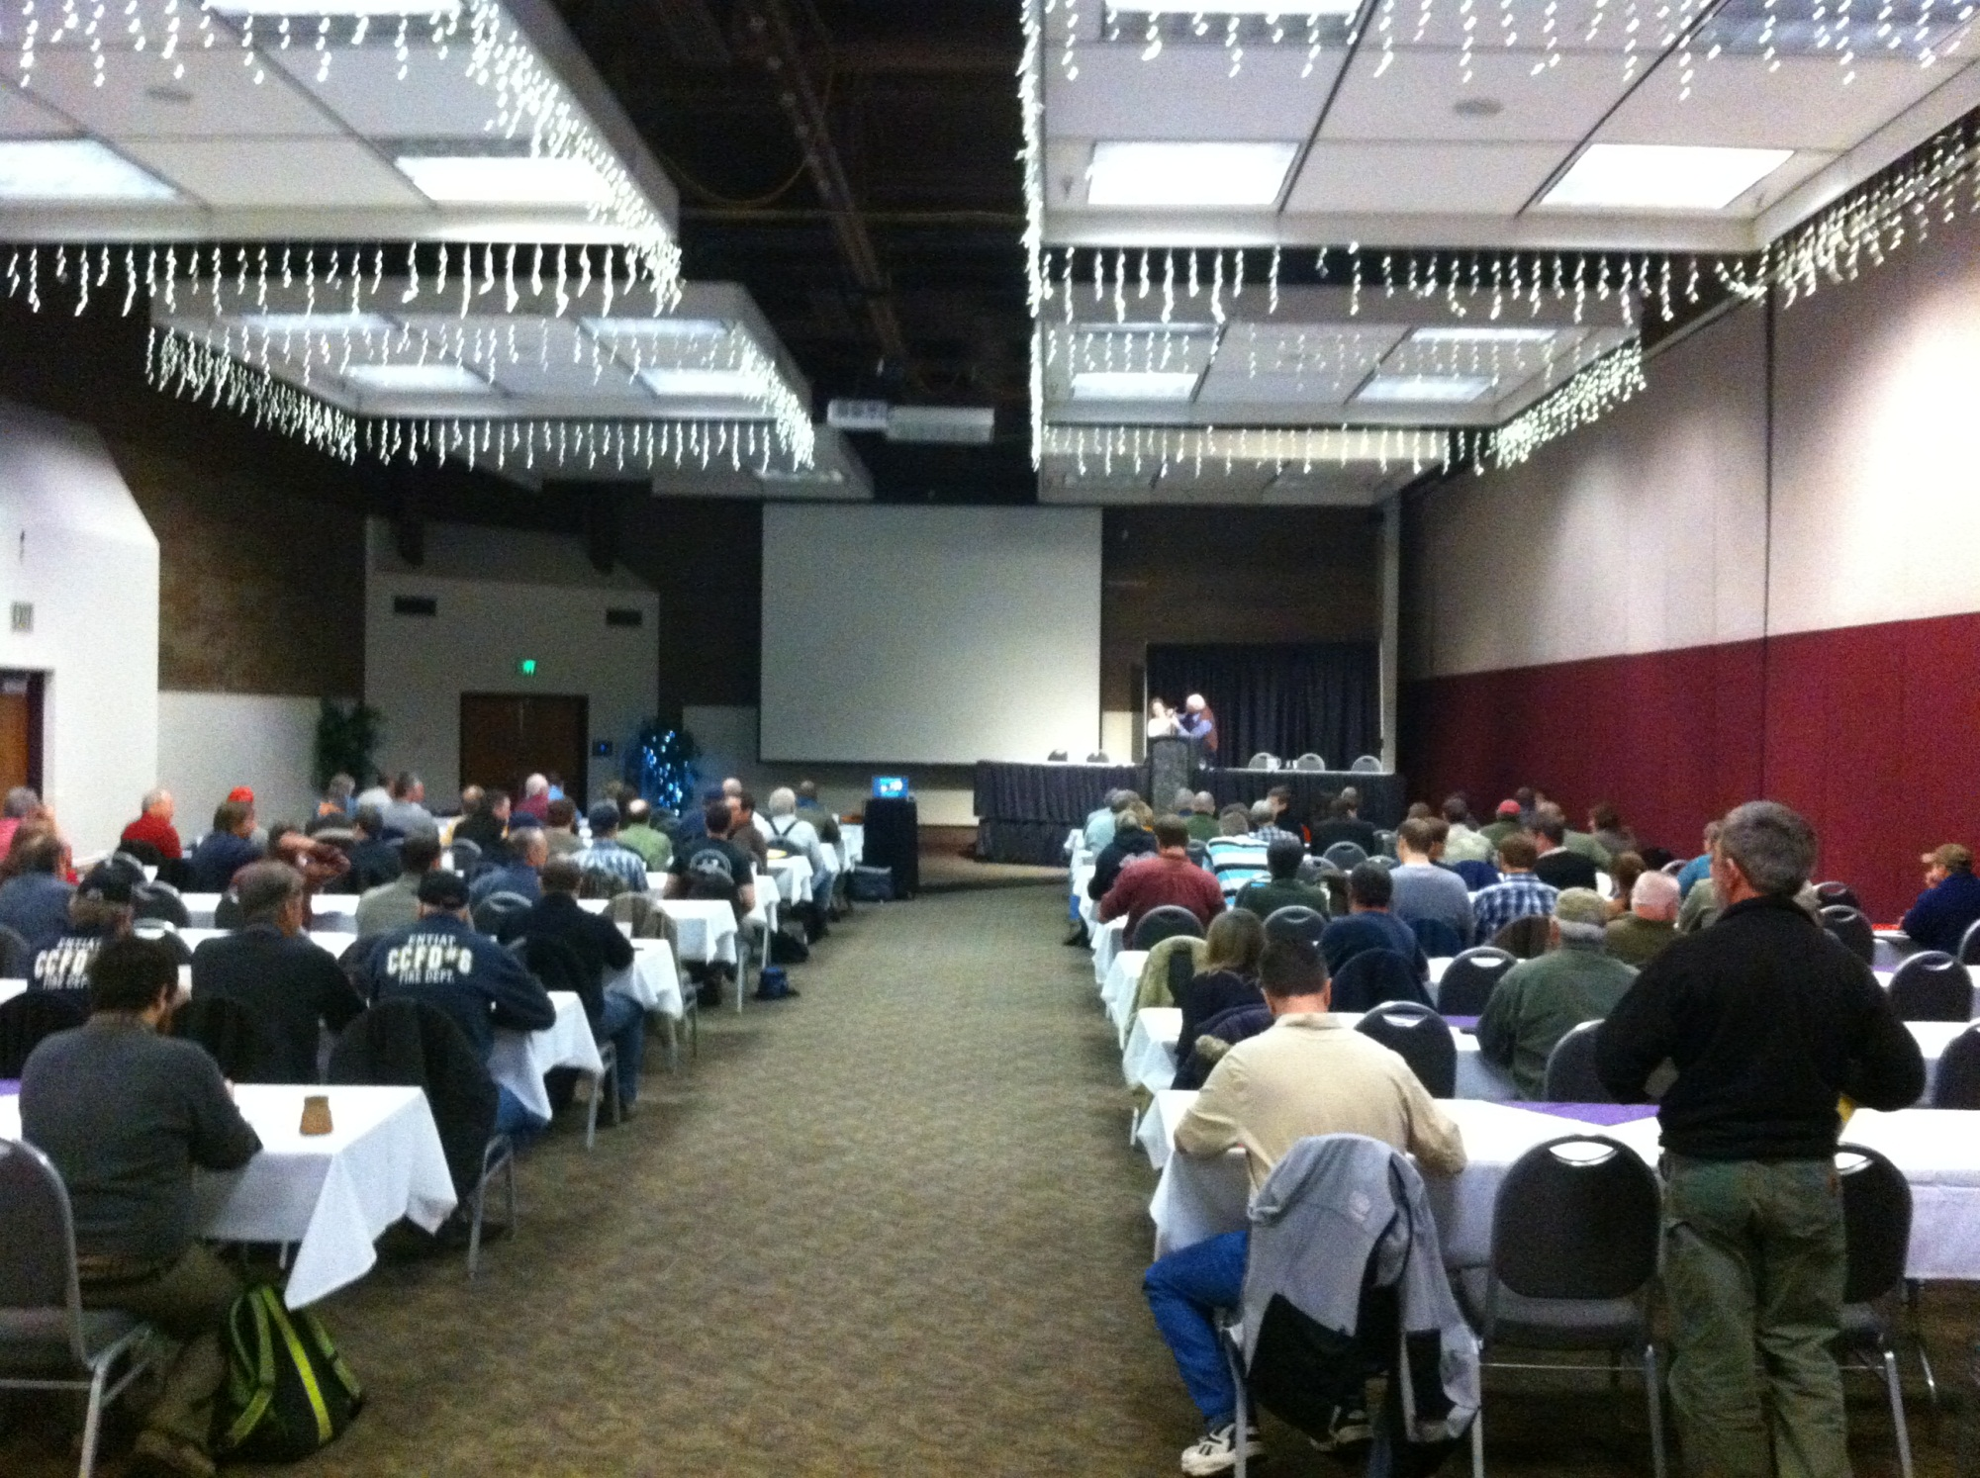
Washington Prescribed Fire Council
Kick off conference: March 6-7th 2012
Photo: Clearwater Basin Collaborative
Notes:
-Lead

Slide 16
http://www.waprescribedfire.org/
safe

Slide 17
Washington Prescribed Fire Council
Top 5 needs for WA Rx Fire Council to address:
Supportive laws and regulations surrounding smoke management
Improved public outreach and education
Access to resources – funding, trained personnel, equipment, etc.
Increased collaboration across agencies
Increased political support

Slide 18
Washington Prescribed Fire Council
Next Steps
Task group – steering committee
Review of mission statement & by-laws
Fall meeting to formalize Steering Committee and Chairperson
Steering Committee further refine and develop milestones based on top 5 needs.
Organize Spring Annual meeting
Photo credit: John Marshall

Slide 19
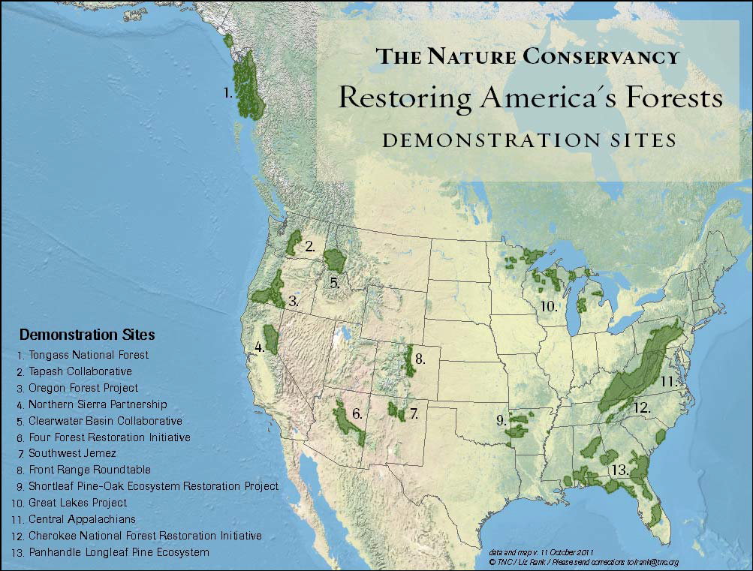
Notes:
State and national level, TNC is heavily invested in the stewardship/restoration of these forests
RAF network alone, over 70 personnel working forest conservation/stewardship issues.

Slide 20

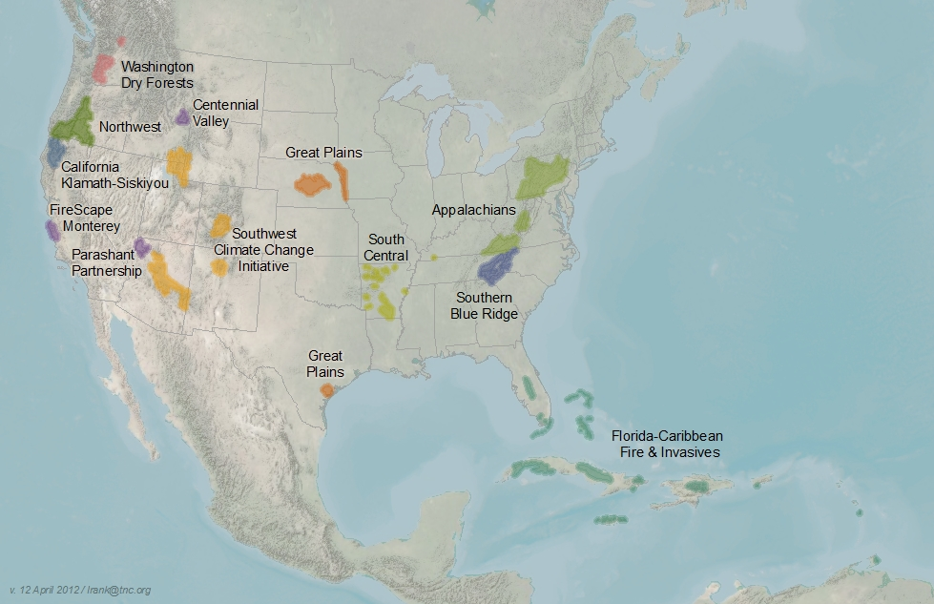
Fire Learning Network
http://www.conservationgateway.org/topic/fire-learning-network
Monastery Complex Fire, 2011
Satus Pass, WA
Notes:
The Fire Learning Network (FLN) is a cooperative program of the Forest Service, Department of the Interior agencies—Bureau of Indian Affairs, Bureau of Land Management, Fish and Wildlife Service and National Park Service—and The Nature Conservancy. The partnership has a ten-year track record of helping to restore our nation’s forests and grasslands and to make communities safer from fire.
The FLN makes targeted investments in people and places that catalyze larger-scale change.
Initiation of the Tapash Sustainable Forest Collaborative of SCW, and NCW WA PFC & WPFC have been supported by the FLN.

Slide 21
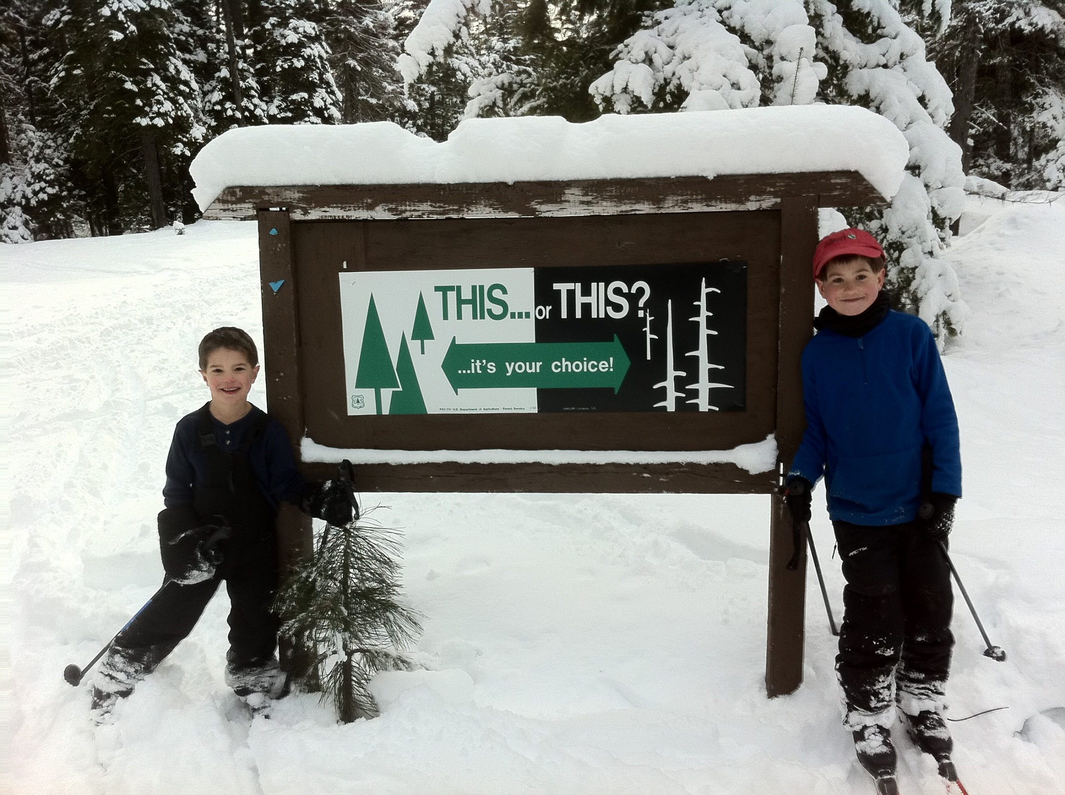
Monastery Complex Fire, 2011
Satus Pass, WA

Slide 22
Washington Prescribed Fire Council
2012 Smoke Management in the Northwest, Boise ID
Reese Lolley, The Nature Conservancy, EWA Forests Program
Wildfire: Monastery Complex Fire, 2011
Satus Pass, WA

Slide 23
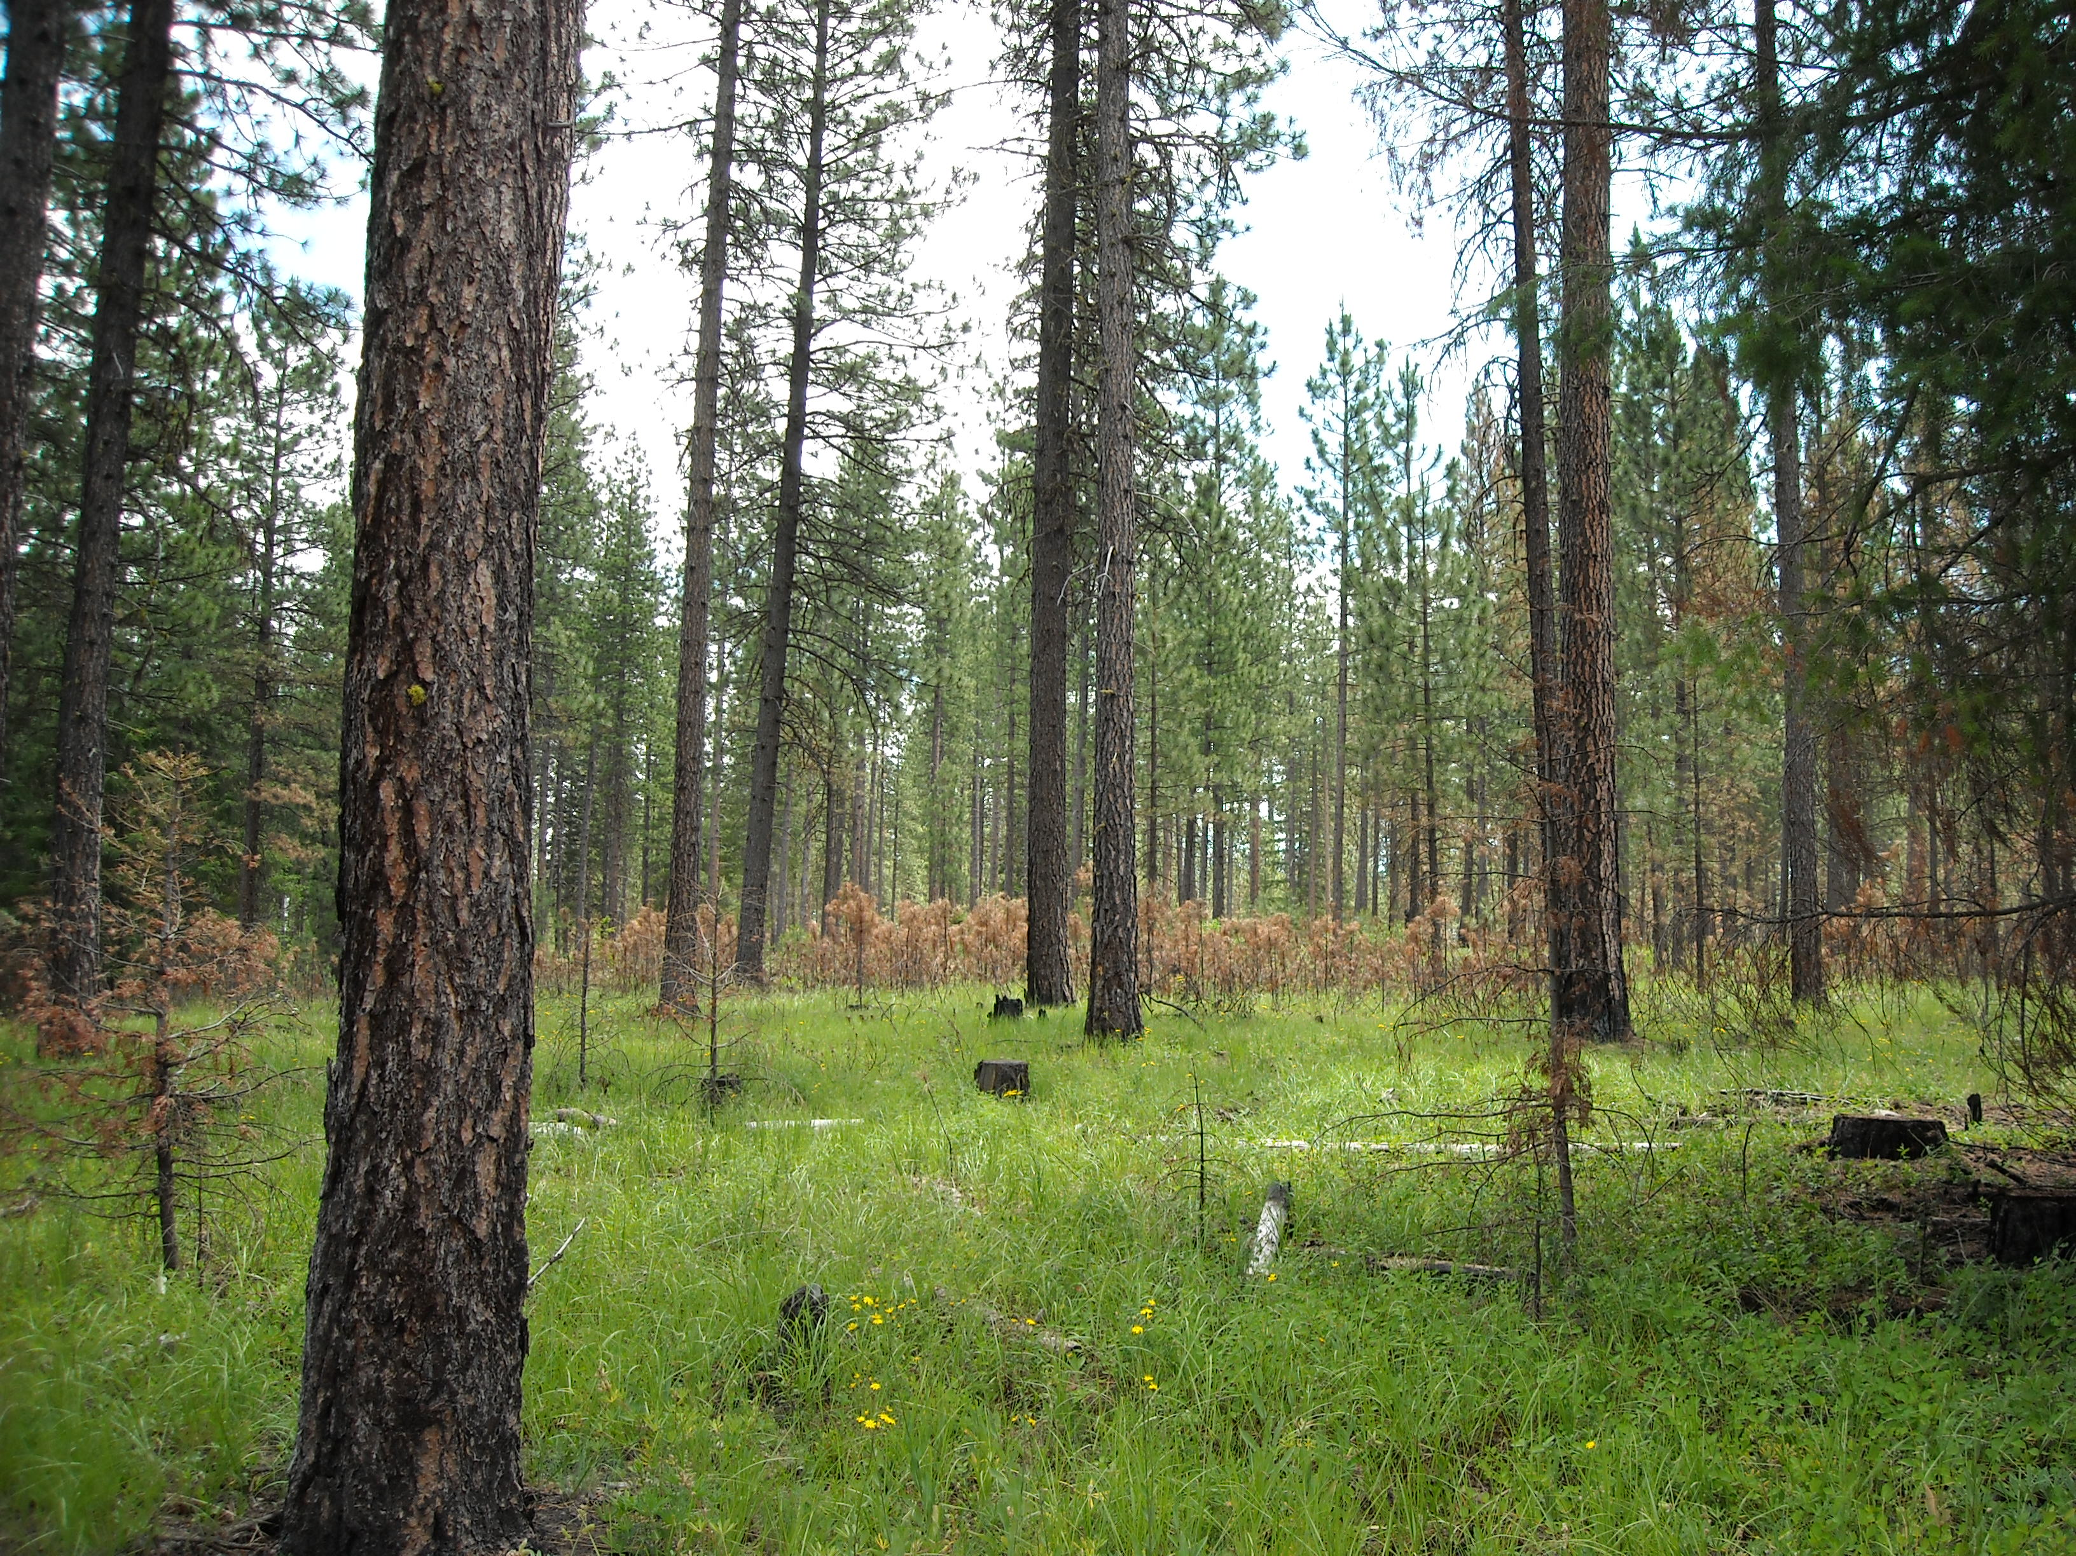
Washington Prescribed Fire Council
2012 Smoke Management in the Northwest, Boise ID
Reese Lolley, The Nature Conservancy, EWA Forests Program
Wildfire: Monastery Complex Fire, 2011
Satus Pass, WA

