Slide 1
EPA UPDATE Annual Smoke Meeting 2012
Mike McGown

Slide 2
Update Topics
NAAQS (PM and Ozone)
Exceptional Events and Wildland Fire Policy
FARR Revisions
NEPA

Slide 3
Particulate Matter
PM 2.5 Annual 11-13 ug/m3 (15)
PM 2.5 24 hour 35 ug/m3 (35)

Slide 4
Next Steps In PM Review As EPA Presented in Last Year’s Meeting
Finalize Staff Policy Assessment
Propose Rule
Spring 2011?
Final Rule
Early 2012?
For more information:
http://www.epa.gov/ttn/naaqs/standards/pm/s_pm_index.html
http://www.epa.gov/pm

Slide 5
Ozone NAAQS
Ozone
January 2010 EPA proposed 8-hr primary standard of 60-70 ppb.
A new Secondary standard
Additional monitoring requirements
Timing
Initially was to be finalized in August, October, and December 2010
Now TBF July 2011 (August, Sept, Nov)
Withdrawn

Slide 6
Current Schedule for Ongoing NAAQS Reviews (Updated April 11, 2012)
MILESTONE | POLLUTANT
 | NO₂/SO₂ Secondary | PM | Ozone | Lead | NO₂ Primary | SO₂ Primary | CO
NPR | Jul 12, 2011 | Intended Jun 2012* | 2013 | Jan 2014 | Aug 2015 | Feb 2016 | Jul 2016
NFR | Mar 20, 2012 | Intended Jun 2013* | 2014 | Nov 2014 | May 2016 | Nov 2016 | Apr 2017
NOTES:
Underlined dates indicate court-ordered or settlement agreement deadlines
*As part of a court filing in Jan 2012, EPA identified a schedule for completing the review of the PM NAAQS including its plan to issue a proposed rule in Jun 2012 and to take final action in Jun 2013.

Slide 7
Exceptional Events Rule and Wildland Fire Policy Update

Slide 8
Background
EPA’s Exceptional Events rule was published on March 22, 2007
Required by Section 319(b) of the Clean Air Act
Provides a mechanism to exclude certain air quality data can from regulatory actions
Replaces previous EPA policies/procedures
Examples of types of exceptional events: High Wind Events, Wildfire Events, Volcanic and Seismic Activities, Chemical Spills and Industrial Accidents
Notes:
(4) Interim provision
Until the effective date of a regulation promulgated under paragraph (2), the following
guidance issued by the Administrator shall continue to apply:
(A) Guidance on the identification and use of air quality data affected by exceptional events (July 1986).
(B) Areas affected by PM–10 natural events, May 30, 1996.
(C) Appendices I, K, and N to part 50 of title 40, Code of Federal Regulations.

Slide 9
Exceptional Events Update
In 2010, Air Deputy Assistant Administrator charged OAQPS to:
Work with EPA Regional Offices and OGC
Develop an action plan and supporting materials to improve implementation of the Exceptional Events Rule
Draft products from the Exceptional Events Rule workgroup distributed a over a year ago for initial review by state, local, and tribal agencies and others by request.
A Notice of availability and opportunity for public comment on revised draft guidance documents expected this spring (announcement to be published in a Federal Register notice).

Slide 10
Exceptional Events Update
EPA has developed draft guidance to address key implementation issues
Describes administrative process and timing for demonstration submittal and review of Exceptional Events Data
Provides previously reviewed demonstrations and best practice components
Provides specific guidance for high wind dust events
Identifies types of evidence that could be used in a fire/ozone event submittal and clarifies EER criteria that apply to all types of events
Responds to comments submitted on draft products distributed last year

Slide 11
Exceptional Events Update Early Summer 2012 ?
Draft Guidance products
Overview of Draft Guidance Documents
Attachments
Frequently Asked Questions
High Winds Guidance Document
Questions designed to focus public review
Response to Comments Document (to be distributed to original commenters via email, will also be in ExEvents docket)
Website http://www.epa.gov/ttn/analysis/exevents.htm
Draft Guidance products under development
Guidance document on wildfire events and ozone
Replacement for EPA’s Interim Fire Policy

Slide 12
Wildland Fire Policy
EPA has received significant input from Land Management Agencies
Examination of 3 tier approach for SMP
How will it be tied to the Exception Events Rule
Internal EPA workgroup currently working on new policy
Distribution of proposed policy back to Land Managers
Proposed Policy for Public Comment (Aug 2012?)

Slide 13
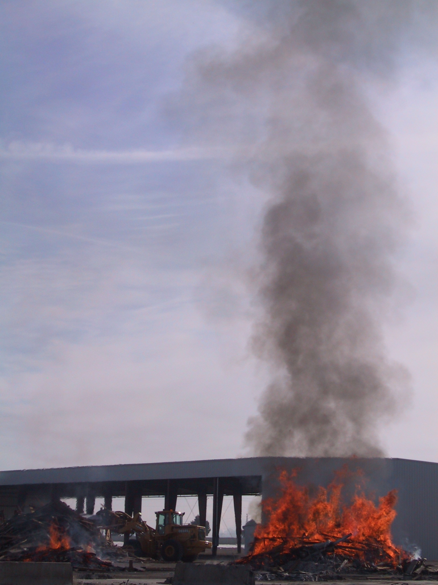
Federal Air Rules for Reservations
FARR Revisions
Before the FARR, we had few legal means to address this type of activity.
Notes:
Notice the bulldozer for scale of the fire.

Slide 14

Federal Air Rules for Indian Reservations: (FARR)
Federally-enforceable air quality regulations on 39 Indian reservations in ID, OR, & WA in order to protect human health and the environment.
Fill the regulatory gap for reservation residents
Air quality protections similar to those outside the reservations.
These rules were effective June 2005.
The FARR is unique to Region 10.

Slide 15
Who is subject to the FARR?
The FARR currently applies to all persons and businesses located within the federally-recognized exterior boundary of the reservation.

Slide 16
Implementation Highlights
12 Burn Bans called in partnership with Tribes during 2011-2012 season.
Approximately 150 Sources Registered
18 Non-Title V Permits issued
Enforcement: FY10: 3 penalties, 11 NOVs, and 15 114’s FY11: 5 penalties, 5 NOVs, and 11 114’s FY12 (thru Feb. 2012): 2 penalties, 10 NOVs
Provided targeted compliance assistance

Slide 17
FARR Overview
The FARR protects people’s health and air quality
Federal Implementation Plans + Tribal partnerships and Delegation Agreements support Tribal Sovereignty and Tribal Capacity Building
Smoke Management through Burn Permits and Burn Bans
Registration Data = First EI of sources and quantities of air pollution on Indian Reservations in R10
Non TV permits allowed sources to take synthetic limits
Rules used as a model by Tribes and States developing their own rules

Slide 18
Why are we revising the FARR now?
2005 rulemaking was a first step to fill regulatory gap.
After 6+ years of implementing the FARR, EPA & Tribes have experience to consider what could be improved, including controls for new sources of air pollution.

Slide 19
FARR Revision Process 2010-13
We are here.
= Opportunities for Tribal Input
Initial list of potential revisions from Tribes & EPA Staff: 2005-2010
April 2010: Met with tribal air staff to discuss initial input on scope of rule revisions and consultation plan
Public Comment
Consultation
& Meetings
as requested
2011
Begin Drafting Rule language:
2012
Draft final FR Notice
Distribute draft internally and to HQ
Consider comments
Consider comments
Distribute draft final FR Notice for internal & HQ review
Distribute draft rule language to tribes and consultation Letter #2
Additional consultation if needed
Complete discussion on rule scope with EPA and Tribal air staff:
Parts still ongoing 2012
Draft proposed FR Notice for internal and HQ review.
Proposed FR Notice signed and published
July 2010: Sent consultation Letter #1
Consider comments on draft rule
Outreach to tribes and stakeholders (industry, environmental groups, state/ locals.)
Final FR Notice signed and published
Consultation as requested
Consider comments
Notes:
Just to show we are early in the process and there are many upcoming opportunities to participate and comment, in addition to any consultation requests.

Slide 20
FARR: Next Steps
Initial phase of consultation with Tribes is complete.
Potential FARR revisions have been identified to improve implementation and address additional sources of air pollution not under the current FARR.
Once internal decisions are made regarding scale and scope of the revisions, we will draft proposal rule language to share with Tribes in another round of formal consultation.

Slide 21
Potential FARR Revisions
Apply the FARR to “all of Indian Country” to align with other federal air rules. The revised FARR to apply to tribal trust land outside the boundaries of the reservation.
Add the new Snoqualmie Reservation to the FARR.
Notes:
EPA will have a “catch all” FIP to cover individual allotments that are not otherwise associated with a Resevation or that have multiple possible connections. Implementation issue.

Slide 22
Phase out the traditional “smudge pots” and regulate the opacity allowed from orchard heaters.
Notes:
Smudge Pots are not regulated by the FARR but are by state and local air agencies around the Reservations with heavy smudge pot use.

Slide 23
Potential FARR Revisions
Align the burn permit rules with what is currently being implemented and reduce implementation burden for Tribes and applicants
Separate the Residential/Small Burn permit rule from the Large Open Burn permit rule so Tribes can choose one option, rather than both.
Apply the General Open Burning Permit and Agricultural Permits rule to Yakama Nation’s FIP at their request for smoke management and help them work toward a Delegation Agreement to implement the FARR on the Reservation.

Slide 24
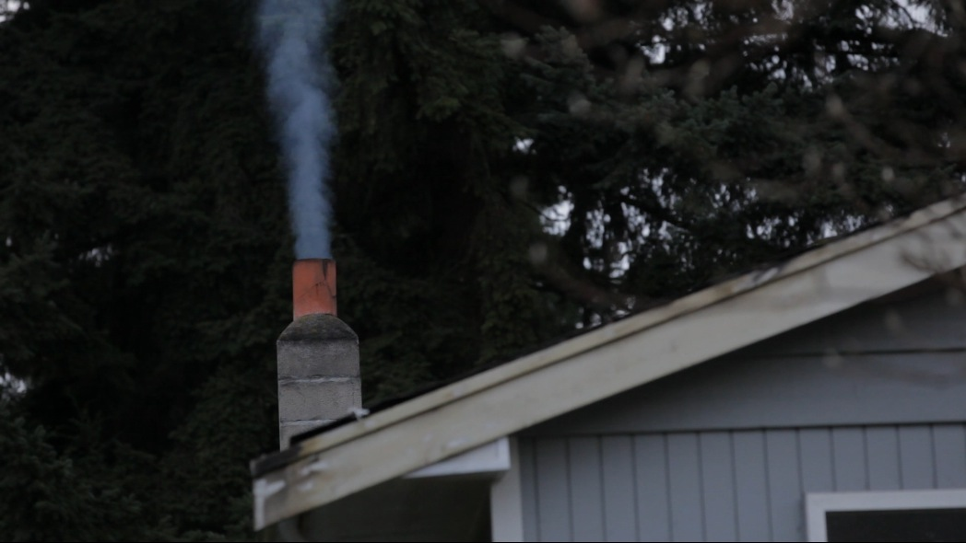
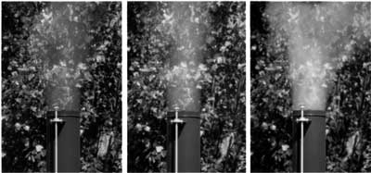
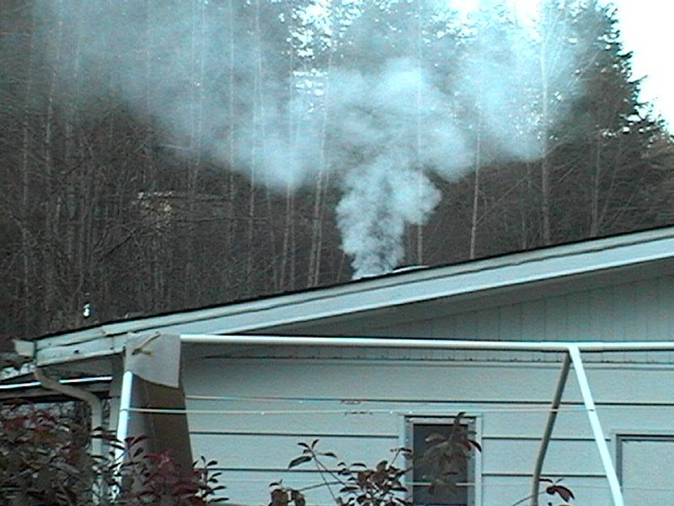
Control the use of wood stoves during FARR Burn Bans in Non Attainment areas: Exemptions for sole source of heat and low income.
Regulate other aspects of wood stove use in order to reduce PM2.5 and “level the playing field” (ex: list of prohibited materials for burning, opacity of wood smoke)
Education/Outreach campaign for “clean burning” : burn only clean dry wood
20%
40%
80%
Notes:
Woodstoves are still allowed during burn bans in nonattainment areas.

Slide 25
Potential FARR Revisions
Expand the scope of the non-Title V permits to add other CAA program requirements (ex: Regional Haze or RACT).
Remove portions of the FARR no longer needed now that Tribal NSR is effective.
Improve and clarify the rules based on implementation experience by R10 and Tribes.

Slide 26
Contacts
Anne Dalrymple, Lead for FARR Revisions, 206 553 6313, dalrymple.anne@epa.gov
Debra Suzuki, Manager, State and Tribal Air Programs Unit, 206 553 0985, suzuki.debra@epa.gov

Slide 27
NEPA Update
EPA R10 Forest Team and NEPA Unit Engagement on Fire and Smoke Management
Finding a balance between landscape restoration needs and protection of human health

Slide 28
Consequences and Trade-offs
All forest treatments have effects on air quality.
What are the air quality trade-offs associated with alternative treatment options?
wildfire, fire use fire, prescribed fire, bioenergy
Forest treatment options also differ in their effects to other resources.
What are the water quality, habitat, and other trade-offs associated with treatment options?
Catastrophic wildfire may have a greater likelihood of increasing in-stream sediment or decreasing shade.

Slide 29
We remain interested in better understanding the problem.
How big is the gap between the acres treated - including mechanical treatments as well as planned and unplanned fire - and the acres that should be treated to restore forest health?
What role does smoke management play in the restoration/ treatment gap?

Slide 30
EPA Region 10 NEPA Review
Clean Air Act Section 309 requires the EPA to review and comment in writing on the environmental impacts of major federal actions.
Significant portion of EPA’s total workload is vegetation management projects, many of which have fire and smoke management issues. These issues are rarely our primary concern.
EPA NEPA review comments have and continue to change in tenor from advocating for fire only as a last resort type option to more readily accepting fire under the appropriate circumstances.

Slide 31
EPA’s Perspective Is Changing
EPA's perspective on smoke management is evolving. Where operationally and economically feasible we favor finding ways to utilize biomass left after harvest. Capturing these short-term sources of climate-change gases for energy production would be beneficial to carbon balances. Further, it would reduce potential air quality impacts.
We also recognize that biomass utilization may not always be operationally or economically feasible - or even environmentally preferable. Many dry forests have been dramatically modified by timber harvest, tree planting, fire suppression and grazing. There is a need to address these forest health issues on a broad (landscape) scale. Mechanical treatments and prescribed fire can be useful in restoring these forests.
Where fire is the appropriate tool, clear communication between fire and smoke managers is key.

