Slide 1
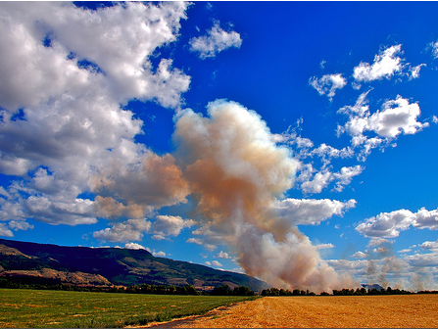
2013 EPA AgSmoke Project
Robert Elleman, EPA Region 10

Slide 2
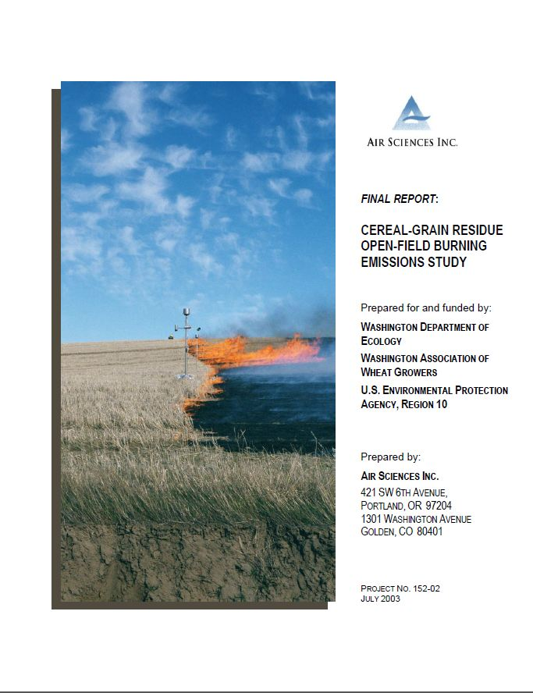
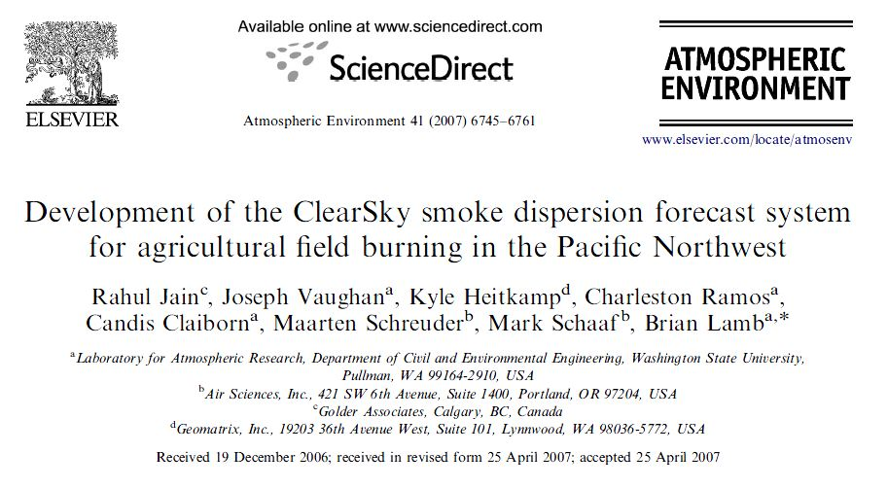
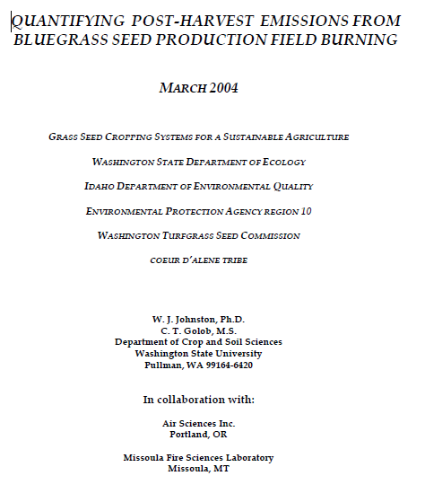
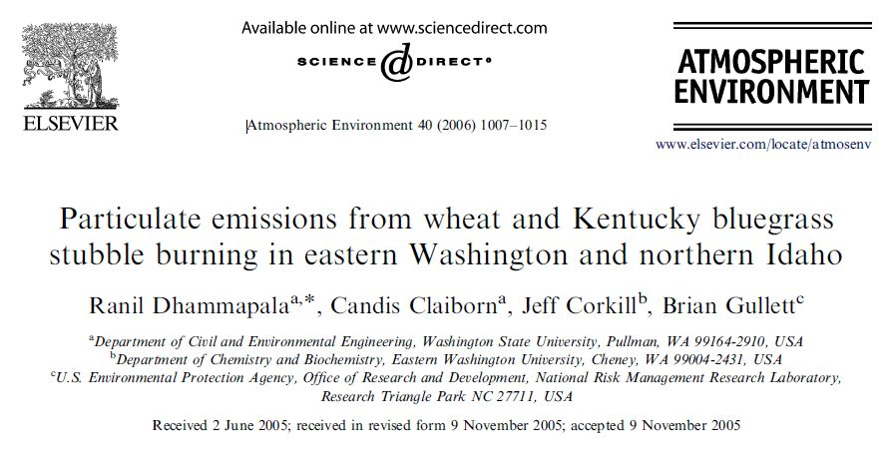
Build on ClearSky

Slide 3
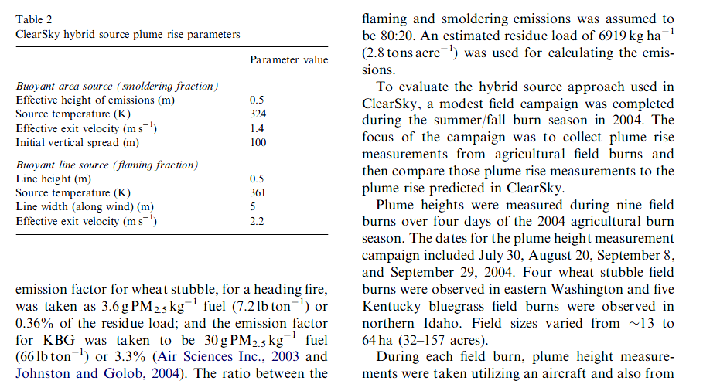
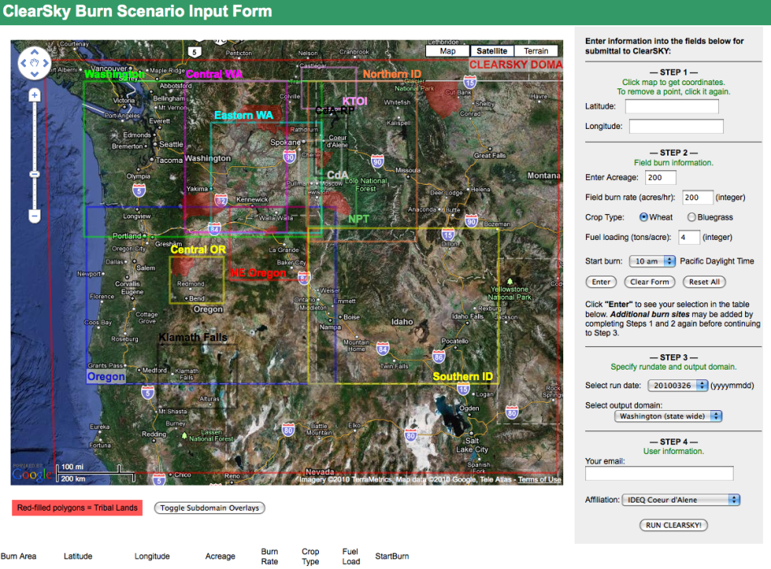
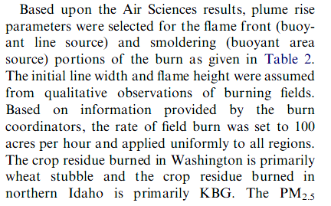
Build on ClearSky
Page 6753 of Jain et al.
Page 6752 of Jain et al.

Slide 4
2013 EPA AgSmoke Project
Measure smoke from agricultural field burning to help Washington State University’s smoke tracer within Airpact-4
Modest study with modest expectations
Need to target effort to highest payoff for model
Partner with Nez Perce Reservation, Washington-Ecology, Idaho DEQ, and WSU
EPA Contacts
Robert Elleman Meteorologist EPA Region 10 Elleman.Robert@epa.gov (206) 553-1531 | Mike McGown Smoke Management Coordinator EPA Region 10 McGown.Michael@epa.gov (208) 378-5764 | Brian Gullett Environmental Engineer EPA National Risk Management Research Laboratory Gullett.Brian@epa.gov (919) 541-1534

Slide 5
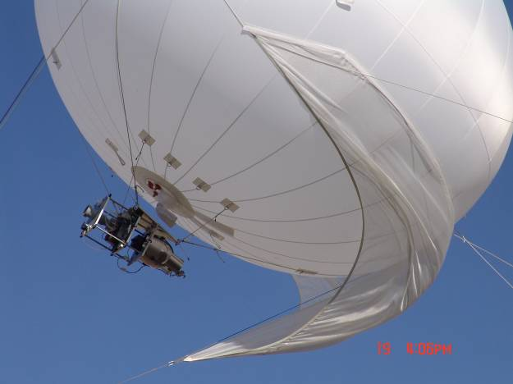
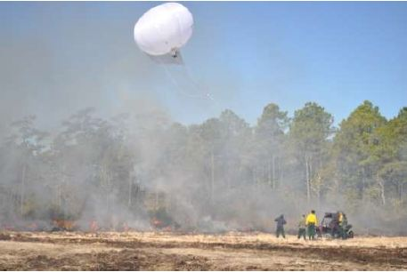
EPA-ORD Instrumented Balloon
CO₂
CO
temperature
GPS
3D wind velocity
black carbon
PM_{2.5}
batch sampling of
VOCs
SVOCs
PM₁₀ and PM_{2.5}
Cl species
PM-borne metals
organic matter

Slide 6
Study Overview
Measure smoke emissions with instrumented balloon and with ground samplers
Seven measurement days during 2013 fall burning season
Ability to move location fairly easily
One or two major locations
Need your help to coordinate measurements with burn locations

