Slide 1
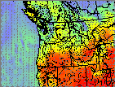

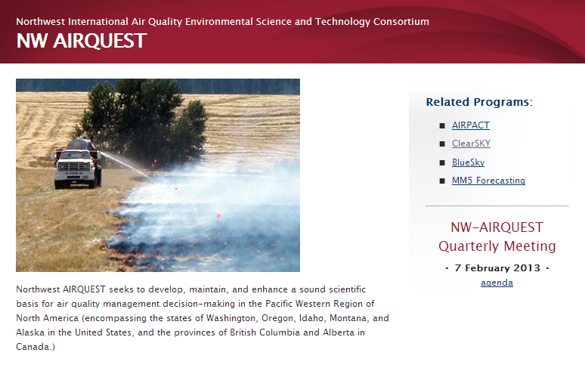
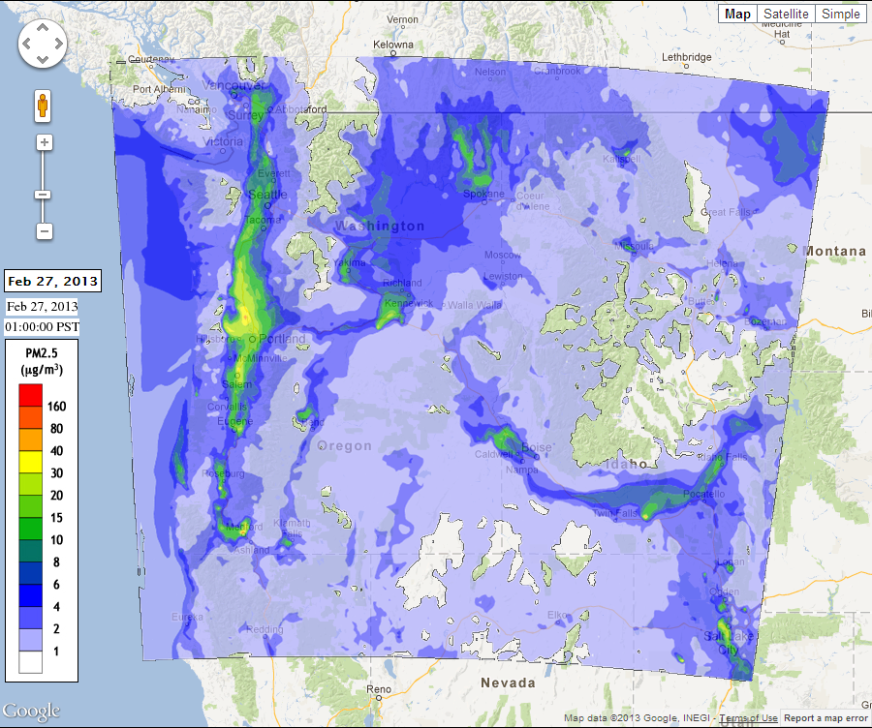
“NW-AIRQUEST Update”
Robert Elleman
EPA Region 10

Slide 2
Northwest Regional Modeling Consortium (NRMC)
NW-AIRQUEST
Started by Puget Sound Clean Air and EPA in mid 90s
Collaborate on meteorological modeling and observations, primarily
Funds UW (Cliff Mass) to produce WRF weather forecasts and catalogue met observations
Funded by Clean Air Act 105 grants, National Weather Service, US Forest Service, Washington DNR, Seattle Public Utilities, Washington Department of Transportation, PNW Tribes, etc.
Sometimes mistakenly referred to as NW-AIRQUEST
Current chair is Rob Elleman, EPA
Off-shoot of NRMC in early 2000s
Collaborate on air quality modeling, emission inventories, analyses, and topical technical issues
Funds WSU to produce air quality forecasts and special projects. Funded with Clean Air Act 105 grant and by PNW Tribes.
Primarily compromised by air quality agencies
As a result, we in the air quality community tend to refer to NW-AIRQUEST when we mean both NW-AIRQUEST or NRMC
Current co-chairs are Phil Swartzendrubber and Eric Saganic, Puget Sound Clean Air
Meteorology
Air Quality

Slide 3
NRMC (WRF, Weather)
Current sustaining members
EPA Region 10
Washington Dept Ecology
Idaho DEQ
Oregon DEQ
Puget Sound Clean Air Agency
Associate members
Environment Canada (P&YR), B.C. Ministry of Environment, US Park Service Pacific West Region
Funding continues to be a problem
Less contribution from National Weather Service, USFS – PNW Research Station, and Puget Sound Clean Air Agency
Less Consortium funding has meant changes in staff at UW
Efforts to pull in heavy users
National Weather Service
USFS – PNW Research Station
Washington Dept Transportation
Seattle Public Utilities
Tribes in PNW

Slide 4
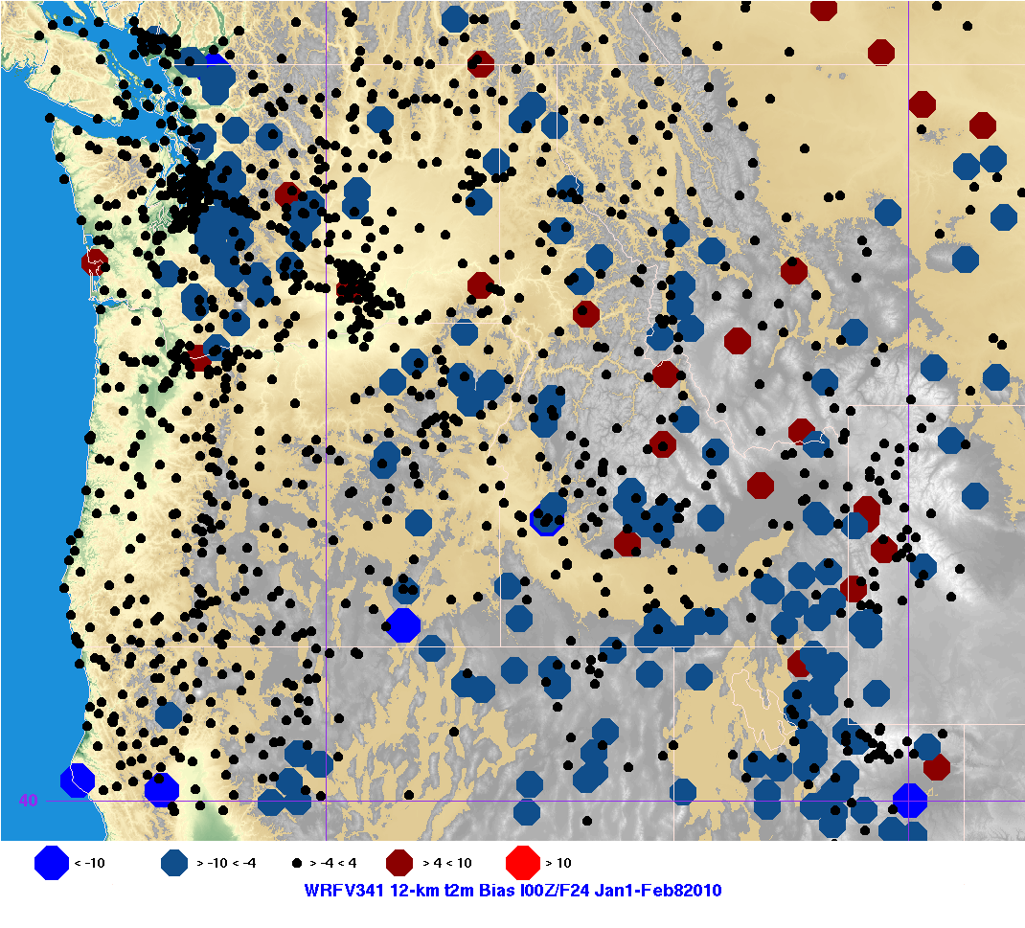
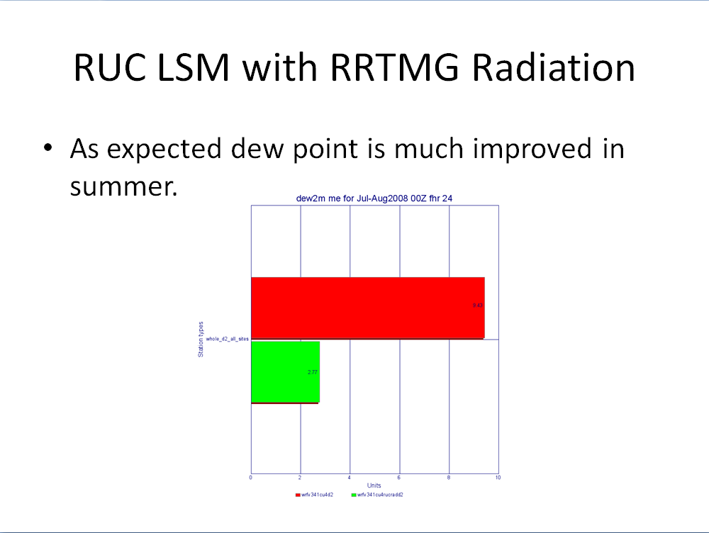
UW WRF Model Enhancements
October 10, 2012
More damping from top of model
Raised model top, thicker damping layer, more layers at top, new damping scheme
WRF 3.4.1
No drag parameterization for now
December 20, 2012
Cumulus parameterization
Simplified Arakawa-Schubert instead of Kain-Fritsch
Coming soon
Radiation model (RRTM-G)
Land surface model (NOAH or RUC)
On horizon
Data assimilation (EnKF)
PBL testing to begin anew in 2013
New drag parameterization

Slide 5
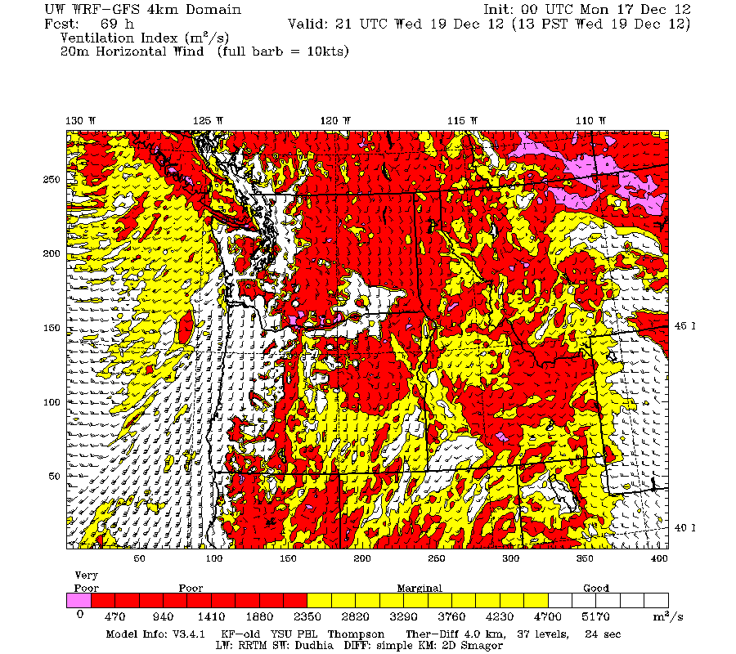
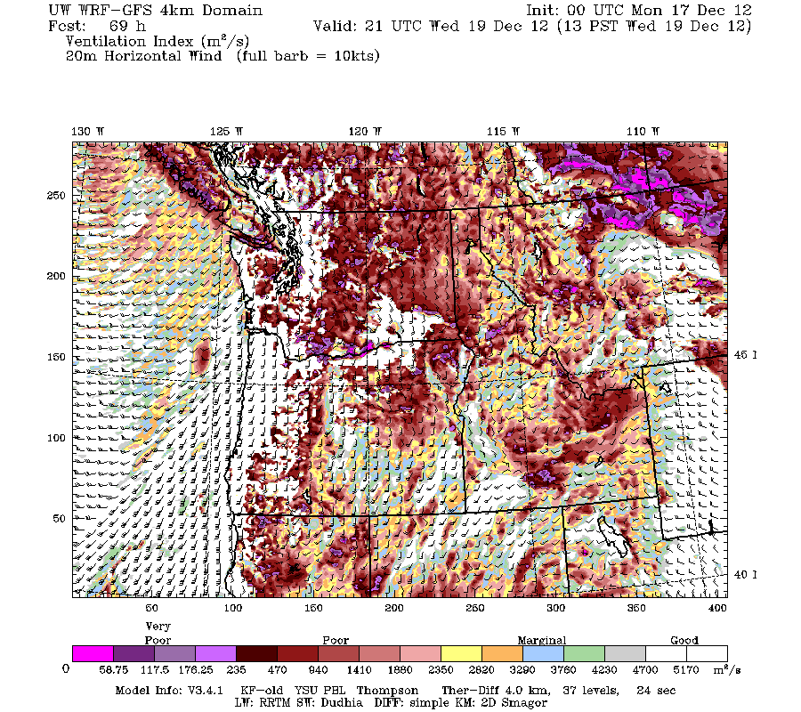
WRF Graphics
Request for input on color scheme for ventilation index: https://docs.google.com/spreadsheet/ccc? key=0AgfoxQEkU1k5dHVDeXRpUzJod GJJeGk0VFRQeWo2QVE#gid=1
More generally, what graphics would help you?
Do we have everything you need?
Changes to current graphics?
Think about it. Contact me: (206) 553-1531, elleman.robert@epa.gov

Slide 6
NW-AIRQUEST Activities
Current sustaining members
EPA Region 10 and PNW tribes
State/Local AQ agencies in PNW
Current collaborative members
Environment Canada
BC Ministry of Environment
Metro Vancouver
USFS Region 6
Workgroups
Emission Inventory
Global Earth Observation System of Systems (GEOSS)
Airpact-4
Changes to ClearSky
Incorporated in Airpact-4 using BlueSky framework
Coarser spatial information than ClearSky, maybe not a bad thing
The rest will covered by Joe Vaughan
UW and WSU
USFS – PNW Research Station
Park Service, Pacific West Region
Washington DNR

