Slide 1
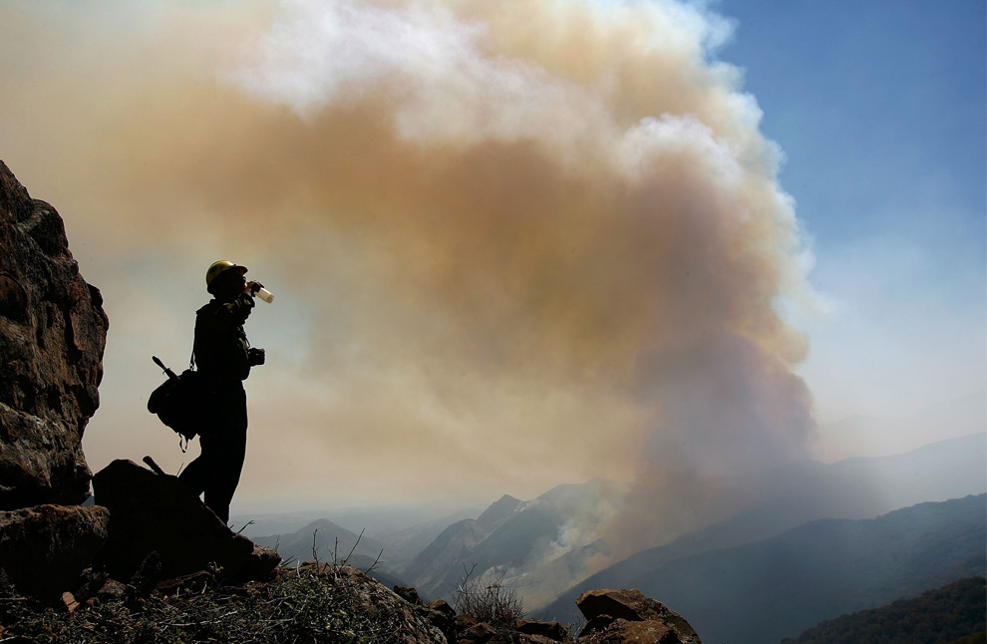

Wildfire Air Quality Response 2012 and Beyond: Where there’s fire,
there’s smoke
Pete Lahm
Forest Service
Fire and Aviation Management
Washington, D.C.
202-205-1084 // 602-432-2614 cell

Slide 2
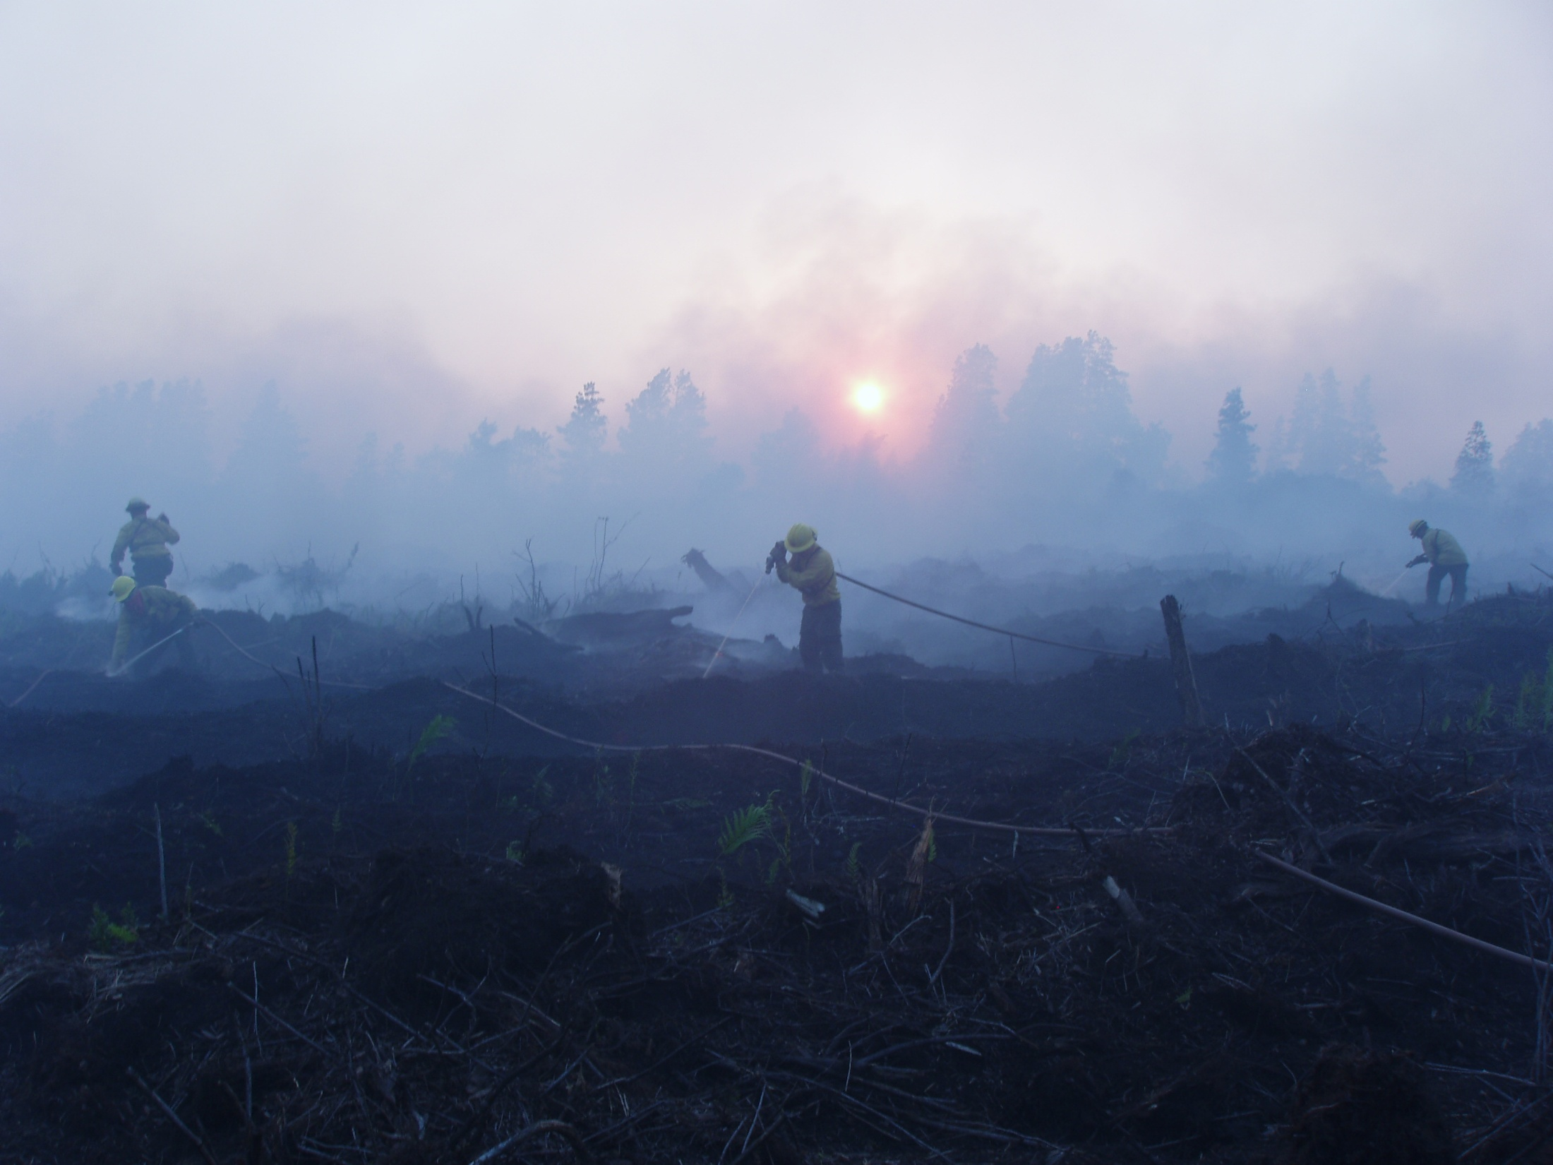
An Evolving Effort (Program)
Air Quality Impacts not Smoke Management
Addressing Public Health Impacts, Transportation Safety and Fire Personnel Exposure
Why an issue now?
2009 Guidance for Implementation of Federal Wildland Fire Management Policy
Stakeholder & Partner collaboration and coordination
Wildland Fire Cohesive Strategy has provided a greater understanding of partner issues and concerns
Wildfire response now uses risk analysis
Wildfires are longer and larger with smoke impacts to fire personnel & public longer with higher levels

Slide 3
An Evolving Effort (Program)
One in three households has someone with respiratory issues: child with asthma, COPD, emphysema, etc.
Address sensitive groups at risk: people with asthma, older adults and those of low income
Smoke impacts to public are longer with higher levels
Fatalities still happening from wildland fire smoke on roads
Work ongoing with EPA, FS and CDC on a national scale
Land managers know more of what the fire will do in terms of: fire spread, growth, intensity, burnouts, fuels, consumption, emissions, weather, duration,…

Slide 4
Interagency Wildland Fire Air Quality Response
National Effort
Cadre of Air Resource Advisors (ARA) Developed
Range of Skills (ARA 1, 2 & 3) (not 310-1 position)
FS, BLM, FWS, NPS, Contractor (EPA & States?)
Coordinated and Assigned via FS Smoke Lead
Multi-tiered Approach
Incident Level
State Level Program Efforts
Area Command
Geographic Area Coordination Centers
Regional Wildfire Decision Support Center

Slide 5
Interagency Wildland Fire Air Quality Response
Incident & regional forecasting & modeling
Collect intelligence to run and interpret models
Monitoring – Deployment, Interpretation and Dissemination (PM2.5)
Community and Base Camp
Transportation Safety Alerts and Response
Cohesive Messaging - Public and Partners:
Community meetings
Area-wide // Multi-incident
Coordinated message (State Health & AQ, NWS)
Planning of AQ impacts of strategy & tactics

Slide 6
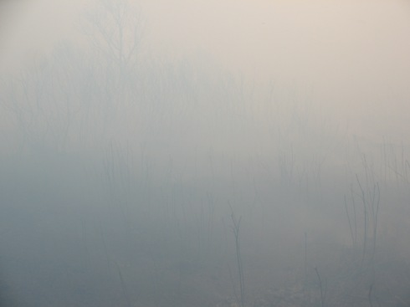
2012 Wildfire Air Quality Response
Requests from: IC, AC, SOPL, FBAN, GACC…
Incidents:
County Line Fire - FL
Dad Fire - NC
High Park Fire - CO
Fontenelle Fire- WY
Halstead & Mustang Fires in ID
Smoke Program Response: AZ, NM, OR, MT, WA
SW ID Area Command
Region 2 Area-wide Decision Support Center
North Zone CA GACC
***Many incidents without direct ARA support issued smoke information and warnings to local affected public and addressed transportation impacts (Inciweb.org)

Slide 7
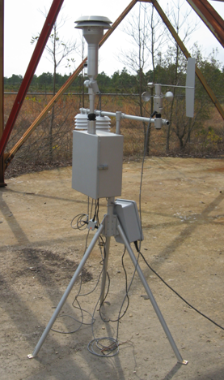
Monitoring:
-15 E-Samplers PM2.5
Tied to GOES available
from NIFC
-Data available on-line at WRCC website & soon on EPA AIRNow
-More in 2013
-Report being written
Many Forests, Refuges and Parks have monitors
➔EPA??? States???

Slide 8
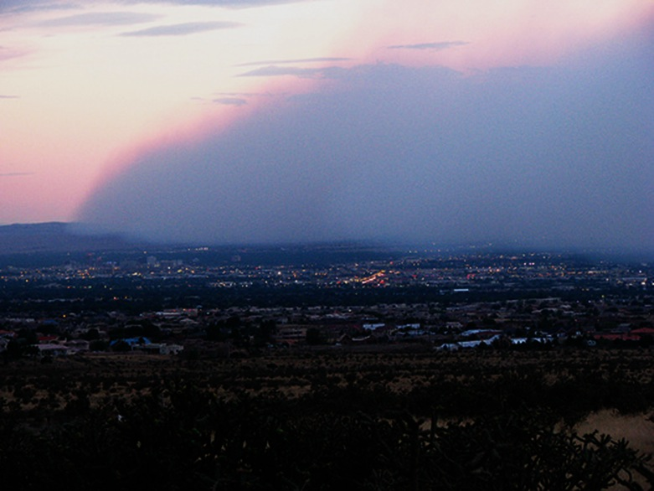
Smoke Information and Predictions
Timely smoke impact information and predictions reduce risk to both fire personnel and the public:
If people know what to expect: plan and react better
People respond when informed of higher risk levels
Sensitive individuals will take protective actions when warned (EPA AIRNow)
Risks and Impacts are individual, local and regional

Slide 9
National AQI - Uniformity Key
Studies show that the U.S. Air Quality Index has an impact – both in terms of changing people’s behavior and in health outcomes.
Important that health messages be consistent
Increase public confidence
Increase exposure reduction measures
Reduce health impacts
Based on best science (NM Pregnant women issue)
Consistency starts with federal agencies
New AQI for PM2.5 promulgated 12/14/12 in effect as of Monday March 18, 2013.
AIRNow display will show the new cutpoints

Slide 10
EPA Projects
Ongoing
Health chapter - USFS Smoke Management Guidelines
Fact sheet for extremely high levels of PM_{2.5} - with CDC, California ARB
PM web course for health care providers - with CDC, which will offer continuing medical education credit
Upcoming
Revise Wildfire Smoke - Guide for Public Health Officials - with federal and state agencies
Revise EPA smoke brochure

Slide 11
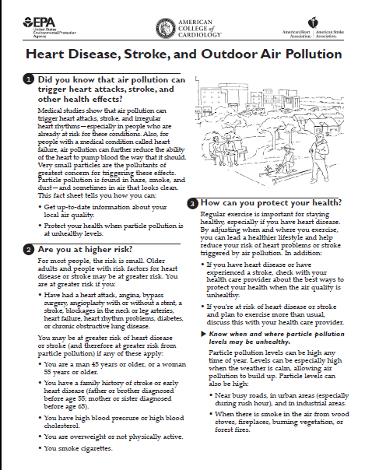
Currently Available Resources
Ozone web course for health care providers - CME through AAFP
Effects of Common Air Pollutants medical poster
Web-based fact sheets
Lung disease - with CDC
Cardiovascular disease - with AHA and ACCP
Particle Pollution and Your Health brochure
School Flag Program factsheet - with CDC

Slide 12
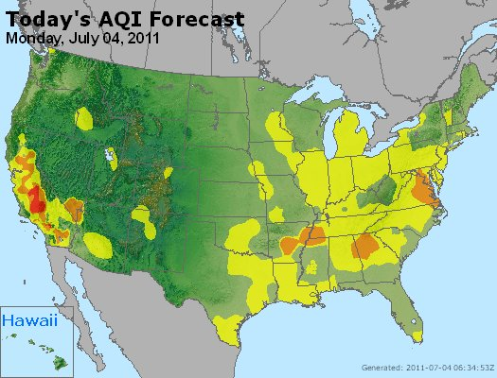
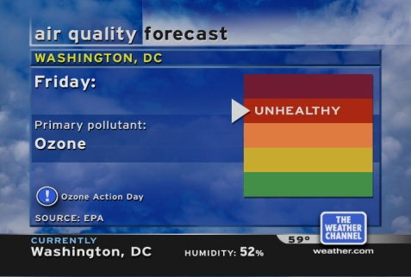
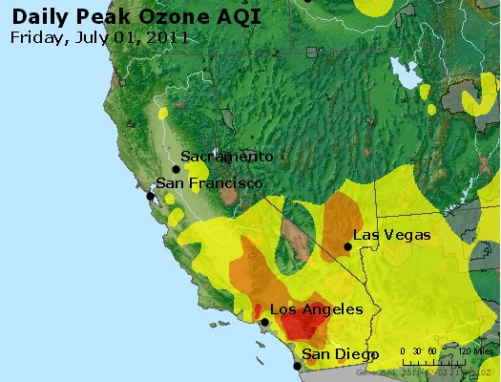
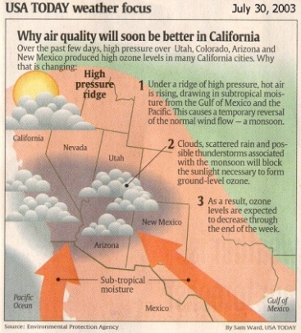
Status
Year Round 24/7 coverage/delivers real-time data (ozone & particles) for 50 States, 6 Canadian Provinces and 24 U.S. National Parks
Exploring the concept of a special smoke section, to be the public’s best resource for air quality information
Next-day AQI forecasts for over 400 cities (summer) and over 300 cities (year-round)
Successful iPhone and Android apps
State-of-the-science information about air pollution health effects for the public, media and stakeholders
Public/private partnerships with The Weather Channel, USA Today, CNN, weather service providers, NOAA National Weather Service

Slide 13
What is the NowCast?
Once known as the “surrogate”
An approach to offer hourly information for pollutants with no hourly standard
Used to calculate a “real time” AQI for public reporting
Gets replaced by the actual NAAQS averaging period the next day, i.e. 24-hour average for PM2.5

Slide 14
Making changes
Wide agreement among stakeholders that the current NowCast does not react quickly to rapid changes
Two main goals for the new NowCast
Capture current hour's PM2.5 concentration and dynamics
Consider previous hours of data as much as possible to approximate a 24 hour average
Considering 3-hour averages as the minimum input, given hourly fluctuations in many instruments

Slide 15
Making changes

Slide 16
Issues and Opportunities
Planning for Wildfire Air Quality Response 2013
Fires of long duration & high spread with heavy fuels = air quality impacts
Develop a plan in advance for response- incident, area, region, partners roles, blogs or existing mechanisms
Building credibility with public, partners & stakeholders through consistent science based messaging
Responding to wildfire air quality not in ICS position training – New to wildfire managers
Responding to 2013 Wildfire Air Quality Impacts
Public health, Transportation safety, Personnel exposure
Early in the incident was a real challenge in 2011 & 12
Not every wildfire needs an AQ response

Slide 17
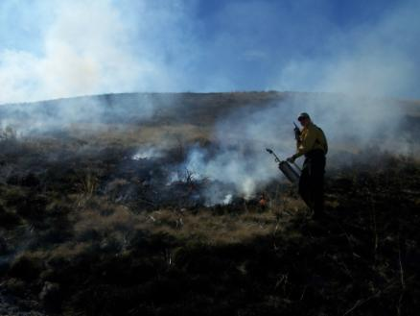
Training Efforts
Air Resource Advisor-
JFSP-supported Training,
March 2013 in Seattle
Smoke Management and Air Quality for Land Managers – Online 90 minute course
Wildfire and Air Quality Decision-making –
4-hr online modular course under development

Slide 18
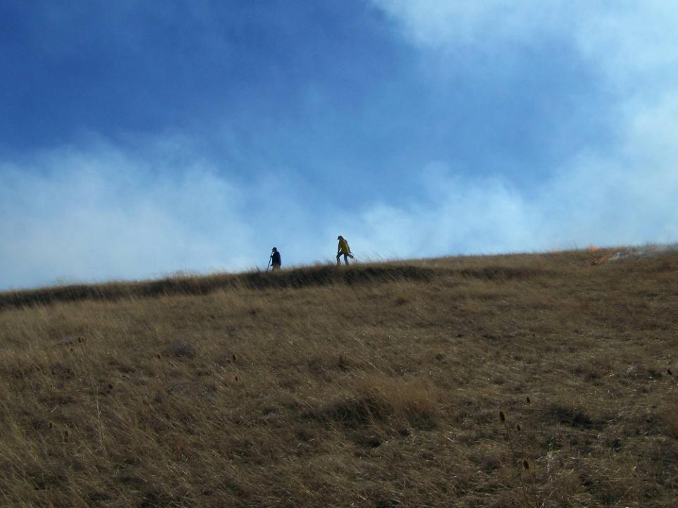
IAWF/NWCG SmoC October 21-25, 2013 College Park, MD International Smoke Symposium
Pete Lahm
202-205-1084 // 602-432-2614 cell
Pete.lahm@gmail.com
The U.S. Department of Agriculture (USDA) prohibits discrimination in all its programs and activities on the basis of race, color, national origin, age, disability, and where applicable, sex, marital status, familial status, parental status, religion, sexual orientation, genetic information, political beliefs, reprisal, or because all or a part of an individual's income is derived from any public assistance program.
Photo courtesy Lorraine Vogt

