Slide 1
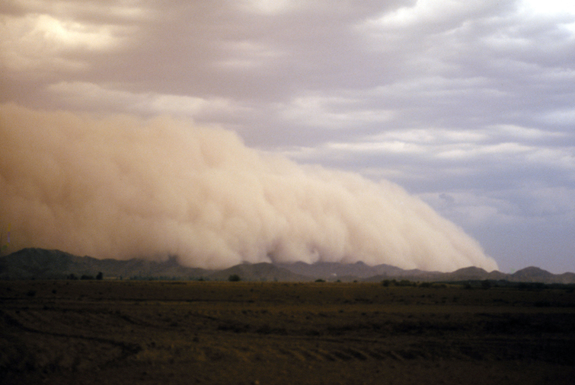

Potential Regulatory Impacts of 2011 and 2012
Exceptional Event Data in Idaho – An Overview
March 14, 2013

Slide 2
EPA – June 2012 Draft EER Guidance 1. The event was not reasonably controllable or preventable. 2. If the event was caused by human activity, that human activity is unlikely to recur at a particular location. 3. Clear causal relationship between specific event and monitored concentration. 4. No exceedance or violation but for the event. EPA’s position is that these four elements represent distinct facts that air agencies must demonstrate for the EPA to concur on an event claim. If the event is natural (e.g. unwanted wildfire) then the second fact is not included in a demonstration.

Slide 3
Regulatory Timelines
Desirable to submit flag and initial description at time of AQS data submittal, i.e. 90 days after the calendar quarter from which data was collected. Deadline is July 1 of year following the event.
Also encourage demonstration submitted by July 1 of year following the event. Deadline is 3 years from calendar quarter during which event occurred, or within 1 year of a regulatory decision (e.g. attainment).
Documentation must be made available by the State for 30 days of public review and comment.
States will consider comments prior to submitting demonstrations to EPA. States must document that a public comment process took place.
Public hearings are not a requirement.

Slide 4
Reasonably Controlled? As with the other elements, whether an event was not reasonably controllable or preventable would be evaluated on a case-by-case basis. EPA would expect for nonattainment areas to already have the technical information needed to reasonably control anthropogenic sources in their jurisdiction. If a set of control measures could reasonably have been in place for contributing sources at the time of the event, then they must have been in place for the event to qualify as an exceptional event under the EER. In general, reasonable controls would not include any control on emissions-generating activity outside of the state or tribal boundaries of the state (or tribal lands) within which the concentration at issue was monitored.

Slide 5
EPA Review of Documentation EPA prioritization of submitted demonstration packages – The EPA will generally give priority to exceptional event determinations that may affect near-term regulatory decisions, such as SIP submittal actions, National Ambient Air Quality Standards (NAAQS) designations, and clean data findings. Following this initial review, the EPA will generally send a letter to the submitting agency that includes a completeness determination and/or a request for additional information, a date by which the supplemental information should be submitted (if applicable), and an indicator of the timing of the EPA’s final review. The EPA anticipates a 60-day response time for states to provide additional requested information. The EPA intends to make a decision regarding event concurrence within 18 months of submittal of a complete package, or sooner if required by a near-term regulatory action.

Slide 6
Exceptional Events Schedule for Initial Area Designations for the 2012 PM2.5 Annual Standard: For data that occurred between 2010-12, flagging must occur by July 1, 2013 and the demonstration would be needed by December 12, 2013. For data in 2013, flagging must occur by July 1, 2014 and demonstration submitted by August 1, 2014.

Slide 7
From EPA (Justin Spenillo – 1/23/2013): As related to Idaho, we are not certain if the exceptional events in the past years will have regulatory significance with regards to the new annual standard. Said another way, if removal of exceptional events data does not lower the annual PM2.5 DV to be below the new standard then it may not be resource efficient to go through the exceptional event process for purposes of initial area designations (there may be reasons for other purposes though). We are working on reviewing the data and would like to make sure the conversation was in progress in the case that a demonstration will be needed on the accelerated schedule.

Slide 8
Recent Exceptional Events In Idaho Salmon PM2.5 - 55 days Franklin PM2.5 - 4 days Pocatello PM10 - 2 days Pinehurst PM2.5 – 27 days Treasure Valley PM2.5 - 3 days St. Luke’s (higher monitor) - 1 day Nampa PM10 - 2 days in 2012 -2 days in 2011

Slide 9
Salmon Data Analysis (2012 - 4th quarter data not QA’d) Annual NAAQS 2012 Annual Average with EE data included = 21.7 ug/m3 Annual Average with EE data excluded = 11.1 ug/m3 2011 Annual Average = 12.9 ug/m3 2010 Annual Average = 10.3 ug/m3 2010 – 2012 three-year average of annual averages = 15.0/11.4 ug/m3 Daily NAAQS 2012 98th percentile with EE data included = 154 ug/m3 98th percentile with EE data excluded = 35 ug/m3 2011 98th percentile = 37 ug/m3 2010 98th percentile = 35 ug/m3 2010 – 2012 three-year average of 98th percentile = 75/36 ug/m3

Slide 10
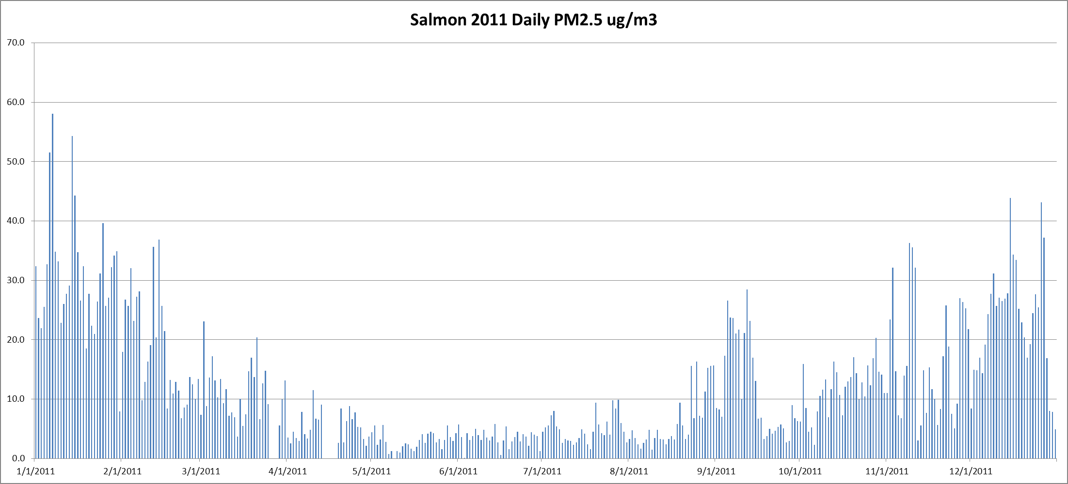

Slide 11
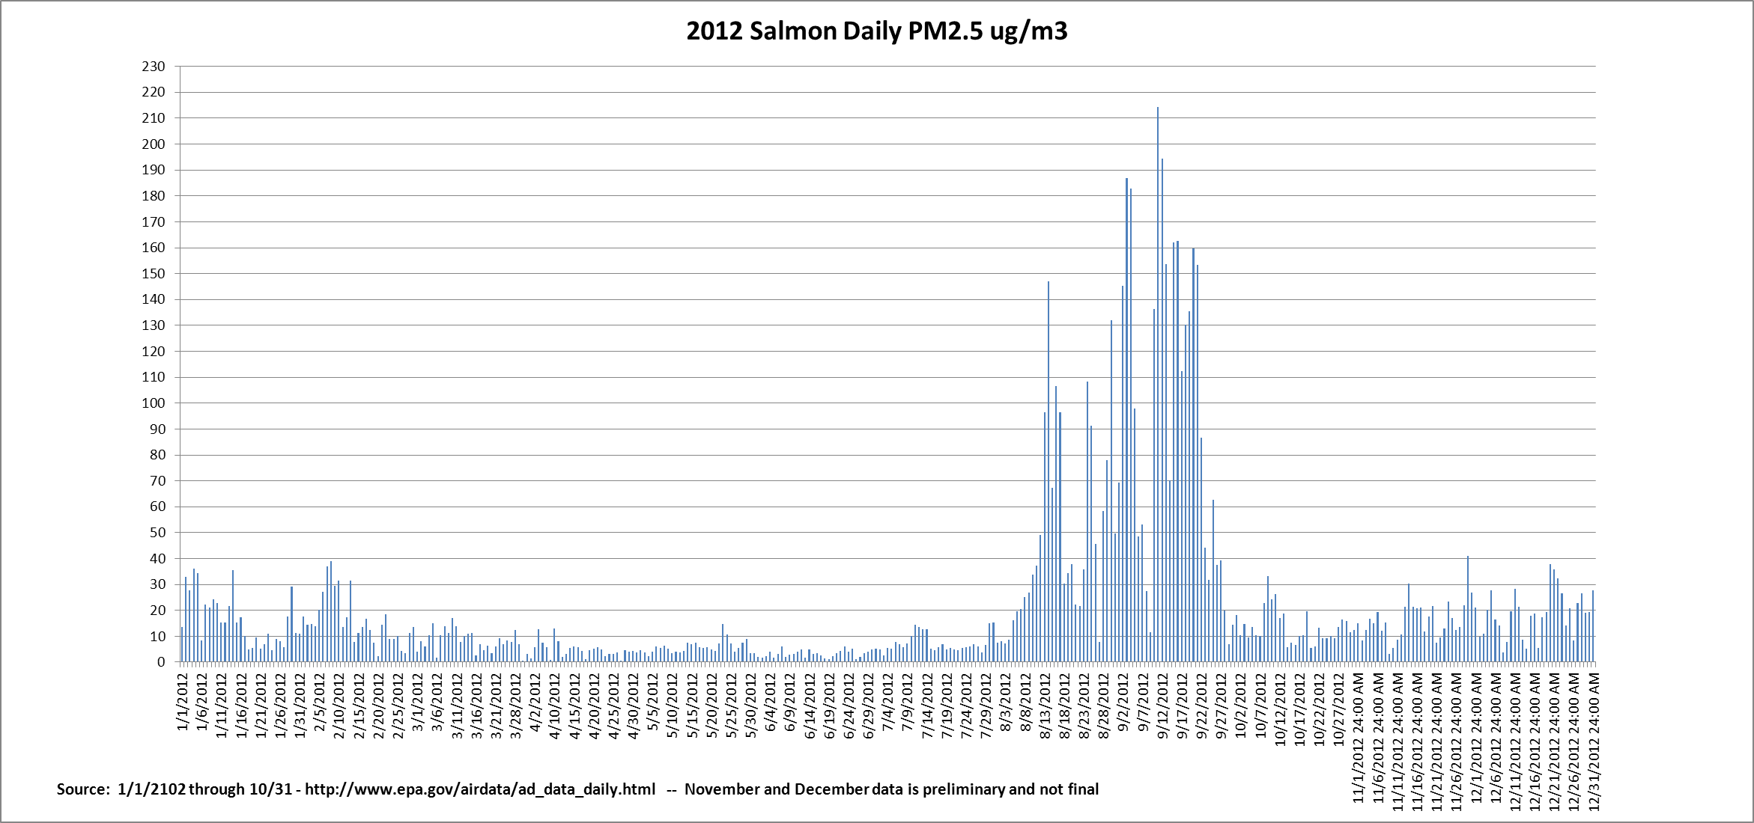

Slide 12
Pinehurst Data Analysis (2012 - 4th quarter data not QA’d) Annual NAAQS 2012 Annual Average with EE data included = 13.6 ug/m3 Annual Average with EE data excluded = 12.9 ug/m3 2011 Annual Average = 11.9 ug/m3 2010 Annual Average = 12.2 ug/m3 2010 – 2012 three-year average of annual averages = 12.6/12.3 ug/m3 Daily NAAQS 2012 98th percentile with EE data included = 38 ug/m3 98th percentile with EE data excluded = 38 ug/m3 2011 98th percentile = 43 ug/m3 2010 98th percentile = 36 ug/m3 2010 – 2012 three-year average of 98th percentile = 39/39 ug/m3 note: filled 3/21/12 – 7/14/12 FDMS data gap with FRM precision data (POC1) – not sure how final 2012 data distribution will look when data in AQS is final.

Slide 13
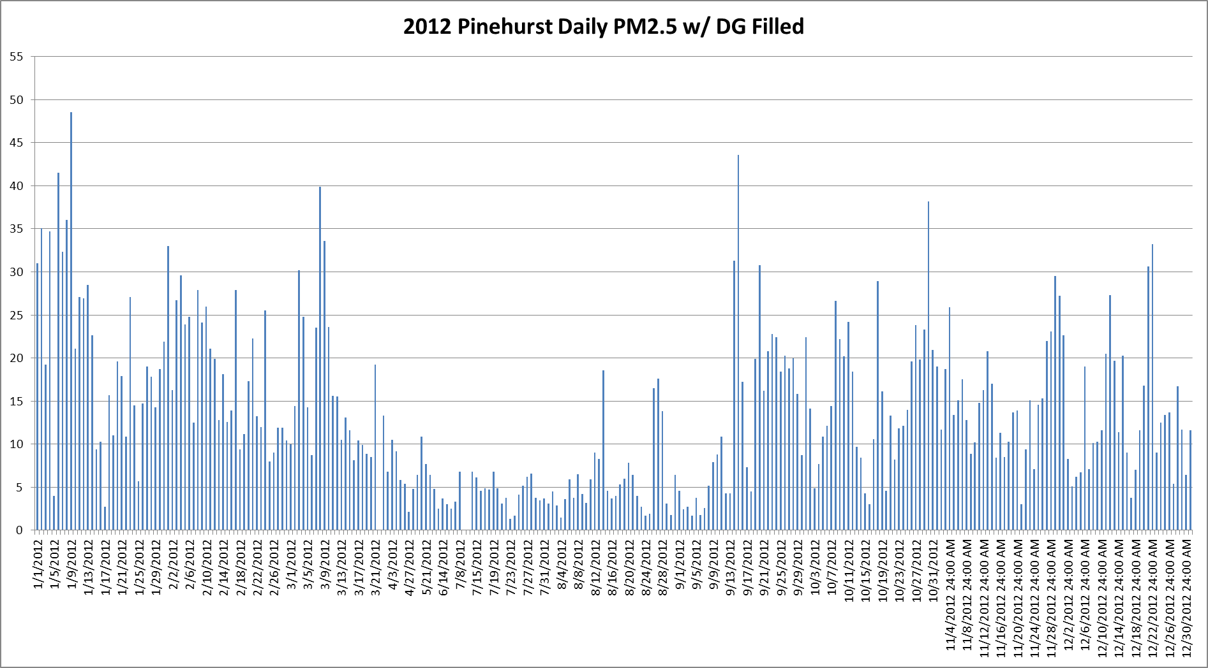

Slide 14
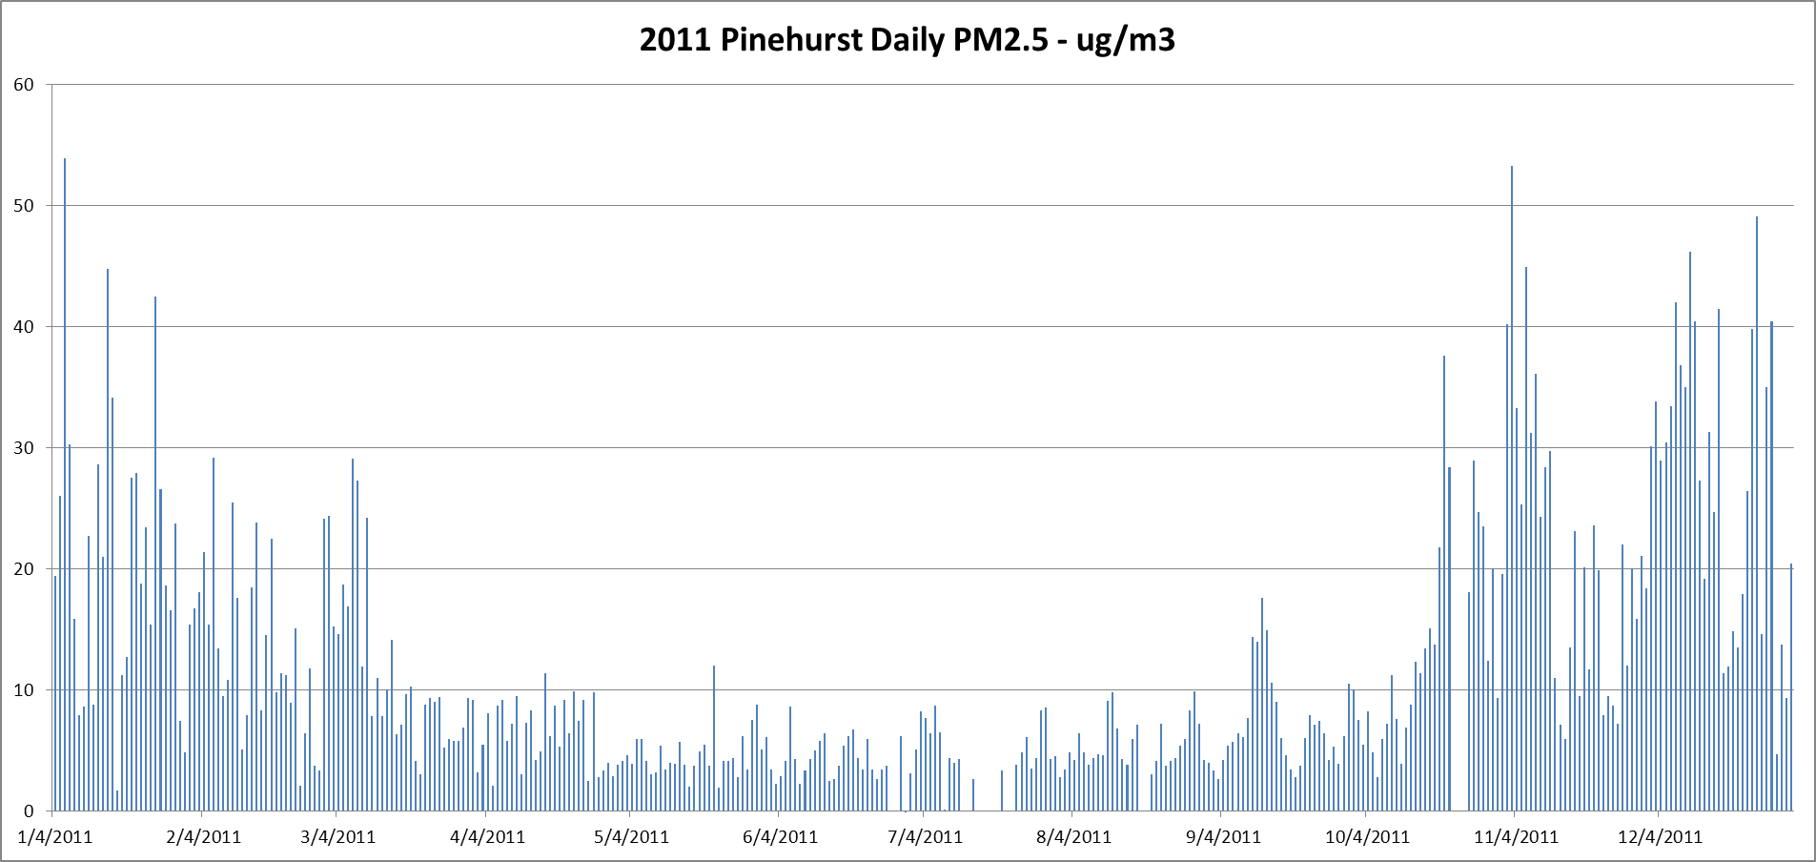

Slide 15
Franklin Data Analysis (2012 - 4th quarter data not QA’d) Annual NAAQS 2012 Annual Average with EE data included = 6.8 ug/m3 Annual Average with EE data excluded = 5.9 ug/m3 2011 Annual Average = 7.4 ug/m3 2010* Annual Average = 16.8* ug/m3 2010 – 2012 three-year average of annual averages = 10.3/10.0 ug/m3 Daily NAAQS 2012 98th percentile with EE data included = 32 ug/m3 98th percentile with EE data excluded = 16 ug/m3 2011 98th percentile = 40 ug/m3 2010* 98th percentile = 70* ug/m3 2010 – 2012 three-year average of 98th percentile = 47/42 ug/m3 *note: 2010 data completeness not met due to site construction – ½ year

Slide 16
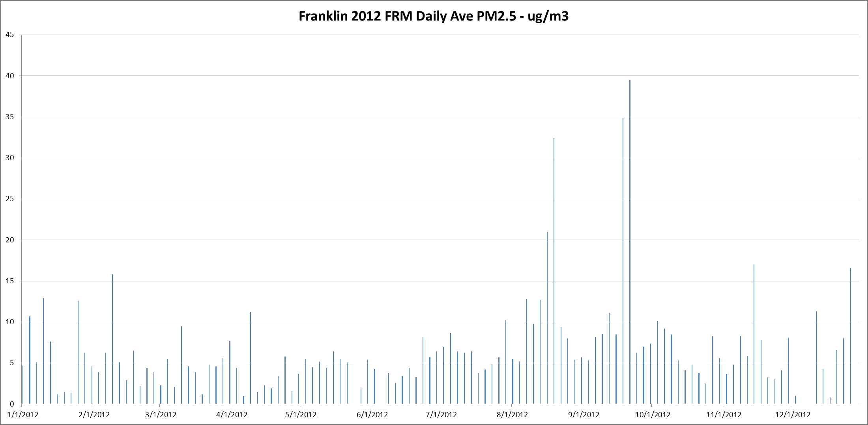

Slide 17
Treasure Valley PM2.5 Data Analysis (2012 - 4th quarter data not QA’d) Boise (St. Luke’s – Meridian) Annual NAAQS 2012 Annual Average with EE data included = 8.5 ug/m3 Annual Average with EE data excluded = 7.3 ug/m3 2011 Annual Average = 7 ug/m3 2010 Annual Average = 5 ug/m3 2010 – 2012 three-year average of annual averages = 6.8/6.4 ug/m3 Daily NAAQS 2012 98th percentile with EE data included = 42 ug/m3 98th percentile with EE data excluded = 22 ug/m3 2011 98th percentile = 29 ug/m3 2010 98th percentile = 12 ug/m3 2010 – 2012 three-year average of 98th percentile = 28/21 ug/m3

Slide 18
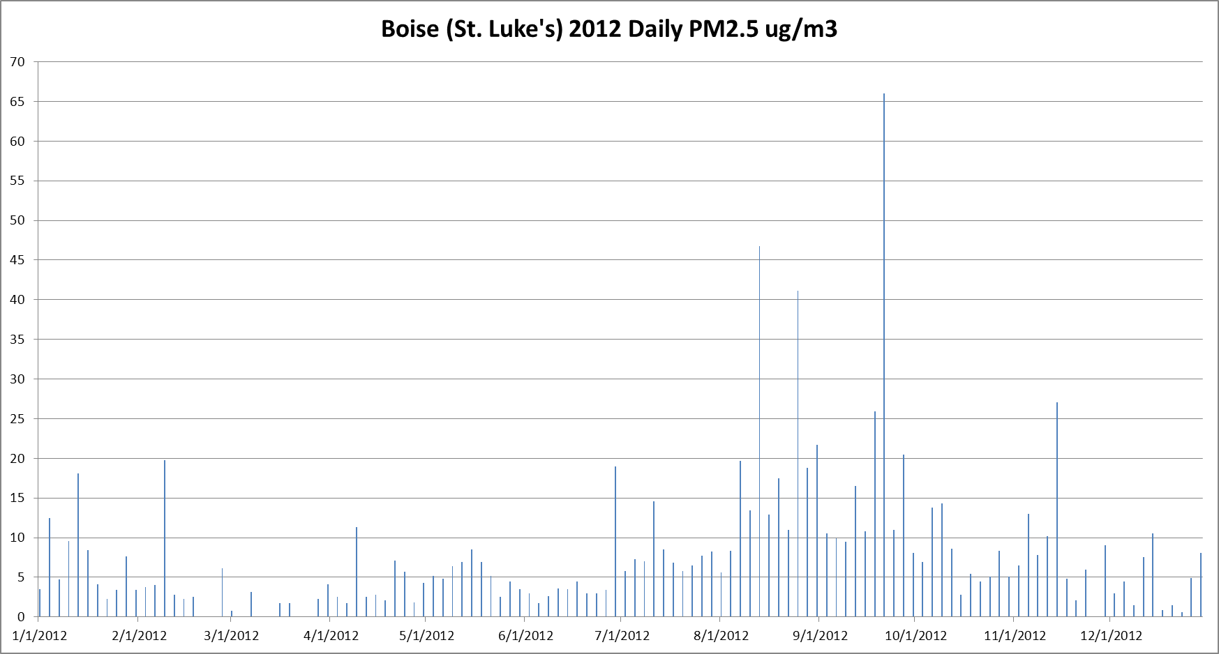

Slide 19
Nampa Fire Station (2012 - 4th quarter data not QA’d) Annual NAAQS 2012 Annual Average with EE data included = 10.6 ug/m3 Annual Average with EE data excluded = 9.8 ug/m3 2011 Annual Average = 8.9 ug/m3 2010 Annual Average = 5.9 ug/m3 2010 – 2012 three-year average of annual averages = 8.5/8.2 ug/m3 Daily NAAQS 2012 98th percentile with EE data included = 27 ug/m3 98th percentile with EE data excluded = 25 ug/m3 2011 98th percentile = 23 ug/m3 2010 98th percentile = 15 ug/m3 2010 – 2012 three-year average of 98th percentile = 22/21 ug/m3

Slide 20
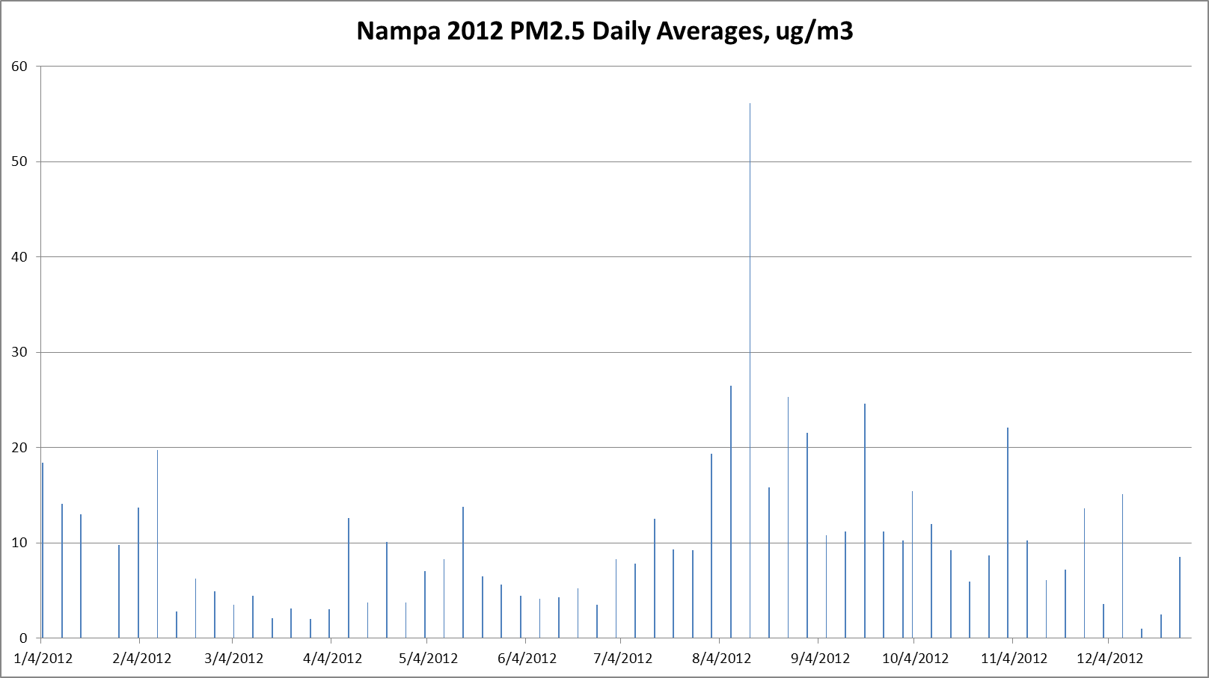

Slide 21
Treasure Valley PM10 Data Analysis (2012 - 4th quarter data not QA’d) Number of Exceedances – Boise Fire Station 2010 0 2011 2 2012 2 2010-2012 3-yr average = 1.3 which violates NAAQS Number of Exceedances – Nampa Fire Station 2010 0 2011 1 2012 1 2010 – 2012 3-yr average = 0.7 All high wind exceptional events

Slide 22
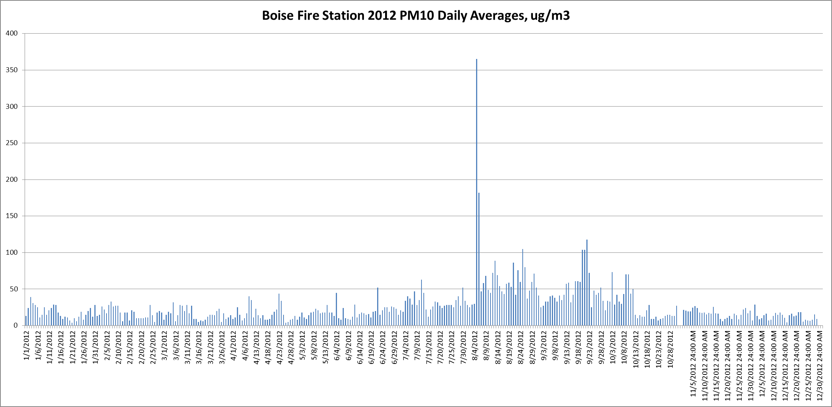

Slide 23
Moving Forward
Which EE data is priority to DEQ for documentation and EPA concurrence?
Regulatory Significance?
Attainment decisions.
SIP Maintenance demonstrations/modeling and design values.
Which EE data is priority to EPA for documentation and EPA concurrence?
Does EPA concur that DEQ has reasonable controls for high-wind dust events in Pocatello and Treasure Valley?
Exceptional Event Documentation Work Process - ?
Schedule?
Team?

