Slide 1
Handheld Air Quality Monitoring
Gary Olson
EPA R-10
Office of Air, Waste and Toxics

Slide 2

The Federal Air Rules for Reservations (FARR)
Established in June, 2005

Slide 3

Purpose of the FARR
These rules create basic federally-enforceable air quality regulations on the 39 Indian reservations in ID, OR, & WA in order to protect human health and the environment.
These rules “level the playing field” and ensure that residents within the boundaries of the reservations enjoy air quality protection similar to that existing outside the reservations.

Slide 4

Who is subject to the FARR?
The FARR applies to all persons and businesses located within the federally-recognized exterior boundary of the reservation.
The FARR applies to everyone inside the federally-recognized exterior boundary (applies to both fee and trust land).
fee
Tribal trust land outside the boundary: the FARR does not apply
trust
trust

Slide 5
Tribal Air Monitoring Goal
Develop approaches, procedures, processes which ensure that the right kind and quality of data is being collected and used to answer the highest priority questions about air quality in Indian country optimally using the resources available.

Slide 6
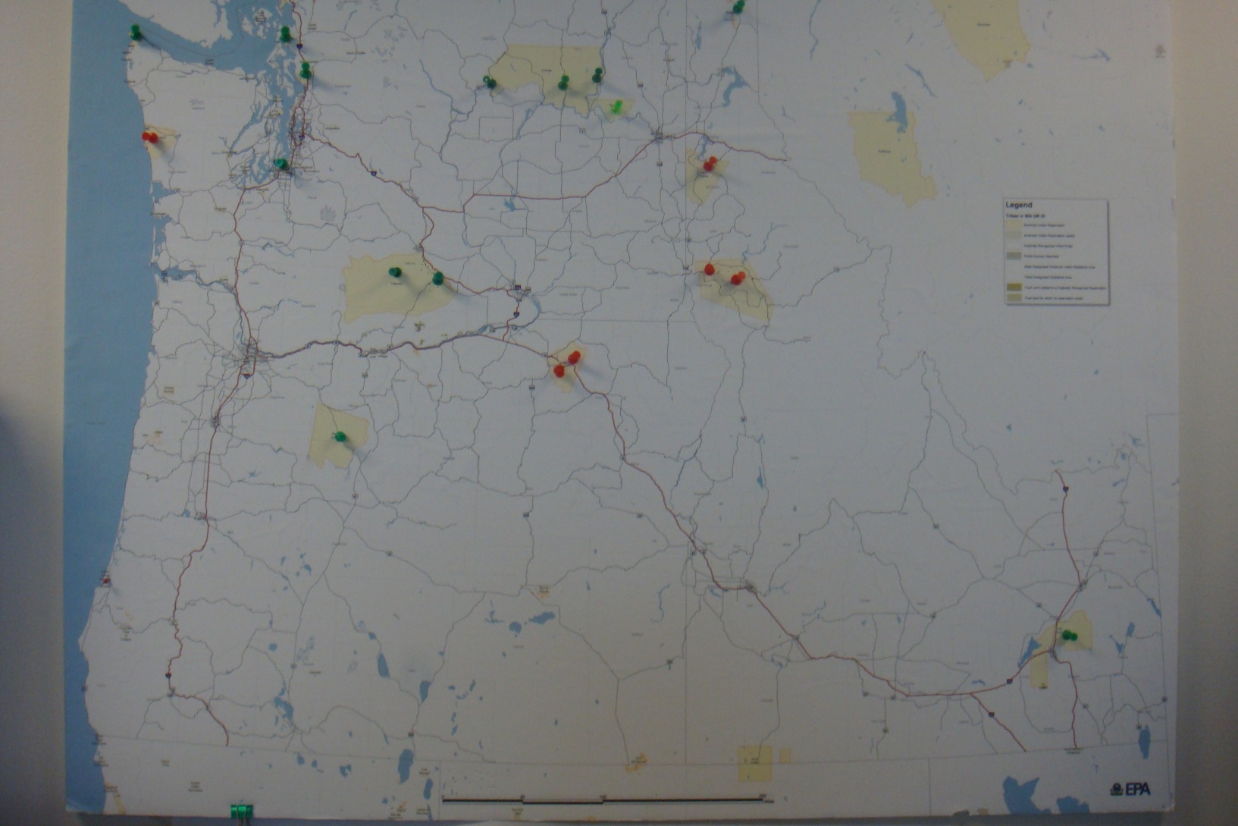
Tribal Monitors in Region 10

Slide 7
Stationary Tribal Monitors
PM 2.5 Nephelometers
PM 2.5 and PM 10 BAMs
PM2.5 and PM 10 TEOMs
22 Stationary PM monitors on 15 reservations
Also have NO2 and O3 on one Reservation
Some Additional monitoring based on situation

Slide 8
Complaints and Concerns
EPA maintains a FARR complaint hotline
Tribal Air Quality Staff handle air quality complaints
There are a number of emission sources on Reservations
Although odors are not regulated under the FARR we have had strong public concern over these.

Slide 9
Problem
Complaints and Concerns are not usually occurring where monitoring is present
We are not monitoring for what the complaint or concern might pertain to

Slide 10

Reason for Obtaining Handheld Monitors
Gain better information about a repeating complaint
Be better able to investigate air quality concern
Be able to determine if changes/ improvements are occurring
Build overall capability of Air Staffs

Slide 11
What we needed in a monitoring system
Detect Air pollutants at a meaningful level for our needs ( generally PPM)
Equipment is easy to use and transport
Equipment is robust
Data is real time and also easy to store and analyze
Cost of equipment is reasonable.
Advantage if could be used for Indoor Air

Slide 12
What we wanted to analyze
PM 10 and PM 2.5
VOC’s
Sulfur Dioxide
Nitrogen Dioxide
Carbon Monoxide
Hydrogen Sulfide
Ammonia
Carbon Dioxide

Slide 13
Equipment
MultiRAE Gas Monitor - has sensors for simultaneously measuring Ammonia, Hydrogen Sulfide, Nitrogen Dioxide, Sulfur Dioxide and Carbon Monoxide, and VOC’s.
EVM-3 Monitor - has sensors to monitor PM10, PM -4 and PM 2.5 (one at a time) and Carbon Dioxide and Carbon Monoxide as well as temperature and humidity.
Colorimetric Tubes and pump – can measure several gases – one at a time .

Slide 14
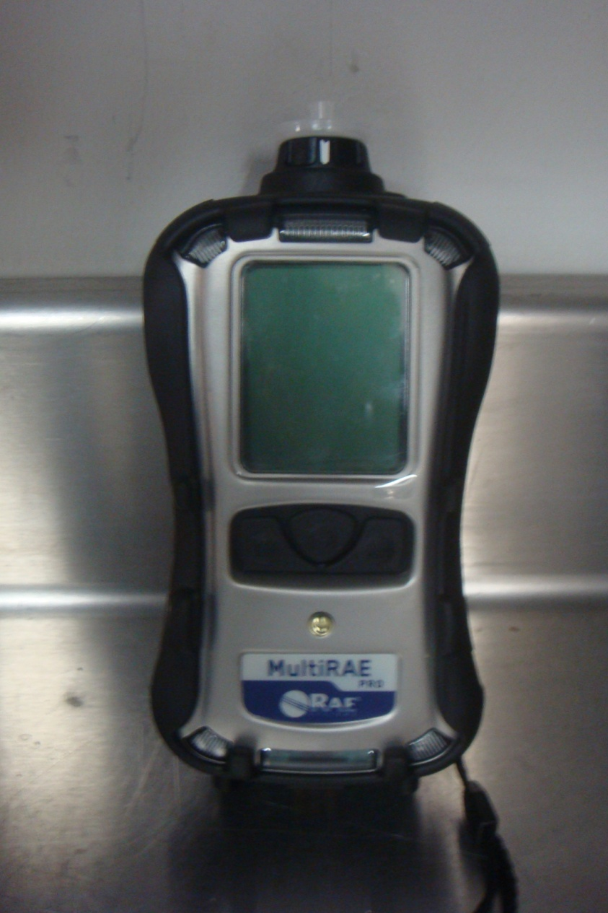
MultiRAE Handheld Gas Monitoring

Slide 15
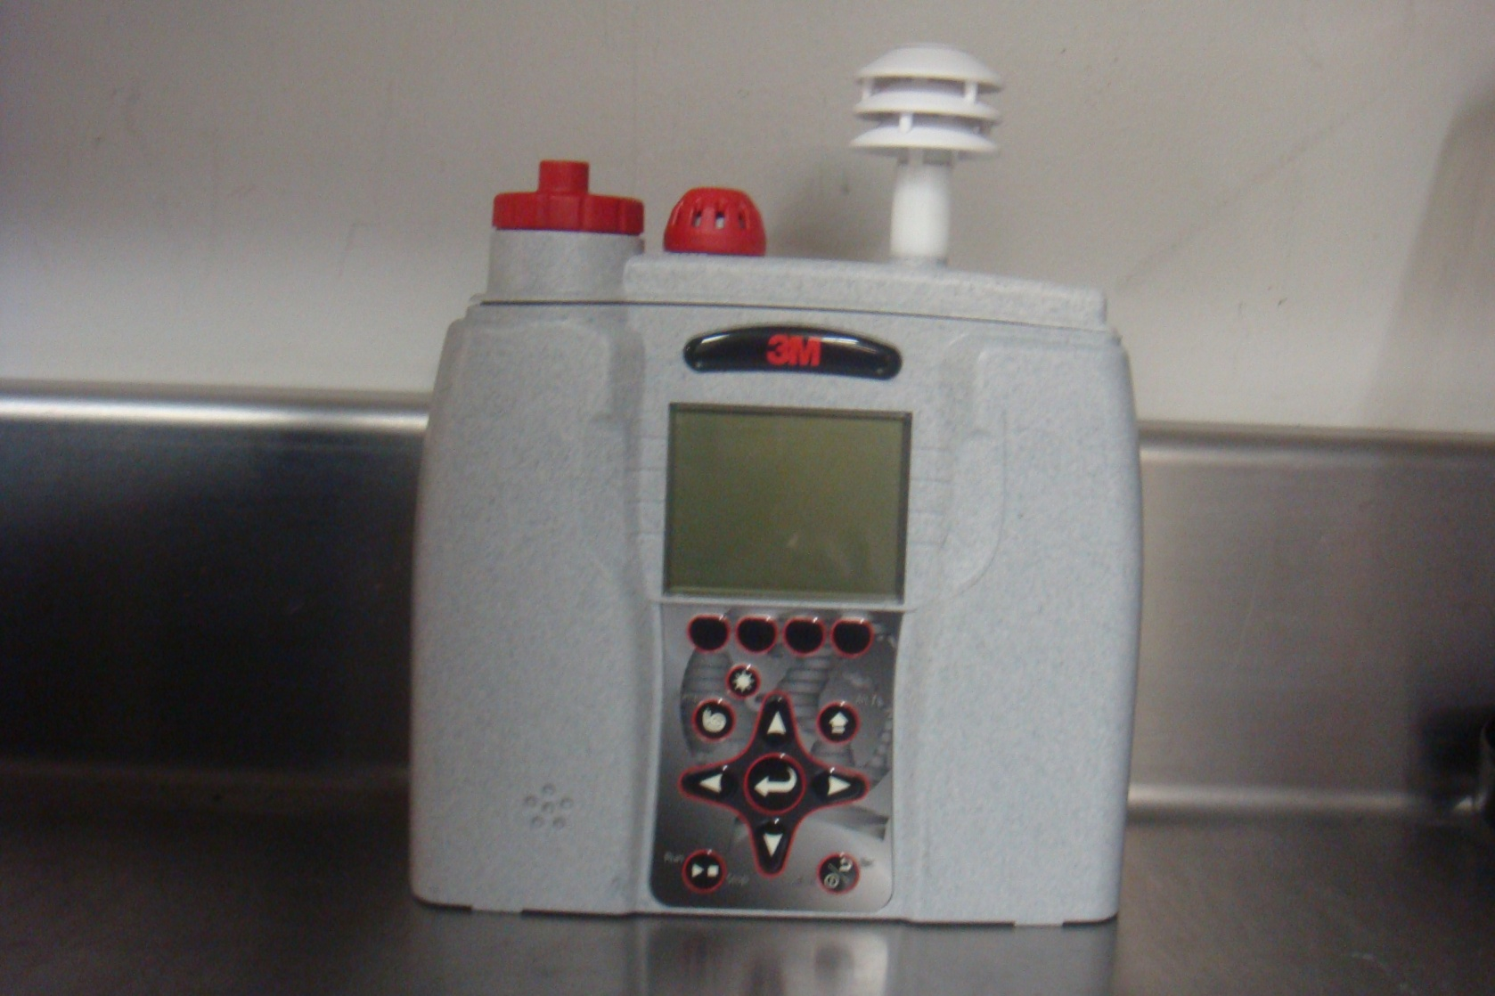
EVM-3 Handheld Gas Monitoring

Slide 16
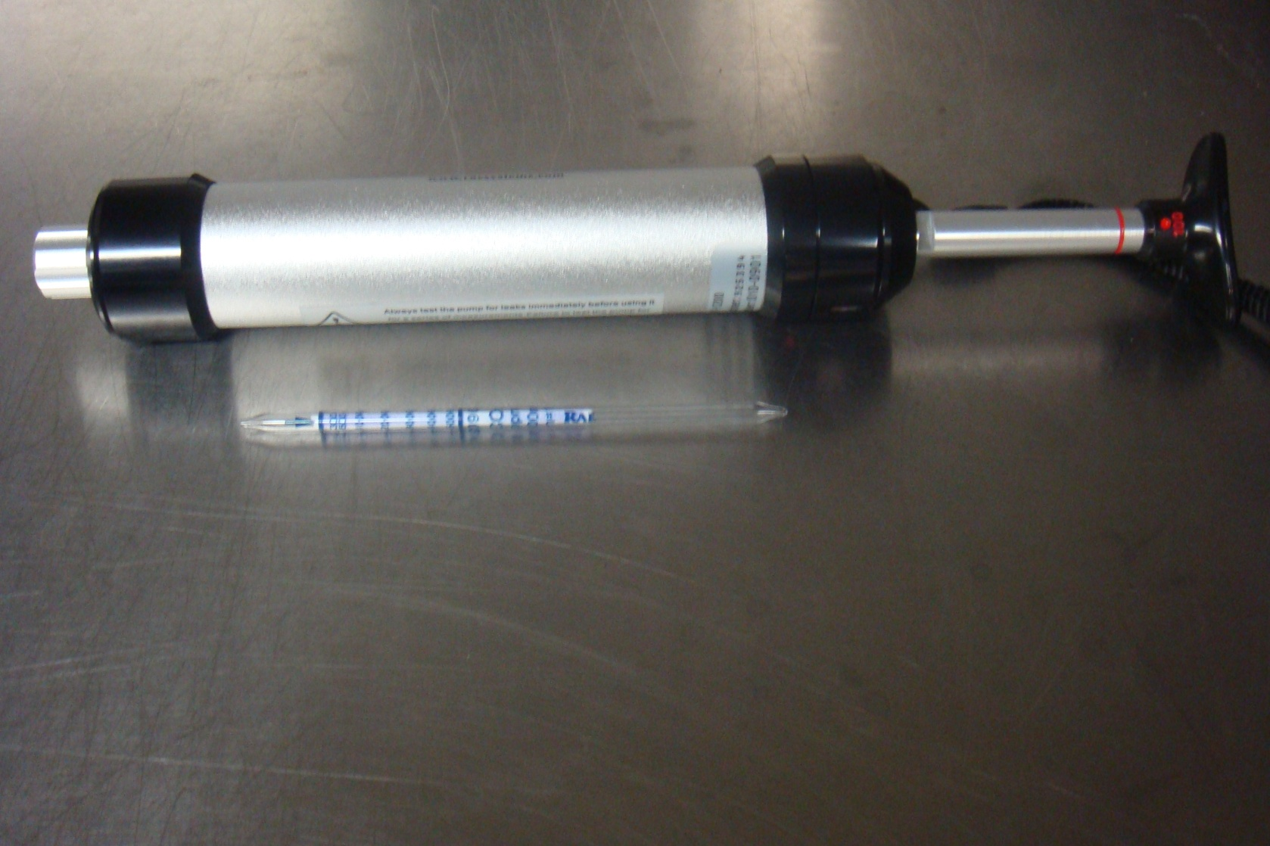
Colorimetric Tubes and Hand Pump

Slide 17
Important Condition for Use
It is important to note that this equipment is to be used for investigation purposes or to increase the understanding of air quality. This equipment is not intended to be used for regulatory or enforcement purposes. It also should not be used for safety evaluations for situations like a confined space evaluation for safety to enter.

Slide 18
QAPP Developed for this Equipment
Program background
Goals and Objectives
Training and Record Keeping
Experimental Design
Quality Control
Data Handling
Reports

Slide 19
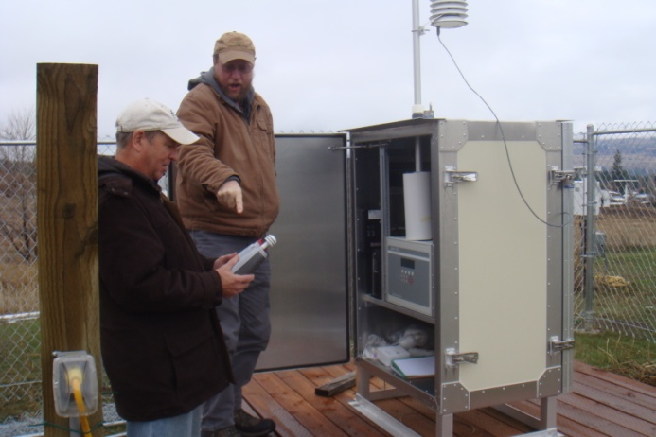
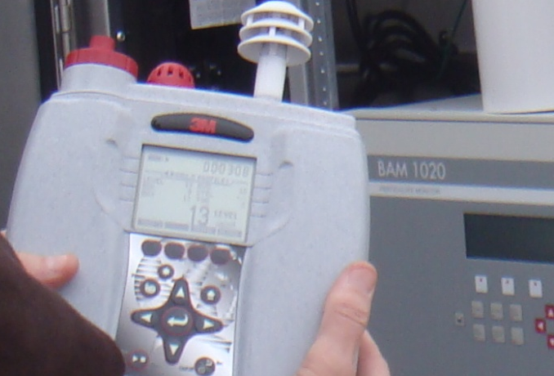

Slide 20
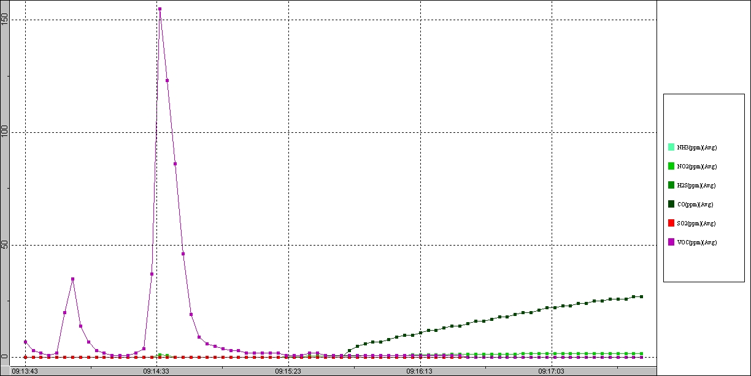
Graph of MultiRAE Results

Slide 21
EVM Report

Slide 22
Questions and Contact Info
Gary Olson
Tribal and Air Toxics Unit
Office of Air, Waste and Toxics
EPA R-10
Olson.gary@epa.gov
206-553-0977

