Slide 1
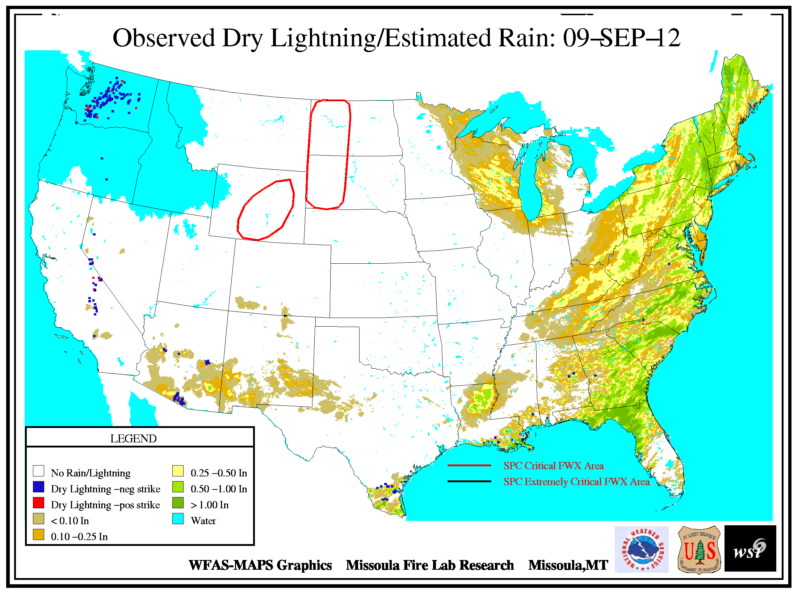

Slide 2
Washington Major Fires 2012 | Acres
Wenatchee Complex (Canyon, Byrd, Poison, Peavine, First Creek, Pyramid, Klone, Cashmere, Basalt, White Pine, Cuitin Lake, Sears Creek, 469 Fire, Upper White, The Maverick, Mule, John, Signal Peak) | 56,478
Table Mountain | 42,312
Cascade Creek | 20,296
Okanogan Complex | 6,169
Yakima Complex | 2,300
Goat | 7,378
Taylor Bridge | 23,500
St Mary’s Mission Road | 16,853
Buffalo Lake Road | 11,299
Barker Canyon | 81,155
Apache Pass | 23,202
Leecher, Highway 141, Diamond Butte, Lost Monument, Mt Barney, Three Lakes | 3,000
 | 294,000

Slide 3
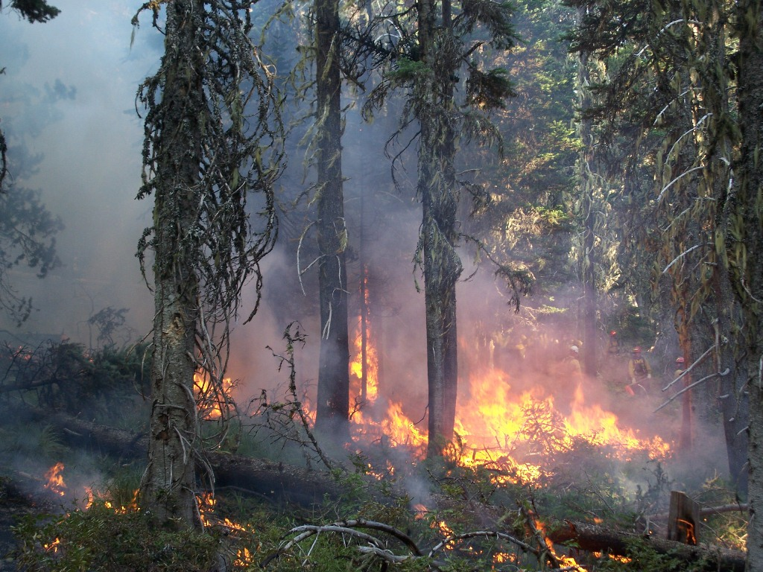
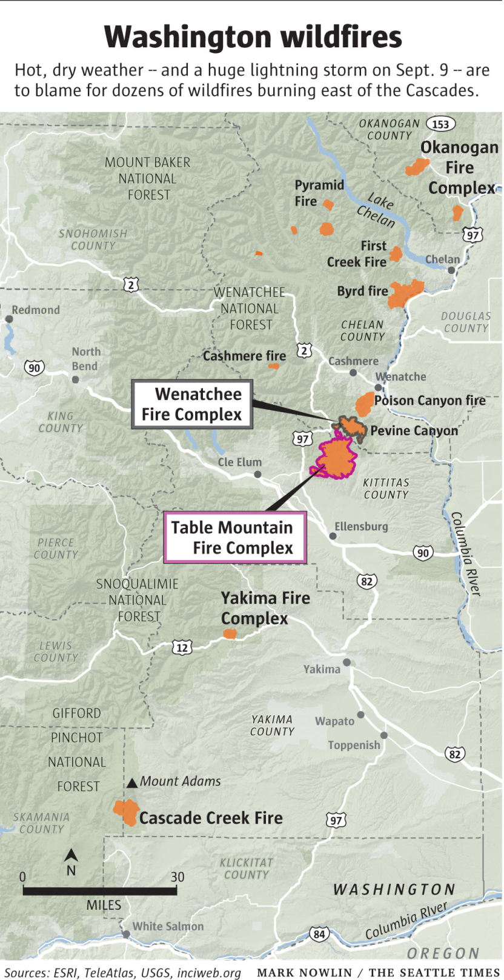

Slide 4
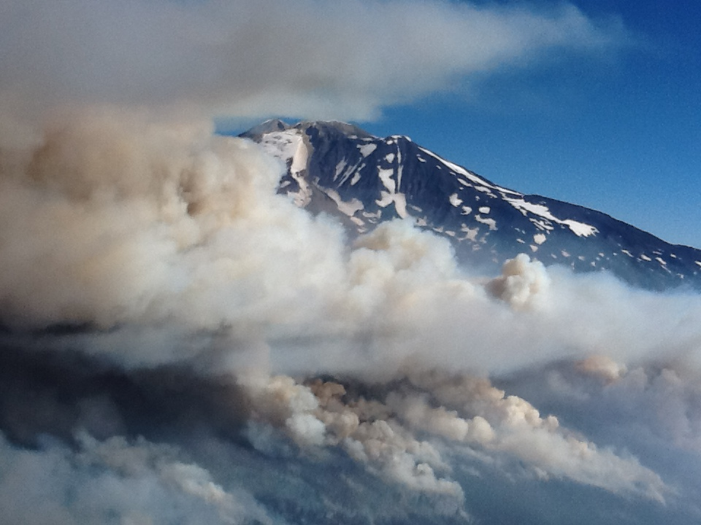
WA 2012 Smoke Incident Working Teams
Technical Issues
Meteorology/Dispersion
Air Quality Monitoring
Fire Reports
Communications
Coordination/Messaging
Public Information Tools

Slide 5
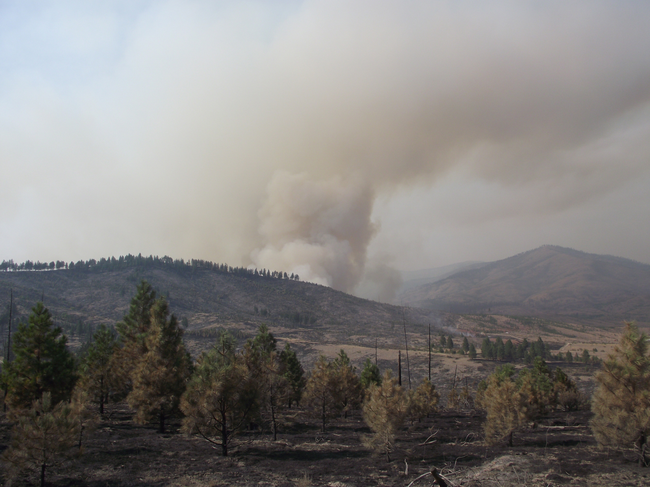

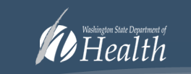






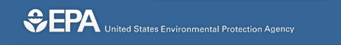
Partners

Slide 6
Roles
Forest Service | State Department of Ecology | Local Health Districts
Coordination of Partners | Weather forecasts, meteorological modeling | Public communications
Fire Info. (growth, burn-outs, meteorology) | Daily monitoring data summaries | Advice for schools
Smoke modeling and interpretation (BlueSky, Hysplit) | Conversion of monitoring data to health warning levels (WAQA) | Indoor monitoring assistance
Supplemental monitoring (cache E-Samplers) acquisition and support | Coordination with other state agencies (Dept. of Health, Emergency Mgmt.) | Advice and distribution of masks
General skunk-works | Health messaging
Fire camp exposures and employee health | Press releases

Slide 7
Forest Service Monitoring Sites

Slide 8
Experimental CO Monitoring

Slide 9
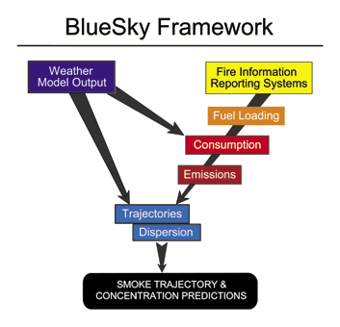

Slide 10
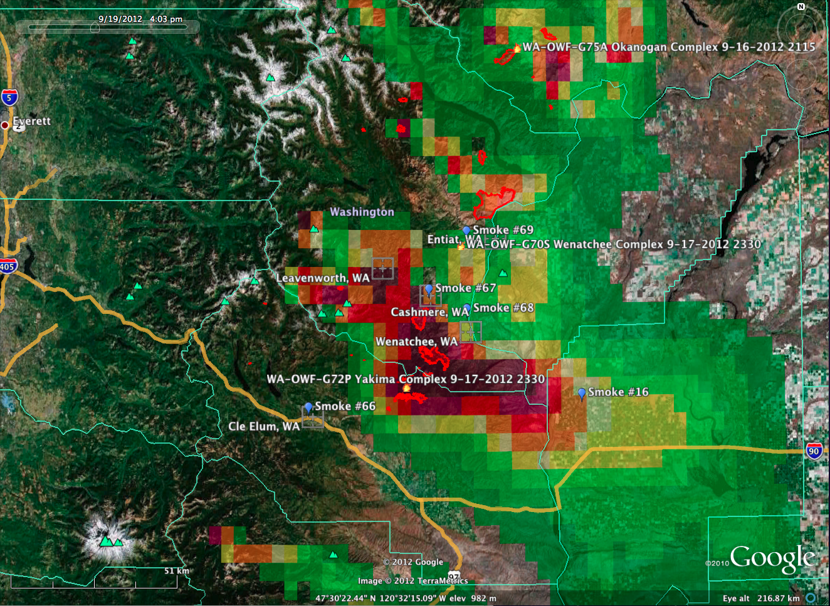

Slide 11
BlueSky Smoke Modeling reflections
Human interpretation of predictions is still critical. Monitors help with this.
Run timing/crashing issue has been resolved.
Smartfire 2 (satellite estimates of burned area) will be implemented soon
Information needed on planned major burnouts
4km resolution performed better but still not good enough to resolve drainage flows. 1.33km would be better.
Solutions still needed: fire growth projections, clean atmosphere assumption.

Slide 12
