Slide 1
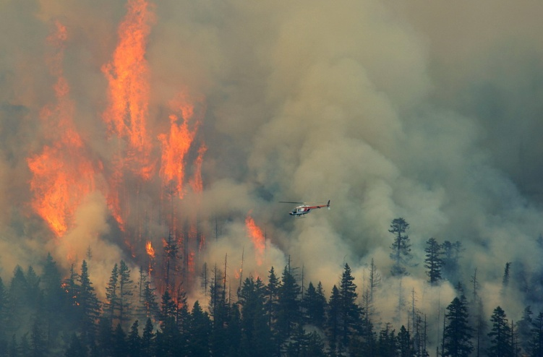
Fire Management 2013 Balancing ecosystems, safety, costs, risk, health, and values
Janice Peterson
Forest Service
Air Resource Manager

Slide 2
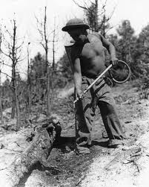
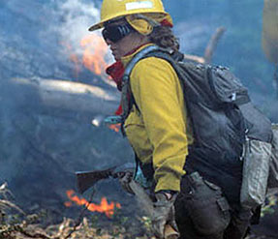
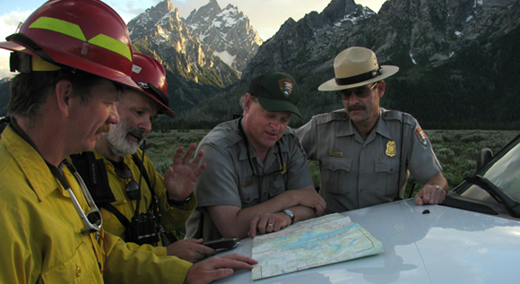
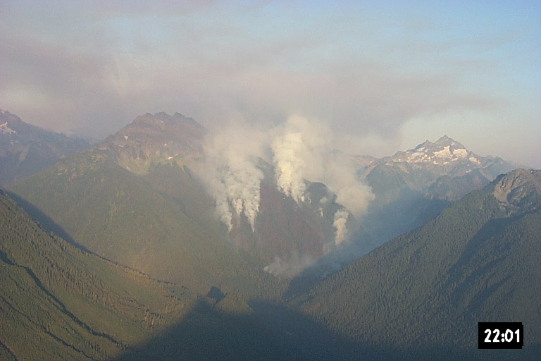
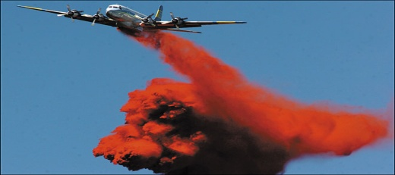
Federal Land Manager approach to fighting wildfire is always evolving
Definitions
Approach
Priorities
Wildland Fire Use
Fire for Resource Benefit
Prescribed Natural Fire

Slide 3

Working Together
Understanding
Building trust
Common goals
Working together
Bla, bla, bla

Slide 4
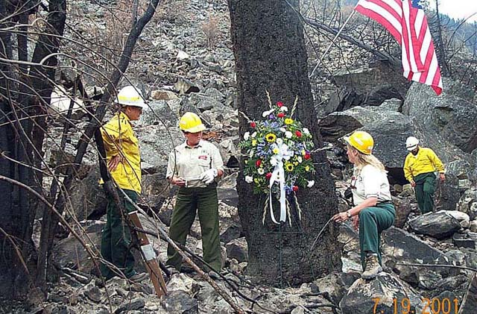
Can We Agree?
Wildfire suppression is dangerous

Slide 5
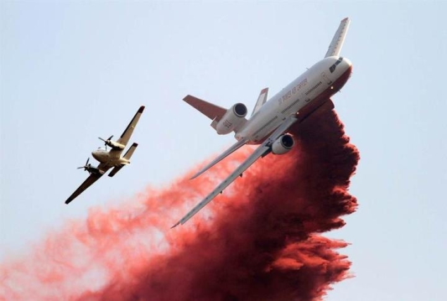
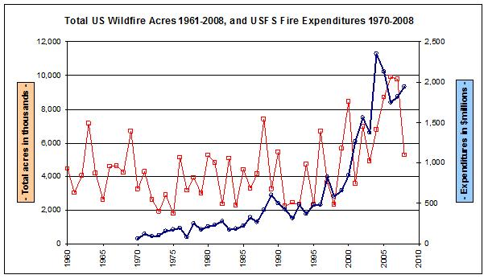
Can We Agree?
Wildfire suppression is expensive

Slide 6
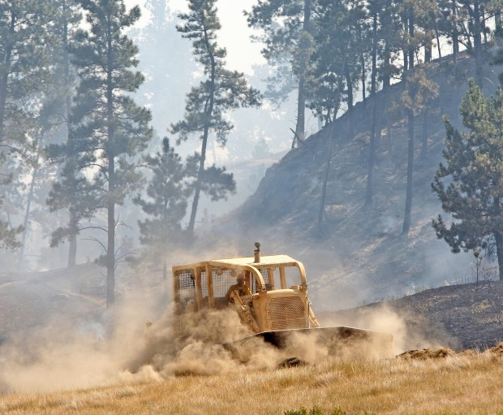
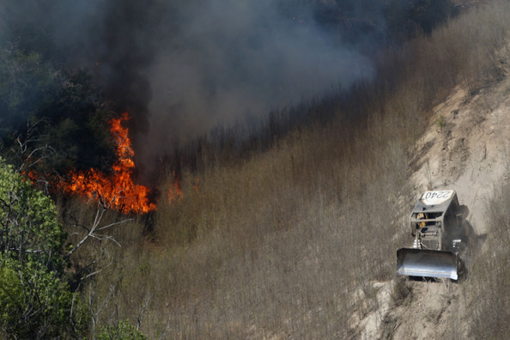
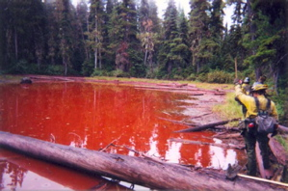
Can We Agree?
Wildfire suppression can harm wildlands

Slide 7
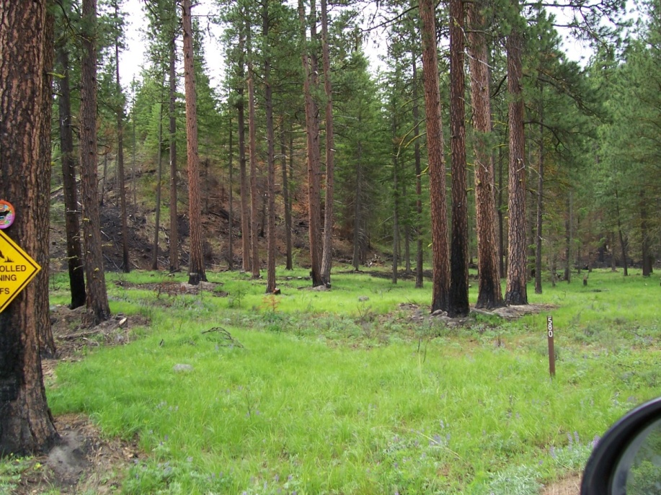
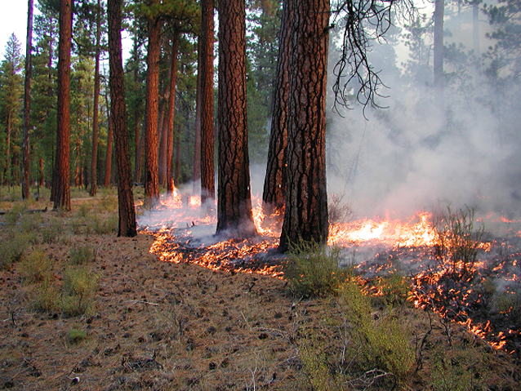
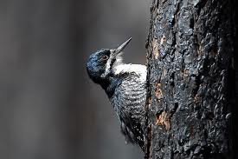
Can We Agree?
Ecosystems that evolved with fire need fire to stay healthy

Slide 8
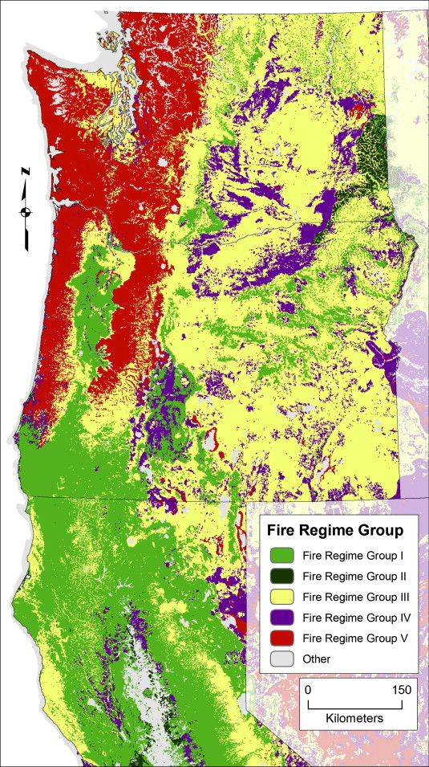
Group I: 35 years, low and mixed severity
Group II: 35 years, replacement severity
Group III: 35-200 years, low and mixed severity,
Group IV: 35-200 years replacement severity
Group V: >200 years, any severity
From Spies et al. 2011

Slide 9
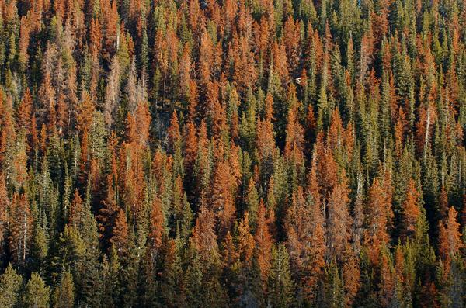
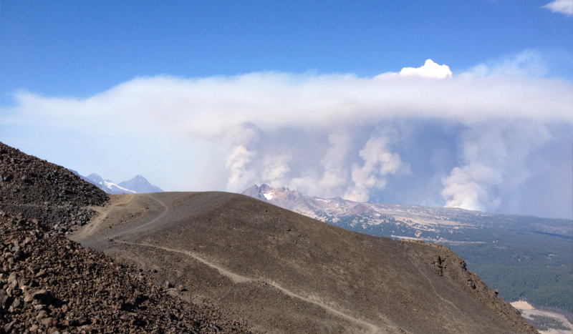
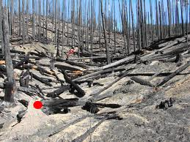
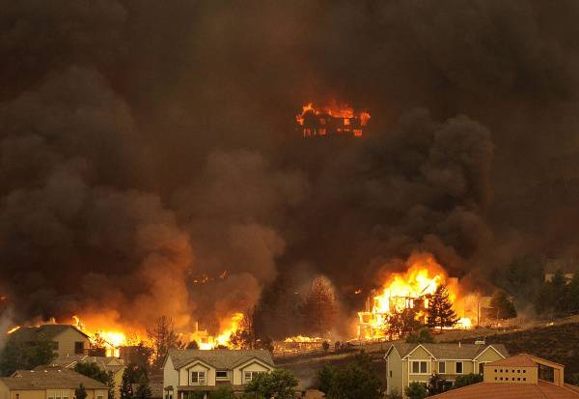
Can We Agree?
Unaddressed fuel accumulations result in destructive, dangerous, unnatural, and uncontrollable wildfires

Slide 10
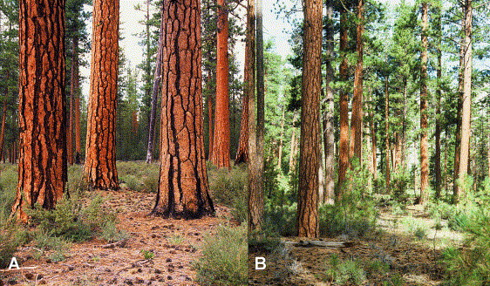
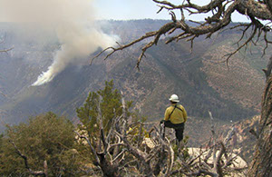
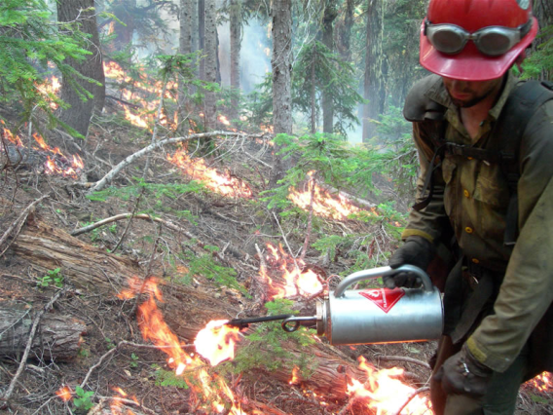
Can We Agree?
Prescribed fires can reduce the risk

Slide 11
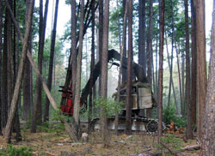
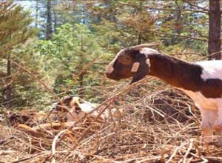
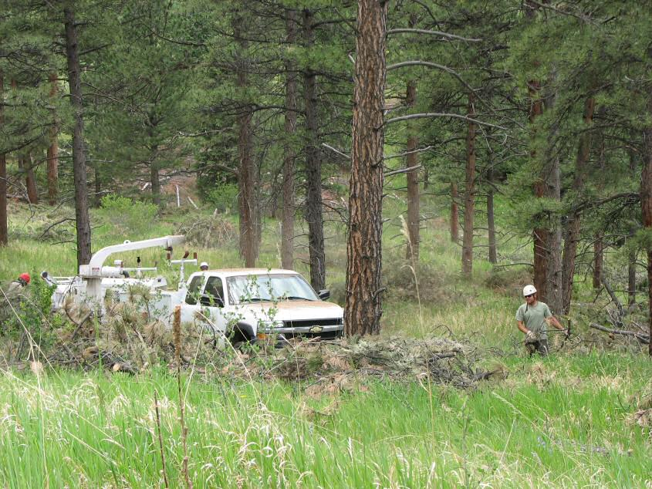
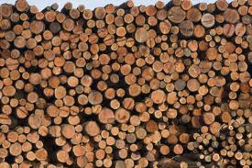
Can We Agree?
Mechanical treatments can reduce the need for fire but not eliminate it

Slide 12
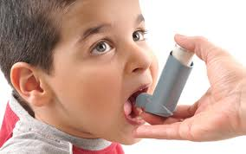

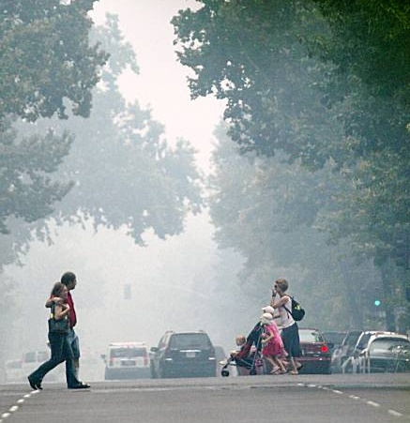
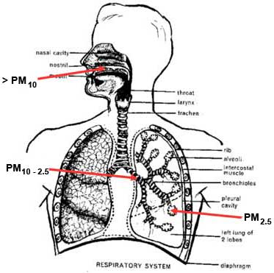
Can We Agree?
Smoke is unhealthy, and unpleasant

Slide 13
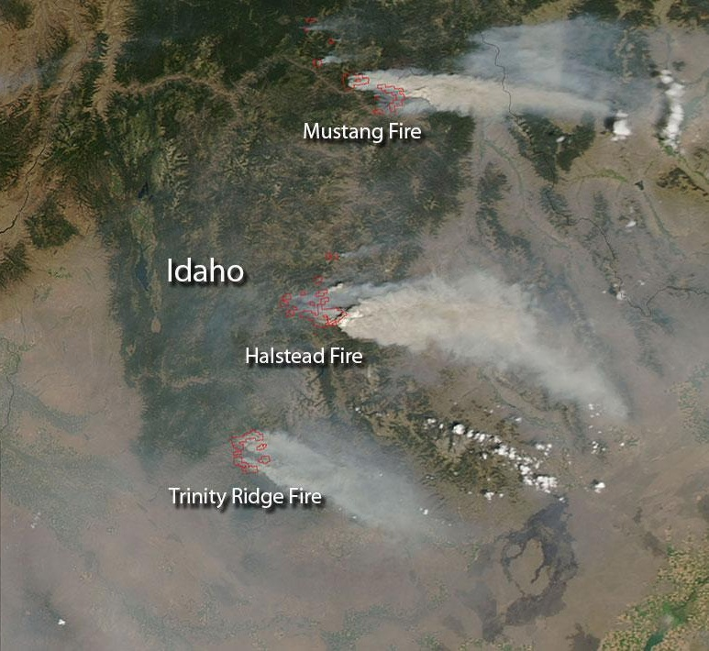
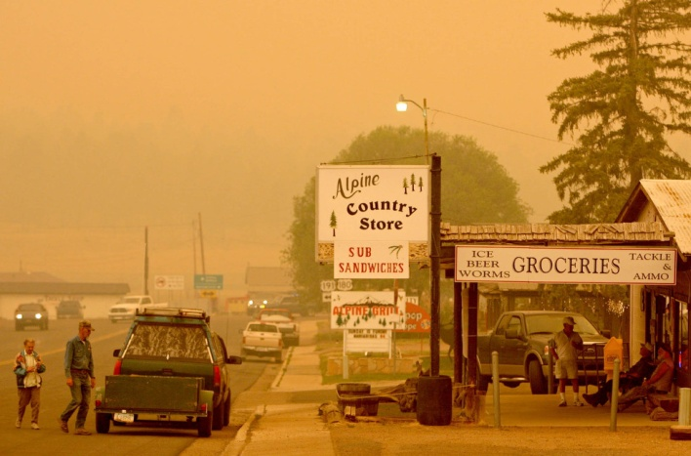
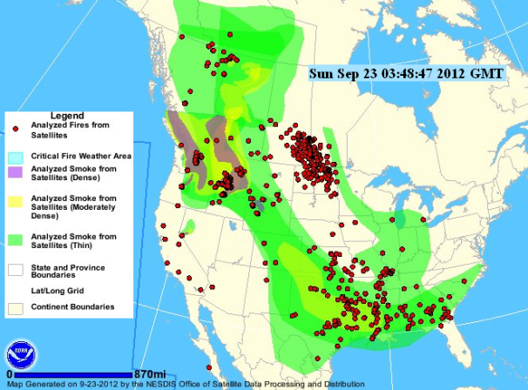
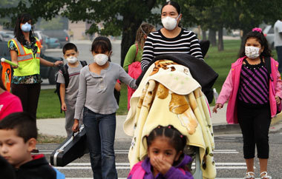
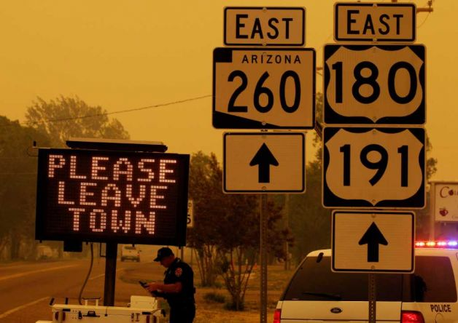
Can We Agree?
Wildfires cause greater impacts to air quality (etc.) than prescribed fires

Slide 14
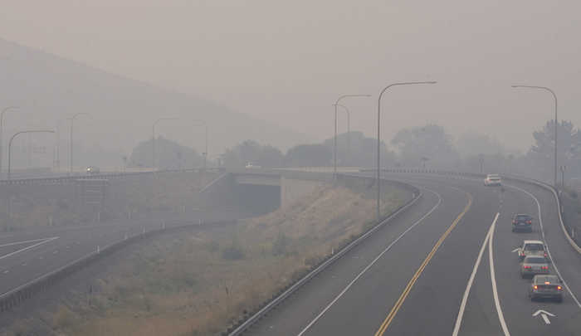
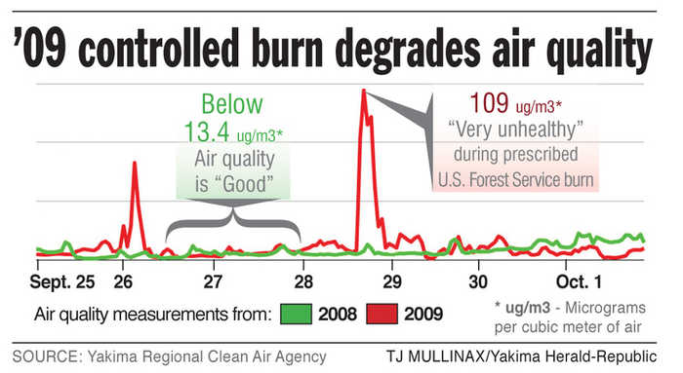
Can We Agree?
Humans are Imperfect
Forecasts
Models
Science
Expectations
Execution
Planning

Slide 15
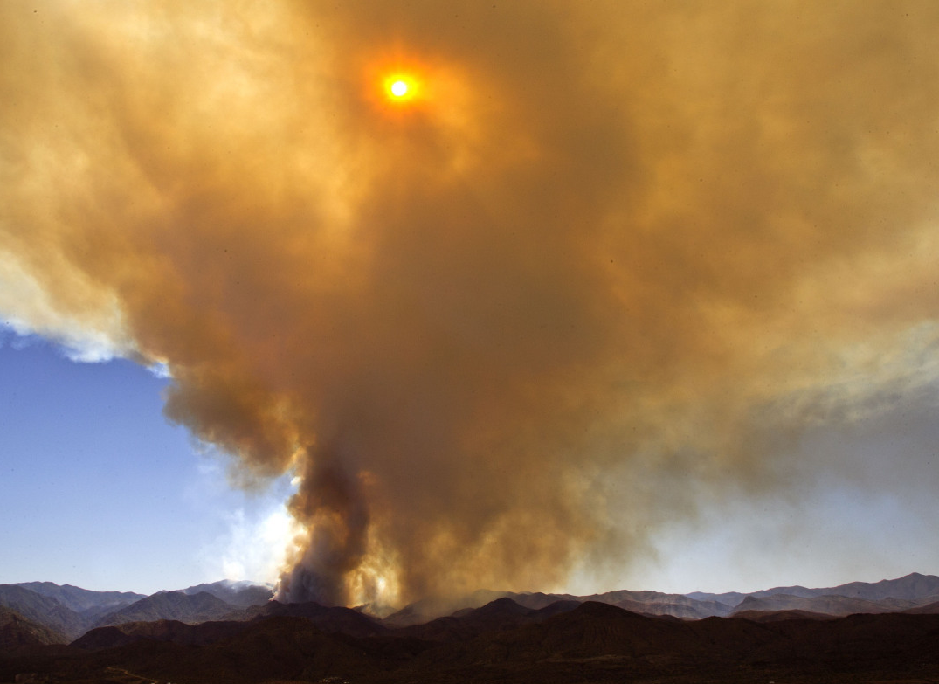
Can We Agree?
Wildfire suppression is dangerous
Wildfire suppression is expensive
Wildfire suppression can damage resources
Ecosystems that evolved with fire need fire to stay healthy
Unaddressed fuel accumulations result in destructive, dangerous, unnatural, and uncontrollable wildfires
Prescribed fire can reduce the risk
Mechanical treatments can reduce the need for fire but not eliminate it
Smoke is unhealthy and unpleasant
Wildfires cause greater impacts to air quality (etc.) than prescribed fires
Humans are imperfect

Slide 16
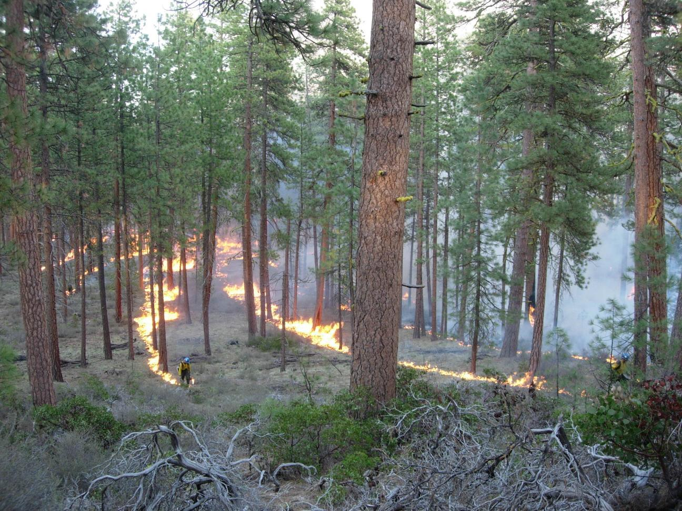
Prescribed Fire Process
Planning (1-3 years in advance)
Alternatives
Costs
Ecosystem needs
Modeling
Approvals
Monitoring

Slide 17
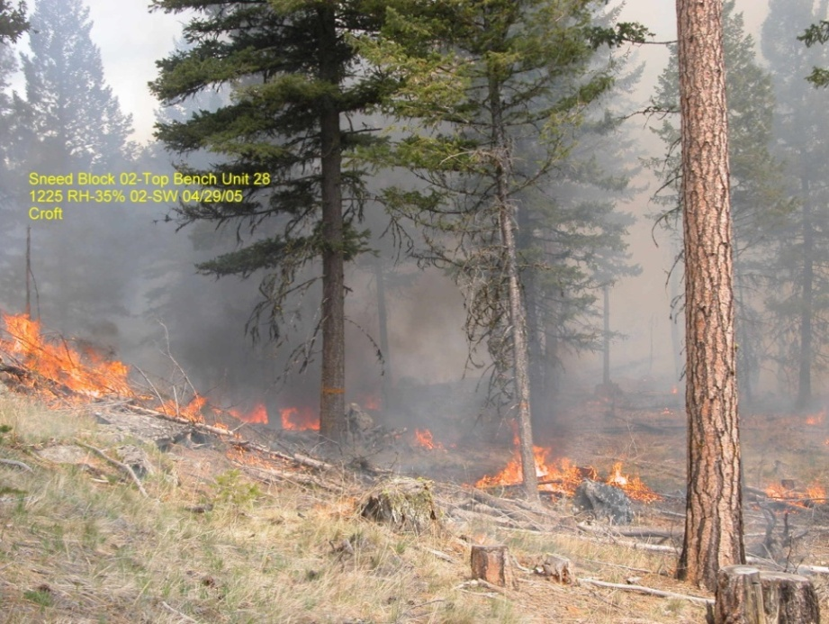
Prescribed Fire
Goals:
Reduce the risk of wildfire
Restore the natural role of fire in ecosystems
Dispose of logging slash
Methods:
Mechanical treatments often needed to reduce fuels prior to fire use
Sometimes mechanical treatments are enough
Low intensity ground fires clean up remaining fuels and weed out small understory trees

Slide 18
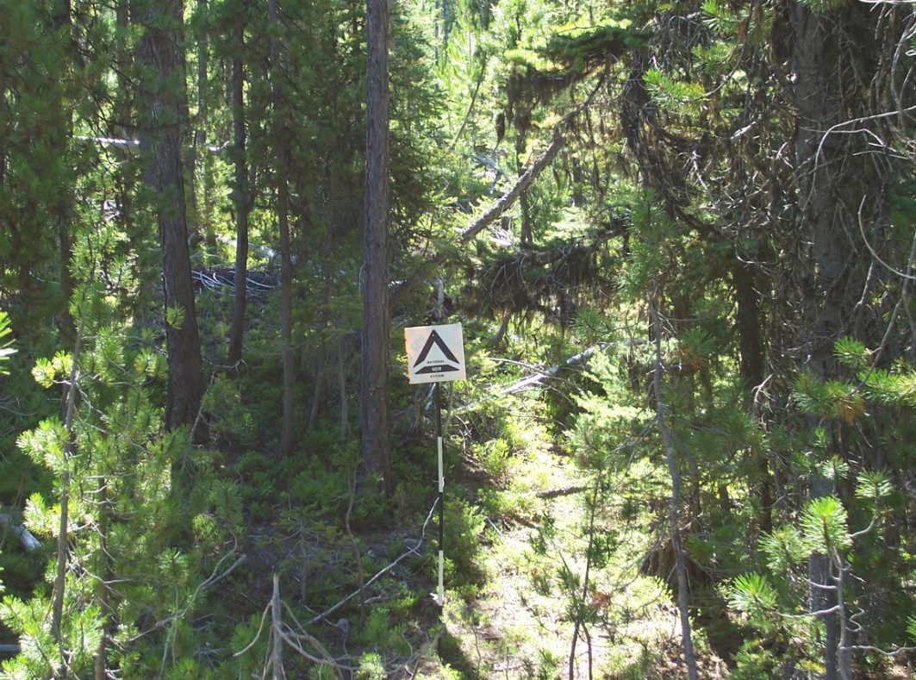
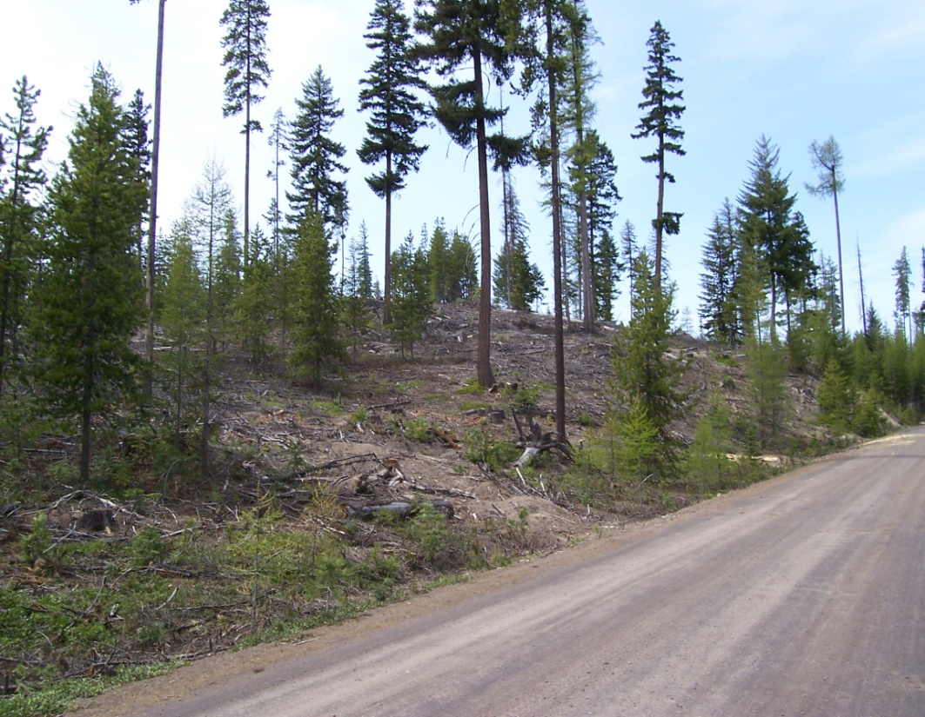
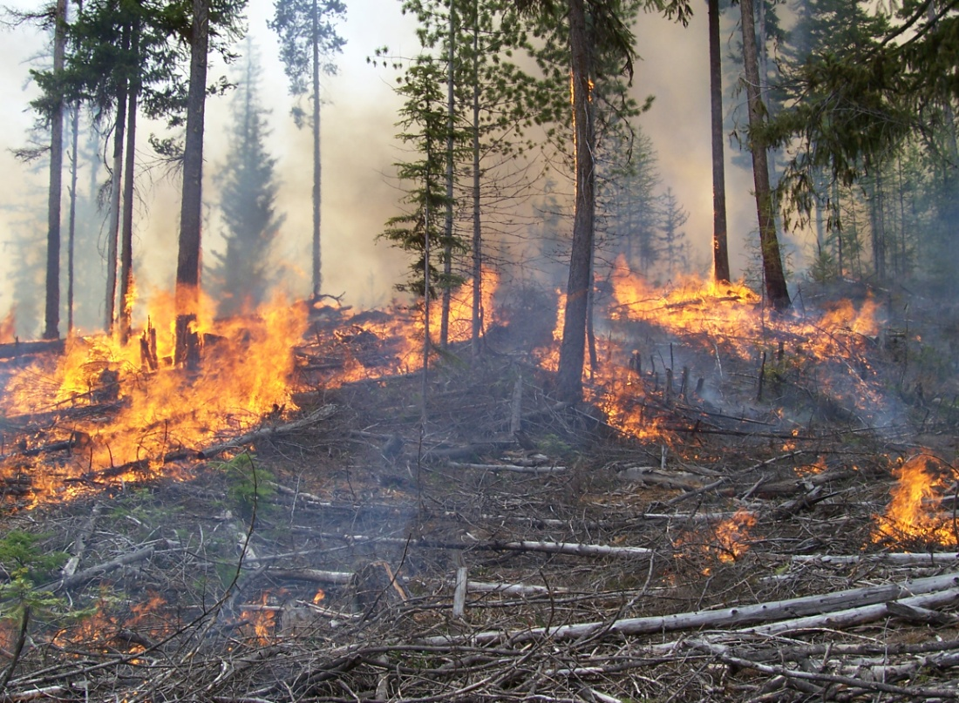

The Process
Dangerous Fuel Conditions
1. Mechanical Treatment
2. Burn Residual Ground Fuels
Healthy, fire resistant forest

Slide 19
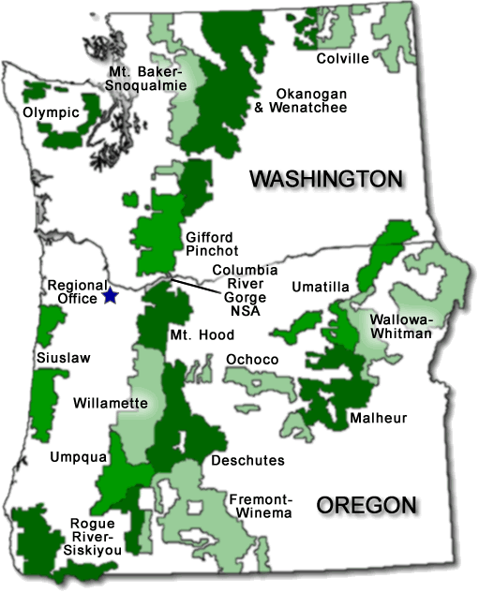
National Forest Fire vs. Mechanical Treatments 2010

Slide 20
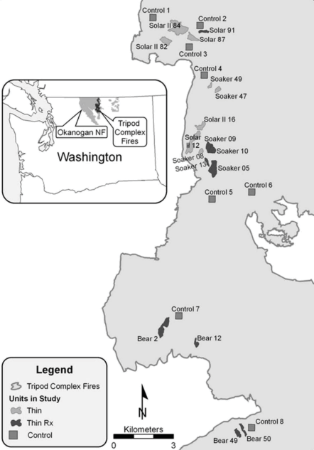
Prescribed Fire Effectiveness (Prichard and Peterson 2011)
Tree survival post Tripod Fire:
57% in thin + RX
19% in thin only
14% in untreated

Slide 21
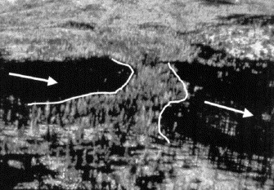
Fuel Treatments as Fire Breaks

Slide 22
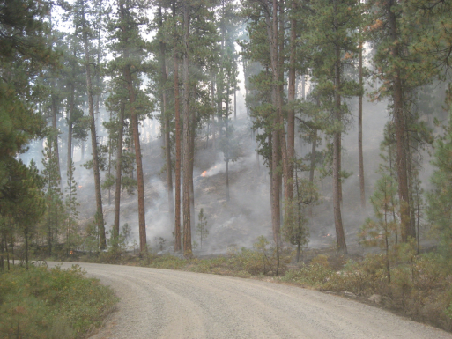
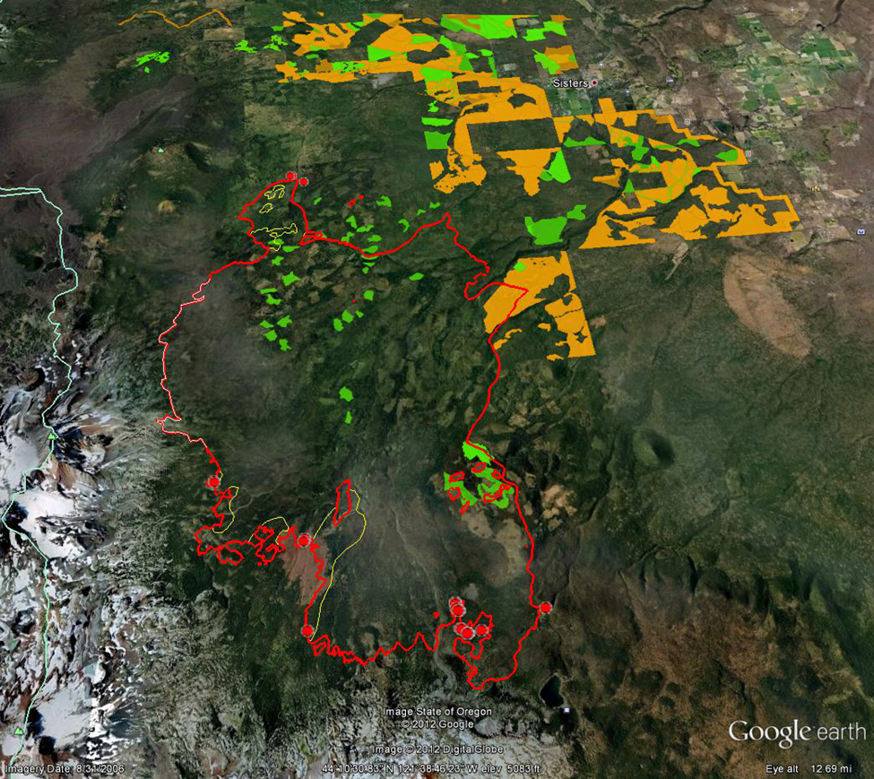
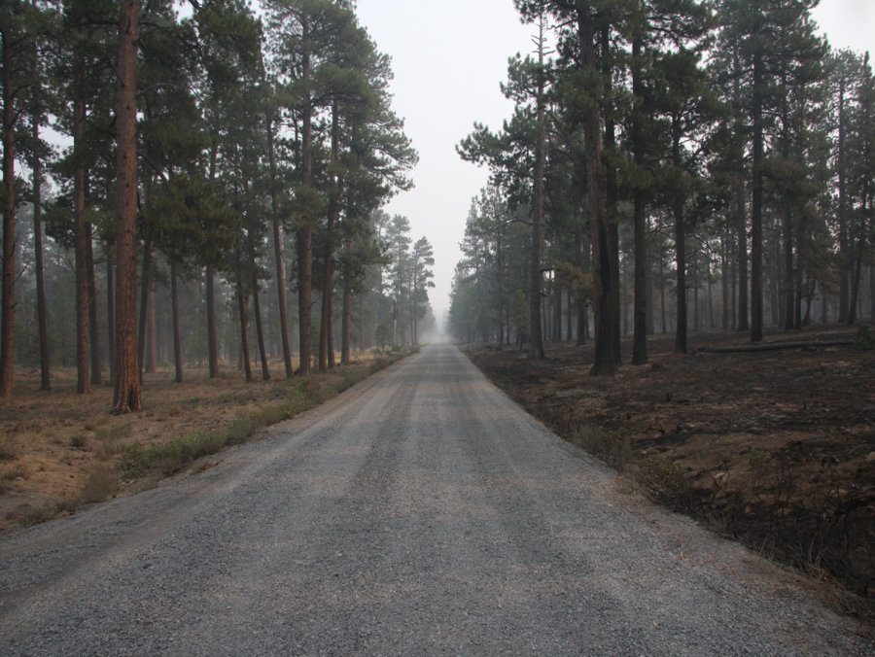

Slide 23
Prescribed Fire Effectiveness (“Realistic” Program Assumptions)
Reducing wildfire acres burned?
Slight
Reducing emissions from wildfire?
Probably yes
Reducing emissions from the sum of wildfire plus prescribed fire?
Maybe, maybe not
Protecting values at risk from wildfire?
Very good

Slide 24
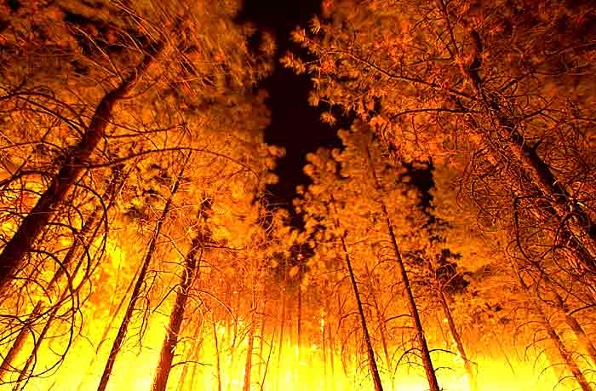
Federal Wildfire Policy
Protection of life and property always an objective
A wildfire may be concurrently managed for more than one objective
Manage unplanned natural ignitions to achieve desired Land and Resource Management Plan objectives when risk is within acceptable limits

Slide 25
Federal Fire Policy
2011 Guidelines
2 Types of Wildland Fires
Planned
(Prescribed Fire)
Unplanned
(Wildfire)

Slide 26

Wildfire Management Approach Drivers
Dangerous fuel conditions
Community protection (WUI)
Firefighter safety
Ecosystem health/changing climate
Increasing firefighting costs
Decreasing agency budgets

Slide 27


Slide 28

One fire, different management

Slide 29



Wildfire Suppression Costs
$5-10,000/day
$23,000/day +$10,000/hour
$50,000/day +$22,000 per hour

Slide 30
2013 Forest Service Chief Wildfire Letter
“Success continues to be defined as safely achieving reasonable objectives with the least firefighter exposure necessary, while enhancing stakeholder support for our management.”

Slide 31










Slide 32

2013 Forest Service Wildland Fire Response Protocol
Direction for Desired Long Duration Events
“In areas identified
pre-season
as having
low threats to values
to be protected, an engagement strategy designed to meet restoration objectives may be considered. Line officers desiring to use wildland fire as an essential ecological process and natural change agent must follow the Seven Standards for Managing Incident Risk to the highest level of performance and accountability.”

Slide 33
Working Together
Understanding
Building trust
Common goals
Working together

Slide 34
Can We Agree?
Wildfire suppression is dangerous
Wildfire suppression is expensive
Wildfire suppression can damage resources
Ecosystems that evolved with fire need fire to stay healthy
Unaddressed fuel accumulations result in destructive, dangerous, unnatural, and uncontrollable wildfires
Prescribed fire can reduce the risk
Mechanical treatments can reduce the need for fire but not eliminate it
Smoke is unhealthy, and unpleasant
Wildfires cause greater impacts to air quality (etc.) than prescribed fires
Humans are imperfect

Slide 35


