Slide 1
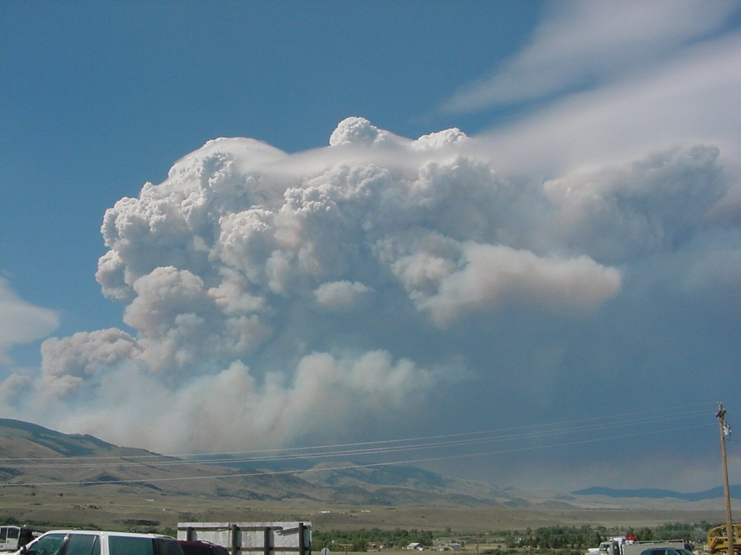

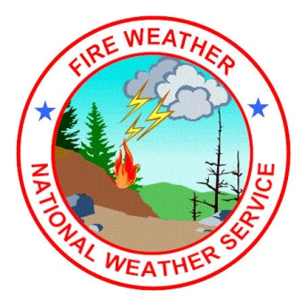

NWS Spokane Fire Weather
Ellensburg WA
March 14 2013
Jeremy Wolf

Slide 2
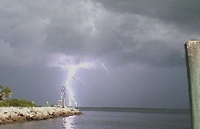
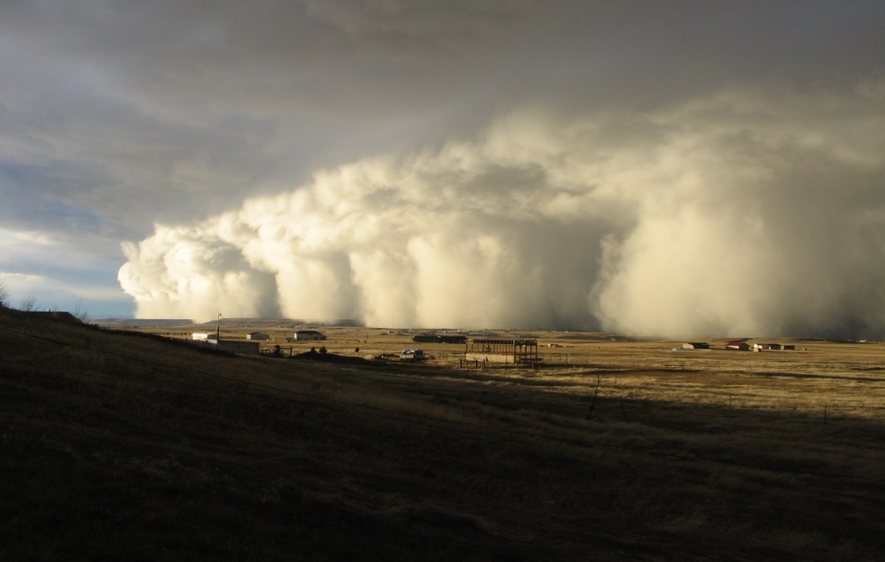
I Will Talk About…
Brief recap of last summer weather/fires
The Outlook for This Summer
NWS Web Page Tools
Basic Smoke Behavior and Terms
Forecast Tools

Slide 3
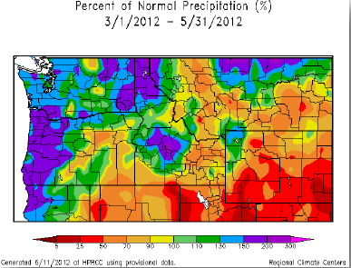
What happened last summer – Weather
A La Nina Winter, transitioned to neutral in the spring and summer
Atmosphere stayed in a La Nina pattern in the spring
This meant cool and wet
** Fire season was
slow to begin

Slide 4
What happened last summer – Central Washington Large fires
Taylor Bridge (23,500 acres)
Started August 13th
Human started on a hot, windy, dry day (abnormally warm/dry continued into the night)
Wenatchee, Okanogan, and Yakima Complexes, Table Mountain, Goat
All started September 8th/9th
A substantial dry lightning outbreak, followed by 2 strong cold front passages
Smoke problems

Slide 5
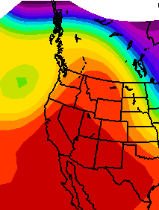
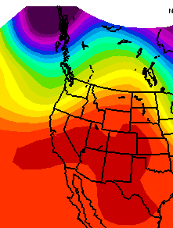
Sept 8-9 Lightning
Classic lightning setup: Breakdown of upper ridge
Sept 8
Sept 9

Slide 6
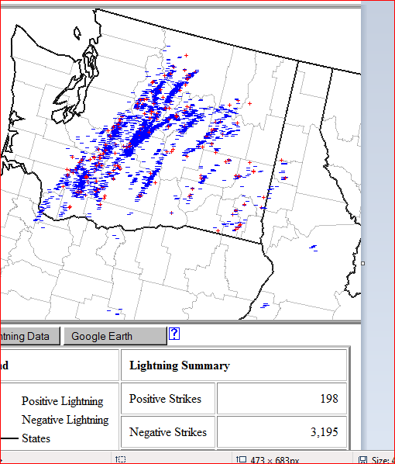
Sept 8-9 Lightning strikes

Slide 7
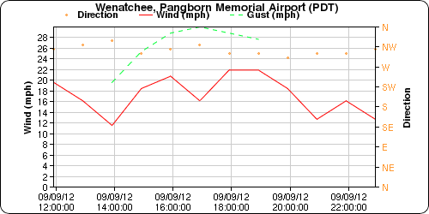
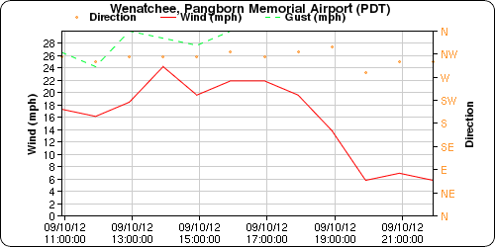
Then the cold fronts and wind
Sept 9
Sept 10

Slide 8
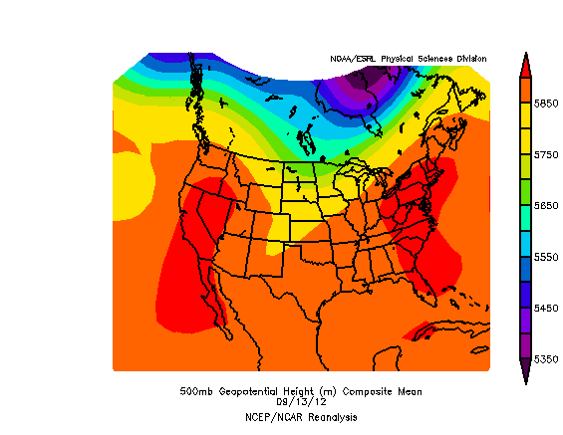
Then high pressure + time of year (September) = strong inversions = dense smoke

Slide 9
How bad was the smoke? – Lowest visibility in Wenatchee by day
Sept 11: 4 miles Sept 20: .75 miles
Sept 12: 1.5 miles Sept 21: 1.25 miles
Sept 13: 1.25 miles Sept 22: 2.0 miles
Sept 14: .25 miles Sept 23: 1.25 miles
Sept 15: 1.25 miles Sept 24: 2.0 miles
Sept 16: 1.00 mile Sept 25: 4.0 miles
Sept 17: 1.5 miles Sept 26: 5.0 miles
Sept 18: .75 miles Sept 27: 2.0 miles
Sept 19: 1.5 miles Sept 28: 1.0 mile

Slide 10
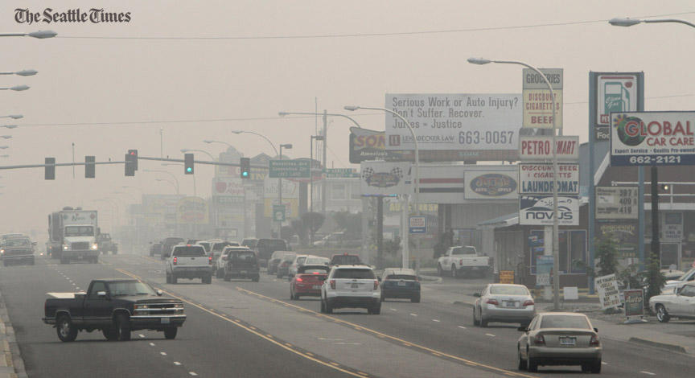
Pictures
Courtesy: Seattle Times

Slide 11
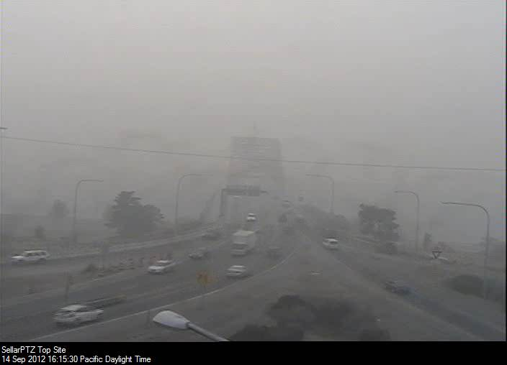
Pictures

Slide 12
Air Quality Alerts
First time posted on NWS Spokane site
Mainly designed to pass on information and for more visibility (e.g. TV METS)
We can continue to relay these on our web page if big smoke problems occur
Possible format changes next time
NWS participated in air quality daily calls
Gave expected Meteorological inputs

Slide 14
IMET (Incident Meteorologist Support)
Provided on-site weather support for the Wenatchee Complex Fires
Fire camp at Confluence State Park
Air quality sensor installed in camp
Participated in daily air quality calls concerning how the fires were specifically adding smoke to the area (prescribed and wildfire burning at the fire)

Slide 15
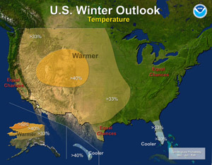
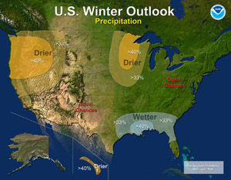
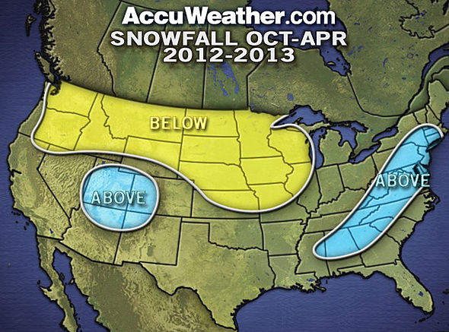
So How Have We Done So Far?

Slide 16
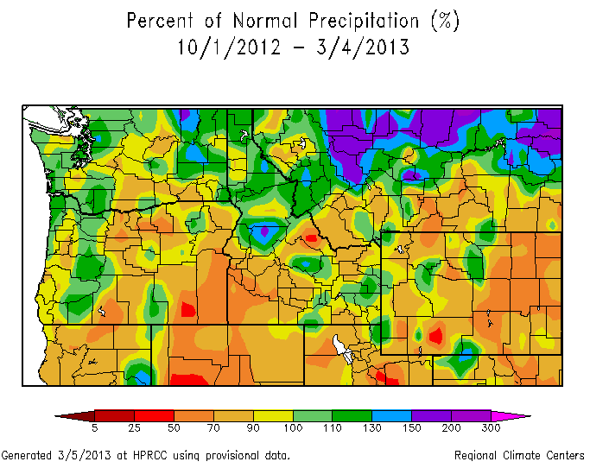
The Water Year since 10/1/2012

Slide 17
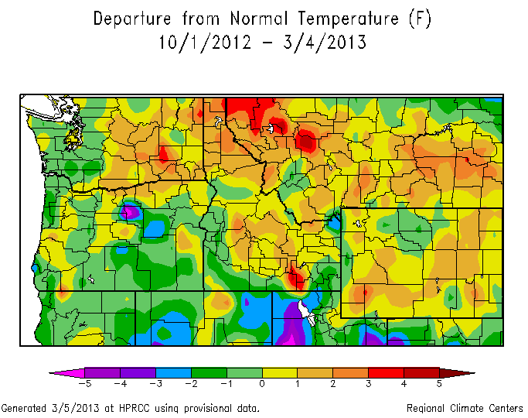
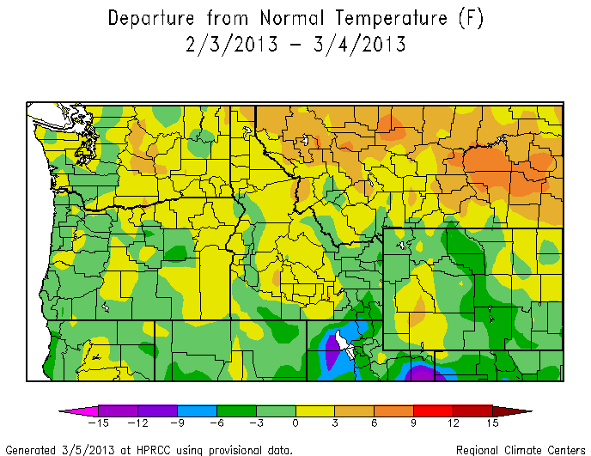
The Departure from Normal Temperature

Slide 18
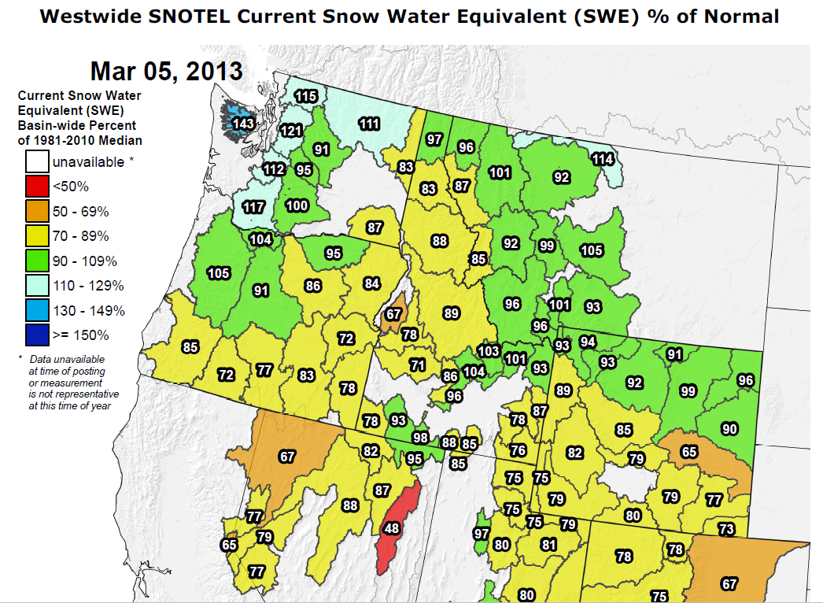
Current Mountain Snow Pack Data
What can we expect for the remainder of the year? Typically we get about 70% of our snow by the end of February. Last two years have not followed this trend.

Slide 19
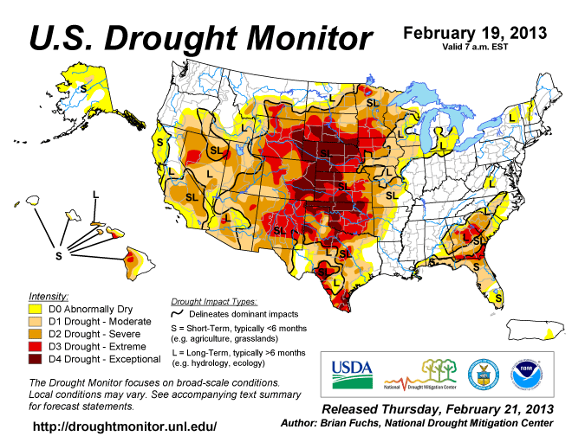
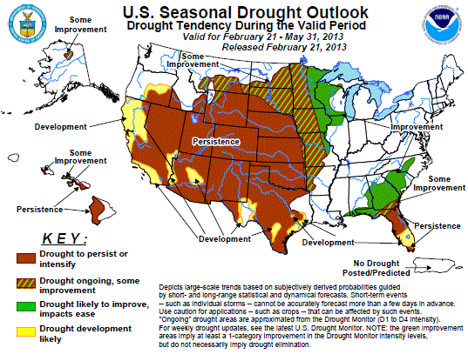

Slide 20
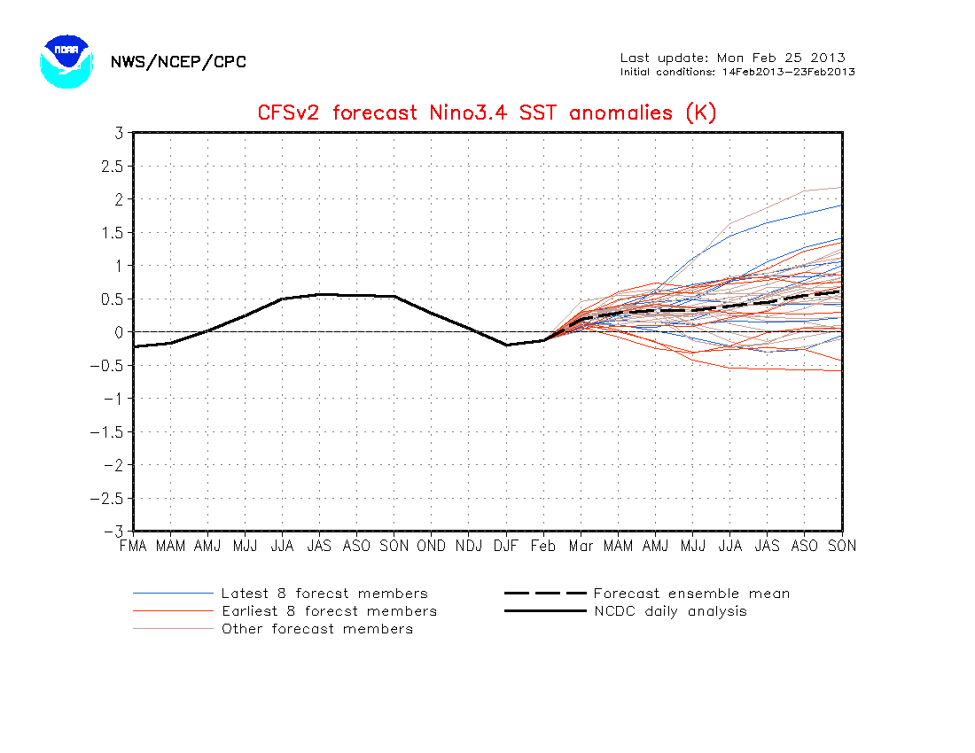
El Nino/La Nina Forecast
ENSO stay neutral or near neutral through late summer

Slide 21
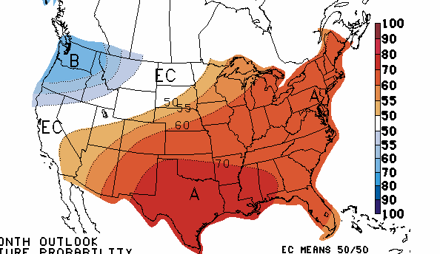
Temperature Outlook for March-April-May 2013
Higher Probability of Below Average Temps in Blue Areas. Leaning towards cooler than normal for early Spring

Slide 22
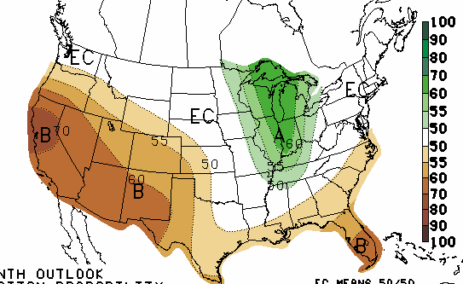
Precipitation Outlook for March-April- May 2013
Higher Probability of Below Average Precip in Orange Areas. About normal or slightly drier for early Spring for PNW

Slide 23
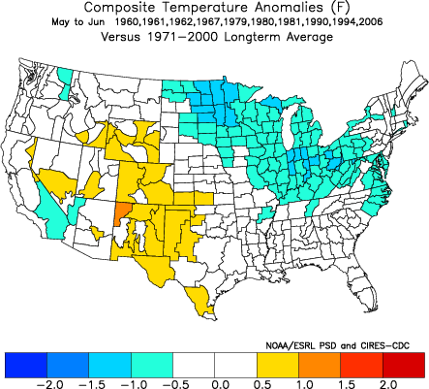
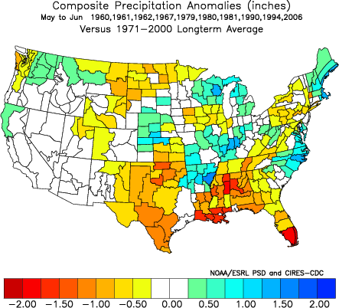
We compared analog years to the long term average for early summer. And this is what we found
Near normal temperatures?, slightly above normal precip

Slide 24
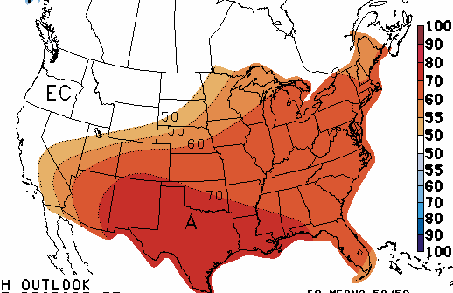
Temperature Outlook for May-June-July 2013
Higher Probability of Above Average Temps in orange Areas. EC means equal chances (uncertainty is high)

Slide 25
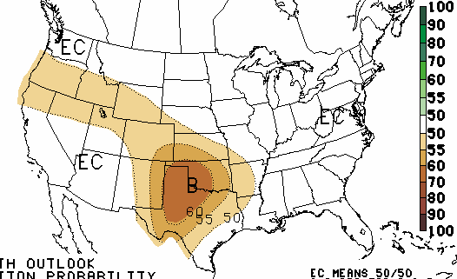
Precipitation Outlook for May-June- July 2013
Higher Probability of Below Average Precip in brown Areas. EC means equal chances (high uncertainty)

Slide 26
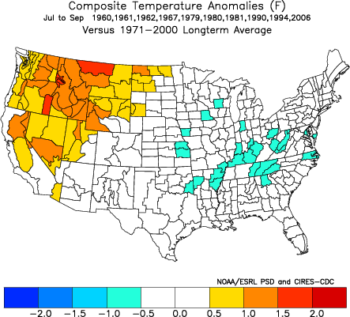
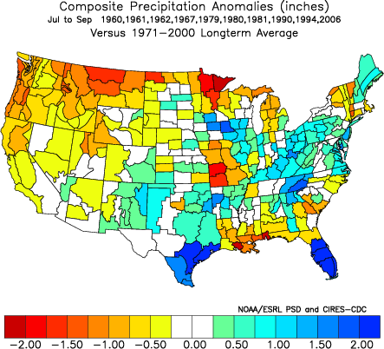
Slightly warmer than normal and drier than normal summer.

Slide 27
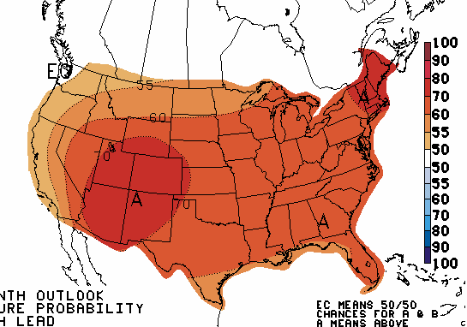
Temperature Outlook for July-August-Sept 2013
Higher Probability of Above Average Temps in Orange Areas

Slide 28
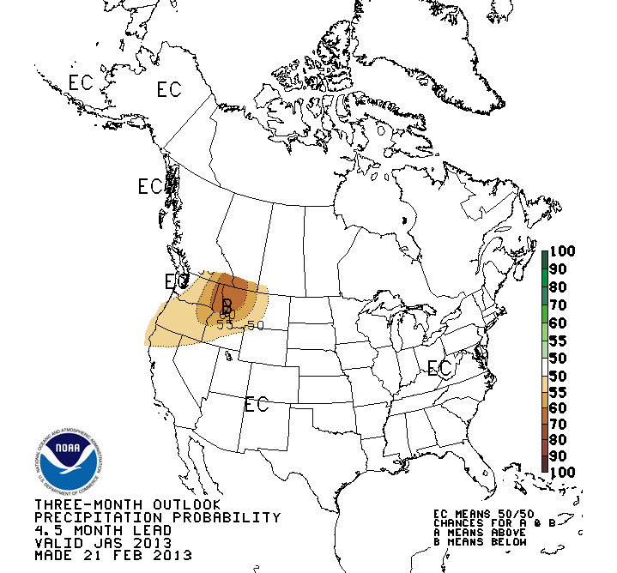
Precipitation Outlook for July-August-Sept 2013
Higher Probability of Below Average Precip in brown Areas

Slide 29
Back to back neutral years summary
May/June
Temperatures uncertain
Near to above normal rain
July/August/September
Temperatures near to above normal
Not a guarantee (a few cases in the past have been cooler than normal)
Precipitation near to below normal

Slide 30
Most Likely to Happen in 2013
*Cooler spring temperatures could result in later
than normal snow melt. But less than normal
snowpack. So about normal green-up.
*(Could cool and wet happen three years in a
row?)
*Better chances for a warmer and drier fire
season
*Stay tuned for “Adjustments” as the time gets closer

Slide 31
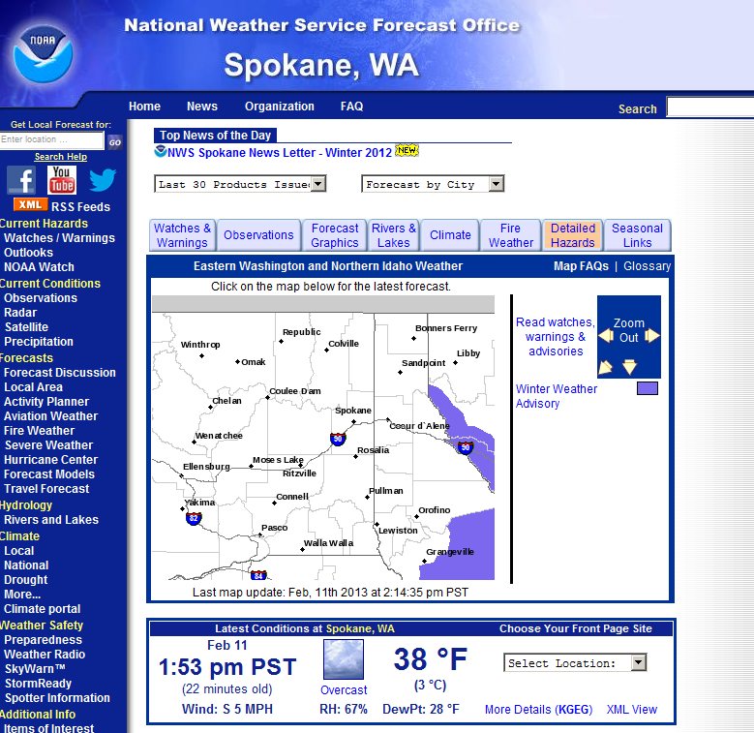
www.weather.gov/spokane
Yep we’ve gone main stream with Facebook and twittter feeds

Slide 32
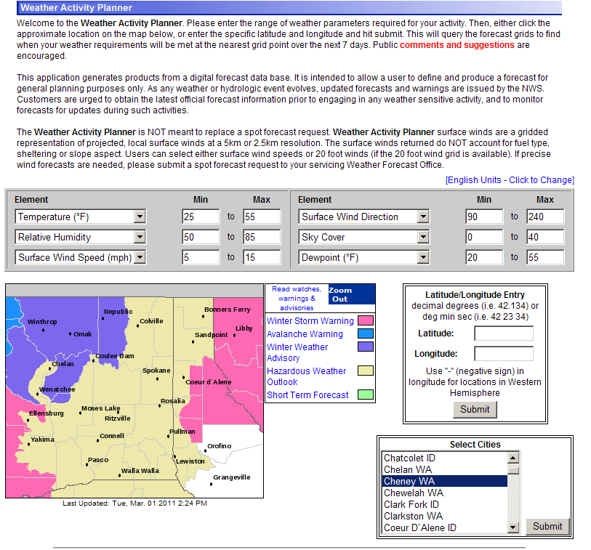
Activity Planner This will get you in the ball park.

Slide 33
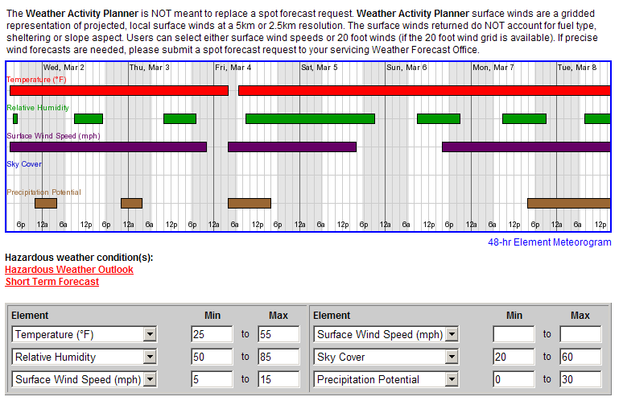

Slide 34
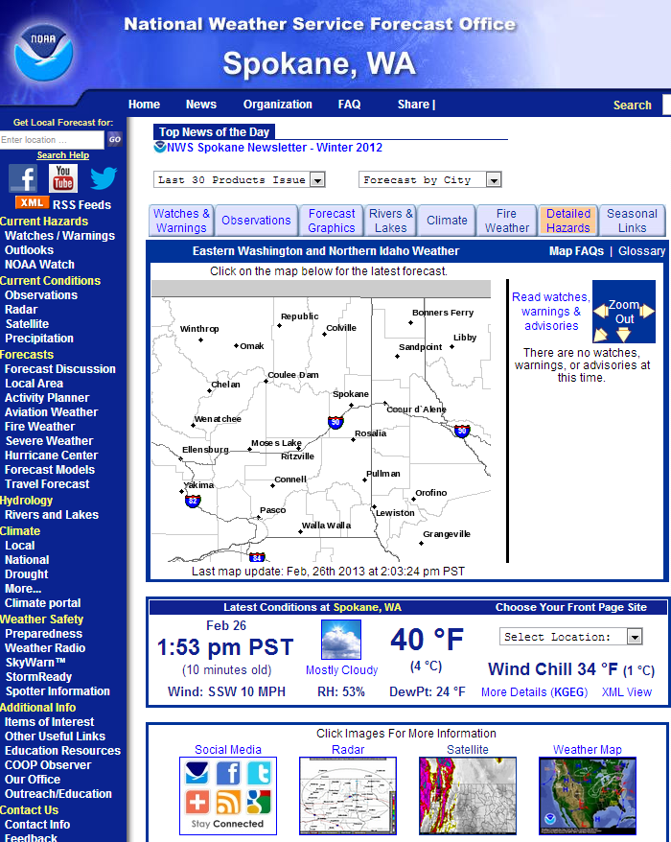
This page is interactive. Just left click anywhere on the map and you will get.

Slide 35
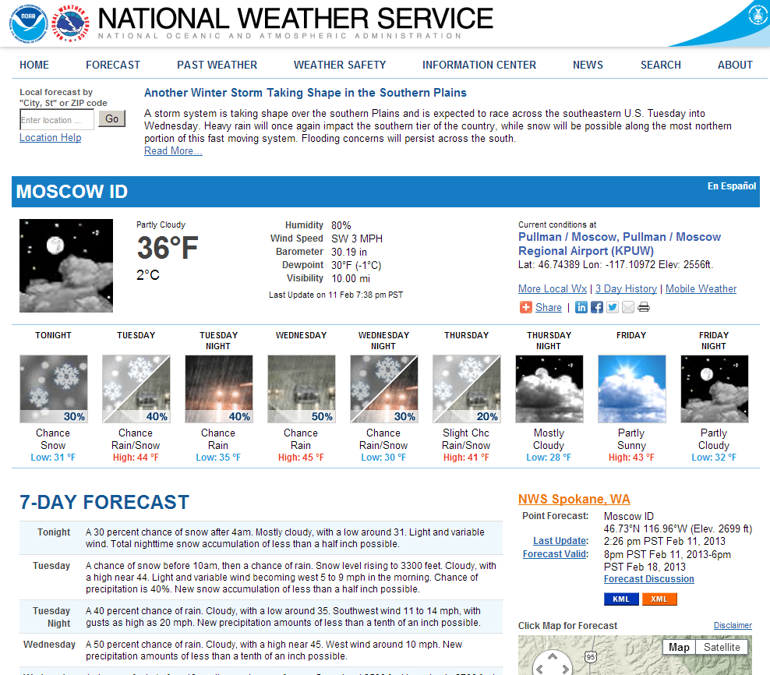
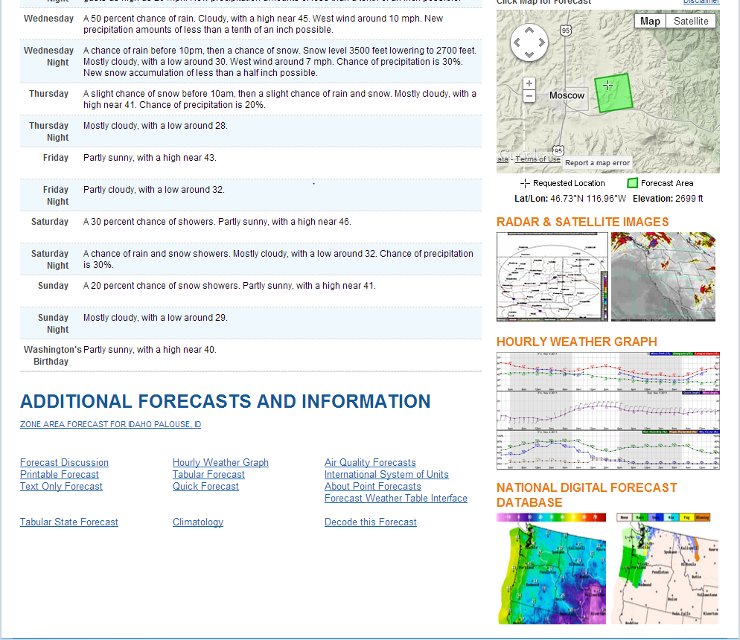

Slide 36
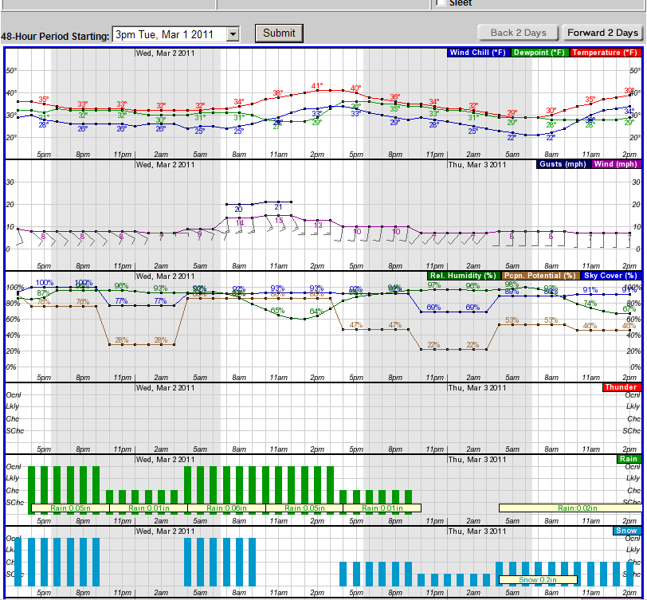

Slide 37
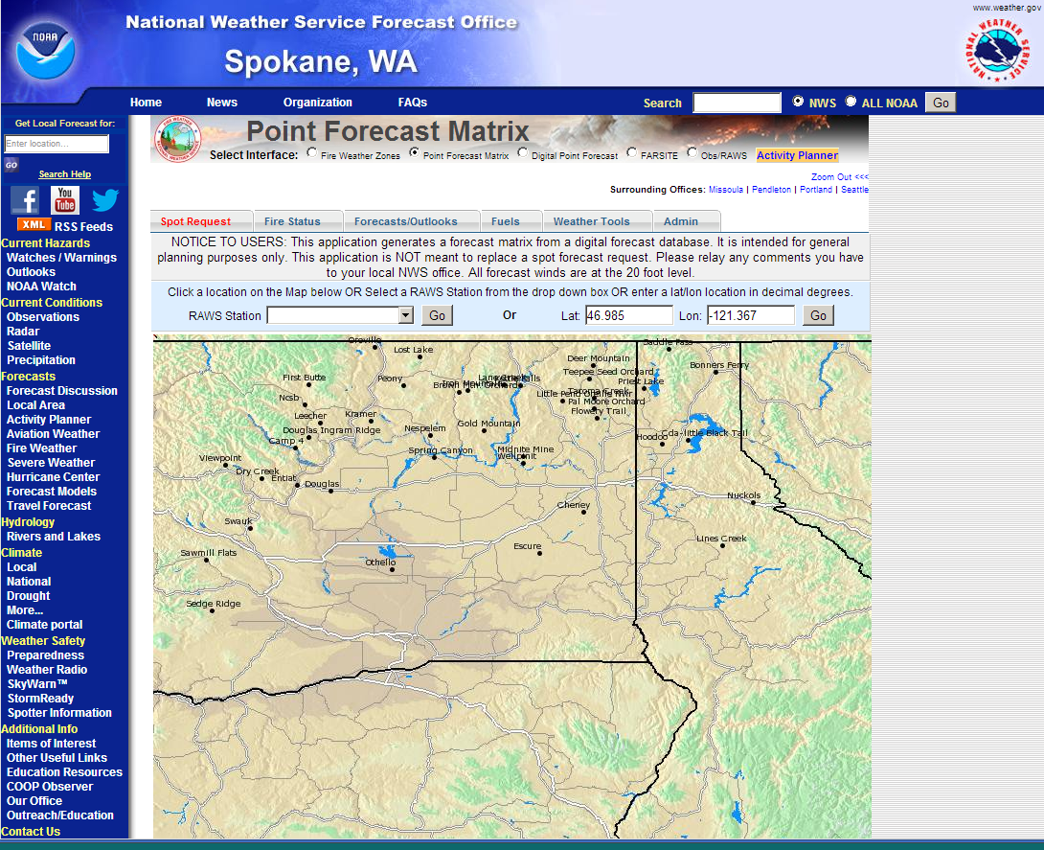
The fire weather page has a suite of different ways to get narrative and graphical forecasts

Slide 38
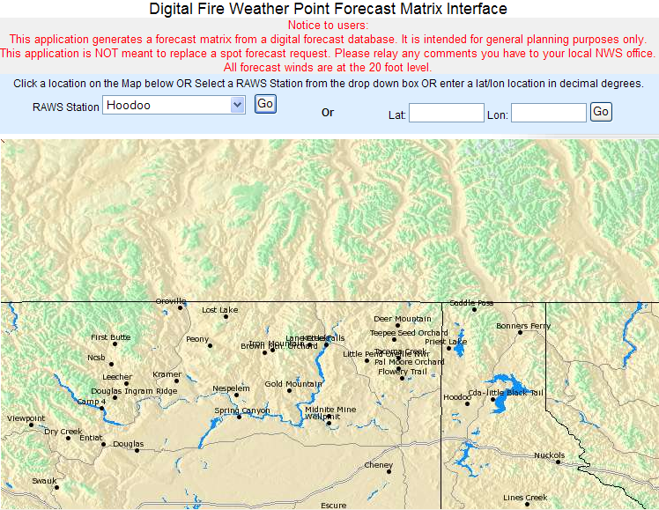

Slide 39
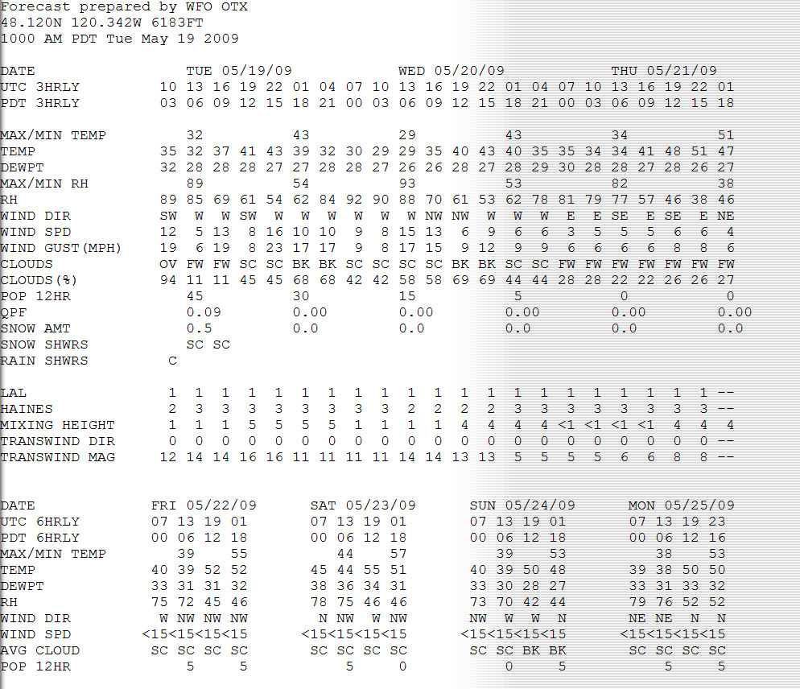

Slide 40
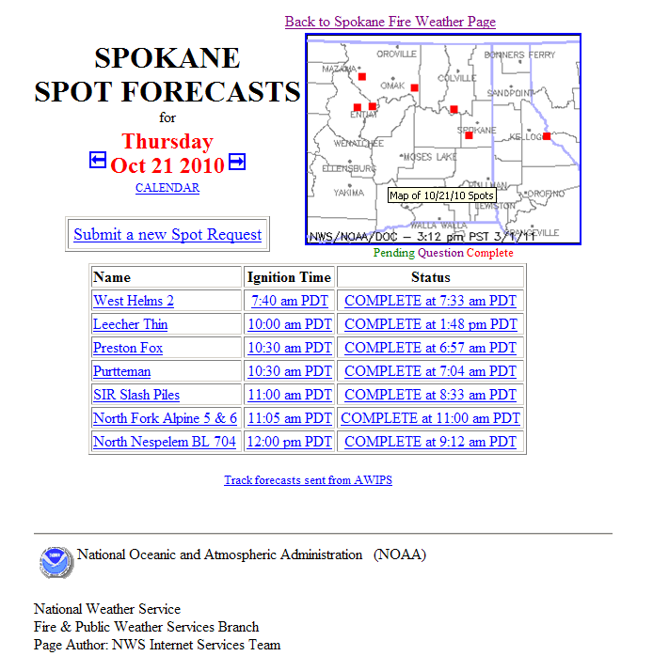
Obs, Obs and more Obs
FEEDBACK
Contact numbers
Spots for next burn period
Smoke
Notes:
I always ask for good observations, representative. More than one ob during the heat of the day, and especially if it is for the next day. We should all go through Dispatch. Spots for the next day are okay if they put that and the time they want it in remarks. MT/ID airshed does not do much meteorology for better results request ventilation forecast on spot request form.

Slide 41
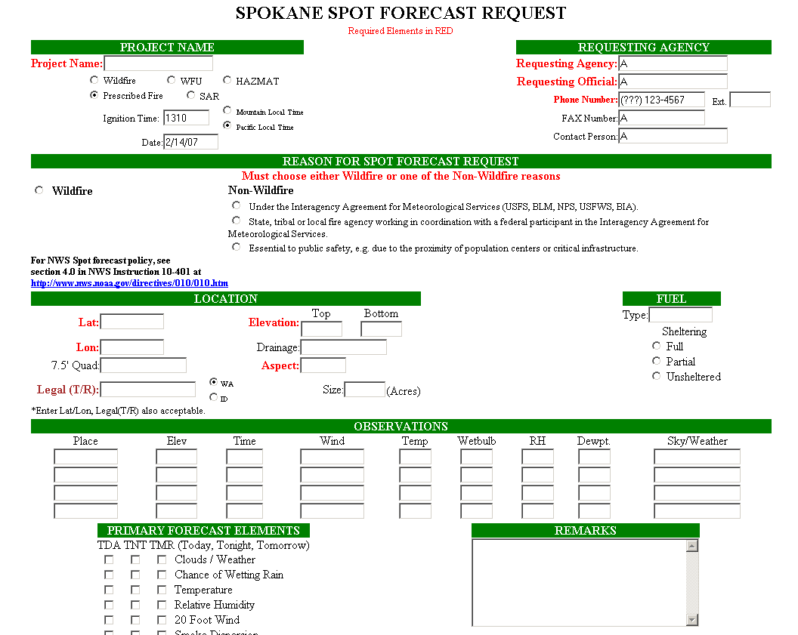
New spot request page coming
By Fall burning season,
Hopefully

Slide 42
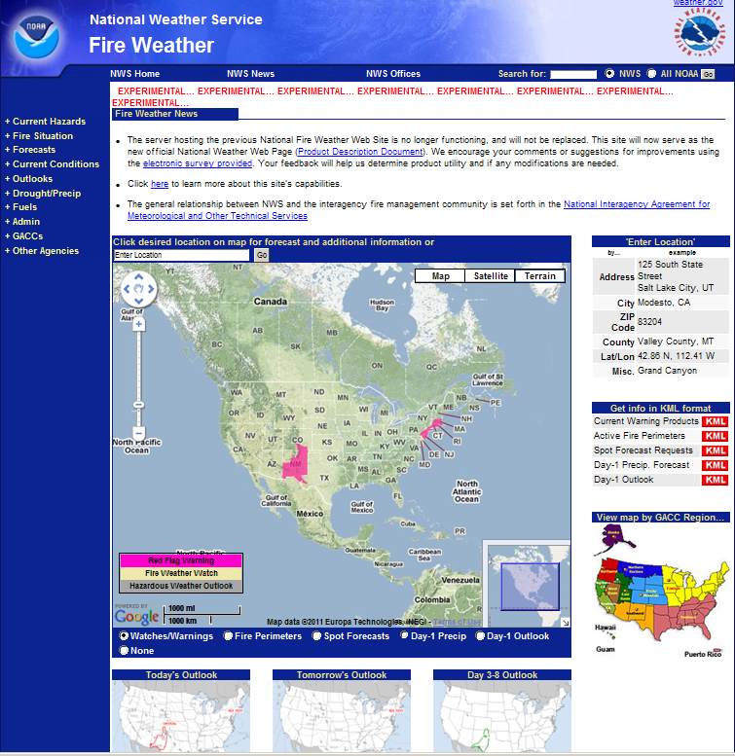
This will remain experimental as the NWS is expecting to update a whole suite of new pages at the same time.

Slide 43
Let’s Talk About Smoke for a Minute

Slide 44
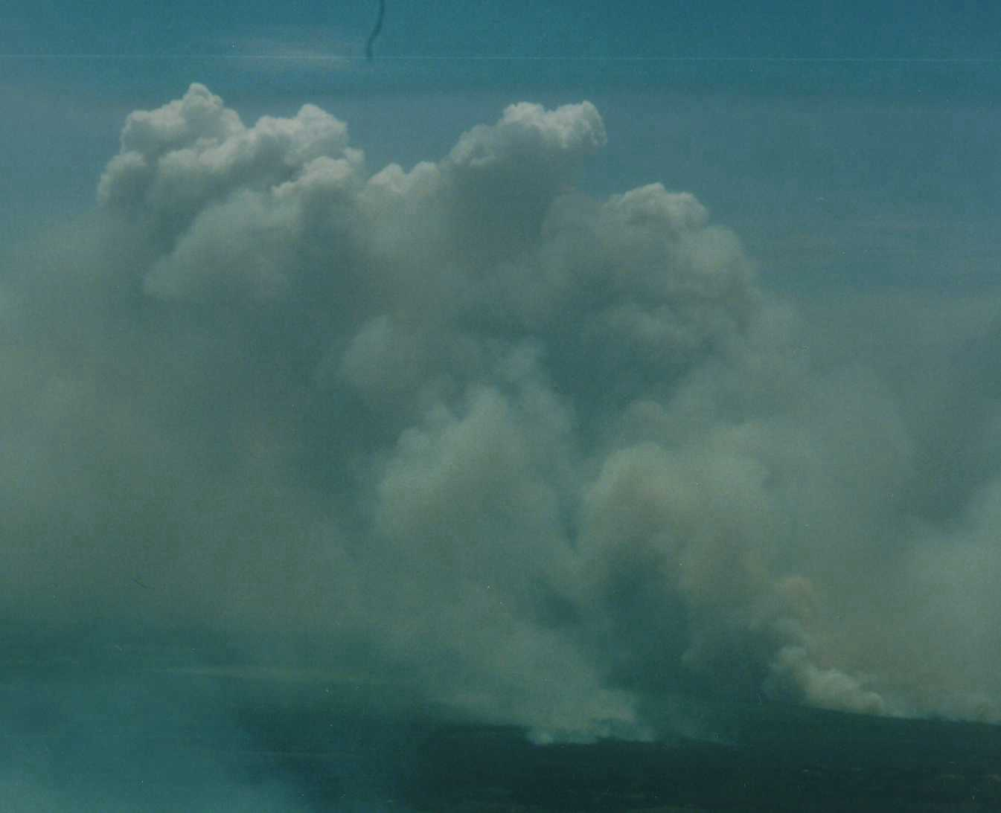
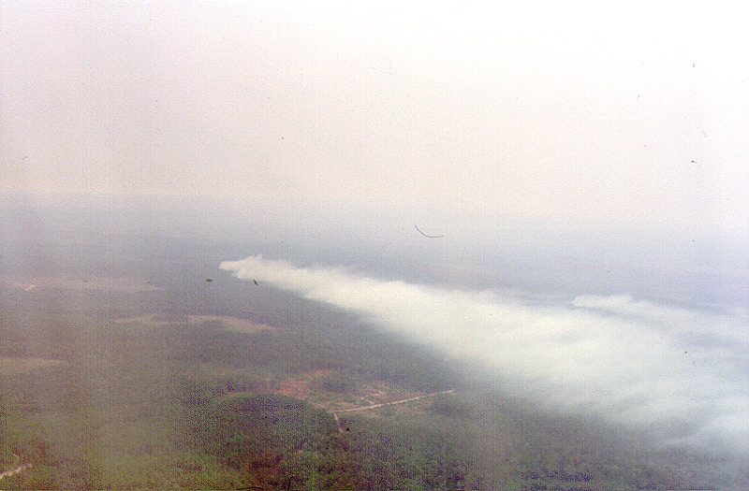
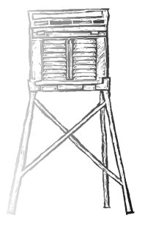
Mixing Height
Mixing Height: The altitude to which smoke and buoyant updrafts will penetrate. Sometimes called the mixed layer.

Slide 45
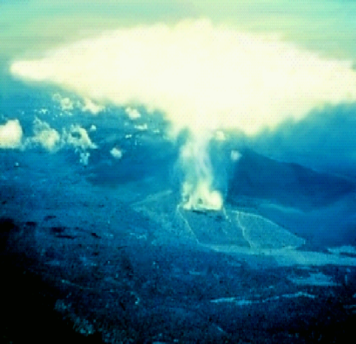

Mixing Height
The convective mixing layer is normally “capped” by a layer of very stable air, which limits the rise of smoke. Smoke columns are often seen spreading out at the top of the mixed layer.
Top of the Mixed Layer
Top of the Mixed Layer

Slide 46

What is the mixing height now?.

Slide 47


Remember from S-290 the atmosphere is always in layers. These layers move up and down through the day
Morning
Afternoon

Slide 48

Pot Peak Fire
Notes:
Notice the different layers that are in the fire plume showing two (2) stable layers with different wind directions and speeds and an unstable layer above the stable layers. Late in the afternoon the fire was able to get into a basin with heavier. The more intense fire was able to punch through the stable layers and create a plume to 26,000 feet.

Slide 49

Evolution of the
Daytime
Mixed Layer
12,000 Ft AGL
Maximum Mixing Height
2 PM
2 PM
7400 Ft AGL
Noon
Noon
2800 FT AGL
10 AM
10 AM
1500 Ft AGL
58ºF
8 AM
8 AM
G r o u n d
55ºF
63ºF
75ºF
80ºF
88ºF

Slide 50

Seasonal Variation in
Mixing Layer Height
Smoke very rarely reaches the maximum meteorological mixing height, because Rx and field burns do not generate a lot of heat. Usually several thousand feet less. Early and late only for a few hours at best.
Smoke very rarely reaches the maximum meteorological mixing height, because Rx and field burns do not generate a lot of heat. Usually several thousand feet less. Early and late only for a few hours at best.

Slide 51

Higher Mixing + Stronger Winds = better Ventilation
Early and late season burns are quite challenging smoke wise.
The best mixing is always lower then expected.
The window of opportunity may be only for a few hours.

Slide 52
Higher Mixing + Stronger Winds = better Ventilation
Early and late season burns are quite challenging smoke wise.
Several burns in the same airshed can and will overcome a moderate day.
DNR does not do mixing height transport winds. Request them with your Spot.

Slide 53

Our Main PC Based Interactive Forecast Sounding Tool - BUFKIT

Slide 54

University of Washington Model Forecasts of Mixing and Venitlation
Boundary Layer height and 20m wind speed. Good for first look big picture.

Slide 55

WFDSS Air Quality Tools
http://firesmoke.us/wfdss
This site was developed to try to provide a "one-stop shopping" portal for air quality tools.
/

Slide 56
NWS Budget Cuts
5% across the board federal cuts (non-defense)
NWS looking at ways to make up this reduce funding
Negotiations continue
No details known yet

Slide 57


Questions, Comments, Feedback?
www.weather.gov

