Slide 1
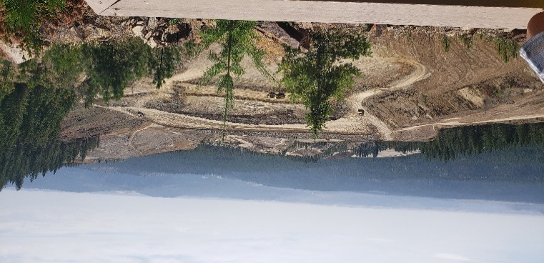

Spokane Tribe
Midnite Mine

Slide 2
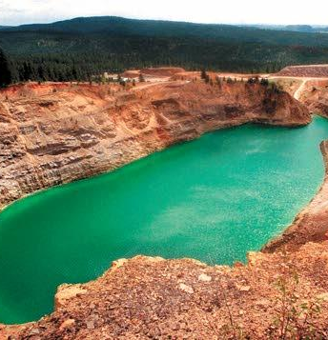
High Uranium and Radium means high Radon
Mine cleanup can increase radon levels
State Indoor Radon Grants (SIRG) to tribal communities for outreach, testing and education
Regional EPA to partner with tribal communities to further enhance understanding of healthy indoor air – radon and coordinate with other SIRG Grantees

Slide 3
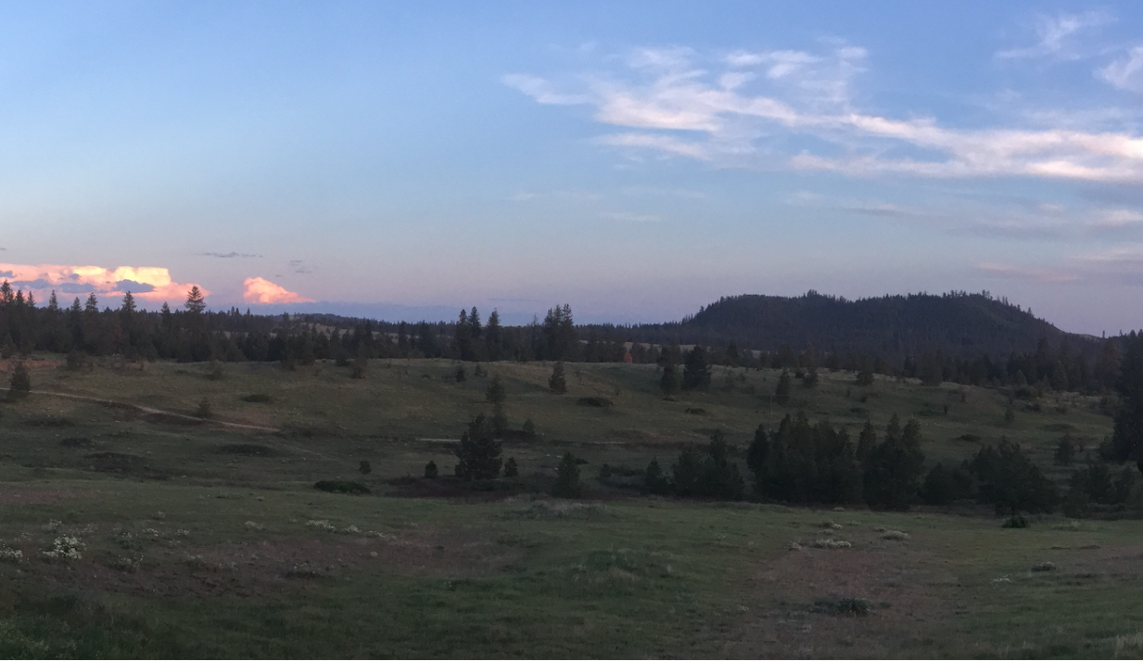
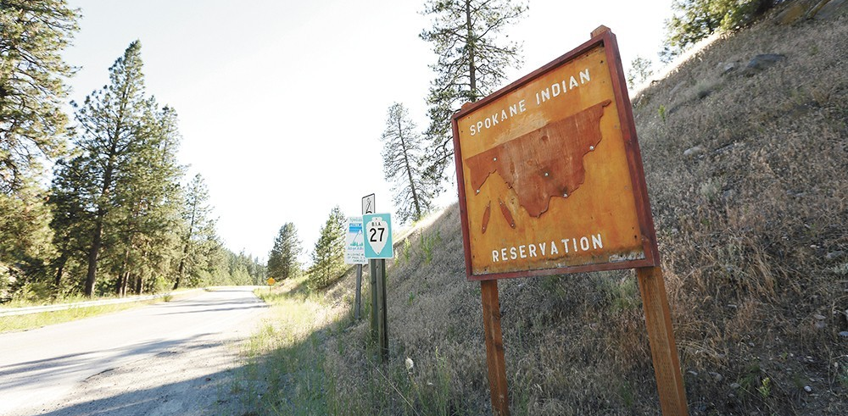
Spokane Tribe Radon Program
Lucas A. Bair
Air Quality Program Manager
Spokane Tribal Natural Resources

Slide 4
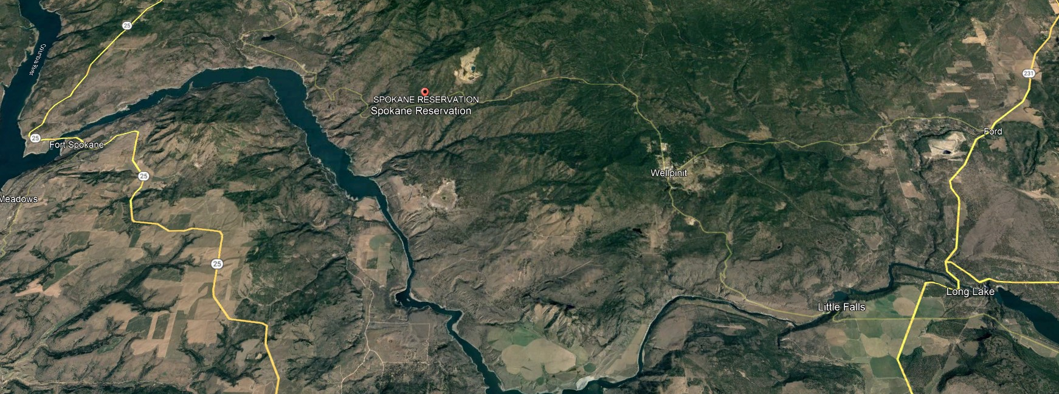
Spokane Tribe of Indians Overview
Reservation
Class 1 Airshed

Slide 5
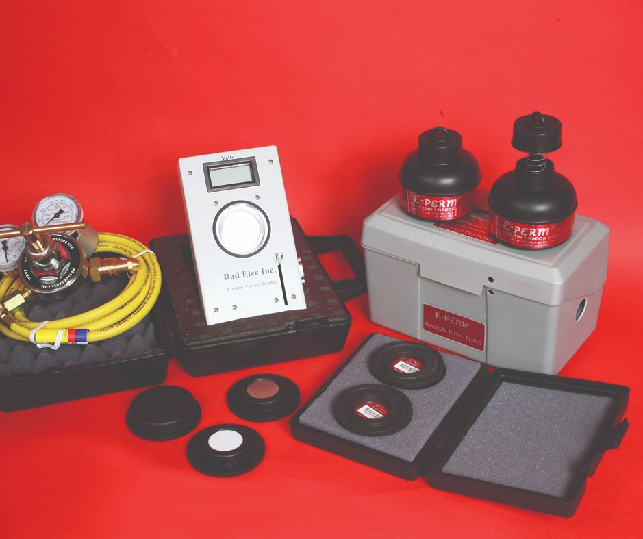
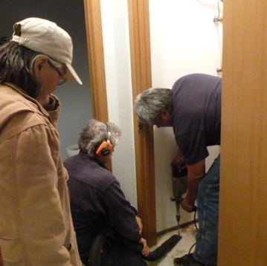
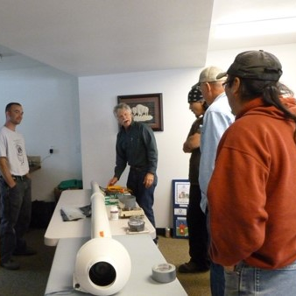
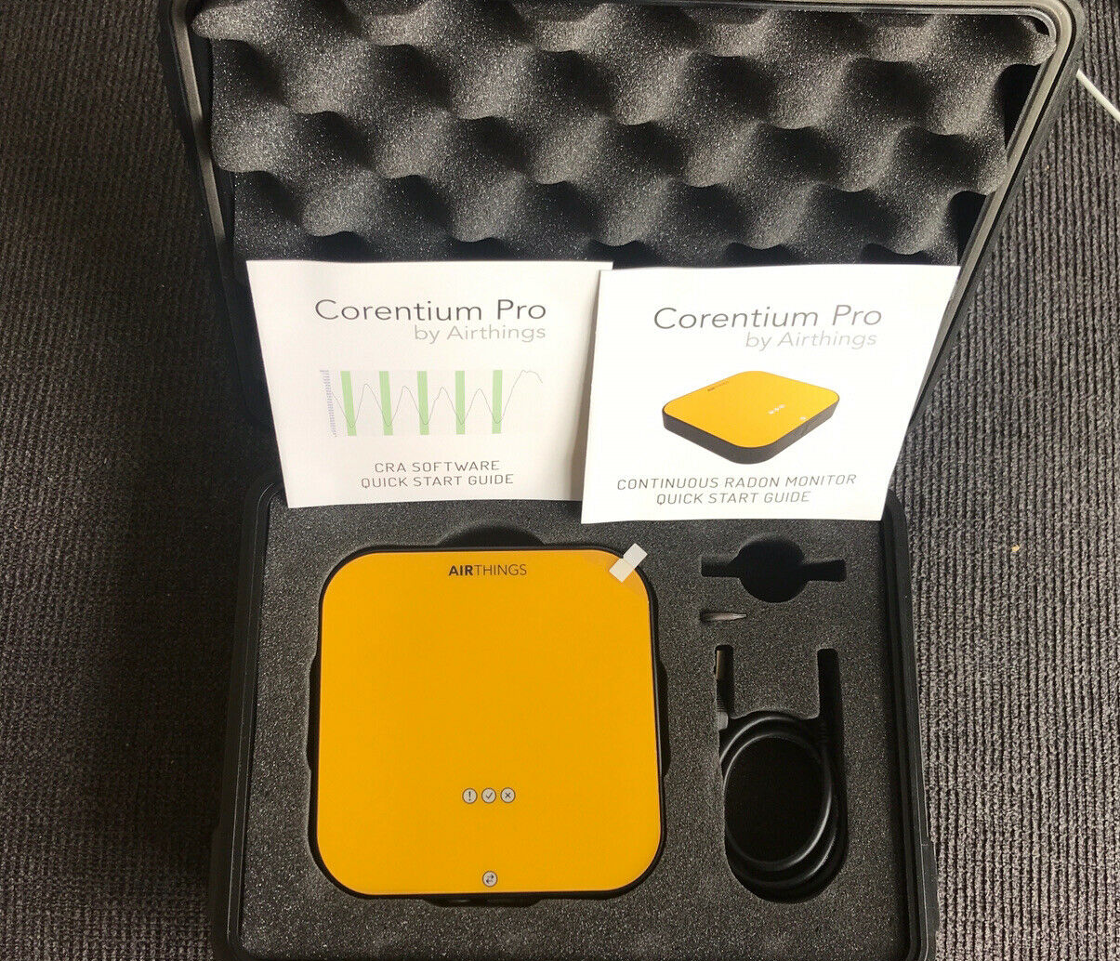
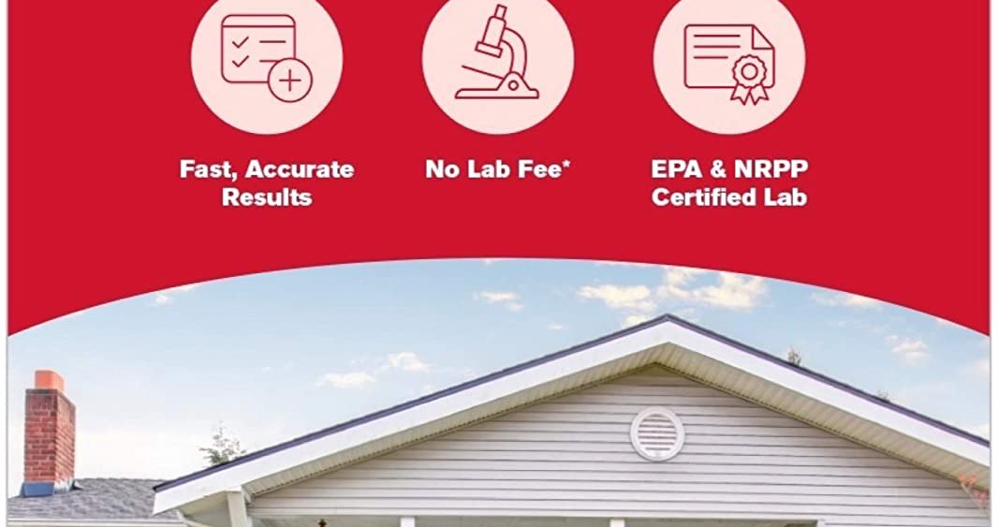
Spokane Tribe Radon Program
Tools for Radon
Housing Program Overview
Accomplishments

Slide 6
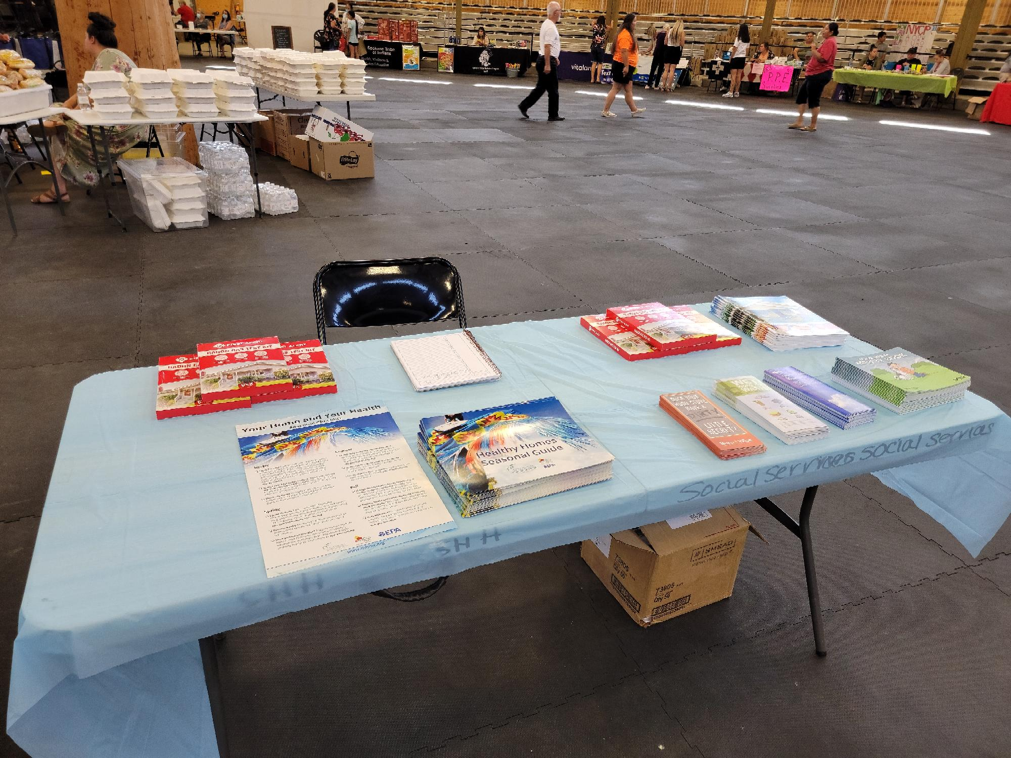
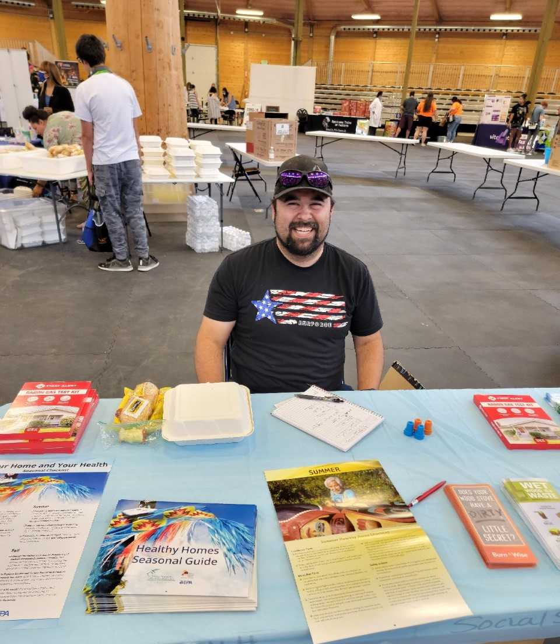
STATE INDOOR RADON GRANT (SIRG)
Purchased Radon Kits
Outreach Activities
Difficulties

Slide 7
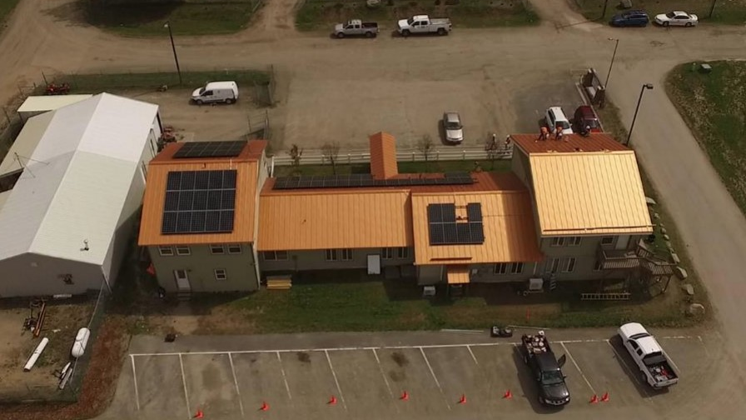
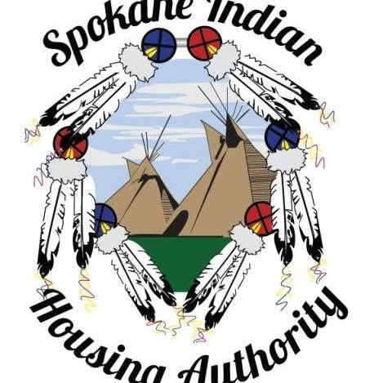
Working with Housing (SIRG)
Goal
Timeframe
Set out to test 80 homes

Slide 8

Lucas Bair lucas.bair@spokanetribe.com (509) 626-4403

