Slide 1
November 9, 2021 R10 Virtual Summit Focused outreach and support for licensed Home-Based Childcare Centers in WA
Notes:
I am here to talk to you today about the Washington State Dept of Health Radon Program project to test home-based childcare centers for radon.

Slide 2
Meet the Team
Vacant
Gary Garrety
Radon Director
Radon Liaison
Lize Williams
Communications Strategist
Notes:
The Department of Health Radon Program includes 2 program staff and 1 communication expert. Currently, the team includes myself as the Radon Liaison (focusing on our contracts and assisting with radon hotline calls), and Lize Williams (who creates and updates all of our radon communication and outreach materials).
--------------------------------------------------------------------------------------------------
In addition to these roles we work on the Washington Tracking Network at DOH. The WA Tracking Network is a set of tools that help display public and environmental health data and information to make that information more accessible and available to the public. The Washington Tracking Network is funded by the Centers for Disease control and prevention and contains over 450 measures of environmental and public health data, included radon.

Slide 3
WA DOH Radon Program
Funded by the EPA SIRG Grant
Goal of grant is to increase awareness and reduce exposure to radon throughout Washington State
Under this grant, we focus on:
Outreach (incl. Radon Hotline)
Home-Based Childcare Center Testing
Renter/Homeowner Testing
Notes:
Our Radon Program is funded by the EPA State Indoor Air Radon Grant (also known as SIRG grant). SIRG grants are available to each state (1 per state) and are renewed annually by EPA. The goal of the grant is to increase awareness of radon throughout Washington State as well as to reduce exposure to radon.
Under this grant, our program focuses on:
Outreach (particularly during Radon Action Month and through our radon hotline)
Testing Home-based Childcare Centers for Radon (through offering free radon test kits to home-based childcare centers)
and providing free test kits to renters and homeowners throughout Washington with the goal of having them test their homes.
----------------------------------------------------------------------------------------------
We also work with other programs in the Agency, such as the Washington Choose Safe Places program, to help reduce radon exposure
State Indoor Air Radon Grants are available to each state and renewed annually by EPA (SIRG).
Usually around $50,000/year from EPA with a 40% match.
Grant mandate is to raise awareness of the risk of exposure to radon and to reduce exposure.
Goal of 2018 grant was focused outreach to in-home Child Care Centers with the offer of free testing kits

Slide 4
Home-Based Childcare Center Testing
Notes:
Today, our focus is on our home-based childcare center testing program, free radon test kit offer, mitigation support and resources to home-based childcare centers.

Slide 5
What’s in a Name?
Center-Based Childcare (~2000 in WA)
State-licensed, staff are licensed and trained
Run similarly to a school – age-based groups
More than one caregiver available
Home-Based Childcare (~3500 in WA)
Run out of the provider’s home, often while caring for own children
May be state licensed and trained
Fewer children
Notes:
There are two main types of childcares in Washington State, Center-Based childcares and Home-based childcares. Our work has focused on Home-Based Childcares, but let’s take a second to understand how they differ…
Center-Based Childcares – are state-licensed facilities and are usually run pretty similarly to a school, with children of various ages cared for in groups. Some of these are run by employers themselves. More than a quarter of infants and toddlers are in center-based care. Unique for center-based childcare centers is that the staff at each center are trained and licensed (required) and because there is more than one caregiver at each facility, there is always a substitute caregiver available. There are ~2000 center-based childcare centers in WA.
Home-Based Childcares – are typically run out of the provider’s home. Often the provider cares for their own children at the same time. While some home-based childcare center providers have received training and are state licensed, many are not. At home-based childcares there are often fewer children than at a center-based childcare center, which may mean more personal attention and less exposure to illness. In WA ~3500 home-based childcares.
-----------------------------------------------------
** Numbers are a rough estimate depending on data available in 2018.

Slide 6
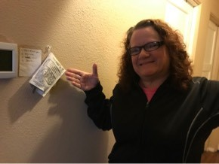
Home-Based Childcare Centers
Notes:
Our project was to focus on home-based childcare centers as they outnumber center-based childcare centers; additionally, by focusing on home-based childcares not only are we reducing exposure to radon for the children receiving childcare at these locations, we’re also reducing radon exposure for the family living in the home.
------------------------------------------------------
** picture is from staff assisting a childcare center with hanging a kit in their home.

Slide 7
The Process
Receive list of centers from DCYF
Send Free Radon Test Kit Offer to Centers
Send Free Radon Test Kits to Interested Centers
Receive & Match Radon Test Results from Lab
Provide support to centers with elevated test results
Notes:
Create data sharing agreement with our Dept of Children, Youth, and Family DCYF in order to receive (confidential) home-based childcare license information (including contact information) for all home-based childcare centers in WA State. This allows us to reach out to each childcare center with our free radon test kit offer.
After receiving emails from interested childcare centers, we send them a free radon test kit with instructions on how to conduct the test.
We then receive radon test results from the lab and match test results to the free test kits (serial #’s) we sent out
If a test is elevated, then we reach back out to the center with support and resources for next steps for mitigation

Slide 8
Lessons Learned
Prioritizing Centers for Testing
Notes:
Free Test Kit Offer
------------------------
We were concerned that with so many home-based childcares in Washington State (~3500) we were concerned that we would need to prioritize who we sent radon test kit offers to based on radon risk geology, so we started by using our radon risk geology map to prioritize sending free test kit offers to childcare centers in high radon risk geology areas.

Slide 9
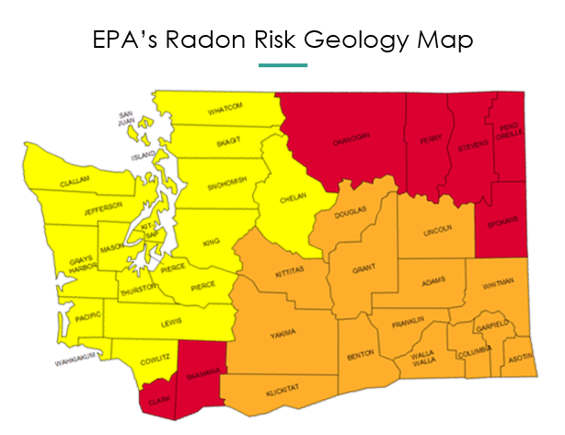
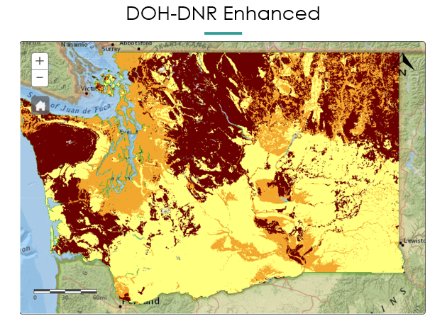
Prioritizing Centers for Testing
Notes:
On the left is EPA’s county level radon risk map for WA state. This map shows risk with yellow for low risk graduating to red showing elevated risk areas.
On the right is the enhanced radon risk geology map created in partnership with WA State DNR. Our updated radon risk geology map uses the same color scheme (yellow for low risk graduating to red showing elevated risk) and allows us to assess radon risk exposure at a finer scale. As part of our process, we validated this map with 30,000 test results received from 8 national labs for 2000-2015.
We were able to use our enhanced map to help target our outreach, education, testing, and mitigation efforts to home-based childcare centers in high radon risk geology areas. After identifying childcares located in high radon risk geology areas, we sent out free test kit offer letters to each childcare. Unfortunately, we received almost no response.

Slide 10
Lessons Learned
Prioritizing Centers for Testing
Notes:
This encouraged us to open up the test kit offer to all ~3500 childcare centers. We printed out the letters for each childcare center and sent them out expecting a much larger response. And we got one, though not necessarily the response we’d hoped. Many were returned to us as having incorrect addresses.

Slide 11
Lessons Learned
Prioritizing Centers for Testing
Returned Letters
Notes:
Luckily we also received email addresses for each home-based childcare center in the dataset we receive from DCYF. So we transitioned to sending our free test kit offer letter out by email instead. We still received a large number of emails that bounced back, but in some cases we were able to resend our offer after having made small adjustments to the email address (such as by identifying and fixing typos in an email address). By making the switch to sending out our free test kit offer letter by email, we were also able to ask requesters to verify mailing address or that they update the physical/mailing address so that we could send the test kit out to the correct address (using this method, we’ve only had 2 test kits ever returned to us for an incorrect address since 2018).

Slide 12
Lessons Learned
Prioritizing Centers for Testing
Returned Letters
Language Barriers and Accessibility
Notes:
We have also run into some language barrier challenges with our free test kit offer program. We were providing our materials into the two most common languages in Washington State (English and Spanish) and finding that we also needed to translate the materials into more languages (such as Russian). To help address some of these challenges, we recently went through and updated each of our letters (our free test kit offers and test kit instructions) to two more of the top languages spoken in WA (Vietnamese and Russian) to help make sure that we are making our program more accessible. We have also been fortunate enough to have Spanish-speaking staff on our larger team at the DOH, who have been instrumental helping us reach a larger audience for our test kit program by helping us reply to questions received as well as promoting the childcare test kit program on a Spanish-speaking radio show and blogs that reach audiences in high-radon risk geology areas.

Slide 13
Lessons Learned
Prioritizing Centers for Testing
Returned Letters
Language Barriers and Accessibility
Return on Free Test Kits
Notes:
We have also had challenges with returns on free test kits, as not all childcares that receive a test kit do end up testing. However, with COVID the interest in testing has increased, so we are hopeful that the amount of test kits sent to the lab does as well.

Slide 14
Lessons Learned
Prioritizing Centers for Testing
Returned Letters
Language Barriers and Accessibility
Return on Free Test Kits
Test Kit Vendors & Working with National Labs
Notes:
Lastly, we have had challenges with keeping test kits in stock, as we were previously limited to working with an already approved DOH-vendor for test kits. This has caused enough delay in us getting test kits out to childcare centers (particularly this year) as test kits are often backordered with the vendor and we were struggling to receive test kit results from the national lab that these test kits were sent to. As we were limited to a pre-approved DOH vendor, we also had to pay more for our test kits (~4x as much as if we had ordered test kits directly from the vendor ourselves). This limited the amount of test kits we were able to order each year and made it harder for us to send out test kits in preparation for winter testing (which is the best time of year to test for radon). We have recently been allowed to expand our ordering of test kits to other vendors, which we hope will make it easier for us to get radon test kits out to interested childcare centers ASAP.

Slide 15
Feedback
“Absolutely!! Such a great offer! Please send me a kit, which I will do immediately. Everyone should be required to do this. If not for our own families, then for the sake of those in our care, that we are responsible for.
Thank you so Much!”
KRPRESCHOOL
Notes:
Overall, this project had been incredibly rewarding and has allowed us to test several childcares as well as to support 6+ childcares with mitigation.

Slide 16
Questions?
Doh.radon@doh.wa.gov

Slide 17
Notes:
END SLIDE

