Slide 1
November 9, 2021 R10 Virtual Summit Radon Data Exchange Network – “Building a Community of interest for the Radon Data Exchange”
Notes:
I am here to talk to you today about the Washington State Dept of Health Radon Program project to test home-based childcare centers for radon.

Slide 2
2017 – 2020 Exchange Network Project
Presenter
Gary Garrety
WTN Operations Manager and Radon Program Liaison
Washington State Department of Health
Identify the gap the project designed to fill
Define the project / Review project design
Identify the project team
Consider what’s now possible
Notes:
Colorado CDPHE had already been very active in national radon work groups and was also in position to leverage long standing and active relationships between local, state and federal partners to make efficient use of resources already in place such as the already existing radon XML schema. Colorado coordinated radon data flow, as well as coordinated states’ and federal partners’ (CDC) participation in the “Community of Interest.”
A condition of the grant was a commitment to re-using existing EN tools. We recognized and committed to using these already existing/available RCS tools:
• Network Authorization and Authentication Services
• OpenNode2 from the EN to participate in data exchange
• Radon Reusability Package to standardize and submit our radon data
• Exchange Network Discovery Services (ENDS) to submit and retrieve service information
• Services Center
• Virtual node: Implement the shared cloud node platform using WIZARD driven functionality

Slide 3
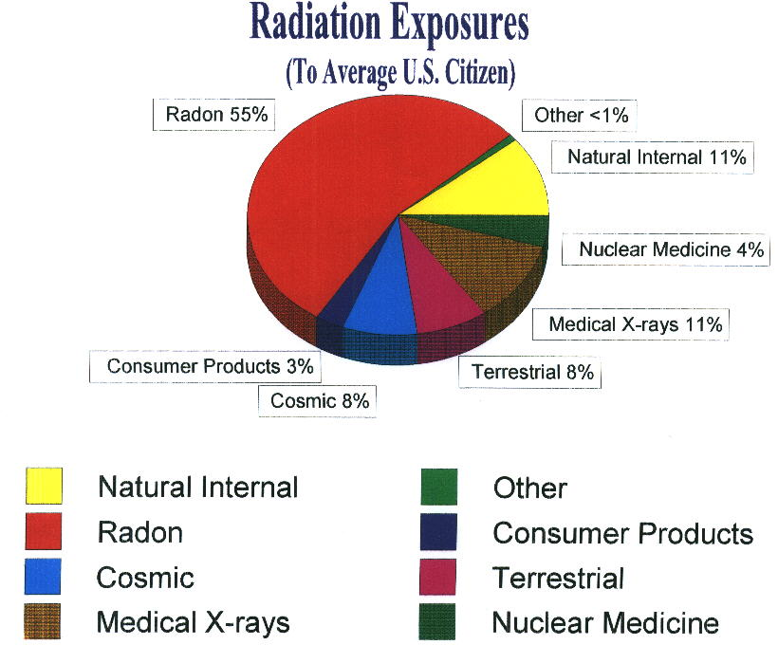
Notes:
Radon is a naturally-occurring radioactive gas that can cause lung cancer.
Radon gas in the environment is the major source of radiation exposure. Naturally occurring it’s found in low concentration of about 0.2 pCi/L in the open environment; however, it can be trapped in buildings where it can concentrate to levels that are harmful.

Slide 4
Timeline
2002 – Washington became a CDC Tracking State
2009 – Colorado became a CDC Tracking State
2013 – Developed Radon Data Display
2014 – EN grant to flow radon data to national repository
2015 – Co-chair CDC Radon Content Workgroup to develop NCDM
2016 – Data to EN and Mobile App developed
2017 – AARST and CO partner to update National Map
2017 – EN grant to expand and facilitate radon data on EN
2018 – EPHTN pilot data flow
2019 – EPHTN public display of radon NCDM
2019 – EN flow of radon data by COI

Slide 5
Varied Data Sharing Approaches
CDC – Tracking
26 grantee states
1 non-grantee state
6 Labs
National Repository with data analysis and mapping display
EPA – Exchange Network
50 States have EN Nodes/pathways to report required data
Active tribal partners
National Repository
Notes:
Reporting data to different federal agencies along different pathways…
Radon is currently an optional NCDM with CDC:
- Optional / Optional – Optional for reporting and Optional for display
-
Radon is currently being proposed for NCDM adoption

Slide 6
Various Data Sources
Radon data is collected by various governments and programs:
Governments
Tribes
Territories
States
Common Programs
Health Department
Geology Department
Environmental Department
Notes:
Radon data is collected by various governments, and by varied programs within those governments

Slide 7
Various Data Sources
Short-term and long-term charcoal test kit analysis done by:
Radon Testing Laboratories
State Testing Laboratories
Private/Commercial Laboratories
Not all radon test data is captured
Some private/commercial labs don’t make data available
Radon Continuous Monitoring (RCM) often conducted by schools, tribes, mitigation companies etc. etc.). Currently no means of capturing this data to include in our radon testing results.
Notes:
Radon testing data are created by different sources. Different tests and testing mediums. Different labs conducting analysis.
State, territorial, and tribal radon programs have worked to identify tests and labs to work with for the collection of radon testing data.
Not all private/commercial labs share data to governments/programs.
Currently no ability for RCM data to be captured.

Slide 8

2017 – 2020 Exchange Network Project
Radon = Environmental Public Health Issue
Radon data is collected, but…
- Varied Origins
- Varied Reporting Routes
- Varied Repositories
together present challenges for accessing and using these data easily and effectively.

Slide 9
Exchange Network Project 2017-2020
https://www.epa.gov/exchangenetwork
The Environmental Information Exchange Network (EN) is a partner-inspired, developed, implemented and governed information network. It facilitates environmental data sharing among EPA, states, tribes and territories. The EN:
Facilitates the sharing of environmental data, especially through shared and reusable services;
Streamlines data collection and exchanges to improve timeliness for decision making;
Increases the quality and access to environmental data;
Reduces burden and costs for co-regulators and the regulated community; and
Supports better decisions on environmental and health issues.

Slide 10
2017 – 2020 Exchange Network Project
Goal: Partner with the Colorado program to improve communication and collaboration by defining and standardizing web services to expand states’ capacity to compile and record radon data
WA Dept of Health Glen Patrick Principal Investigator Lauren Freelander WA Radon Program Director Tina Echeverria Project Manager | CO Dept of Health and Environment Eric Brown, MPA Environmental Data Coordinator
Notes:
Colorado CDPHE had already been very active in national radon work groups and was also in position to leverage long standing and active relationships between local, state and federal partners to make efficient use of resources already in place such as the already existing radon XML schema. Colorado coordinated radon data flow, as well as coordinated states’ and federal partners’ (CDC) participation in the “Community of Interest.”
A condition of the grant was a commitment to re-using existing EN tools. We recognized and committed to using these already existing/available RCS tools:
• Network Authorization and Authentication Services
• OpenNode2 from the EN to participate in data exchange
• Radon Reusability Package to standardize and submit our radon data
• Exchange Network Discovery Services (ENDS) to submit and retrieve service information
• Services Center
• Virtual node: Implement the shared cloud node platform using WIZARD driven functionality

Slide 11
Exchange Network Project 2017-2020
WA Proposal:
Improve communication and collaboration among the radon “Community of Interest,” including highly impacted states, regarding standardized radon data collection and the creation of nationally consistent radon data measures,
AND
Coordinate and provide technical expertise to expand states’ capacity to compile radon data, recode the data to defined schema, and provide these data to the EN using standardized web services.
How’s that work?
Establishing a radon “Community of Interest” and an EN node or virtual network that will reduce burden on reporting partners will:
Increase data flow to the EN by making it easier
More data and more accessible data will improve public awareness, and home testing
Improve public access to these data. More data will be publicly accessible quicker, at lower program burden and lower program cost.
Increase data flow to the National Radon Data Exchange
Notes:
WA submitted a proposal for the EPA Exchange Network (EN) grant to standardize schema for reporting and produce a robust radon data repository.
Utilizing EN might make the data easier to access from the labs, so that states wouldn’t have to get the radon data directly from each of the labs. The data could then flow from the repository to CDC. Making the data more complete, and less burden on states.
Several ways to approach the need for more comprehensive and available radon data
Simplify it, streamline it, and make it available to all
Radon – Optional NCDM with CDC:
- Optional / Optional – Optional for reporting and Optional for display
Radon is now being proposed for NCDM adoption

Slide 12
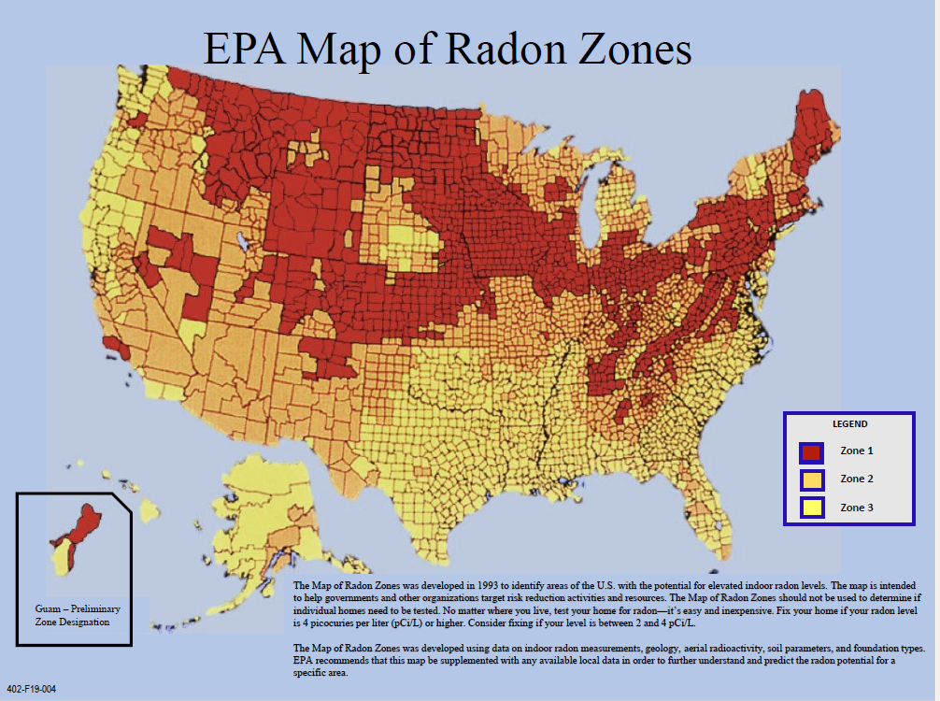
Notes:
Map of Radon Zones created by the EPA in 1993 used data on indoor radon measurements, geology, aerial radioactivity, soil parameters, and foundation types.
EPA recommends that this be supplemented with any available local data in order to further understand and predict the radon potential for a specific area.

Slide 13
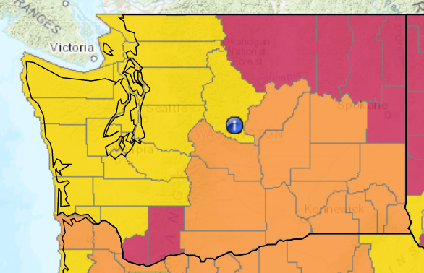
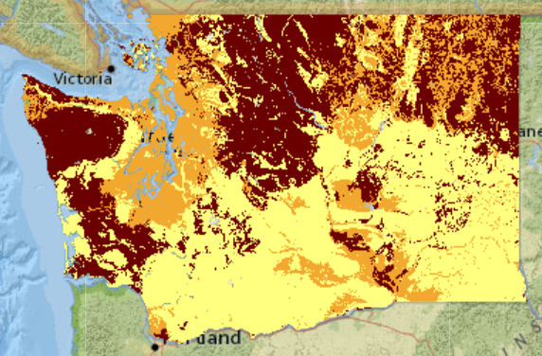
Mapping Radon Zones
EPA Map of Radon Zones
Developed in 1993 to identify areas of the U.S. with the potential for elevated indoor radon levels.
WA Enhanced Radon Risk Map
Developed in 2016. Based on small scale-sediment and hard rock geology as well as over 30,000 radon test results (2000 – 2015).
Notes:
EPA zone map is still widely used by people deciding on whether to test, mitigation companies staging services, outreach efforts and legislation.
- WA has limited radon legislation but does call out the 7 counties on the EPA zone map for specific building codes
WTN combined test results

Slide 14
New National Radon Map - Pathways
NEPHTN
Standard Schema for data format
Public Display of data from 14 states and 6 National Testing Labs.
Data aggregated by County (Census Tract in future)
EN
Matching Standard Schema for data format
Option for public or secure data download. Currently 4 states
Record level test results
AARST
Collaborated with CO and CDC to map National Testing Lab data from 5 labs
Notes:
WA submitted a proposal for the EPA Exchange Network (EN) grant to standardize schema for reporting and produce a robust radon data repository.
Utilizing EN might make the data easier to access from the labs, so that states wouldn’t have to get the radon data directly from each of the labs. The data could then flow from the repository to CDC. Making the data more complete, and less burden on states.

Slide 15
WHAT’S NEXT?
Notes:
Radon NCDM adoption
Updated Radon national map

Slide 16
Notes:
END SLIDE
Quick Help Tips
Insert this slide at the end of the presentation. It is not editable.

