Slide 1
Division of Water’s Guide to Submitting Data to the Water Quality Exchange (WQX)
2021

Slide 2
Introduction

Slide 3

EPA’s Introduction to the Water Quality Exchange (WQX)
https://www.youtube.com/watch?v=4doKGKUySNk

Slide 4
Why does DOW Require Community Partners to Submit Data to WQX?
Water Quality Exchange (WQX) is a United States Environmental Protection Agency (EPA) framework for accepting and storing the nation’s water quality data.
Providing data through the WQX assists the Division of Water (DOW) by providing:
Standardization: A standardized data structure helps to ensure DOW can efficiently process and correctly interpret community partner data.
Ownership: Data submitted through WQX maintains transparency, traceability, and accountability to the data generator.
Accessibility: Data stored in WQX are publicly available and easily accessible via the Water Quality Portal (WQP) to DOW and other interested users.

Slide 5
Why does DOW Require Community Partners to Submit Data to WQX?
It is important to understand that managing data from a variety of sources is no easy task. In general, each data source has its own data format/style/structure. It is not only time consuming for DOW to manually transform all incoming data into a standard structure, but it is also error prone.
In other words, you are the expert on your data and are best suited to reformat it as necessary. Once data is formatted and uploaded to WQX, DOW can easily and accurately extract that data for consideration in water quality program updates and decisions.

Slide 6
Recommended Workflow
We recommend this workflow because we think it simplifies the submission process into a logical set of milestones. However, there are no issues following a different workflow that is better suited to your program or data set.
Register for CDX and WQX Accounts
Review Required Fields and Values
Submit Project and Monitoring Location Information to WQX
Download WQX Submission Templates
Collect Data
Perform Quality Control Analyses
Submit Results to WQX
Submit DOW Metadata Survey

Slide 7
Training Videos

Slide 8
ORSANCO WQX / WQX Web Training
Day 1: https://youtu.be/fUddGNuhpEU
WQX Web High level Overview.
WQX Template Overview
Entering Data into WQX Web (basic Projects and Monitoring locations)
Day 2: https://youtu.be/YZ7iovCeBbo
Entering Data into WQX Web Continued (detailed overview of import configurations and how to submit results)
Water Quality Portal Overview

Slide 9
Account Registration

Slide 10

EPA’s Getting Started with WQXweb: How to Gain Access
https://www.youtube.com/watch?v=KA6QPEiZfZ8

Slide 11
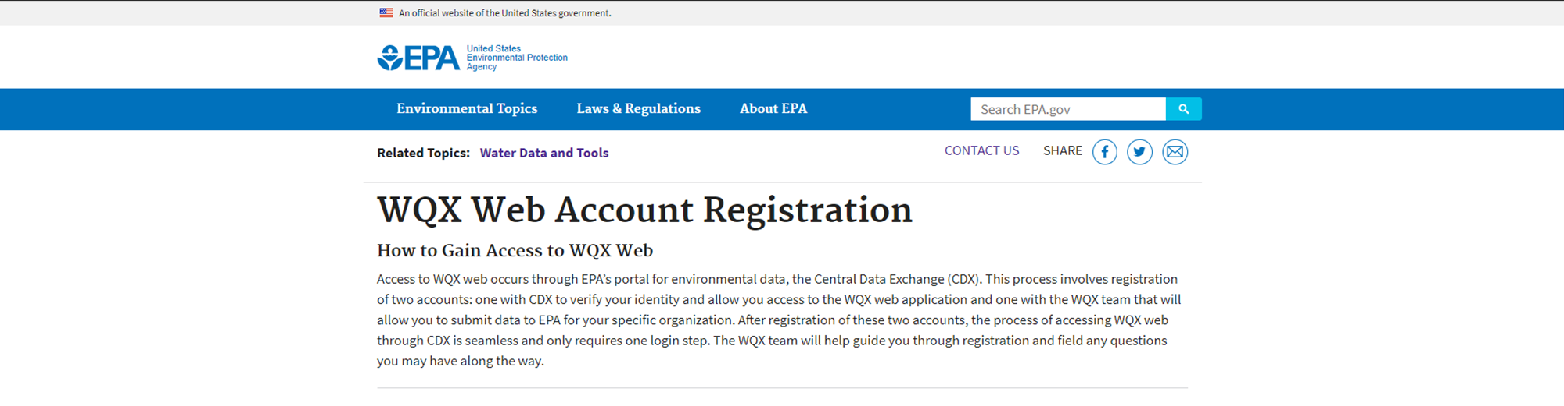
CDX and WQX Account Registration
Follow the directions on EPA’s WQX Web Account Registration webpage.
You will need to create both a Central Data Exchange (CDX) and a WQX account
Data is submitted through CDX where user information is authenticated, and data are validated.
Signing up for a WQX account provides you the ability to submit data to WQX via CDX.
If you do not receive any email response from EPA within 1-business day, we recommend calling the WQX Support number. The support staff will ensure your registration request was not flagged as spam.

Slide 12
Log In to CDX and WQX

Slide 13
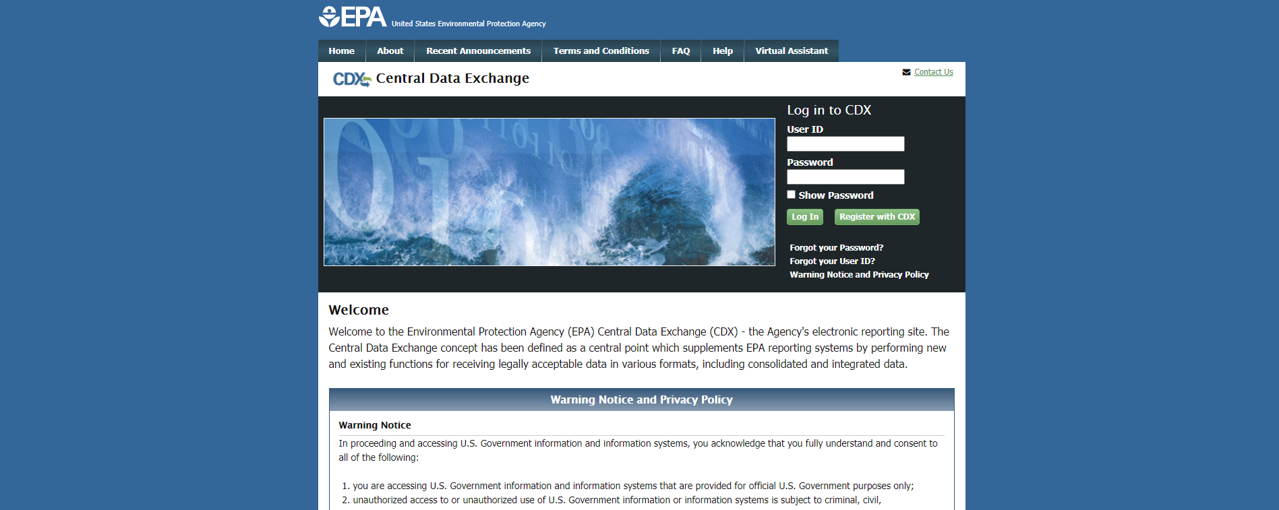
Log In to CDX
Log in to CDX: https://cdx.epa.gov/

Slide 14
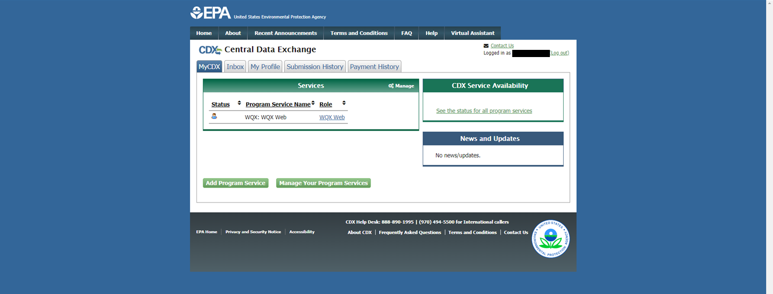
Log In to WQX
Select
Log in to WQX

Slide 15
Uploading Data to WQX
Overview and Recommendations

Slide 16
Overview
There are two overarching requirements when submitting to WQX via the WQX-web platform:
Data must be provided in an expected format and include expected values (the templates help with this).
Data must be uploaded in the correct order (i.e., project information and monitoring location information must be uploaded first).

Slide 17
Overview
You will need to load each sheet of the template independently and in the correct order:
Import the Projects sheet
Import the Monitoring Locations sheet
Once the Projects and Monitoring Locations sheets have been imported you can import any of the remaining sheets

Slide 18
Overview
The Project and Monitoring Location Information only needs to be uploaded once.
This information can be used for multiple result submissions within a year or across multiple years.
It is possible to reference the same Monitoring Locations across multiple Projects within your data results.

Slide 19
Recommendations
We recommend uploading your project and monitoring location information prior to the start of sampling.
In most cases, this information should be available prior to sampling.
If possible, getting this information into WQX early will…
Help you to become familiar with the WQX workflow.
Break the submission process into more manageable subtasks.

Slide 20
Recommendations
When working with a laboratory, we recommend you discuss the potential of the laboratory providing the data in the template format or close to the template format. If the laboratory is willing to match the template format, you could save yourself a large amount of time.

Slide 21
Recommendations
Review the appropriate WQX submission template during project planning.
Matching the WQX format and structure as closely as possible during data collection, validation, and storage should simplify the WQX submission process.
Understand what is a valid input for each column (i.e., domain values).
You can download the most up-to-date domain values from EPA’s webpage.
We recommend downloading “All-Individual Domains Library (ZIP)” or each individual domain zip. The “All - The Entire Domain Lists (ZIP)” is a little overwhelming and difficult to navigate.

Slide 22
Recommendations
Plan to review your data before submission.
It can be easy to introduce a typo or misalign rows. These issues can typically be caught during a data review. Catching these issues early on will safe a lot of time in the long run.
Ideally the review should be performed by someone independent of the compilation of data. For example, staff person-1 populates the template and staff person-2 reviews the content before submission.
We estimate that this process will generally take ~30 mins. However, this depends on the size and complexity of your data set.

Slide 23
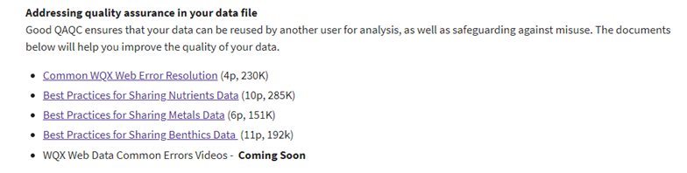
Recommendations
Review the applicable “Best Practices” documents provided by EPA.
This is an image from EPA’s webpage (2021-05-14) describing the best practices for sharing different types of data. Follow the link provided above for the most up-to-date information.

Slide 24
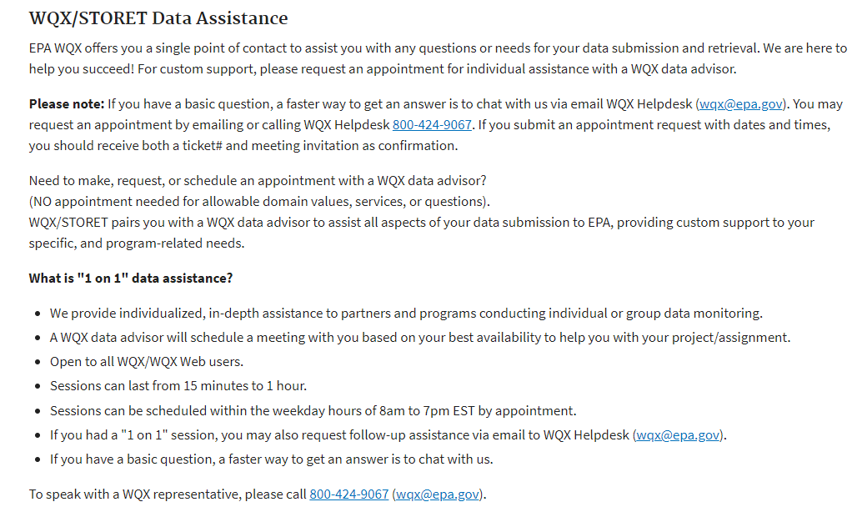
Recommendations
If you get stuck, we recommend scheduling time with EPA’s WQX helpdesk.
This is an image from EPA’s webpage (2021-05-14) describing the assistance the WQX helpdesk can provide. Follow the link provided above for the most up-to-date information.

Slide 25
Download WQX Data Upload Templates

Slide 26
Data Templates
We strongly recommend that you become familiar with the structure and expected content within the data templates before you begin collecting data.
This will ensure you collect all the necessary information to complete the template
When working with a laboratory, we recommend you discuss the potential of the laboratory providing the data in the template format or close to the template format. If the laboratory is willing to match the template format, you could save yourself a large amount of time.

Slide 27
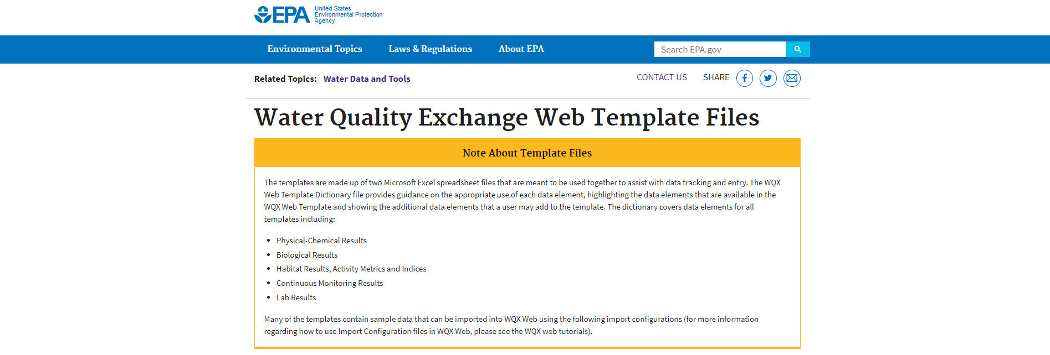
Download a WQX Template File
Read EPA’s Water Quality Exchange Web Template User Guide
Visit EPA’s Water Quality Exchange Web Template Files webpage
Download the appropriate Template File

Slide 28
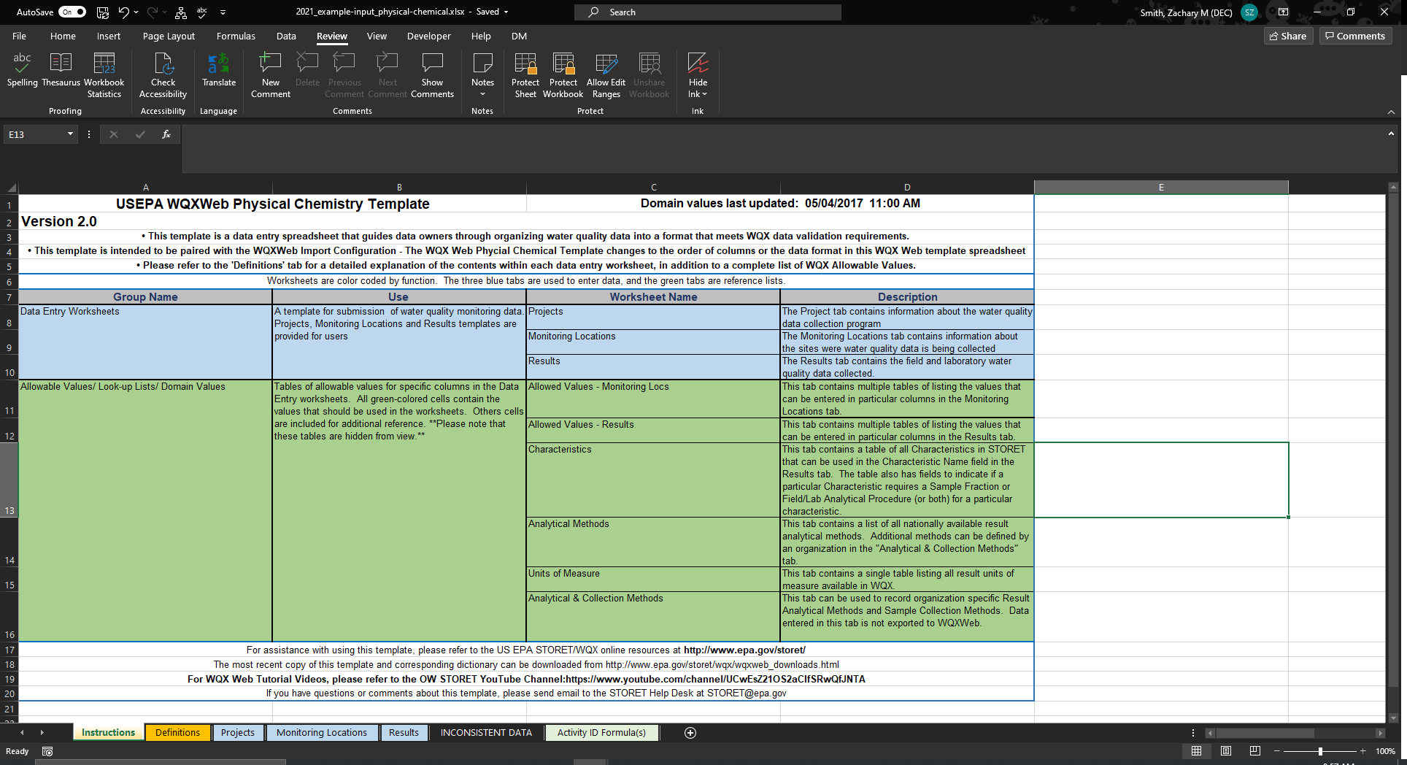
This is an example of the template layout. The template represented here is the Physical Chemical Template (Physical Chemical Template.xlsx).
Begin by reviewing the “Instructions” sheet in this workbook.

Slide 29
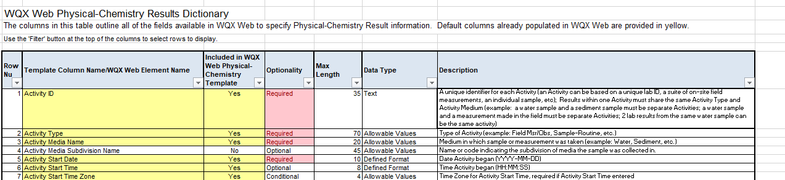
Data Dictionary
When you download the templates from EPA’s webpage you will receive a zip file. One of the files provided is a data dictionary describing the information expected within each column. This file can be a helpful reference while filling out the data template.

Slide 30
Uploading Data to WQX
Project Information

Slide 31
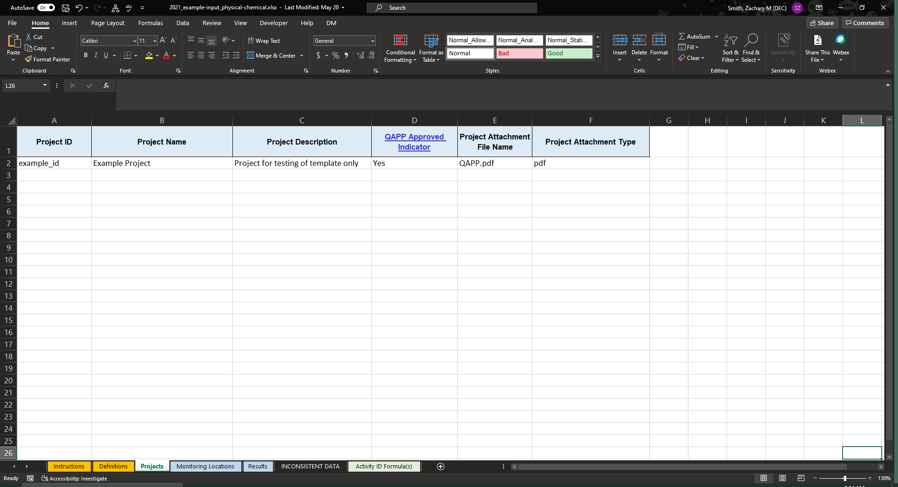
Start by opening the “Projects” sheet within the WQX template
Select

Slide 32
1. Provide a Project ID, Name, and Description for your data
2. Indicate if you have an approved QAPP:
Yes or No*
* DOW is required to have a QAPP associated with all water quality data. Submitting data without a QAPP prevents DOW from being able to use your data.

Slide 33
3. If you answered “Yes” to the QAPP Approved Indicator:
You will need to include your QAPP in a zip file and attach the zip file during your upload of the Project information to WQX.
Here you need to indicate the name of the QAPP document (“QAPP.pdf”) contained within the zip file, NOT the name of the zip file you will include as an attachment.
Best practice is to include the file extension in this cell. In this example, I have included “.pdf” after “QAPP”.
4. Specify the file extension associated with the file name provided in “Project Attachment File Name.”

Slide 34
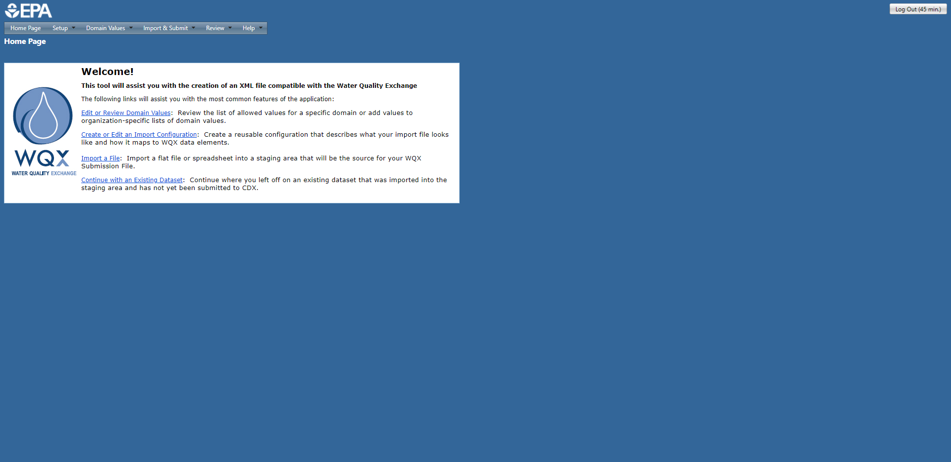
Select

Slide 35
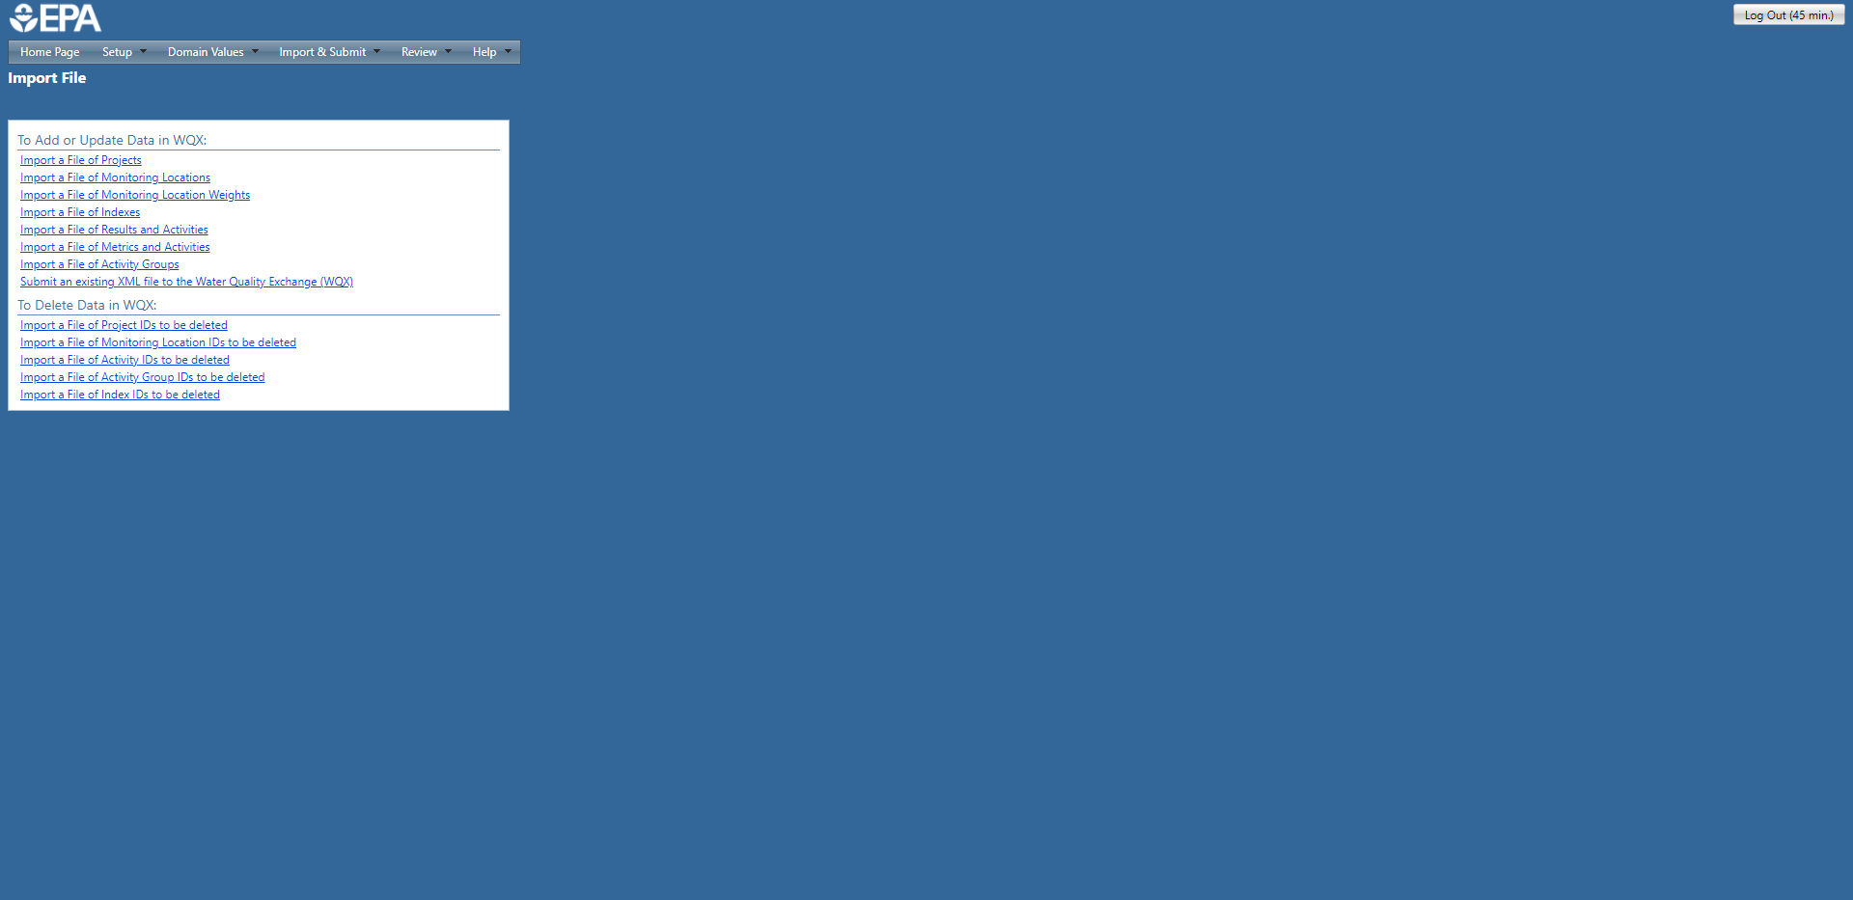
You will need to load each sheet of the template independently and in the correct order:
Import the Projects sheet
Import the Monitoring Locations sheet
Once the Projects and Monitoring Locations sheets have been imported you can import any of the remaining sheets

Slide 36
Select
You will need to load each sheet of the template independently and in the correct order:
Import the Projects sheet
Import the Monitoring Locations sheet
Once the Projects and Monitoring Locations sheets have been imported you can import any of the remaining sheets

Slide 37
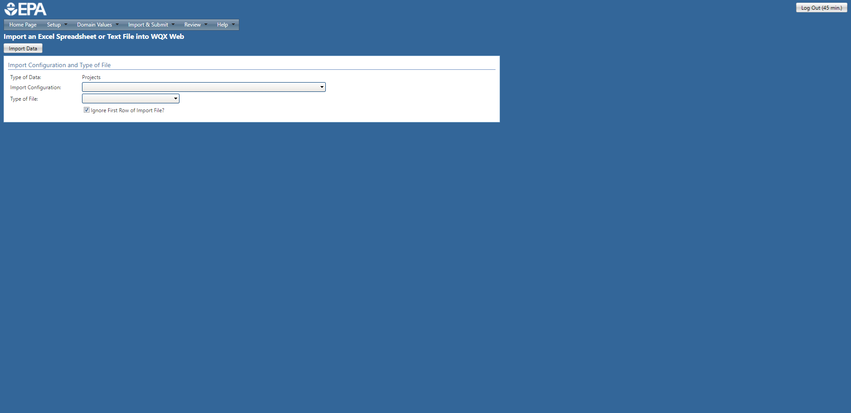
Select

Slide 38

Select

Slide 39
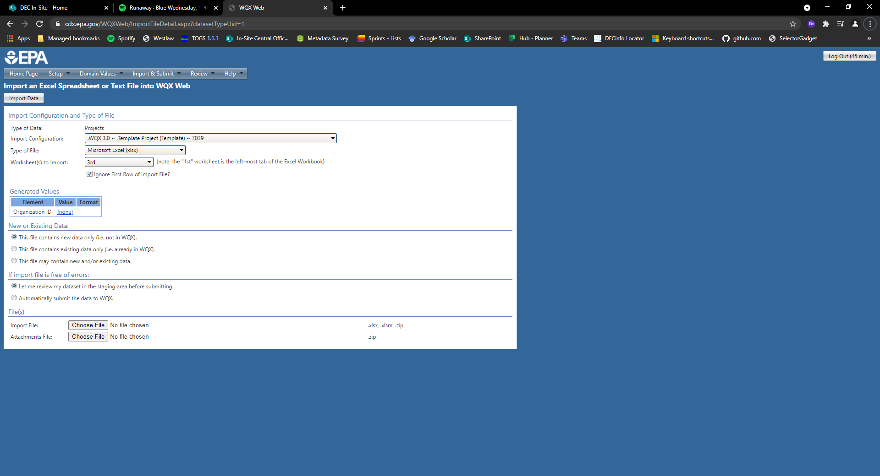
Select

Slide 40
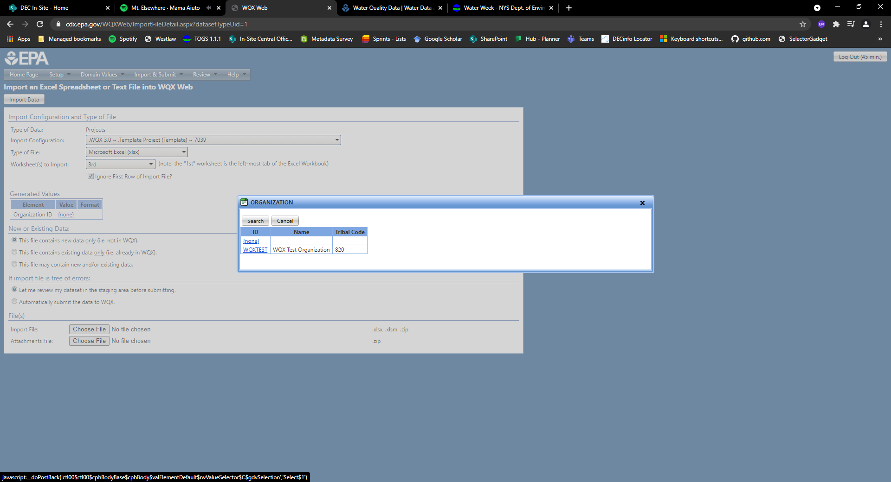
Select
Select your Organization ID. In this case I am using a dummy organization ID, WQXTEST.

Slide 41
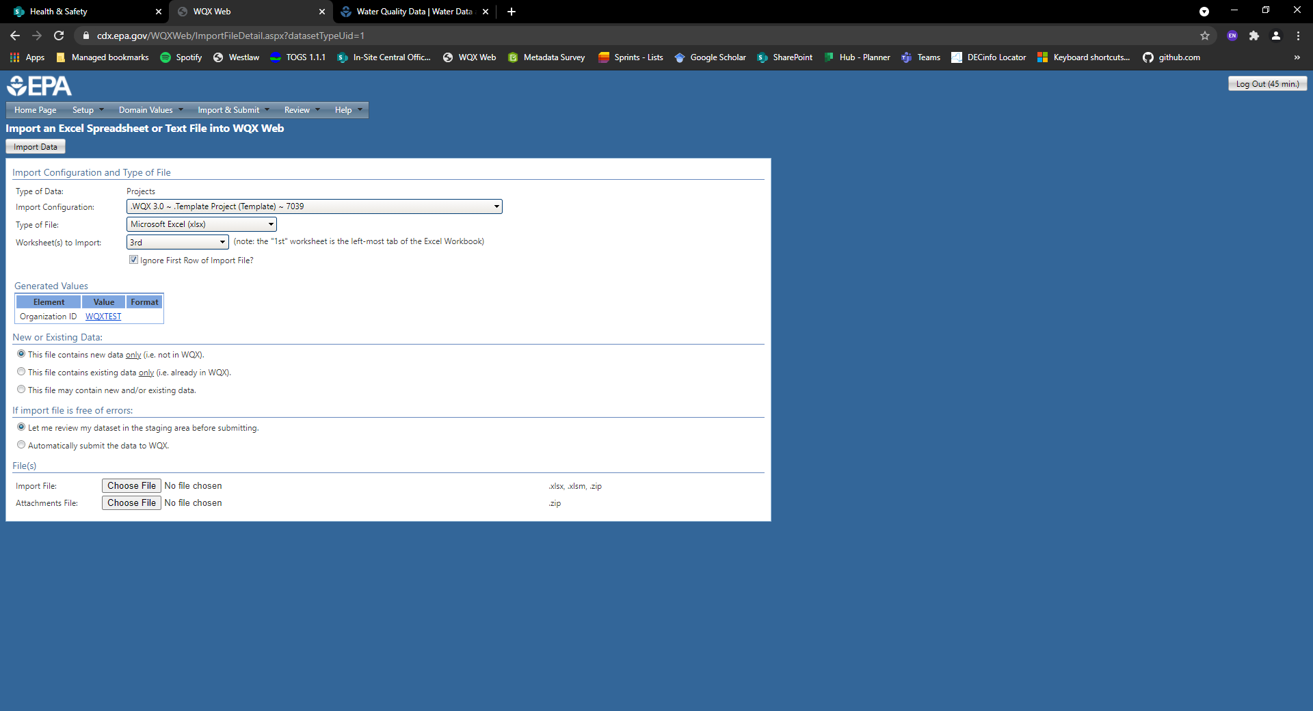
Select
In general, you will want to have the new data option selected.
Select
We recommend that you review all the data in the staging area before submission.

Slide 42
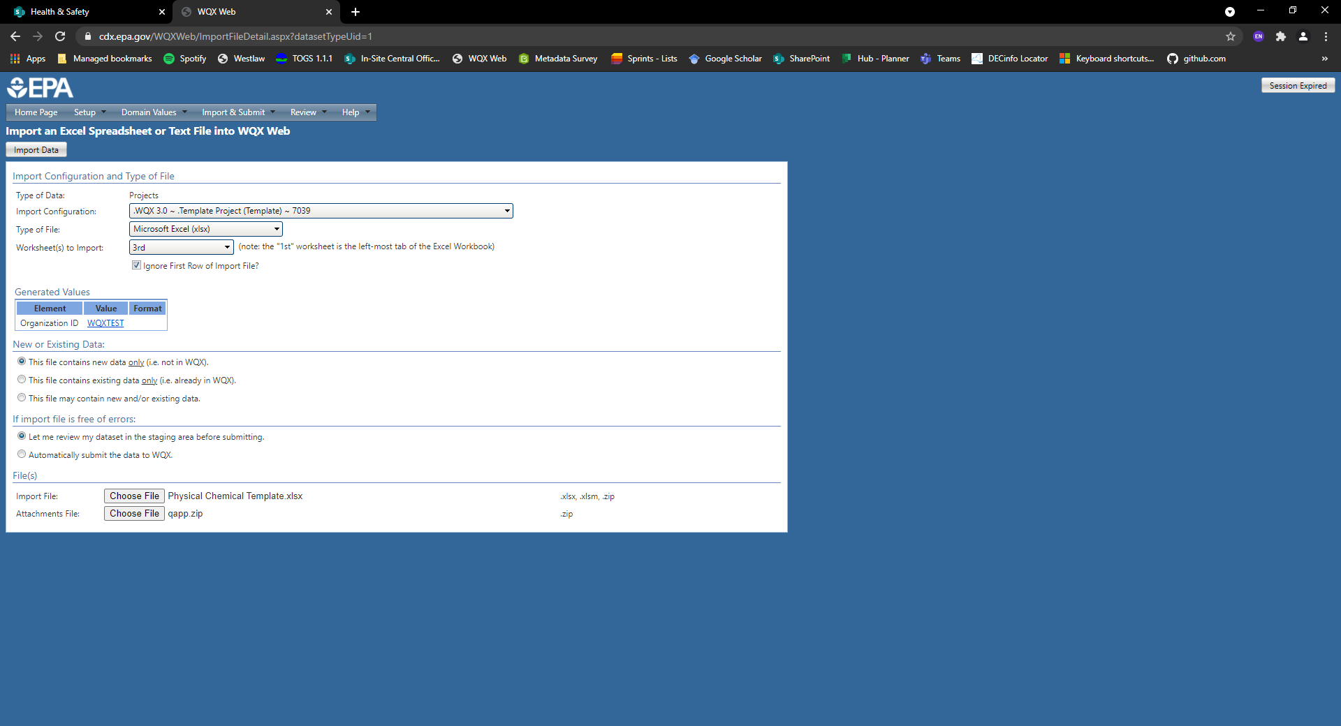
Select
Import File: Please attach the XLSX template file that includes your data.
Attachments File: Please attach a zip file with any relevant documents, such as a Quality Assurance Project Plan (QAPP).

Slide 43
Select
Once all the fields below are complete, click on this button to import your data.

Slide 44
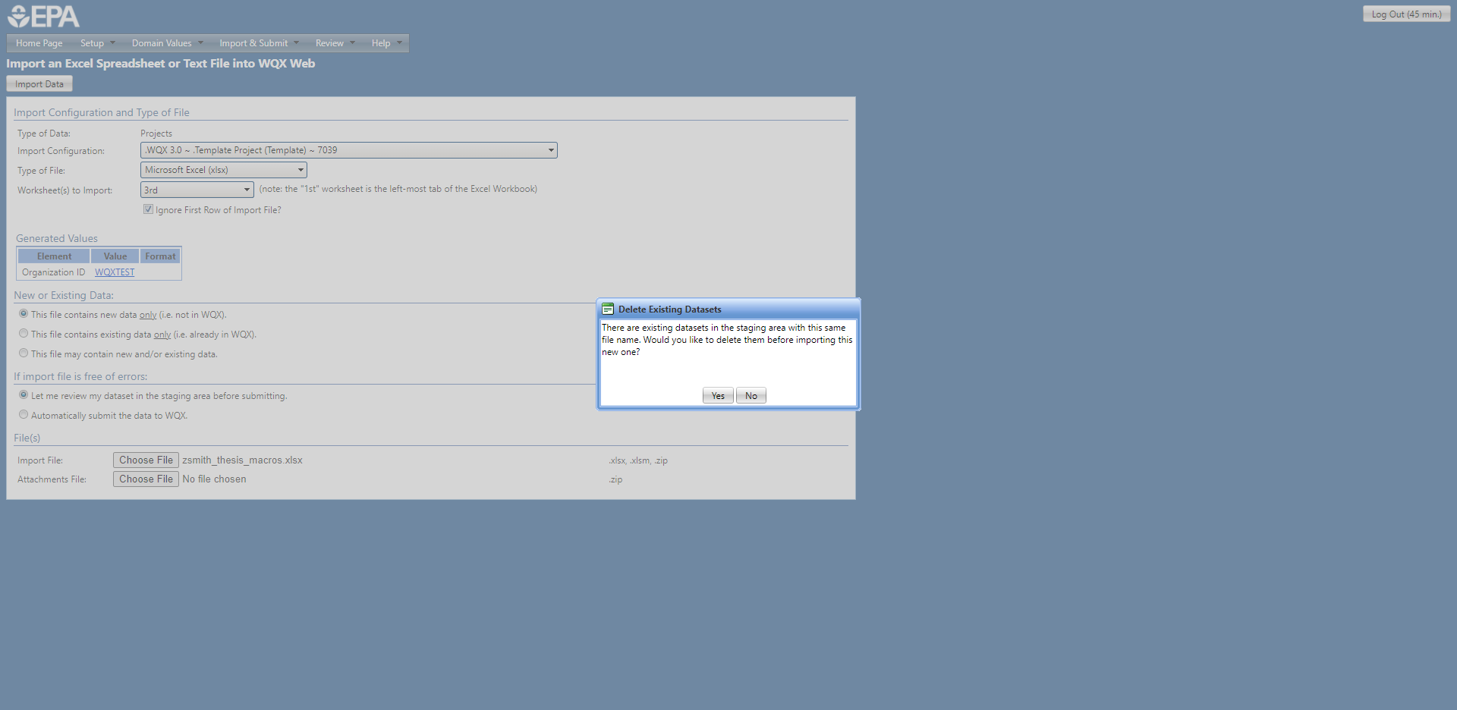
If you receive a pop-up window, select “Yes.”

Slide 45
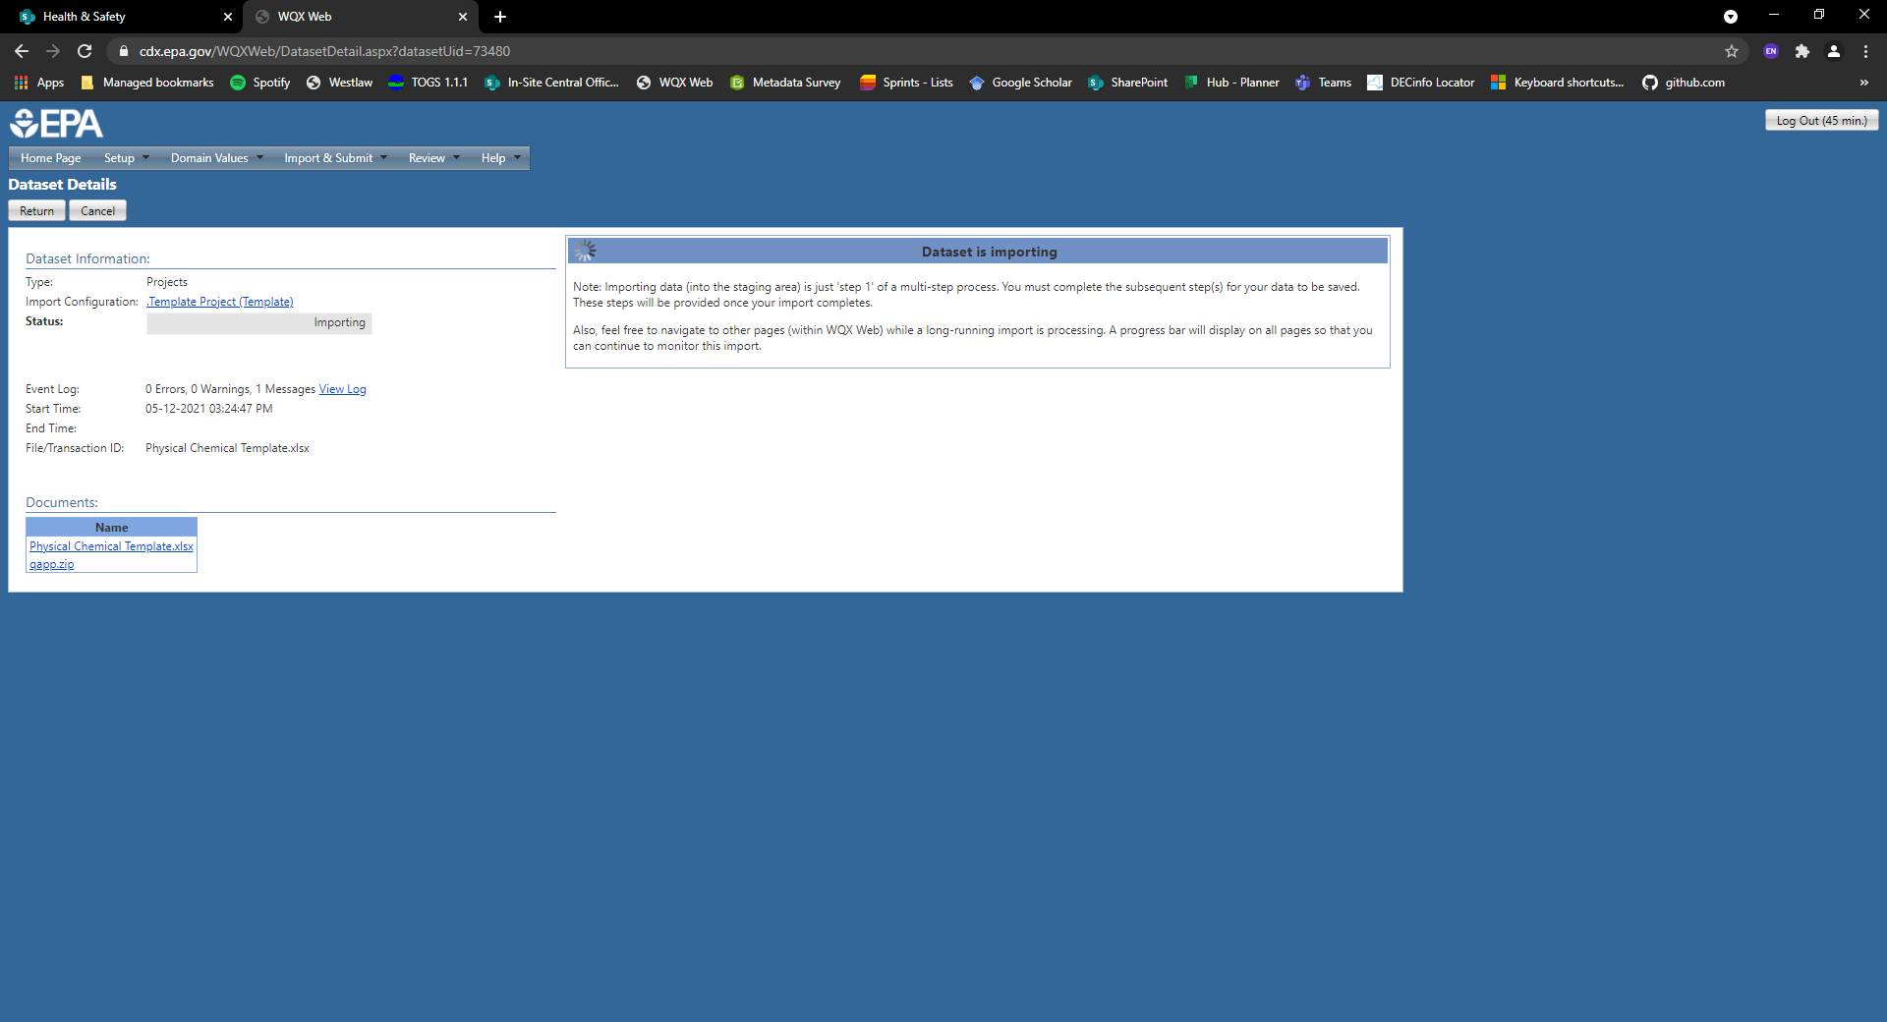
After clicking on the import button, you should see this window indicating that the data is being imported and validated.

Slide 46
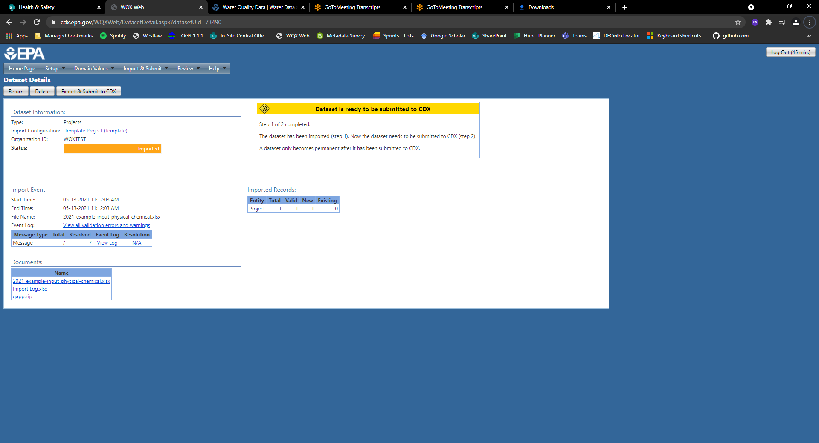
Select
2. Submit your information to CDX/WQX
1. If you receive this message box, then your data passed the validation checks and is ready for submission to CDX/WQX

Slide 47
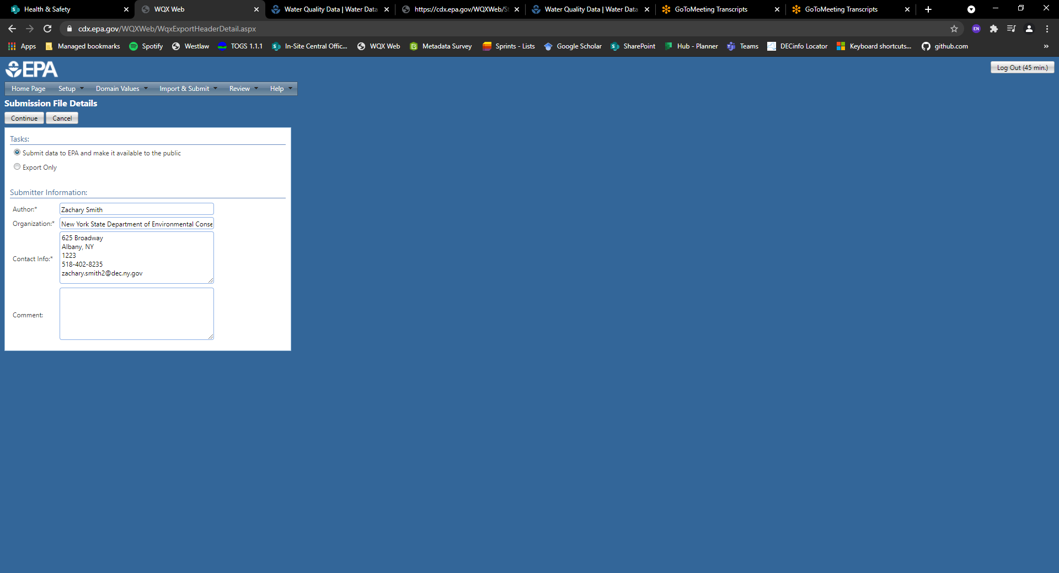
Select
3. Select “Continue” to submit the data file
Select
2. Make sure you are making the data publicly available
Ensure the submitter information is accurate.

Slide 48
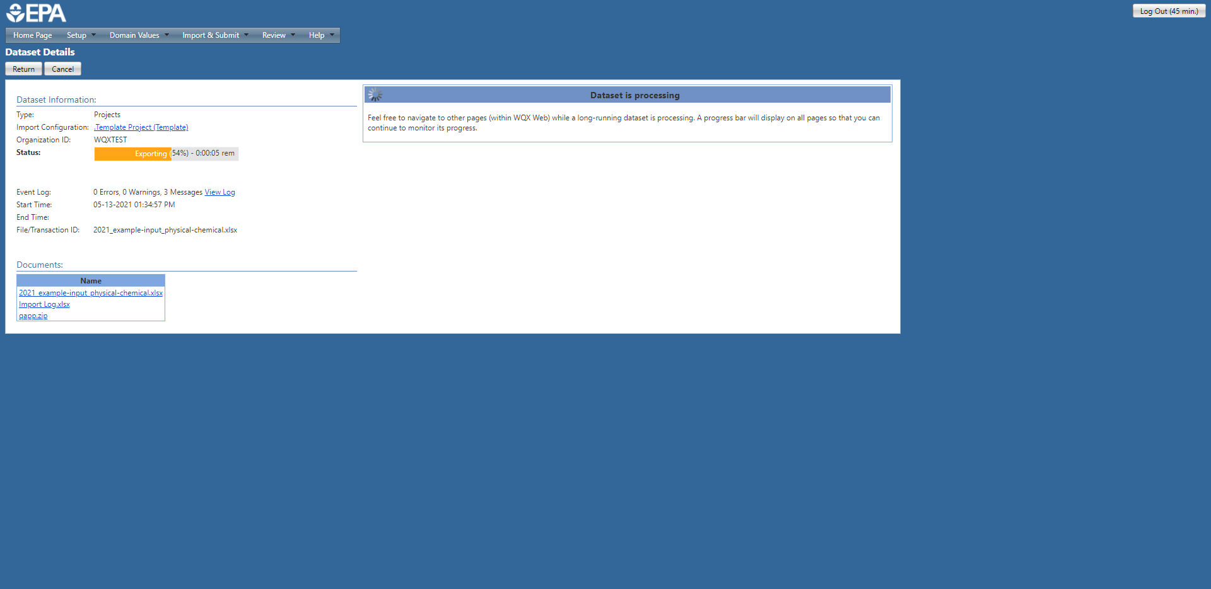
You should see a message indicating the data is processing and status bar estimating the remaining time left.
Please be patient, this process can take a while.

Slide 49
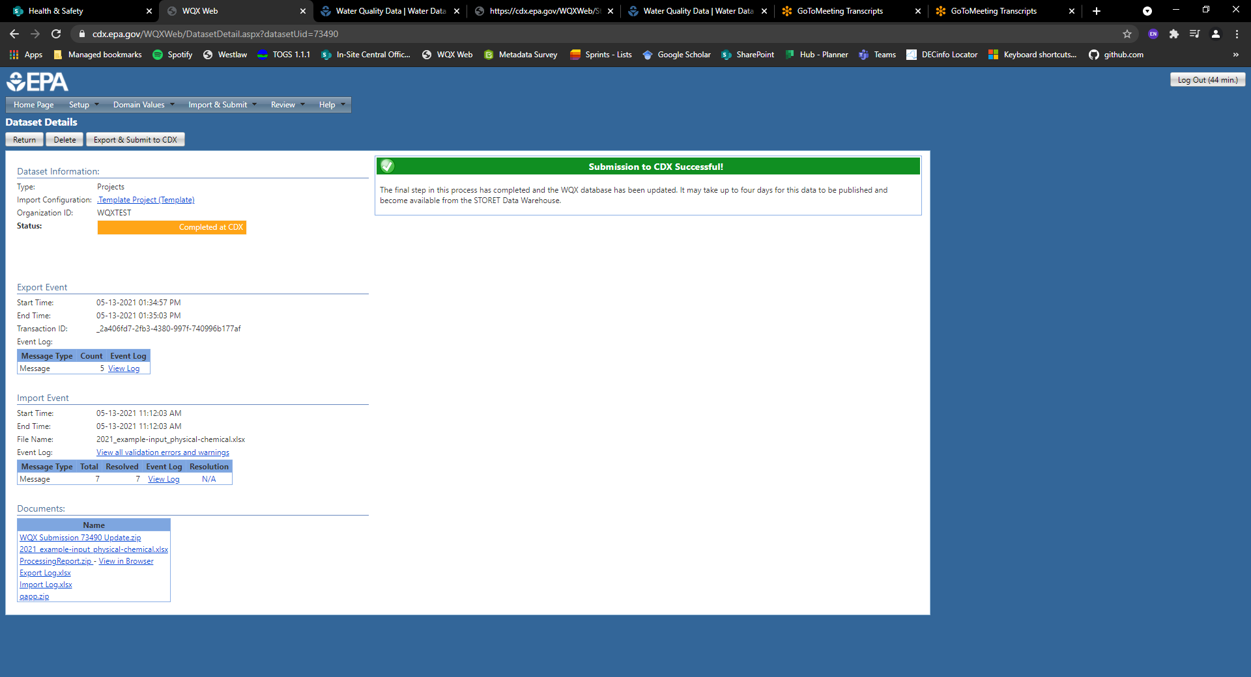
If your submission was successful, you should receive the message above.
Please see the “Troubleshooting Errors and Warnings” section if your submission was unsuccessful.

Slide 50
Uploading Data to WQX
Troubleshooting
Errors and Warnings

Slide 51
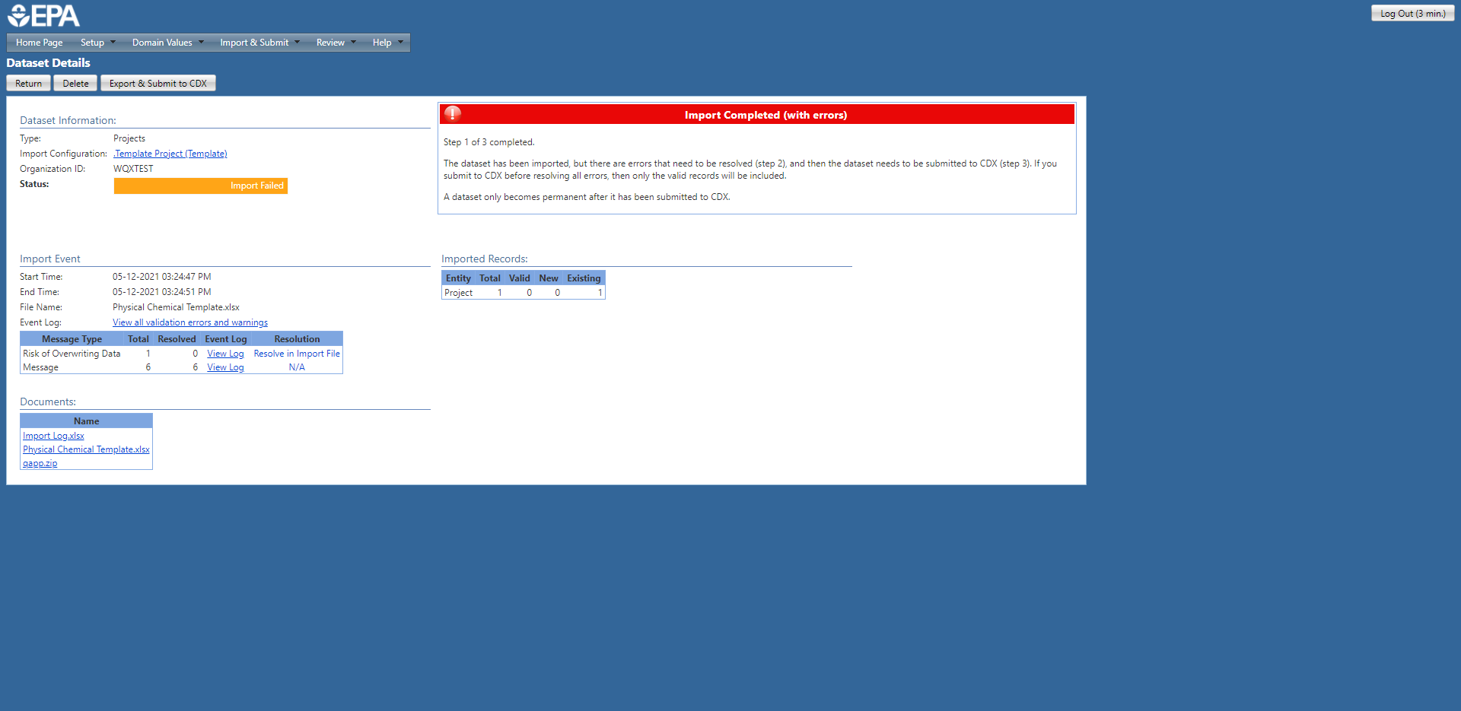
Select
2. Event Log: click on this clink to review the identified error(s) and/or warning(s).
1. If there are any issues with your submission, you will receive an error message like this.

Slide 52
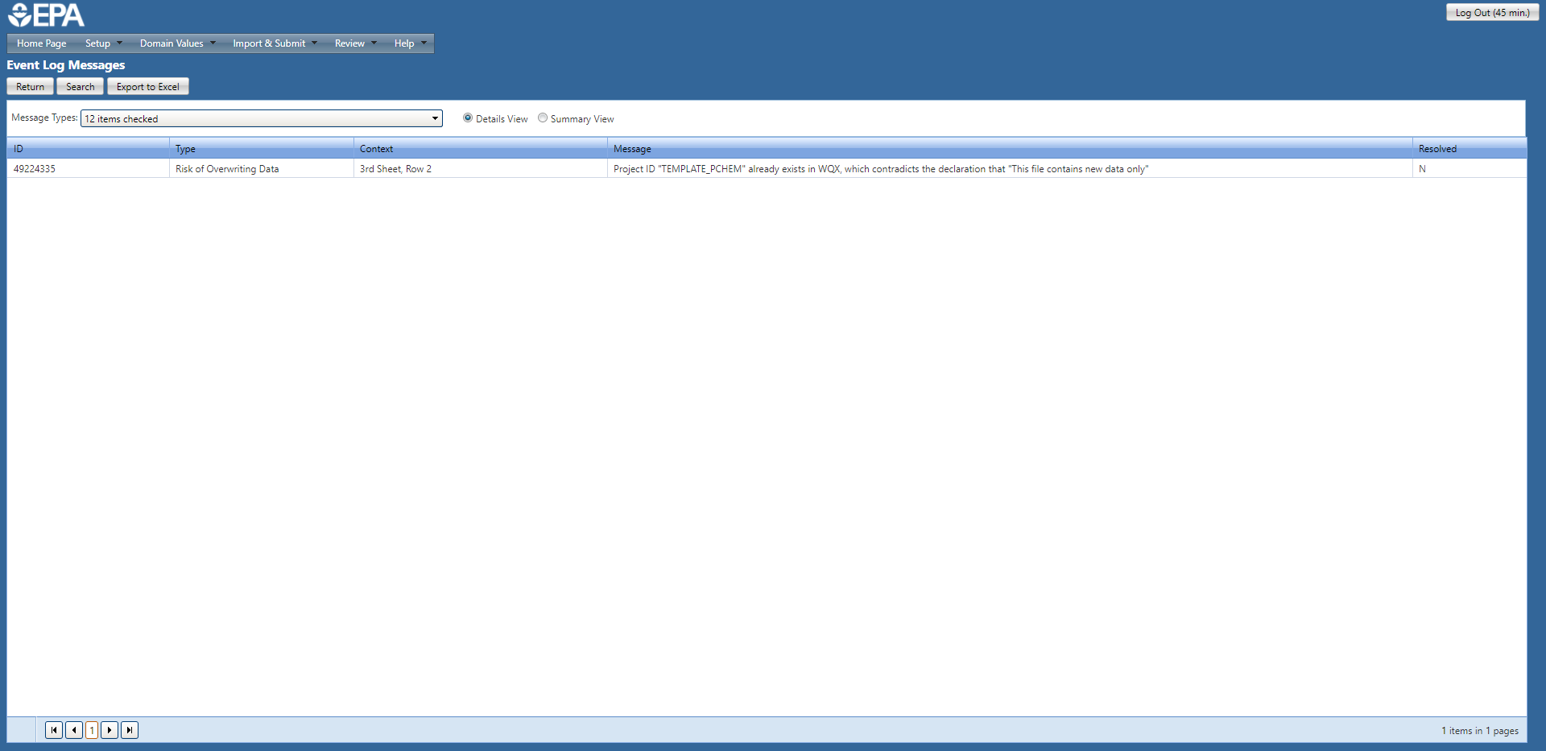
Select
It may be helpful to export the table below for future reference.
This is the window that appears after click on the Event Log link on the previous slide.
In this case:
The “Type” field tells us that the submitted data has the “Risk of Overwriting Data” currently in WQX.
The “Message” field indicates that the Project ID “Template_PCHEM” is already present in WQX. Therefore, the Project ID must be updated to avoid conflicting with the data currently in WQX.

Slide 53
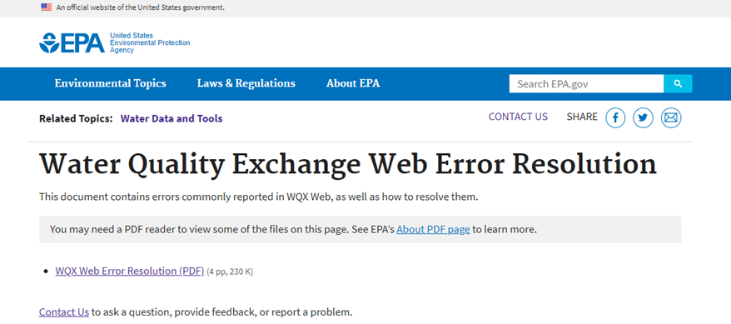
Error Resolution
It will likely be helpful to review EPA’s Water Quality Exchange Web Error Resolution document.

Slide 54
Uploading Data to WQX
Monitoring Locations

Slide 55
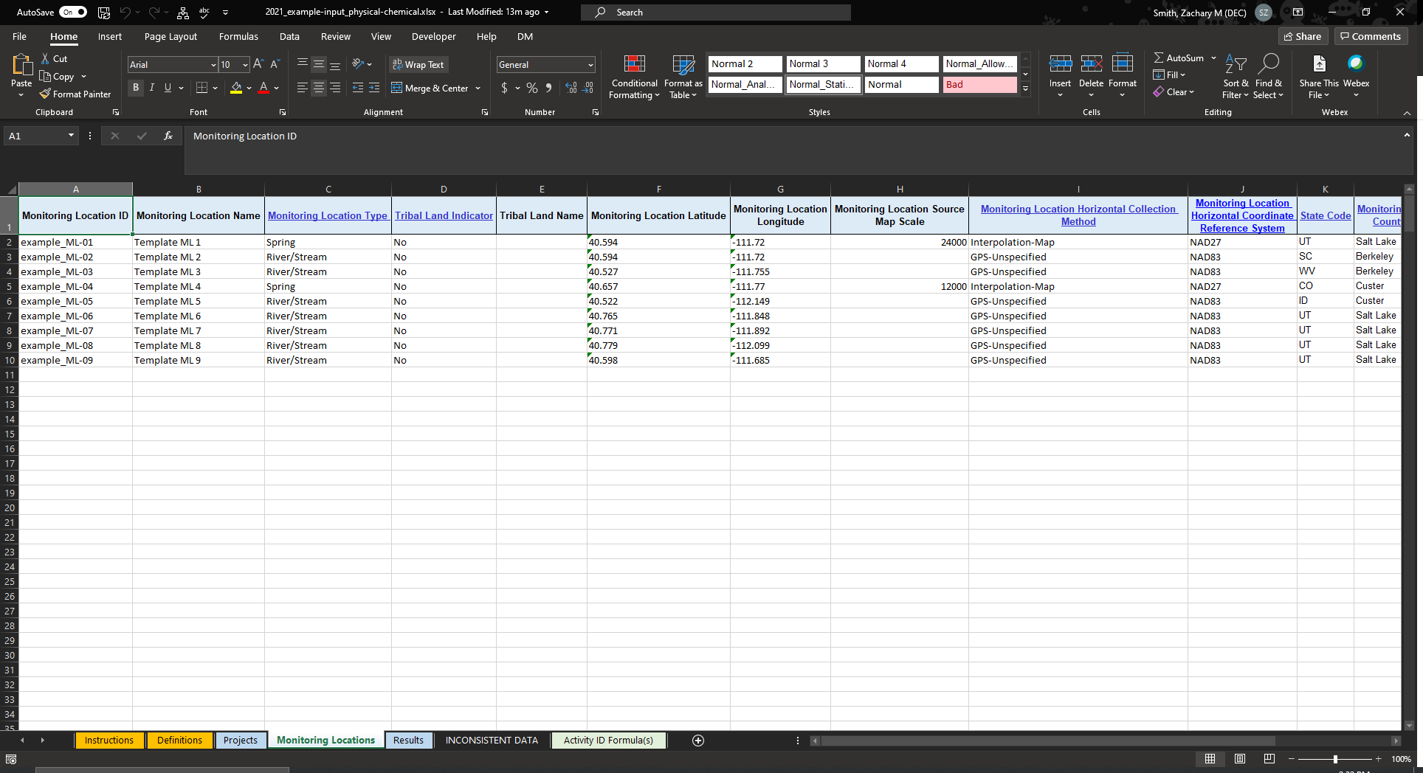
Start by opening the “Monitoring Locations” sheet within the WQX template
Select

Slide 56
A unique monitoring location ID and description. This should not represent a unique sampling event. This Monitoring Location ID will be referenced in the “Results” sheet when supplying sampling event information.

Slide 57
Indicate what type of waterbody is represented by your monitoring location. There is a dropdown menu of valid inputs. This column has data validation rules and will prevent you from entering values that are not valid in WQX.

Slide 58
Indicate if the monitoring location is associated with tribal lands. “Tribal Land Name” should be left blank if “Tribal Land Indicator” is “No.”

Slide 59
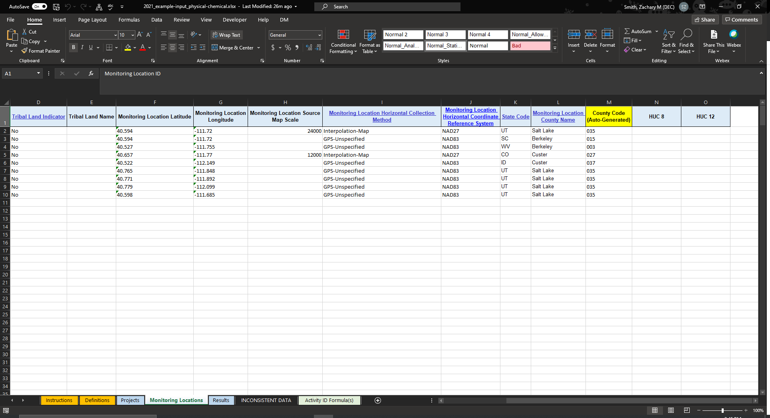
Enter Monitoring location coordinates (Latitude and Longitude)

Slide 60
2. If you used a map, please specify the scale of the map in the “Monitoring Location Source Map Scale”. Otherwise, leave this column blank.
1. Did you use a GPS or a map to locate your monitoring location? We anticipate that most users will be using a GPS to identify their sampling location.

Slide 61
1. State Abbreviation. Our users should generally be specifying “NY”.
2. Enter the County Name that your monitoring location falls within. This will automatically generate the county code.

Slide 62
Select
Navigate back to this page with the “Home Page” button
Select
*Please note that the submission process for Monitoring Location Information is nearly identical to the process for submitting Project Information.

Slide 63
Select
You will need to load each sheet of the template independently and in the correct order:
Import the Projects sheet
[Should have been successfully submitted before proceeding]
Import the Monitoring Locations sheet
Once the Projects and Monitoring Locations sheets have been imported you can import any of the remaining sheets

Slide 64
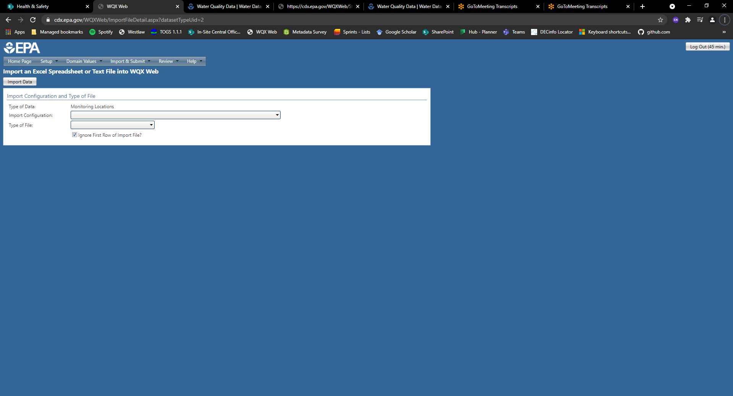
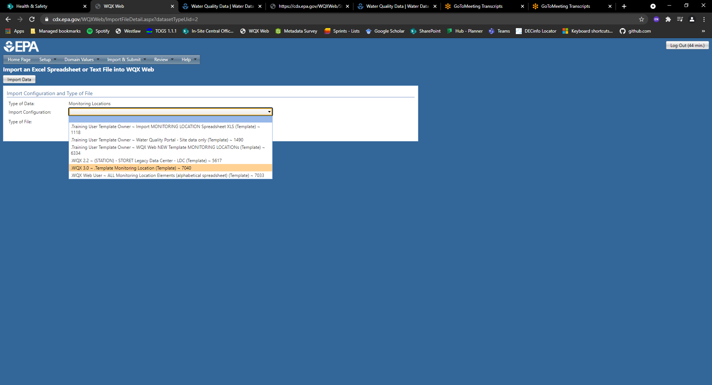
Select
Select

Slide 65
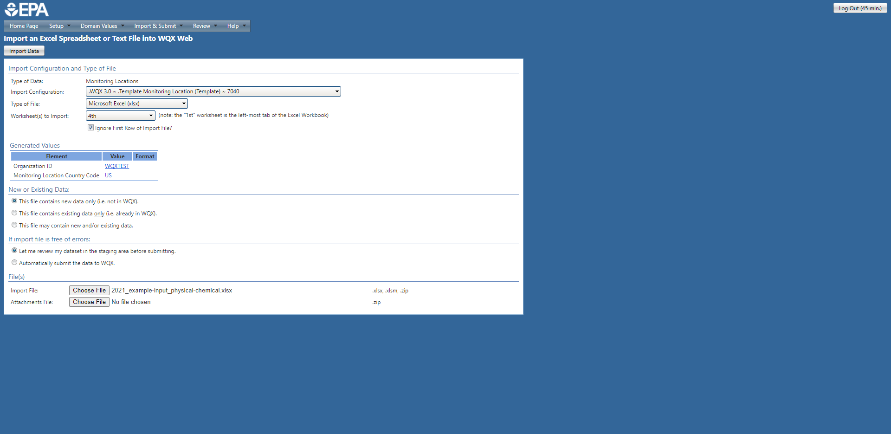
Select
4. Click here to import data
Select
Use the same Organization ID you used when importing your project information
Leave the default Monitoring Location Country Code as “US”
Select
3. Upload the same XLSX template you used when importing your project information. This time you are importing a different sheet, the “Monitoring Locations” sheet, from the Excel Workbook template.

Slide 66
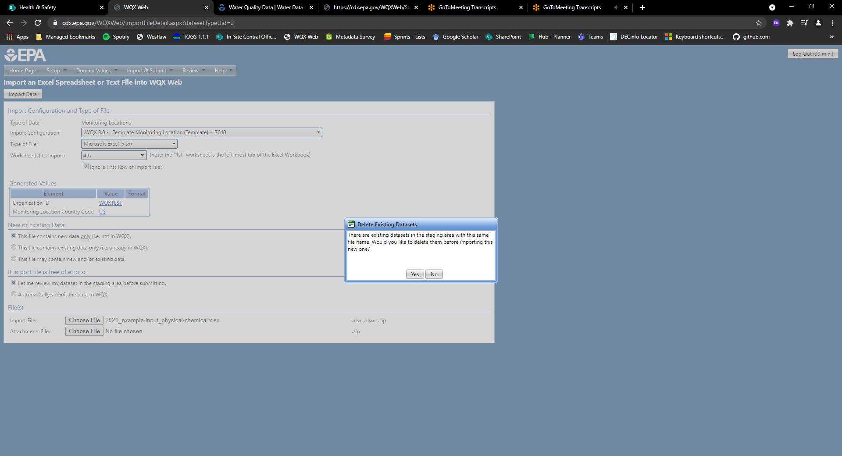
Select
This message will likely appear at this stage of the process.
Please select “Yes” to continue.

Slide 67
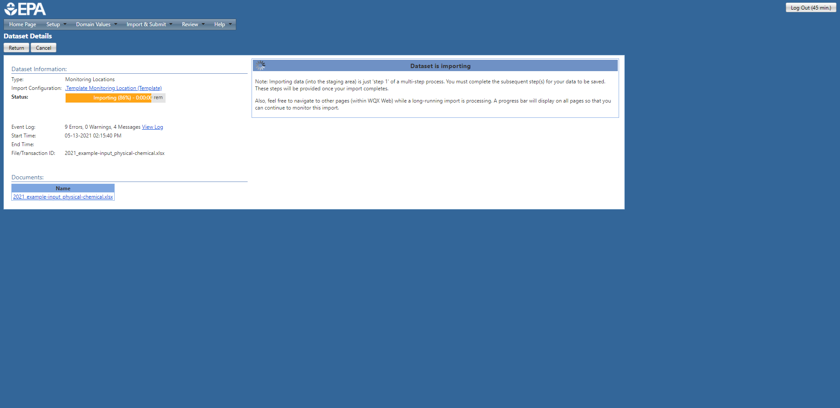
After clicking on the import button, you should see this window indicating that the data is being imported and validated.

Slide 68
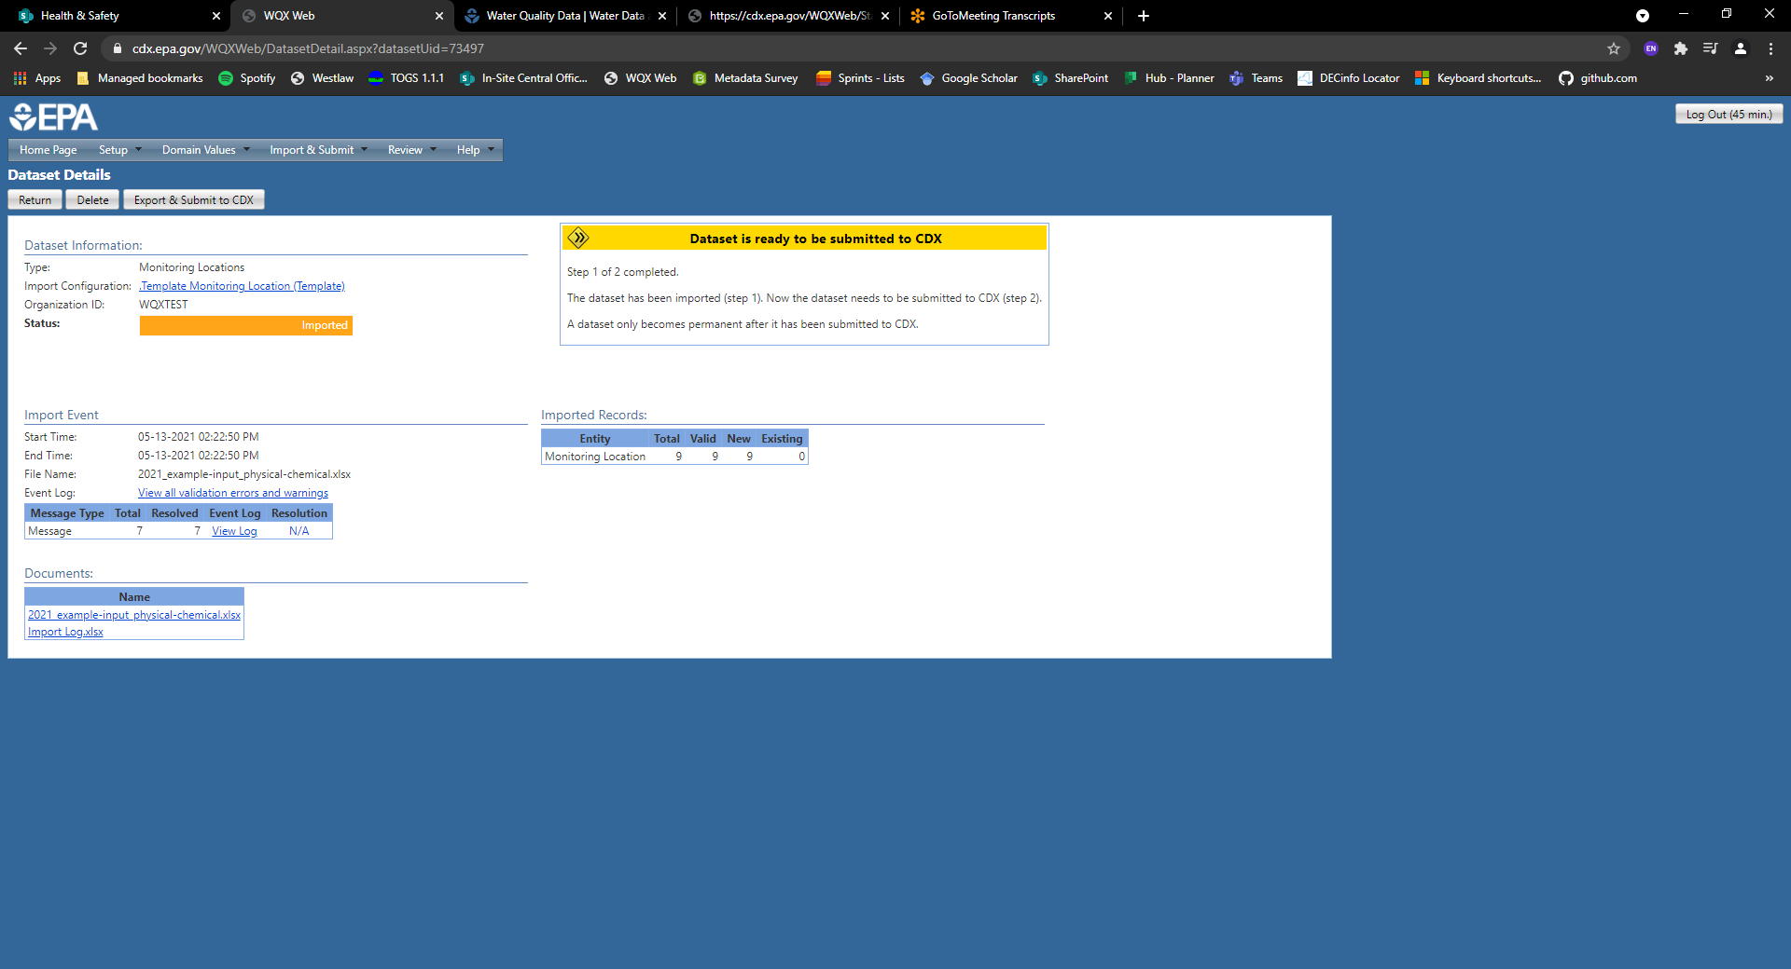
Select
2. Submit your information to CDX/WQX
1. If you receive this message box, then your data passed the validation checks and is ready for submission to CDX/WQX

Slide 69
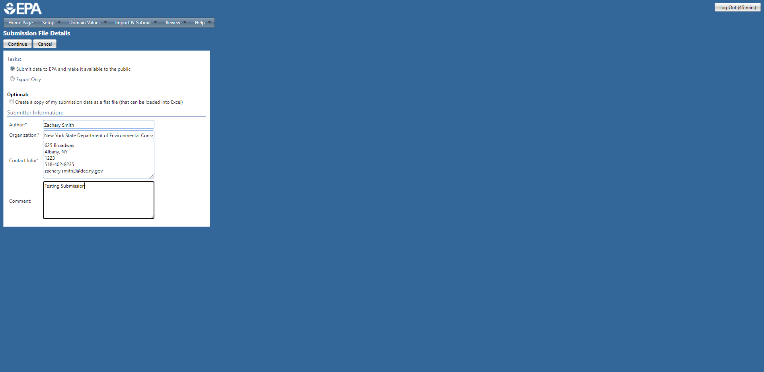
3. Select “Continue” to submit the data file
Select
Select
2. Make sure you are making the data publicly available
Ensure the submitter information is accurate.

Slide 70
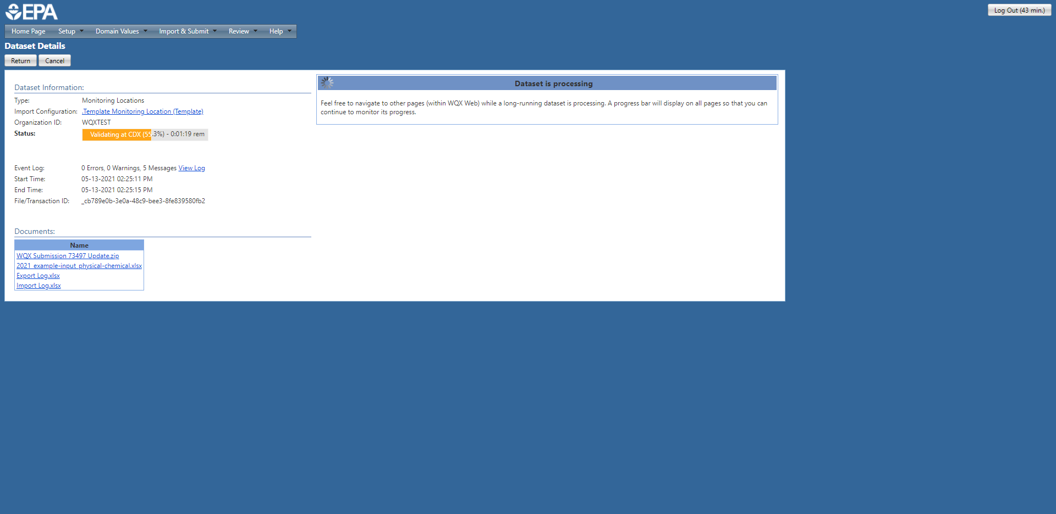
You should see a message indicating the data is processing and status bar estimating the remaining time left.
Please be patient, this process can take a while.

Slide 71

If your submission was successful, you should receive the message above.
Please see the “Troubleshooting Errors and Warnings” section if your submission was unsuccessful.

Slide 72
Uploading Data to WQX
Results

Slide 73
Please Note
When results columns are not required, I have highlighted them green in my personal template. Therefore, you will not see the same green columns when you download the templates.

Slide 74
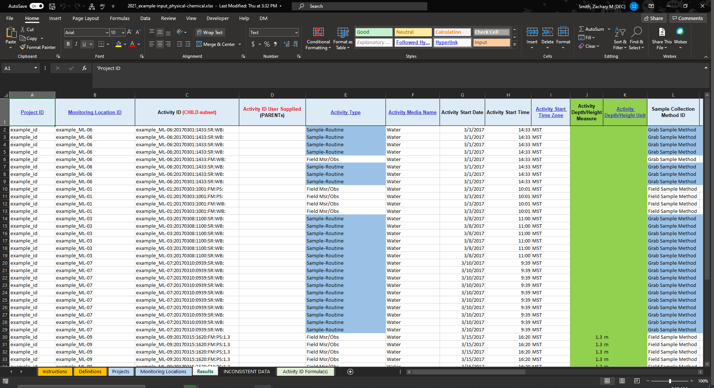
Enter the appropriate Project ID associated with the results in each row.
Remember that the Project ID must be present in WQX (i.e., you must submit the Projects sheet to WQX) before you can submit this sheet. If you attempt to submit this sheet to WQX before the Projects sheet, you will receive an error message stating that your Project ID was not found in WQX.
Most likely this will be the Project ID you identified within this template. However, you could also utilize a Project ID you established previously (e.g., last year or 5-years ago).

Slide 75
Enter the appropriate Monitoring Location ID associated with the results in each row.
Remember that the Monitoring Location IDs must be present in WQX (i.e., you must submit the Monitoring Locations sheet to WQX) before you can submit this sheet. If you attempt to submit this sheet to WQX before the Monitoring Locations sheet, you will receive an error message stating that your Monitoring Location(s) were not found in WQX.
Most likely the Monitoring Location IDs will correspond with the IDs you identified within this template. However, you could also utilize Monitoring Location IDs you established previously (e.g., last year or 5-years ago). Please note that Monitoring Location IDs can be used for multiple projects.

Slide 76
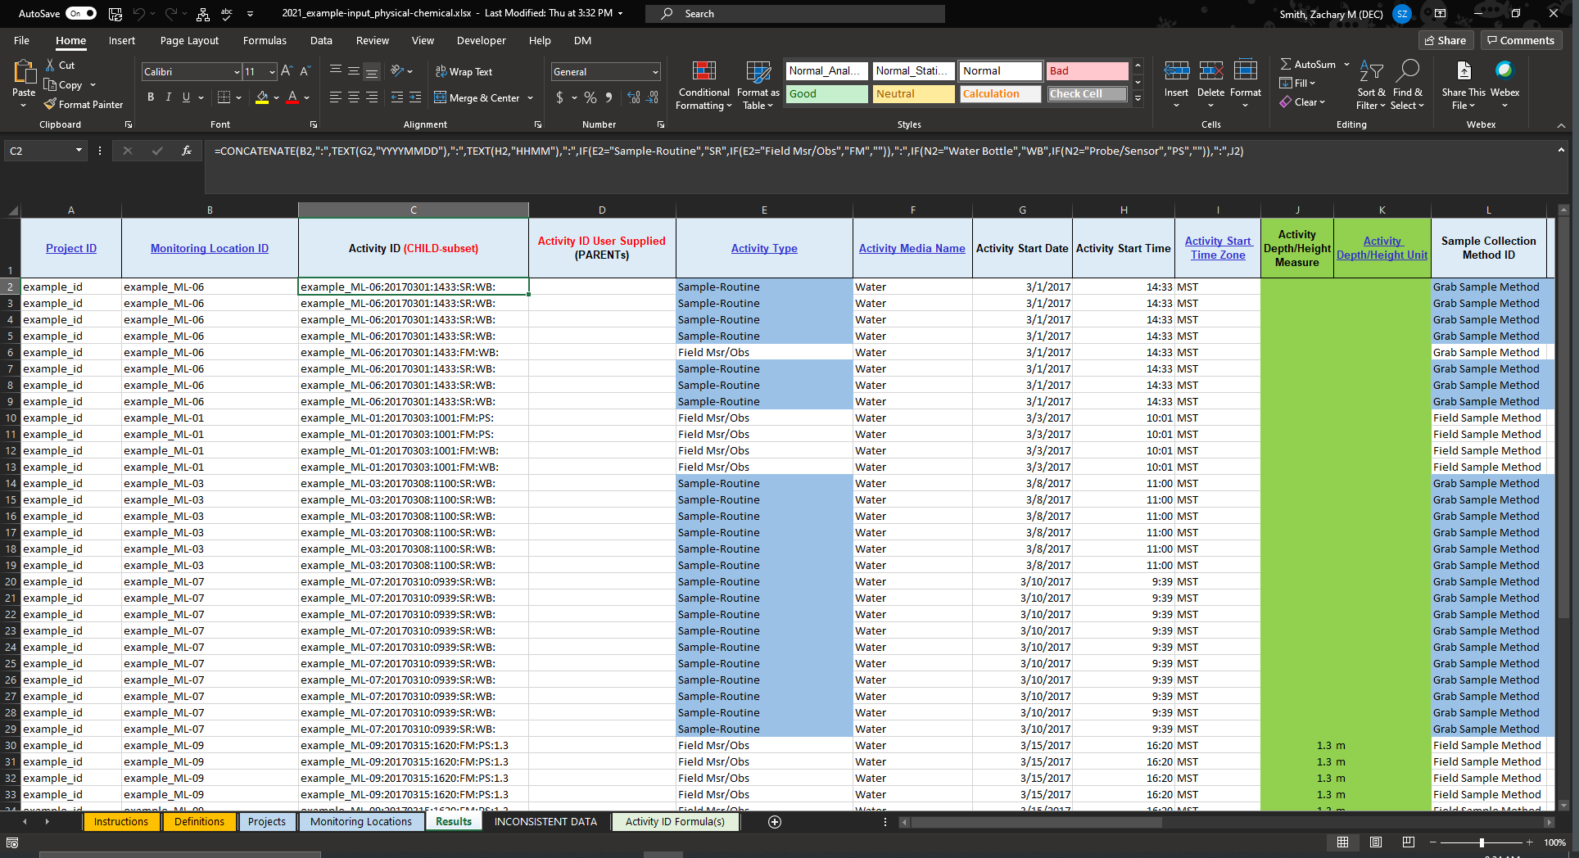
2
1
The Activity ID is a way of identifying a unique sampling event.
You can provide your own Activity IDs, but it is recommended that you use one of the Activity ID Formula(s) provided by EPA.
By default, the templates include a recommended formula for identifying a unique sample activity/event.
See the next slide for an interpretation of this formula in this example.
There are other formulas available in the Activity ID Formula(s) sheet within this template.
Description
“An Activity ID must be completely unique across an Organization, so Activity IDs cannot be reused for multiple activities.”
-EPA Instructions WQX Web Monitoring Data Entry Template
3

Slide 77
The formula concatenates (pastes together) the following information…
Monitoring Location ID
Activity Start Date as YYYYMMDD
Activity Start Time as HHMM
Activity Type (Modified)
Sample Collection Equipment Name (Modified)
Activity Depth/Height Measure
Each element above is separated by a colon (:).

Slide 78
The formula concatenates (pastes together) the following information…
Monitoring Location ID
Activity Start Date as YYYYMMDD
Activity Start Time as HHMM
Activity Type (Modified)
Sample Collection Equipment Name (Modified)
Activity Depth/Height Measure
Each element above is separated by a colon (:).

Slide 79
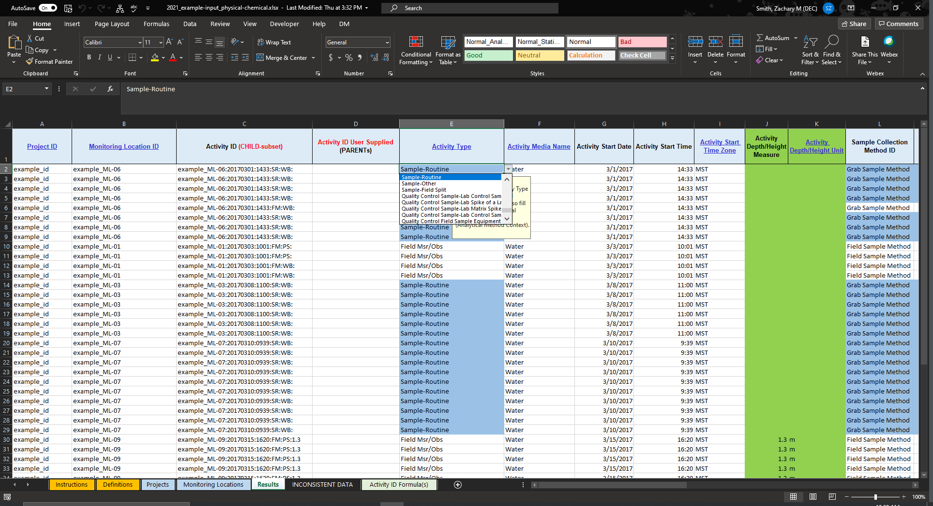
This field has data validation restrictions on it, and therefore will send you an error message if you supply invalid information.
You can use the drop-down menu to review and select a valid input.
Description
“Sample-Routine (for samples taken and sent to a lab) or Field Msr/Obs (for measurements taken at a site such as with a probe or other on site instrument) There are others for sample blanks, etc. Please use the drop-down menu to select the correct type.”
-EPA Instructions WQX Web Monitoring Data Entry Template

Slide 80
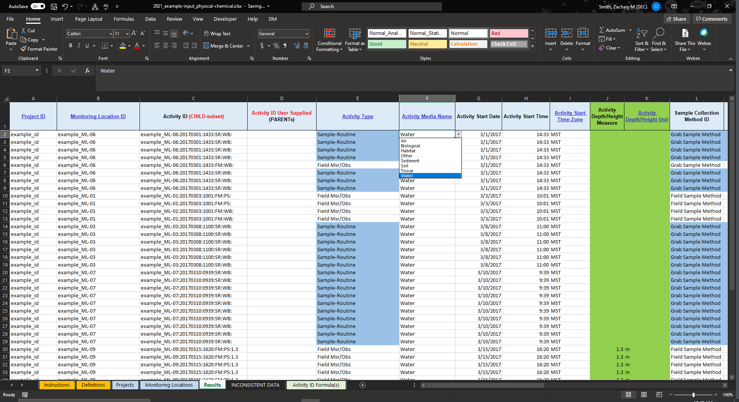
This field has data validation restrictions on it, and therefore will send you an error message if you supply invalid information.
You can use the drop-down menu to review and select a valid input.
Description
What type of media was sampled?
Water? (Most likely)
Sediment?
Etc.

Slide 81
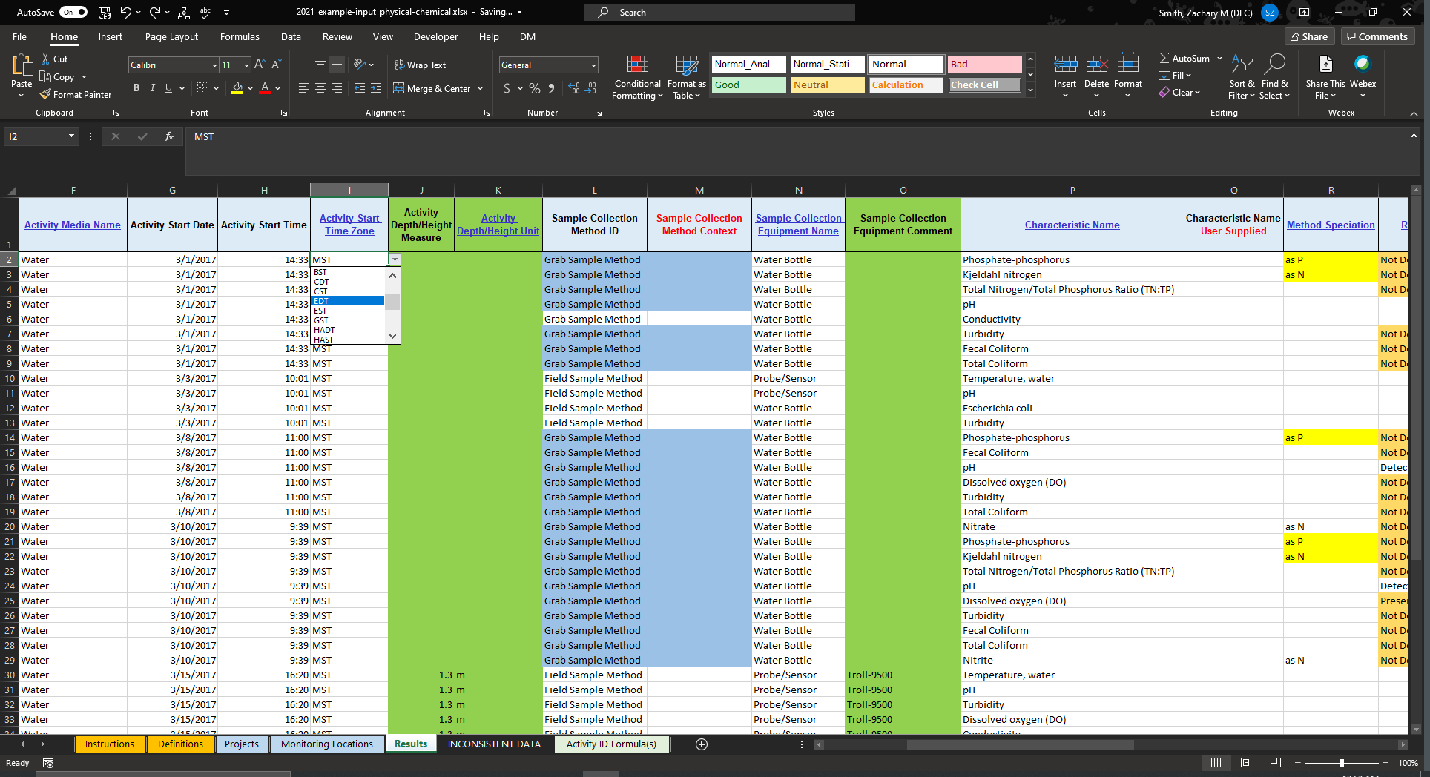
Description
When were the samples collected?
Date
Time
Time Zone
This field has data validation restrictions on it, and therefore will send you an error message if you supply invalid information.
You can use the drop-down menu to review and select a valid input.
We anticipate that most of our users will use Eastern Daylight Time (EDT) or Eastern Standard Time (EST)

Slide 82
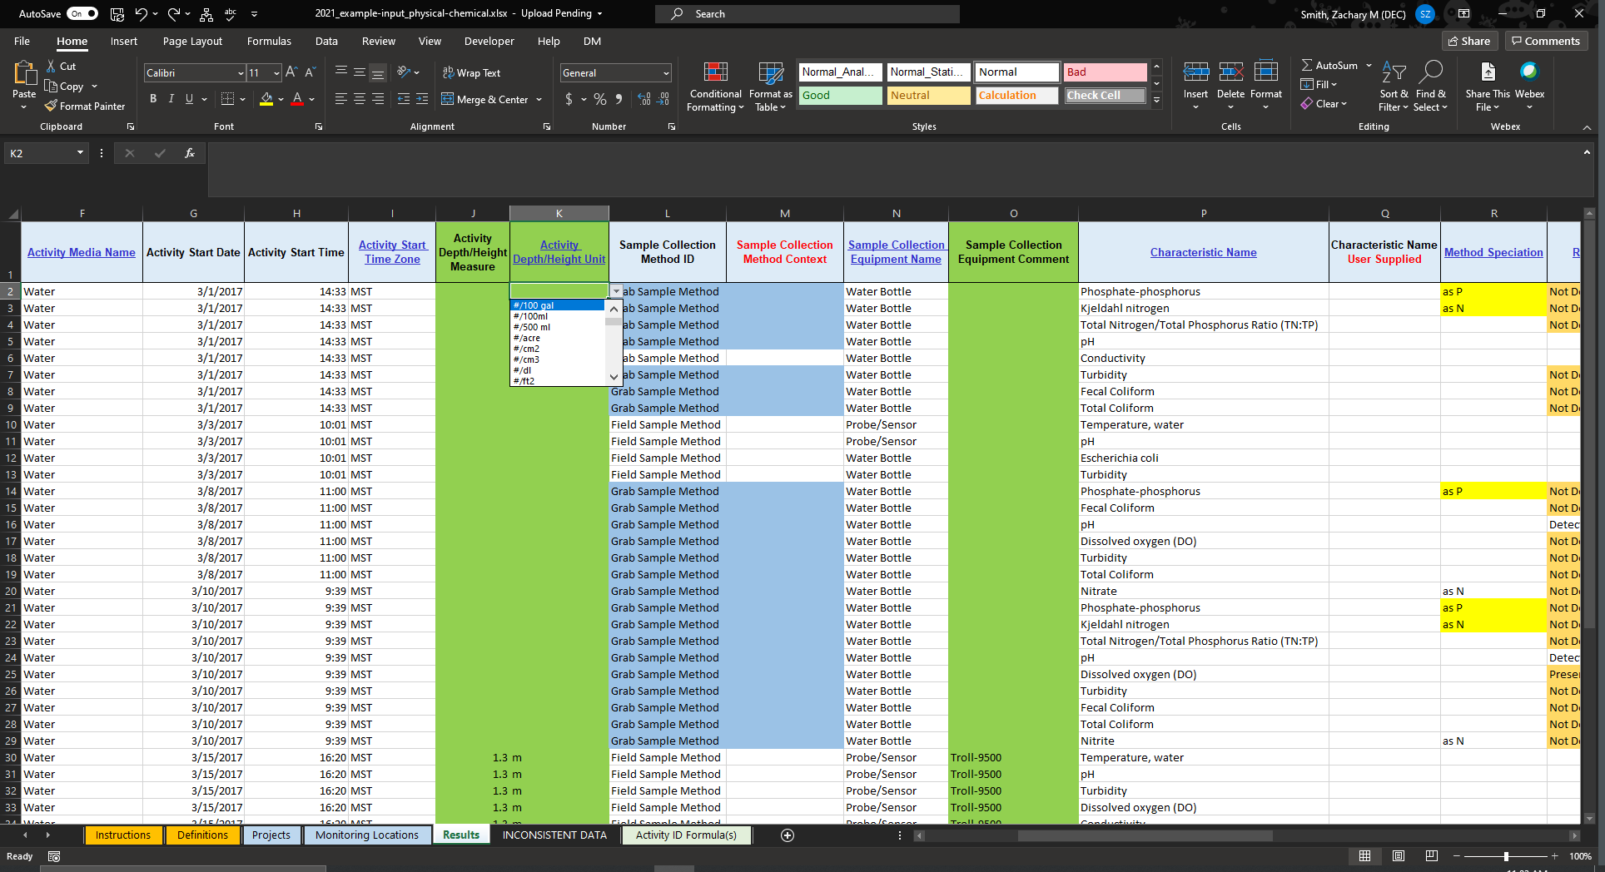
Description
At what depth did you collect your samples?
These fields are not required but recommended.
This field has data validation restrictions on it, and therefore will send you an error message if you supply invalid information.
You can use the drop-down menu to review and select a valid input.

Slide 83
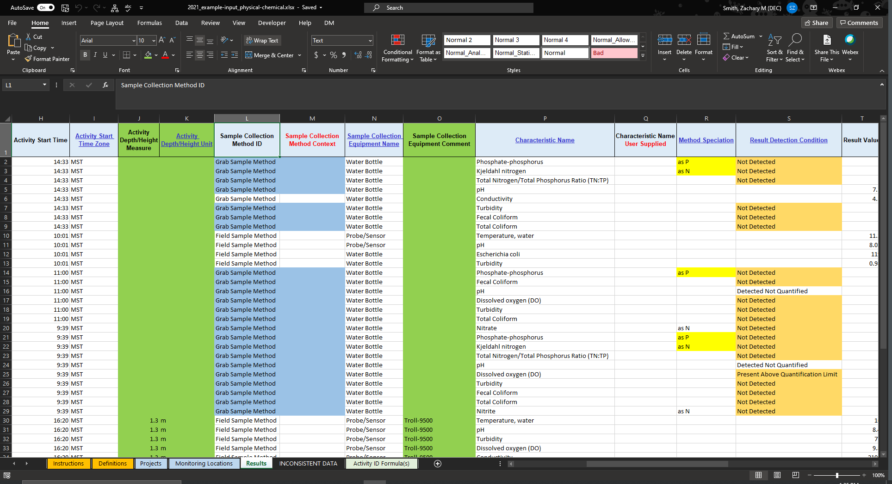
Description
“Identifies sample collection or measurement method procedures. Where a documented sample collection method has been employed, this enables the data provider to indicate the documented method that was employed during the field sample collection. Otherwise, the sample collection procedure will best be described in a freeform text. Conditional:
Required if Sample Description block is reported.
Required if Activity Type contains the term 'Sample’ “
-EPA’s Data Definitions
Recommendation
If not referencing a method published by another agency, such as EPA or USGS, provide a unique name for your collection method. We recommend aligning with terminology used in your QAPP.
If referencing a method published by another agency, such as EPA or USGS, search the domain values provided by EPA for the correct input.

Slide 84
Recommendation
Unless referencing a published collection method from another agency, such as EPA or USGS, provide your organization ID.

Slide 85
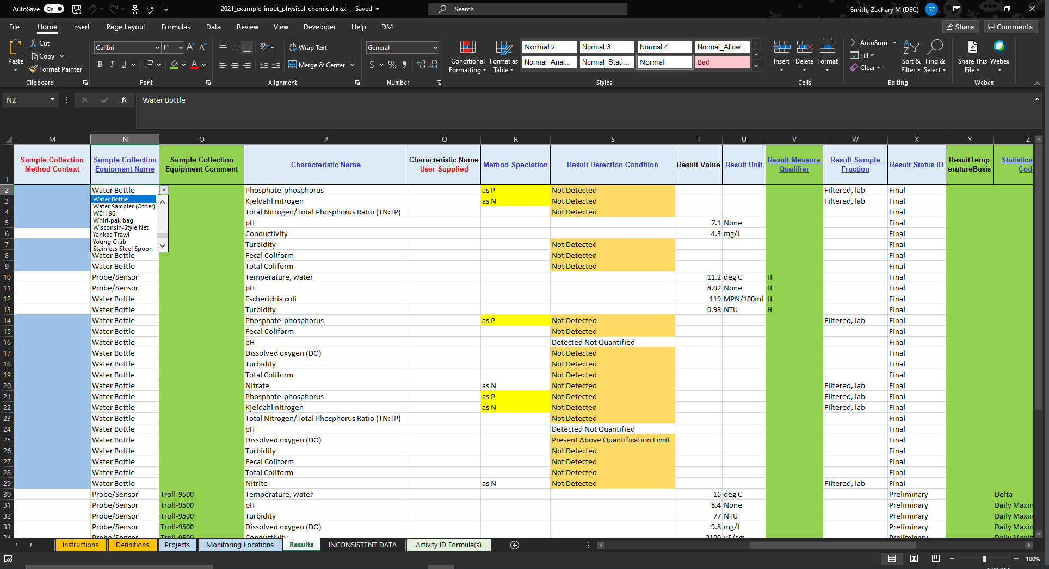
This field has data validation restrictions on it, and therefore will send you an error message if you supply invalid information.
You can use the drop-down menu to review and select a valid input.
Description
What type of equipment was used to collect the sample?
The sample “Collection Equipment Comment” column is not required, but could be used to provide additional details about the sampling equipment.

Slide 86
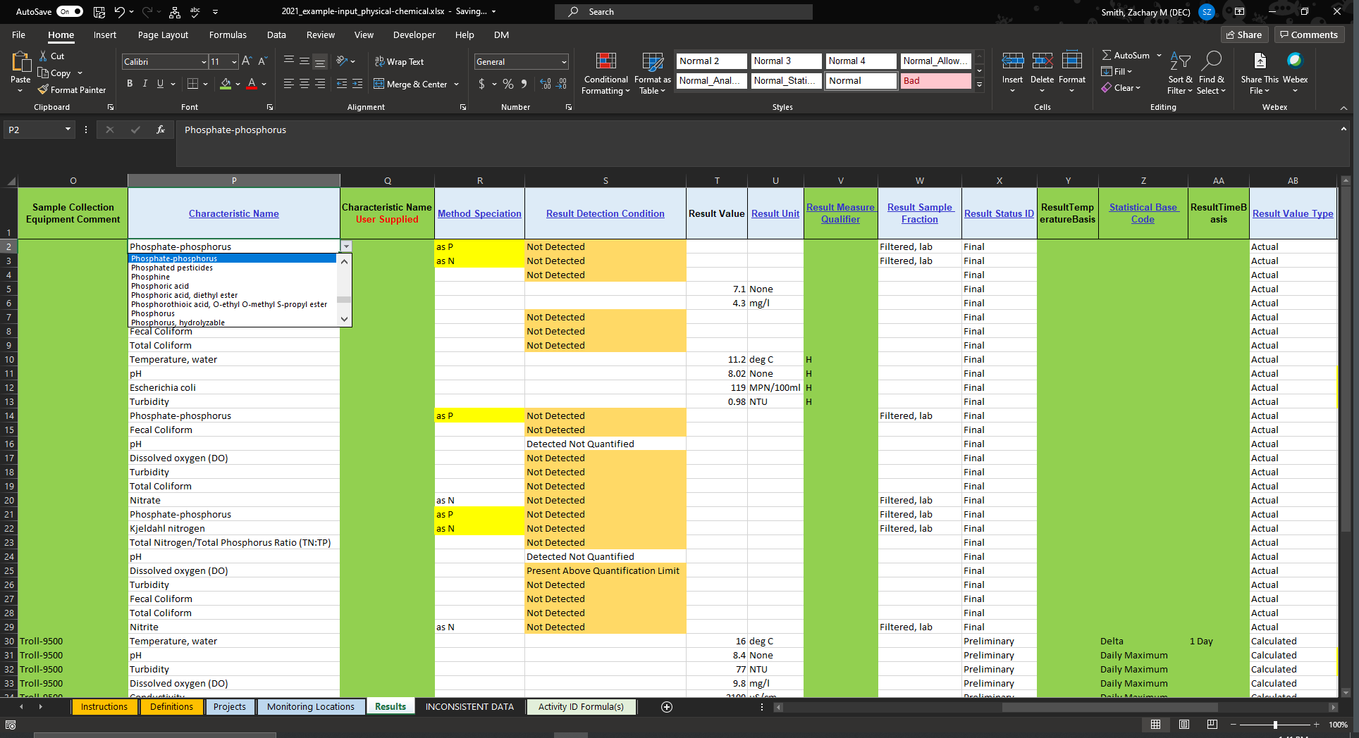
Description
What physical, chemical, or biological parameter is represented in each row?
The sample “Characteristic Name User Supplied” column is not required but could be useful when converting your organizations name to the valid name to be included in WQX.
For example, your organization might label data as “DO” and WQX requires that same data to be labeled “Dissolved oxygen (DO)”
This field has data validation restrictions on it, and therefore will send you an error message if you supply invalid information.
You can use the drop-down menu to review and select a valid input.

Slide 87
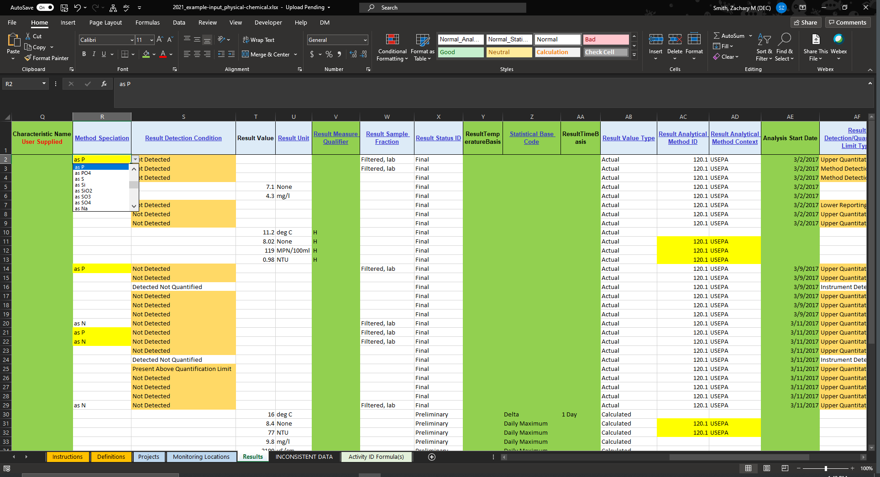
Description
“Method Speciation Name is required if a form of Nitrogen or Phosphorus is being reported. For example, Ammonium may be measured as N or as NH4. If you need guidance on how to report nutrient data, please see our WQX Nutrient Best Practices Guide at: https://www.epa.gov/waterdata/wqx-nutrients-best-practices-guide”
-EPA Instructions WQX Web Monitoring Data Entry Template
This field may be required based on the supplied “Characteristic Name” (see the domain values for CharacteristicName)
This field has data validation restrictions on it, and therefore will send you an error message if you supply invalid information.
You can use the drop-down menu to review and select a valid input.

Slide 88
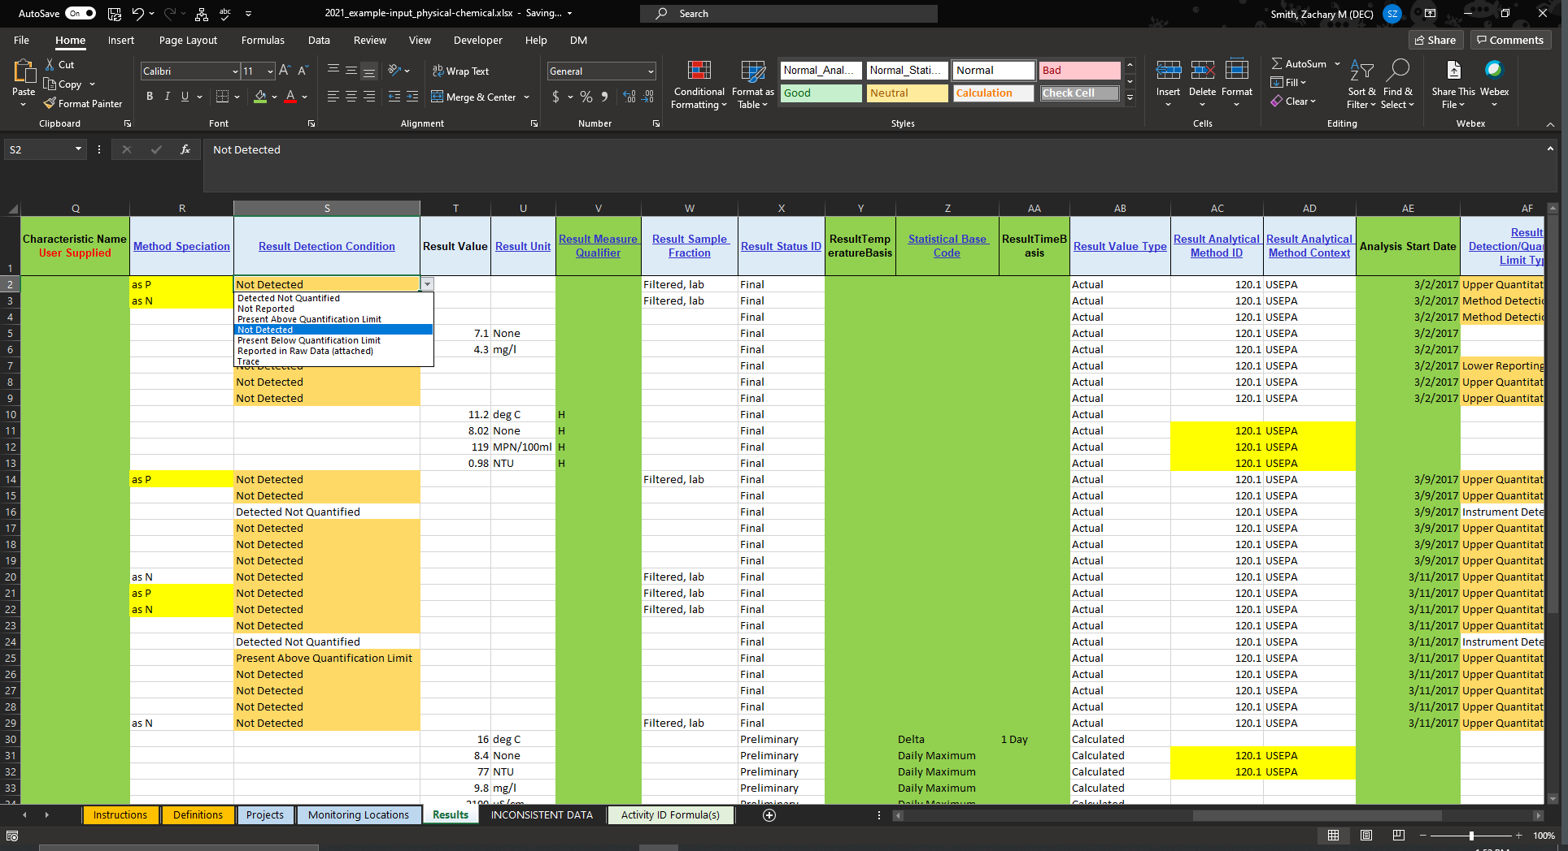
This field has data validation restrictions on it, and therefore will send you an error message if you supply invalid information.
You can use the drop-down menu to review and select a valid input.
Description
Could the results be quantified?
For most users, this information will be supplied by an analytical laboratory.
This field should be left blank if there were no issues with detection.

Slide 89
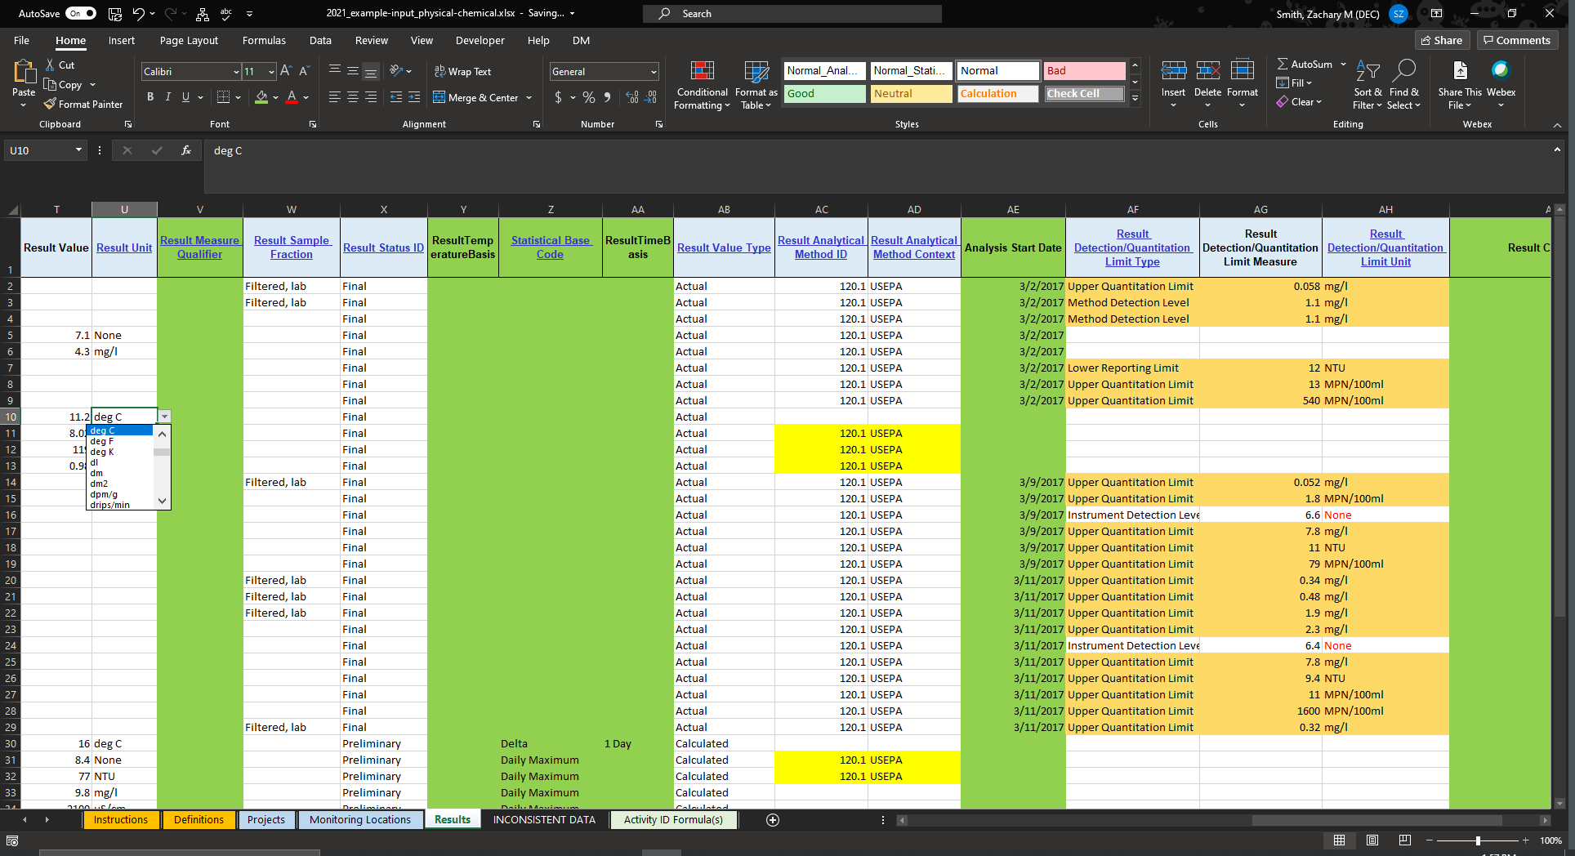
Description
What is the quantified result value for the characteristic/parameter measured?
This should be numeric. NO character values (e.g., <, >).
If the results were not detected, leave both the “Results Value” and the “Result Unit” fields blank.
The “Result Unit” is required when the “Result Value” is supplied and vice versa.
Preferably report character values as result detection condition (Present below/above).
This field has data validation restrictions on it, and therefore will send you an error message if you supply invalid information.
You can use the drop-down menu to review and select a valid input.

Slide 90
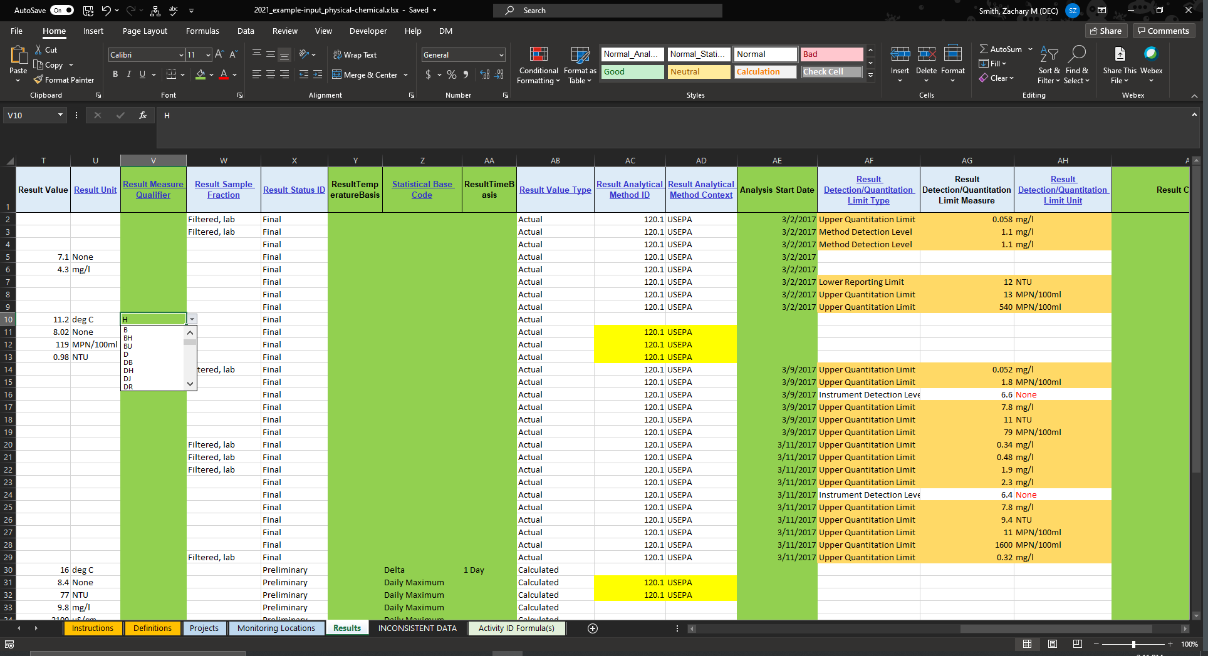
Description
Indication of any issues that may affect the results.
These will frequently be reported by the laboratory but may also be determined during your Quality Control process.
To interpret the qualifier codes please review:
This field has data validation restrictions on it, and therefore will send you an error message if you supply invalid information.
You can use the drop-down menu to review and select a valid input.

Slide 91
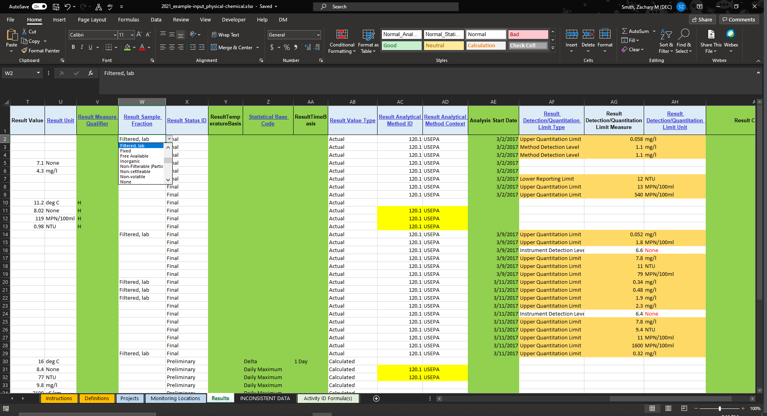
Description
“Sample Fraction is a description of the portion of the characteristic being analyzed. Sample Fraction will usually be Total, Dissolved, Unfiltered, Filtered. Please check with your lab to confirm the sample fraction used for the analysis. In addition, nutrient data should be captured as filtered/unfiltered given “Total” is ambiguous for nutrient data.”
-EPA Instructions WQX Web Monitoring Data Entry Template
This field may be required depending on the “Characteristic Name” provided. See the domain values for CharacteristicName.
This field has data validation restrictions on it, and therefore will send you an error message if you supply invalid information.
You can use the drop-down menu to review and select a valid input.

Slide 92
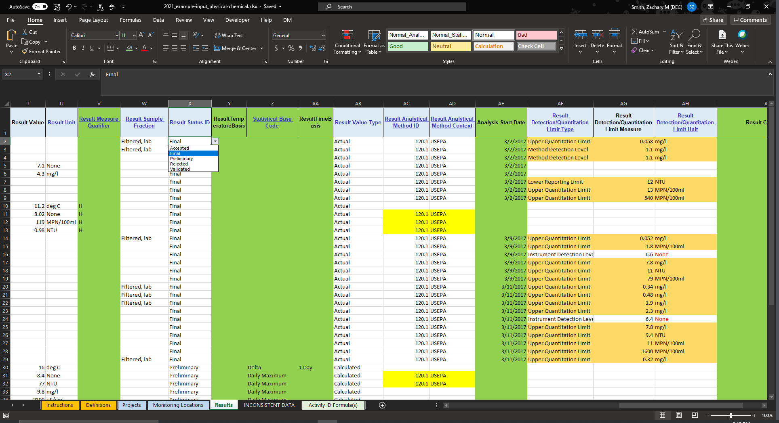
Description
“Result Status ID is required if you reported a result. In order for your data to be uploaded to the Water Quality Portal, this field MUST NOT BE set to “Preliminary”.
-EPA Instructions WQX Web Monitoring Data Entry Template
This field has data validation restrictions on it, and therefore will send you an error message if you supply invalid information.
You can use the drop-down menu to review and select a valid input.

Slide 93

Description
Was there a controlled temperature required for the analysis?
This should be reported by the laboratory when required.

Slide 94

Description
Has the data been summarized by some statistic?
The ResultTimeBasis can provide additional context to the statistical base code
These fields should be left blank if no summary statistic was applied.
Example: Daily Mean
Statistical Base Code = “Mean”
ResultTime Basis = “1 Day”
This field has data validation restrictions on it, and therefore will send you an error message if you supply invalid information.
You can use the drop-down menu to review and select a valid input.

Slide 95

Description
Does the result represent the actual, estimated, or calculated value?
We anticipate that most users will supply “Actual” results.
If the statistical Base Code column is populated, you most likely should selected “Calculated”.
Please review your lab results to see if they have been corrected, adjusted, or estimated in anyway.
This field has data validation restrictions on it, and therefore will send you an error message if you supply invalid information.
You can use the drop-down menu to review and select a valid input.

Slide 96

Description
“Result Analytical Method ID and Context (The organization that owns the method) are the analytical procedures used by the lab for analyzing samples. You can find the Analytical methods in the results you receive from your lab or by contacting them. These cells are required for any activity type with “sample” in the domain name and ALL Nutrient characteristics.”
-EPA Instructions WQX Web Monitoring Data Entry Template
This field may be required based on the supplied:
Activity Type (see the domain values for ActivityType)
Characteristic Name (see the domain values for CharactersiticName)
This field is not required if “Biological Intent Name” is “Individual”, “Population Census”, “Frequency Class”, or “Group Summary”
This field has data validation restrictions on it, and therefore will send you an error message if you supply invalid information.
You can use the drop-down menu to review and select a valid input.

Slide 97

Description
When did the laboratory start performing the analysis?
Not required but recommended.
This should be reported by the lab or can be requested from the lab.

Slide 98

Description
“Result Detection Condition - If you indicate a sample is “Not Detected” or above/below a detection limit, you must provide the Detection Limit Type, Limit, and Unit. This should be provided by the lab along with appropriate units.
-EPA Instructions WQX Web Monitoring Data Entry Template
These fields have data validation restrictions on them, and therefore will send you an error message if you supply invalid information.
You can use the drop-down menu to review and select a valid input.

Slide 99

Description
You have the option to provide any additional details about the result that were not covered in the previous columns.
This column is not required.

Slide 100
You will need to load each sheet of the template independently and in the correct order:
Import the Projects sheet
Import the Monitoring Locations sheet
Once the Projects and Monitoring Locations sheets have been imported you can import any of the remaining sheets
Follow the instructions from the previous sections to submit your results.
Select

Slide 101

Select
For the results template described in this section, you will want to select the Physical/Chemical Template (7043)

Slide 102
Thank You
Zachary M. Smith
Research Scientist
zachary.smith2@dec.ny.gov
Connect with us: Facebook: www.facebook.com/NYSDEC Twitter: twitter.com/NYSDEC Flickr: www.flickr.com/photos/nysdec

