Slide 1
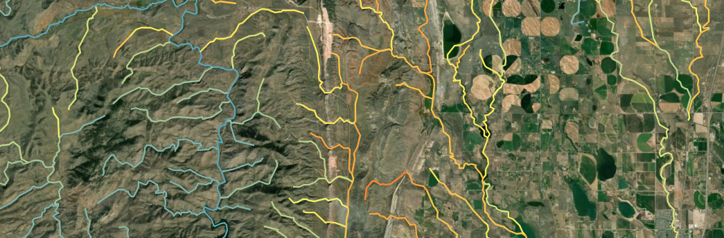
Freshwater Explorer a database story map
Susan Cormier, NCEA
Chris Wharton and Isabelle Bertani, TetraTech, Inc.
John Olson, CSU Monterrey Bay

Slide 2
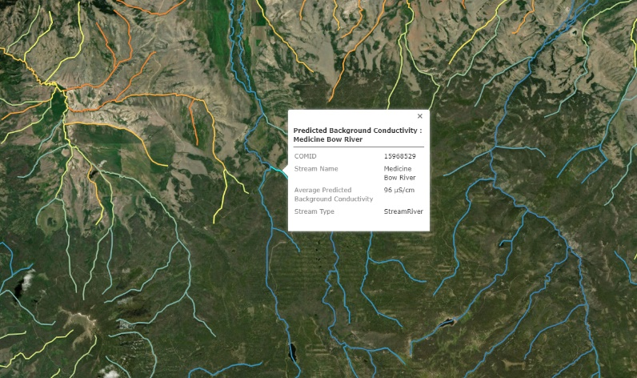
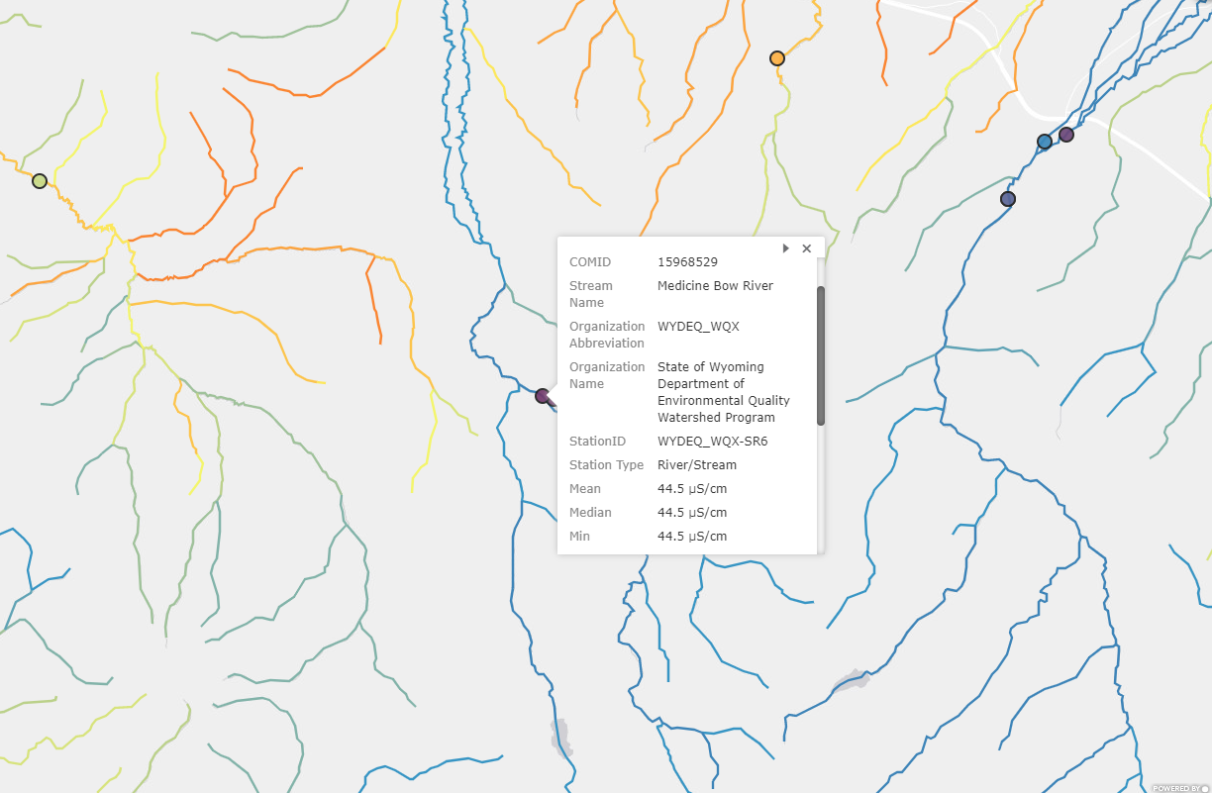
What is the Freshwater Explorer?
The Freshwater Explorer is an interactive-web based platform that provides the status of the salt and mineral content (i.e., freshness) for freshwater resources across a network of streams in the contiguous 48 states.
Freshness, defined as conductivity, are presented as color-coded predicted stream reach values and point (site-specific) measured values.
Juxtaposing background and measured conductivity over satellite imagery lets users see patterns and potential factors associated with fresh water conditions.

Slide 3
Why was the Freshwater Explorer developed?
Currently, this type of data is stored in EPA’s Water Quality Portal, but is not very accessible or intuitive in a spatial context.
How was it developed?
To enable self-sufficiency and greater access, scientists at ORD developed national datasets that let users independently compare background and measured water freshness (i.e., conductivity).
Methods and approaches were published in peer-reviewed journals.
The national datasets were derived from conductivity data in OWOW’s signature Water Quality Portal. Presently, more than 400 monitoring groups contribute data to the (WQP) resulting in a spatially and temporally robust dataset.
The national datasets are presented as an interactive StoryMap.
OST, OWOW, Regions 3, 5, 6, 9, and 10 were consulted during development or reviewed the Freshwater Explorer

Slide 4
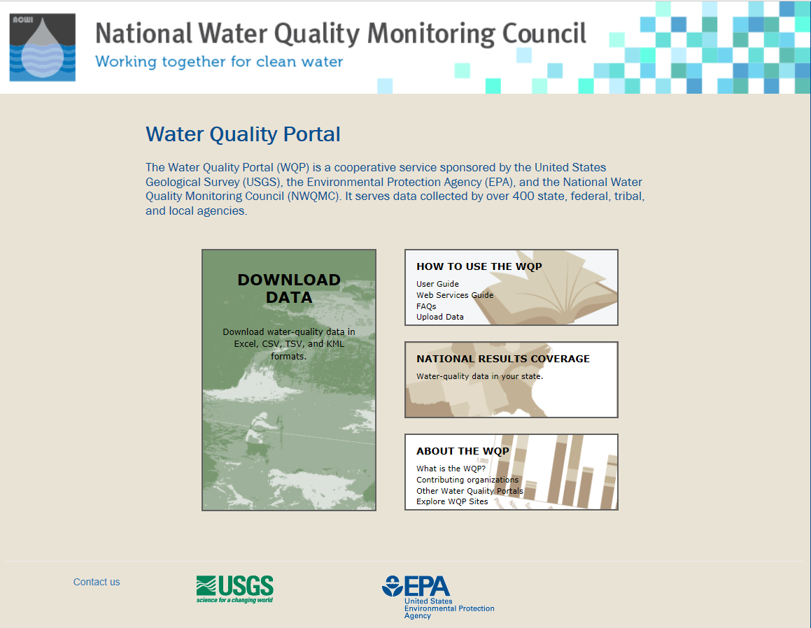
Who are the primary audiences?
The 400+ entities that contribute to the WQP
Federal, state, local agencies, monitoring groups, NGO’s, and industry with a need to access local water quality data.
Audience requires some degree of technical knowledge.

Slide 5
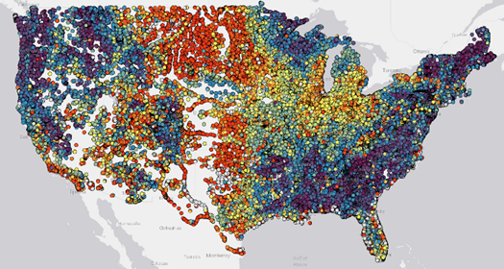
What are the anticipated uses and benefits of the Freshwater Explorer?
It provides information on the status of water resources for a network of streams in the contiguous 48 states color-coded for predicted and measured freshness, i.e., low salt and mineral content.
Currently, only measured conductivity data is provided, a measurement of fresh water and water quality that is stored in EPA’s Water Quality Portal.
The web-based story map allows users to quickly access information about estimated background and measured conductivity.

Slide 6
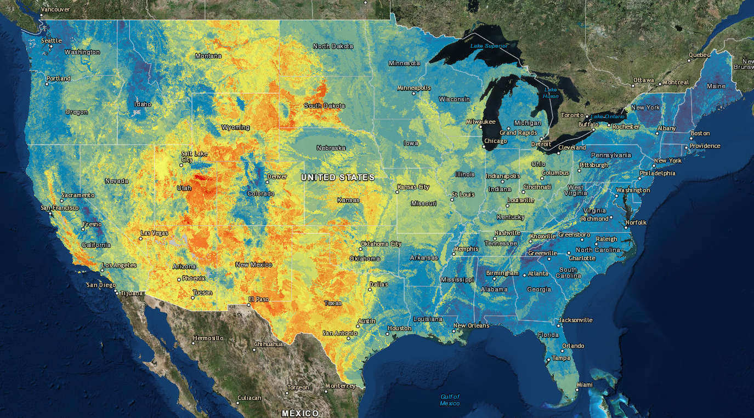
Observations
Nationally, wetter and higher elevation portions of the country have naturally fresher water, particularly in the Northwest, East and Southeast.
Measured conductivity in these areas are often near predicted background conductivity.
In the arid West and agricultural Mid-West, predicted conductivity is greater.
Measured conductivity often is greater than predicted natural conditions owing to various sources of mineral loadings
Locally, there are a variety of apparent causes of increased conductivity including road deicing, marine intrusion, agricultural, urban and industrial releases and run-off

Slide 7
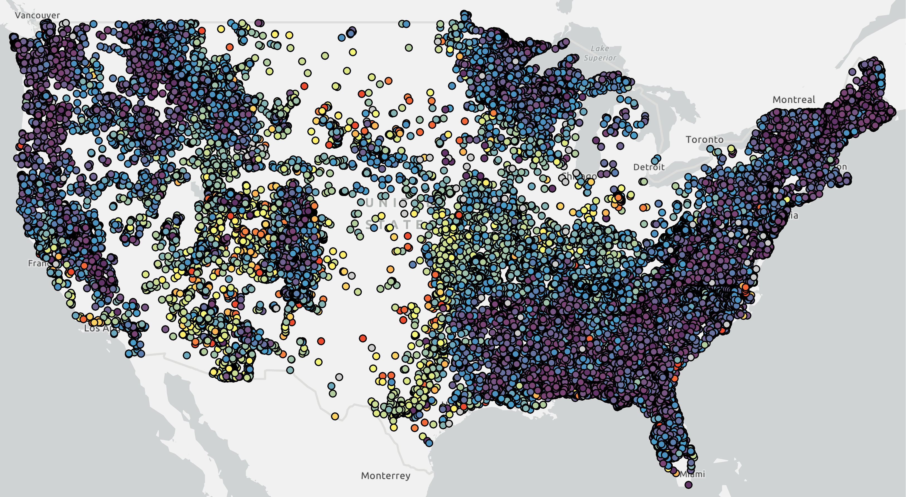
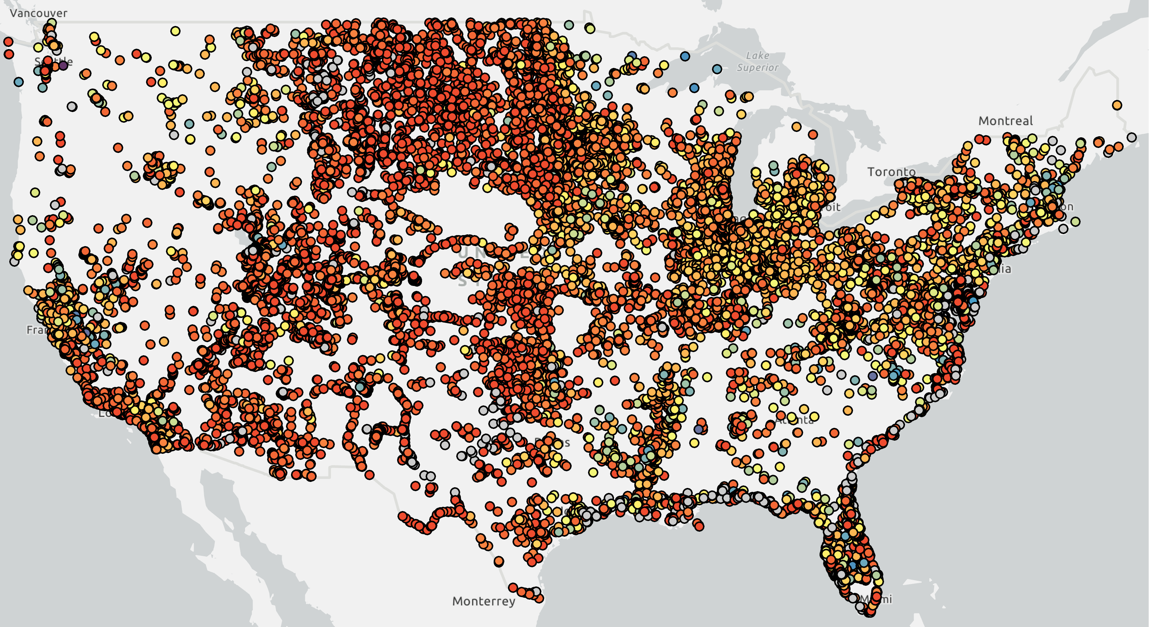
Changes in Freshness compared to Background
Measured less than or no more than 100 microS/cm > predicted Background
Measured 500 microS/cm greater than predicted Background
Causes may include: sea water intrusion, drought, loadings, etc.
Notes:
Areas with increased mineralization color coded with same color scale
Subtract background from most recent measured conductivity

Slide 8
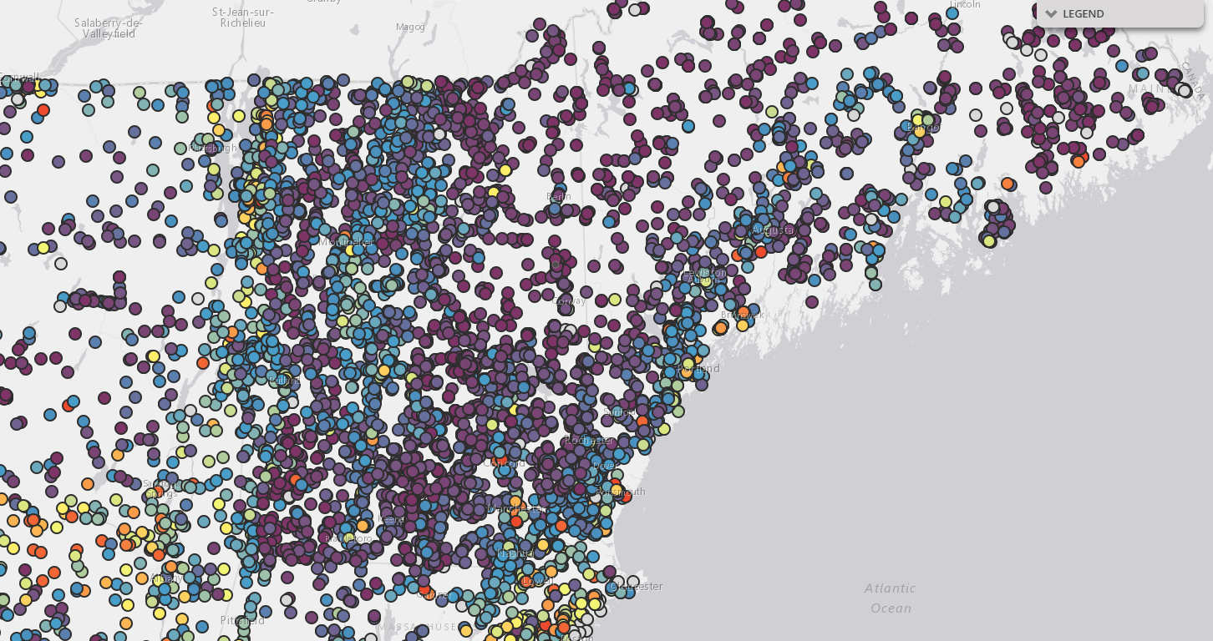
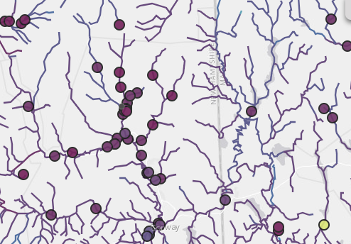
Local Example

Slide 9
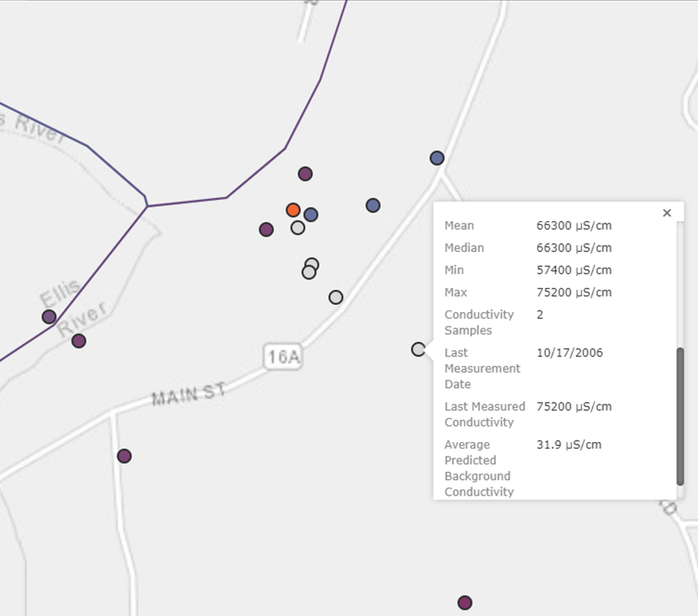
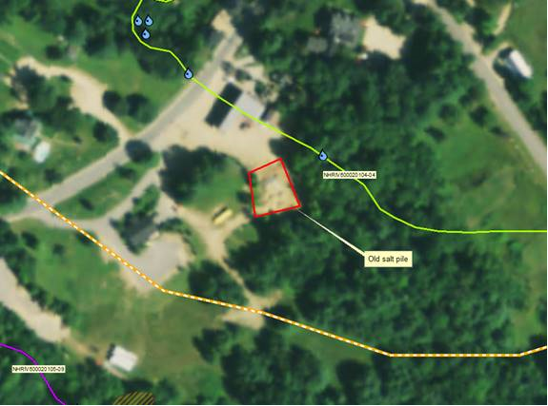
Freshwater Explorer Example
Courtesy of:
Matt Wood, Assessment Coordinator
NH Department of Environmental Services
23,360 μS/cm
75,200 µS/cm
2006
75200 µS/cm
2008 Salt Pile Area
Predicted: 31.9 µS/cm

Slide 10
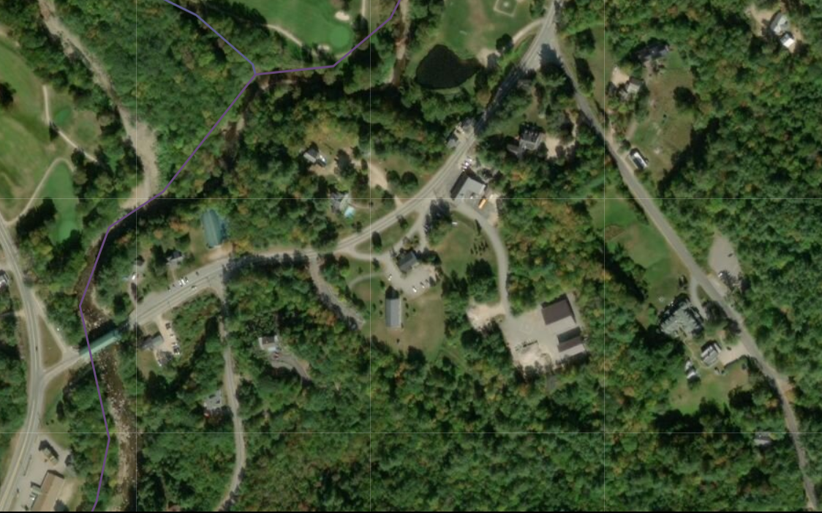
Salt pile was removed
and covered salt storage was built
75,200 µS/cm
2006
Salt Pile Area
2006
New Storage Area 2018
10

Slide 11
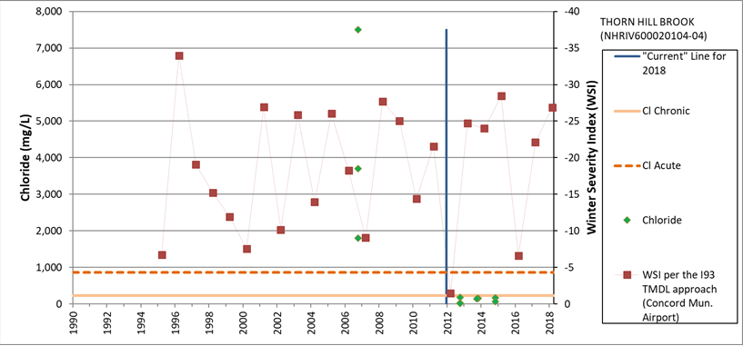
Plans are to delist from 303d after a bit more monitoring
Chloride level decreased dramatically after moving pile away from stream and covering some of it
Winter Severity Index
Courtesy of:
Matt Wood, Assessment Coordinator
NH Department of Environmental Services
Chloride (mg/L)
Notes:
We have confirmed that the salt pile in Jackson, NH was removed and a covered salt storage was built. Below is a graph showing the Chloride data before and after. The red line is the Winter Severity Index which is used to differentiate winter conditions from year to year. More negative WSI means more severe winter (ie. More need for salt). We will be looking to Delist this water body from our 303d list after a bit more monitoring. Also below are some aerial photos showing the original location of the salt pile and the covered storage. Seems like a great example to use for your presentation

Slide 12
Freshwater Explorer has 3 Data sets
1. Results of a model that predicts natural background conductivity from empirical data (Natural Background Stream Conductivity (NBSC) Model).
2. Measured data (National Conductivity Dataset) from the EPA Water Quality Portal (WQP), the nation's largest source for water quality monitoring data.
3. Measured data (Measured Conductivity - NWIS) from the National Water Information System (NWIS) collected by USGS.

Slide 13

Brief Explanation of the Empirical Background Conductivity Model
estimated based on geology, climate, soil, vegetation, topography, and other factors
Notes:
Background stream conductivity can be estimated based on geology, climate, soil, vegetation, topogaphy, and other factors (Olson and Cormier 2019).

Slide 15
Clean-up process for Measured Data
Remove SC values ≤ 0. | SC values are positive and cannot be negative
Remove SC values reported with units different from Siemens or mho | Considered ambiguous. E.g., SC reported as NTU, or ºC
Convert remaining SC values to µS/cm (e.g., values as mS/cm were multiplied by 1000). | Allowed direct comparison among samples
Flag sites with SC values < 10 µS/cm as uncertain (gray circles) | Identified data reported as µS/cm but likely measured as mS/cm
Flag SC values > 5000 µS/cm (grey circles). | Data reported as mS/cm but likely measured as µS/cm, brine, or marine.

Slide 16
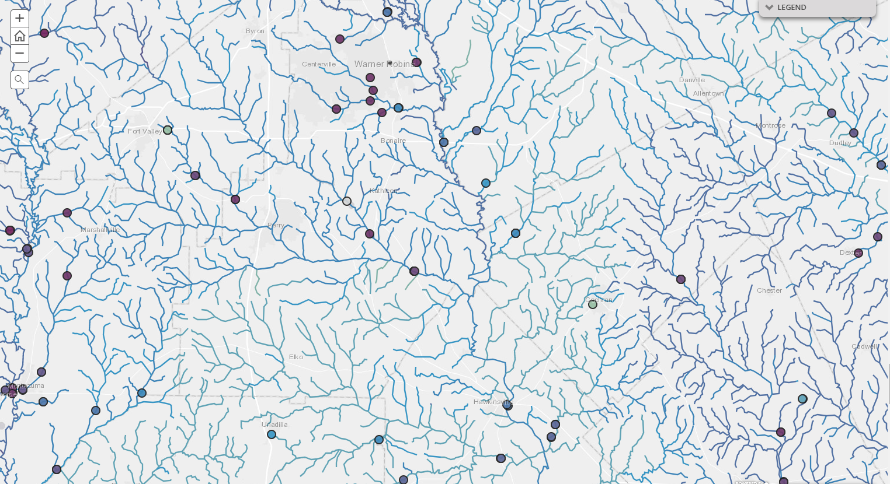
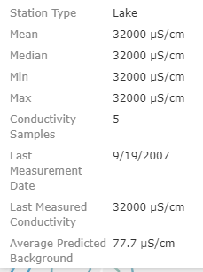
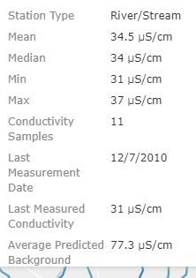
Flag SC values > 5000 µS/cm (grey circles)
32000 µS/cm
31 µS/cm
Data reported as mS/cm
but likely measured as µS/cm, or is brine or marine.
Mossy Cr. Perry GA

Slide 17
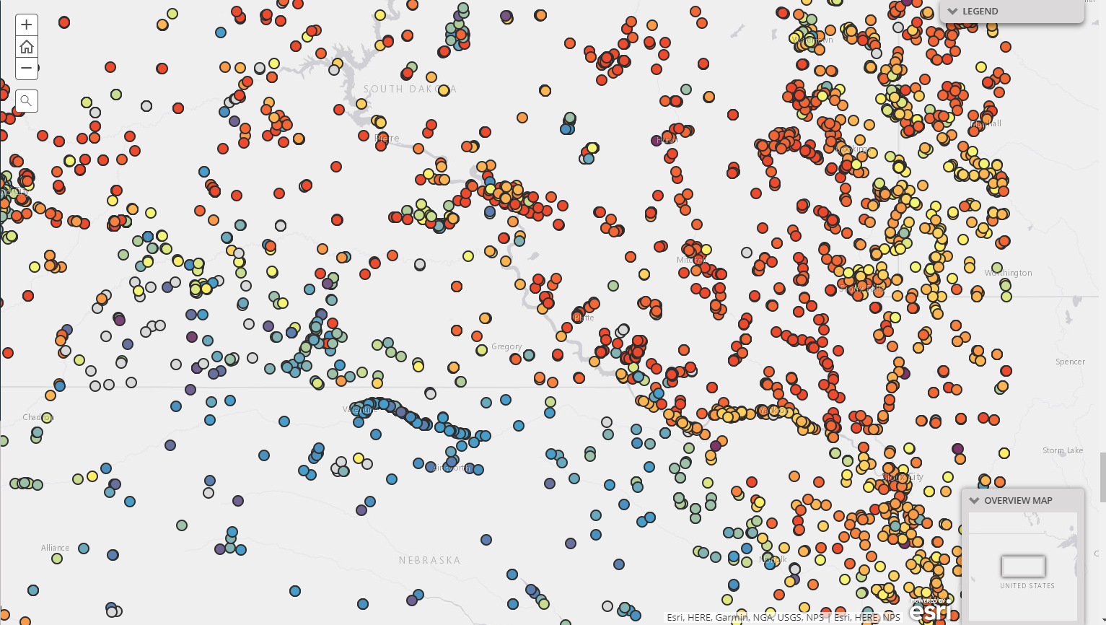
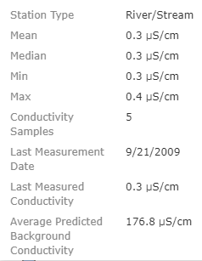
Flag sites with SC values < 10 µS/cm
as uncertain(gray circles)
Identified data reported as µS/cm but likely measured as mS/cm
0.3 µS/cm
Little White River

Slide 18
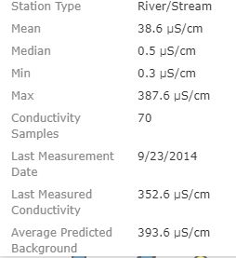
But, some may still be there, especially near the 10 µS/cm threshold.
38.6 µS/cm
393.6 µS/cm
Bear-in –the-Lodge Creek

Slide 19
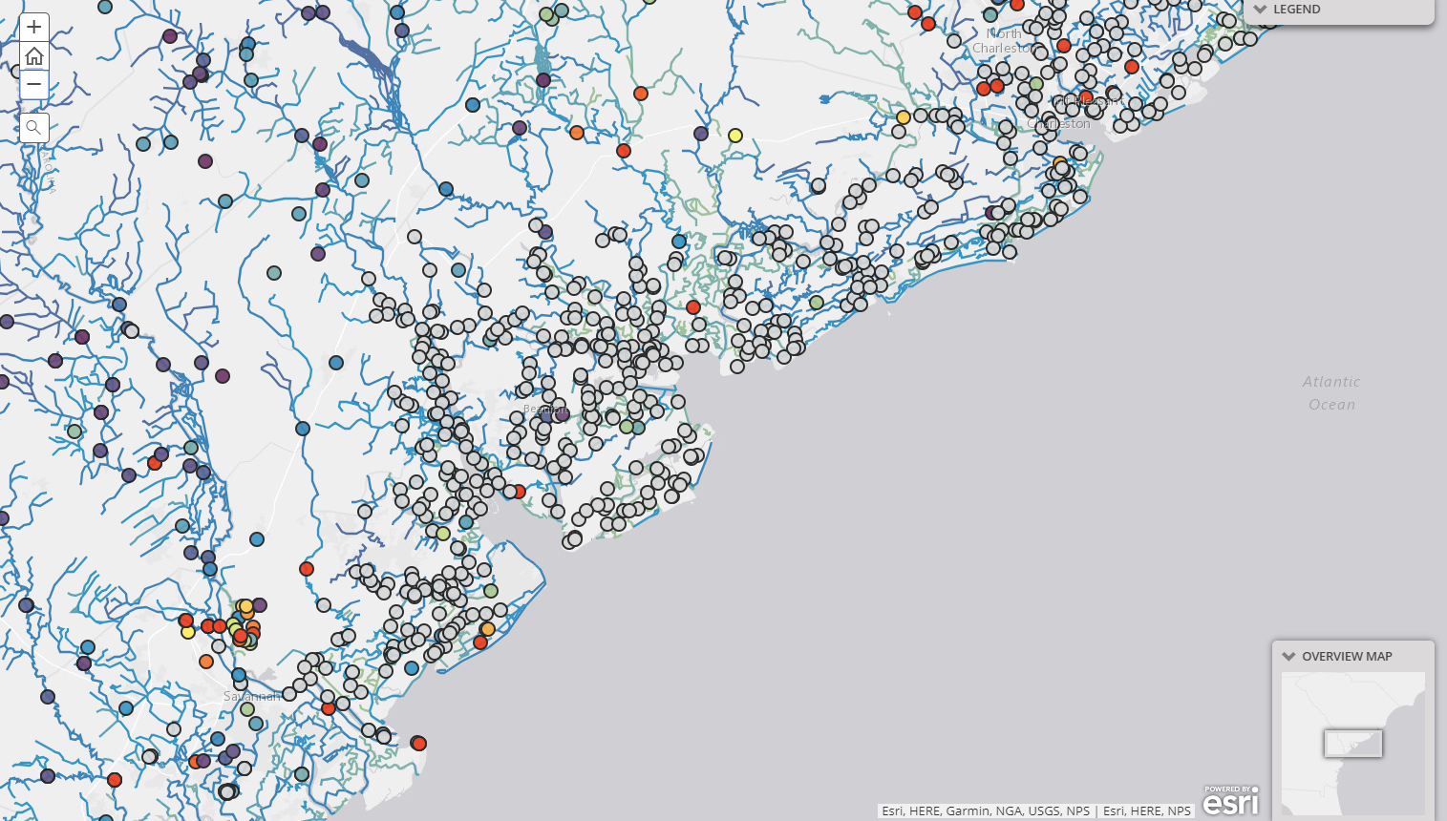
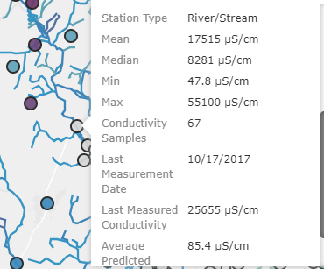
8281 µS/cm
47.8 µS/cm
55100 µS/cm
Probably tidal

Slide 20
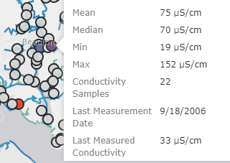
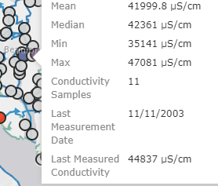
Purple in a sea of gray dots?
33 µS/cm
44837 µS/cm

Slide 21
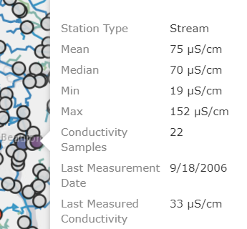
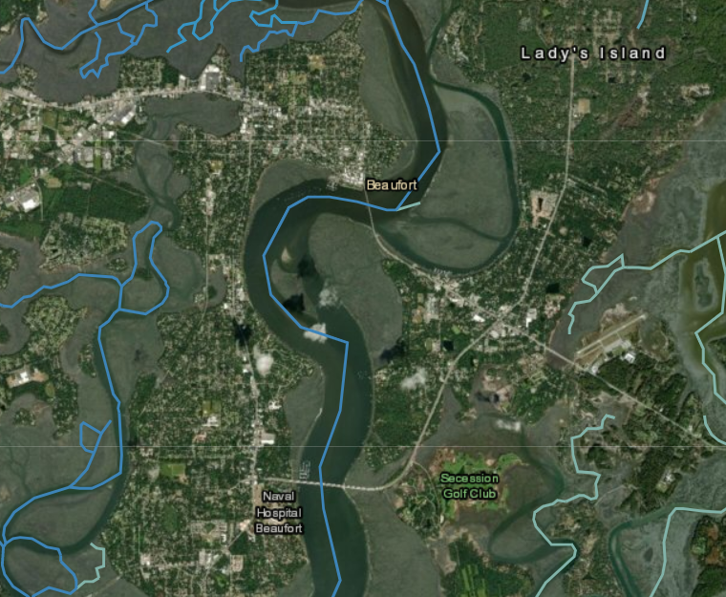
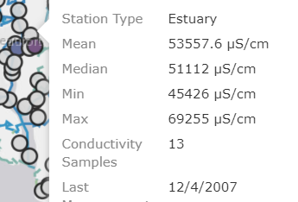
Check water body type
Stream
Estuary

Slide 22
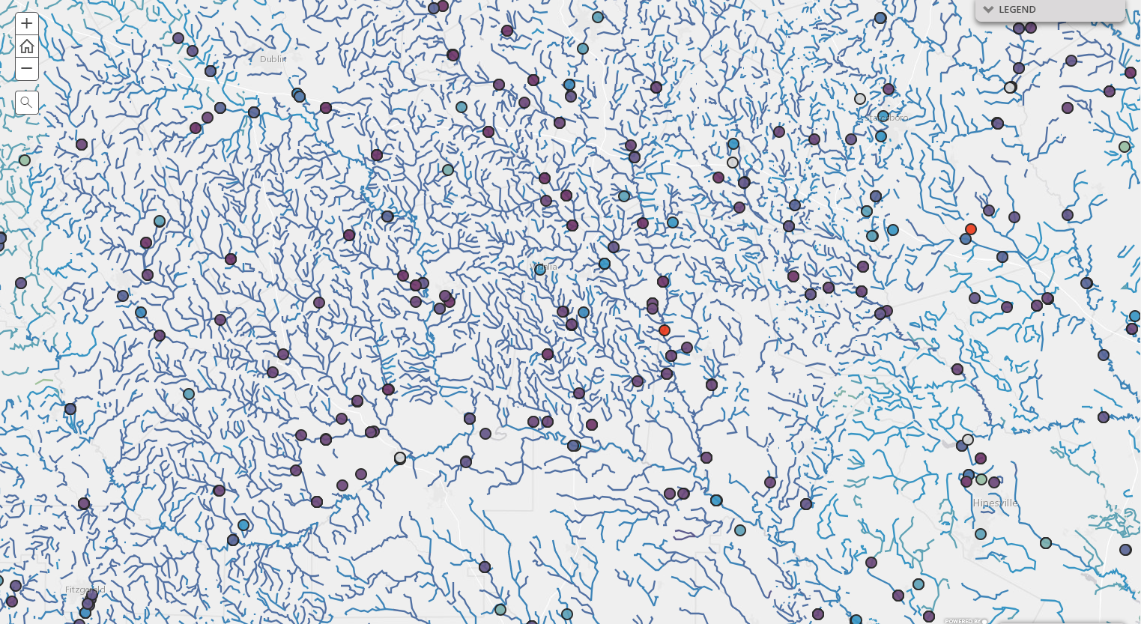
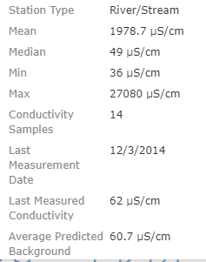
One incorrect unit entry can affect the mean
1978.7 µS/cm
49 µS/cm
36 µS/cm
27080 µS/cm
14

Slide 23
QUESTIONS ABOUT DATA ENTRY
 | Organization Formal Name | Samples | Sta. | Min. Cond. | Max. Cond. | Mean Cond. | Cond. In Other Units | Cond. Samples < 10 | Cond. Samples > 5000 | Potentially Excluded for Units | Potentially Excluded for Value
FL | Biological Research Associates (Florida) | 6 | 1 | 0 | 0 | 0.00 | 0 | 6 | 0 | 0% | 100% | No data or zero conductivity?
FL | Broward Co Dept of Natural Resource Protection (Florida) | 1848 | 49 | 271 | 58600 | 16481 | 0 | 0 | 858 | 0% | 46% | Mix of fresh and estuarine?
FL | Broward County Environmental Protection Department | 1347 | 52 | 235 | 58800 | 16425 | 0 | 0 | 618 | 0% | 46% | Duplicate entry?
FL | Charlotte Harbor National Estuaries Program (Florida) | 4068 | 1719 | 5 | 59590 | 31612 | 0 | 5 | 3475 | 0% | 86% | Min of 5 entered as µS but is mS?
FL | City of Cape Coral | 18819 | 40 | 0 | 56 | 9.21 | 0 | 12439 | 0 | 0% | 66% | Measured as mS recorded as µS?
FL | City of Deltona | 86 | 3 | 1 | 568 | 335 | 1 | 3 | 0 | 1% | 3% | Incorrect units
FL | City of Lakeland, Lakeland Florida | 489 | 21 | 45 | 273 | 172 | 0 | 0 | 0 | 0% | 0% | Fresh, looks correct
FL | CITY OF MARCO ISLAND | 44 | 6 | 48356 | 53220 | 51453 | 0 | 0 | 44 | 0% | 100% | marine

Slide 24
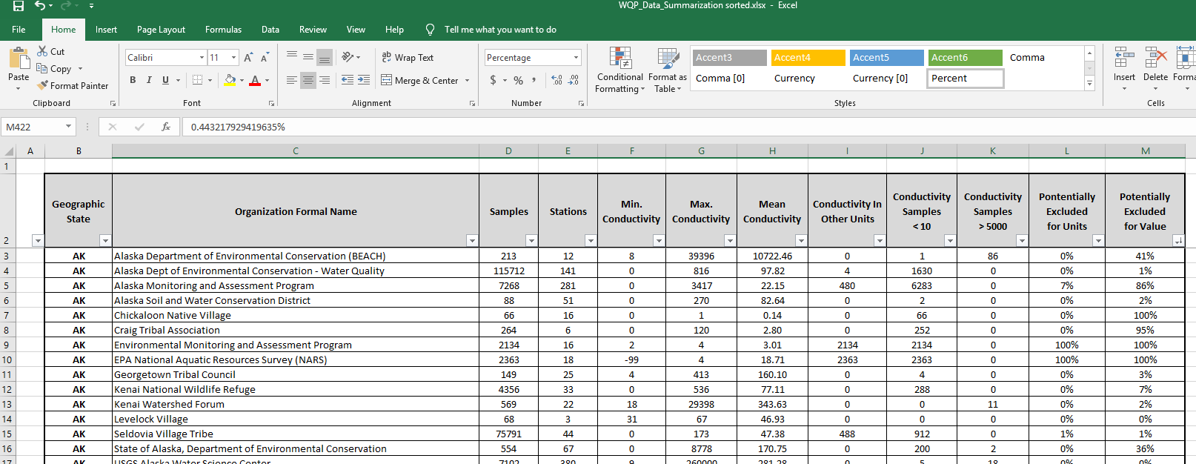
How to check and make corrections
WQP Data Query Access

Slide 25
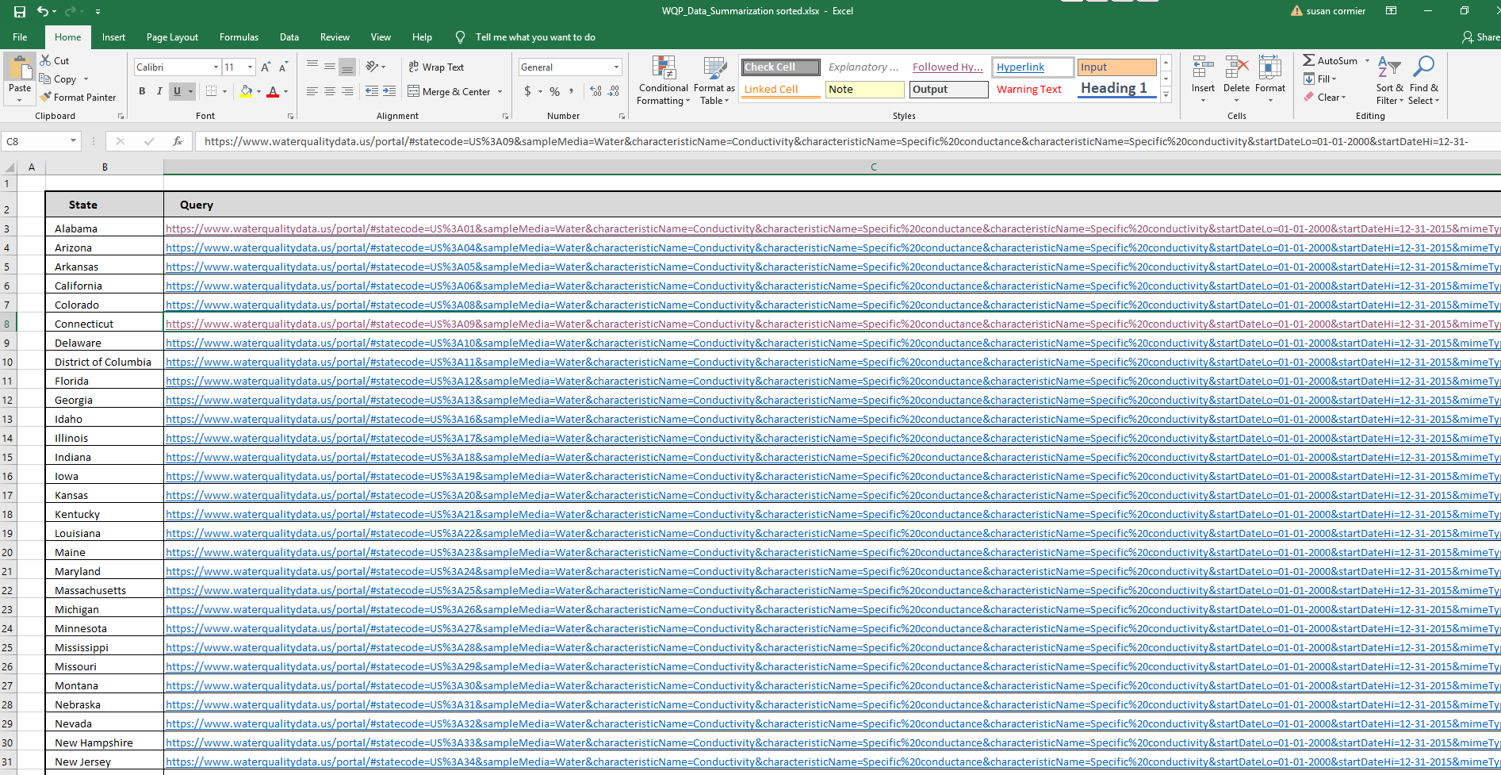
Select data set

Slide 26
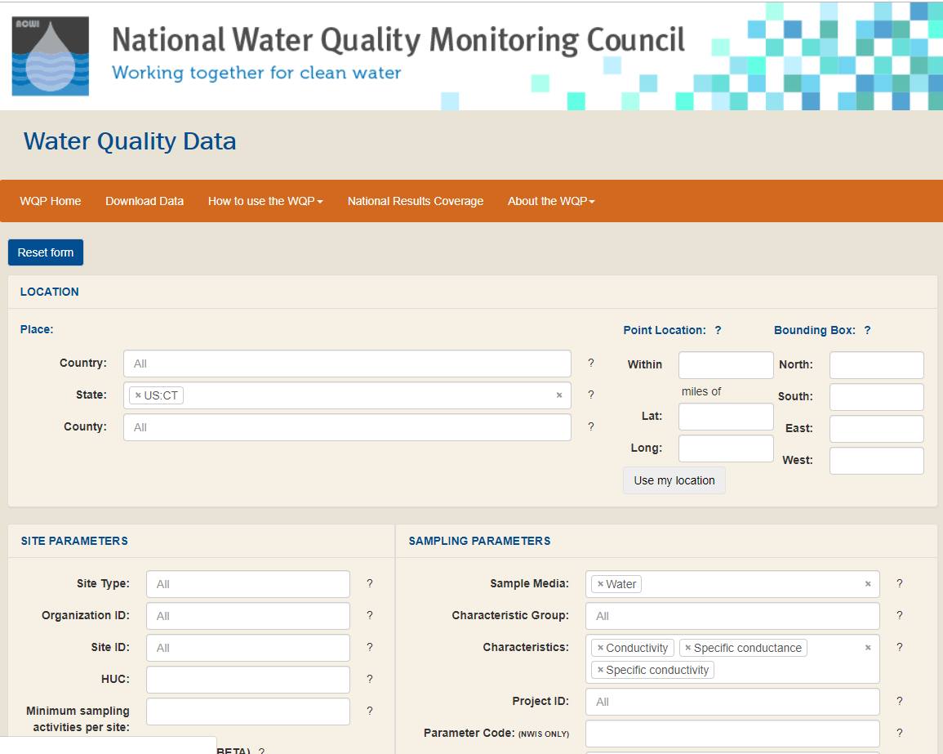
Scroll down the page

Slide 27
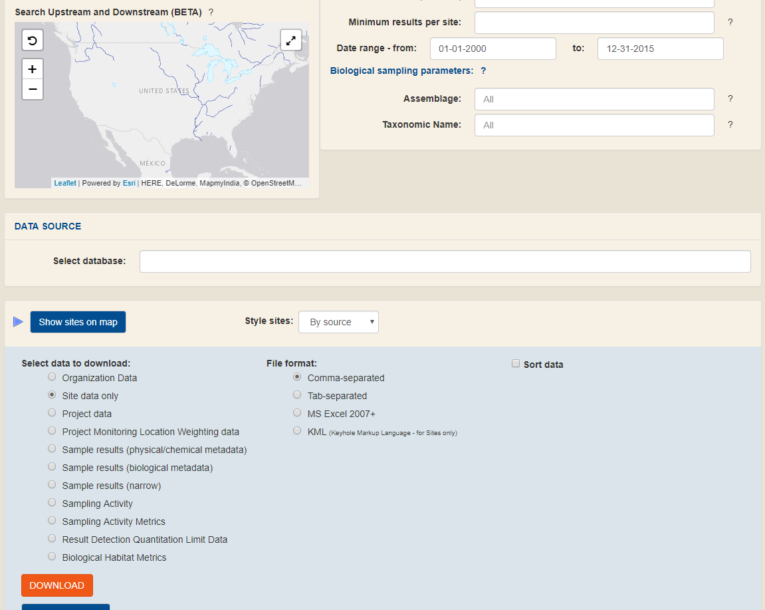
Check how many samples

Slide 28
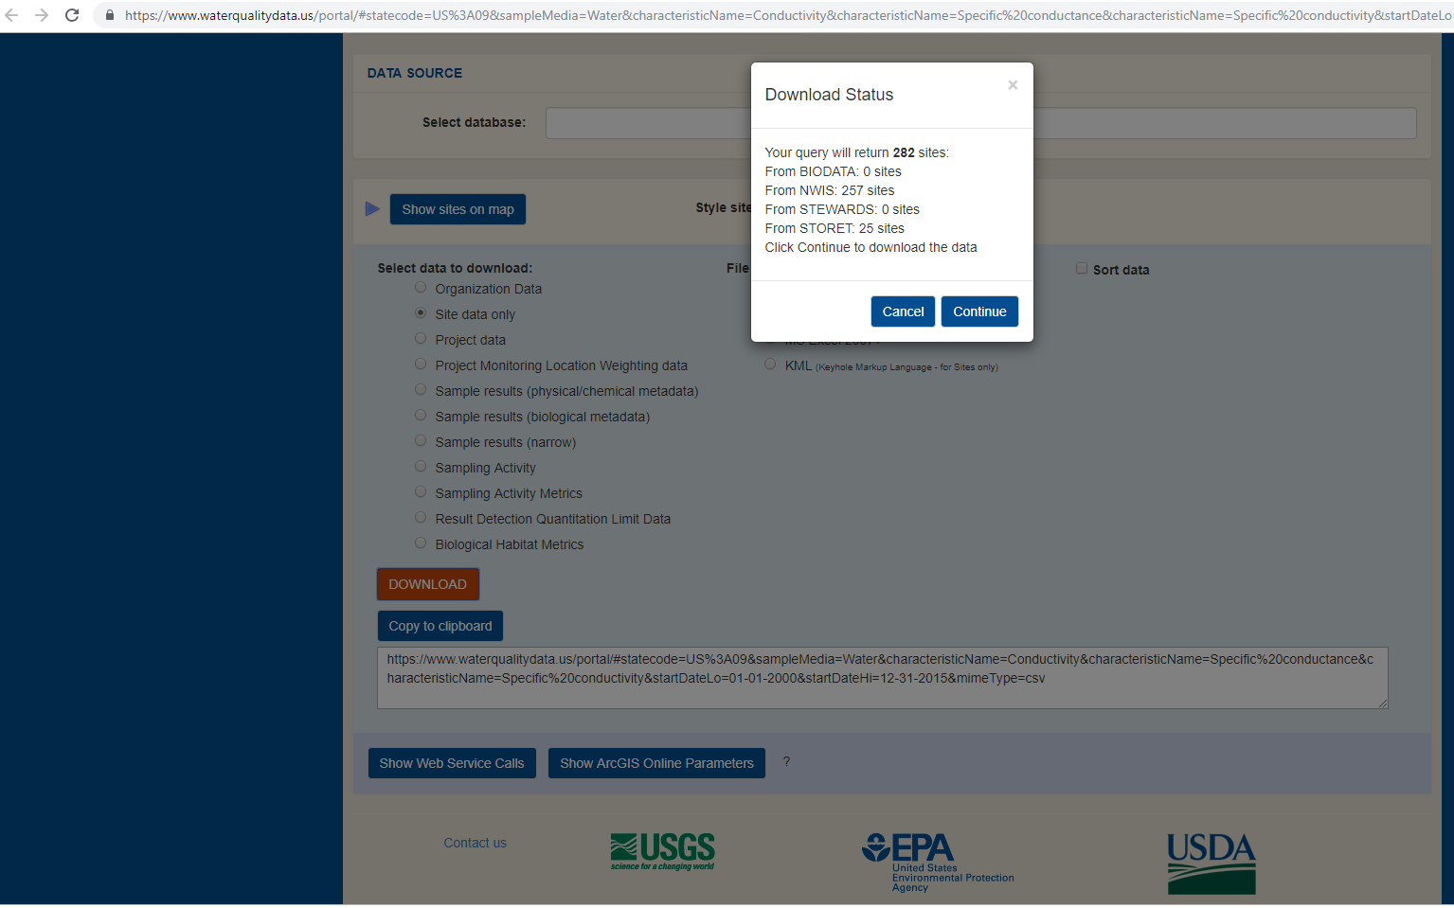
Reports how many samples, can download locational data or you can choose to get all data

Slide 29
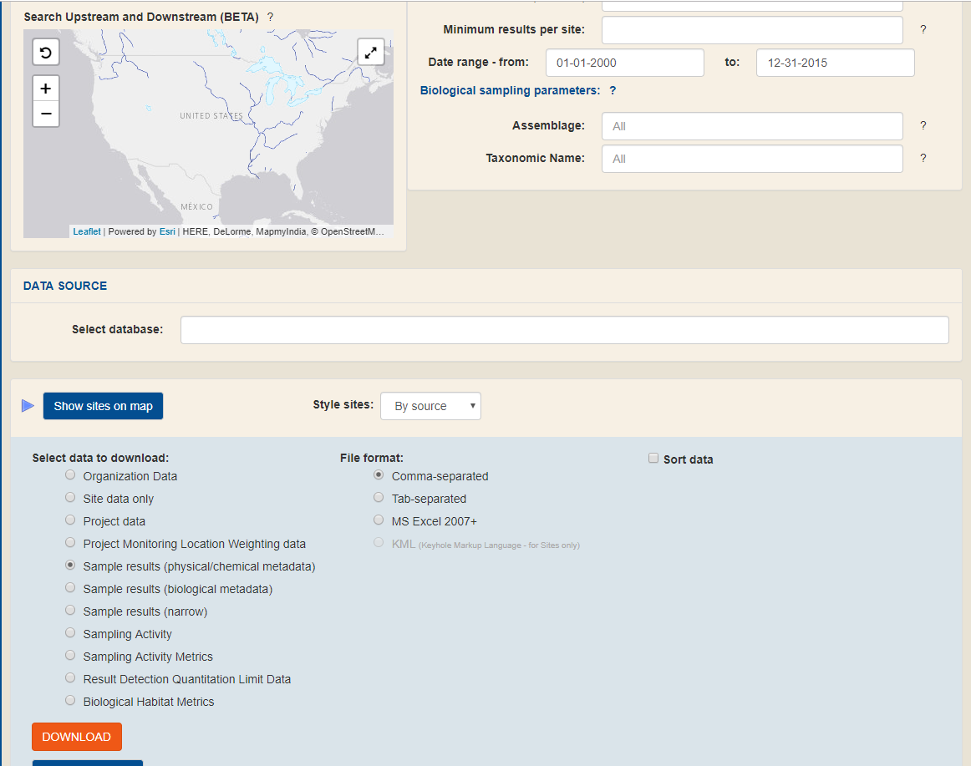
Choose sample results and download

Slide 30
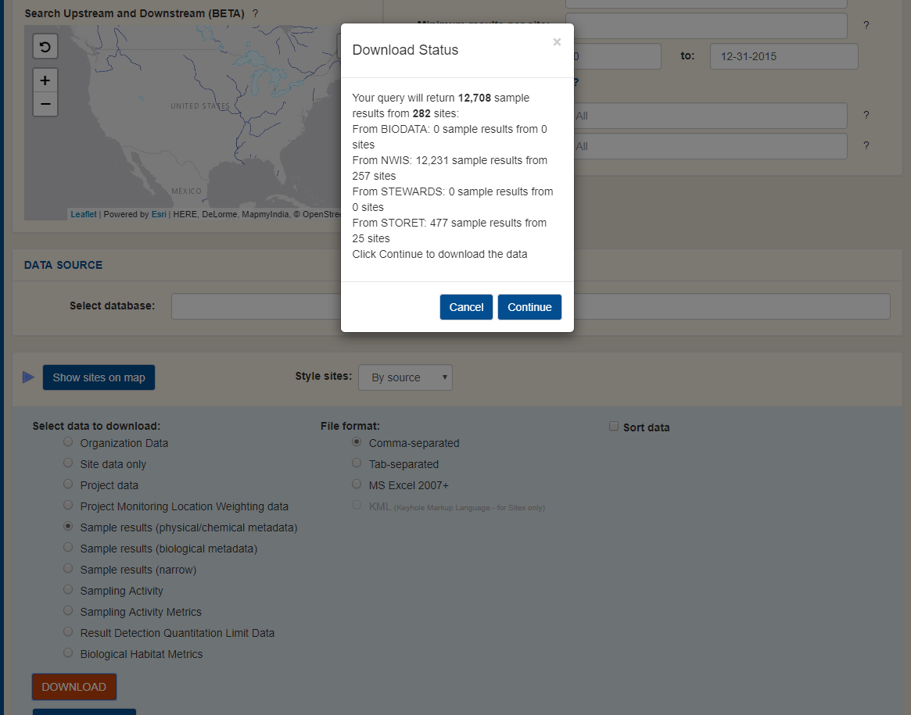
Chose continue or download

Slide 31
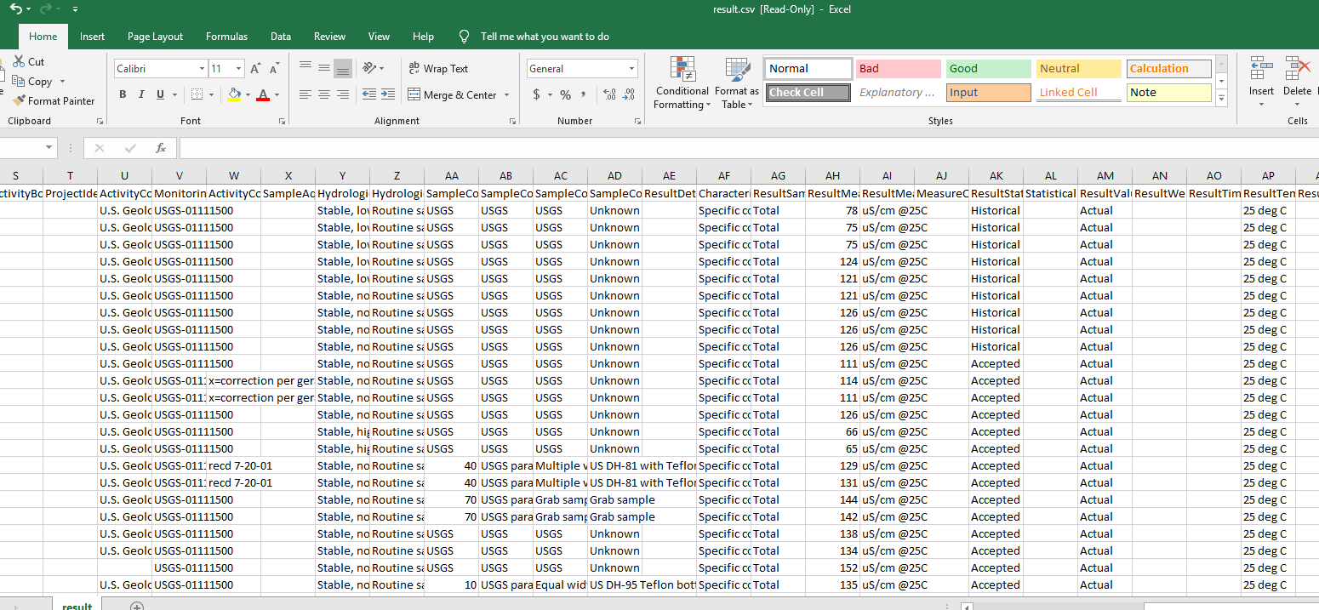
An Example Output: Geophysical data download
which we then screened for use in Freshwater Explorer

Slide 32
Comments or Questions?

