Slide 1
Water Quality Indicators (WQI) Tool Version 2.0 View, Focus, and Screen Ambient Monitoring Data
April 2018
https://echo.epa.gov/maps/wqimap

Slide 2
Agenda
Tool Background
Using Tool/Live Demo
WQI Derivative Projects
Future Plans

Slide 3
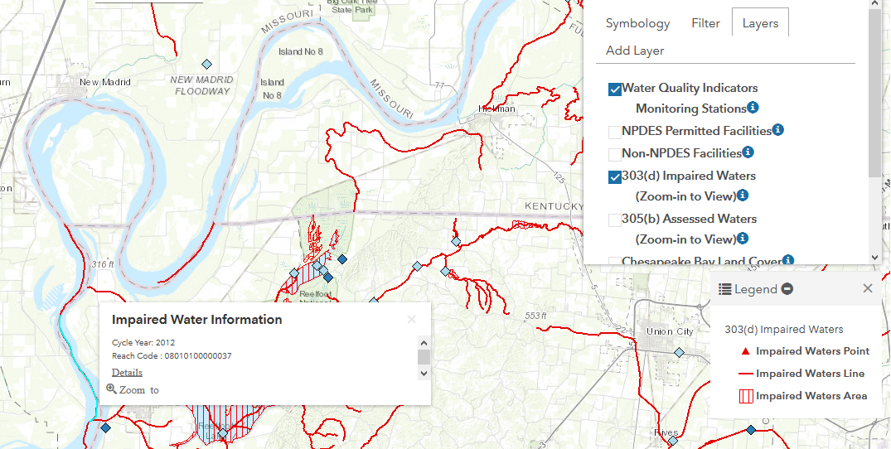
Issues Focusing Solely on Impaired Waters
303(d) Listed As Impaired Waters Indexed to NHDPlus Version 2.1, EPA OW

Slide 4
Project Approach
Normalize Monitoring Data
QA/QC data
Visualize Data
Compared to WQ Criteria
With additional data layers
Gather Monitoring Data
Calculate representative statistic
US Water Quality Portals 2009-Present
Derive and use available total nitrogen and total phosphorus measurements in Water Quality Portals data (2009-Present).
Calculate relevant statistics (percentiles, counts) with data and compare to CWA 304(a) ANE Criteria, Harmful Algal Bloom (HAB) Criteria, user supplied criteria.
When total nitrogen is not reported, derive it by combining subspecies of nitrogen present in the NWIS and STORET.
Only measurements reported as total phosphorus are used.
Other important steps:
identifying and considering non-detects – currently substituting ½ detection limit
identifying and averaging duplicate samples
identifying and validating ambiguously reported data
identifying and rejecting poorly reported data (e.g. missing units)

Slide 5
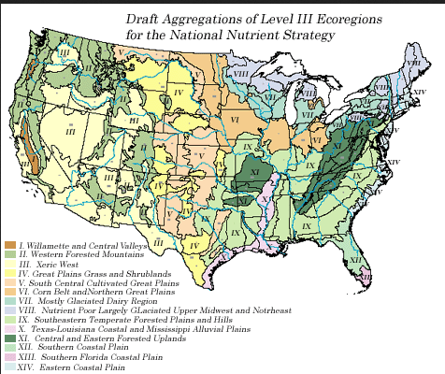
Scope
Nutrients Monitoring Records 2009-Present
Data Sources
National Water Quality Monitoring Council – Water Quality Portal
EPA’s STOrage and RETrieval Data Warehouse (STORET)
USGS National Water Information System (NWIS)
USDA Sustaining The Earth’s Watersheds – Agricultural Research Database System (STEWARDS)
ECHO Facilities Map Service
CWA 304(a) National Criteria
Aggregate Nutrient Ecoregional (ANE) Criteria
Yuan, L. L., & Pollard, A. I. (2015). Deriving nutrient targets to prevent excessive cyanobacterial densities in US lakes and reservoirs. Freshwater Biology, 60(9), 1901-1916.
CWA 303(d) impaired waters and CWA 305(b) assessed waters map services (NHDPlus Version 2.1)
National Land Cover Data Set (2011)
Chesapeake Bay Land Cover

Slide 6
NPDES Permitting Use Case
What are the recent nutrient concentration trends of the receiving water body?
Locate nitrogen or phosphorus hotspot and facilities upstream from hotspot.
Do upstream facilities discharge nitrogen or phosphorus?
Do upstream facilities have nitrogen or phosphorus limits?
This is a screening tool!

Slide 7
Water Monitoring Use Cases
Finding potentially impaired water bodies
A water body has not been designated impaired for nutrient pollution
Helping to determine a water body is no longer impaired for nutrients
Finding facilities that discharge into a water body impaired for nutrient pollution
This is a screening tool!

Slide 8
Prioritizing Inspection Resources Use Cases
Identifying inspection priorities on unassessed waters or assessed waters that are not impaired for nutrients
Identify potential non-compliance
Identify un-permitted facilities
This is a screening tool!

Slide 9
Live Demo
https://echo.epa.gov/maps/wqimap
ECHO Gov log in required (lan ID and password)

Slide 10
Future Plans
Pollutant Expansion
Pathogens – e. coli, enterococci, possibly fecal coliforms
Suggested new pollutants/parameters
New Map Layers
Updated County Level CAFO Counts
Enhanced Searching
Between monitoring locations – ‘Upstream Downstream’ Analysis
Between NPDES facilities
Modernize treatment of detection limits

Slide 11
Accessing the Tool
Go to: https://echo.epa.gov/maps/wqimap
You will be asked to log into ECHO Gov with your Lan ID and password.
Resources and Technical Documentation
https://echo.epa.gov/files/echodownloads/Data-Analytics/
You must have an ECHO Gov account to access.
Register here: https://echo.epa.gov/user/register
Download the dataset (publicly available):
https://echo.epa.gov/tools/data-downloads/wqi-data-review

Slide 12
Questions, Comments & Feedback?
Rusty Wasem
(202) 564-7096
wasem.russell@epa.gov
Bob Greenspun
(202) 564-2506
greenspun.robert@epa.gov
A 508 compliant version of this presentation will be made available upon request.

Slide 13
The following slides to be used if live demo is not possible.

Slide 14
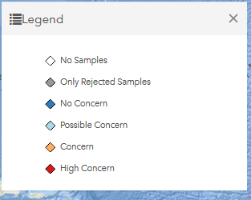
Using the Tool: The Legend
No Samples
n = 0
Only Rejected Samples
All samples were rejected
No Concern
Threshold Statistic < 1.00 of criteria
Possible Concern
Threshold Statistic 1.00 < 5.00 of criteria
Concern
Threshold Statistic 5.00 < 10.00 of criteria
High Concern
Threshold Statistic >= 10.00 of criteria

Slide 15
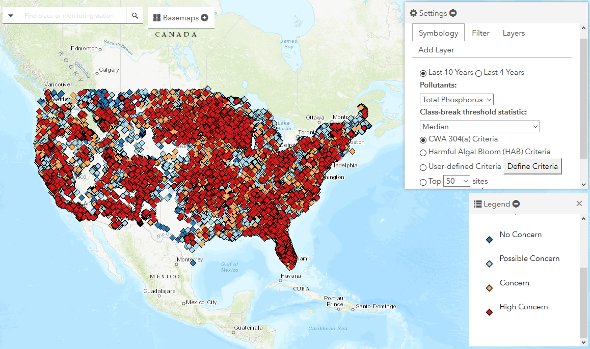
Using the Tool: Default View

Slide 16
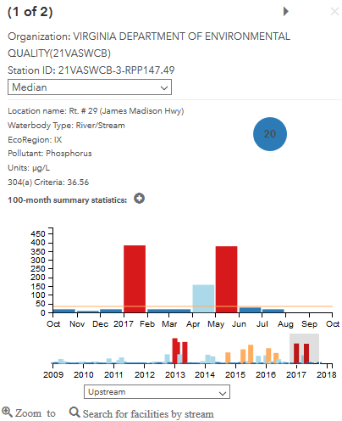
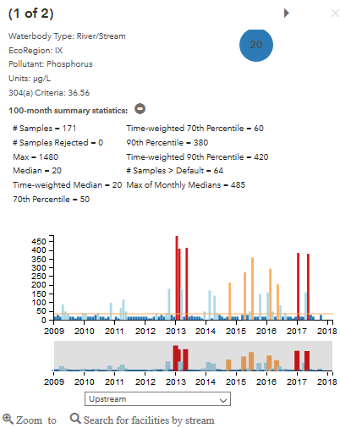
Using the Tool: Viewing Symbol Pop Up Window

Slide 17
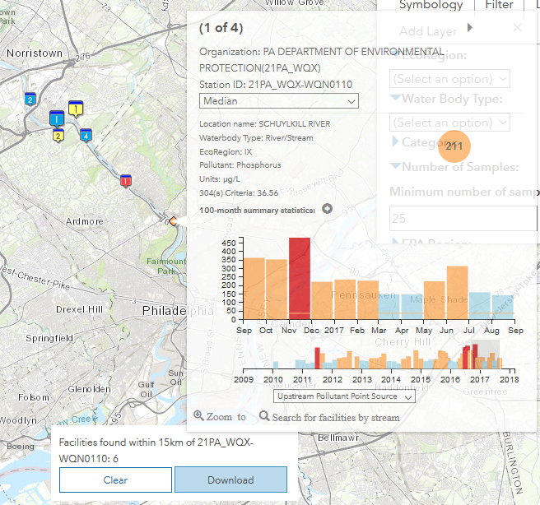
Using the Tool: Search for Upstream Facilities
Select 15 km upstream, downstream, or upstream pollutant point source
Click here to search Pollutant Upstream up/downstream
Download facility list as a .csv file
Feature searches 15 km upstream/ downstream (tributaries and main stem)
Maps up/downstream NPDES facilities
ECHO Symbol pop ups include compliance summary and links more reports
Download facility list as a .csv file

Slide 18
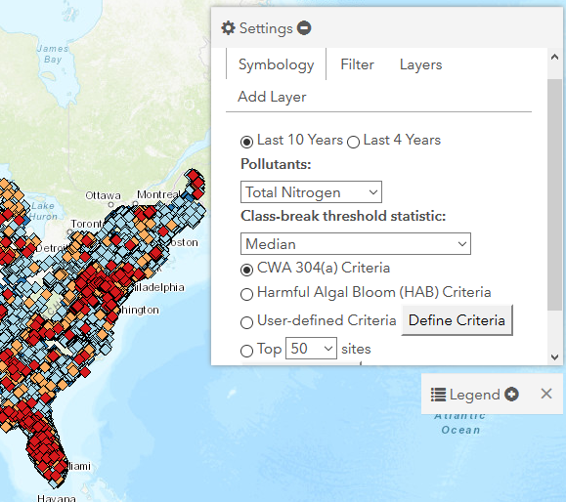
Using the Tool: Symbology Tab Options
Timeframe
Pollutant
Class-break threshold statistic
CWA 304(a) Criteria
HAB Criteria
User Defined Criteria
Top 50-500 Sites

Slide 19
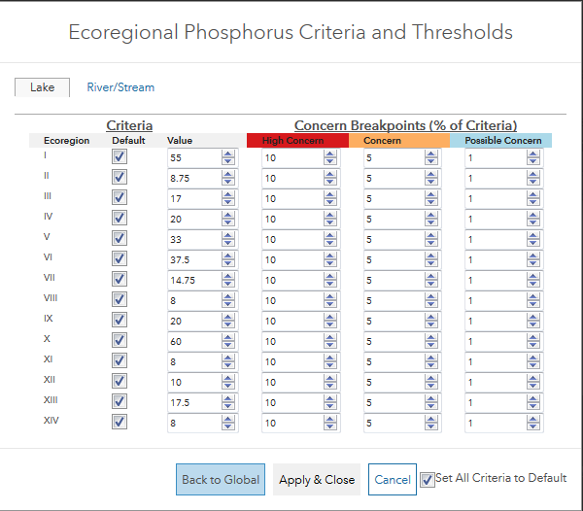
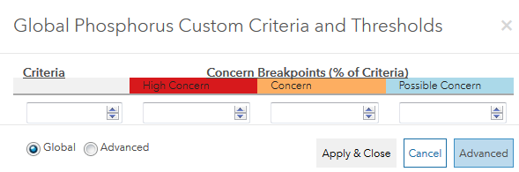
Using the Tool: User Defined Criteria and Break Points
Set criteria and breakpoints either globally or by Ecoregion

Slide 20
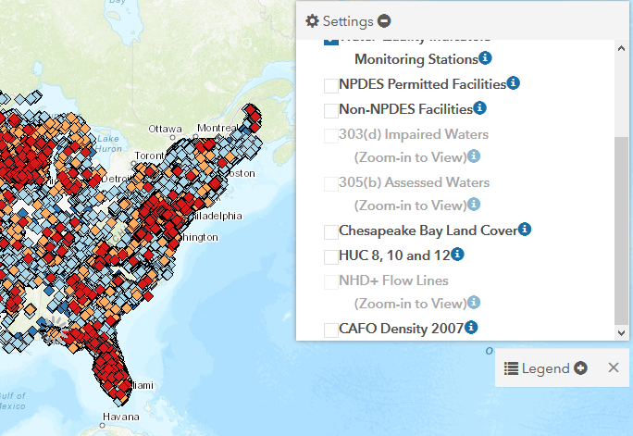
Using the Tool: Layers Tab Options
Check Box(s) & Zoom to View Layer(s)
NPDES Permitted Facilities
CWA 303(d) Impaired Waters*
CWA 305(b) Assessed Waters*
HUC 8, 10 and 12*
NHD+ Flow Lines*
CAFO Density
Click the to view a layer’s legend
*To view these layers, you must be zoomed in

Slide 21
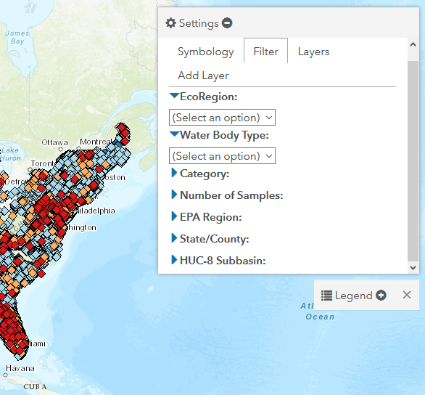
Using the Tool: Filter Tab Options
Filter by:
Ecoregion: I-XIV
Water Body Type: River/Stream or Lake/Reservoir
Category:
Station category (eg. High Concern only)
Number of Samples
EPA Region
State/County
HUC-8 Subbasin

Slide 22
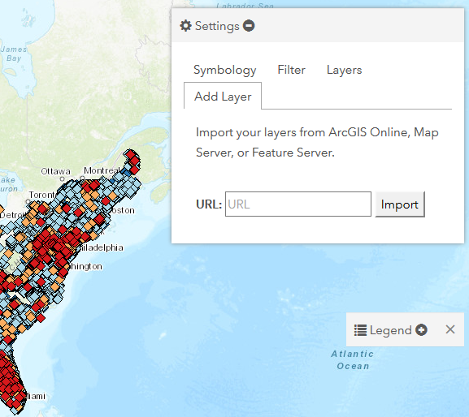
Using the Tool: Adding a Map Layer
Import your own map or map layer, by adding the service URL in the Add Layer Tab

Slide 23
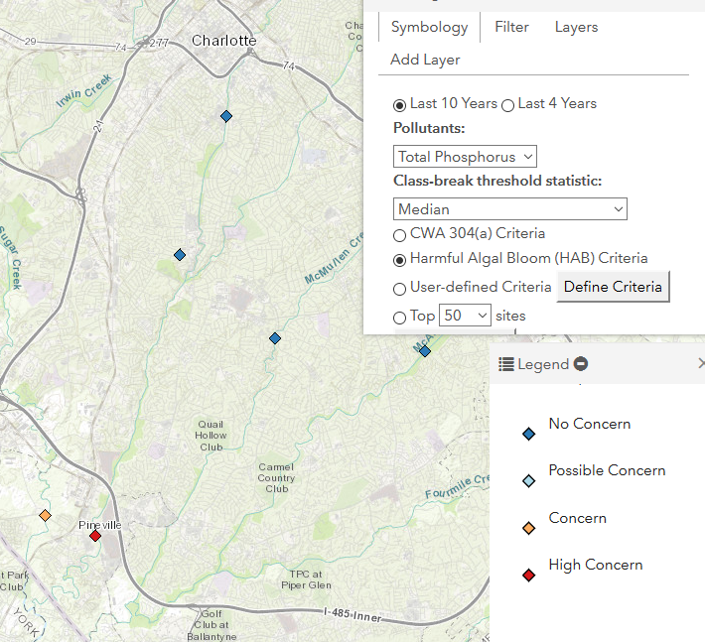
Prioritizing Inspection Resources Use Cases
Filter Minimum Number of Samples = 40
Select Top 50 Sites National
Zoom to Charlotte NC Area
Change Minimum Number of Samples = 0
Select HAB Criteria
Upstream locations below threshold
Who is discharging in between?
Downstream location 10x above threshold

