Slide 1
Water Quality Indicators (WQI) Tool
Version 2.5
View, Focus, and Screen Ambient Monitoring Data
https://echo.epa.gov/maps/wqimap

Slide 2
Agenda
Tool Background
Using Tool/Live Demo

Slide 3
Project Approach
Normalize Monitoring Data
Visualize Data
Compared to WQ Criteria
Additional data layers for context
Gather Monitoring Data
US Water Quality Portals Last 10 years
QA/QC data
Calculate representative statistic
Combine subspecies of nitrogen
Currently only nutrient data
Pathogen data being incorporated
Other important steps:
  Only measurements reported as total phosphorus are used.
  identifying and considering non-detects – currently substituting ½ detection limit
  identifying and averaging duplicate samples
  identifying and validating ambiguously reported data
  identifying and rejecting poorly reported data (e.g. missing units)

Slide 4
Version 2.5 New Features
Data Outside of CON-US Now Available
Upstream Discharger Pollutant Search
  Find upstream facilities permitted to discharge selected pollutant
Add Your Own Map Layer
Quarterly Data Refresh

Slide 5
Use Cases
NPDES Inspection Planning
NPDES Permitting
Water Monitoring
Nutrient Trading
This is a screening tool!

Slide 6
Live Demo
https://echo.epa.gov/maps/wqimap
ECHO Gov log in required (lan ID and password)

Slide 7
Future Plans
WQI Map Services Will Move to a Cloud Server (June 2019)
Public Release (Summer 2019)
Release of Alternate Data Format (Summer 2019)
  WQI dataset is publicly available here: https://echo.epa.gov/tools/data-downloads/wqi-data-review
Pollutant Expansion
  Pathogens – e. coli, enterococci, fecal coliforms
  Lead
Enhanced Searching
  Between monitoring locations – ‘Upstream Downstream’ Analysis
  Between NPDES facilities

Slide 8
Thank you WQX Community!
WQI Version 1.0 was able to use ~50% of the nutrient data in the Water Quality Portal (~3.5 million records)
WQI Version 2.5 currently uses ~80% of the available nutrient data (~7 million records over the last 10 years)
WQI Data Usability Dashboard
  https://echo.epa.gov/maps/wqimap/dataquality

Slide 9
Accessing the Tool
Go to: https://echo.epa.gov/maps/wqimap
  You will be asked to log into ECHO Gov with your Lan ID and password.
Resources and Technical Documentation
  https://echo.epa.gov/files/echodownloads/Data-Analytics/
You must have an ECHO Gov account to access
  Register here: https://echo.epa.gov/user/register
Download the dataset (publicly available):
  https://echo.epa.gov/tools/data-downloads/wqi-data-review

Slide 10
Questions, Comments & Feedback?
Rusty Wasem
(202) 564-7096
wasem.russell@epa.gov
A 508 compliant version of this presentation will be made available upon request.

Slide 11
Slides 12-20 to be used if live demo is not possible.

Slide 12
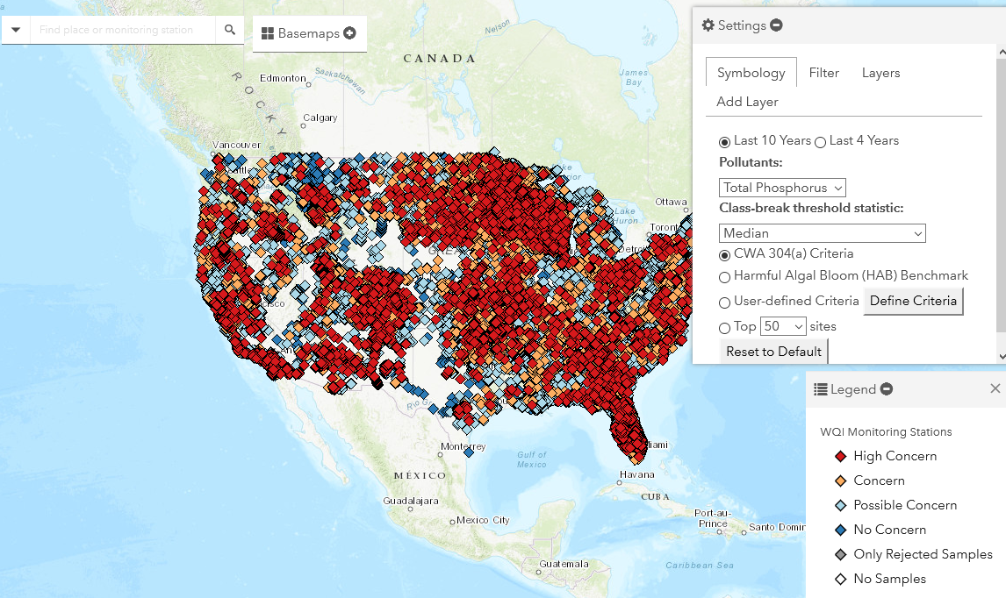
Using the Tool: Default View

Slide 13
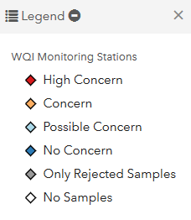
Using the Tool: The Legend & Default Breakpoints
High Concern
  Threshold Statistic >= 10.00 of criteria
Concern
  Threshold Statistic 5.00 < 10.00 of criteria
Possible Concern
  Threshold Statistic 1.00 < 5.00 of criteria
No Concern
  Threshold Statistic < 1.00 of criteria
Only Rejected Samples
  All samples were rejected by QA/QC
No Samples
  n = 0

Slide 14
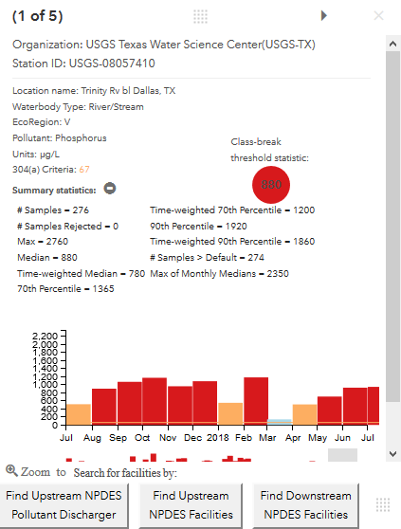
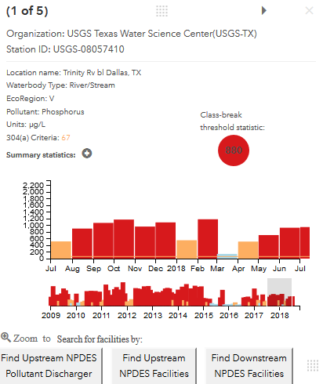
Using the Tool:
Viewing Symbol Pop Up Window

Slide 15
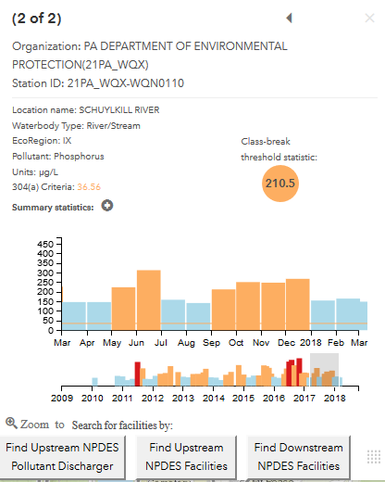
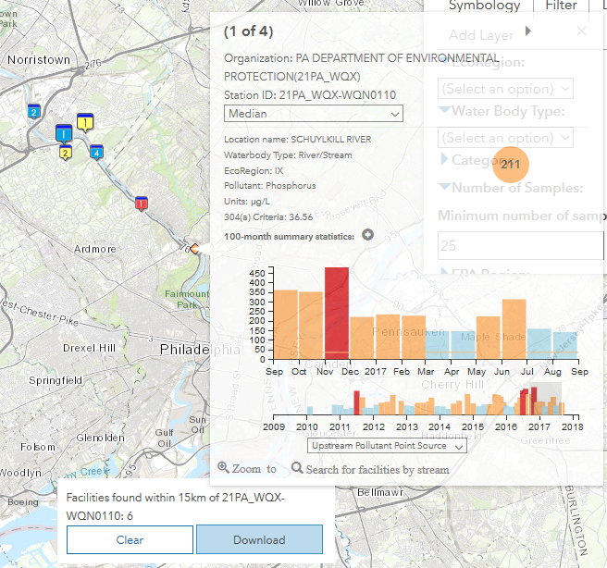
Using the Tool: Search for Upstream Facilities
Click to search 15 km upstream, downstream, or upstream pollutant point source
Download facility list as a .csv file
Feature searches 15 km upstream/ downstream (tributaries and main stem)
Maps up/downstream NPDES facilities
  ECHO Symbol pop ups include compliance summary and links more reports
Download facility list as a .csv file

Slide 16
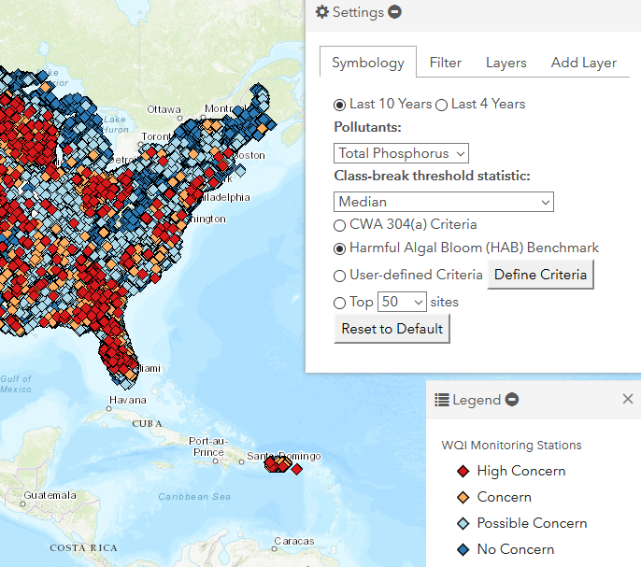
Using the Tool: Symbology Tab Options
Timeframe
Pollutant
Class-break threshold statistic
CWA 304(a) Criteria
HAB Criteria
User Defined Criteria
Top 50-500 Sites

Slide 17
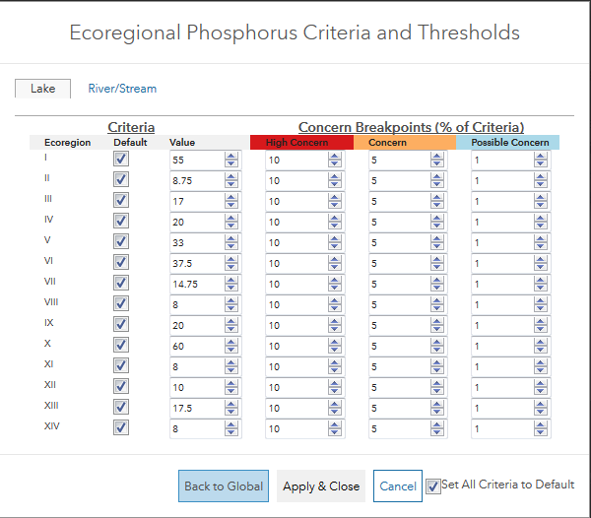
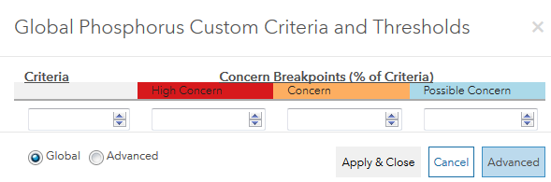
Using the Tool: User Defined Criteria and Break Points
Set criteria and breakpoints either globally or by Ecoregion

Slide 18
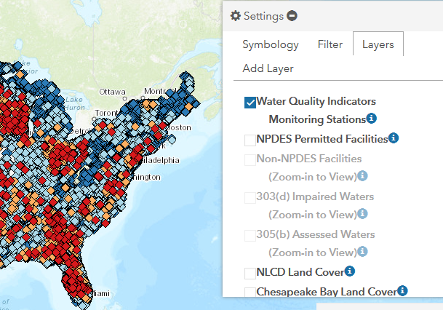
Using the Tool: Layers Tab Options
Check Box(s) & Zoom to View Layer(s)
  NPDES Permitted Facilities
  CWA 303(d) Impaired Waters*
  CWA 305(b) Assessed Waters*
  HUC 8, 10 and 12*
  NHD+ Flow Lines*
Click the to view a layer’s legend
*To view these layers, you must be zoomed in

Slide 19
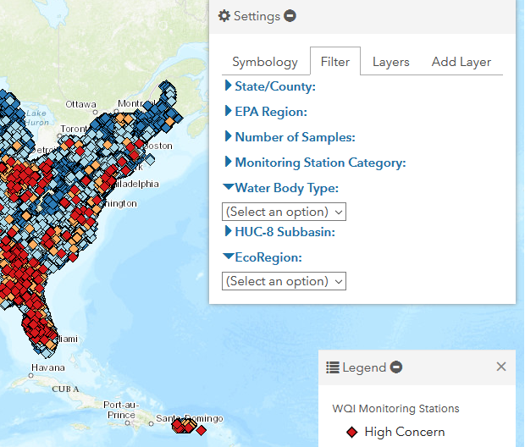
Using the Tool: Filter Options
Geographic
  State County
  EPA Region
  Ecoregion: I-XIV
  Water Body Type: River/Stream or Lake/Reservoir
Station Category:
  High Concern, Concern, Possible Concern, No Concern
Number of Samples
Hydrologic
  HUC-8 Subbasin

Slide 20
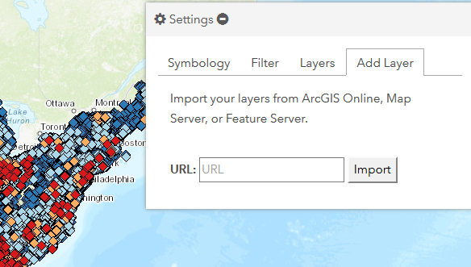
Using the Tool: Adding a Map Layer
Import your own map or map layer, by adding the service URL in the Add Layer Tab

